Slide 1






party

Slide 2
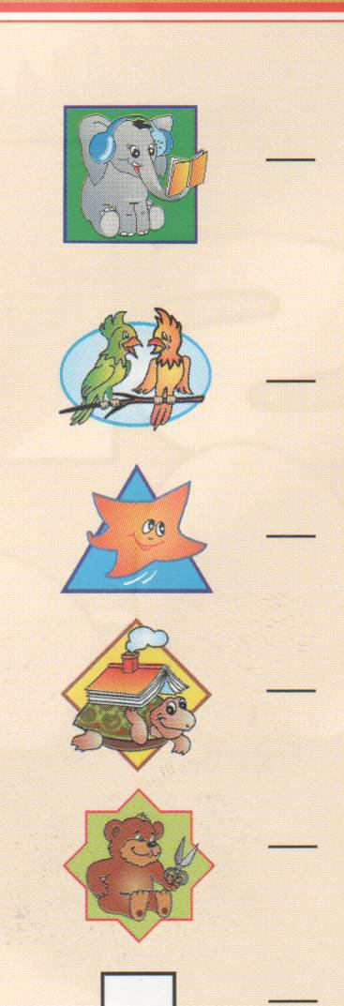
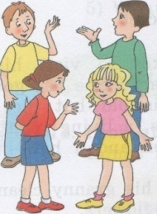

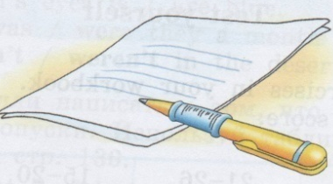
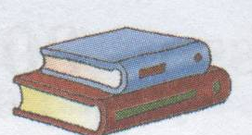
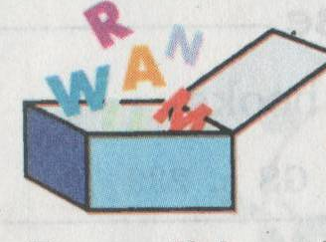


Slide 3
party

Slide 4
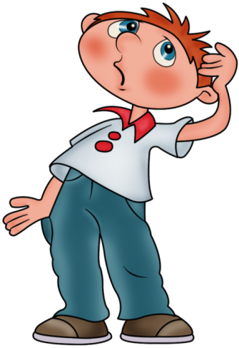

Slide 8
D H K O
L S W T

Slide 9
i
o
a
u
e
[ ]
[ ]
[ ]
[ ]
[ ]

Slide 10
g
h
k
r
w
[ g ]
[ h ]
[ k ]
[ r ]
[ w ]

Slide 11







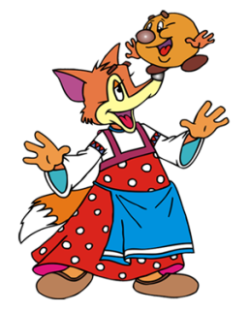


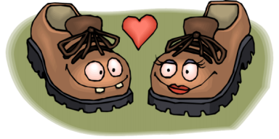

Slide 12


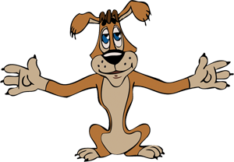
10

Slide 13


Slide 15
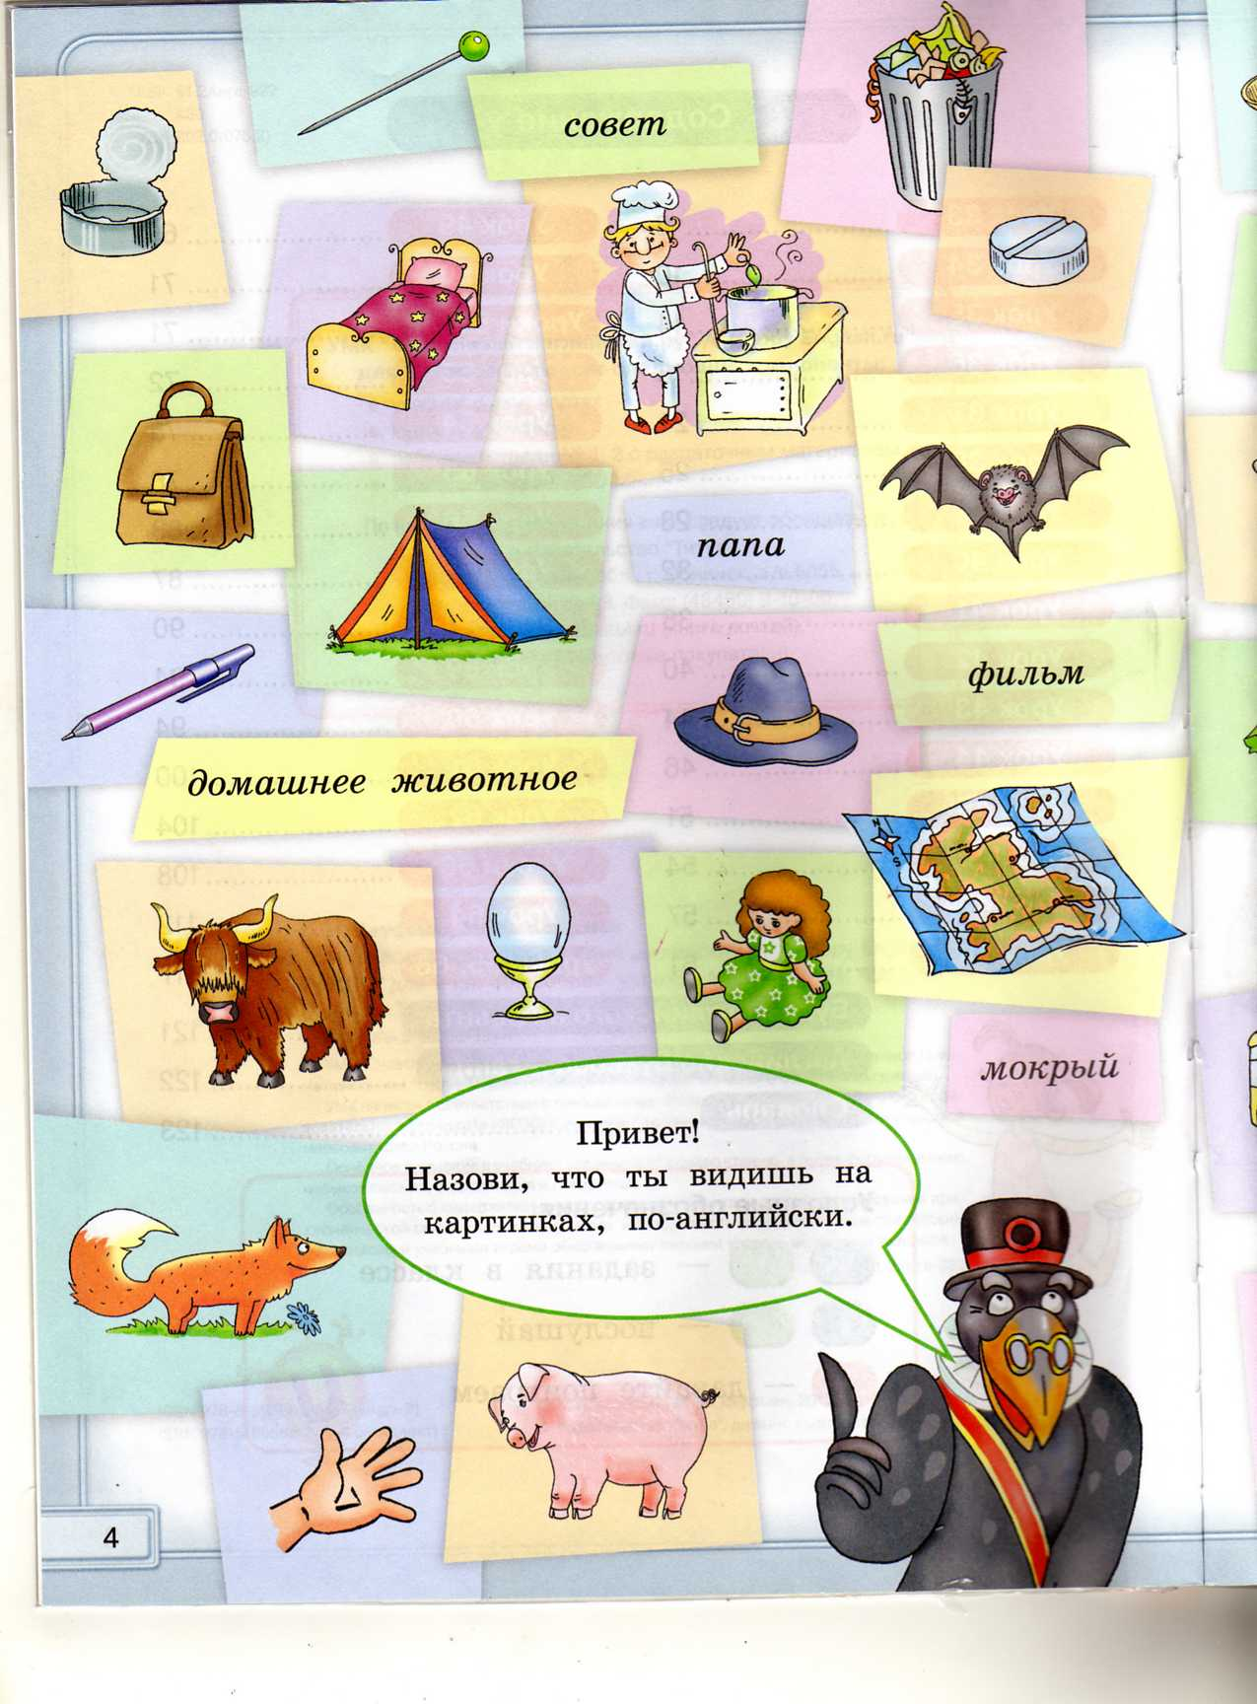
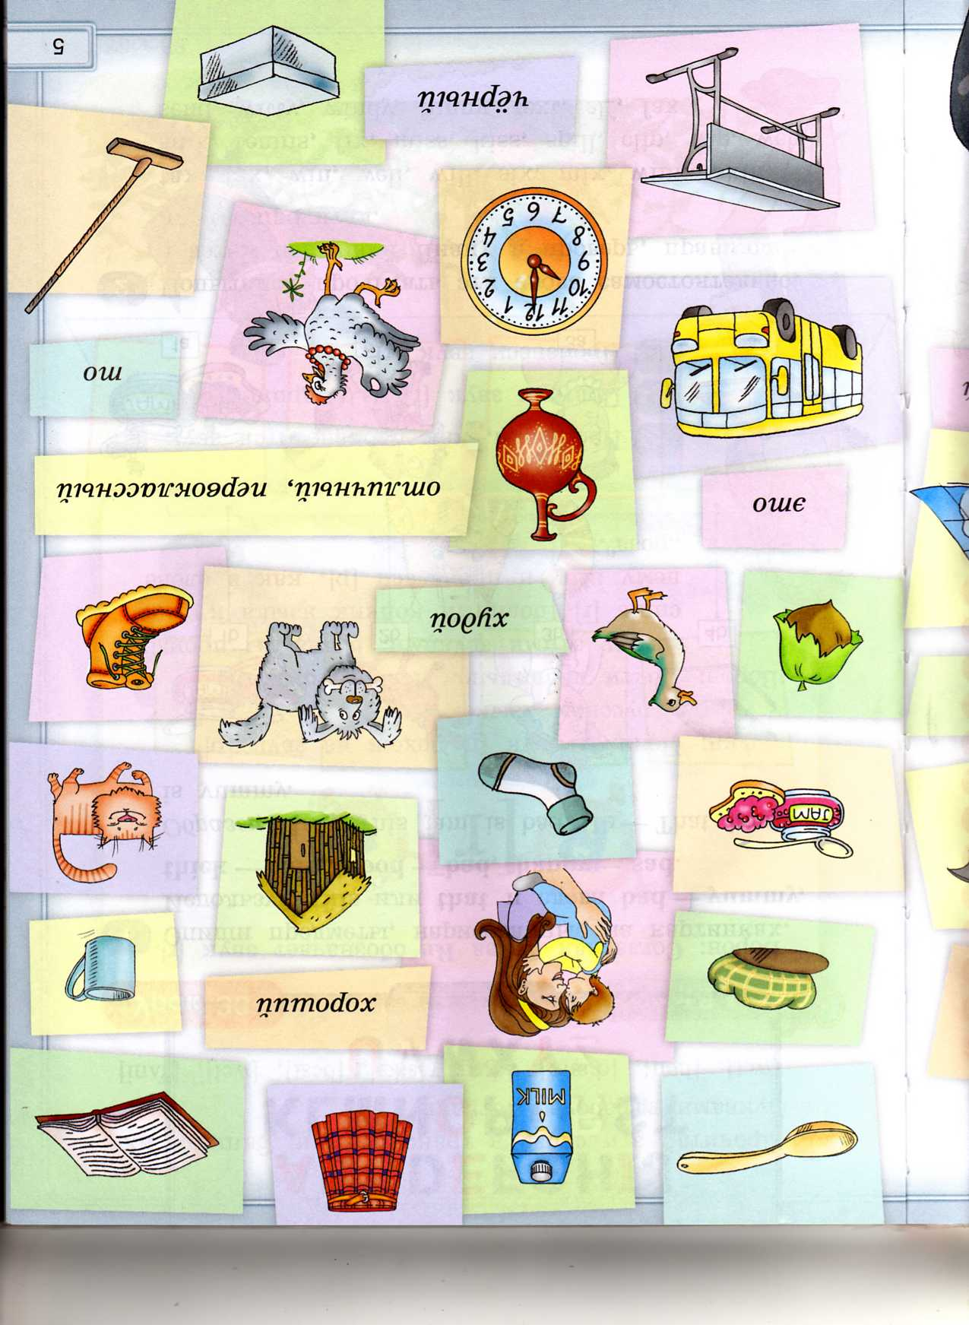
bus
yak
cap
hut
doll
nut
mug
pill
tent
hand
boot
bed

Slide 16

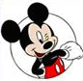
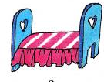

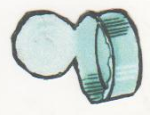
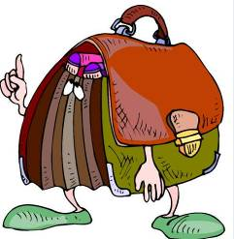
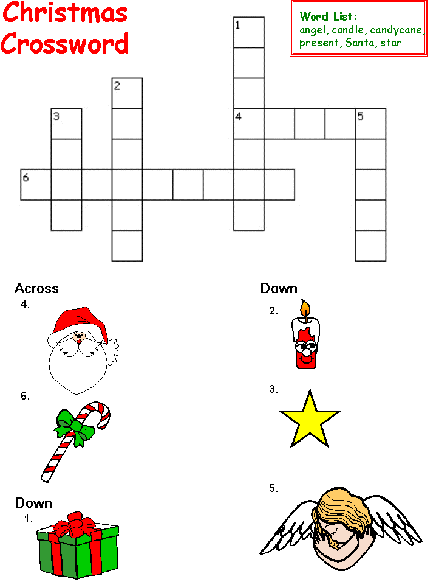
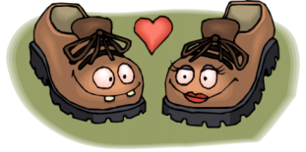
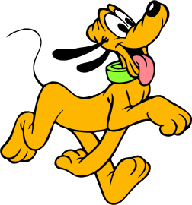
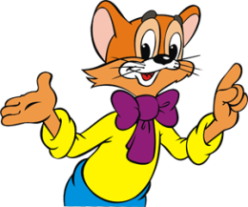


Slide 17
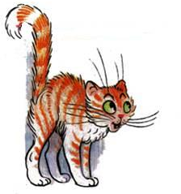






Slide 18
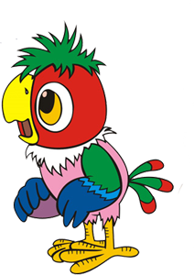
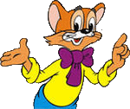
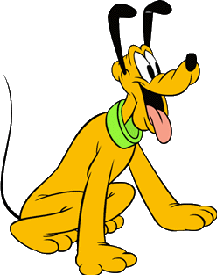

Slide 24
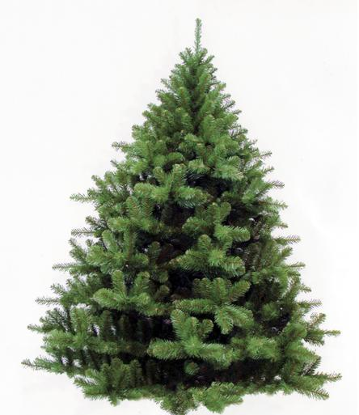






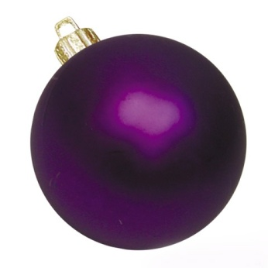

Slide 26
“Beautiful colours”
Yellow and green
Orange and blue
Beautiful colours
Colours for you!
Purple and brown
Red, white and grey
Beautiful colours
Beautiful day!
Beautiful, beautiful, so beautiful
Beautiful, beautiful, beautiful!

Slide 27
“Beautiful colours”

Slide 28




Slide 29
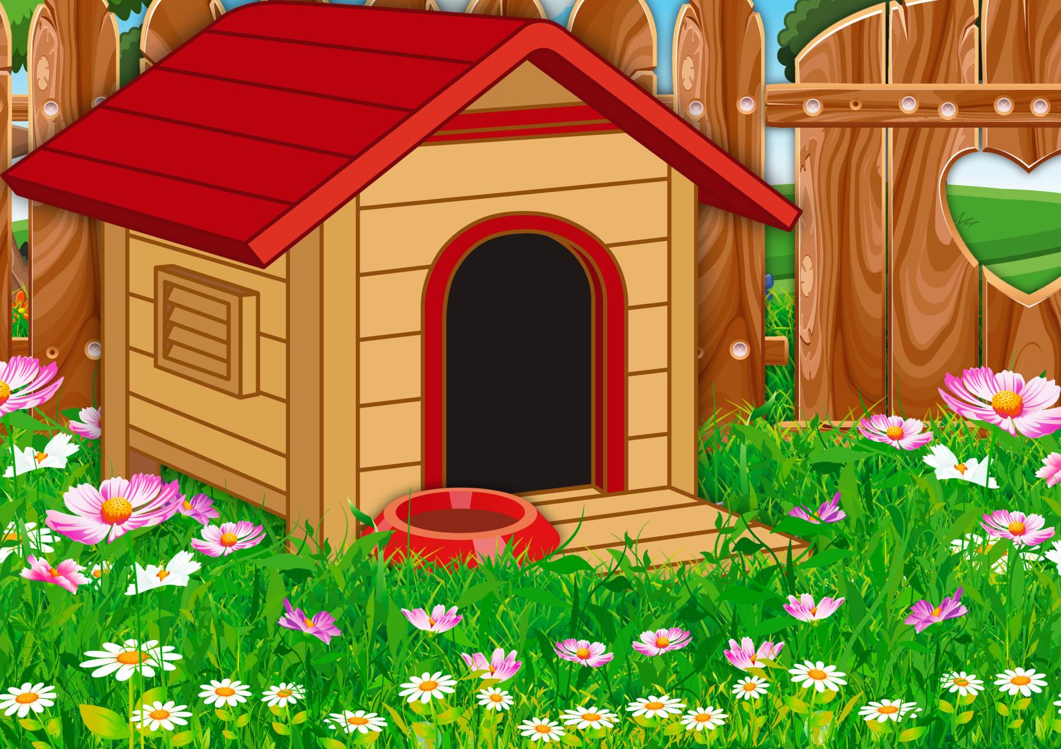
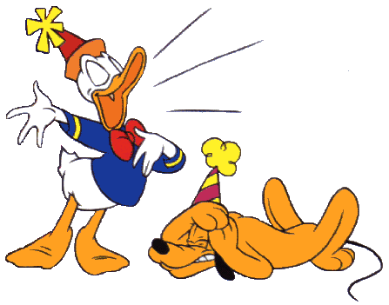

Slide 30


Slide 31


Slide 32
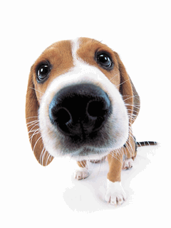
Is it a ………………………. ?

Slide 33

Is it a ………………………. ?

Slide 34

Is it a ………………………. ?

Slide 35
Is it a ………………………. ?

Slide 37
desk
milk
mum
box
clock
nut
book
spoon
black
box
wet
sad
red
pin
cat
mug
kilt
cap
big
map
dog
hat
test
net
doll
tin
egg
pill

Slide 38
leg
flat
mop
pig
man
hand
tent
bat
mad
left
hen
list
pen
hot
flag
tin
bed
ten
and
bag
tip
fox

Slide 39
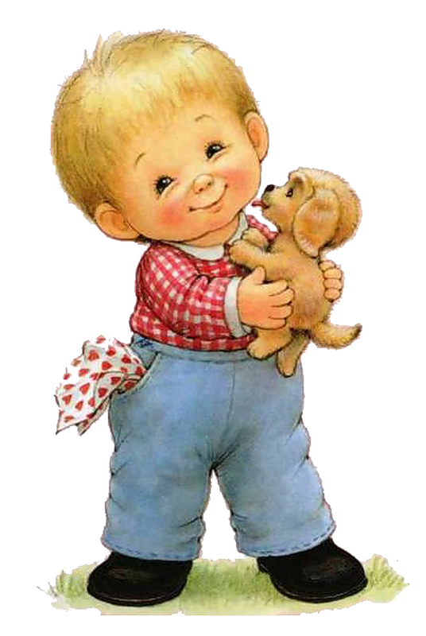
It is Tim .
Tim is not big.
Tim is six.
It is his dog.
His dog is funny.
It can run.
Tim is happy.

Slide 40
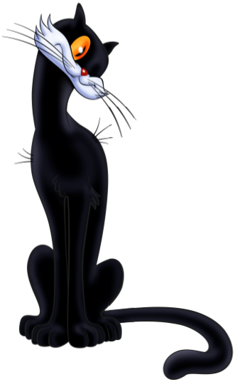
It is a cat.
The cat is big and slim.
It is funny.
The cat is black.
It can run and jump.
The cat is six.

Slide 41
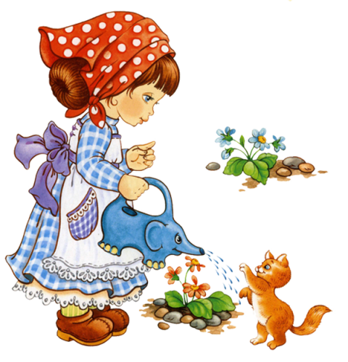
It is Kim.
Kim is slim and not big.
Kim has a pet.
It is a cat.
The cat is funny and happy.
It can run and jump.

Slide 42


Slide 43

slim
well
hot
sad
wet

Slide 45
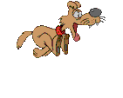





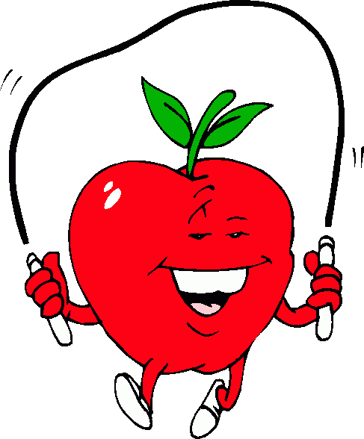


Slide 46
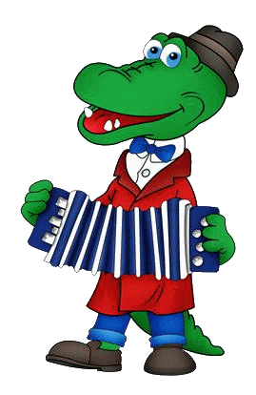
It is a .
It is .
2
It is .
It is .
большой
It is .
сильный
It can .
плавать

Slide 47
It is a .
5
It is .
It is .
It is .
маленький
It is .
веселый
It can .
летать

Slide 48
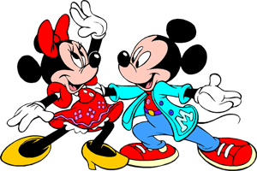

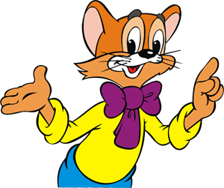

Slide 49


V. Who can find the most animals?
catfrogfoxmonkeypigdog
cat , frog, fox, monkey, pig, dog

Slide 50
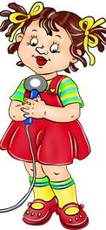
Hello! Hello! Hello!
Hello! How are you?
I like to be with you,
And you, and you, and you.
La-la-la, la-la-la, la-la-la-la
La-la-la, la-la-la-la
La-la-la, la-la-la, la-la-la-la
La-la-la, la-la-la-la

Slide 51
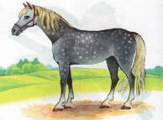
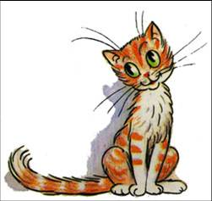

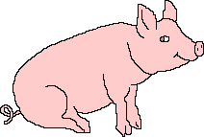
Crossword puzzle
B
H
C
S
E
L
E
P
H
A
N
T
A
I
N
I
O
T
A
I
R
O
G
R
K
G
N
S
E
E
E
R

Slide 52
V. Who can find the most animals?
catfrogfoxmonkeypigdog
cat , frog, fox, monkey, pig, dog

Slide 53
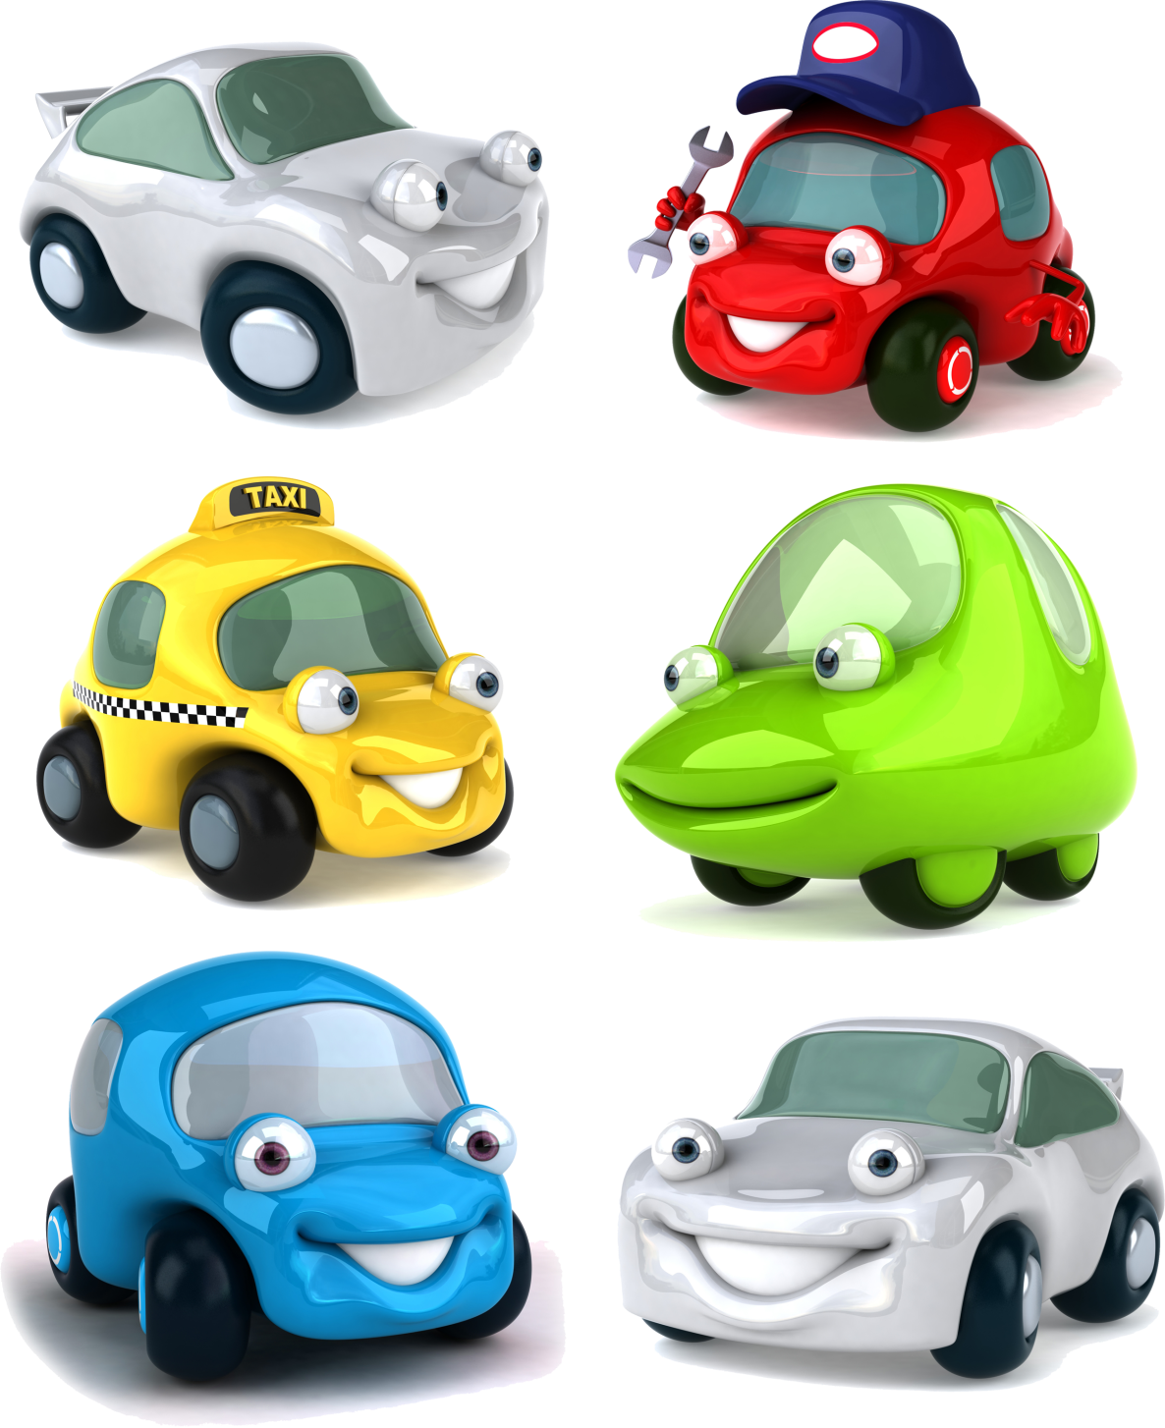

Slide 55


Slide 56
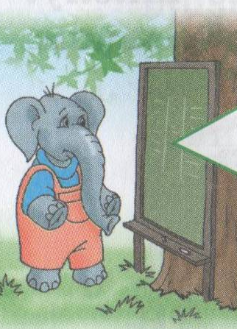
read
school
nine
milk
like
play
many
I am Thomas .
I am ____________ .
I go to _______________ .
I can ___________ and write .
I _______ to swim and skip.
For breakfast I like _________ and cakes.
I have got ____________ friends.
We ___________ together.

Slide 57
I have a dog, a little dog,
And Bingo is his name-o.
I have a dog, a little dog,
And Bingo is his name-o.
B-i-n-g-o, B-i-n-g-o,
B-i-n-g-o,
And Bingo is his name-o.

Slide 58
Hello! Hello! Hello!
Hello! How are you?
I like to be with you,
And you, and you, and you.
La-la-la, la-la-la, la-la-la-la
La-la-la, la-la-la-la
La-la-la, la-la-la, la-la-la-la
La-la-la, la-la-la-la

Slide 59


