Slide 1
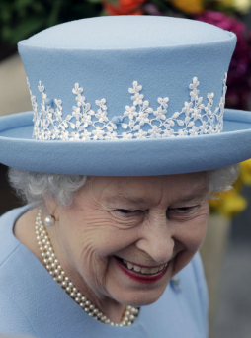
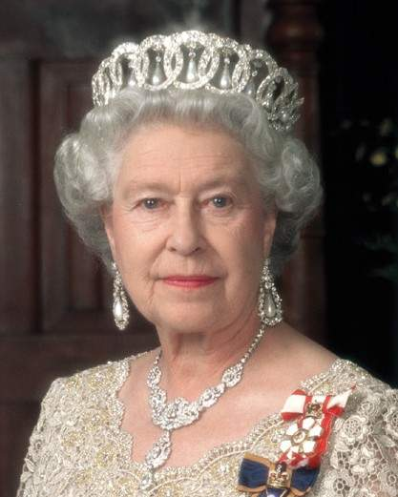
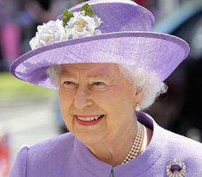
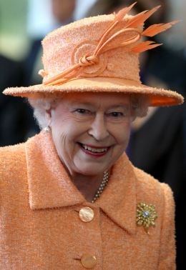
Queen’s Birthday

Slide 2
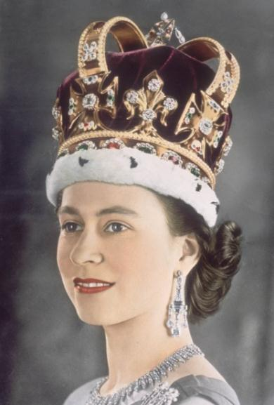
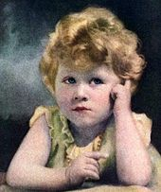
Queen Elizabeth II
She was born on April 21, 1926.
She became Queen on February 6, 1952.

Slide 3
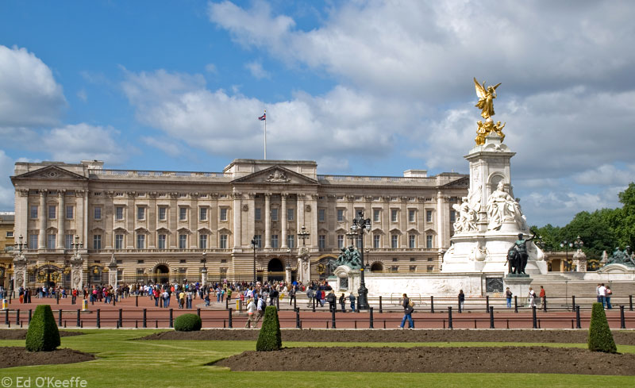
Queen Elizabeth II
She lives in Buckingham Palace
in London.

Slide 4
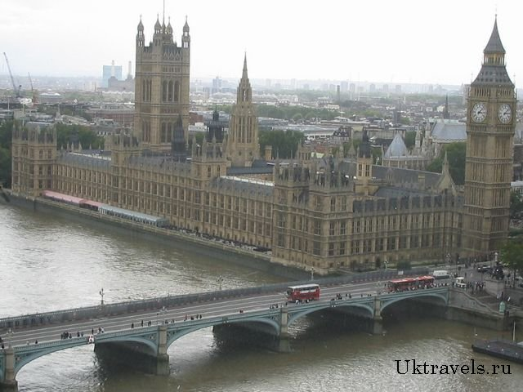
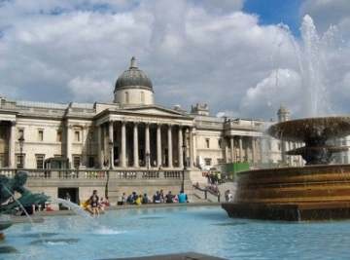
Queen’s
2 Birthdays
April 21
Real Birthday
2nd Saturday in June
Official Birthday

Slide 5
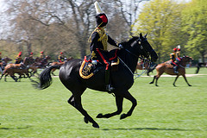
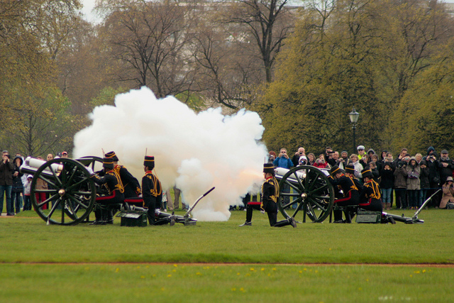
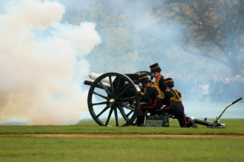
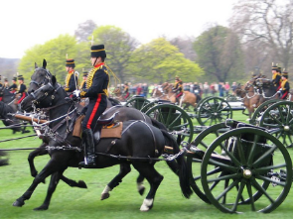
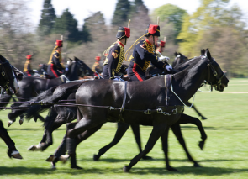
The Queen’s
Real Birthday
21 April
Royal Salute

Slide 6
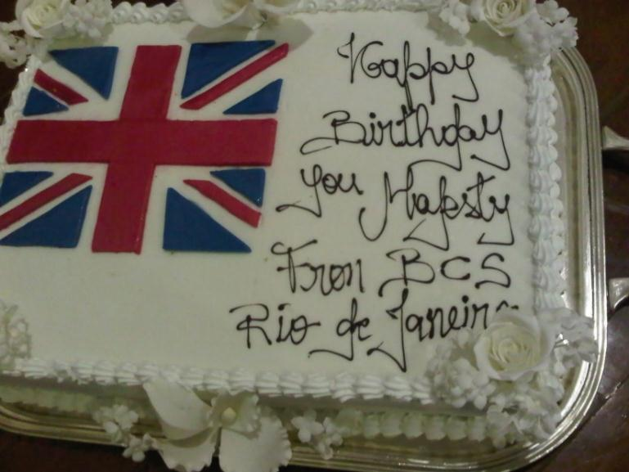
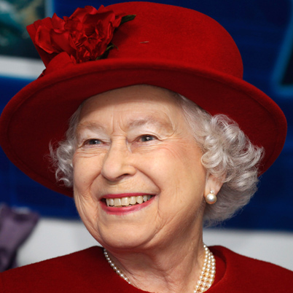
Queen`s birthday cake
Her Majesty’s cake

Slide 7
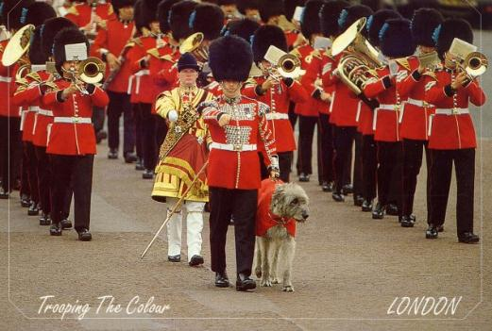
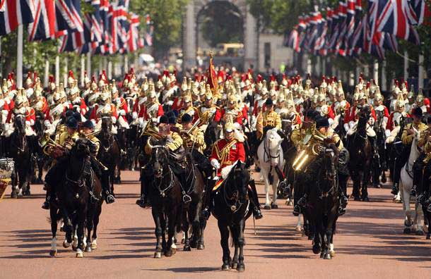
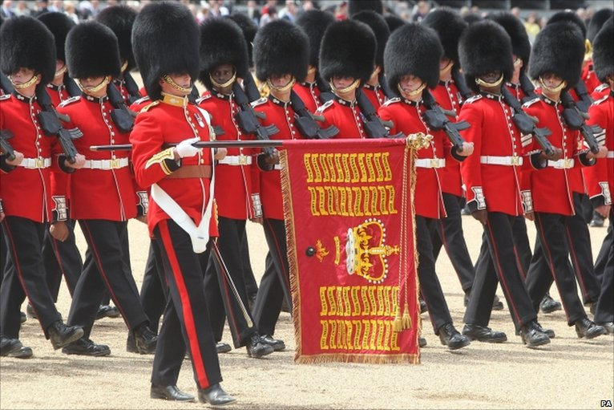
The Queen’s Official
Birthday
Trooping the Colour or
the Queen’s Birthday Parade
Second Saturday
in June

Slide 8
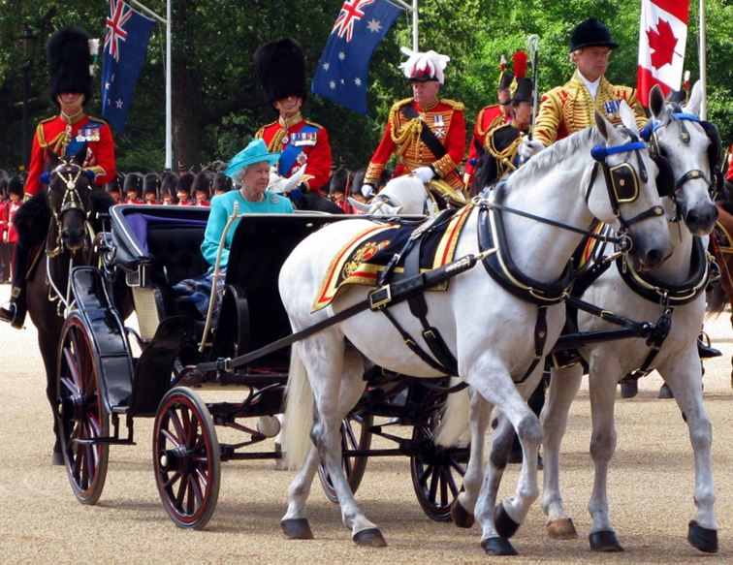
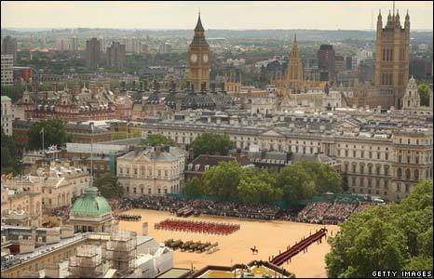
Trooping the Colour ceremony on Horse Guards Parade
Trooping the Colour Ceremony

Slide 9
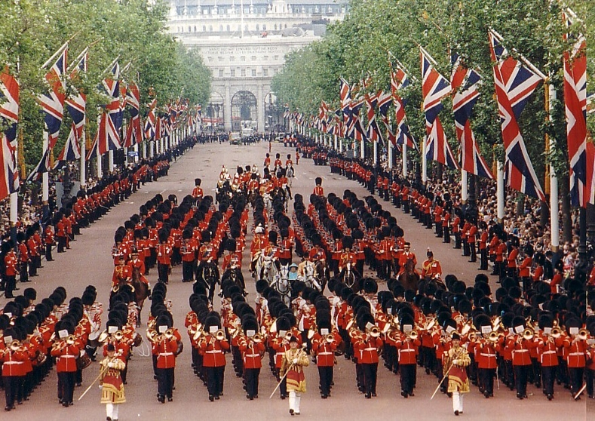
Trooping the Colour
The Queen attends the ceremony to take the salute from thousands of guardsmen who parade the colour.

Slide 10
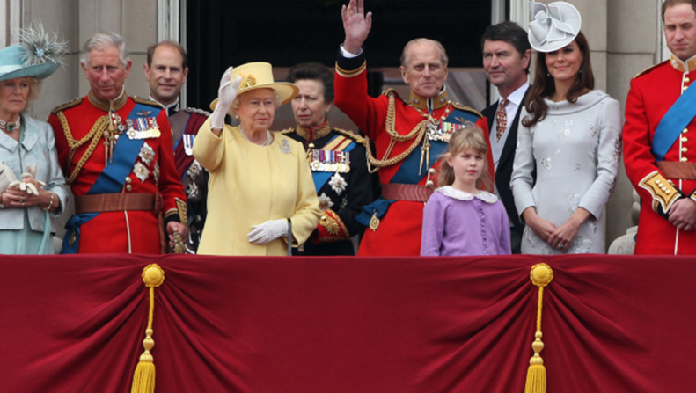
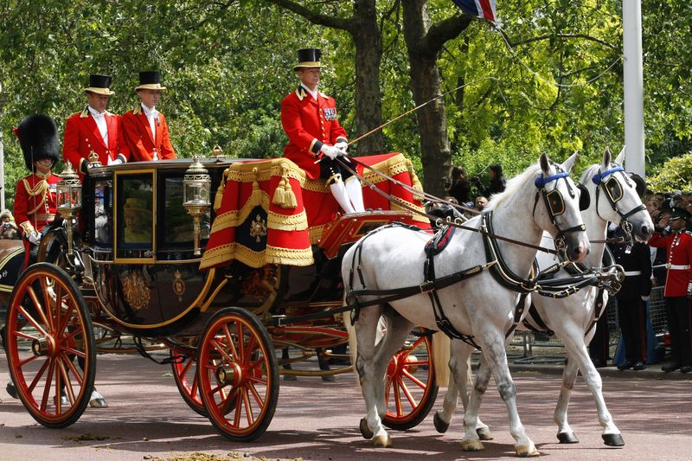
The Royal Procession arrives at Horse Guards Parade and the Queen takes the Royal Salute.

Slide 11
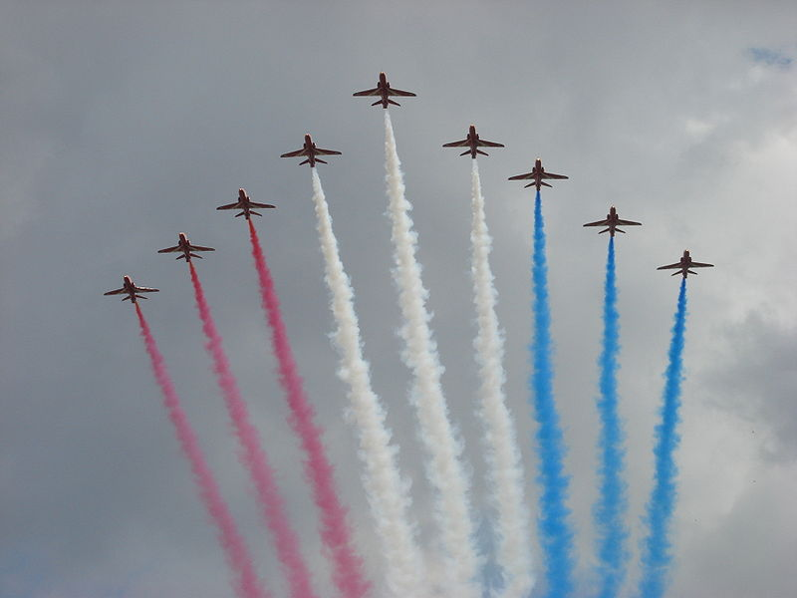
After the event, the Royal Family gathers on the balcony of Buckingham Palace to watch Royal Air Force past at 1⁰⁰ pm
The Royal Family gathers on the balcony of Buckingham Palace to watch Royal Air Force fly past at 1⁰⁰ pm.

Slide 12

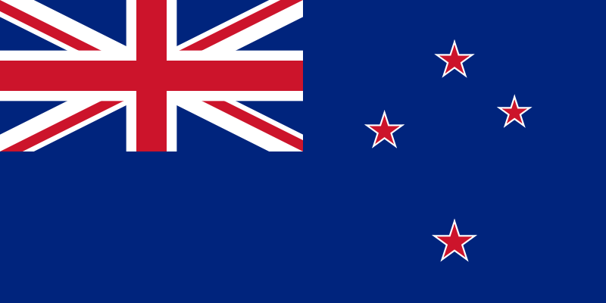
The Queen’s Birthday In Other Countries
Australia
Second Monday
in June
New Zealand
First
Monday
in June

Slide 13
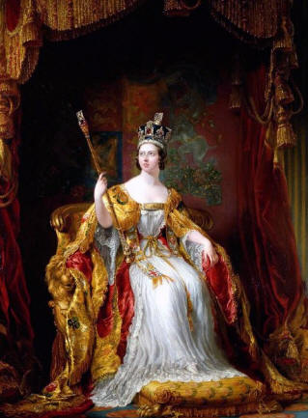

Queen Victoria Day
Queen Victoria
Canada
The third Monday of May

Slide 14
Can you answer the questions?
In 2013 the Queen’s Birthday Parade will be on June 15. When is the Queen’s second birthday?
What does Trooping the Colour mean?
How old is the Queen?

