Slide 1
The 6th of March, Monday
In all weathers
Module 7c

Slide 2
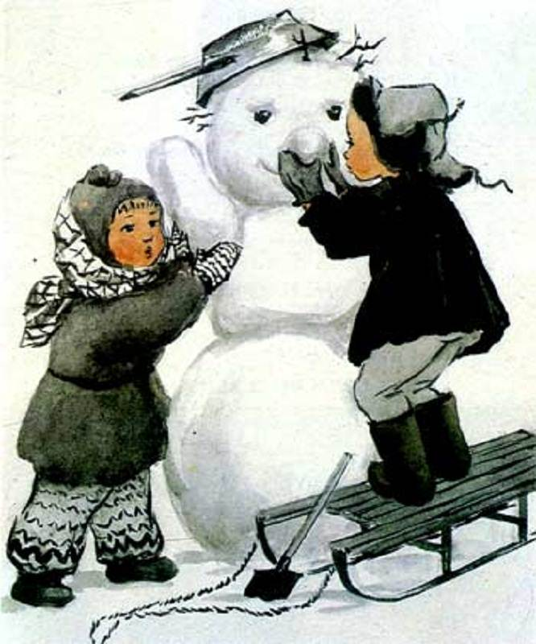
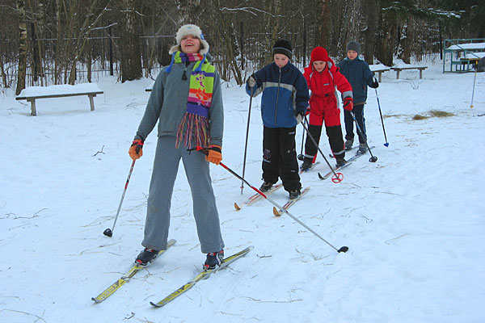
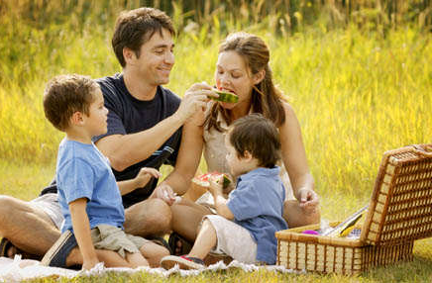
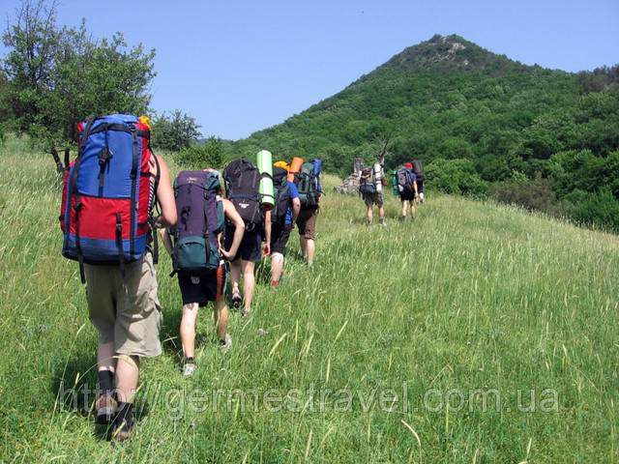
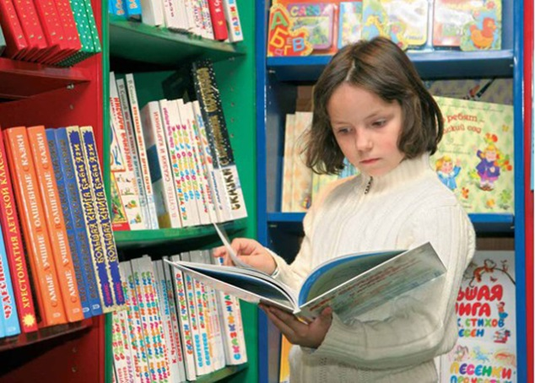
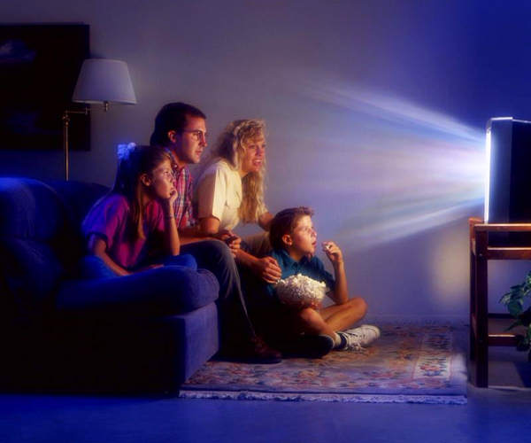

Slide 3

Activities in all weathers

Slide 4
We will learn to speak about:
Weather
Activities
What the mates and you like doing in different weather

Slide 5
We can find information from:
Watching a video
Reading a text
Listening to the teacher or other people

Slide 6
Activities
1.go skiing
3.read a book
5.have a picnic
2.watch TV
4.make a snowman
6.go camping
a
b
c
e
f
d

Slide 7
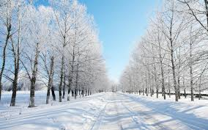
What do you like doing when it is
warm in winter?

Slide 8
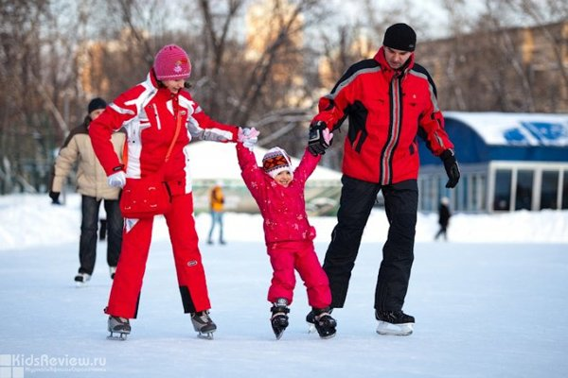
go skating

Slide 9
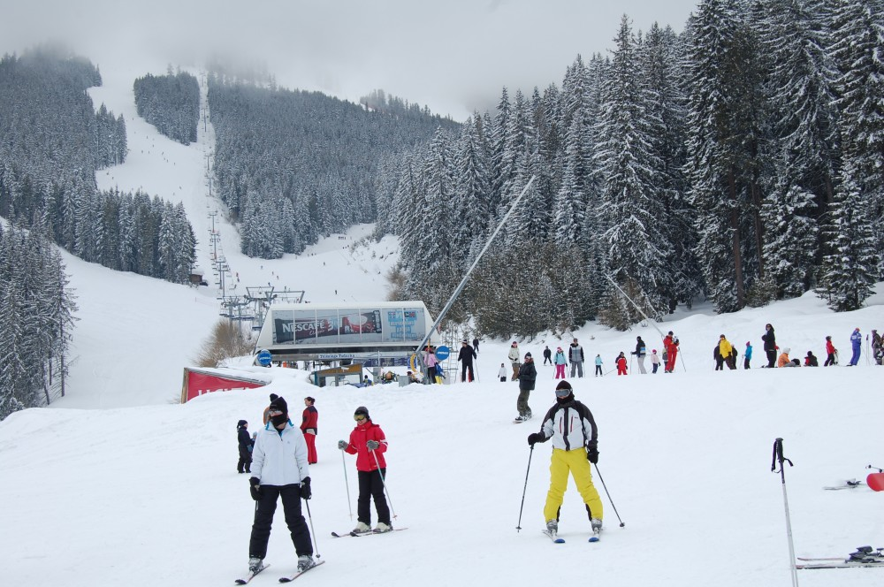
go skiing

Slide 10
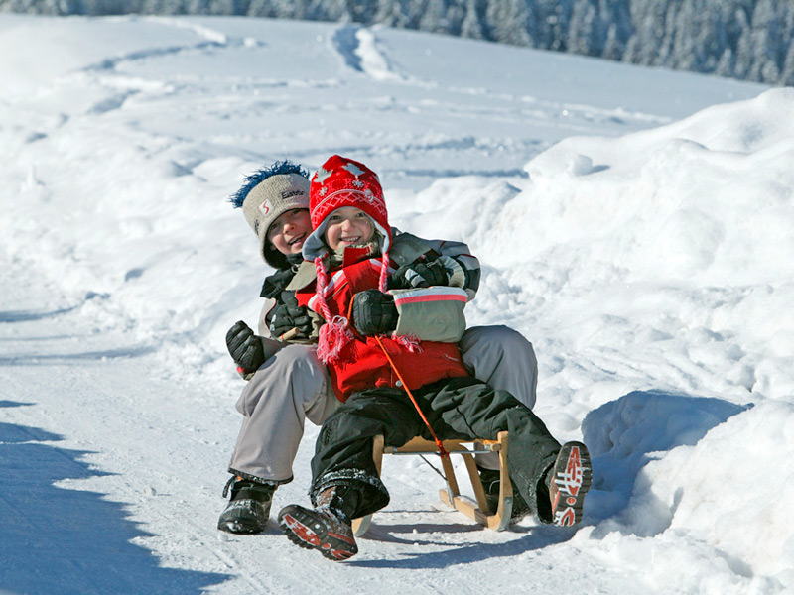
sledding

Slide 11

What do you like doing when it is
hot?

Slide 12
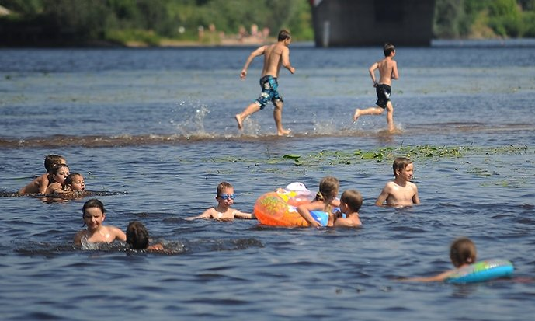
go swimming

Slide 13
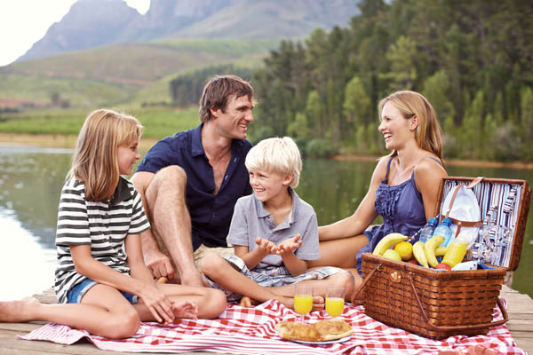
have a picnic

Slide 14
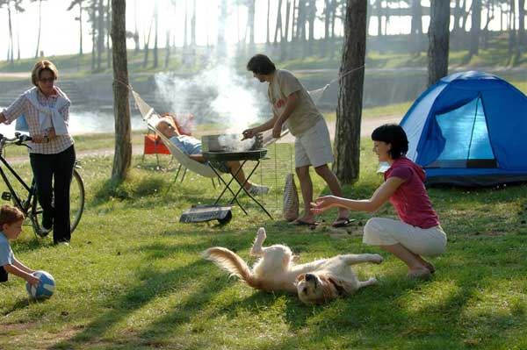
go camping

Slide 15
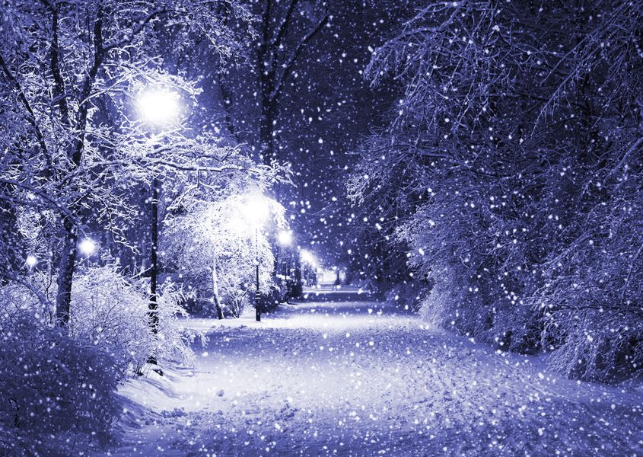
What do you like doing when it
snows?

Slide 16
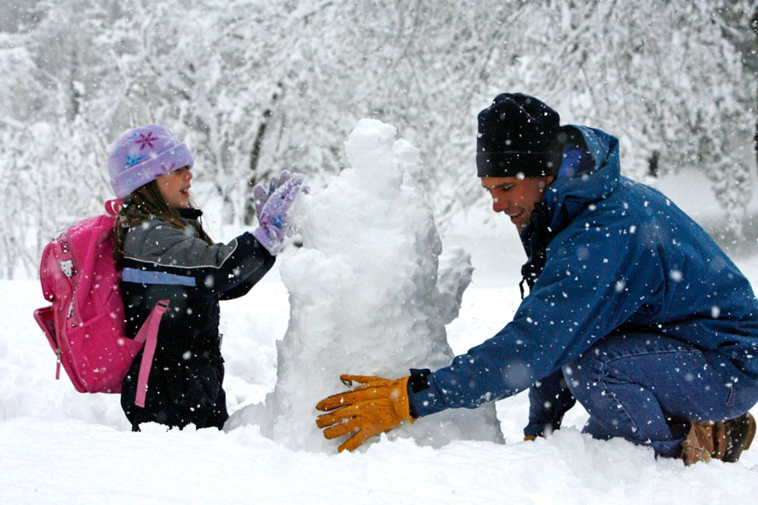
make a snowman

Slide 17
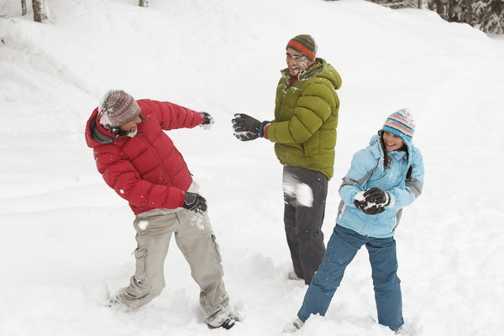
snowball

Slide 18
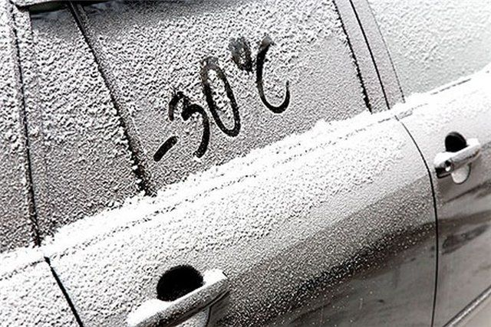
WHAT do you like doing when it is
COLD?

Slide 19
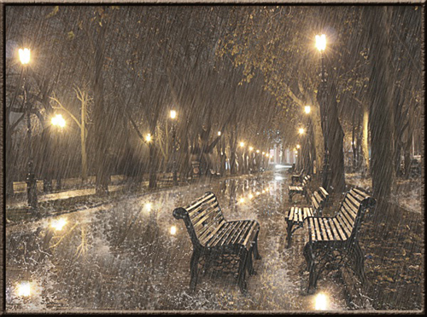
….or it
RAINS ?

Slide 20
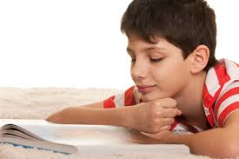
read a book

Slide 21
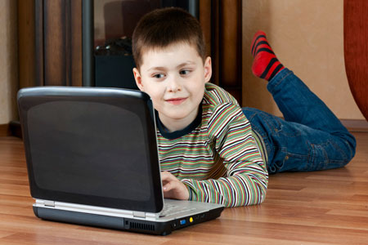
play computer games

Slide 22
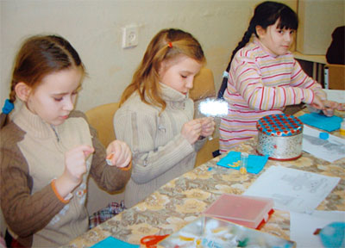
do needlework

Slide 23
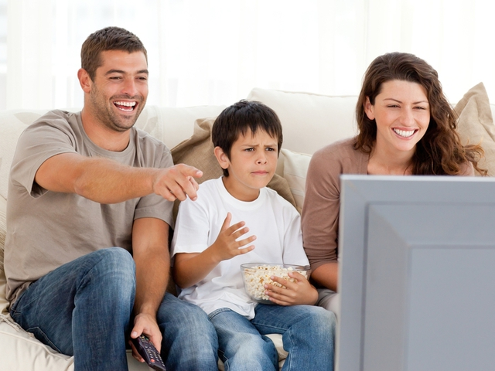
watch TV

Slide 24
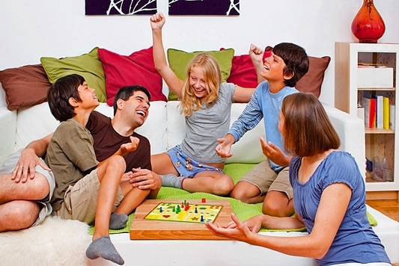
play board games

Slide 25
Activities
1.go skiing
3.read a book
5.have a picnic
2.watch TV
4.make a snowman
6.go camping
a
b
c
e
f
d

Slide 26
Answer the questions
1. Are they going camping?
4. Are they skiing?
2. Are they reading a book?
5. Are they having a picnic?
3. Are they making a snowman?
6. Is she watching TV?

Slide 27
Choose the correct phrase(s).
When it is hot I can… a) go skating b) go swimming c) watch TV

Slide 28
When it is warm in winter I can… a) play computer games b) go skiing c)go camping

Slide 29
When it rains I can… a) read a book b) have a picnic c) play board games

Slide 30

Homework
p. 90 выучить слова
p.90 ex. 5 письменно
WB p. 55
Thank you!
See you later!

