Slide 1

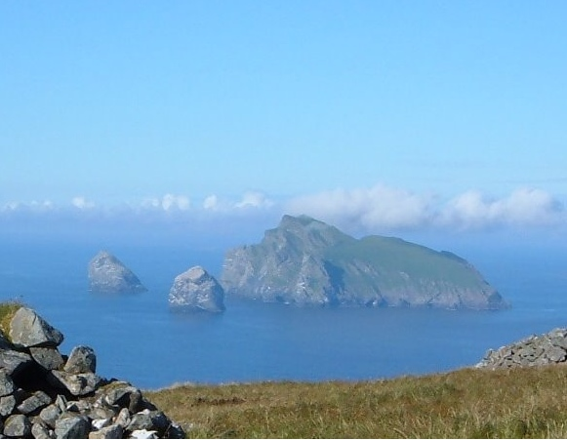
National Nature Reserves in Great Britain

Slide 2
Why were National Nature Reserves established?
(important, the most, habitats, species, to protect, and)
National Nature Reserves were established to protect the most important habitats and species.

Slide 3


Slide 4
Which of the following can you see in Scotland`s National Nature Reserve?
Spotlight 7, Module 8d, Culture Corner

Slide 5
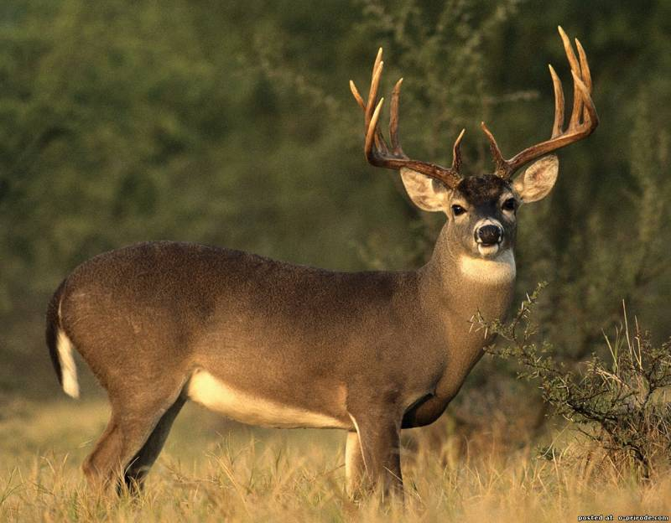
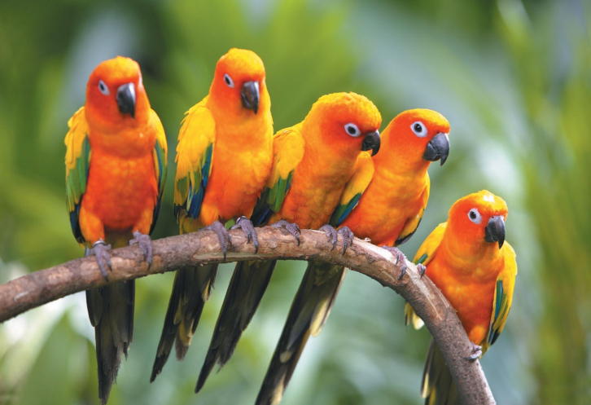
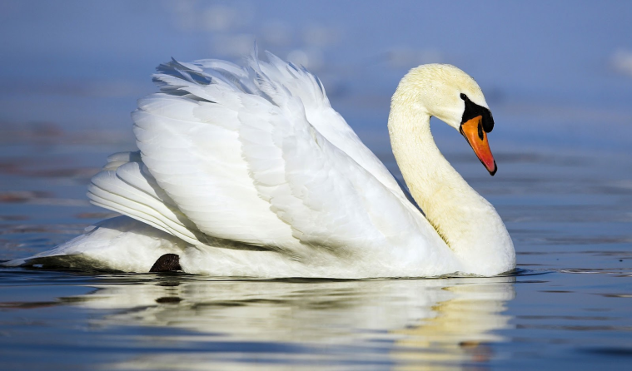
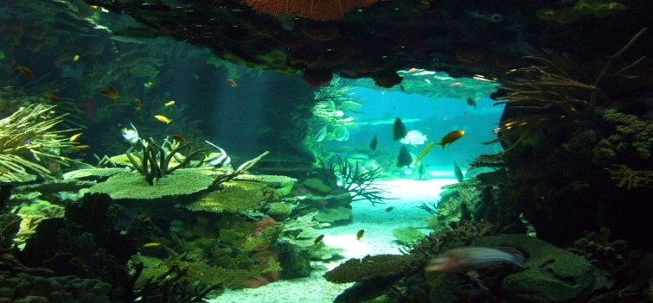

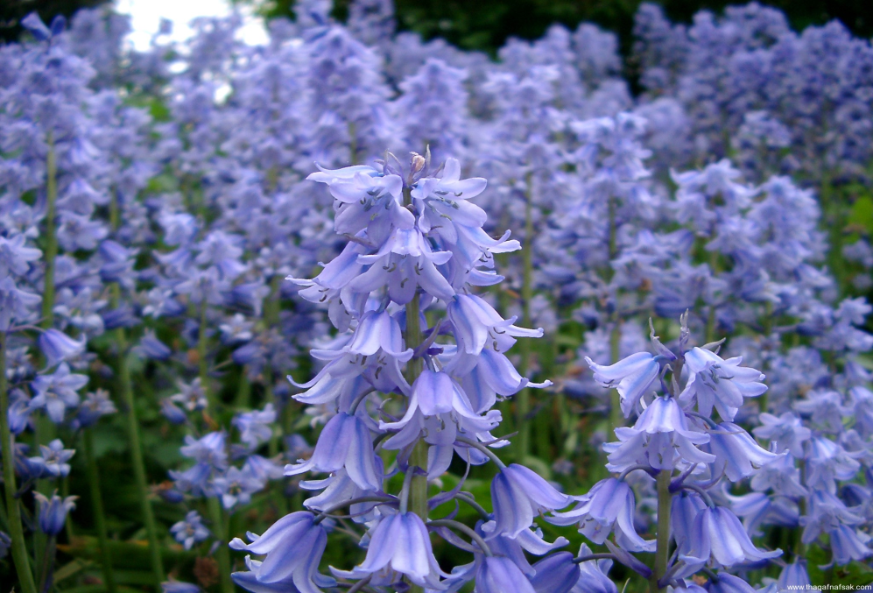
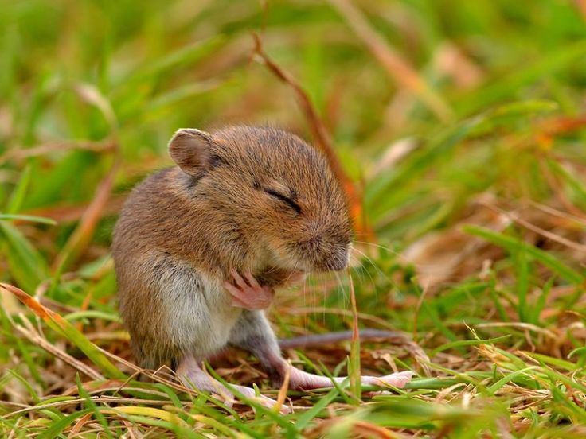
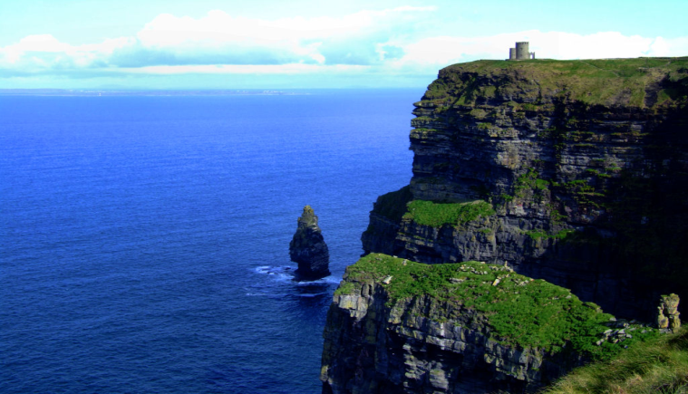
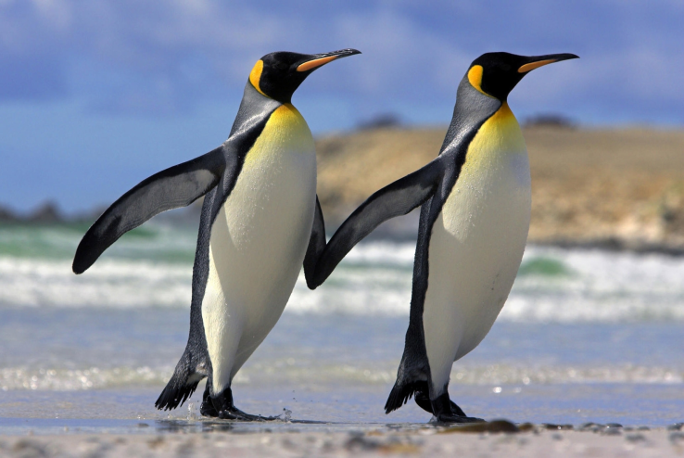
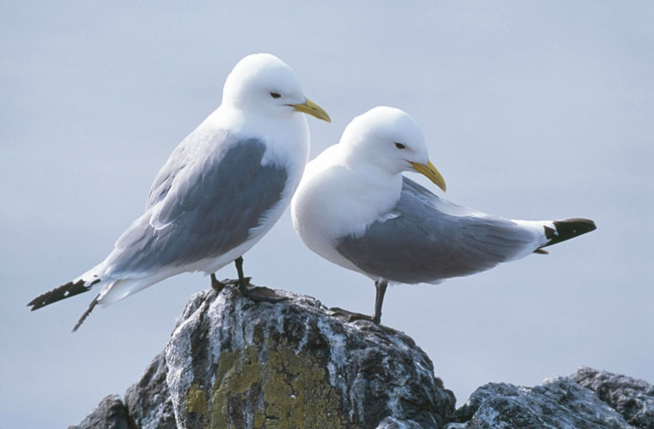
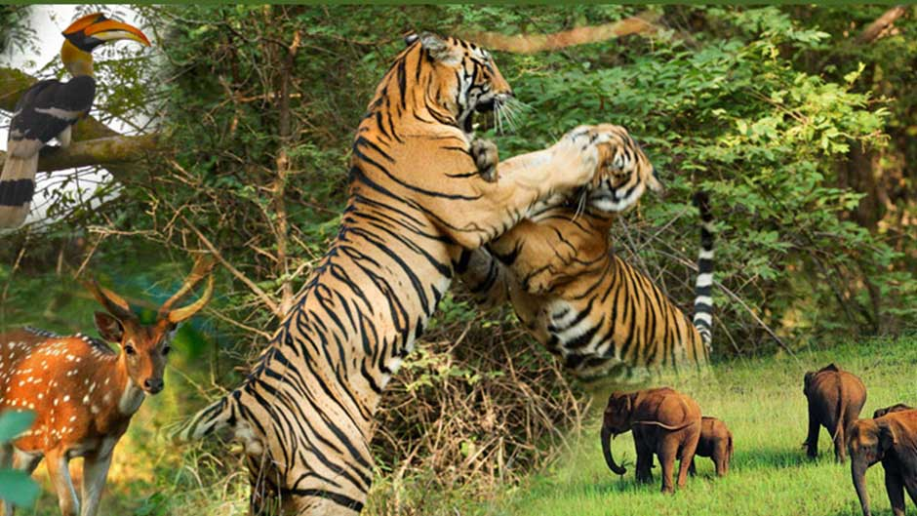
deer parrots swan
bluebells field mice cliffs
underwater cave
penguins seabirds wildlife

Slide 6
Listen and check

Slide 7
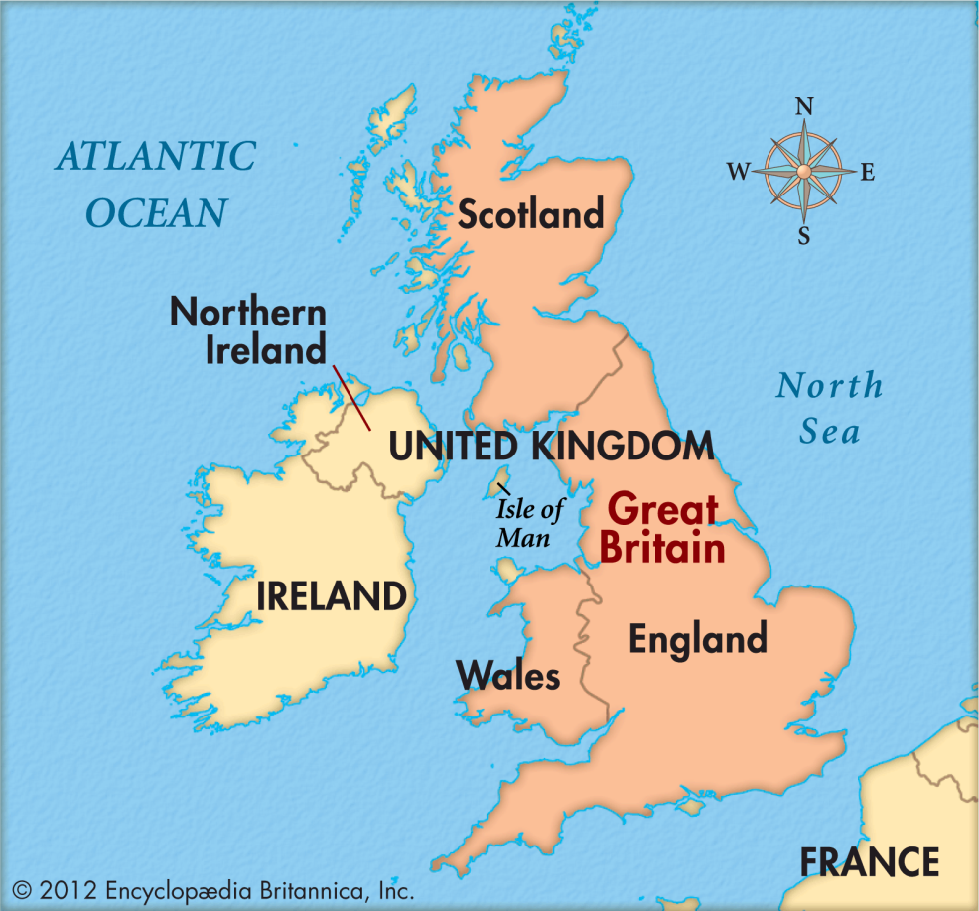
There are 47 NNRs
in Northern Ireland
There are 67 NNRs in Wales
There are 73NNRs
in Scotland
There are 224 NNRs in England

Slide 8
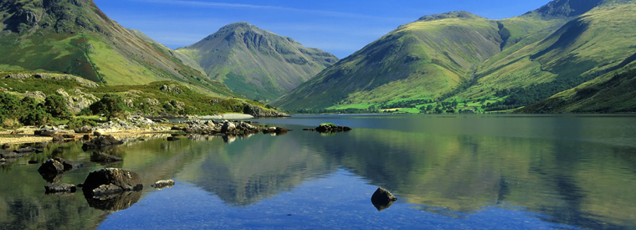
England`s National Nature Reserve

Slide 9
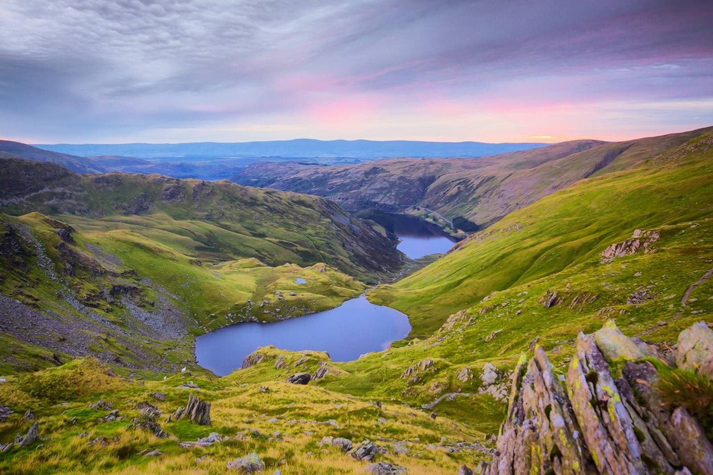
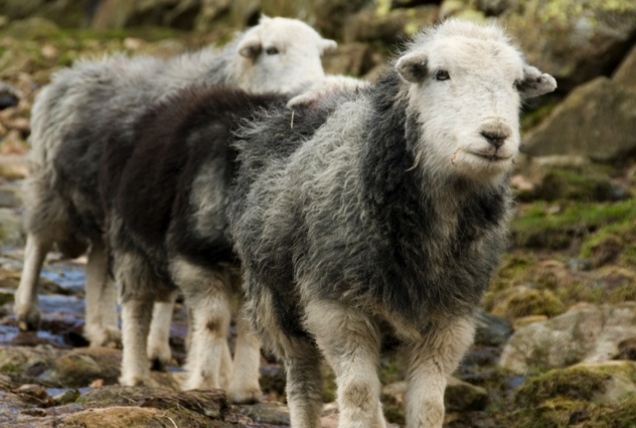
The Lake District National Park
is in North West England .
It is the largest national reserve in the country.
It is famous for its lakes, forests and mountains.
Here you will find twelve of Britain’s largest lakes in one district .
It is also the only place in Britain where you can see ‘grey’ sheep.
Best time to visit in spring or in summer.

Slide 10
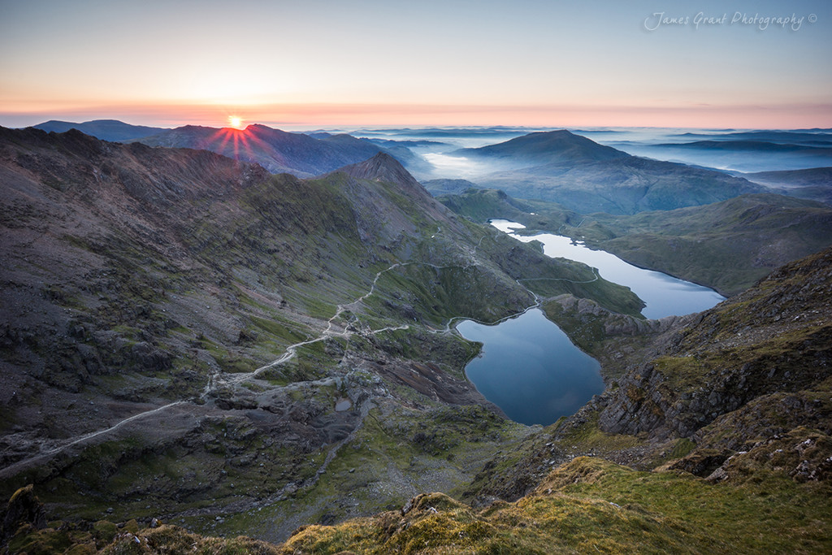
National Nature Reserve of Wales

Slide 11
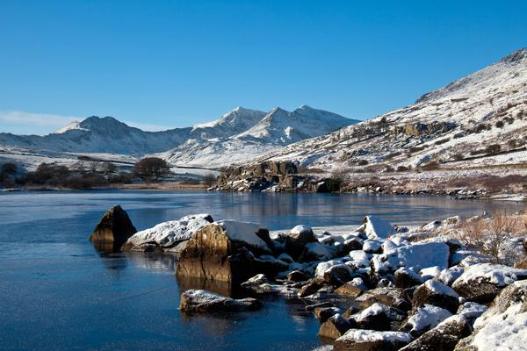
Snowdon
is a region of North Wales.
It is the second largest National Reserve after the Lake District.
Snowdonia region is rich in wildlife.
There is the highest peak in England and Wales, Mount Snowdon that reaches 1085 metres.
It is one of the best places for climbing.
People can visit this reserve in any time of a year.

Slide 12
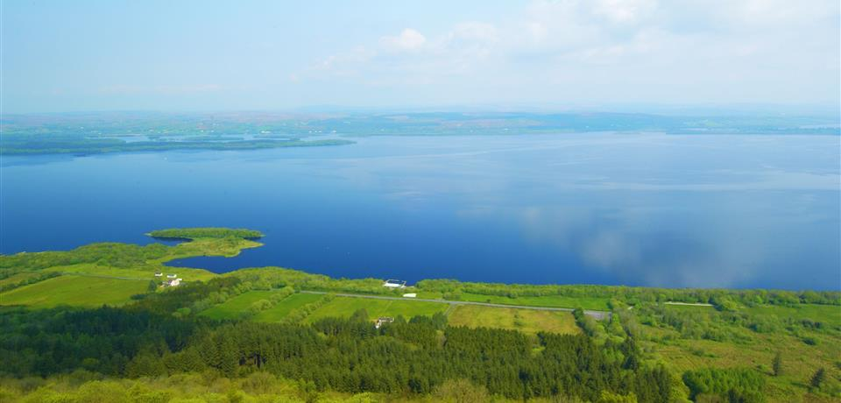
National Nature Reserve of Northern Ireland

Slide 13
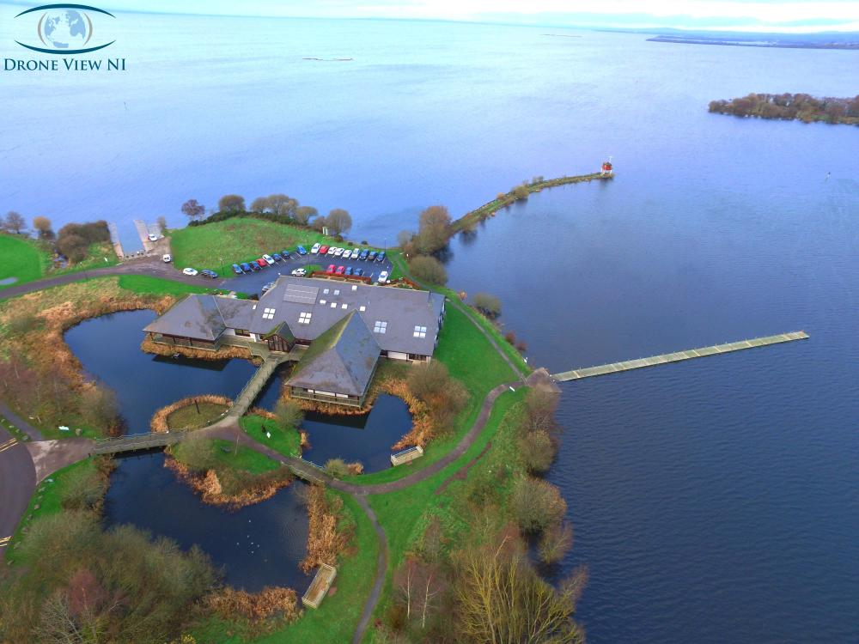
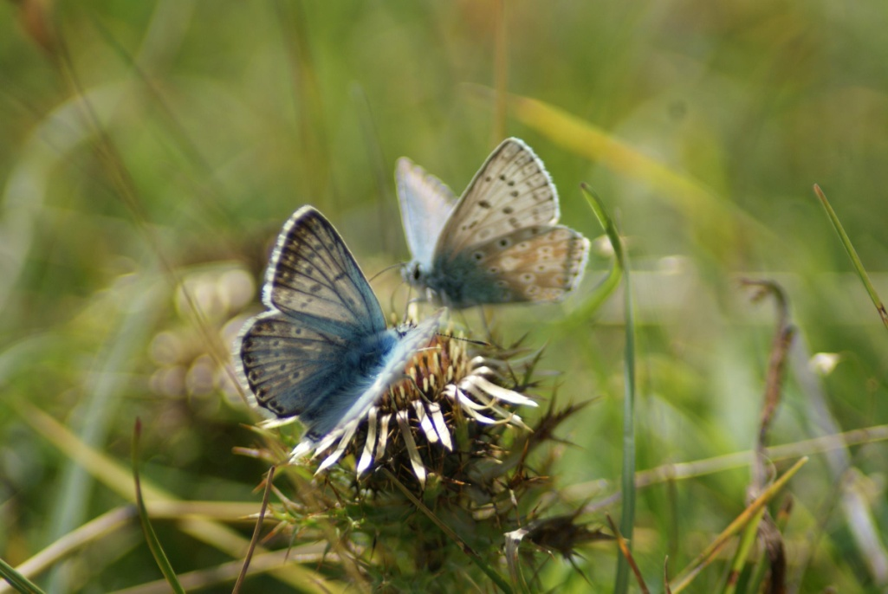
Oxford Island
is a National Nature Reserve on the southern shores in Northern Ireland.
The reserve is famous for a great variety of natural habitats.
Oxford Island contains rare and common wild plants.
14 species of butterflies can be found there.
About 60 species of moth (мотылек) have also been recorded.
The best time to visit is summer.

Slide 14
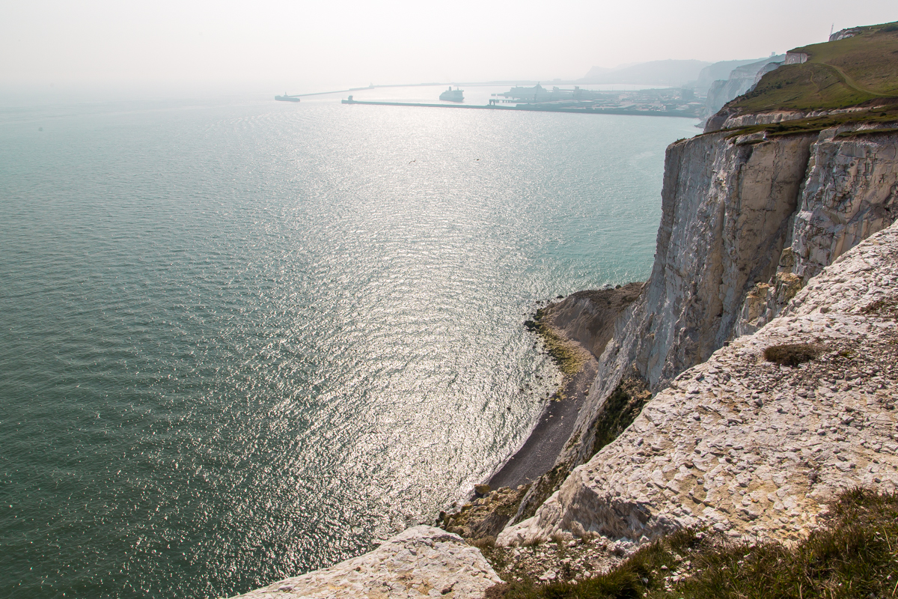
What Nature Reserve in Great Britain would you like to visit?
Why?

Slide 15
Answer the questions.
What is the best place for diving?
St Kilda
What is the best place for climbing?
Snowdon
What reserve is one of the most important wetlands in Europe?
Insh Marshes

Slide 16
Where can you find a lot of species of butterflies?
Oxford Island
Where is the highest peak?
Snowdon
What is the largest national reserve in the country?
Lake District
What is the Lake District famous for?
Lakes, forests and mountains

