Slide 1
SUPERSTITIONS
GOOD AND BAD: DO YOU BELIEVE IN THEM?

Slide 2
Discussion questions
WHAT ARE SOME THINGS THAT BRING GOOD LUCK?
WHAT ARE SOME THINGS THAT BRING BAD LUCK?
WHAT ARE OTHER SUPERSTITIONS THAT EXIST?

Slide 3
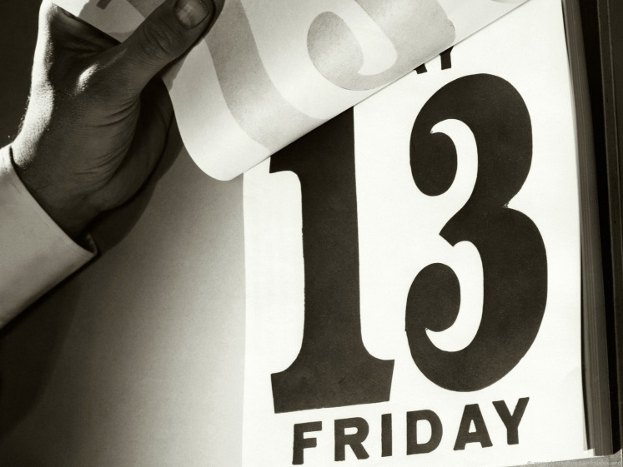
1. FRIDAY THE 13TH
FRIDAY THE 13TH IS CONSIDERED AN UNLUCKY DAY (ACCORDING TO CHRISTIAN TRADITION, JESUS DIED ON A FRIDAY)
THE NUMBER “13” HAS BEEN CONSIDERED UNLUCKY FOR A LONG TIME SINCE “12” IS CONSIDERED TO BE THE PERFECT NUMBER (12 MONTHS / 12 HOURS ON THE CLOCK / 12 APOSTLES / ETC.)
DID YOU KNOW THAT MOST BUILDINGS DON’T EVEN HAVE A 13TH FLOOR?
QUESTIONS: HAS SOMETHING UNLUCKY HAPPENED TO YOU OR SOMEONE
ON FRIDAY OR “TUESDAY” THE 13TH?

Slide 4
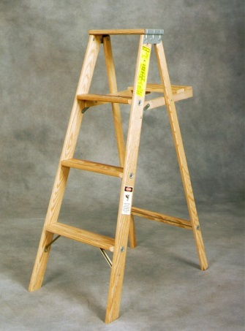
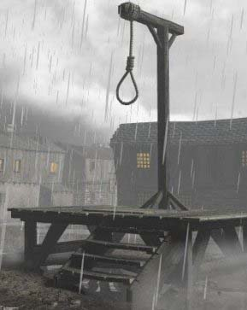
2. WALKING UNDER A Ladder
WALKING UNDER A LADDER IS CONSIDERED BAD LUCK
THE REASON IT IS CONSIDERED BAD LUCK IS BECAUSE LADDERS ARE ASSOCIATED WITH GALLOWS AND EXECUTIONS
ANOTHER POPULAR BELIEF IS BECAUSE A LADDER CAN CREATE A TRIANGLE SHAPE. THIS TRIANGLE SHAPE CAN BE INTERPRETED AS THE HOLY TRINITY (FATHER, SON AND THE HOLY GHOST). WALKING THROUGH THE LADDER WOULD BREAK THE TRIANGLE AND BE BLASPHEMOUS
QUESTIONS: HAVE YOU EVER WALKED UNDER A LADDER OR DO YOU AVOID IT?

Slide 5
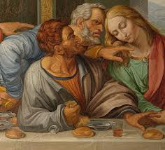
3. Spilling salt
SPILLING SALT IS CONSIDERED BAD LUCK
THIS SPICE WAS EXTREMELY EXPENSIVE DURING ANCIENT TIMES AND THE ELIZABETHAN ERA (1558 – 1603)
THE MOST COMMON BELIEF REQUIRES YOU TO TOSS SOME SALT OVER YOUR LEFT SHOULDER INTO THE DEVIL’S FACE WHO IS THERE
ANOTHER POPULAR REASON COMES FROM THE LAST SUPPER BY LEONARDO DA VINCI WHERE JUDAS SPILLED THE SALT
QUESTIONS: HAVE YOU EVER SPILLED SALT? DO YOU DO ANYTHING
WHEN IT HAPPENS?

Slide 6
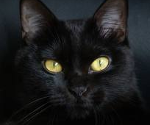
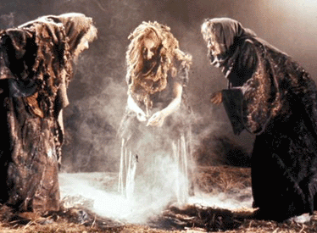
4. Black cats CROSSING YOUR PATH
BLACK CATS CROSSING YOUR PATH IS CONSIDERED BAD LUCK
MOST LIKELY, THE SUPERSTITIONS COMES FROM THE OLD BELIEF THAT WITCHES HAVE BLACK CATS
IT WASN’T UNTIL THE MIDDLE-AGES IN EUROPE WHEN THE CAT BECAME ASSOCIATED WITH WITCHES.
THE BELIEF WAS THAT WITCHES WOULD TRANSFORM THEMSELVES INTO BLACK CATS TO WALK AROUND THE STREETS AND LOOK FOR PEOPLE TO HEX
THE COLOR BLACK IS ALSO ASSOCIATED WITH EVIL
QUESTIONS: HAVE YOU EVER SEEN A BLACK CAT? DID YOU THINK IT WAS
BAD LUCK?

Slide 7
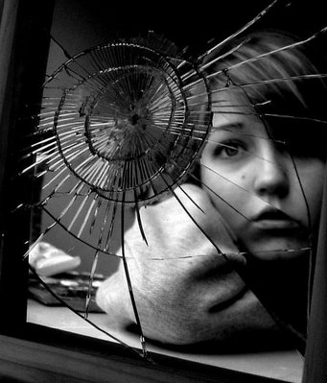
5. BREAKING A MIRROR
BREAKING A MIRROR GIVES YOU BAD LUCK FOR SEVEN YEARS!
THE SUPERSTITIONS COMES FROM THE BELIEF THAT MIRRORS DON’T JUST REFLECT YOUR IMAGE, THEY ALSO HOLD PIECES OF YOUR SOUL. IF YOU BROKE A MIRROR, YOUR SOUL WAS TRAPPED IN THE PIECES OF THE MIRROR
ESSENTIALLY, A BROKEN MIRROR CREATED A BROKEN SOUL
QUESTIONS: HAVE YOU EVER BROKEN A MIRROR? DID IT GIVE YOU BAD LUCK?

Slide 8
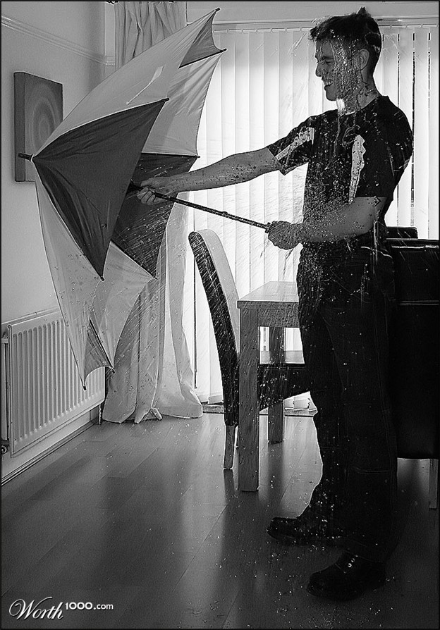
6. OPENING AN UMBRELLA INSIDE
OPENING AN UMBRELLA INSIDE BRINGS YOU BAD LUCK
LEGEND SAYS THAT A ROMAN WOMAN OPENED HER UMBRELLA INSIDE HER HOUSE AND MOMENTS LATER, HER HOUSE COLLAPSED
ANOTHER STORY IS ABOUT A BRITISH PRINCE WHO RECEIVED TWO UMBRELLAS FROM A VISITING KING AND HE DIED TWO MONTHS LATER
QUESTIONS: HAVE YOU EVER OPENED AN UMBRELLA INSIDE?

Slide 9
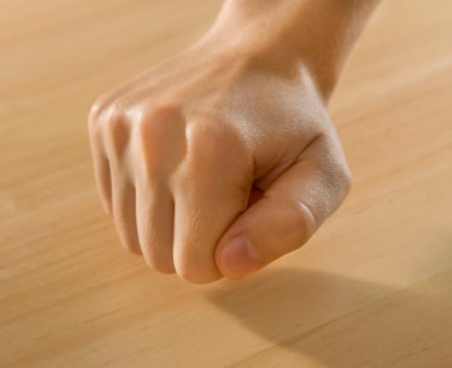
7. KNOCKING ON WOOD
KNOCKING ON WOOD WARDS OFF BAD LUCK
THE FIXATION ON WOOD MAY COME FROM OLD MYTHS ABOUT GOOD SPIRITS LIVING IN TREES
IN ENGLISH FOLKLORE, PEOPLE WOULD KNOCK ON WOOD WHILE TELLING SECRETS TO HIDE THEIR COMMUNICATION FROM EVIL SPIRITS AND TALK MORE IN PRIVATE
IT CAN ALSO BE ASSOCIATED WITH THE CHRISTIAN CROSS WHICH WAS MADE OF WOOD
QUESTIONS: WHAT WOULD BE A SITUATION WHERE YOU WOULD KNOCK
ON WOOD? HAVE YOU EVER KNOCKED ON WOOD?

Slide 10
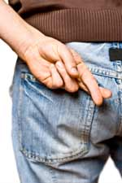
8. CROSSING YOUR FINGERS
PEOPLE WISHING FOR GOOD LUCK WILL OFTEN CROSS THEIR FINGERS
THE REASON, AS THE STORY GOES, IS THAT TWO PEOPLE USED TO CROSS INDEX FINGERS WHEN MAKING A WISH, A SYMBOL OF SUPPORT FROM A FRIEND
THE TRADITION BECAME SOMETHING PEOPLE COULD DO BY THEMSELVES AND NOWADAYS, JUST SAYING “FINGERS CROSSED” IS ENOUGH
CROSSING YOUR FINGERS CAN ALSO BE ASSOCIATED WITH THE CHRISTIAN CROSS
QUESTIONS: HAVE YOU EVER CROSSED YOUR FINGERS? FOR WHAT?

Slide 11
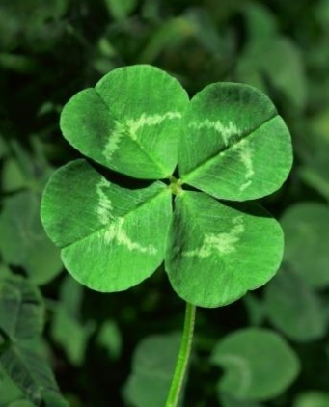
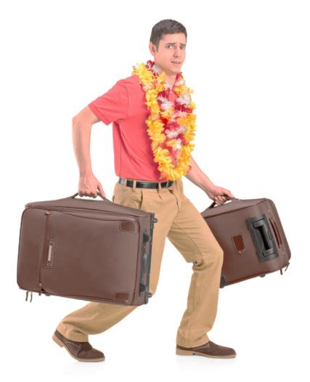
OTHER SUPERSTITIONS
AN APPLE A DAY KEEPS THE DOCTOR AWAY
FINDING A FOUR LEAF CLOVER IS GOOD LUCK
STEP ON A CRACK, BREAK YOUR MOTHER’S BACK
AT THE END OF A RAINBOW IS A POT OF GOLD
A RABBIT’S FOOT BRINGS GOOD LUCK
GARLIC PROTECTS AGAINST VAMPIRES
RUNNING AROUND THE HOUSE WITH LUGGAGE ON NEW YEAR’S WILL MAKE YOU TRAVEL MORE

Slide 12
Which one do I use???
-ANOTHER: USE “ANOTHER” FOR SINGULAR COUNTABLE NOUNS
1. LET’S WATCH A MOVIE ANOTHER DAY.
2. SHE HAS ANOTHER CELLPHONE NOW.
-OTHER: USE “OTHER” FOR PLURALS OR UNCOUNTABLE NOUNS
1. DO YOU HAVE ANY OTHER QUESTIONS?
2. SHE HAS OTHER NECKLACES AT HER HOUSE.
3. THAT BOOK HAS OTHER INFORMATION.
-THE OTHER: SPECIFIC
1. THE OTHER DAY, I WENT TO TEXAS.
2. CAN YOU PASS ME THE OTHER BOOKS?
EXERCISE: MAKE TWO SENTENCES WITH EACH WORD

