Slide 1
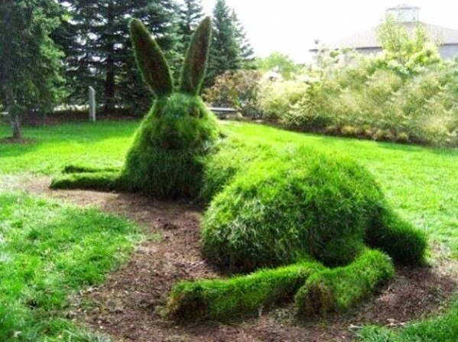
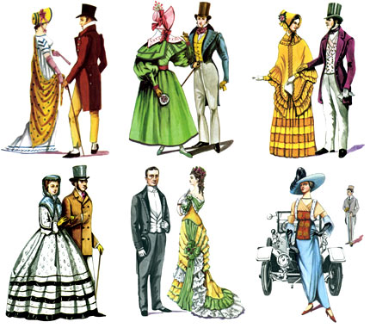
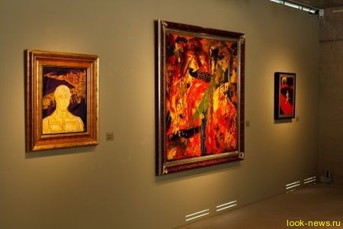
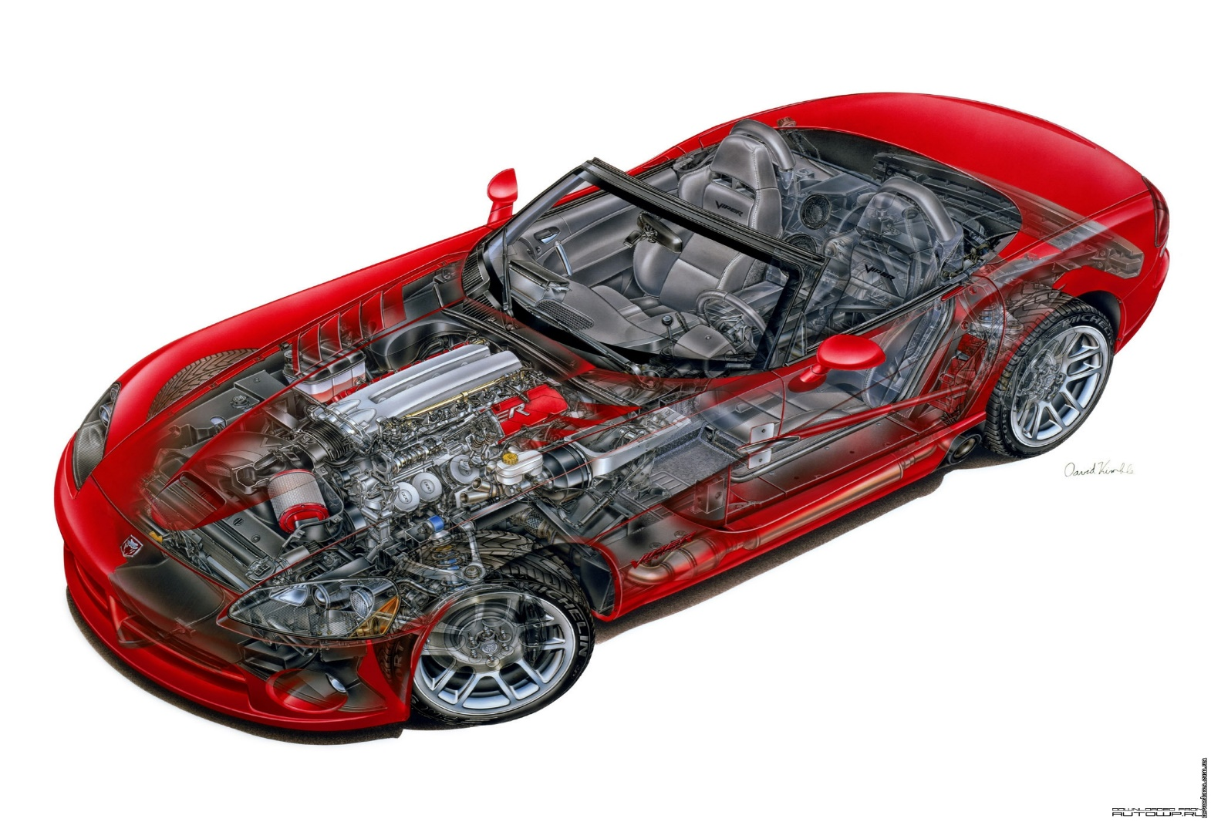
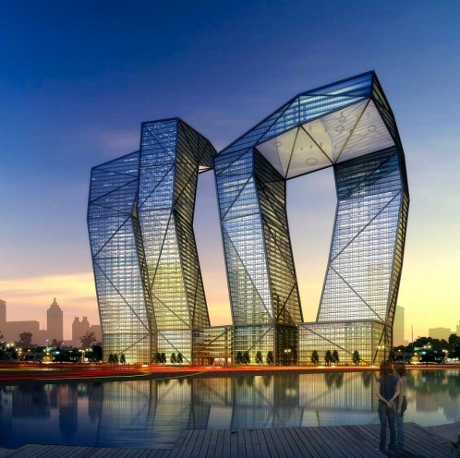
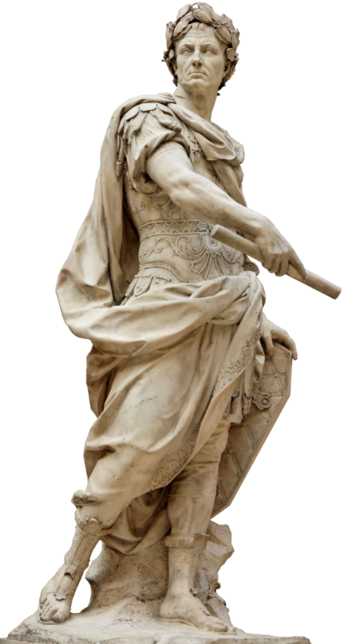

Slide 2
drawing, painting, sculpture, architecture, design, fashion
The expression or application of human creative skill and imagination, typically in a visual form such as painting or sculpture, producing works to be appreciated primarily for their beauty or emotional power

Slide 4
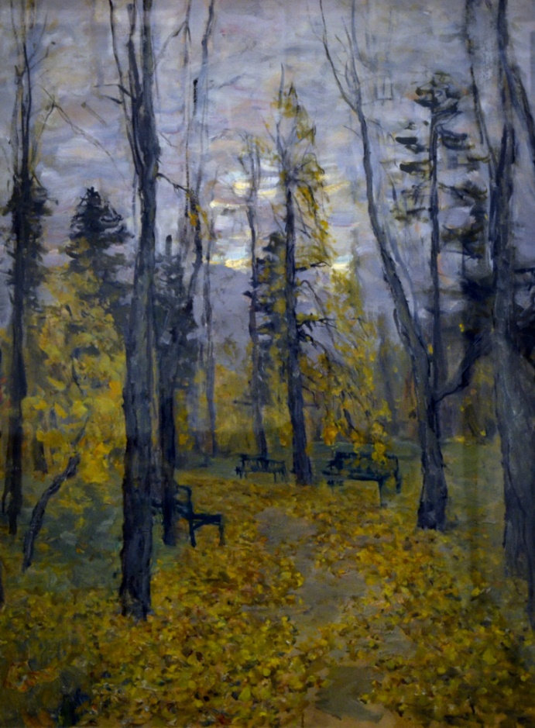
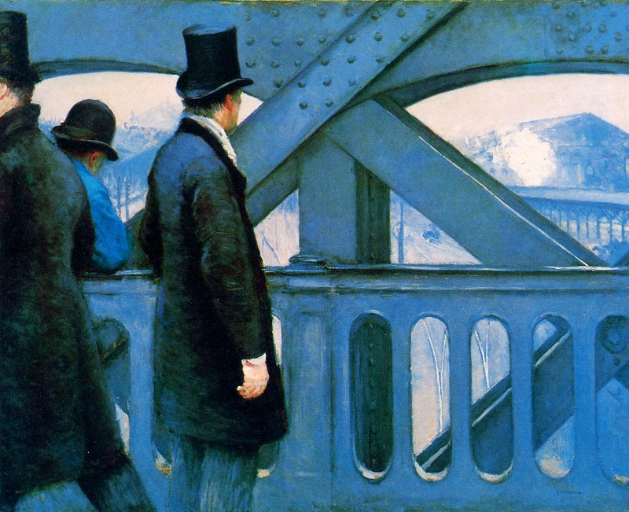

Slide 5
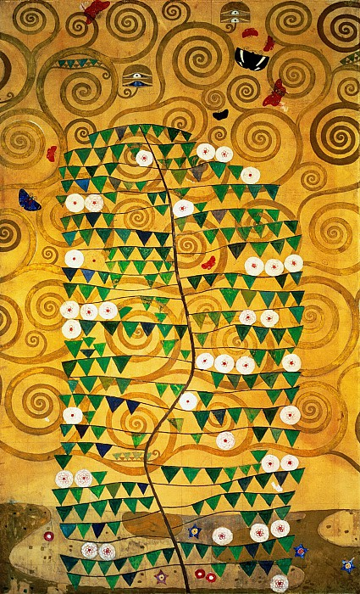
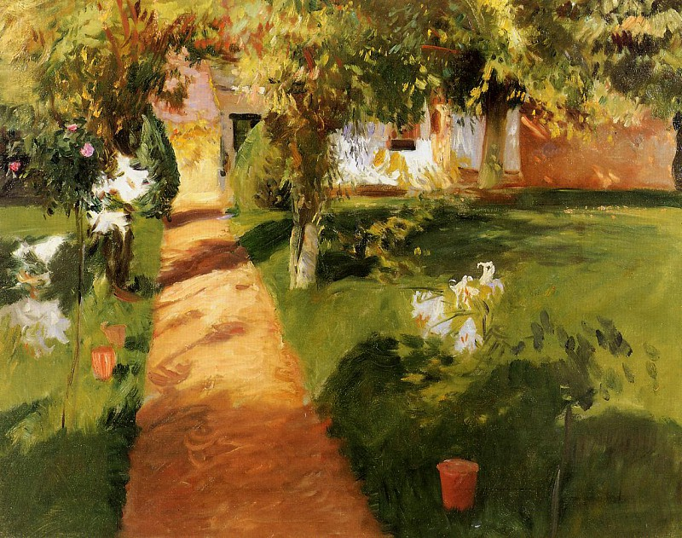

Slide 6
Matching
Colour | Adjective
red | Calm, relaxed
pink | Imaginative, creative
orange | Calm, cool
yellow | Quiet, mysterious
green | unhappy
blue | relaxed
purple | angry
white | calm
black | Peaceful, calm
grey | happy

Slide 7
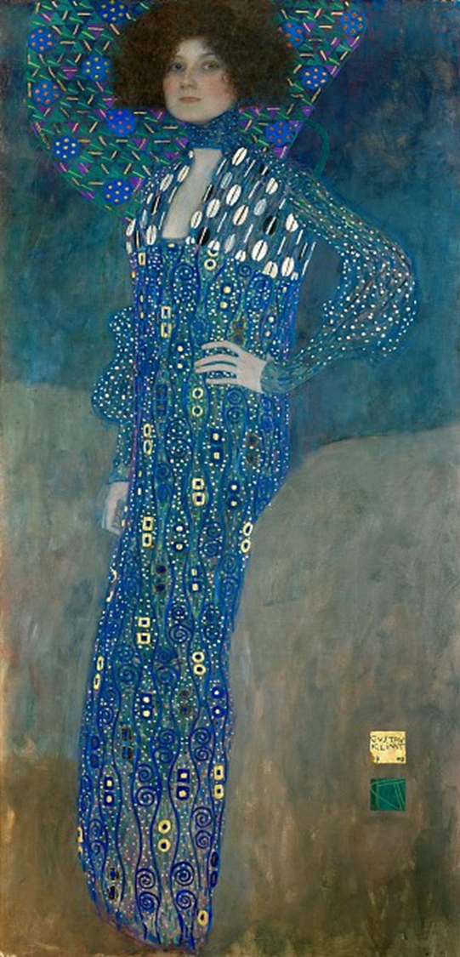
This painting makes me…

Slide 8
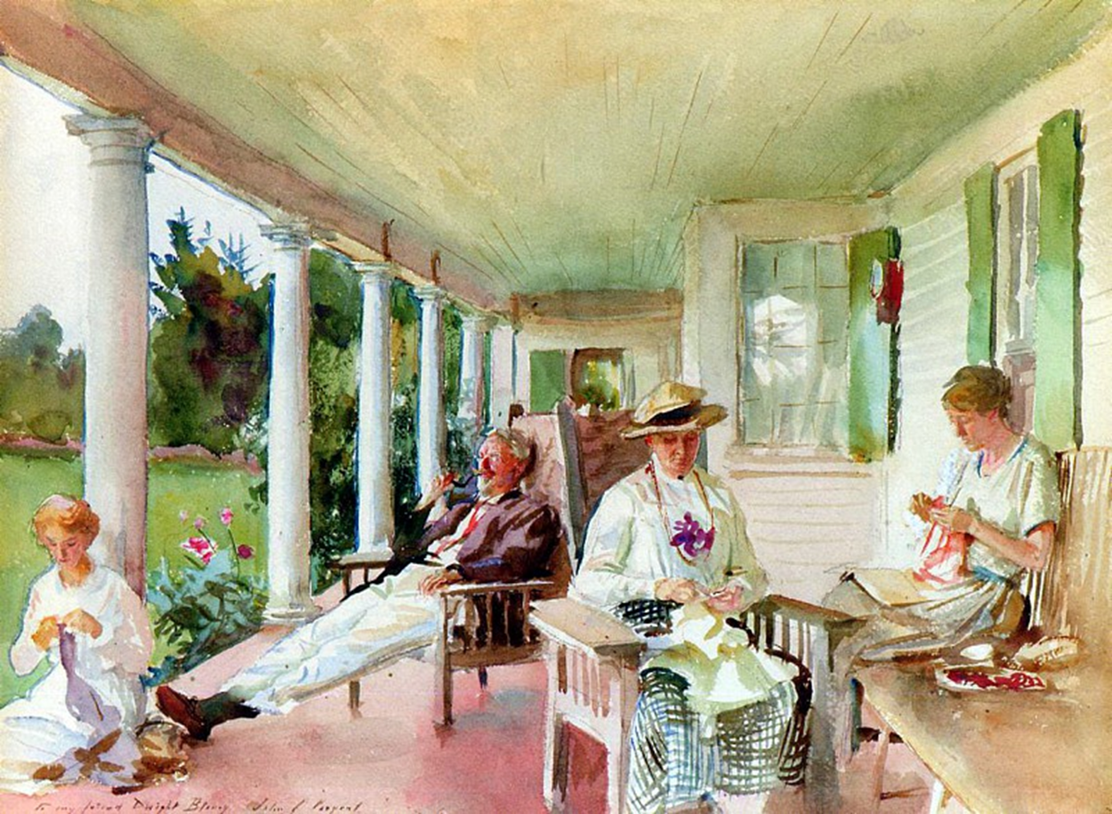
This painting makes me…

Slide 9
This song makes me…
Calm
Imaginative, creative
cool
Quiet, mysterious
unhappy
relaxed
angry
Peaceful
happy
sad

Slide 10
Hometask
The painting shows…
Subject+is/are+V-ing
The artist uses warm/cold colours like… to show they are(he/she is)….
7-10 sentences

