Slide 1
Наиболее распространенные вопросы в задании С4
Павловец Галина Ивановна
Учитель английского языка
МАОУ гимназия №4 г. Канска
Красноярского края

Slide 2
2
3
4
1
6
7
5
11
8
9
10
12
14
13
16
15
17
18
19
20
21

Slide 3
Let’s do the task

Slide 4
age restriction
Определите тип вопроса,
который Вам следует задать.
Is there a minimum\ any age restriction for this film?
Check yourself

Slide 5
availability of (smth)
Определите тип вопроса,
который Вам следует задать.
Is (something) available?
Check yourself

Slide 6
courses available
Определите тип вопроса,
который Вам следует задать.
What courses are available at your school?
Check yourself

Slide 7
directions to the hotel\ gym
Определите тип вопроса,
который Вам следует задать.
How can I get to your hotel?
Check yourself

Slide 8
discounts for groups\ party reductions
Определите тип вопроса,
который Вам следует задать.
Are there any discounts for groups?
Check yourself

Slide 9
discounts for students
Определите тип вопроса,
который Вам следует задать.
Are there any discounts for students?
Check yourself

Slide 10
distance from the city centre
Определите тип вопроса,
который Вам следует задать.
How far is the (hotel) from the city centre?
Check yourself

Slide 11
duration of the course\ tour
Определите тип вопроса,
который Вам следует задать.
How long is the course\ tour?
How long does the course\ tour last?
Check yourself

Slide 12
entrance fee
Определите тип вопроса,
который Вам следует задать.
What is the entrance fee?
How much is the ticket?
How much does (….) cost?
Check yourself

Slide 13
hotel facilities
Определите тип вопроса,
который Вам следует задать.
What facilities are available at the hotel?
Check yourself

Slide 14
if breakfast is included
Определите тип вопроса,
который Вам следует задать.
Is breakfast included into the price?
Check yourself

Slide 15
if textbooks are included
Определите тип вопроса,
который Вам следует задать.
Are textbooks included into the price?
Check yourself

Slide 16
location of the hotel\ gym\ club
Определите тип вопроса,
который Вам следует задать.
Where is your hotel\ gym\ club situated\ located?
Check yourself

Slide 17
online (advance) reservation\ booking
Определите тип вопроса,
который Вам следует задать.
Can I book\ purchase a ticket online (in advance)?
Check yourself

Slide 18
opening hours (of the club)
Определите тип вопроса,
который Вам следует задать.
What are the opening hours (of your club)?
When is (the club) opened?
Check yourself

Slide 19
photo permission\ taking pictures
Определите тип вопроса,
который Вам следует задать.
Is it allowed to take pictures
during the tour?
Check yourself

Slide 20
possible accommodation
Определите тип вопроса,
который Вам следует задать.
What kind of accommodation do you offer?
Check yourself

Slide 21
double\ single room price per night
Определите тип вопроса,
который Вам следует задать.
What is the double\ single room price per night?
Check yourself

Slide 22
price of a three-week course
Определите тип вопроса,
который Вам следует задать.
How much is a three-week course?
How much do I have to pay for a three-week course?
Check yourself

Slide 23
refund for a ticket
Определите тип вопроса,
который Вам следует задать.
Can I get a refund for the ticket if I miss the concert?
Check yourself

Slide 24
dates for departures
Определите тип вопроса,
который Вам следует задать.
What are the dates for departures?
Check yourself

Slide 25
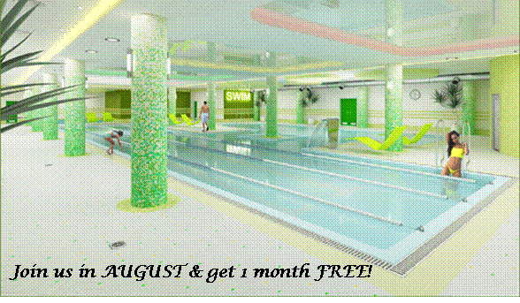
Task 2. Study the advertisement.
You are going to study abroad for three months and want to find a swimming pool you could attend.
You’d like to get more information about this swimming pool. In 1.5 minutes you are to ask five questions to find out the following:
1) location of the swimming pool 2) opening hours 3) sauna availability 4) price for 3 months 5) discounts for students You have 20 seconds to ask each question.

Slide 26
Where is your swimming pool located?
What are the opening hours?
Is sauna available?
How much do I have to pay for three months?
What is the price for three months?
Are there any discounts for students?

Slide 27
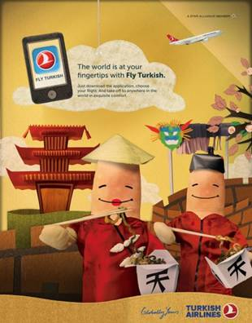
Task 2. Study the advertisement. You are going to visit Japan this summer and you'd like to have more information about the flights to Japan. In 1.5 minutes you are to ask five questions to find out the following:
1) departure dates 2) travel time 3) return ticket price 4) discounts for students 5) buying the ticket online You have 20 seconds to ask each question.

Slide 28
What are the dates for departures?
How long does the travel last?
How much does the return ticket cost?
How much is the return ticket?
What is the price of the return ticket?
Are there any discounts for students?
Can I book\ purchase a ticket online?

Slide 29
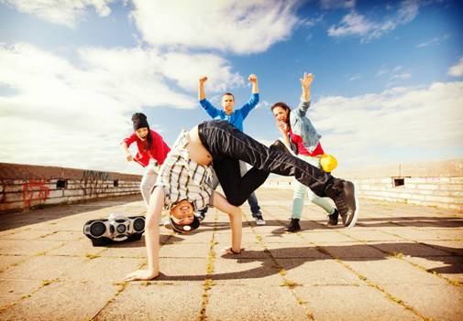
Task 2. Study the advertisement. You are considering starting breakdance lessons and now you’d like to get more information. In 1.5 minutes you are to ask five direct questions to find out about the following:
1) tuition fee
2) course location
3) duration of the course
4) special clothes
5) evening classes
You have 20 seconds to ask each question.

Slide 30
How much does the tuition cost?
What is the tuition fee?
Where is your course located?
How long is the course?
How long does the course last?
Do I need special clothes?
Are there classes in the evening?

Slide 31
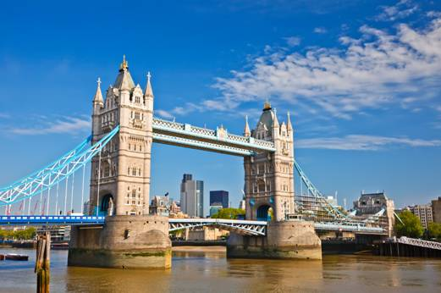
Task 2. Study the advertisement. You are considering going on this sightseeing tour and now you’d like to get more information. In 1.5 minutes you are to ask five direct questions to find out the following:
1) duration of the tour
2) the starting point
3) number of bridges you’ll visit
4) the price for a group of 10
5) discounts for students
You have 20 seconds to ask each question.
London Bridges Sightseeing Tour!

Slide 32
How long is the tour?
How long does the tour last?
Where does the tour start?
How many bridges will we visit?
What is the price of a group of ten?
How much do I have to pay for a group of ten?
Are there any discounts for students?

