Slide 1
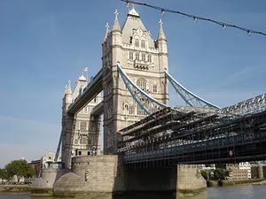
Discover Britain: England
Презентация к уроку
6 класс
English VI
O.V. Afanasyeva, I.V. Mikheeva
Подготовила
Цепкова М.А.
учитель английского языка

Slide 2
We’ll begin our journey with England, the largest part of the UK, visiting its regions : the Southeast, the Southwest, East Anglia, the Midlands and the North of England.

Slide 3
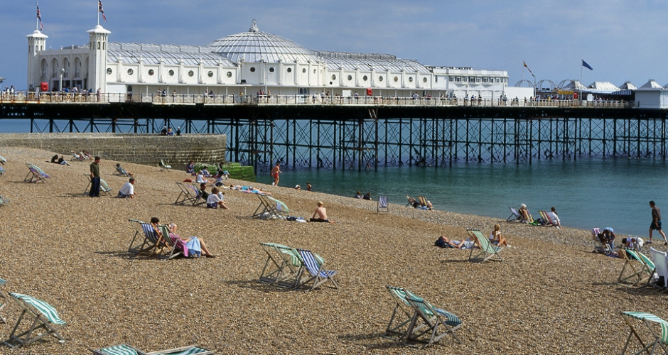
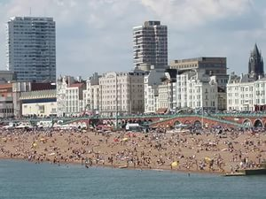
The South East is a highly populated region of England. London, the capital of the UK, and such historical cities as Windsor, Dover and Brighton are situated here. Brighton is famous resort in the UK.

Slide 4
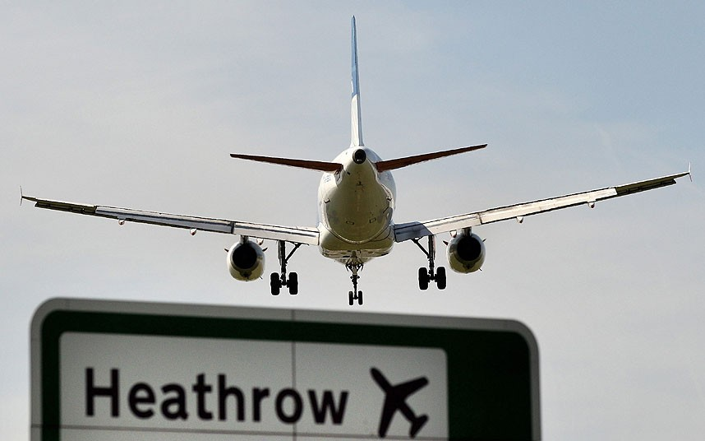
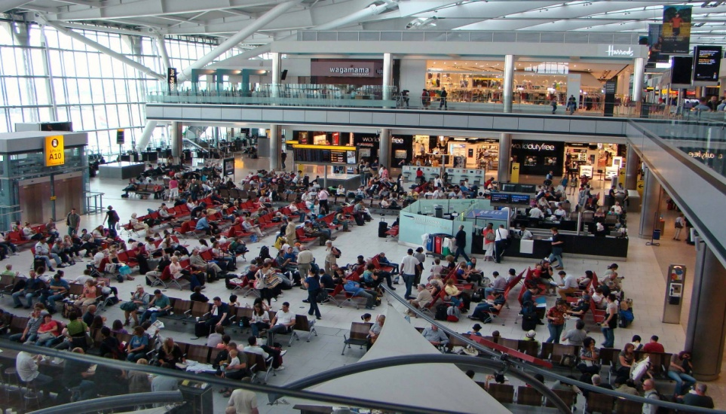
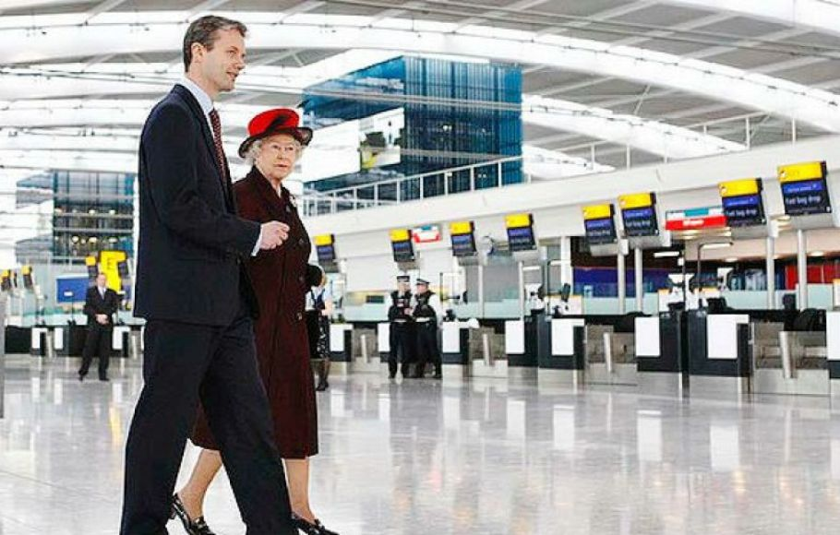
Heathrow Airport, one of the world’s busiest airports is here.

Slide 5
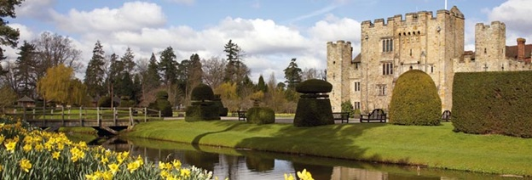
The County of Kent situated here is known as the garden of England.

Slide 6
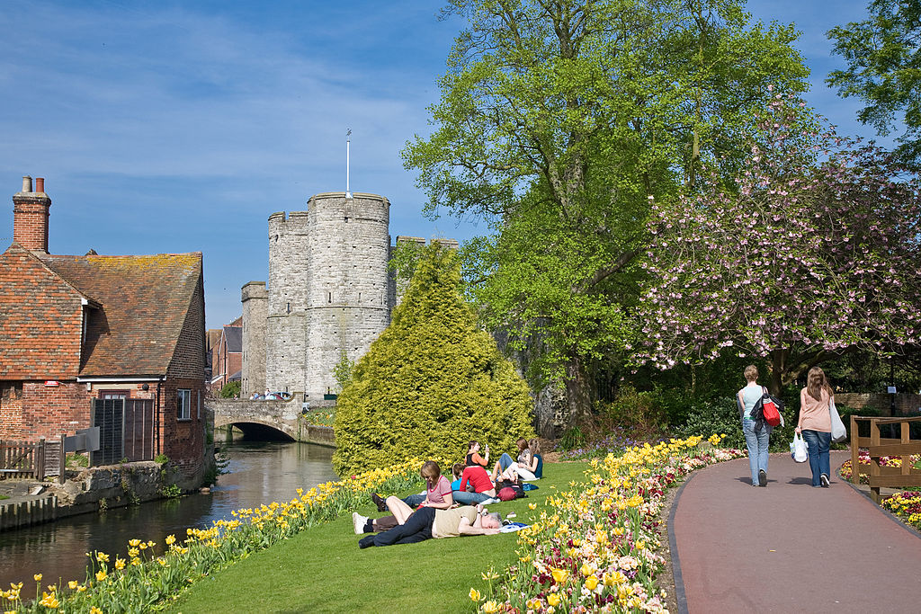
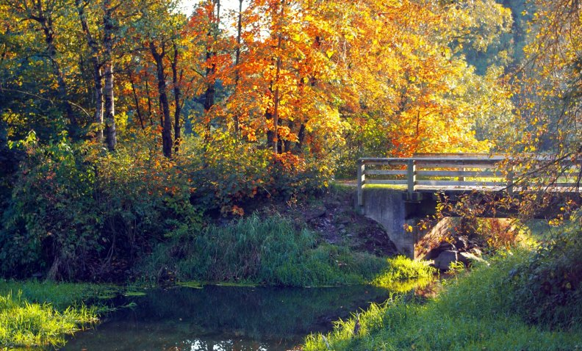

Slide 7
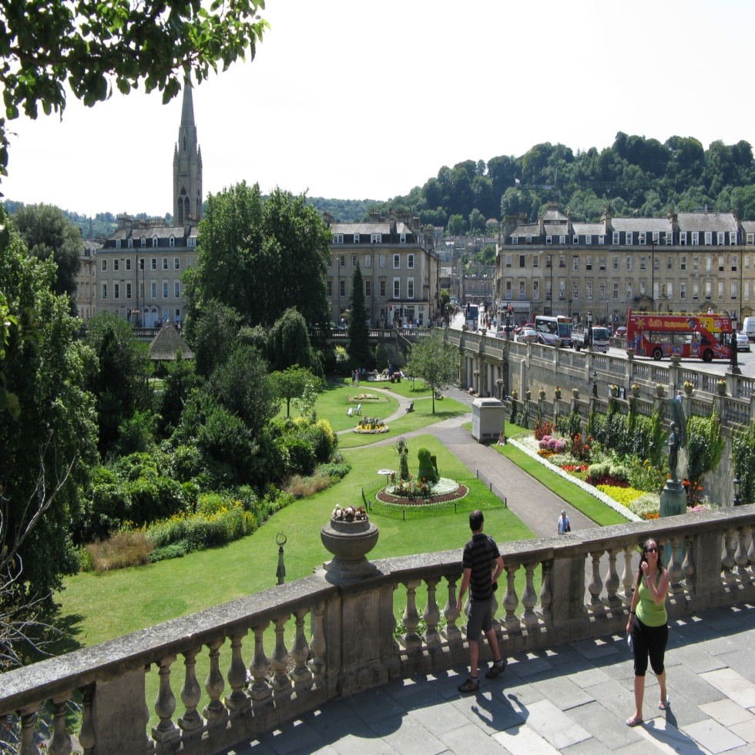
The Southwest is the region where the main activity is farming. The two principal cities of the region are Bristol and Bath.

Slide 8
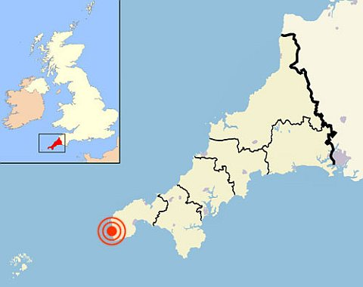
The most westerly point of Great Britain “Land’s End” is also in the Southwest.

Slide 9
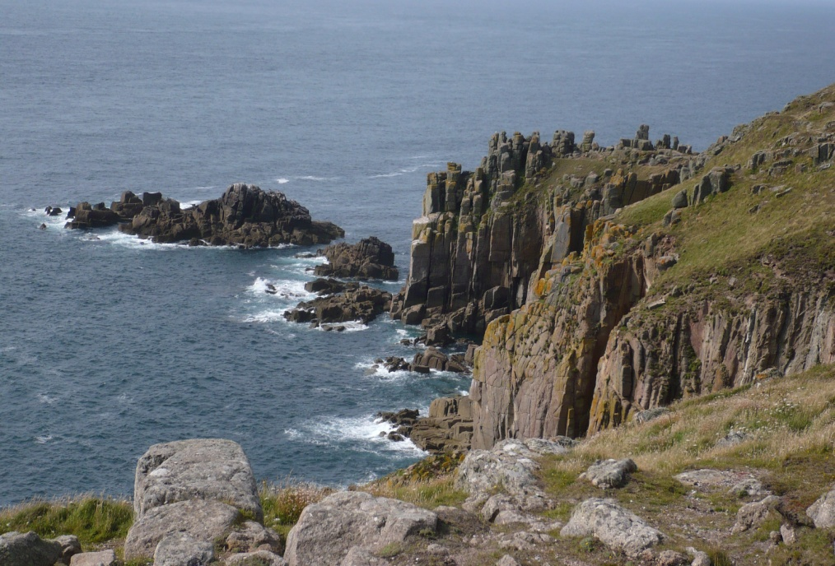
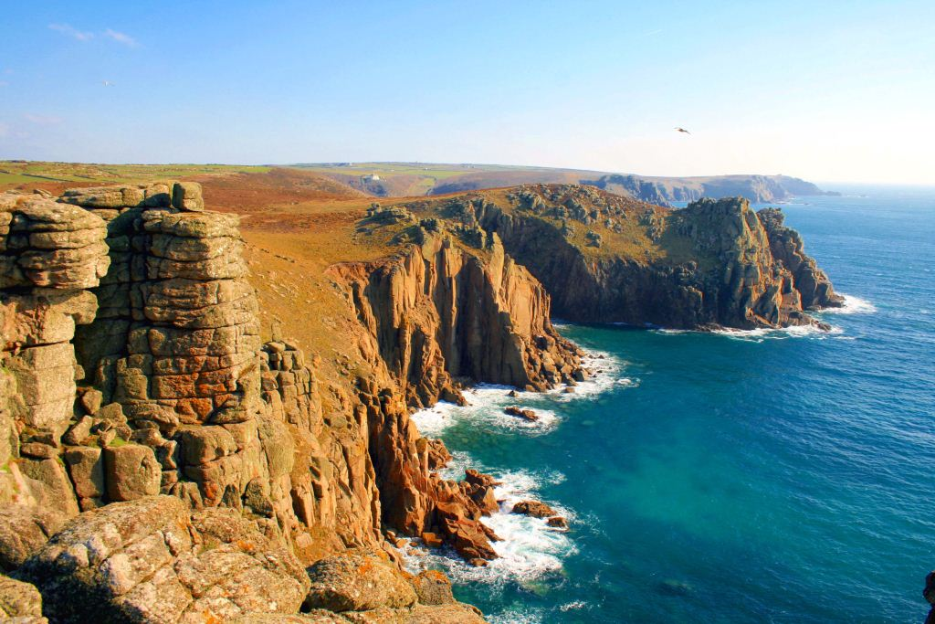
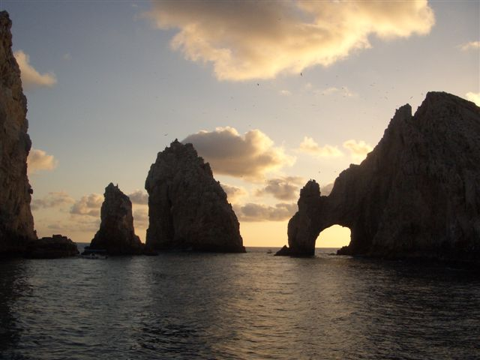

Slide 10
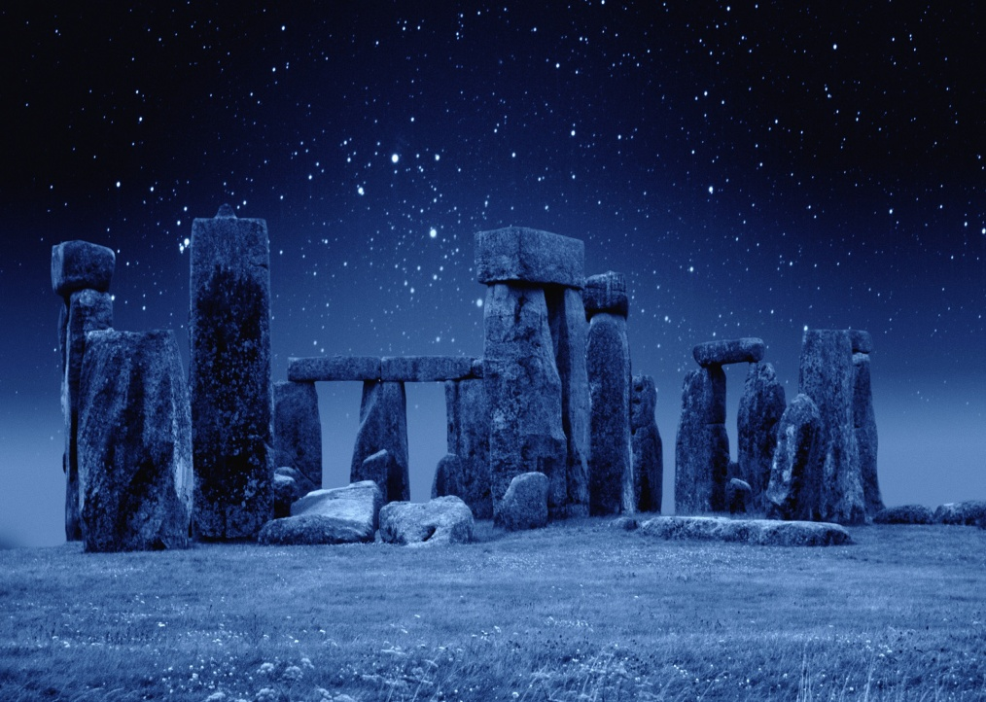
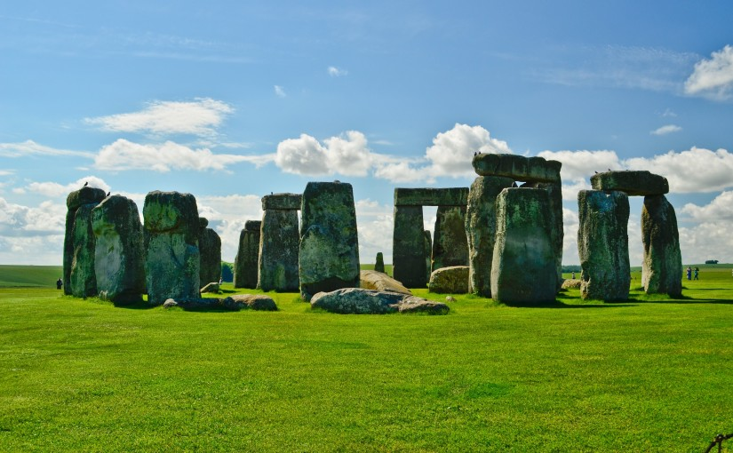
You can see the famous Stonehenge in the Southwest.

Slide 11
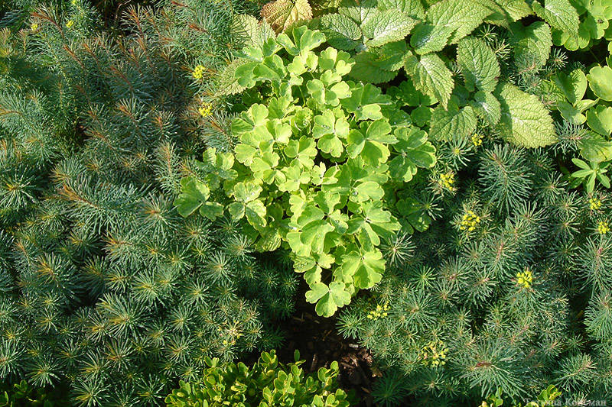
East Anglia is very flat and it is another farming region. The part of East Anglia called the Fens consists of flat land.

Slide 12
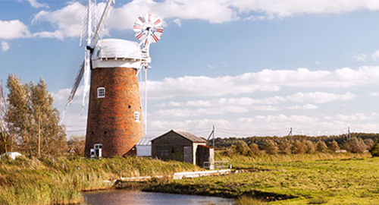
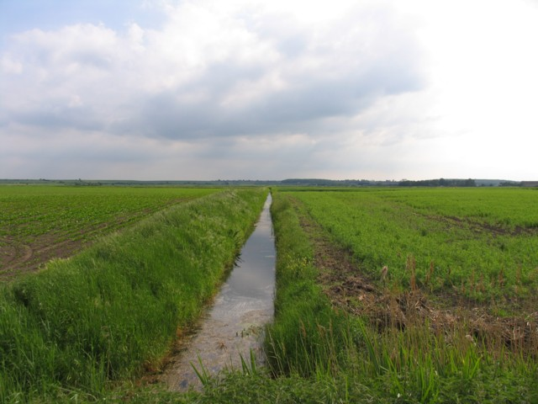
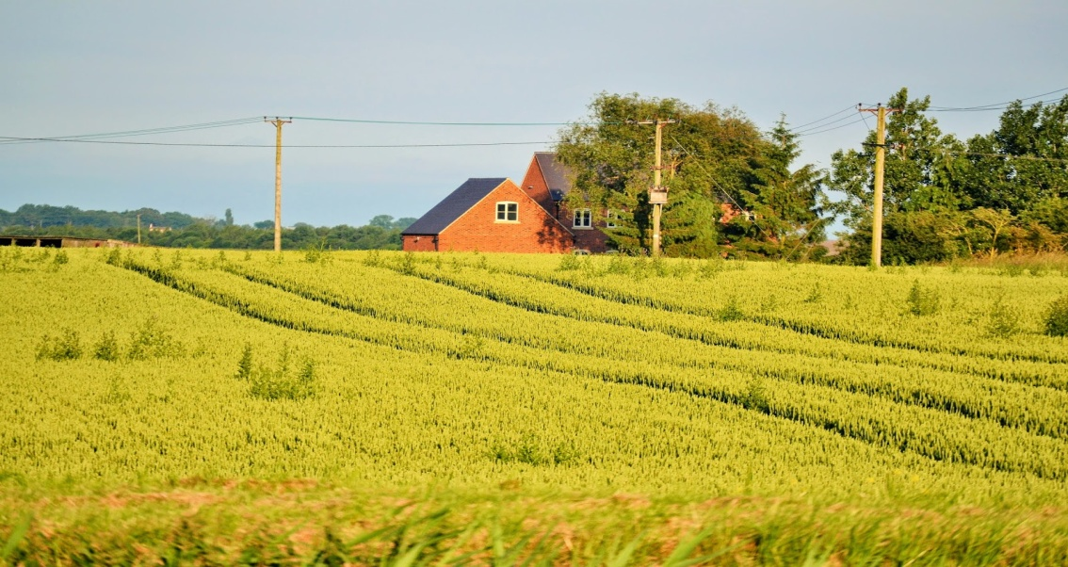

Slide 13
Oliver Cromwell, an English general and politician (1599-1658) who was leader of the army against King Charles I in the Civil War and later became Lord Protector of England, was born in the Fens area.

Slide 14
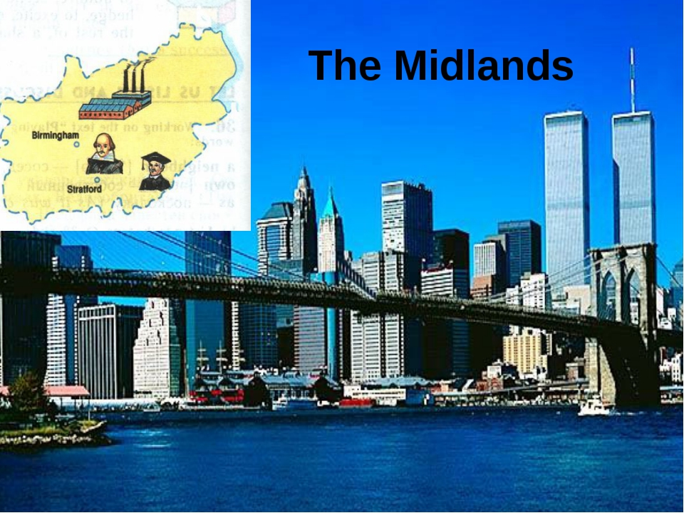
The Midlands, known as the heart of England, is the largest industrial part in the country. The most important industrial cities are Manchester, Sheffield, Liverpool, which is one of Britain’s big ports, and Birmingham.

Slide 15
Stratford – upon – Avon is connected with English culture: Stratford is the birthplace of the great William Shakespeare

Slide 16
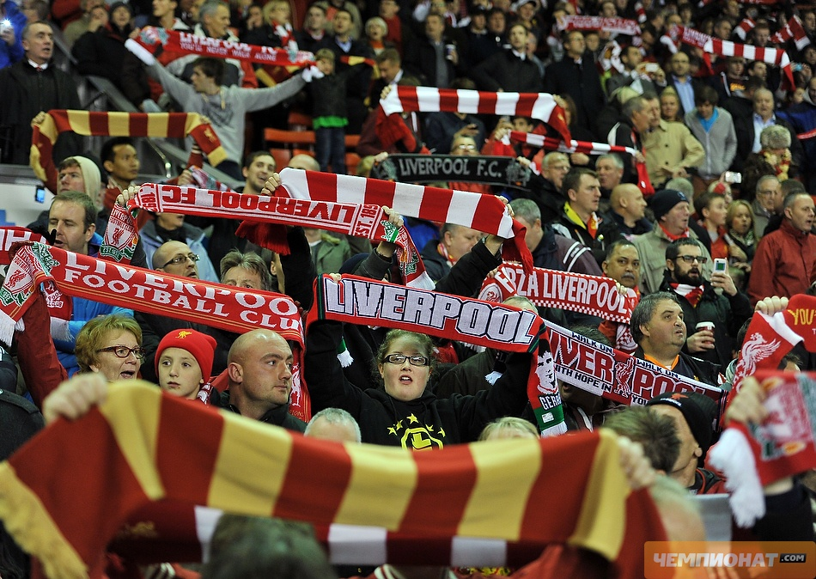
Liverpool is a city of football, industrial city and one of Britain’s big port.

Slide 17
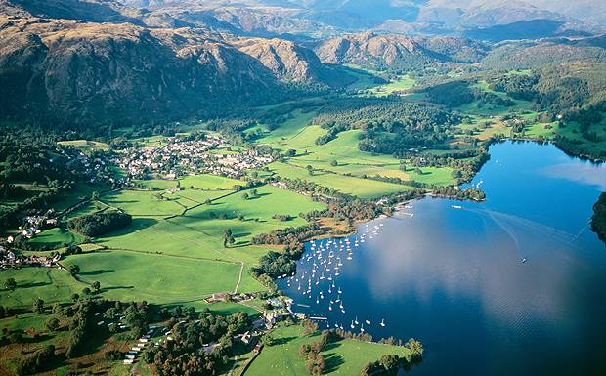
The North of England
The main attractions of the North of England is the Lake District.

Slide 18
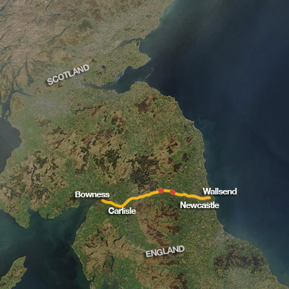
Many tourists come over especially to look at the ruins of Hadrian’s Wall, a stone wall built across the North of England by the order of the Roman ruler Hadrian to defend the Northern border of Roman Britain from the Scottish tribes.

Slide 19
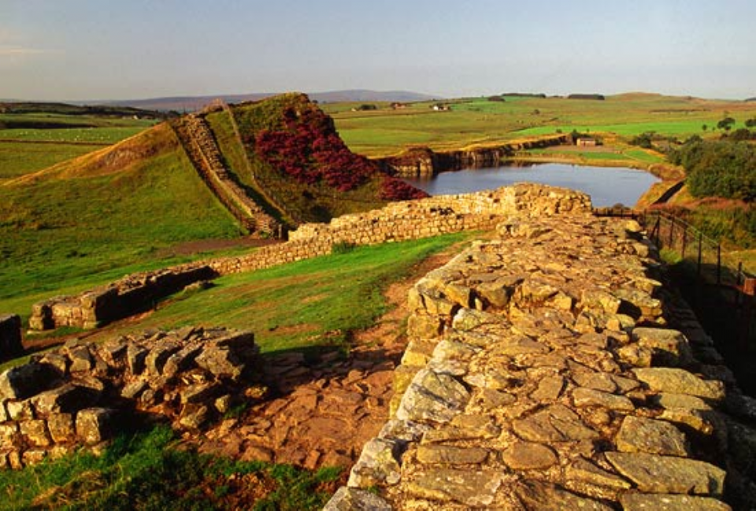
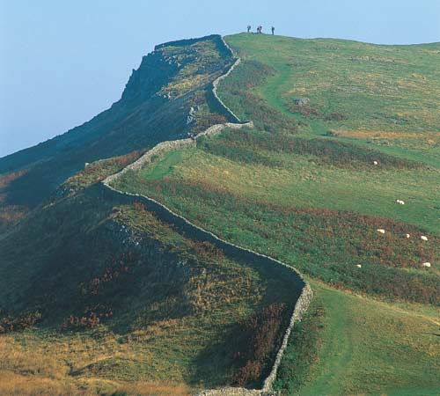
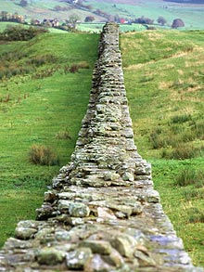
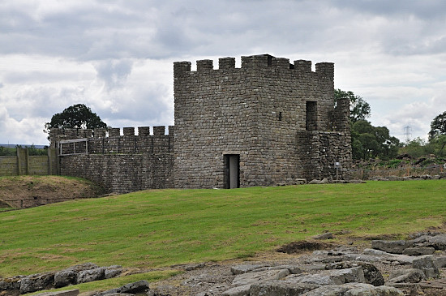

Slide 20
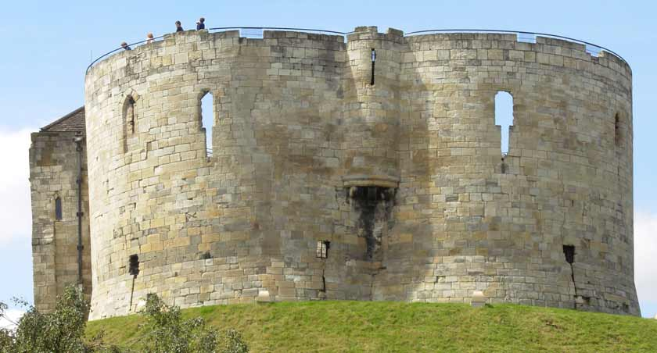
The main cities of the North of England are York and Newcastle-upon-Tyne.

Slide 21
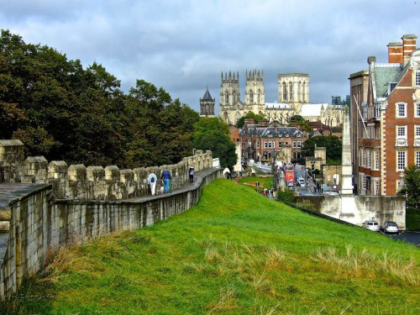
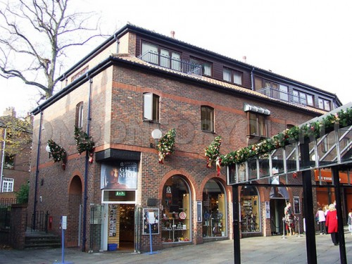

Slide 22
Answer the questions:
1. What are the principal cities in the Southeast?
2. What county is called the “garden of England”?
3. What is the Southeast famous for?
4. Why do people find the Southwest attractive?
5. Why is Land’s End called that way?
6. Where was Oliver Cromwell from? What can you say about the man?
7. What is Stratford -upon-Avon famous for?
8. What are the main attractions of the North of England ?
9. What do you know about Hadrian’s Wall?

