Slide 1
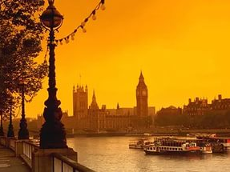
Детское объединение
«Занимательный английский».
Руководитель
Абрамова Нина Витальевна.
Муниципальное бюджетное учреждение дополнительного
образования «Дом детского творчества города Димитровграда
Ульяновской Области»

Slide 2
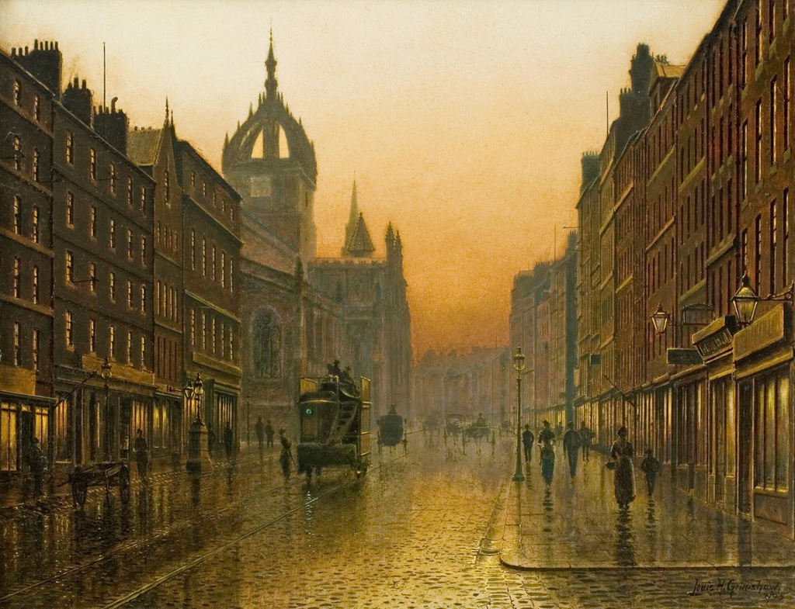
Цель. Знакомство с достопримечательностями столицы Великобритании—Лондоном.
Задачи:
познакомиться с достопримечательностями столицы Великобритании,
закрепить знания английского языка,
обогатить словарный запас

Slide 3
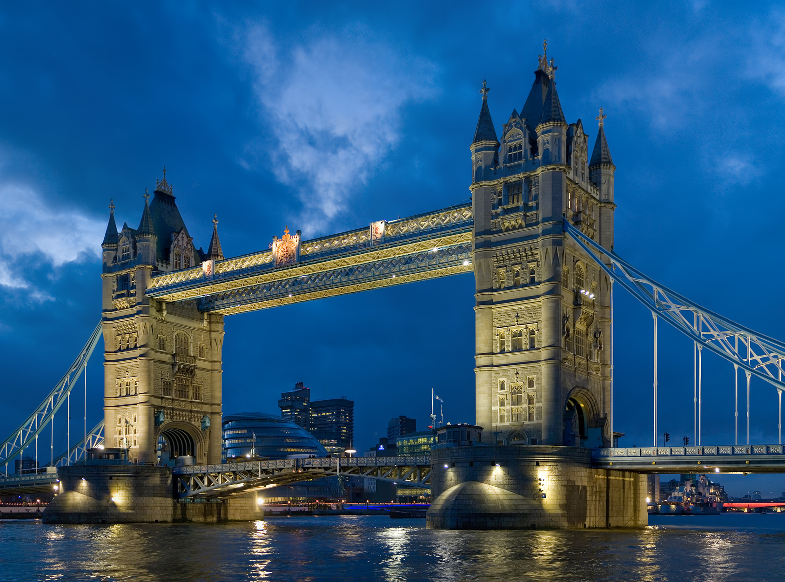
Travelling to London.

Slide 4
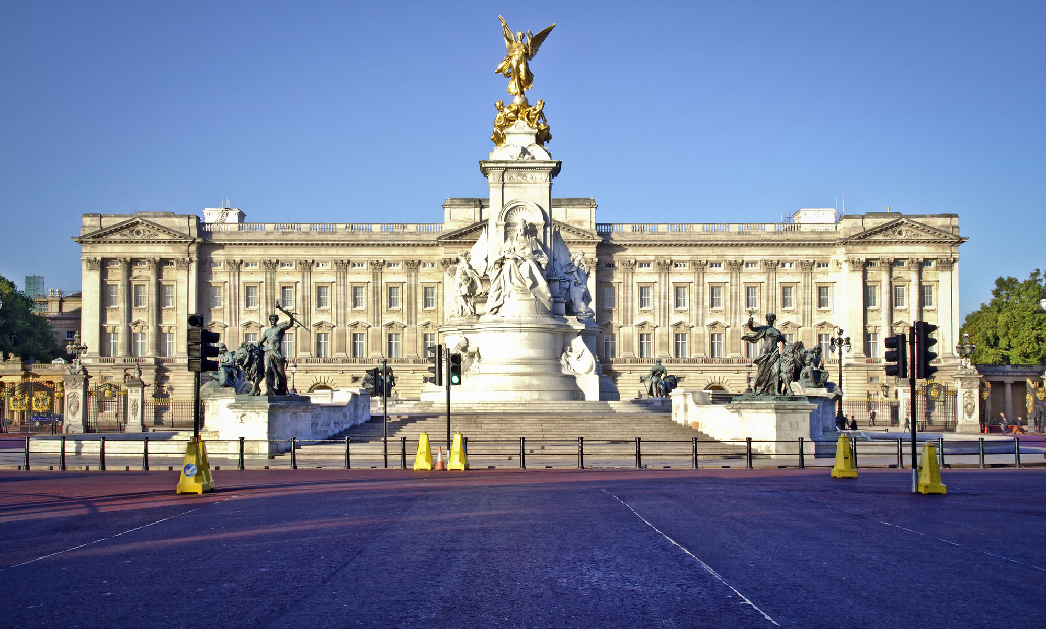
Buckingham Palace.

Slide 5
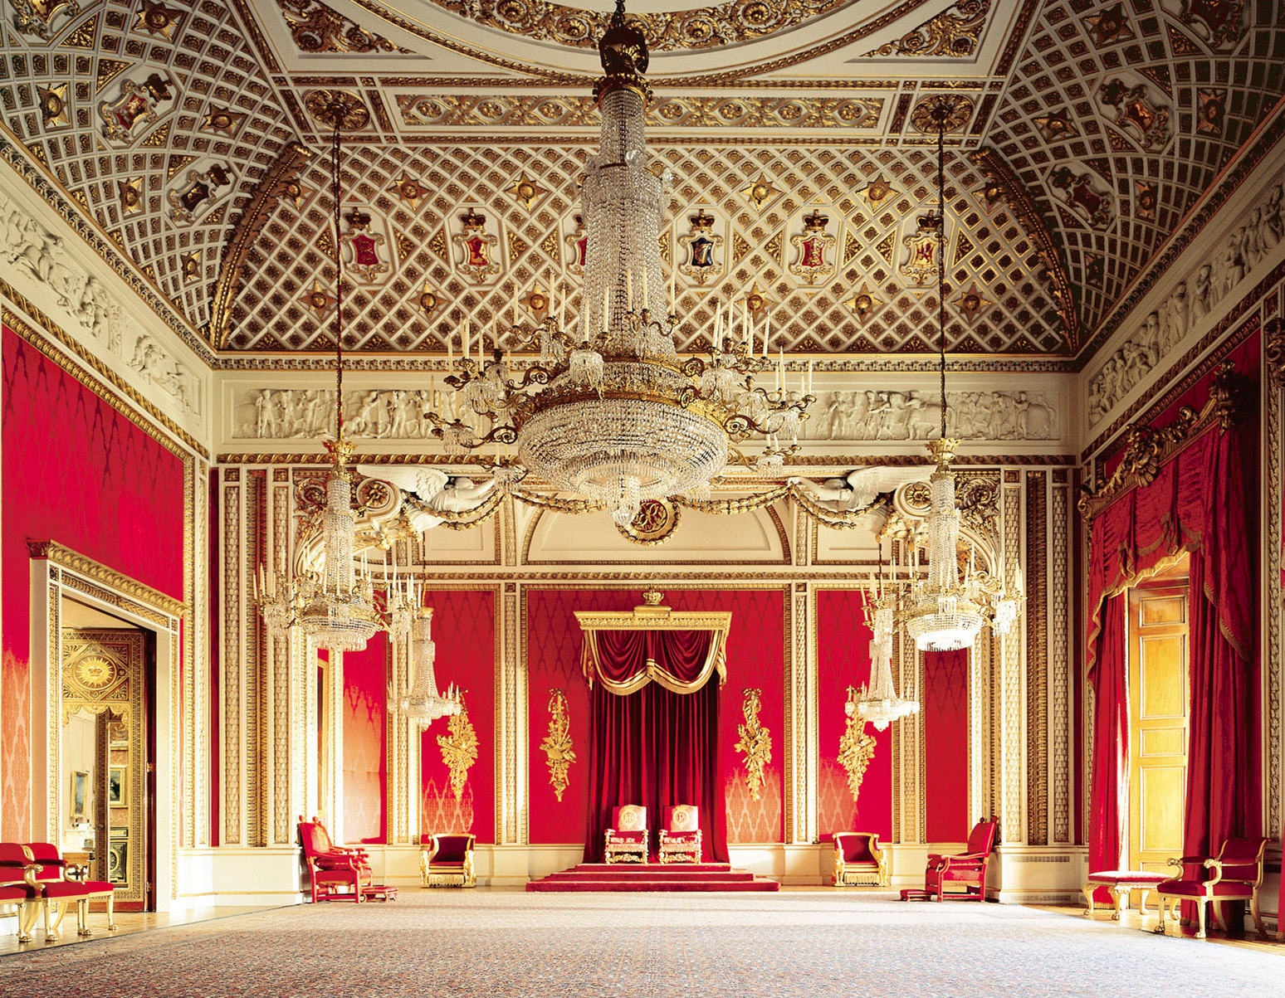
Buckingham Palace is the official residence of Queen Elizabeth. It is located near Green Park. When the Queen is in the residence, the Royal Standard flies over Buckingham Palace.

Slide 6
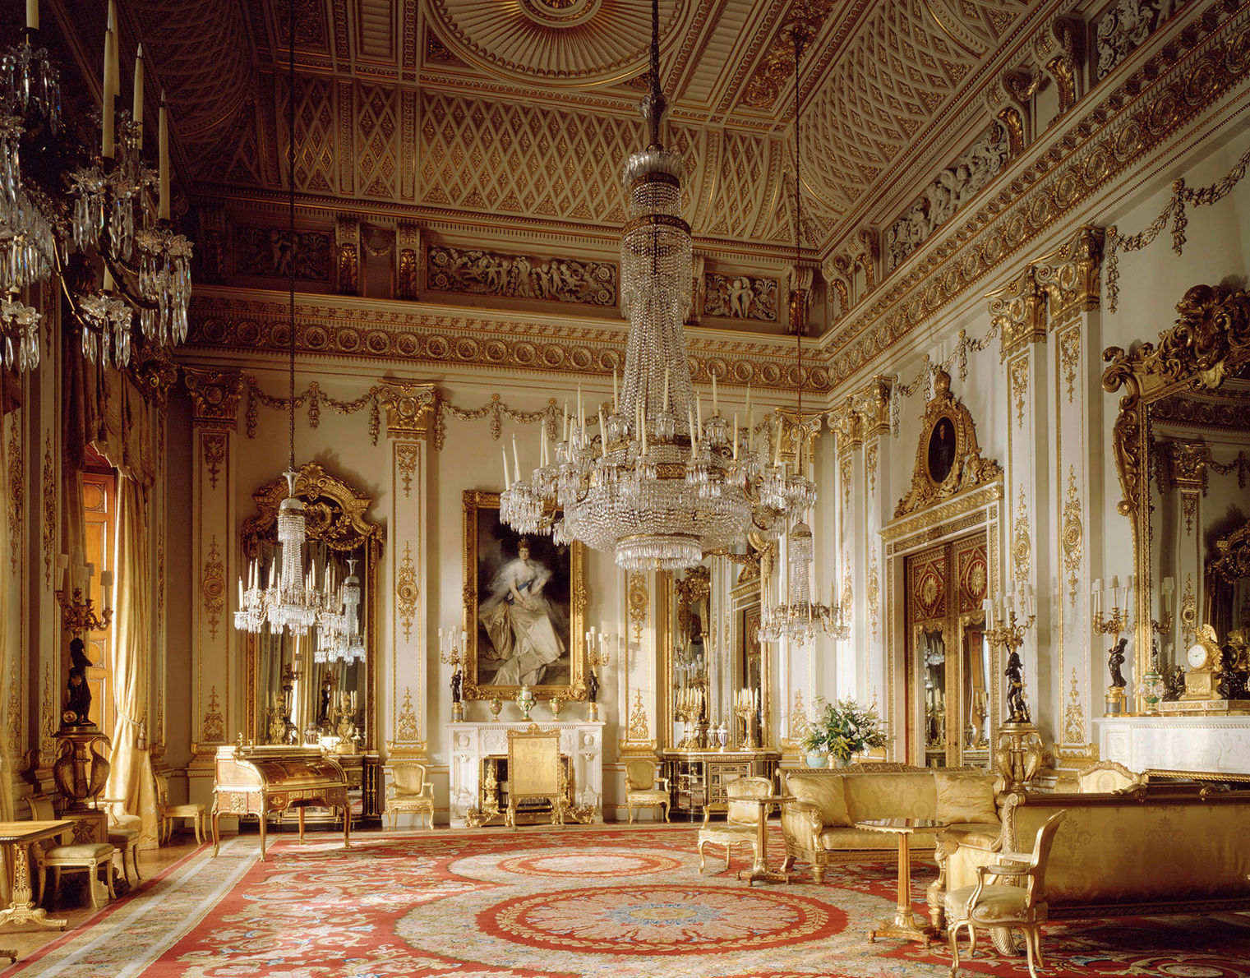
There are 775 rooms where members of the Royal family and their servants live. There are also rooms for guests. There are offices, on-site post and even swimming pool in the palace.

Slide 7
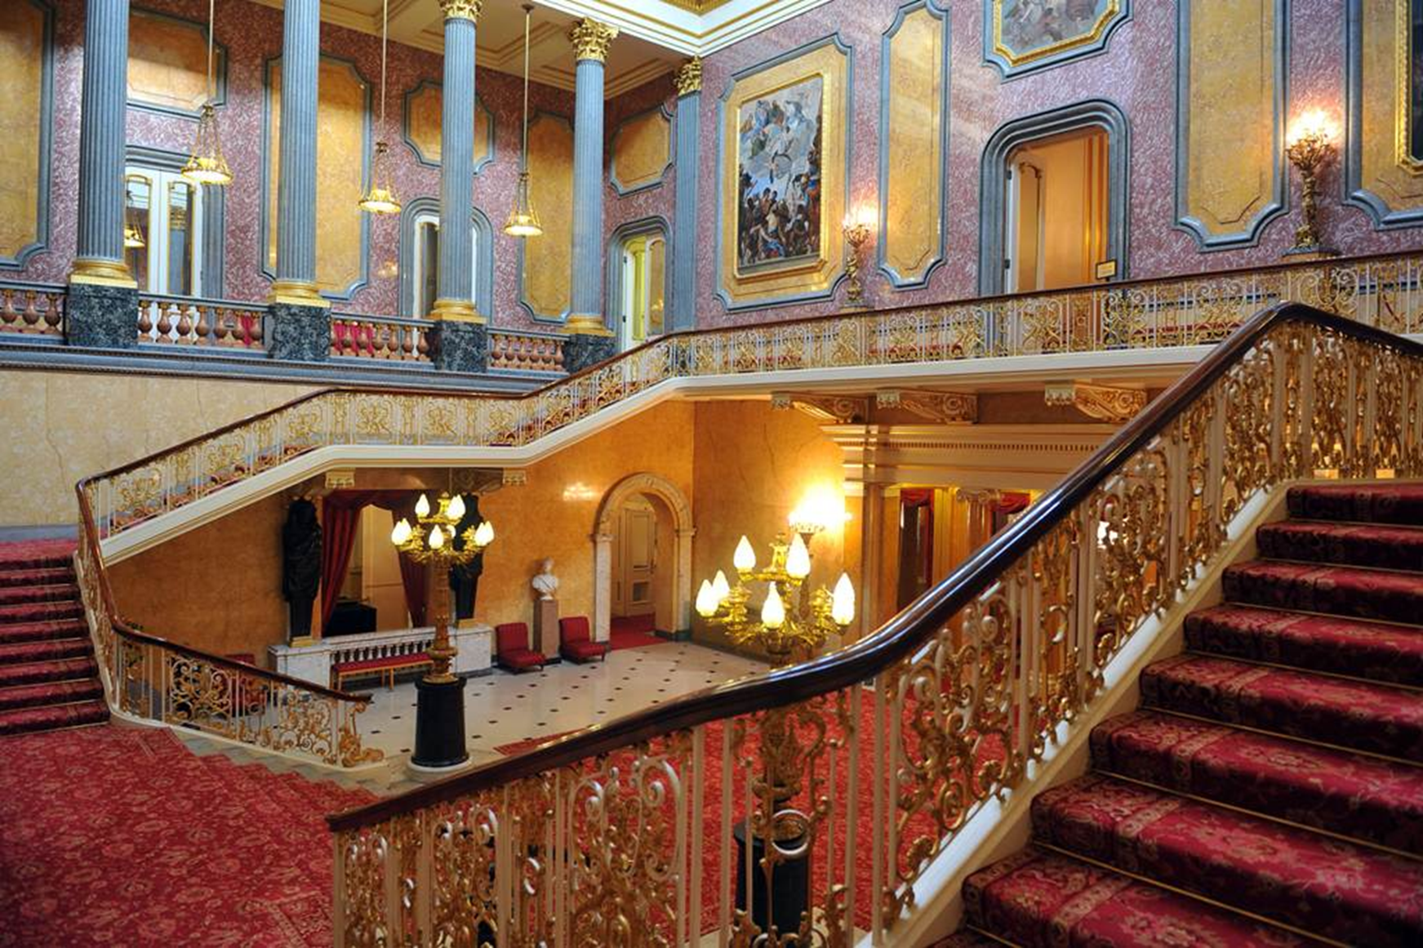
Throughout the year right in front of Buckingham Palace the ceremony of the Changing of the Guard takes place, attracting a lot of tourists.

Slide 8
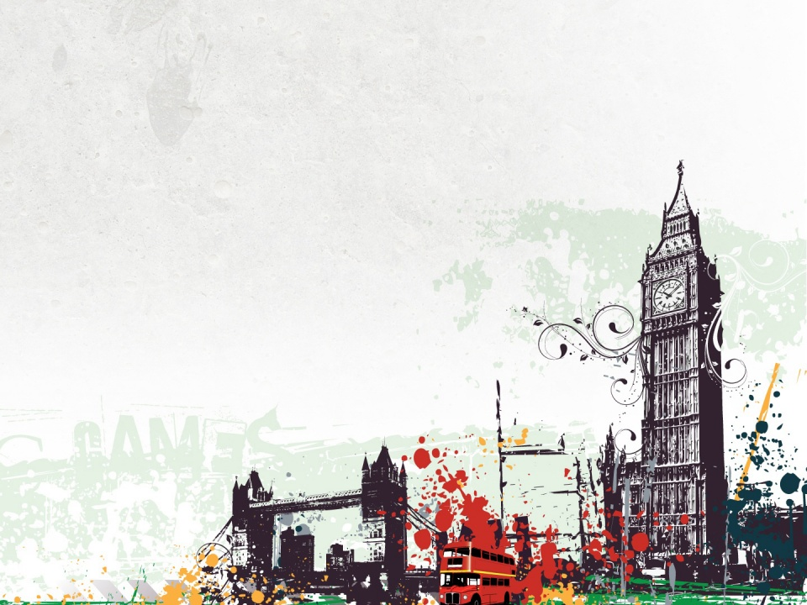
Remember !
Buckingham Palace.
Repeat !

Slide 9
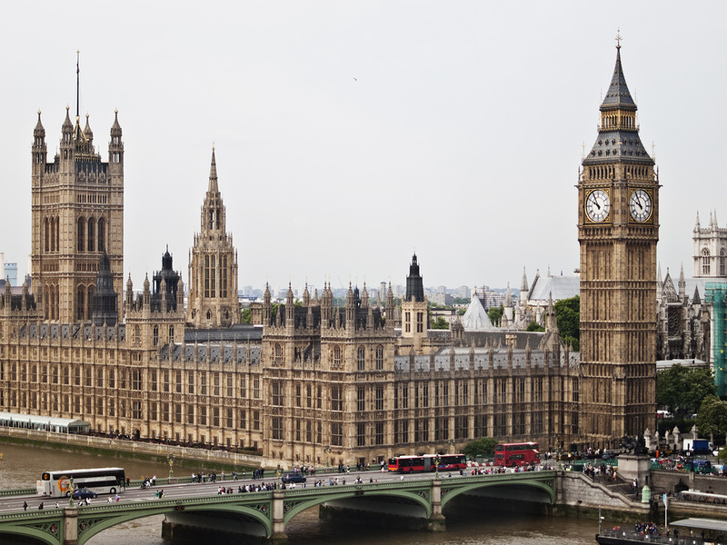
Westminster.

Slide 10
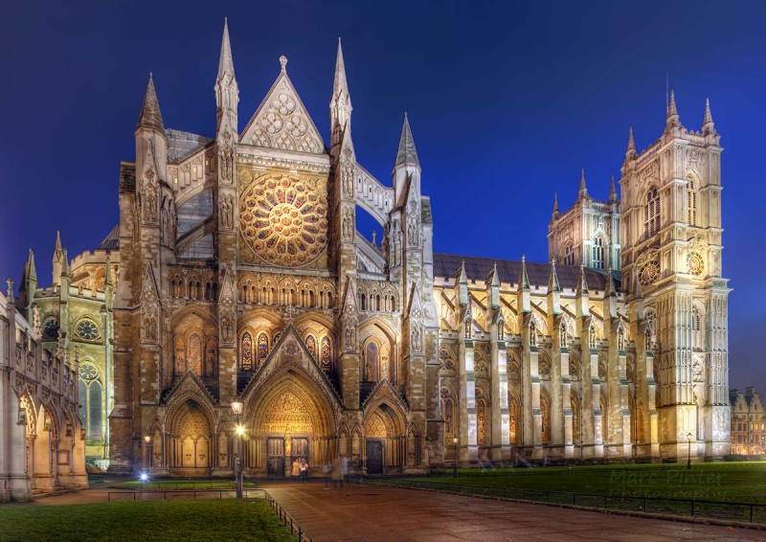
Westminster is a historical area of central London with several famous landmarks.
Westminster Abbey, a Gothic church, is located there. The church is a traditional place of coronation and burial site for all British kings and queens.

Slide 11
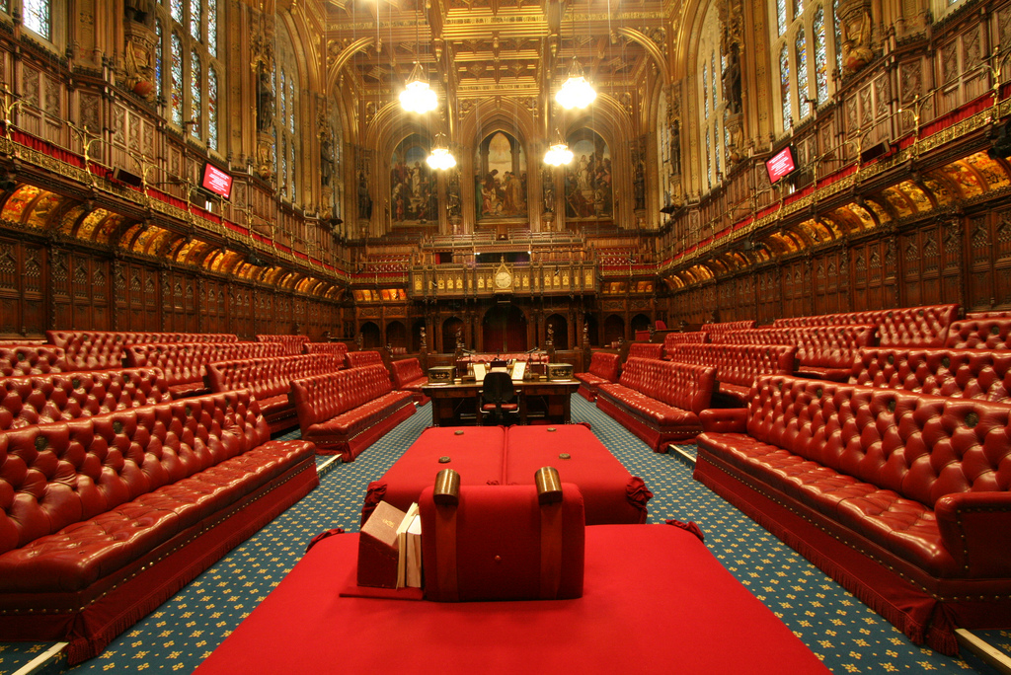
Not far from the church there is the Palace of Westminster which is the meeting place of the House of Commons and the House of Lords.

Slide 12
Remember !
Westminster.
Repeat !

Slide 13
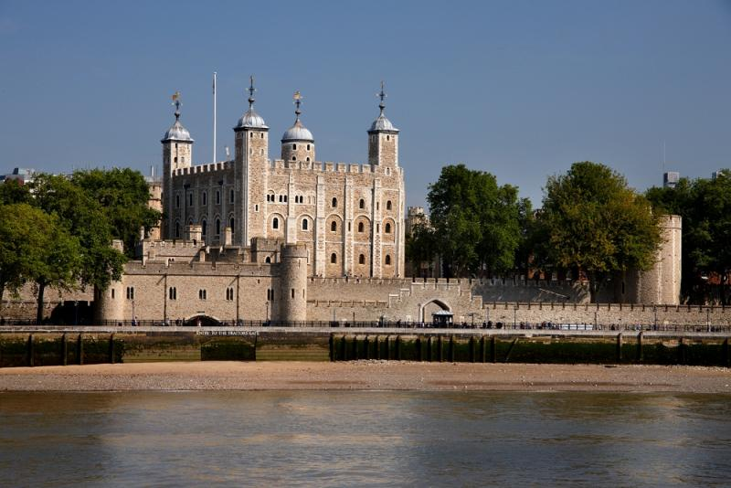
The Tower of London

Slide 14
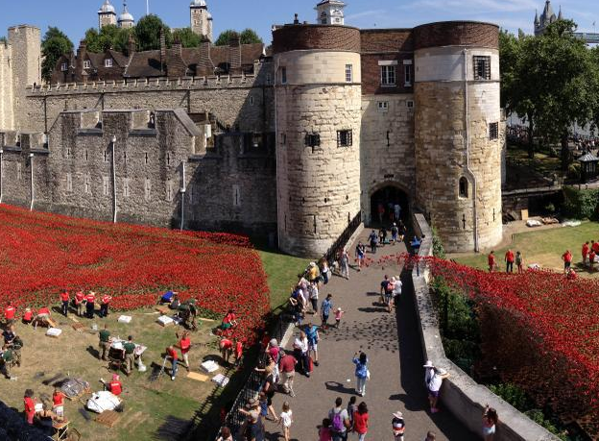
Every day its doors are open for tourists. A few black ravens live on its territory. The walls of the Tower are still guarded by palace guard in historical outfits.

Slide 15
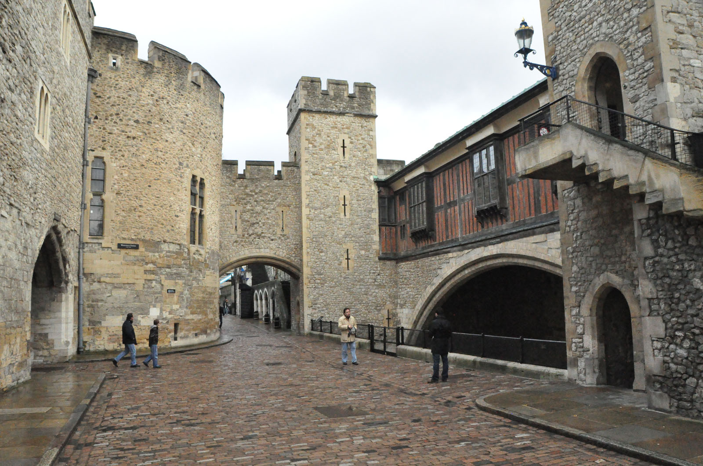
At different times the Tower was used as a royal residence, fortress, prison, mint and, even, zoo. Today the Tower of London is the place where the Crown Jewels are kept.

Slide 16
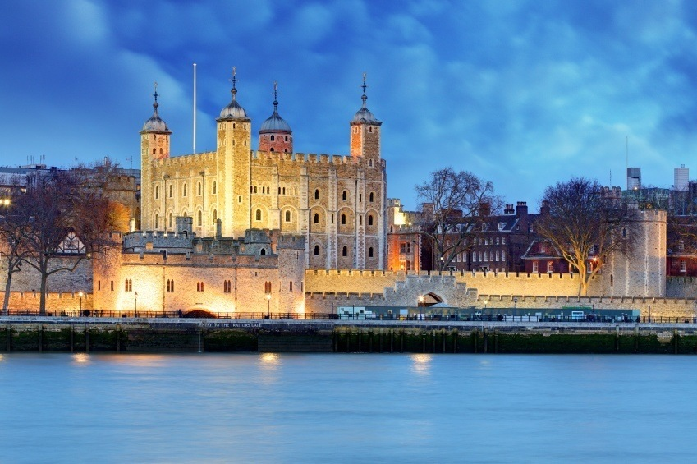
The Tower of London is one of the main London's places of interest. It is located on the north bank of the River Thames and is one of the oldest buildings.

Slide 17
Remember !
The Tower of London.
Repeat !

Slide 18
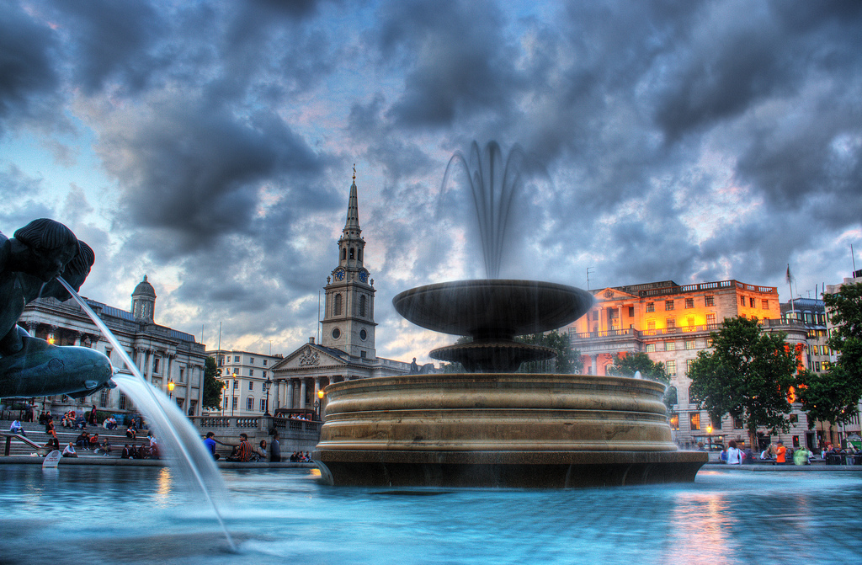
Trafalgar Square.

Slide 19
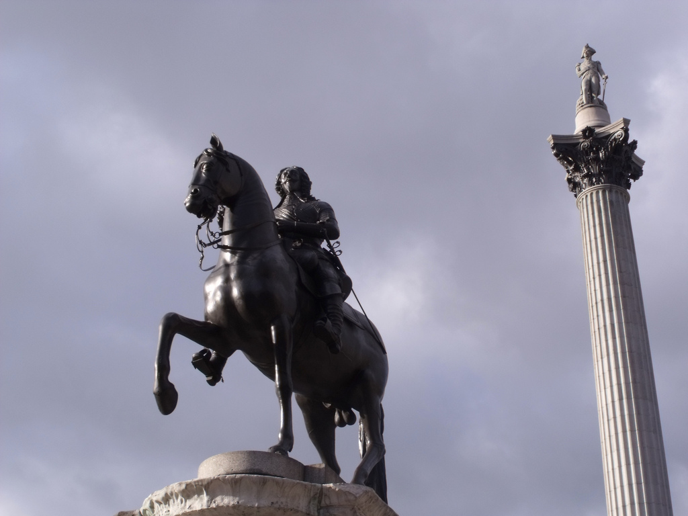
Trafalgar Square is located in the centre of London. It was named after the victory in the Battle of Trafalgar. In the centre of the square there is Nelson's column with four lions at the bottom of it.

Slide 20
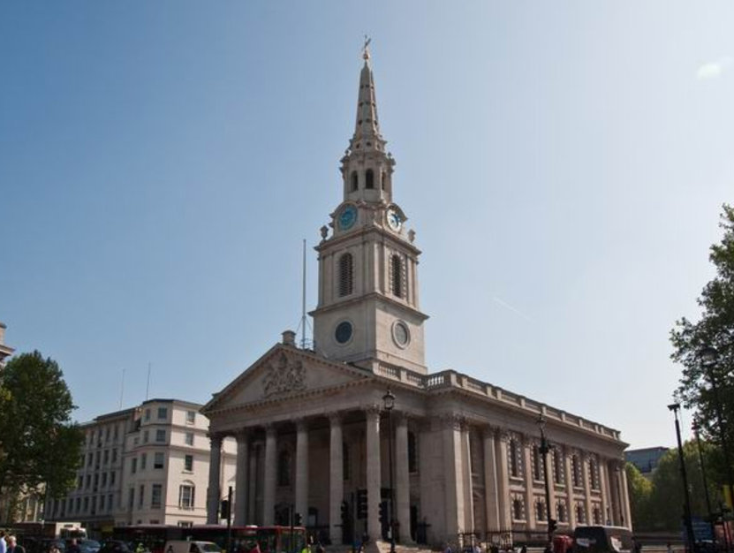
There are beautiful fountains in the square. Some famous buildings, such as the National Gallery, St. Martin-in-the-fields and Admiralty Arch, are also located there.

Slide 21
Remember !
Trafalgar Square.
Repeat !

Slide 22
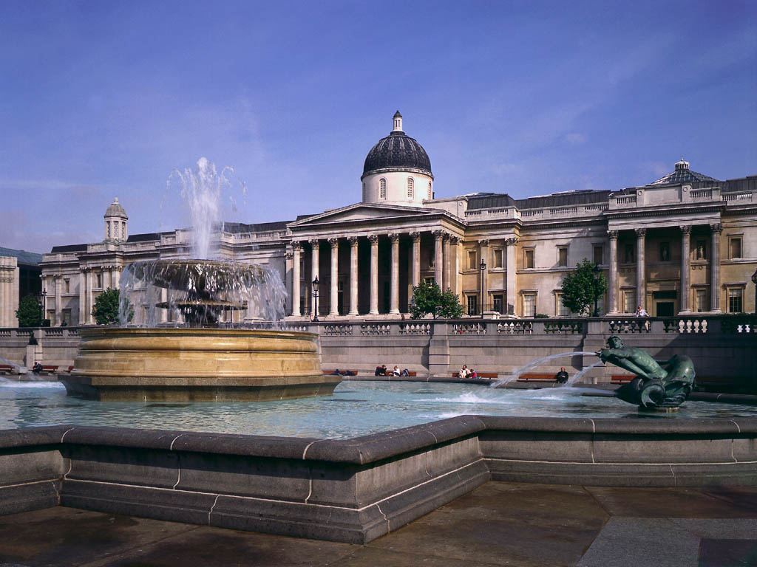
London National Gallery.

Slide 23
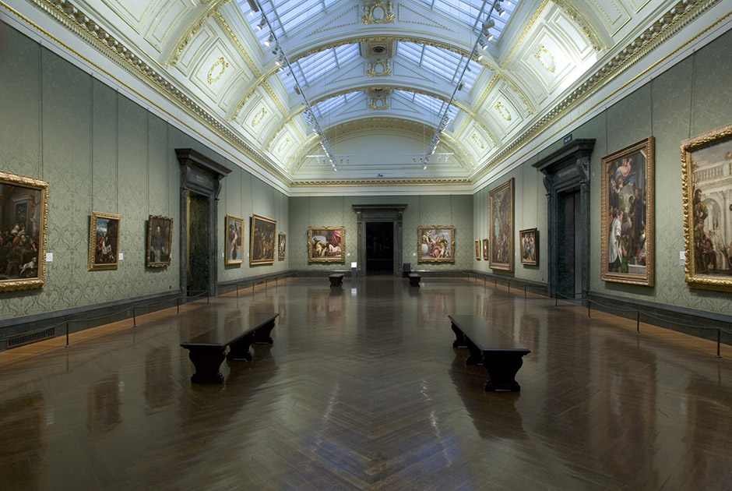
The gallery has more than 2000 works of world-known artists of XIII-XX centuries. You can spend the whole day there and it will not be enough. What is interesting, is that the gallery is free for everyone.

Slide 24
Remember !
London National Gallery.
Repeat !

Slide 25
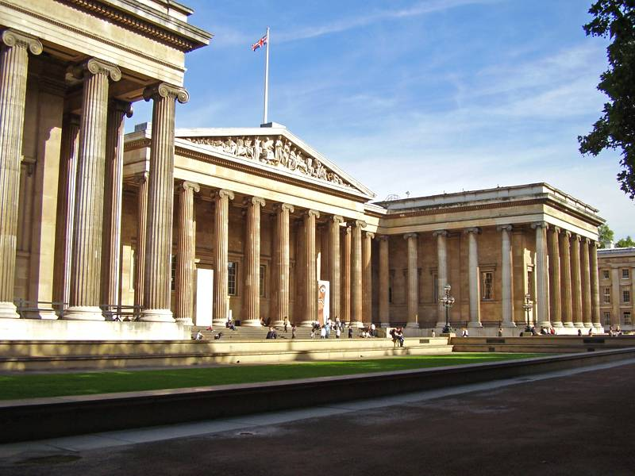
The British Museum.

Slide 26
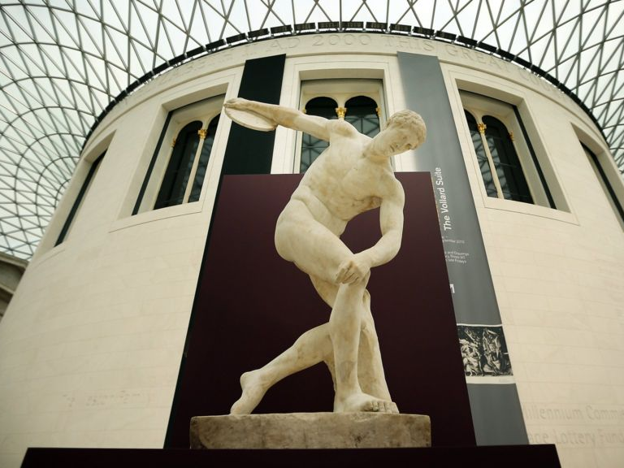
The British Museum is one of the largest museums in the world. It was founded in the XVIII century and in the XIX century it was already divided into different departments.

Slide 27
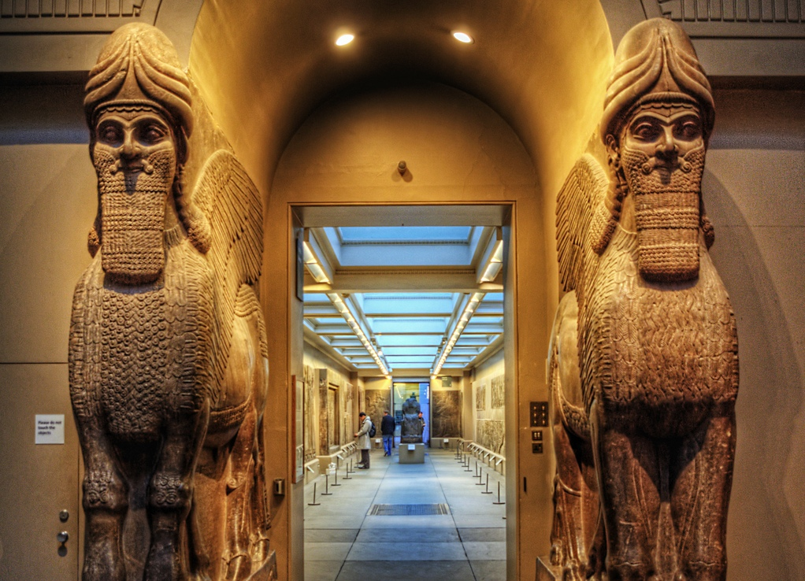
The museum houses large collections of artefacts representing different cultures of the world, both ancient and modern.

Slide 28
Remember !
The British Museum.
Repeat !

Slide 29
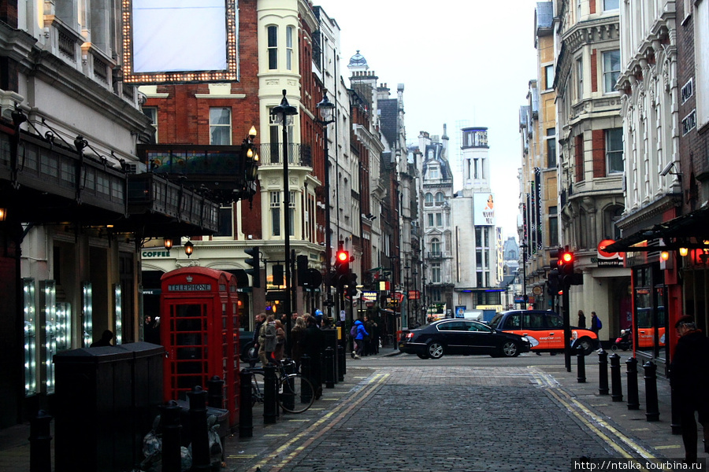
Oxford Street.

Slide 30
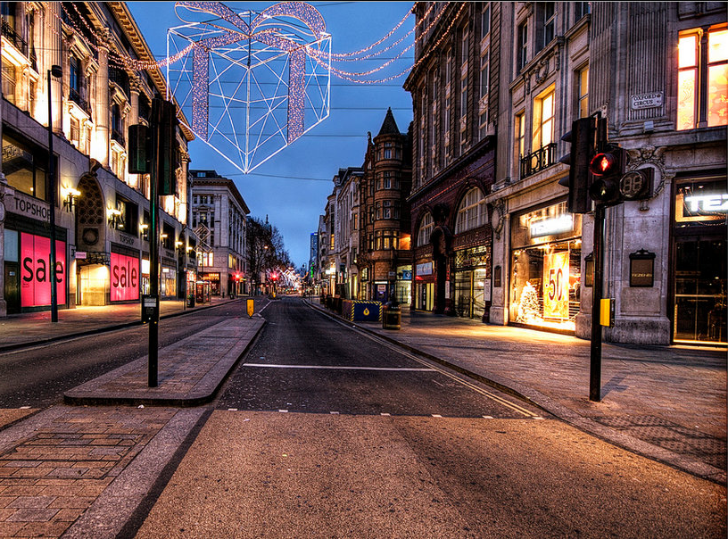
Oxford Street is a lively shopping street located in the centre of London. There are hundreds of shops in this street. The street is 1,9 km long. It is one of the busiest commercial streets in Europe.

Slide 31
Remember !
Oxford Street.
Repeat !

Slide 32
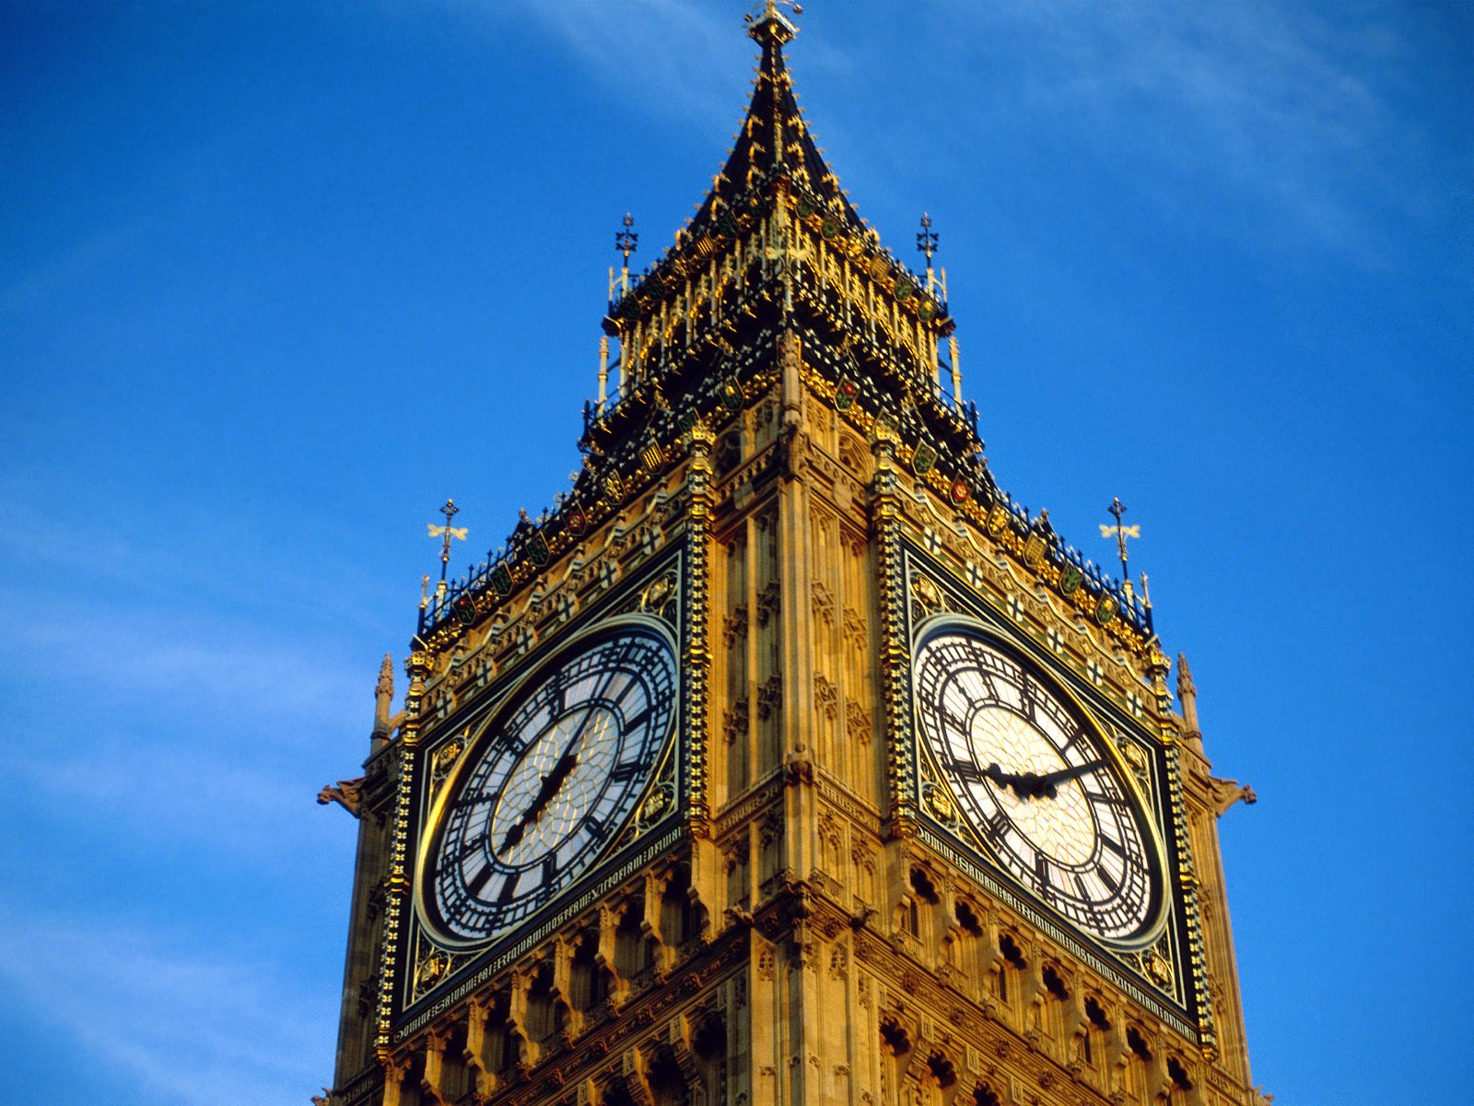
The Big Ben.

Slide 33
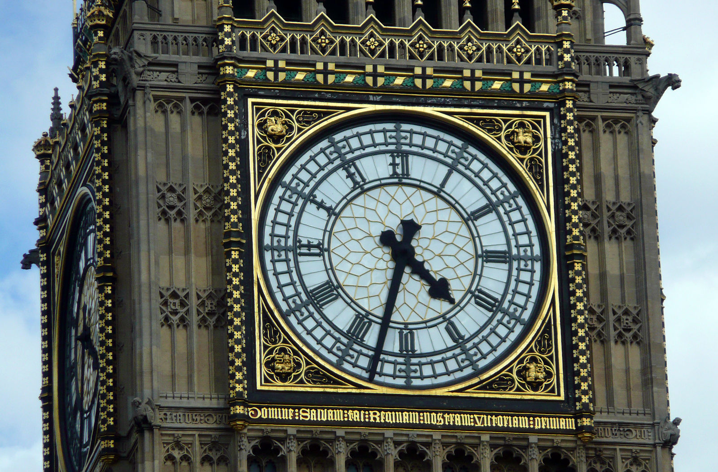
The world-known clock. Everyday about 500 tourists come to London to see the Big Ben.
Built in 1858, it was named after an architect whose name was Ben (Benjamin).

Slide 34
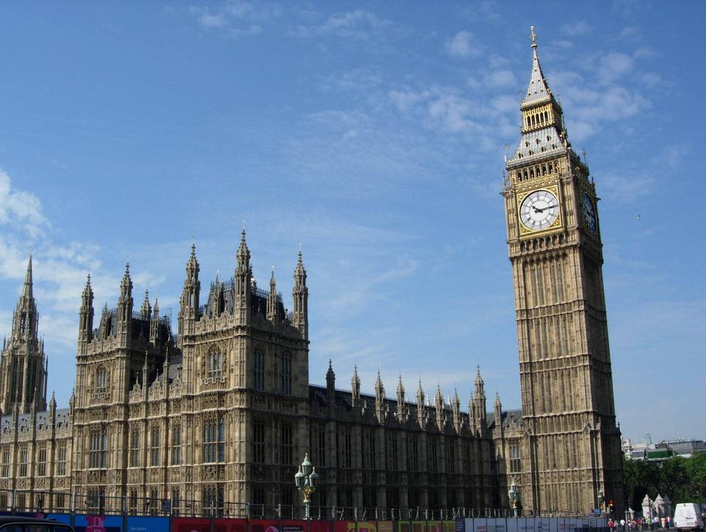
The interesting fact is that you are not allowed to get inside the Big Ben if you aren’t an Englishman. No tourists allowed.

Slide 35
Remember !
The Big Ben.
Repeat !

Slide 36
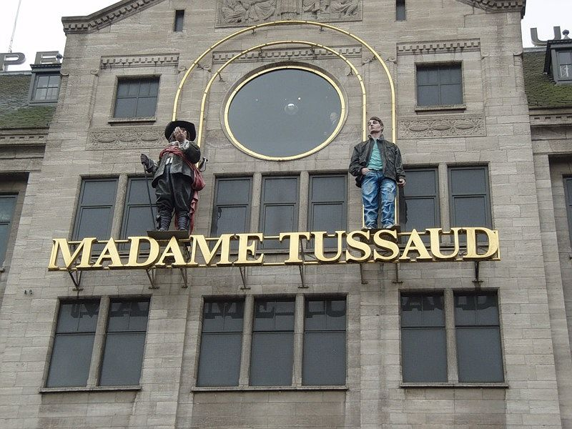
Madam Tussaud's Museum.

Slide 37
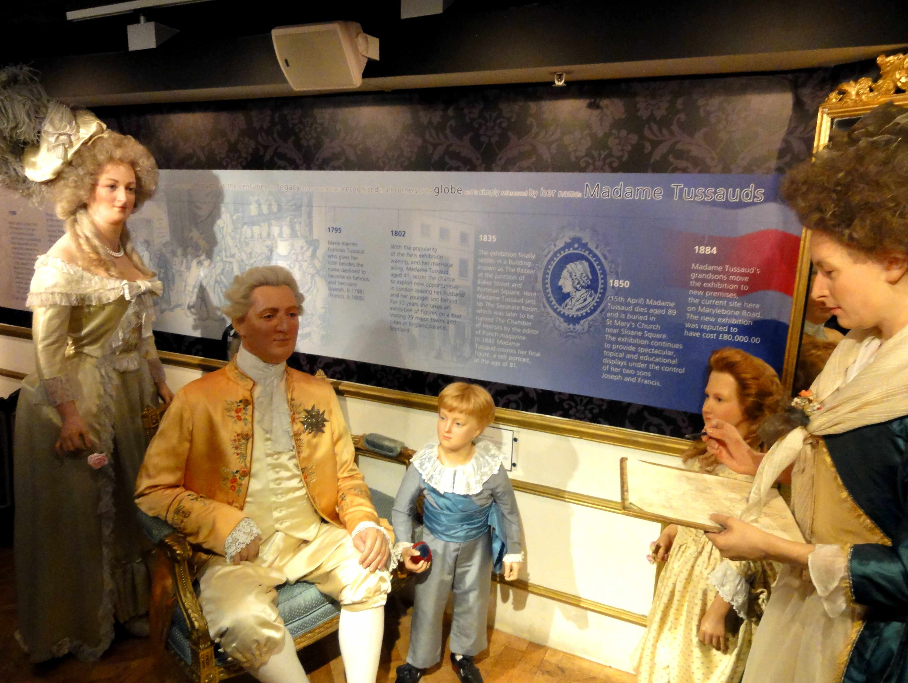
The most famous museum of waxworks. It presents all famous people from singers and actors to Prime Ministers and Presidents.

Slide 38
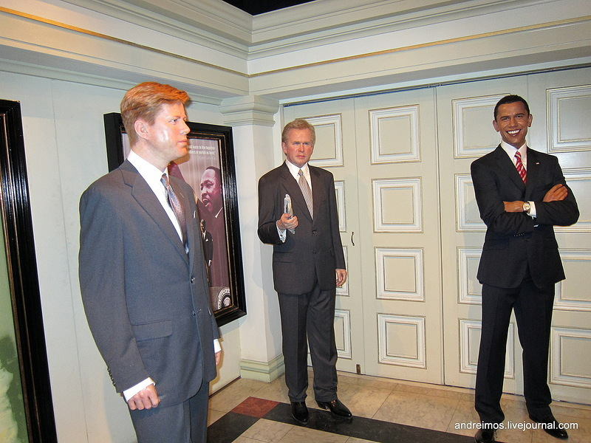
All the waxworks are of such a good quality, that sometimes you can mistake them for a real person.

Slide 39
Remember !
Madam Tussaud's Museum.
Repeat !

Slide 40
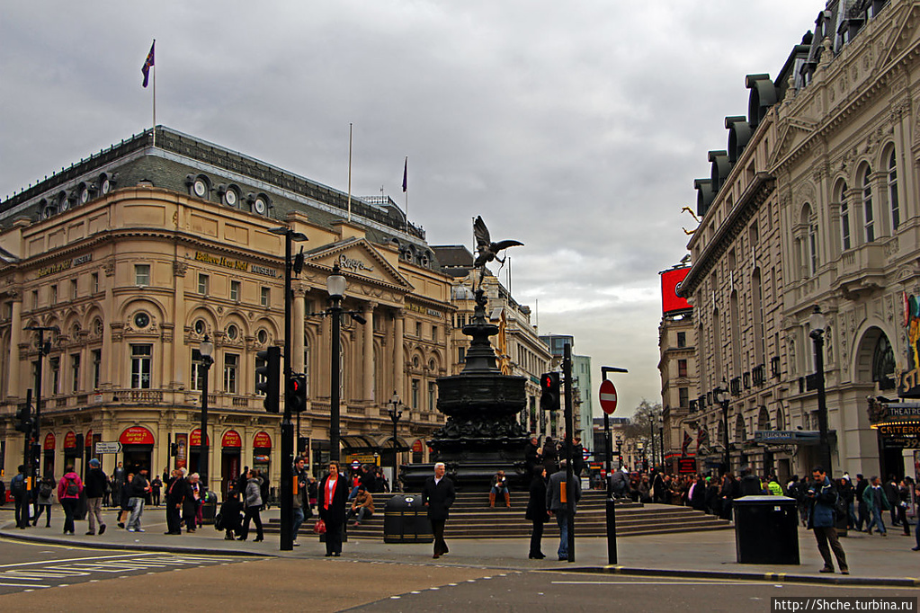
Piccadilly Circus.

Slide 41
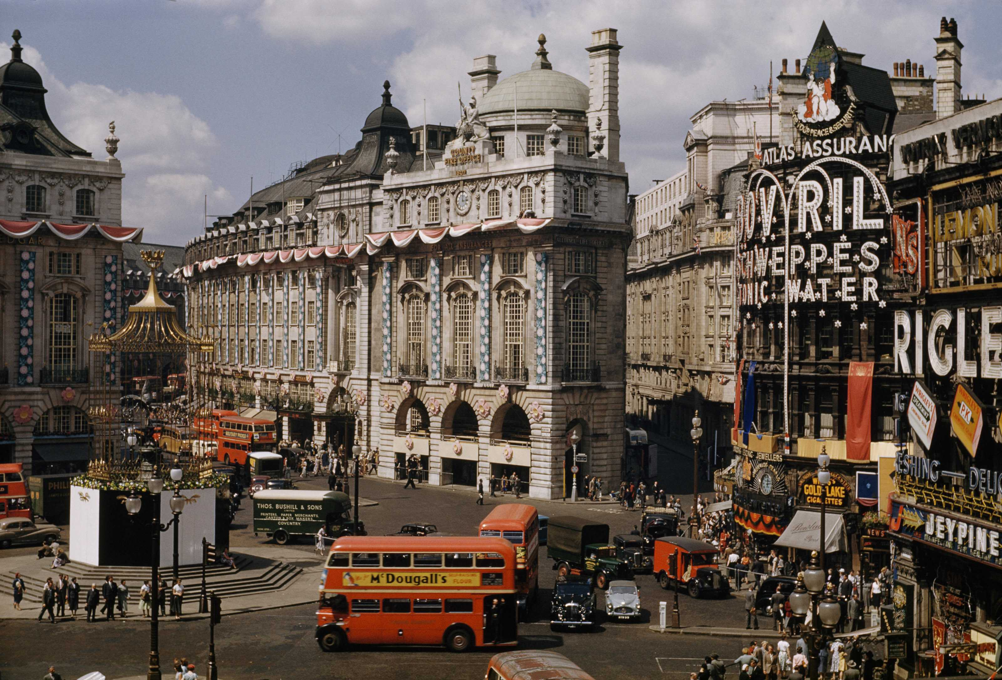
The place is far from what is called “a circus”. It is a well-known meeting point of the city. It has become so popular, that is now considered to be a place to visit for all the tourists.

Slide 42
Remember !
Piccadilly Circus.
Repeat !

Slide 43
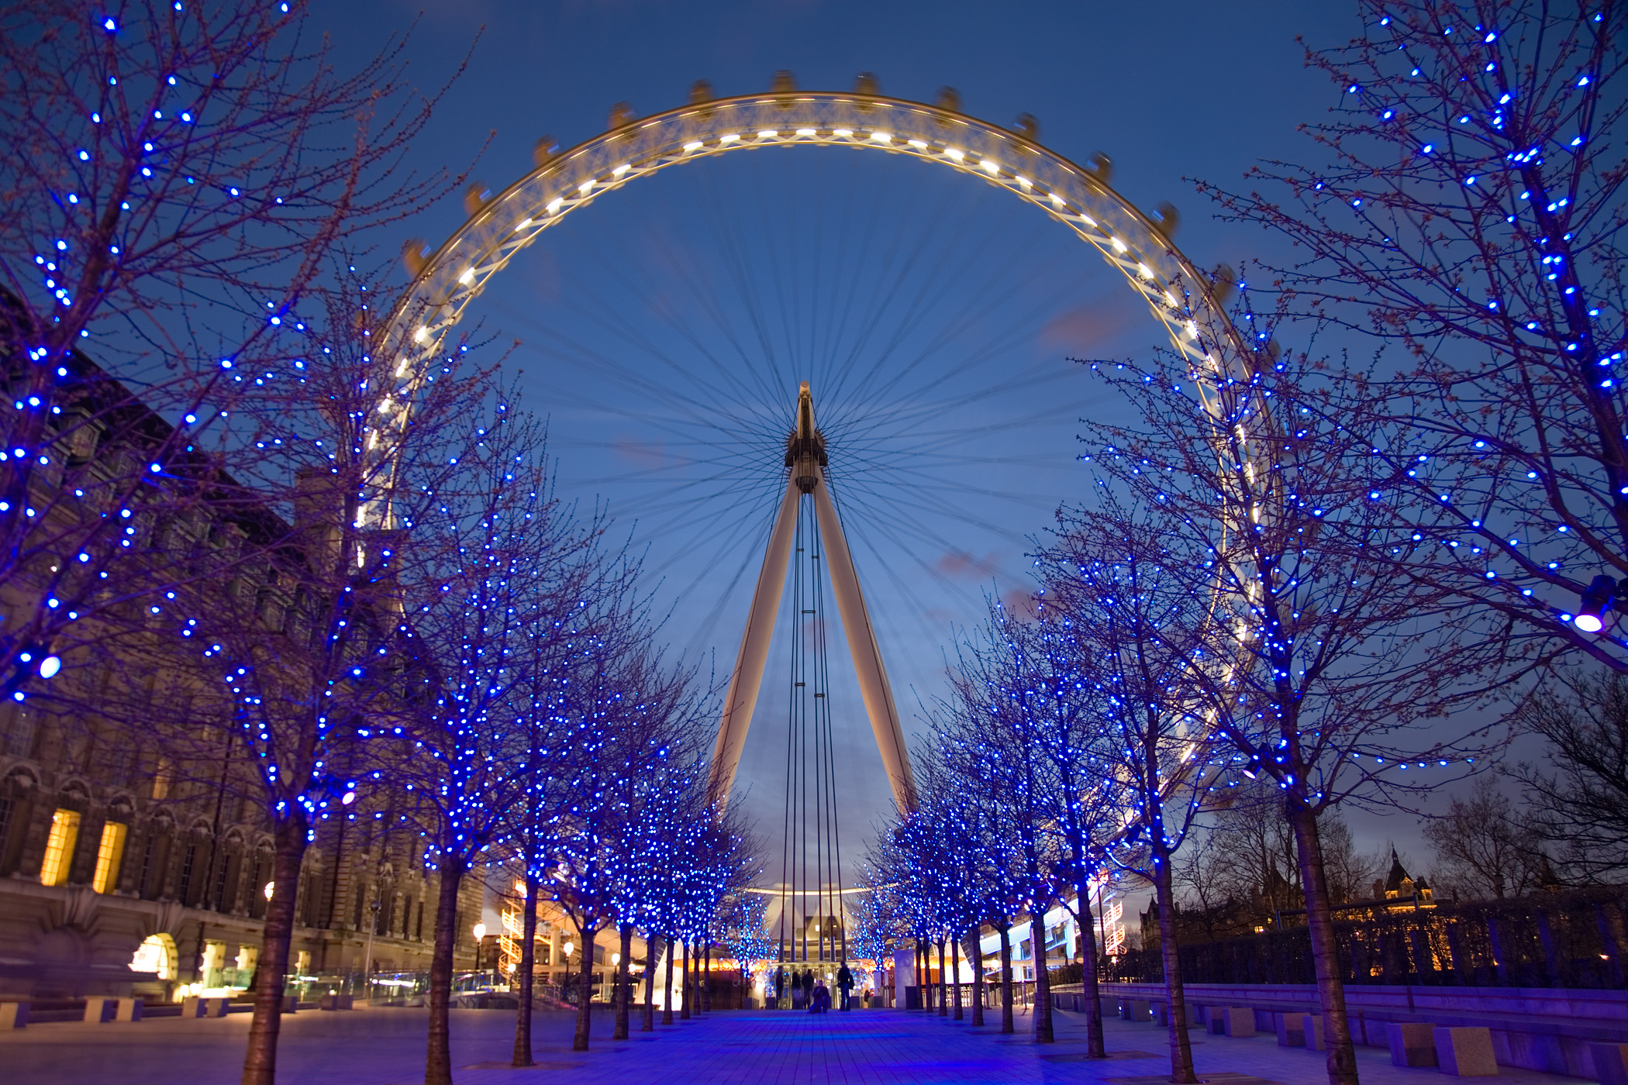
London Eye.

Slide 44
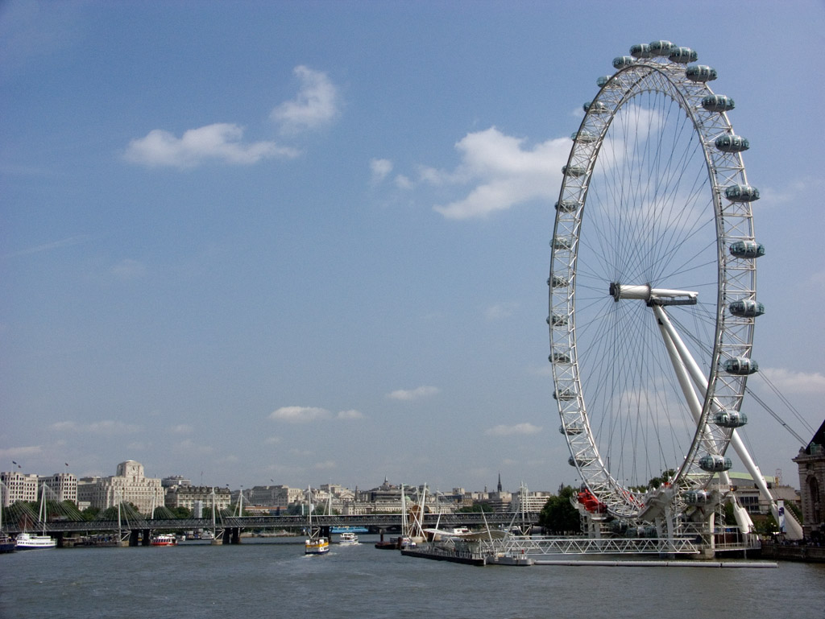
It is one of the biggest observation wheels in the world. Its height is 135 meters. It has 32 cabins which symbolize 32 districts of London. It takes 30 minutes to make a full circle. But it is the view you will never forget.

Slide 45
Remember !
London Eye.
Repeat !

Slide 46
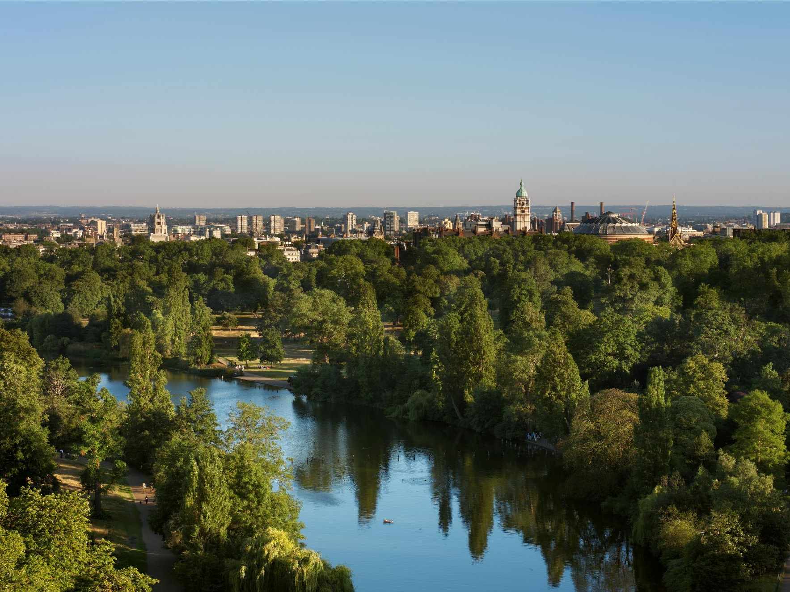
Parks of London.

Slide 47
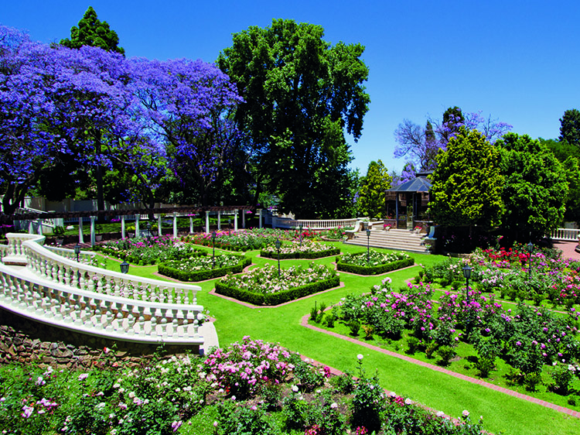
London is famous for its parks. Combined, all these parks cover more land than the Principality of Monaco.

Slide 48
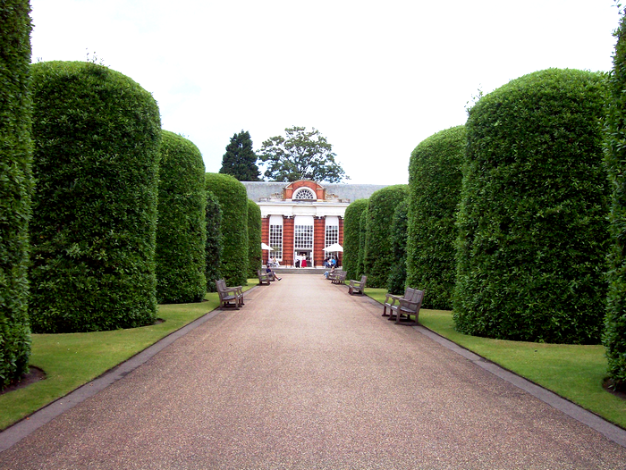
The most well-known is the Hyde Park. It is a traditional place of festivals and celebrations.

Slide 49
Remember !
Hyde Park.
Repeat !

Slide 50
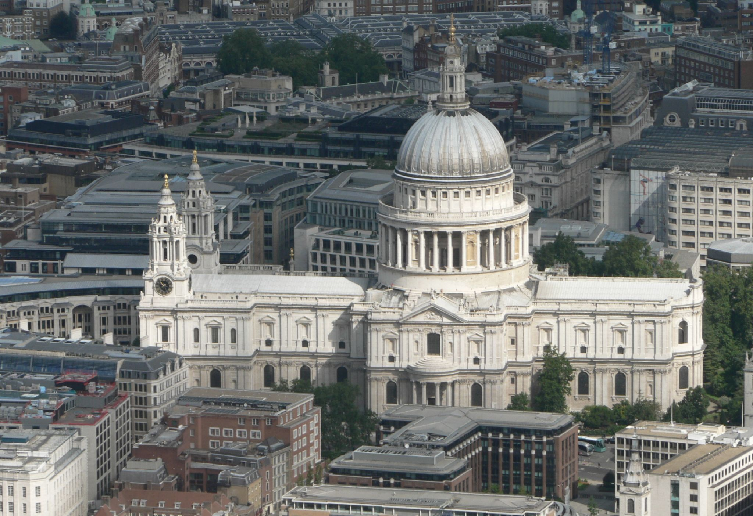
St. Paul’s Cathedral.

Slide 51
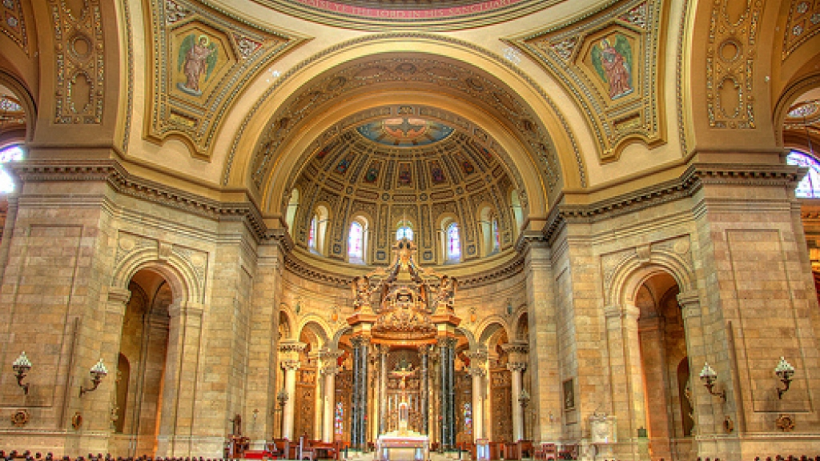
It was built on the highest point of London 300 years ago. It is the London Bishop’s residence and is the most popular place of visit.

Slide 52
Remember !
St. Paul’s Cathedral.
Repeat !

Slide 53
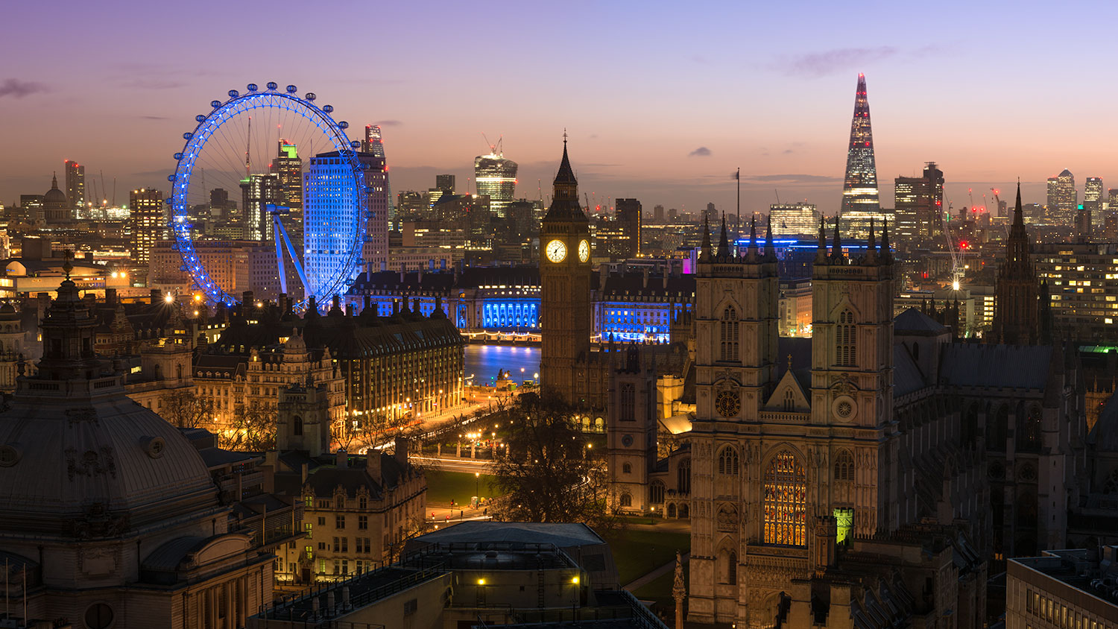
Our journey has come to an end.
Let’s remember all of places that we visited today.

Slide 54
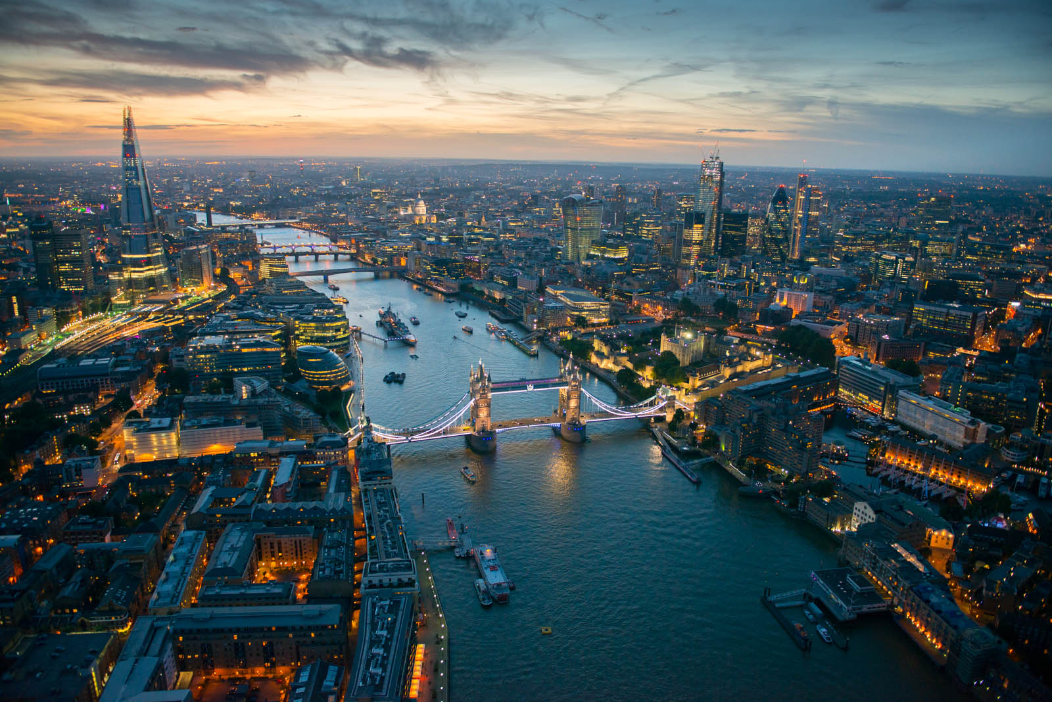
Buckingham Palace.
Westminster.
The Tower of London.
Trafalgar Square.
London National Gallery.
The British Museum.
Oxford Street.
The Big Ben.
Madam Tussaud's Museum.
Piccadilly Circus.
London Eye.
Hyde Park.
St. Paul’s Cathedral.

Slide 55
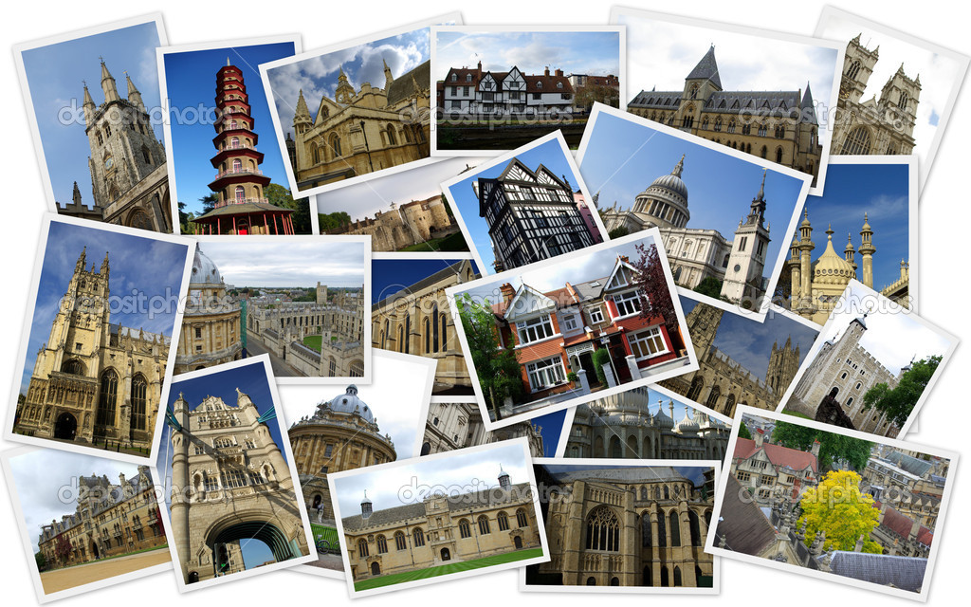
Good bye!

