Slide 1
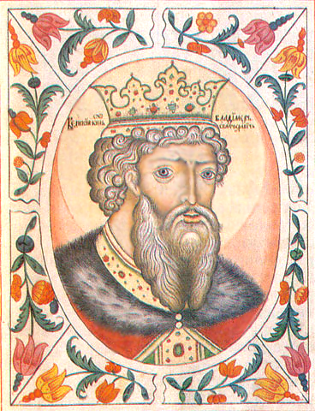
The Christianization of Rus’
Teacher: Sibiryov Sergey Olegovich
School: Vasiljevskaya

Slide 2
Tasks for the lesson
1. To disclose the process of Christianization of Rus’.
2. To evaluate the importance of adopting Christianity during the reign of prince Vladimir for both social & political development of the country.

Slide 3
Prehistory
According to the legends, Christianity was first brought to the territory of modern Belarus, Russia and Ukraine by Saint Andrew, the first Apostle of Jesus Christ. He traveled over the Black Sea to the Greek colony of Chersonesus Taurica in Crimea, where he converted several thousand men to new faith. Allegedly Saint Andrew traveled also north along the Dnieper River, where Kiev would be founded around the 5th century, and as far north as the future location of Veliky Novgorod.

Slide 4
Prehistory
Saints Cyril and Methodius were the missionaries of Christianity among the Slavic peoples of Bulgaria, Great Moravia and Pannonia. Through their work they influenced the cultural development of all Slavs, for which they received the title "Apostles to the Slavs". They are credited with devising the Glagolitic alphabet, the first alphabet used to transcribe Old Church Slavonic, as well as Cyrillic script used now in many Slavic countries. After their deaths, their pupils continued their missionary work among other Slavs. But most people were still pagans…

Slide 5
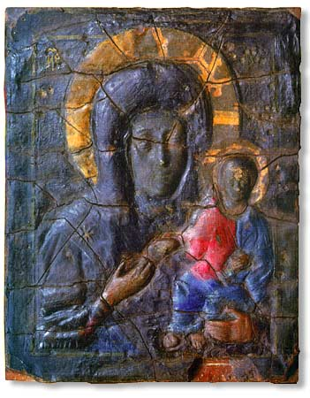
Prehistory
It is believed that during The Rus'–Byzantine War of 860 there was a miracle that strongly influenced on Rus’ military leader Askold & his army. As the story goes, during the siege of Constantinople after sleepless nights of praying Byzantine Emperor Michael and Patriarch Photius put the precious relic – the veil of the Theotokos – into the sea, there arose a storm which dispersed the boats of the barbarians. Shortly after, in 866 Askold & his suite were baptized. Unfortunately, it wasn’t a beginning of Christianization as in 882 Askold was killed by Oleg of Novgorod who was a pagan…

Slide 6
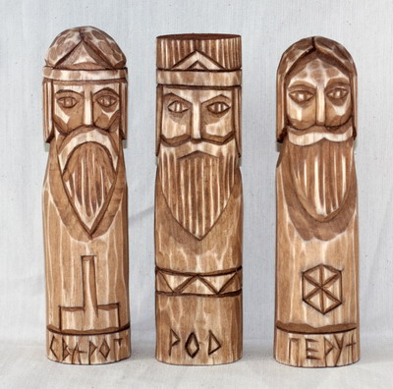
Prehistory
In 945 or 957 St. Princess Olga decided to adopt Christianity & was baptized. Nevertheless, her son, Sviatoslav (reigned 963-972), continued to worship Perun and other gods of the Slavic pantheon remaining a stubborn pagan all of his life.
And still despite numerous efforts to Christianize the Rus', their effect was not lasting due to many processes…

Slide 7
The beginning of Vladimir’s reign
And it was Vladimir who finally led pagan Rus’ to Christianity…
But at first he faced many difficulties on this way:
Vladimir
(reigned 980-1015)
The problem of
Vyatichi &
Radimichs
rebellions
The problem of
keeping all lands
together
The problem of
uniting
the nation

Slide 8
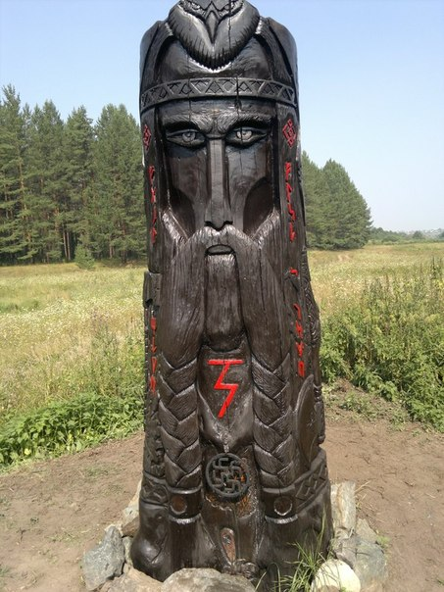
The first religious reform
The first religious reform by Vladimir took place in 980 when Perun was chosen as the supreme deity of the Slavic pantheon. Also, six more idols of gods were included in the pantheon. Dissentients (as well as Christians) were often killed if they refused to worship these gods.
This reform failed & by the late 980s Vladimir had found it necessary to adopt monotheism from abroad.

Slide 9
The search for God
The Chronicle reports that, in 986, Vladimir met with representatives from several religions. It is believed that upon the meeting with Muslim Bulgarians of the Volga, Vladimir found their religion unsuitable due to its rules & taboos against alcohol and pork. He also consulted with Jewish envoys, questioned them about their religion but ultimately rejected it, saying that their loss of Jerusalem was evidence of their having been abandoned by God.
In 987, as the result of a consultation with his boyars, Vladimir sent envoys to study the religions of the various neighboring nations.
Of the Muslim Bulgarians of the Volga the envoys reported there is no joy among them; only sorrow and a great stench. In the gloomy churches of the Catholics his emissaries saw no beauty; but at Orthodox Hagia Sophia they found their ideal: "We no longer knew whether we were in heaven or on earth," they reported, "nor such beauty, and we know not how to tell of it."

Slide 10
Year 988.
Baptizing of Rus’

Slide 11
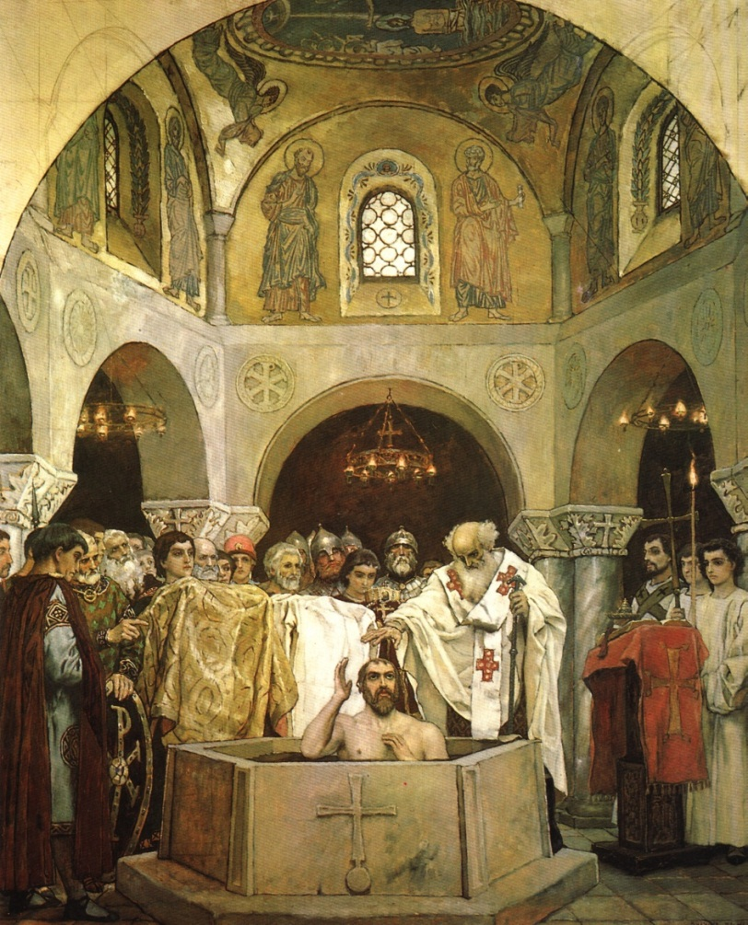
Baptizing of St. Vladimir
But adopting Christianity was not only the question of faith. Vladimir was also in search for a political power for his country. Threatening with a siege of Constantinople he made Byzantine emperor Basil II do him a favour. In exchange for marital tie with emperor's sister Vladimir agreed to accept Orthodox Christianity as his religion and bring his people to the new faith, being baptized in 988 in Chersonesus. Returning to Kiev in triumph, Vladimir exhorted the residents of his capital to the Dnieper river for baptism. He destroyed the statues of Slavic pagan gods (which he had himself raised just eight years earlier).

Slide 12
The reasons of adopting Christianity
customs &
traditions
close to the Slavs’
stable trade
relations with
Byzantine
religious leader
is obedient
to the king
Orthodox
Christianity
One God is
in Heaven –
one king
is on Earth

Slide 13
The conditions of adopting Christianity
1.The failure of the first religious reform.
2.Influence of neighbor Christian countries.
3.Good relations with Byzantine.
4.Dynastical marriage with princess Ann.

Slide 14
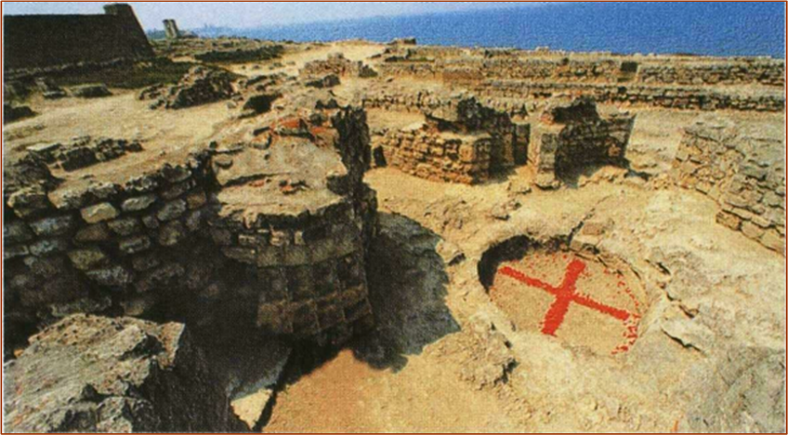
Font in Chersonesus

Slide 15
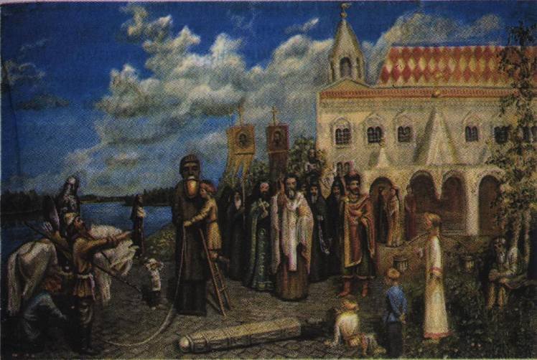
The destructions of idols in Kiev

Slide 16
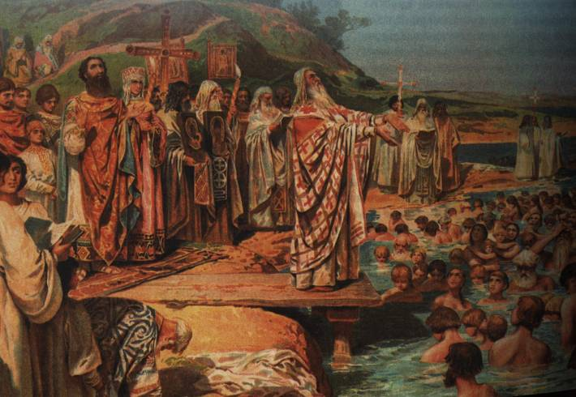
Baptizing of Kiev residents

Slide 17
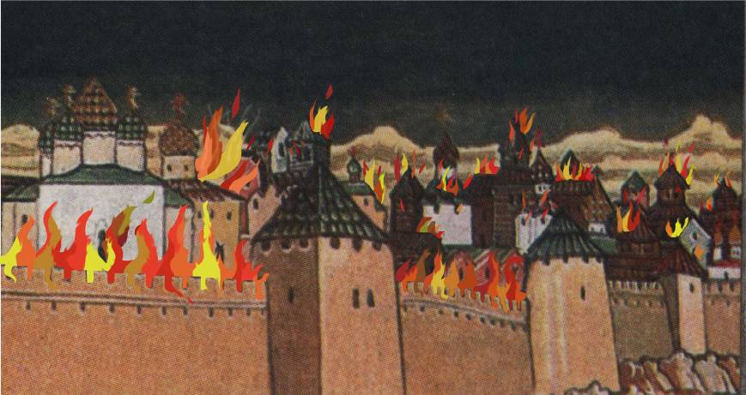
Forcing the Novgorodians into Christianity "by fire“ (991)

Slide 18
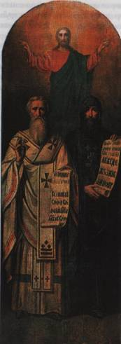
Consequences of adopting Christianity
Rus’ had much positive for its development after adopting Christianity:
it became a politically powerful country
trade developed
writing was begun
chronicles were begun
building churches was begun
icon-writing was begun

Slide 19
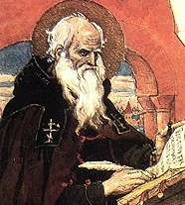
The beginning of chronicles
St. Nestor the Chronicler

Slide 20
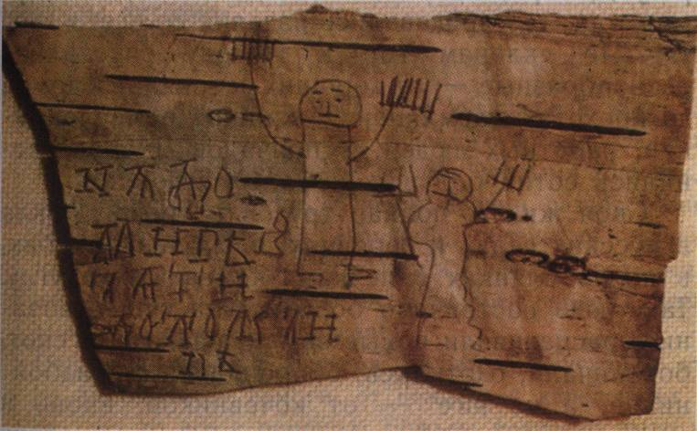
Onfim’s birch bark manuscript

Slide 21
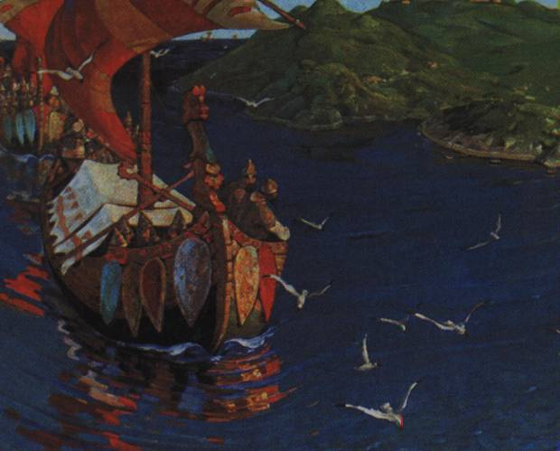
The development of trade

Slide 22
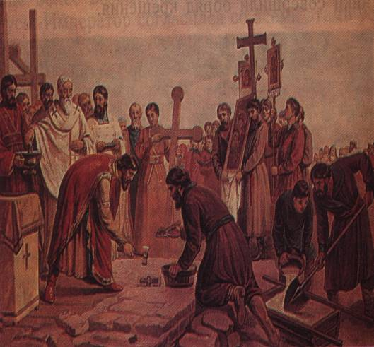
The construction of churches

Slide 23
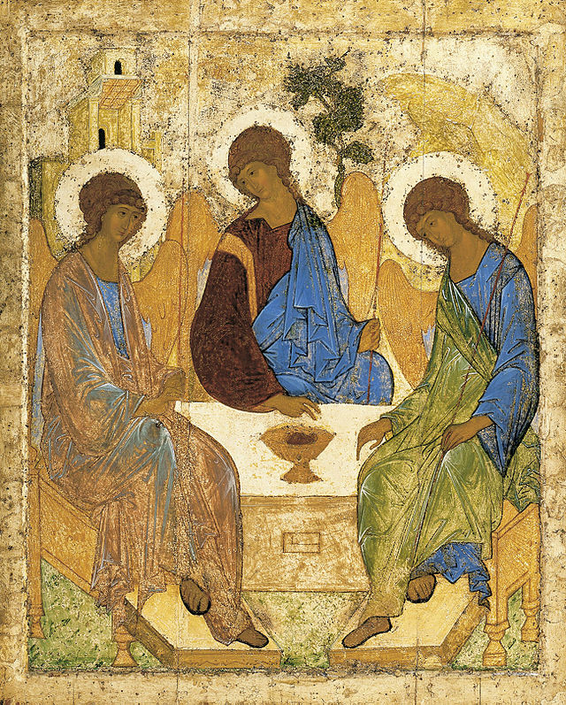
The beginning of icon-writing

Slide 24
Ancient Rus’ before & after baptizing
before the year 988 | appeared after the year 988
Early stages of writing, home education, spoken way of transmitting the experience | Spreading of Cyrillic script, beginning of Chronicles, creating monastery & prince's schools.
Folk tales, songs, dances; constructions from wood – houses, fortresses, bridges | Church hymns & liturgy, fresco painting, mosaic; construction churches from stone
Developed wood- and metalworking, leather crafting, pottery, jewelry making | About 60 different kinds of crafts. The beginning of coining
Polygyny, stealing brides, relative freedom of women | Monogamy, church marriage, women’s obedience to men, increasing of man’s responsibility for family & children’s upbringing
Usual rule | Canon (Church) law as the basis for “Russian Justice”
Princes fought for expanding their territories & strengthening their power | Identifying of place of Rus’ in the world, the idea of strong prince’s authority, powerful & united country

Slide 25
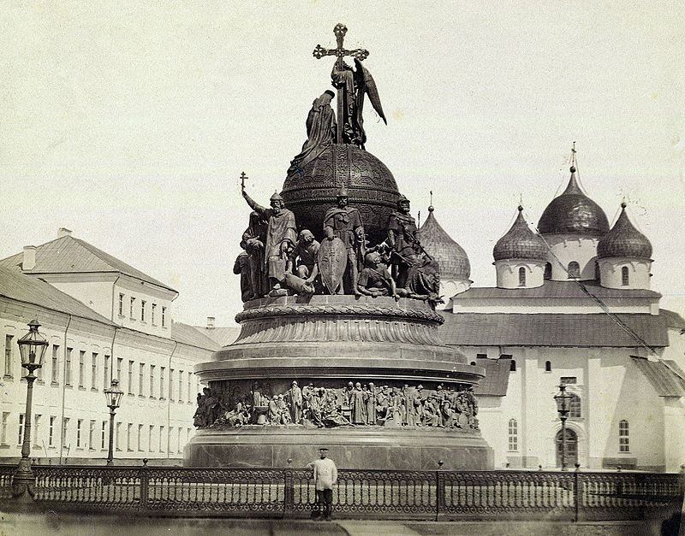
The Millennium of Russia

