Slide 1
The 2nd of March
Classwork

Slide 2
Презентация к уроку
“Do your parents understand you ?”
9класс «Happy Englsh.ru»
учитель:Саушина О.Н.
МБОУ «СОШ№8»г.Рузаевка
Республика Мордовия

Slide 3
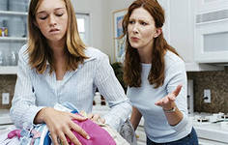
Read the poem and repeat after me:
Mag`s mom likes to nag Likes to lecture, drive Mag mad. Can Mag obey mom if she nags, Can mom not nag Mag behaving bad.

Slide 4

“Do your parents understand you ?”

Slide 5
The questions of the lesson:
How are you getting on with your parents?
Do you have understanding with them?
Do you often reach compromise with your mother and father?

Slide 6

Listen and repeat:
to be fed with something or somebody
to lecture somebody
to be a loser
to be cool with something
to reach a compromise
to be grateful to smb/ for smth.
to deserve smth.
It occurred to me

Slide 7
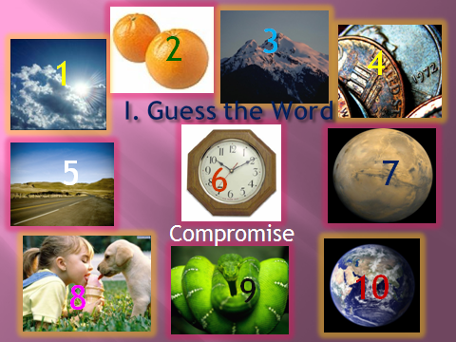

Slide 8
How to avoid(prevent) the conflicts ?
You should
You shouldn’t
To be able to listen to each other,
to reach a compromise ,
to give some pieces of advice (to ask for advice),
to respect smb. opinion,
to try to forgive and approve, to understand the younger (older) generation, rely on own family,
to tell day and night to (keep the room tidy),
to spoil the mood, to threaten or frighten (bully),
to make fun of smb.,
to make smb. feel uncomfortable,
to lecture smb.,
to shout and quarrel in a loud voice…

Slide 9
Complex Object

Slide 10
want
expect | somebody | to do something
would like
don't/doesn't want
don't/doesn't expect | somebody | to do something
wouldn't like

Slide 11
make | somebody | do something
let
don't/doesn't make | somebody | do something
don't/doesn't let

Slide 12
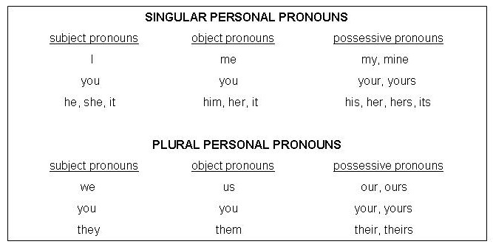
Personal Pronouns

Slide 13
I want (he) to be my friend.
They would like (we) to learn English.
They expected (she) to arrive at 6 p.m.
She doesn’t want (her daughter) to come home late.
Tom expects (I) to write a letter every week.
Our parents want (we) to be friends.
I’d like (you) to offer him help.
I don't want (she) to read the letter.

Slide 14
Open the brackets and use the Complex Object.
Example: He expected ( they, arrive) at 5. –
He expected them to arrive at 5.
Do you want (they, stay) at the hotel or with us?
2. I’d like ( the teacher, look through) my report.
Let (I, introduce) the guests to you.
4. He expects (she, invite) him to party.

Slide 15


Do your parents understand you?

Slide 16
Listen to the dialogue

Slide 17

Let’s have a friendly and understanding family!

