Slide 1
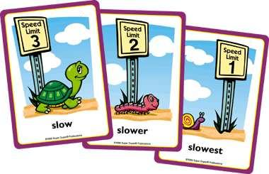
Degrees of comparison of adjectives

Slide 2
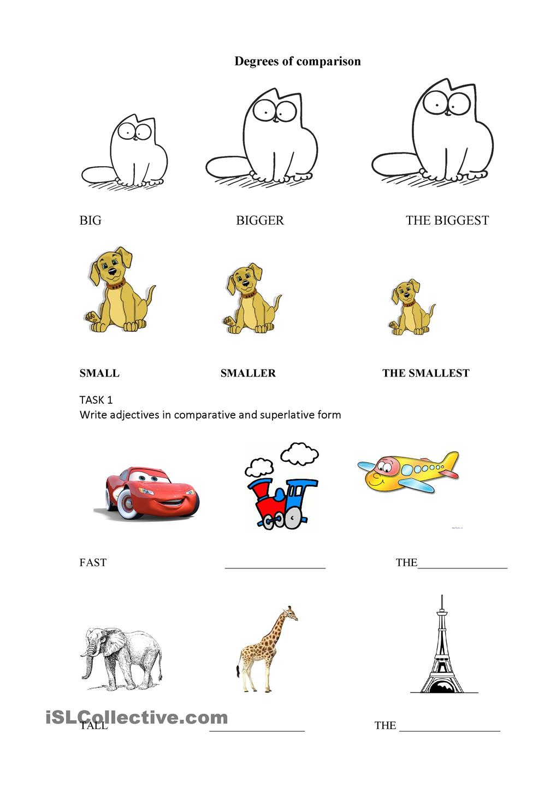
Compare:
big
bigger
the biggest

Slide 3
Compare:
small
smaller
the smallest

Slide 4
Compare:
fast
faster
the fastest

Slide 5
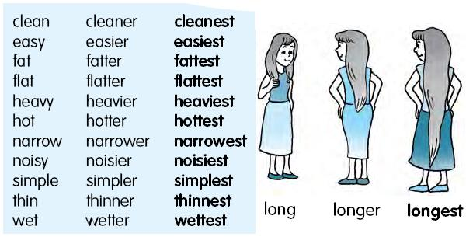
Compare:
long
longer
the longest

Slide 6
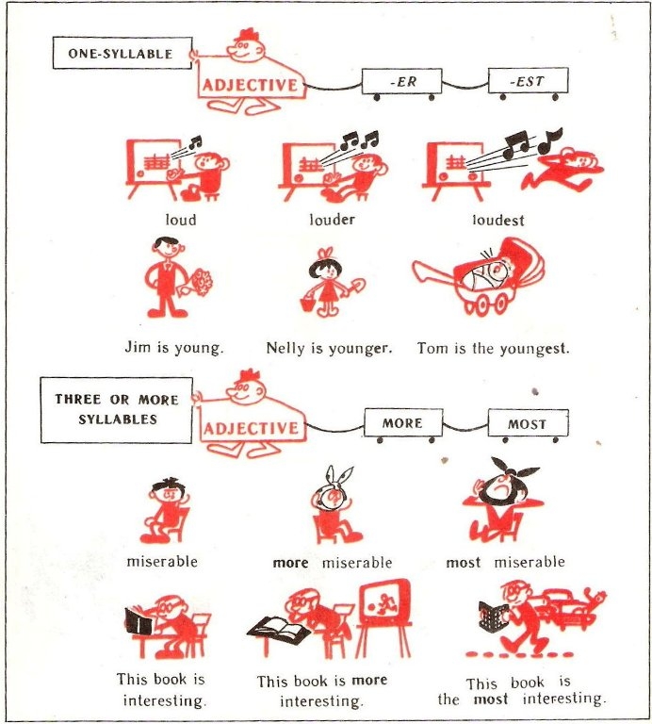
Compare:
loud
louder
the loudest

Slide 7
Compare:
young
younger
the youngest

Slide 8
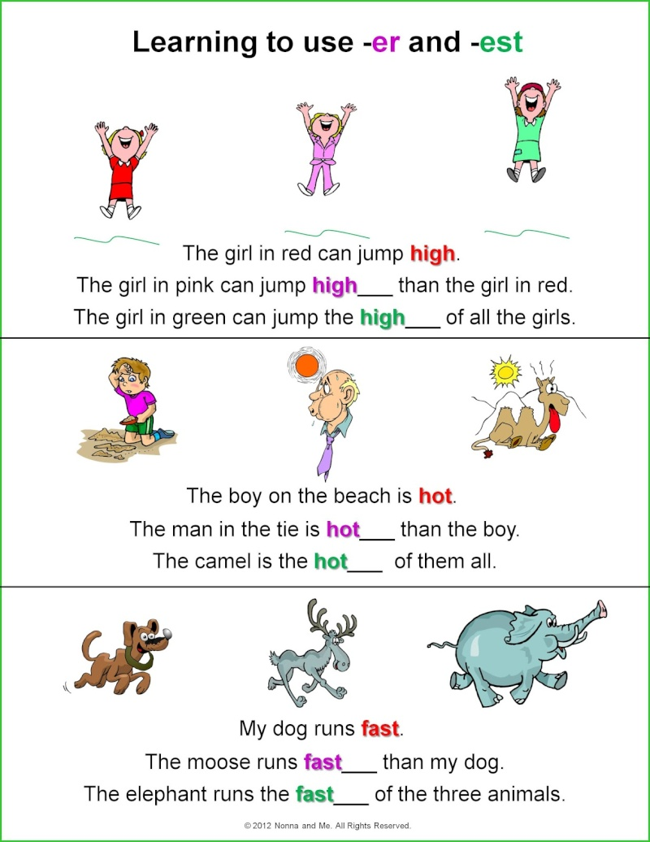
Compare:
high
higher
the highest

Slide 9
Compare:
hot
hotter
the hottest

Slide 10
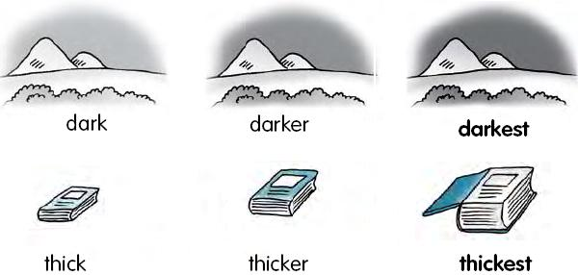
Compare:
dark
darker
the darkest

Slide 11
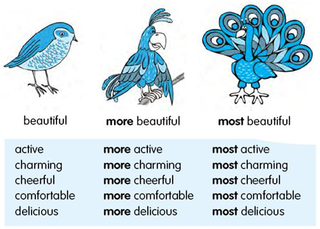
Compare:
good
better
the best

Slide 12

Образуйте степени сравнения следующих прилагательных
easy_______________________________________
short______________________________________
nice_______________________________________
big________________________________________
small______________________________________
tall________________________________________
long_______________________________________
hot________________________________________
strong______________________________________
early_______________________________________
thick_______________________________________
wise________________________________________

Slide 13
Open the brackets
better
1) Two heads are _____________ than one.(good)
2) Mike is ____________ than Nick. (tall)
3) This is ___________ hotel in our city. (cheap)
4) My ______________ brother is five years. (old)
5) Winter is _____________season of the year. (cold)
6) Which is _______________day of the year? (long)
7) In spring the days are ____________than in winter. (long)
8) Your English is ___________now. (good)
9) It is _________today than it was yesterday. (cold)
taller
the cheapest
elder
the coldest
the longest
longer
better
colder

Slide 14
Open the brackets
1. Dogs are _______________________ than cats ( clever ).
2. Monkeys are the _____________________ animals (funny ).
3. Giraffes have the____________________ necks. (long)
4. Giraffes are big but elephants are ____________________.(big) They are the_______________animals at the Zoo. (big)
5. My sister likes cats, but I think that dogs are the___________(nice).
b) Ann: Kate, this is my dress. Your dress is ___________________(short).
Kate: No, I think this is my dress. It is the ________________of all my dresses. (long)
Ann: But you look funny in it. It is too big. You are_________ than I am. (small) And these are my shoes. They are _________________than your shoes. (big)
Kate: Sorry, Ann.
cleverer
funniest
longest
bigger
biggest
nicer
short
shortest
smaller
bigger

Slide 15
Многосложные прилагательные
Положительная | Сравнительная | Превосходная
прилагательное | More + прилагательное | The most + прилагательное
beautiful
More beautiful
The most beautiful
Красивый
Красивее
красивейший

Slide 16
Образуйте степени сравнения прилагательных
wonderful
necessary
interesting
comfortable
popular
active
famous
pleasant
beautiful
light-minded
well-read

