Slide 1
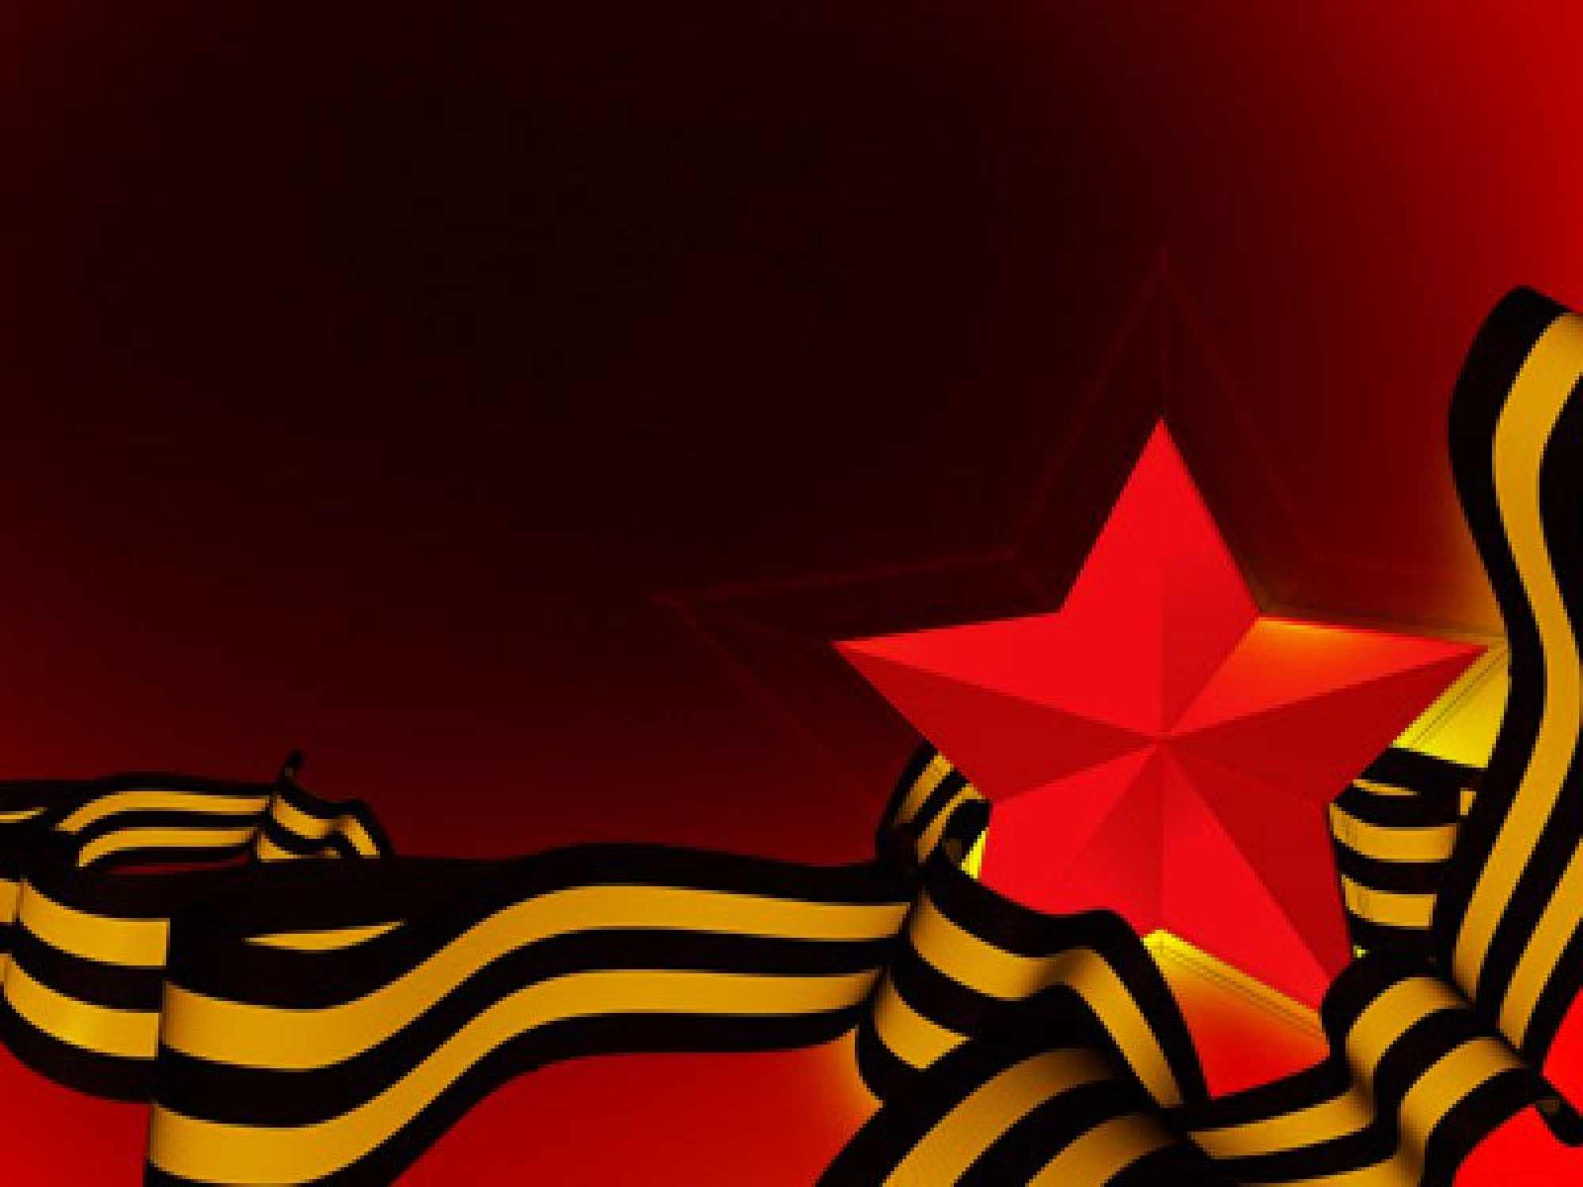
Monuments and Memorials
1941-1945
Подготовила
учитель МБОУ «Гимназия №1, им. Н.И. Борцова»
г. Лебедянь, Липецкой области
Дорофеева О.Е.

Slide 2
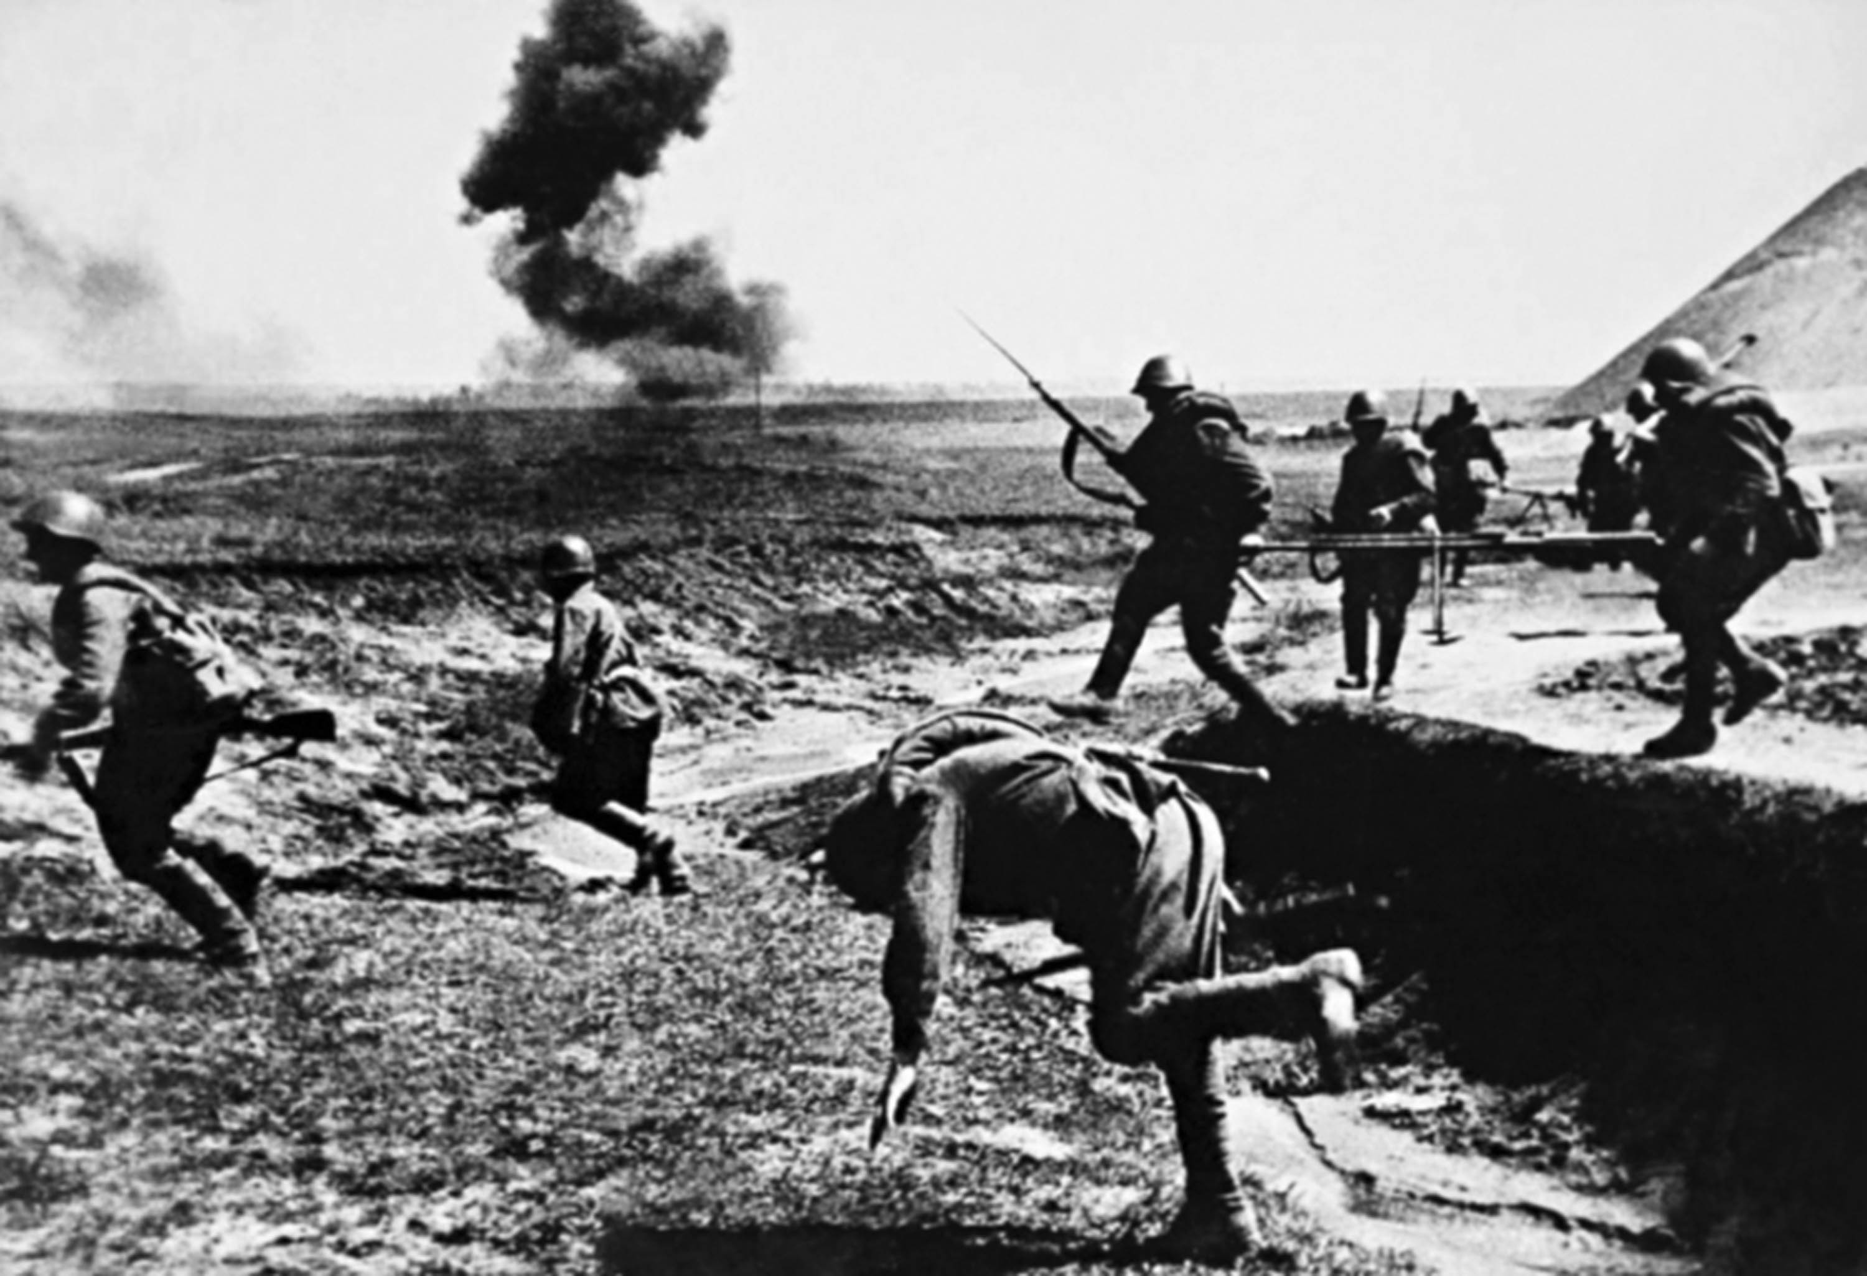
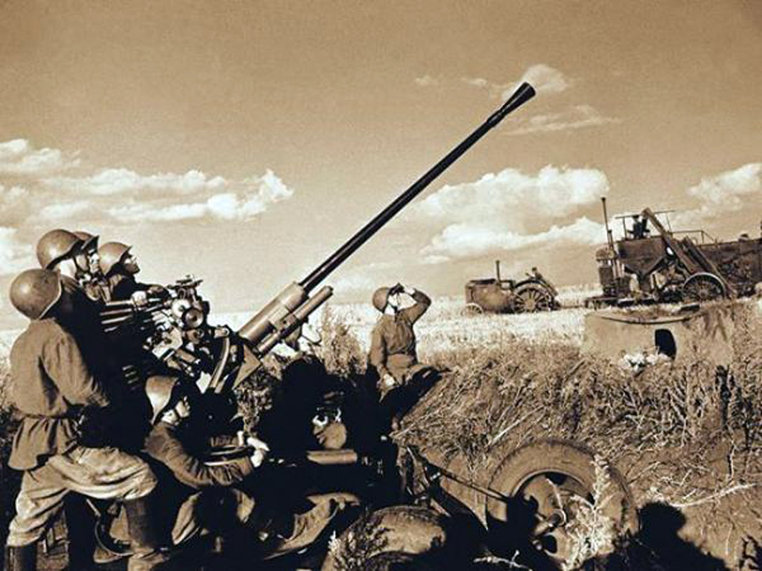

Slide 3
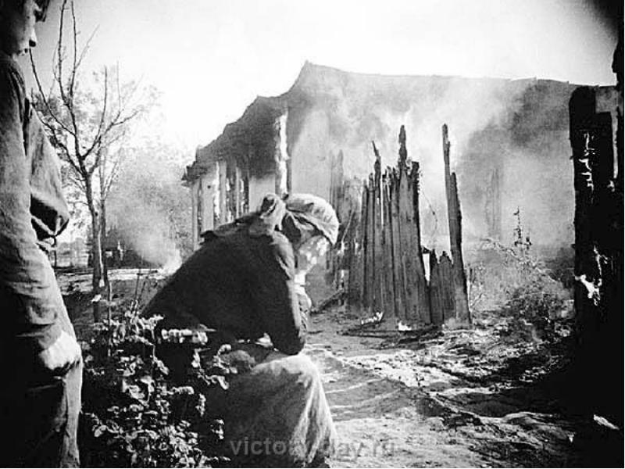
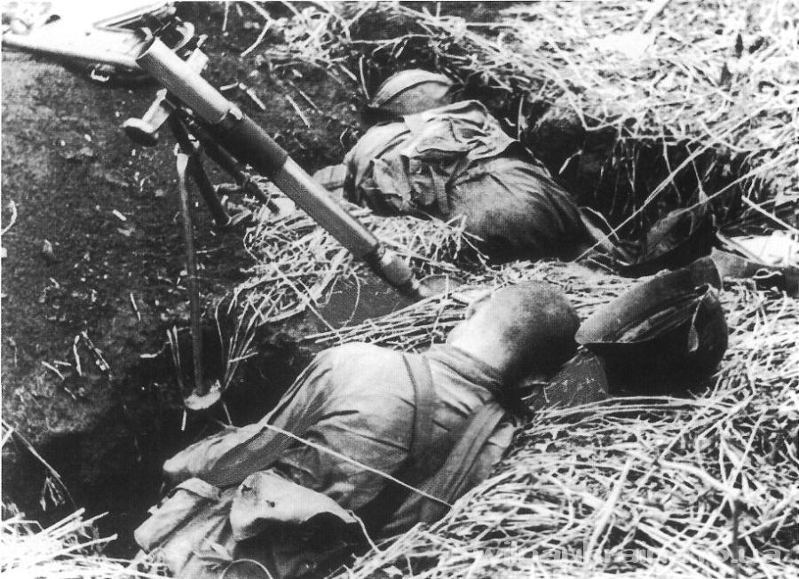

Slide 4
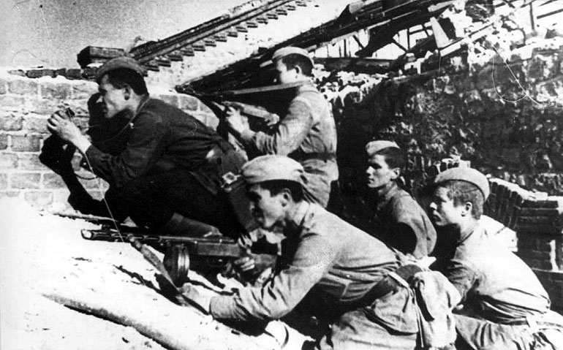

Slide 5
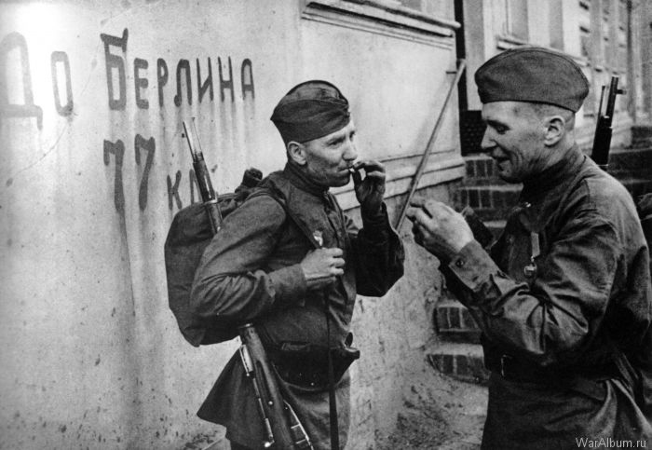

Slide 6
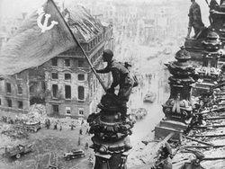

Slide 7
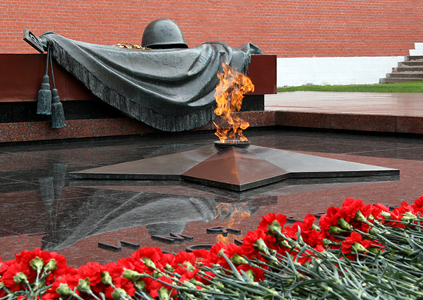

Slide 8
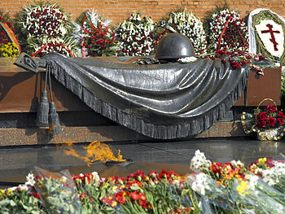
Tomb of the Unknown Soldier
in the Alexander Garden at the Kremlin Wall.

Slide 9
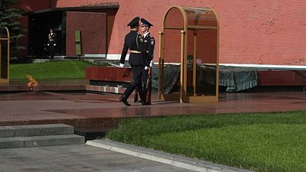
Changing of the Guard
at the Tomb of the Unknown Soldier

Slide 10
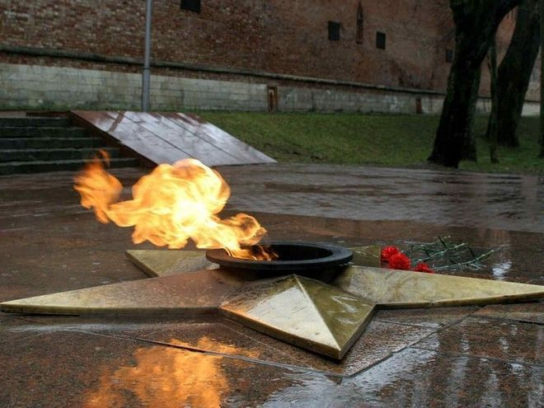
The Eternal Flame

Slide 11
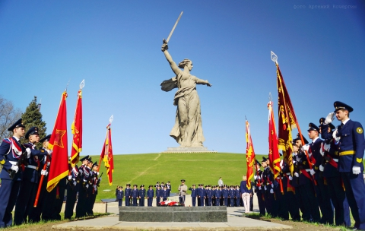
The Motherland Calls, The Motherland,
or The Mamayev Monument,
Is a statue in Mamayev Kurgan in Volgograd, Russia,
commemorating the Battle of Stalingrad. 15 October, 1967
Yevgeny Vuchetich

Slide 12
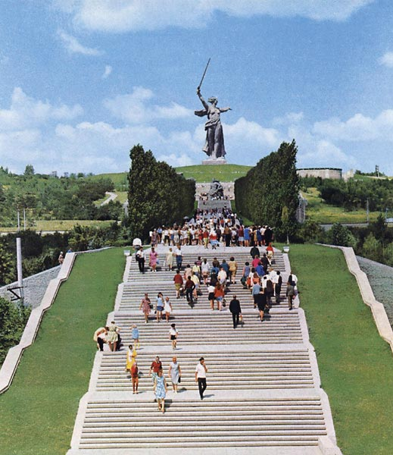
The figure itself measures 52 metres, and the sword 33 metres.
Two hundred steps, symbolizing the 200 days of the Battle of Stalingrad

Slide 13
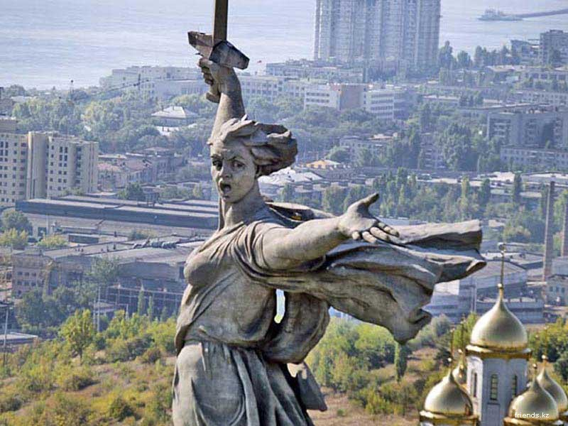

Slide 14
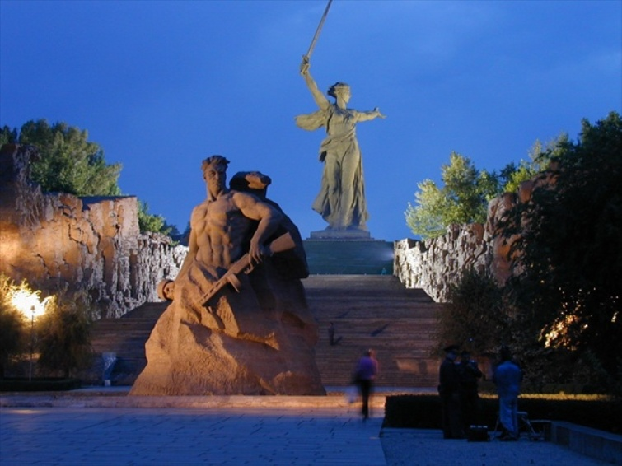

Slide 15
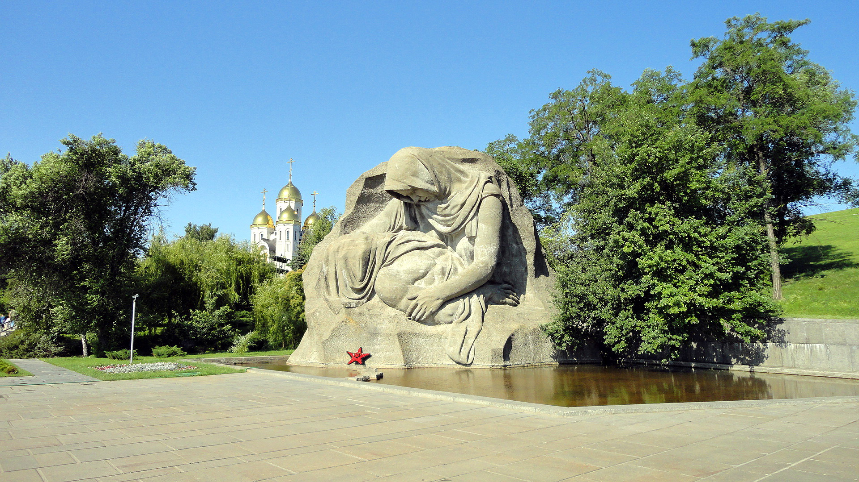
Monument Mothers Sorrow

Slide 16
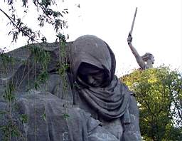

Slide 17
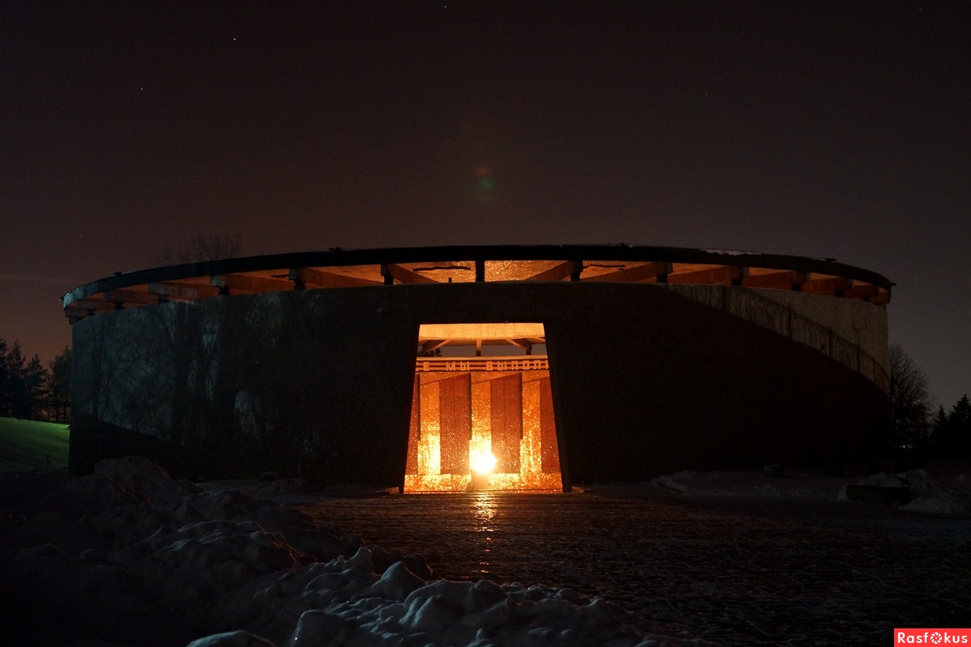

Slide 18
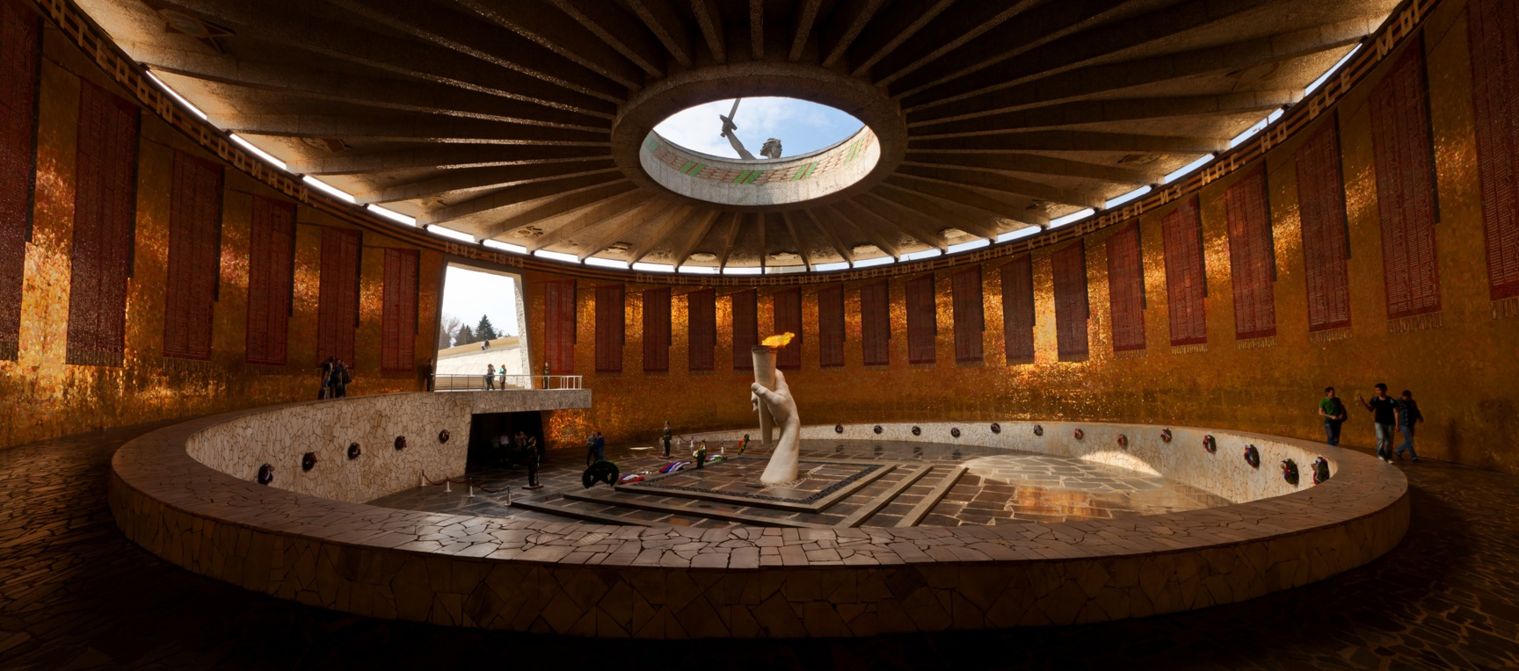
The Eternal Flame

Slide 19
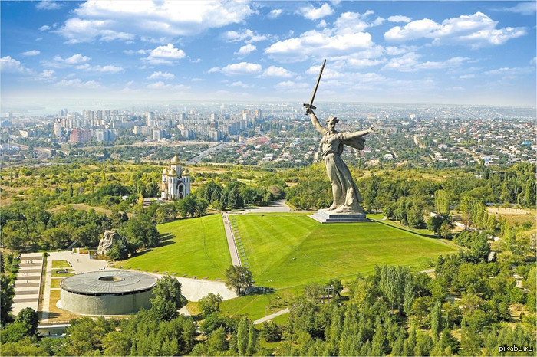

Slide 20
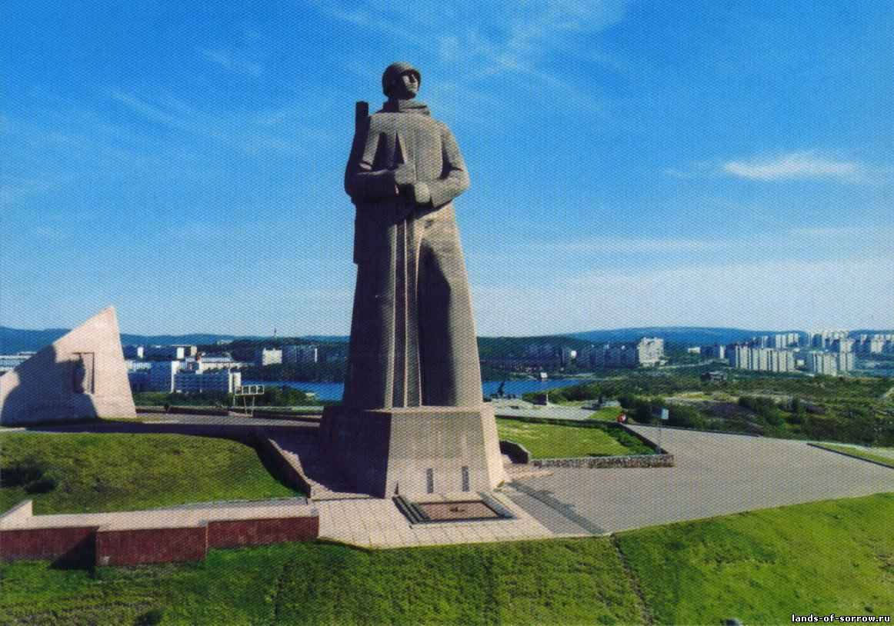

Slide 21
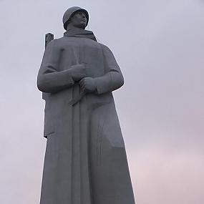
Alyosha of Murmansk

Slide 22
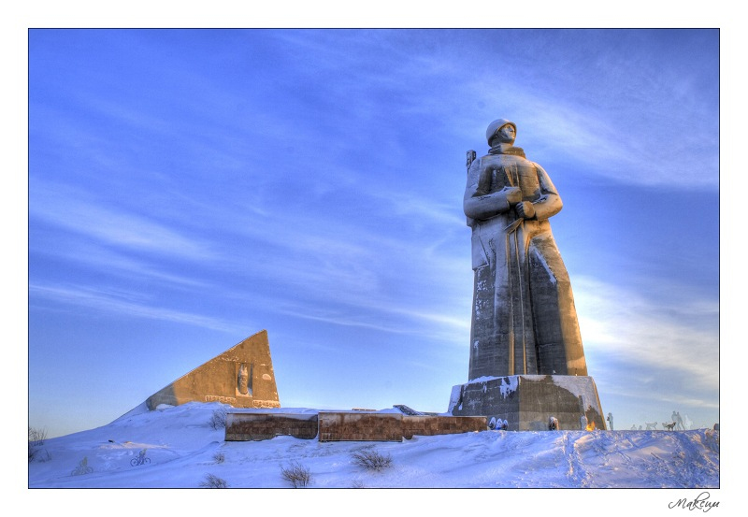
Defenders of the Soviet Arctic during the Great Patriotic War

Slide 23
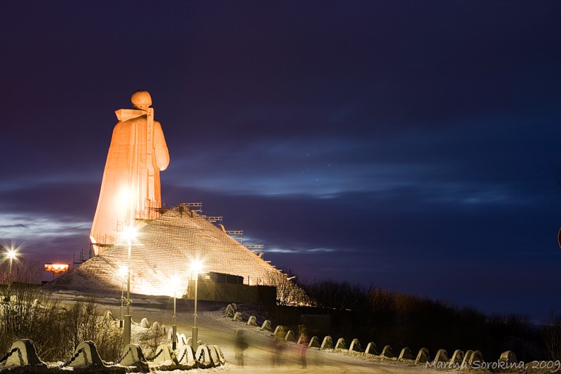
I. A. Pokrovsky (architect)
I. D. Brodsky (sculptor)
October 19, 1974

Slide 24
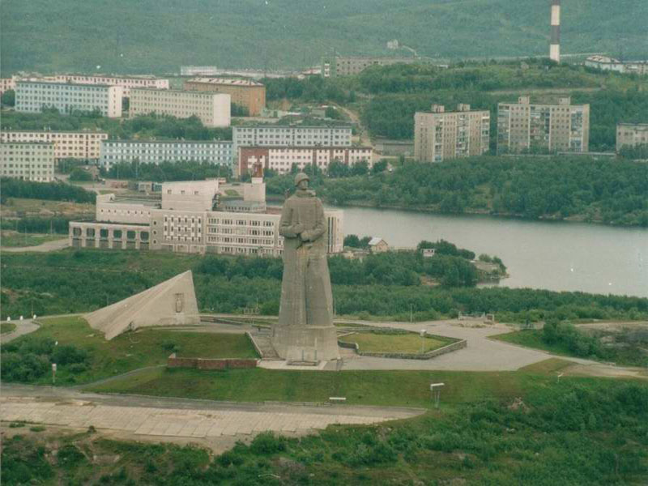
The height of the pedestal is 7 metres; the statue is 35.5 metres tall. It is the second-tallest statue in Russia, after The Motherland Calls in Volgograd

Slide 25
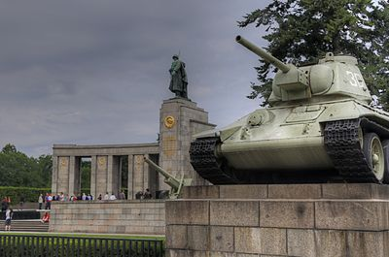
Soviet World War II memorial in Berlin, Germany

Slide 26
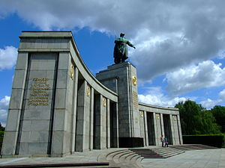
For Soviet war dead (80,000 soldiers) of the Battle of Berlin,
1945

Slide 27
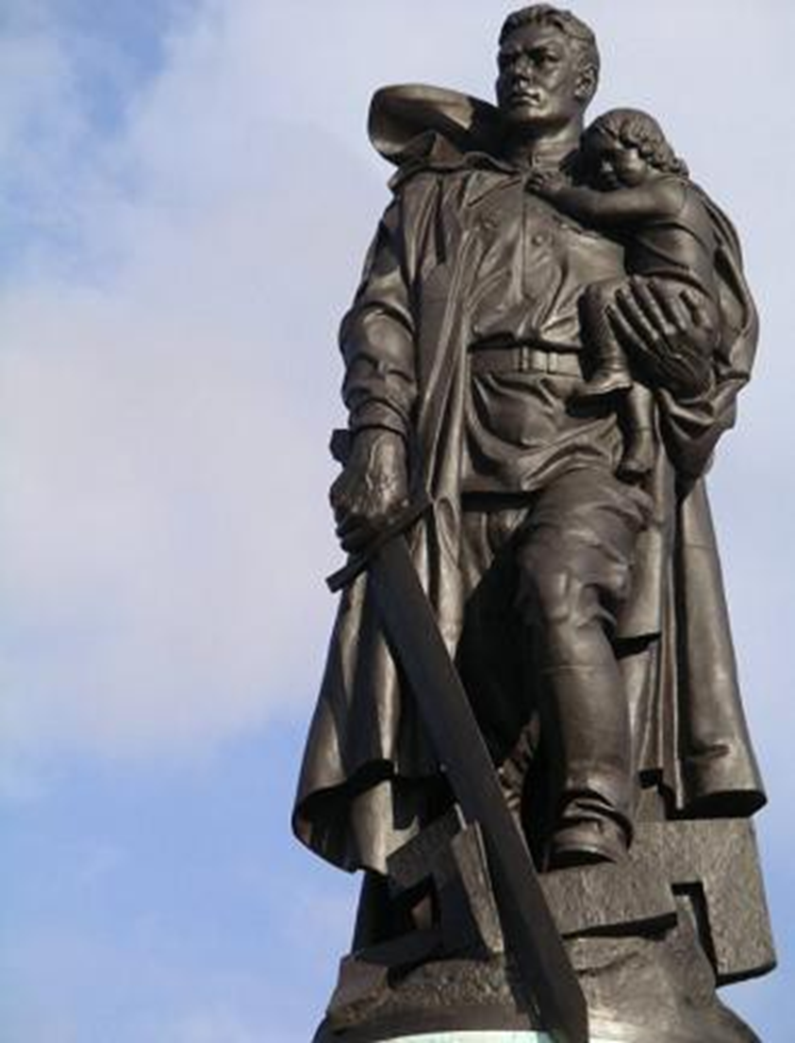

Slide 28
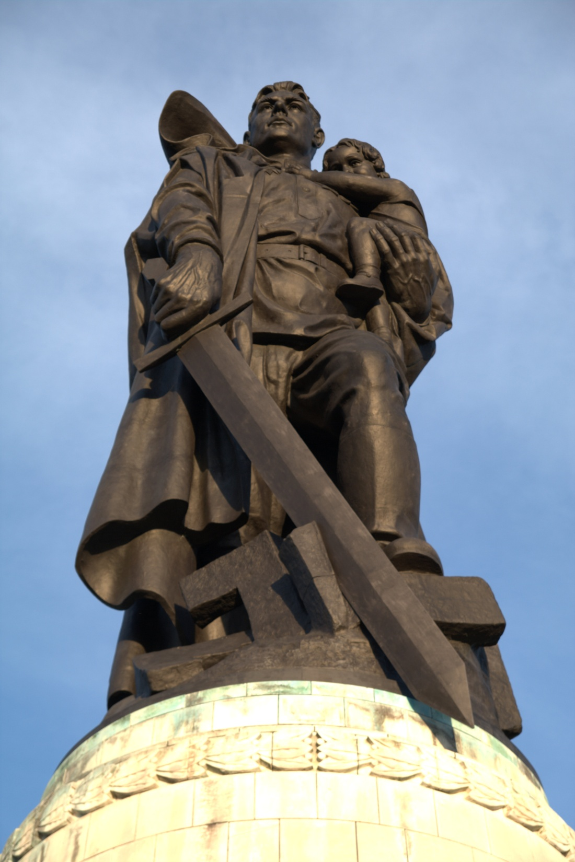
Soviet War Memorial
is a vast war memorial and military cemetery in Berlin's
Treptower Park.
a monument by Soviet sculptor Yevgeny Vuchetich:
a 12-m tall statue of a Soviet soldier with a sword holding a German child,
standing over a broken swastika.
8 May, 1949

Slide 29
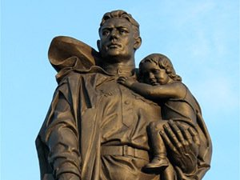
The Vuchetich statue commemorates the deeds of Sergeant of Guards Nikolai Masalov, who during the final storm on the center of Berlin risked his life under heavy German machine-gun fire to rescue a three-year-old German girl.

Slide 30
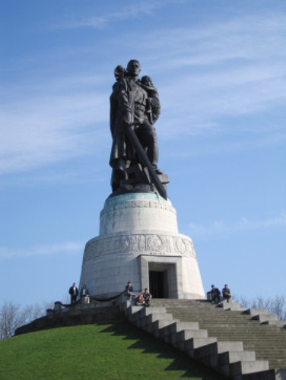
И в Берлине, в праздничную дату,
Был воздвигнут, чтоб стоять века,
Памятник Советскому солдату
С девочкой спасенной на руках.
Он стоит, как символ нашей славы,
Как маяк, светящийся во мгле.
Это он, солдат моей державы,
Охраняет мир на всей земле.

Slide 31
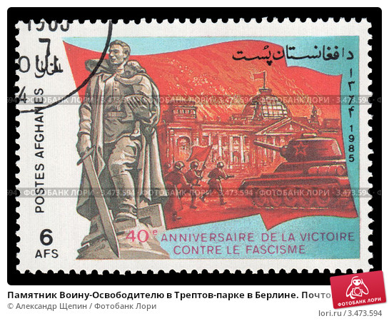

Slide 32
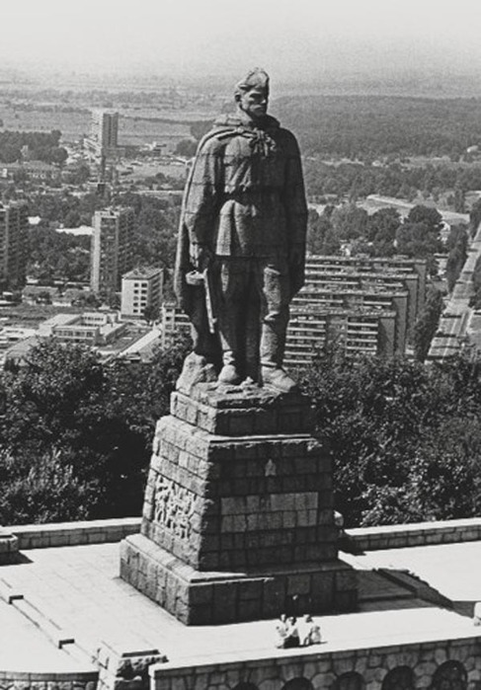
Alyosha
statue of a Soviet soldier on Bunarjik Hill in Plovdiv, Bulgaria.

Slide 33
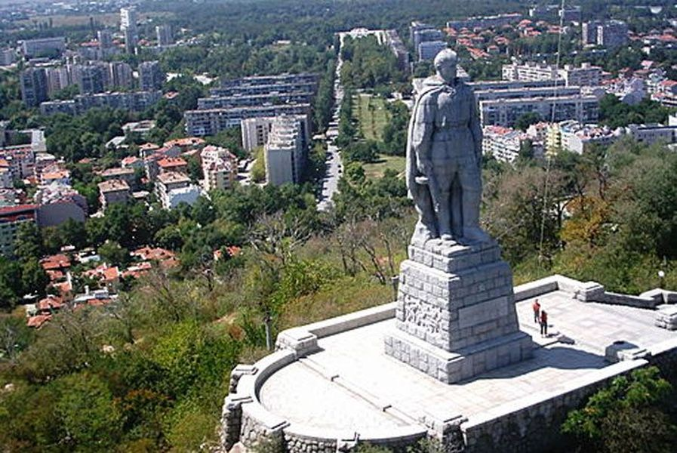
It was installed in 1954-57

Slide 34
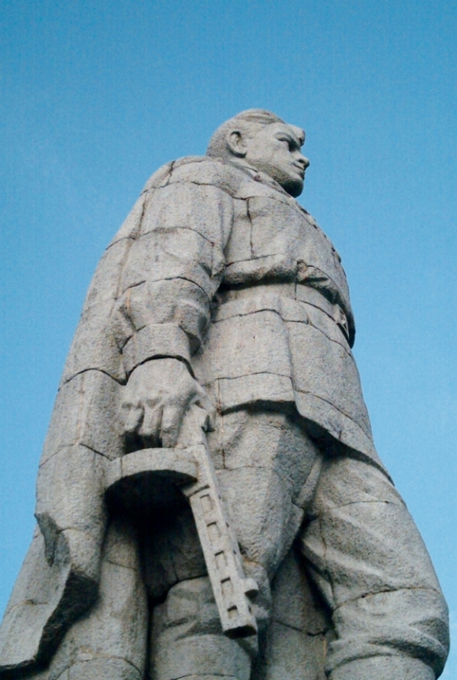
11-metre tall tatue of a Soviet soldier The statue tops a 6-metre pedestal lined with granite.
Alyosha Skurlatov, a soldier of the 3rd Ukrainian Front who served as the model for this statue, died in 2013 at the age of 91

Slide 36
Apple trees and pear trees were a flower,
River mist was rising all around.
Young Katusha went strolling by the hour
On the steep banks,
O'er the rocky ground.
*o’er = over

