Slide 1
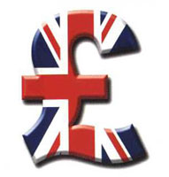
WHAT DO YOU KNOW ABOUT POLITICAL SYSTEM
OF THE UK?
Notes:
WHAT DO YOU KNOW ABOUT POLITICAL SYSTEM OF THE UK?

Slide 2
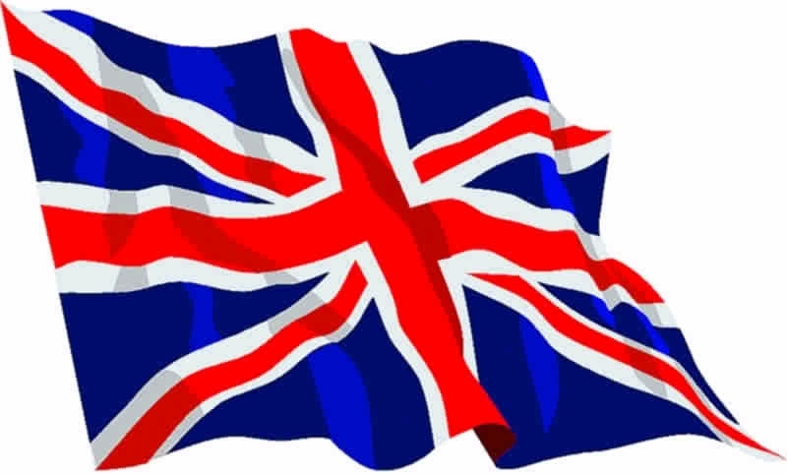

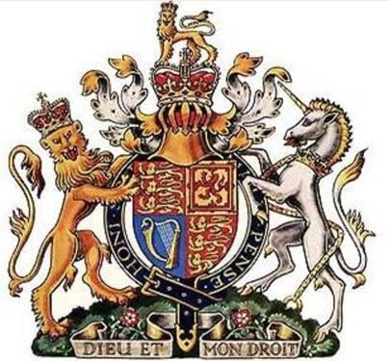
The National Anthem
of the UK
The Flag
People all over the world know the first line of the national anthem of Great Britain which is called"God Save the Queen". It was adopted after the War with Napoleon.
The State Emblem
God save our gracious Queen
Long Hue our noble Queen
God save the Queen!
Send her victorious
Happy and glorious
Long to reign over us
God save the Queen!

Slide 3
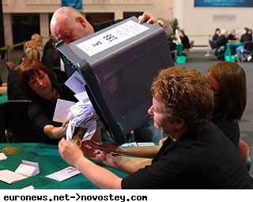
The United Kingdom Is a Parliamentary Democracy:
government is voted into power by the people, to act in the interests of the people. Every adult has the right to vote - known as 'universal suffrage'.

Slide 4
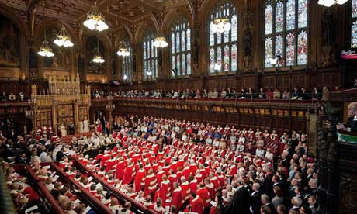
Alongside this system, the UK is also
a constitutional monarchy .
This is a situation where there is an established monarch (currently Queen Elizabeth II ), who remains politically impartial and with limited powers.

Slide 5
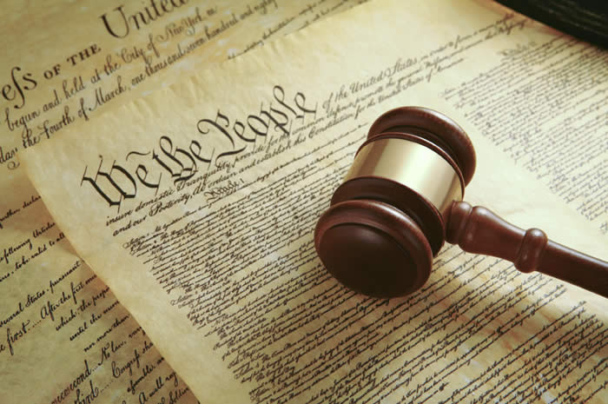
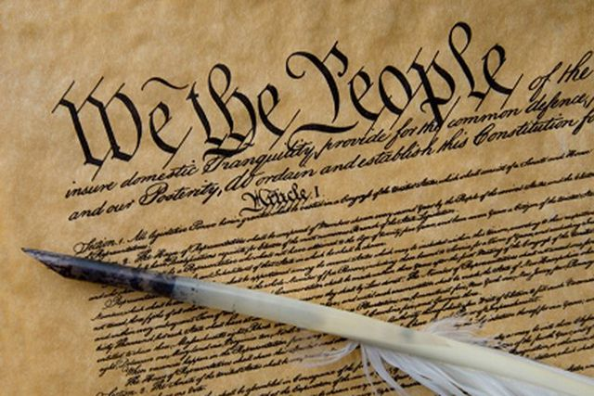
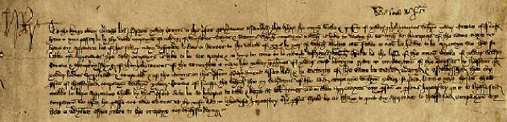
is the set of laws and principles under which the United Kingdom is governed.
The Constitution
of the United Kingdom
Unlike many other nations, the UK has no single constitutional document. This is sometimes expressed by stating that it has an uncodified or "unwritten" constitution.

Slide 6
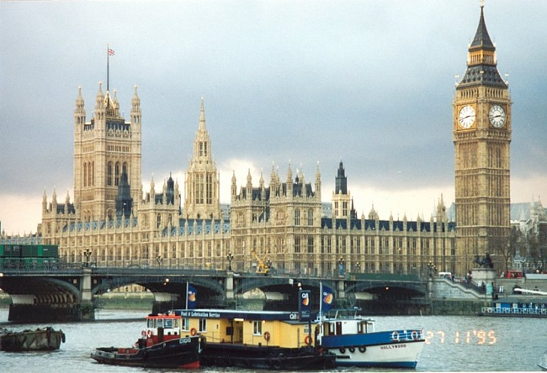
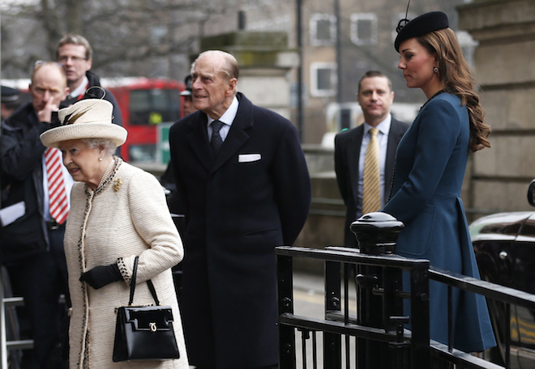
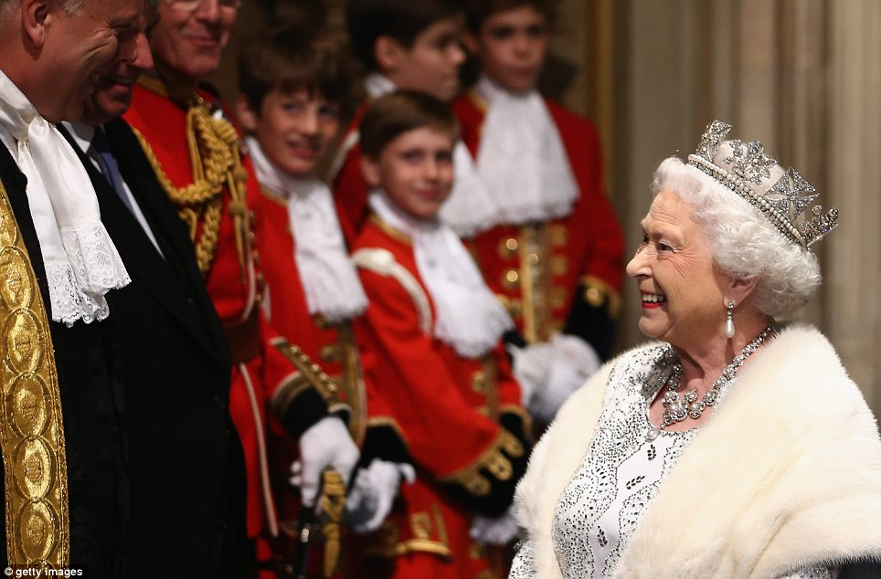
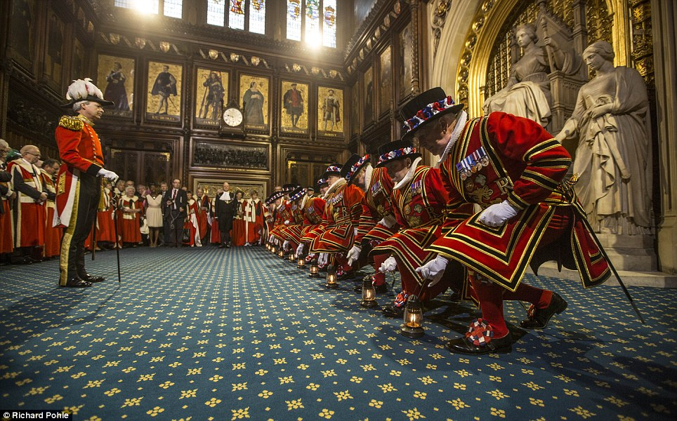
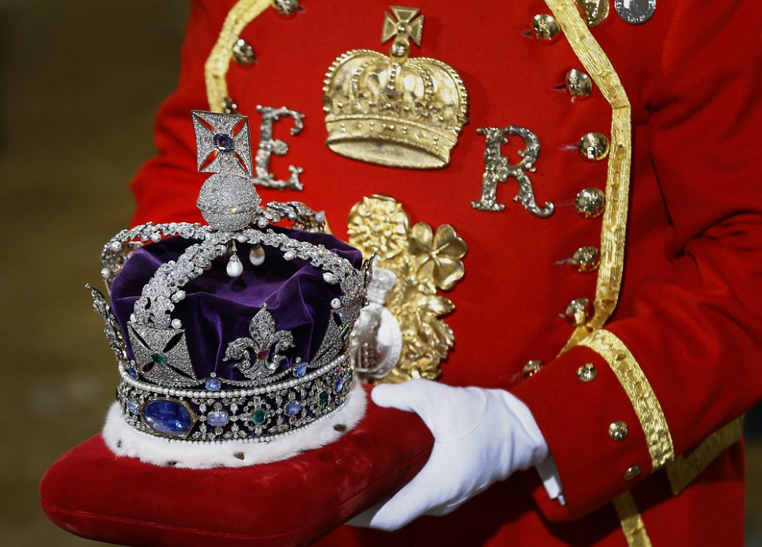
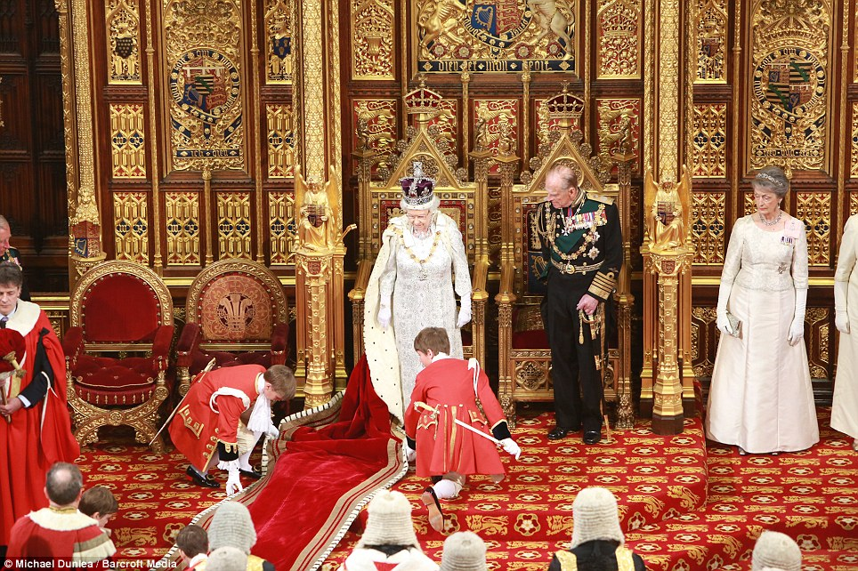
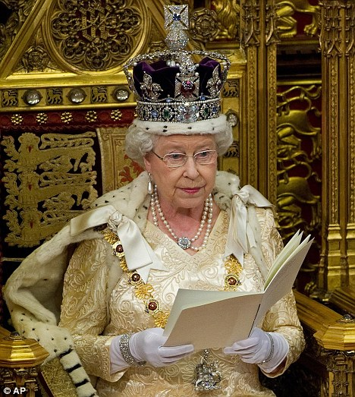
WHAT ARE THE DUTIES
OF THE QUEEN?
It is often said that the Queen is politically neutral and her role is largely ceremonial. However, the Queen is still involved in many important acts of government. The Queen calls and dissolves Parliament. She normally opens the new session of Parliament with a speech from the throne and outlines her Government's programme. Before a bill becomes law the Queen must give it her Royal Assent, which is announced to both Houses of Parliament.

Slide 7
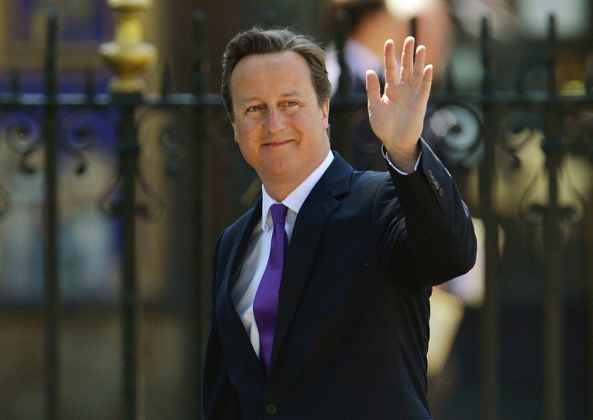
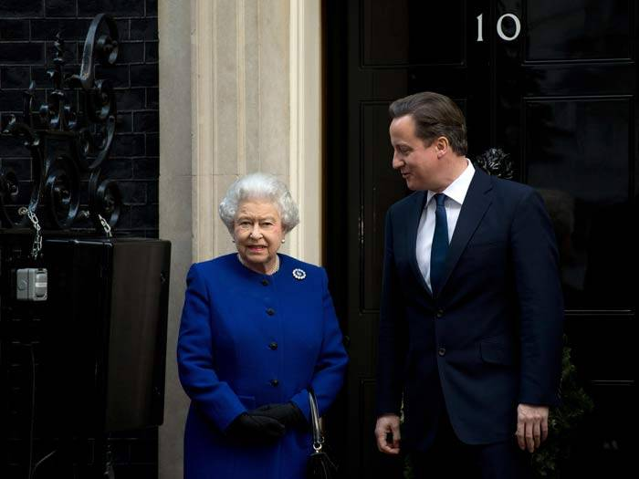
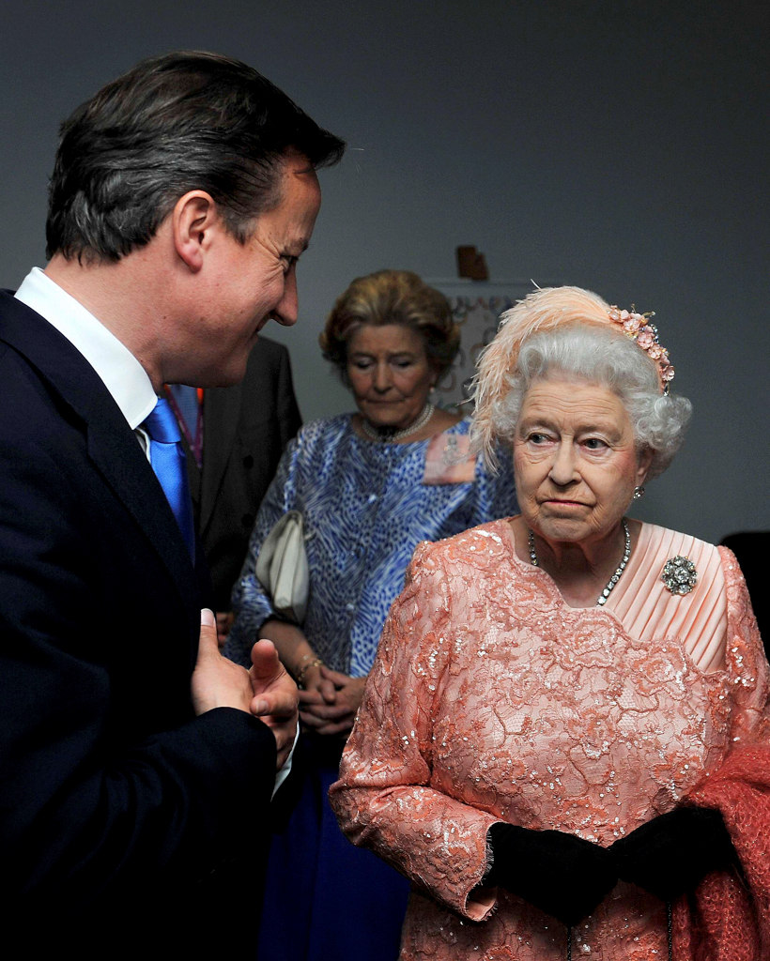
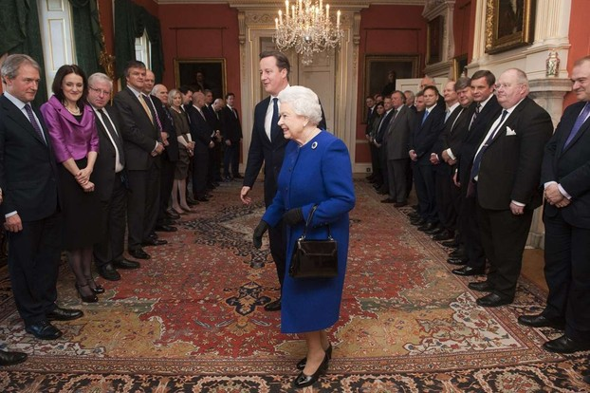
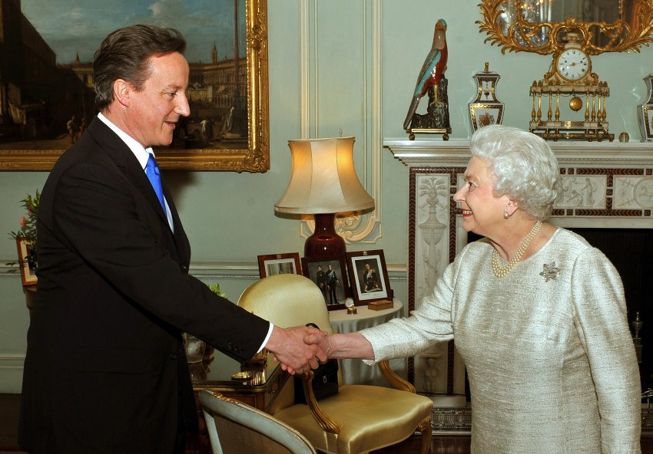
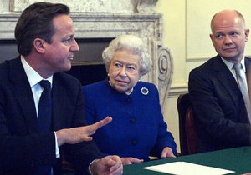
The Queen
makes appointments to many important state offices, on the advice of the Prime Minister or the relevant Cabinet Minister. She has the power to conclude treaties, to declare war and to make peace, to recognize foreign states and governments and to annex territory.

Slide 8
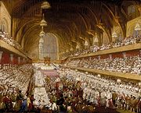
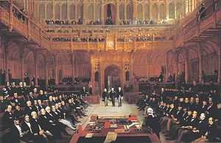
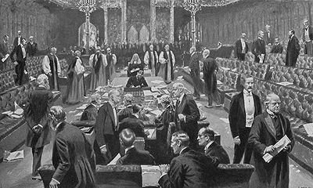
THE PARLAMENT
The Parliament is the supreme legislative body and the highest authority in the UK. It consists of the House of Commons and the House of Lords. British parliamentary system is one of the oldest in the world, it developed slowly during the 13th century after King John´s signature of
Magna Carta in 1215.

Slide 9
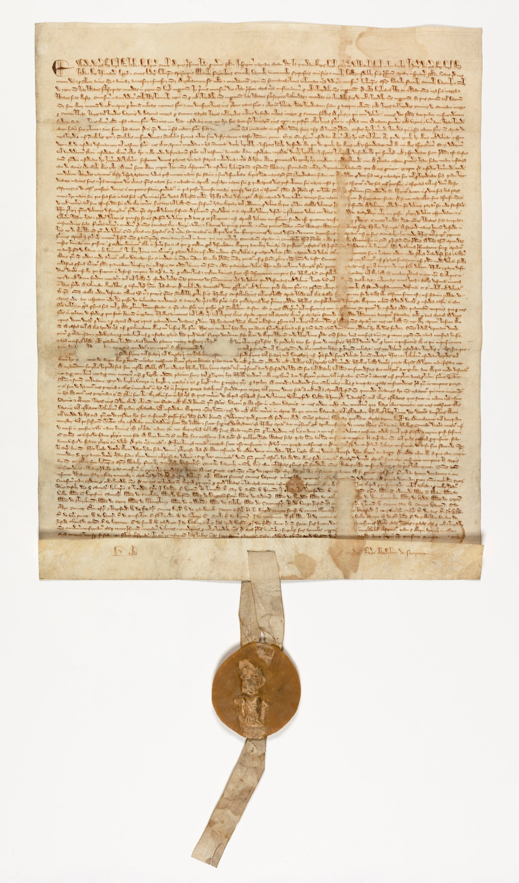
Magna Carta
(Latin for Great Charter), also called Magna Carta Libertatum or The Great Charter of the Liberties of England, is an Angevincharter originally issued in Latin in the year 1215.
Magna Carta was the first document forced onto a King of England by a group of his subjects, the feudal barons, in an attempt to limit his powers by law and protect their rights.

Slide 10
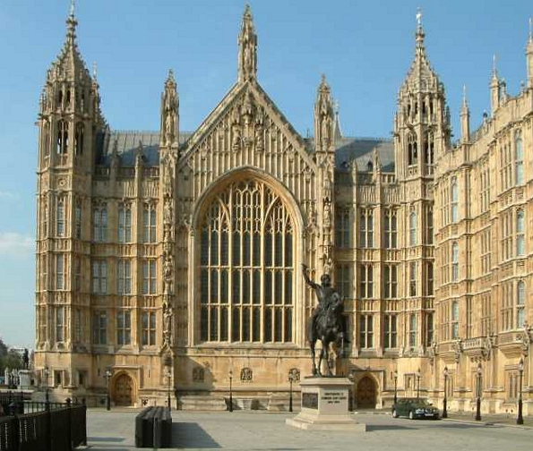
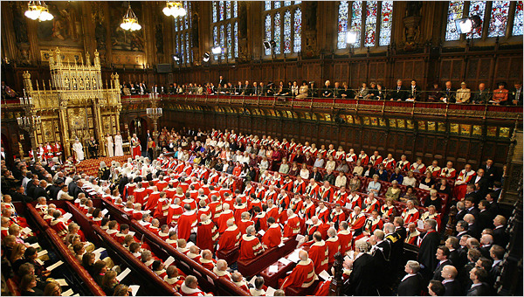
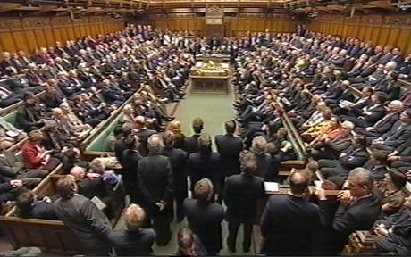
The two Houses of Parliament share the same building, the Palace of Westminster on the left bank of the Thames
The House of Lords is made up of hereditary and life peers and peeresses, two archbishops and 24 bishops of the Church of England. Its main function is law-making.
The House of Commons consists of 650 paid members (MPs) who are elected at a General Election, which must be held every five years. Voting is not compulsory and is from the age of 18.

Slide 11
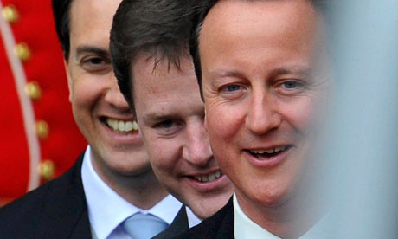
UK MAJOR POLITICAL PARTIES
Britain has a multi-party system — a system in which two or more political parties can gain control of government separately or in coalition. The oldest and most important parties of the UK are the Conservative Party, the Labour Party and the Liberal Democrats.
Labour leader Ed Miliband; deputy prime minister and Lib Dem leader, Nick Clegg, and Conservative prime minister, David Cameron.

Slide 12

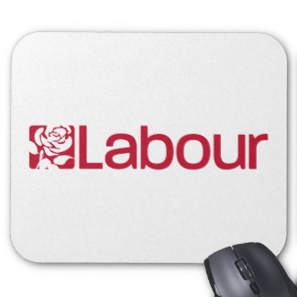
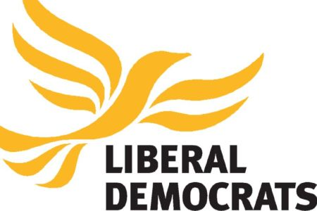
The name Conservative was first used in 1830 — 'conservative' because the Party aims to conserve traditional values and practices.
The original title of the Labour Party, the Labour Representation Committee, makes the origins of the party clear — to promote the interests of the industrial working class.
The Liberal Party emerged in the mid-nineteenth century as a suc­cessor to the historic Whig party. 'Whig' was originally a Scottish Gaelic term for horse thieves.

Slide 13
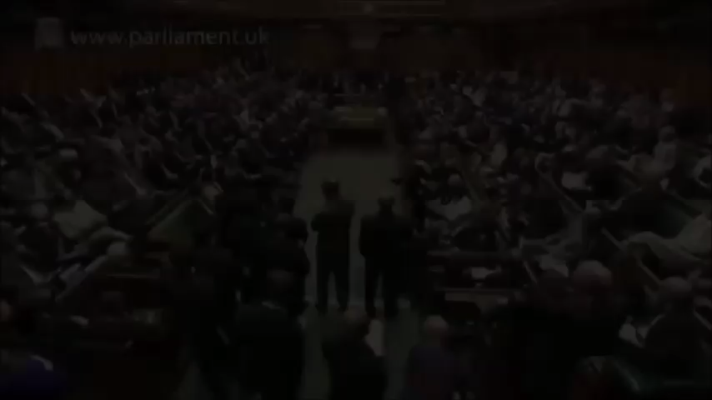
One of the important parliamentary tasks is answering the questions. From Monday to Thursday all ministers must answer MPs´questions for one hour (questioning time). Two days a week the Prime Minister must answer MPs´questions.
Questioning time

Slide 14
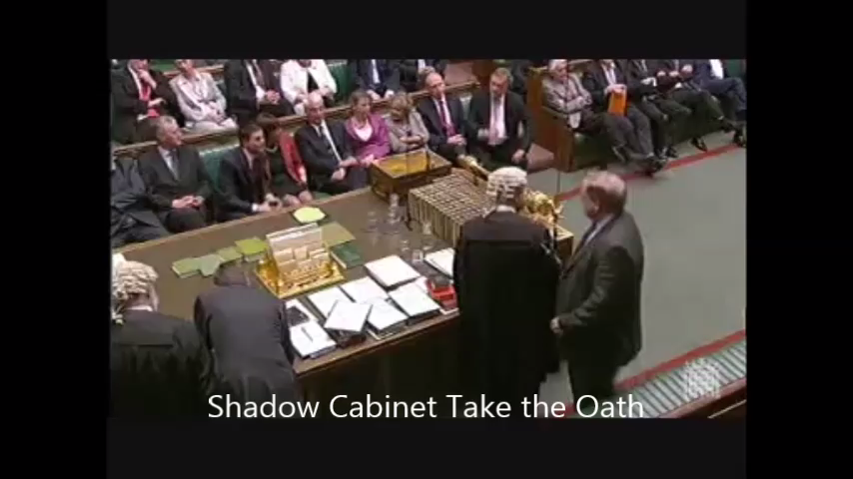
FORMING A GOVERNMENT
The Government is formed by the party which has the majority in Parliament and the Queen appoints its leader as the Prime Minister.
The Cabinet is the executive organ of government. It´s made up by the leading ministers and heads of government departments (about 20 people).
The second largest party forms the official Opposition with its own leader and „shadow cabinet“.
The usual wording of the oath is: "I... swear by Almighty God that I will be faithful and bear true allegiance to Her Majesty Queen Elizabeth, her heirs and successors, according to law. So help me God."

