Slide 1
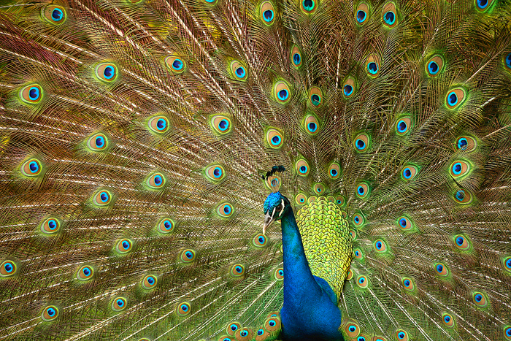
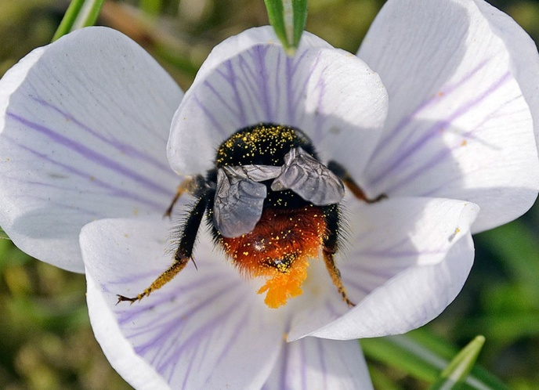
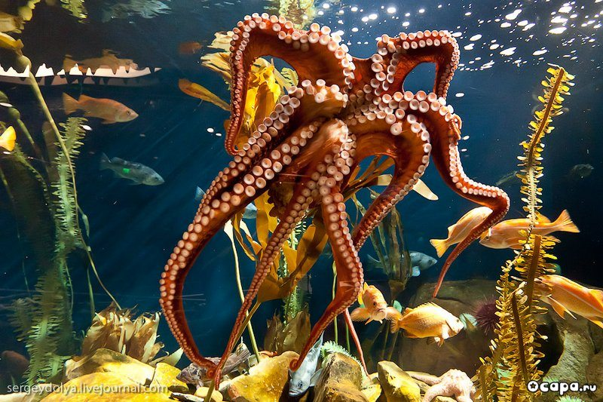
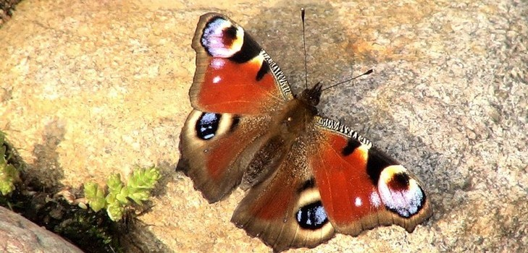
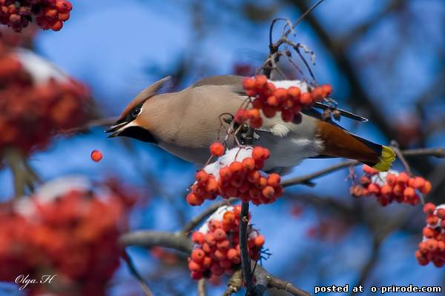
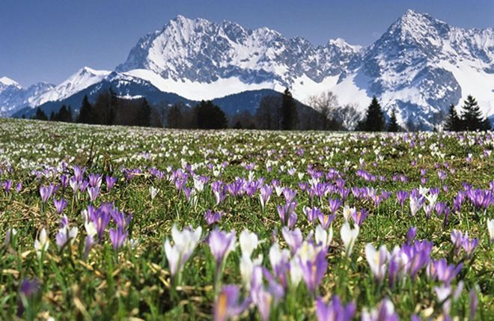
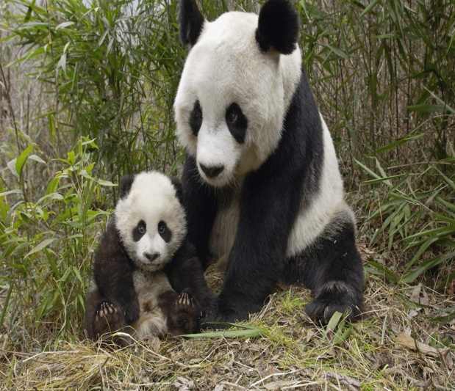
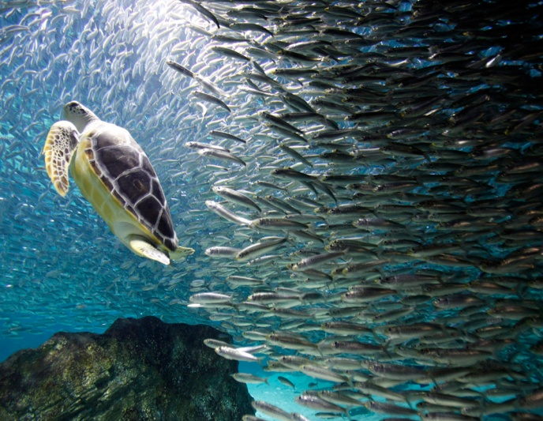
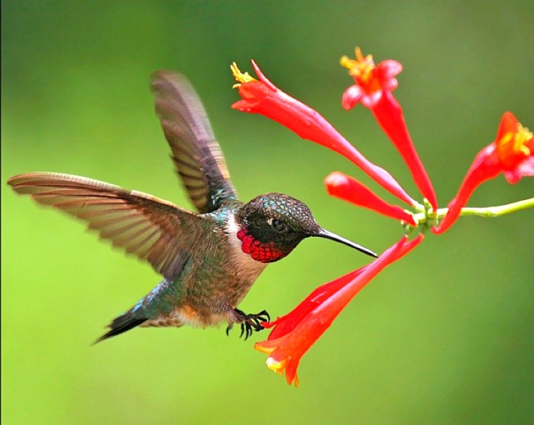

Slide 2
Read and find an odd word:
a) a butterfly, an elephant, a caterpillar, a spider, a ladybird
b) an emu, a parrot, a swallow, a nightingale, a shamrock
c) an elk, a squirrel, a dragonfly, a hedgehog, a fox
d) a robin, a pine, an oak, a birch, a daffodil

Slide 3
a) a butterfly, a caterpillar, a spider, a ladybird
b) an emu, a parrot, a swallow, a nightingale
c) an elk, a squirrel, a hedgehog, a fox
d) a pine, an oak, a birch, a daffodil
Insects, birds, animals, plants are …
LIVING THINGS

Slide 4
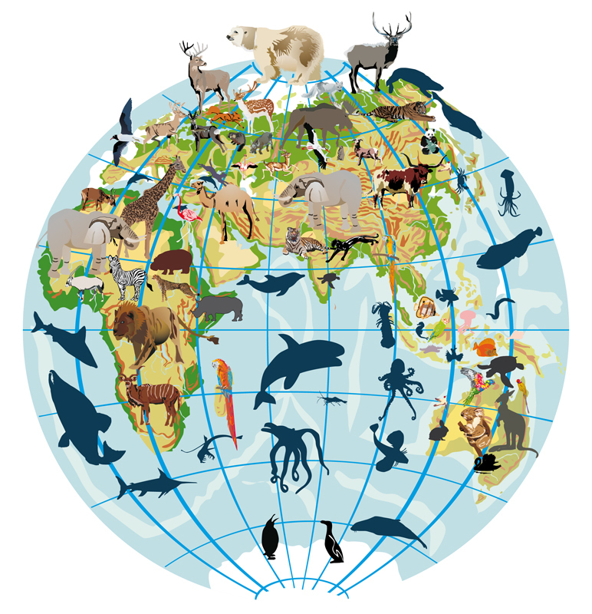
Theme:
Living Things around Us

Slide 5
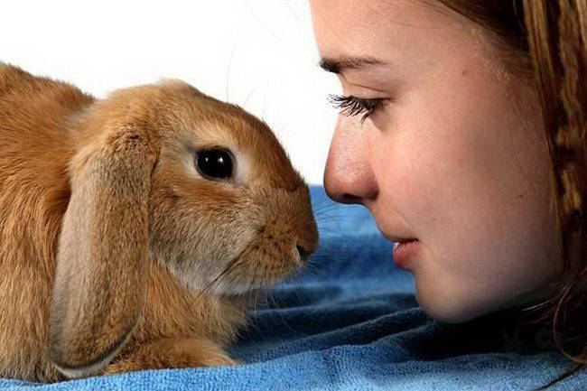
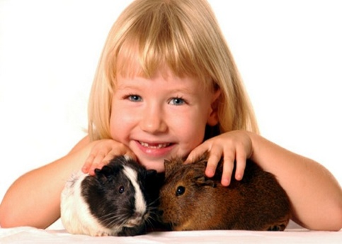
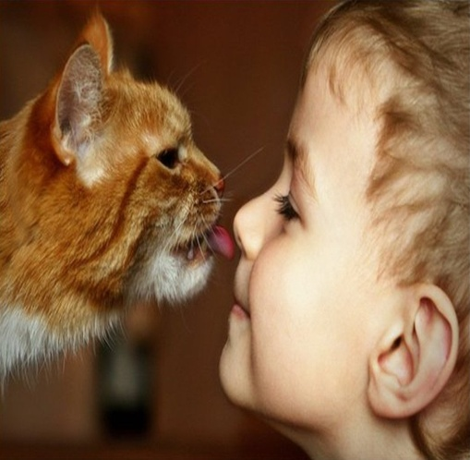
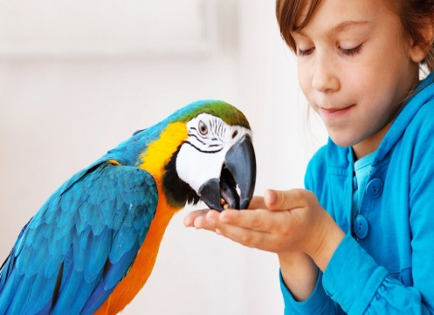
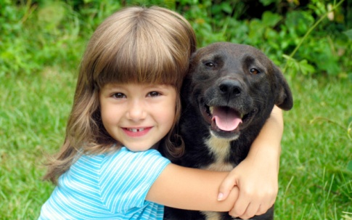
Answer the questions:
Why does the poet want to buy the animals?
Do you think animals in a pet shop often look lonely?
Why do people buy animals and keep them?
What do you think about keeping animals?
What animals should not become pets?

Slide 6
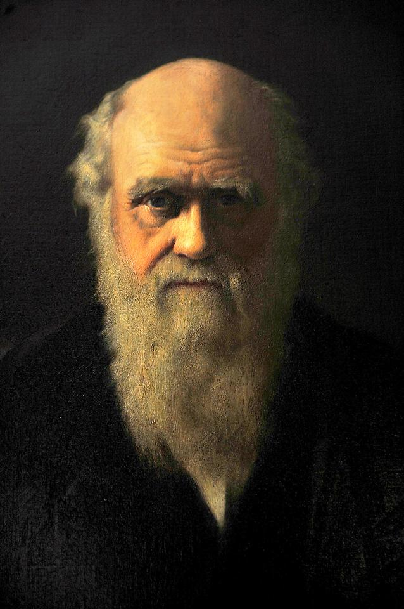
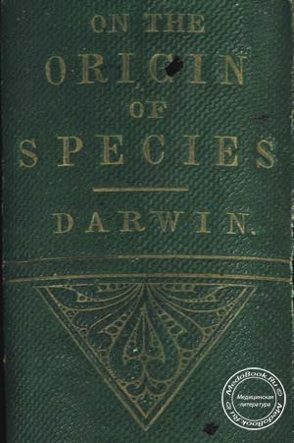

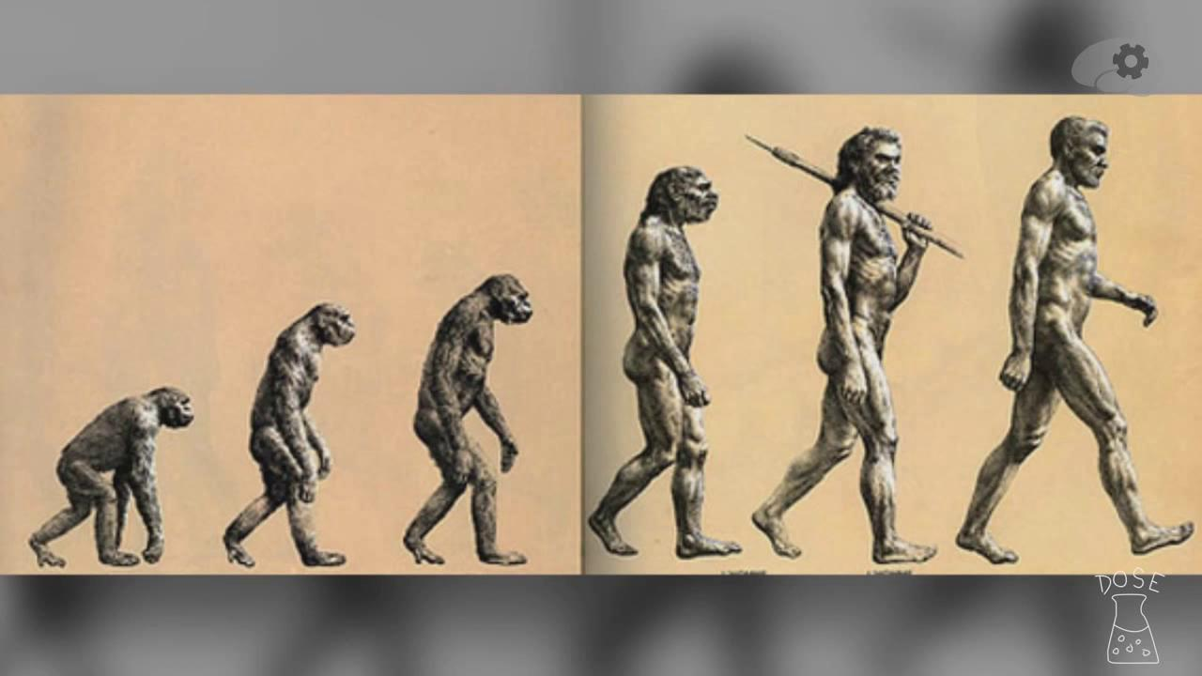
Charles Darwin (1809 – 1882)
Theory of Evolution

Slide 7
Choose the right variants to complete the sentences.
Charles Darwin was born … .
in the seventeenth century
in the eighteenth century
in the nineteenth century
2) Charles Darwin was born in … .
Great Britain b) the USA c) Australia
3) Some of Darwin’s relatives were interested in … .
painting b) living things c) writing stories
4) At the beginning of the 19th century he … .
made a voyage
had a train journey about South America
lived for some time on the Pacific Islands
Charles Darwin’s body lies … .
in one of the English cathedrals
on some Pacific island
on the Pacific coast of South America

Slide 8

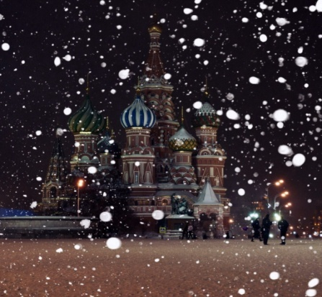
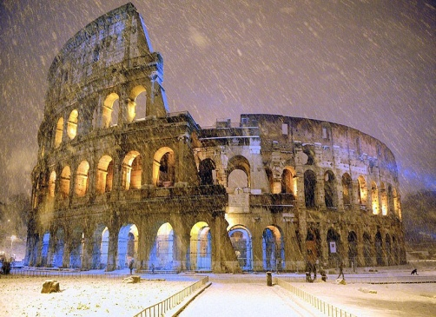
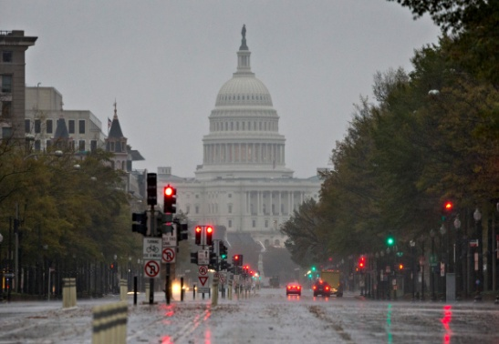
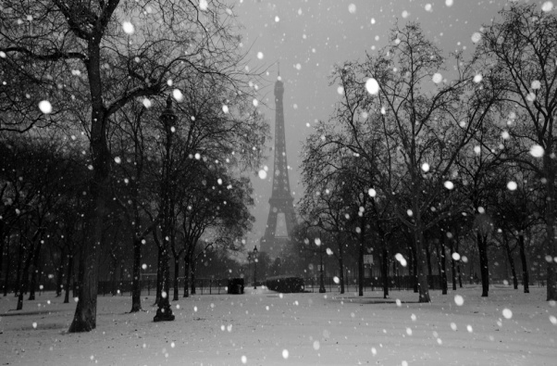
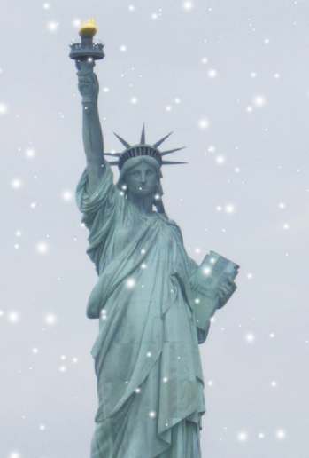
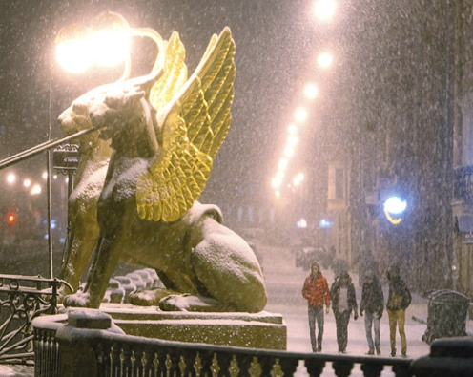
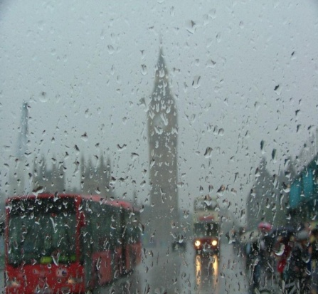
It is 9 p.m. now. Say how long it has been raining or snowing in these cities.
2) since 11 a.m.
Example:
It has been snowing in New York since 8 p.m.
It has been snowing in New York for an hour.
1) since 9 a.m.
3) since 3 p.m.
4) since 1 p.m.
since 8 p.m.
5) since 6 p.m.
6) since noon

Slide 9
Read the dialogues, then make your own dialogues with the words on the right.
- Your dog is so clever. Have you taught it this year?
- Oh, no. I’ve been training it for years.
2) - Your roses are so beautiful. Have you planted them this year?
- Oh, no. I’ve been growing them for years.
3) - You have a wonderful stamps collection of butterflies. When did you start it?
- I’ve been collecting them for years.
cat
parrot
guinea-pig
tulips
lilies
bluebells
dragonflies
budgies
monkeys

Slide 10
Phrasal verbs
make
Off
быстро уйти, убежать, сбежать
up (2)
гримировать, накладывать косметику
Out
разобраться, понять
(с трудом)
up (1)
сочинять, придумывать

Slide 11

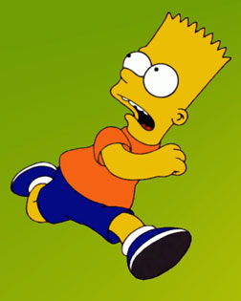

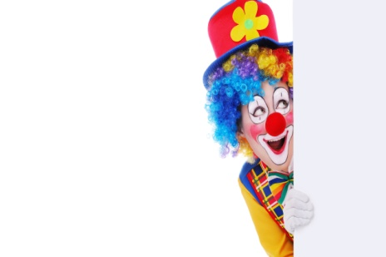
Complete the sentences with up, off, out.
1)She is a very unusual girl. I can’t make
her … .
2)The boy gave the letter to Sherlock Holmes and made … .
3)I think young girls should not make … their lovely faces.
4)The children made … a little poem and wrote it in the card.
5) Don’t make …: I’ve got something to tell you.
6) They stood far from me and I couldn’t make … what they were saying.
7) My sister takes a long time to make … in the morning.
8) I don’t believe you. I think you’ve made it all … .
make out
разобраться,
понять с трудом
make off
убежать, сбежать
make up
сочинять,
придумывать
make up
гримировать,
накладывать косметику

Slide 12

Word Building
Noun + able = adjective | Verb + able = adjective
comfort + able = comfortable fashion + able = fashionable reason + able = reasonable | understand + able = understandable enjoy + able = enjoyable break + able = breakable read + able = readable move + able = movable eat + able = eatable

Slide 13
Build the adjectives with –able and complete the sentences
You can wear this watch playing volleyball. This watch is not … . I can’t read this text. I don’t think it is … . It has been in the water too long. Yesterday we went to the circus. It was such an … visit. Wooden chairs are not always … . This is a … radio station. | break read enjoy comfort move

Slide 14
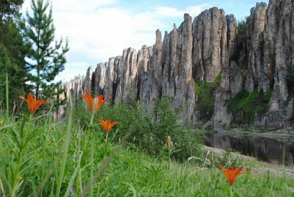
It’s time to relax
..\клип В МИРЕ ЖИВОТНЫХ.mp4

Slide 15
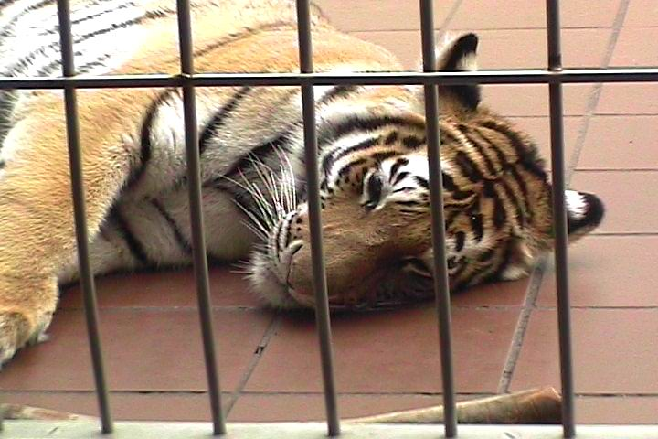
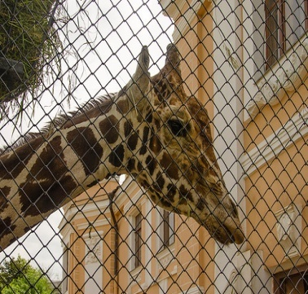
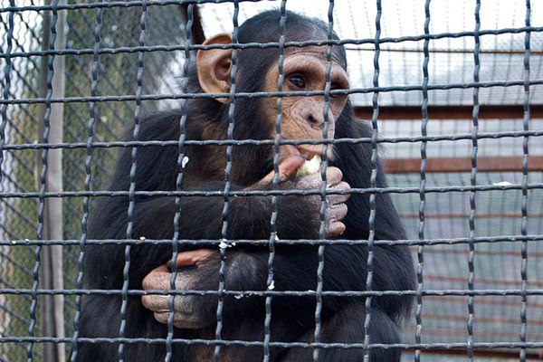
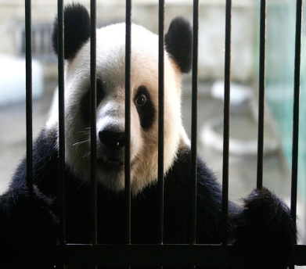
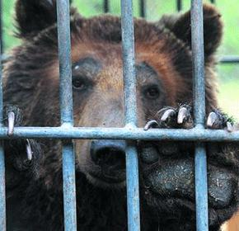
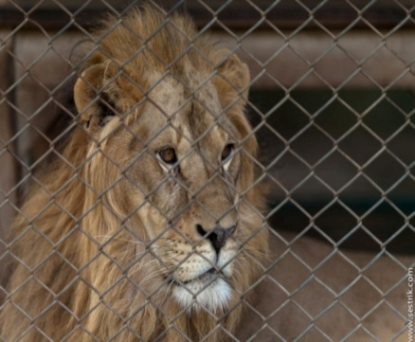
Is keeping animals in the zoo a good idea? Read the lists of pros and cons. What is your answer to the question?
Pros | Cons
Zoos help scientists and common people to learn more about animals. Zoos show us how rich the animal world is. Animals feel fairly comfortable in modern zoos. To visit a zoo is enjoyable, especially for children. | They often keep animals in cages, and it is very unkind. There are a lot of old zoos, which are small and dirty. Visitors may kill zoo animals when they feed them. Zoo animals may be dangerous for visitors.

Slide 16
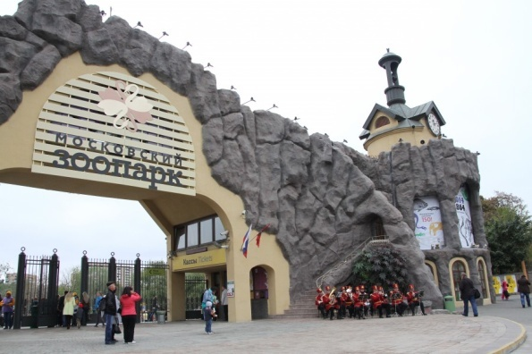
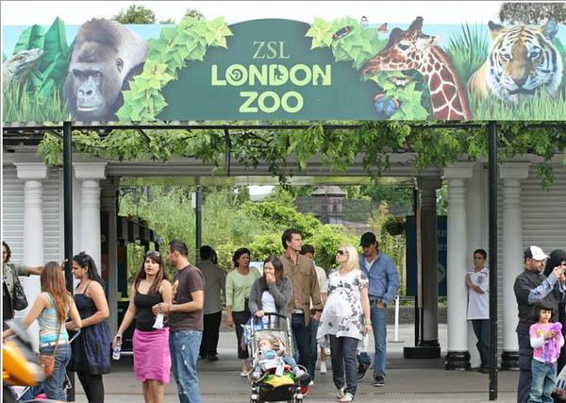

Describe a zoo you have once visited or an ideal zoo.
Use these words and expressions:
to save, endangered (rare, exotic animals), to take part in fun activities, to see performances, to visit exhibitions, to feed, to move the zoo to the country, to take away the cages, to put your hands into the cages, to touch animals, to tease (дразнить), to throw litter, to be noted down (быть занесенным) in The Red Book, to be closer to …

Slide 17

Workbook: p. 95 Ex 18

