Slide 1
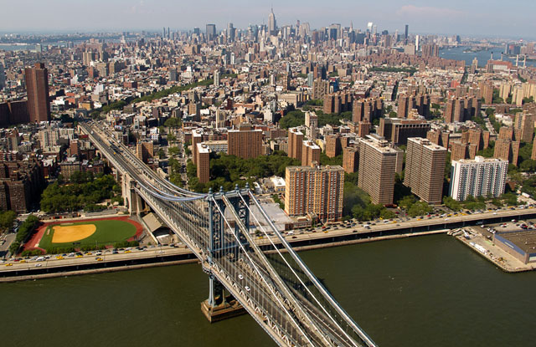
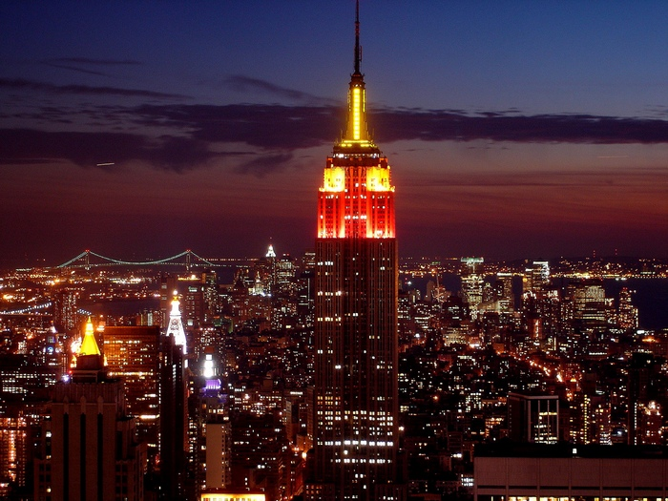
Welcome to New York

Slide 2
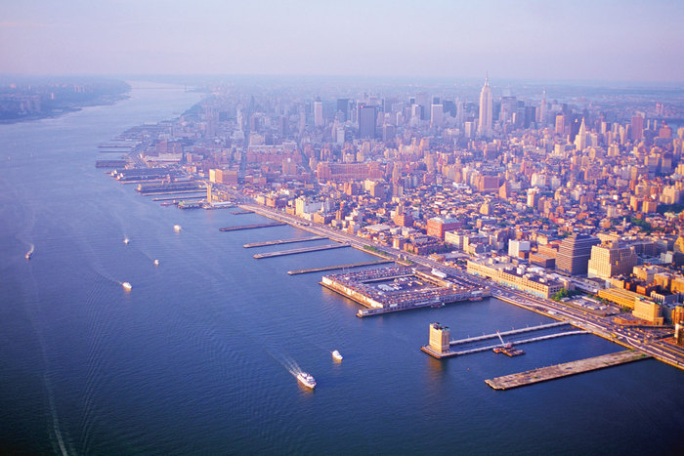
New York is on the Hudson River. It is the largest city in the USA

Slide 3
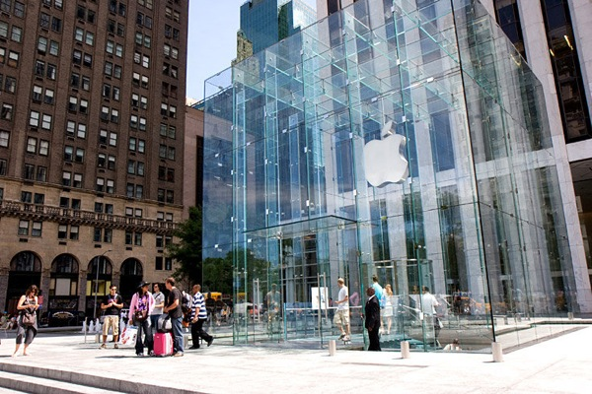
Another name for New York is Big Apple

Slide 4
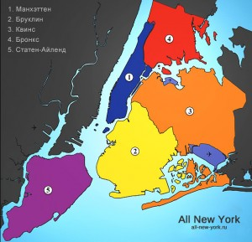
New York consists of five boroughs: Manhattan, Brooklyn, Queens, Staten Island and the Bronx

Slide 5
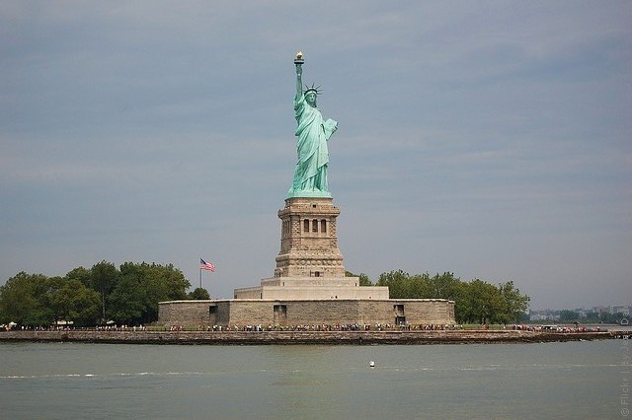
One of the most famous symbols of America is the Statue of Liberty

Slide 6
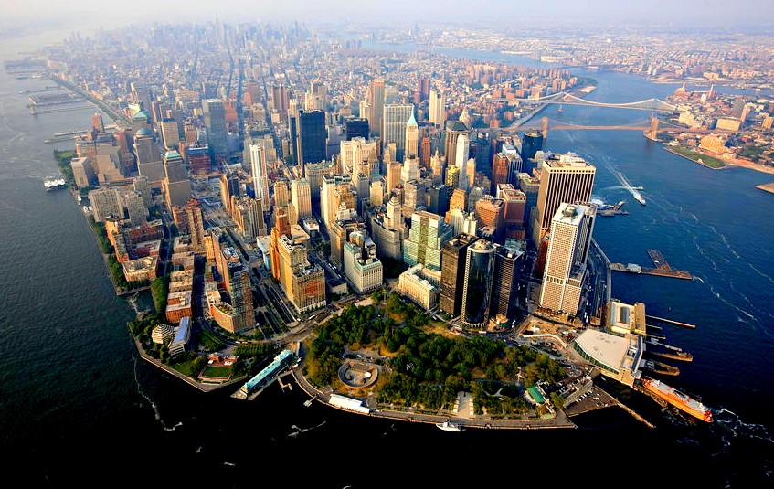
The heart of New York is Manhattan
It has a lot of sights

Slide 7
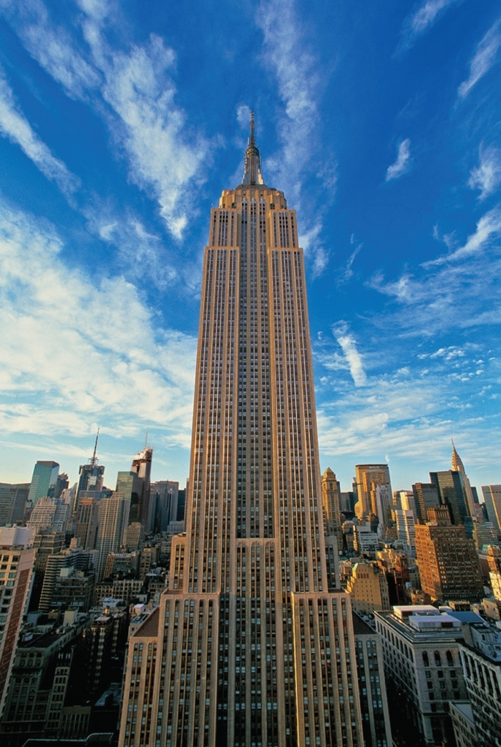
One of them is the Empire State Building. It is the tallest skyscraper
but only since September 11, 2001

Slide 8
One of New York’s most famous museums is the Guggenheim Museum. It’s famous for its building, which was designed by a famous architect, Frank Lloyd Wright

Slide 9
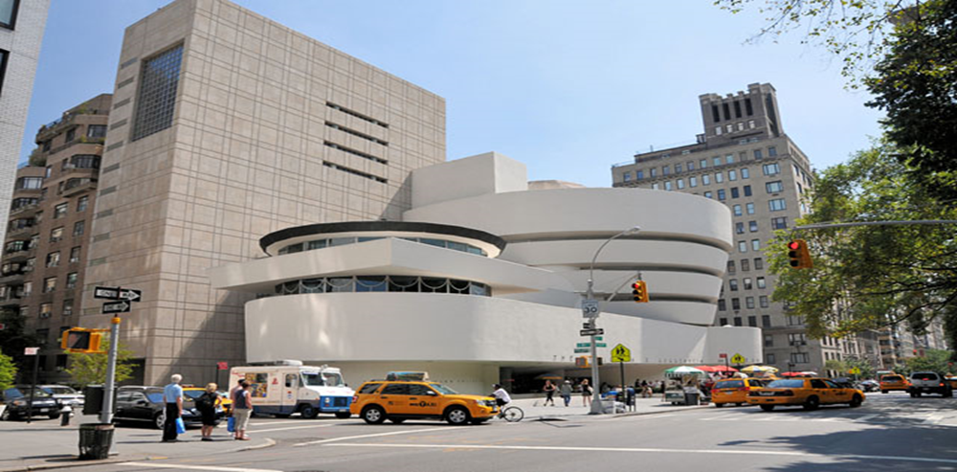

Slide 10
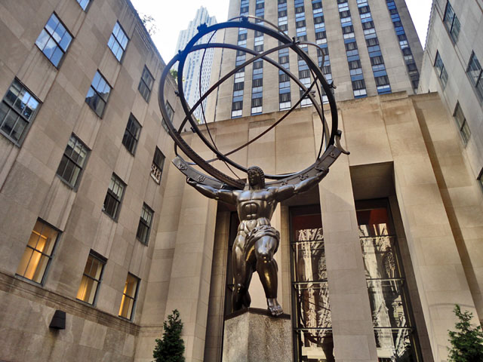
The Rockefeller Center is another famous sight. Its buildings and gardens make up this “city within a city”

Slide 11
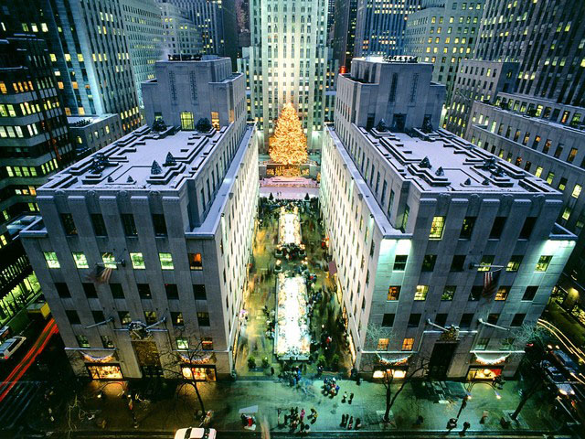

Slide 12
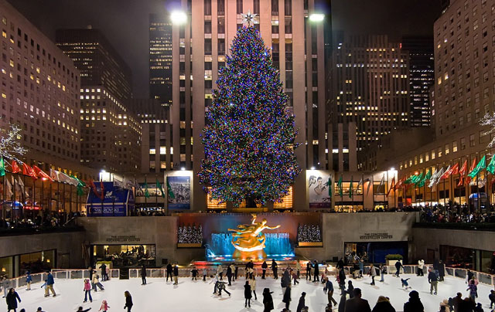
The Rockefeller Center Christmas trees are the largest and the most beautiful in New York

Slide 13
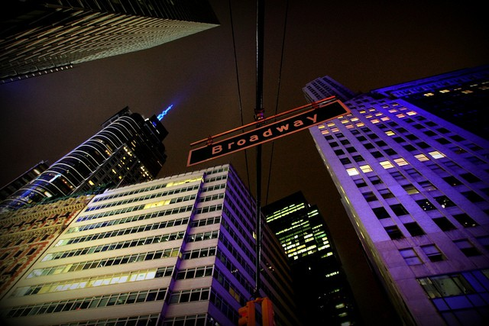
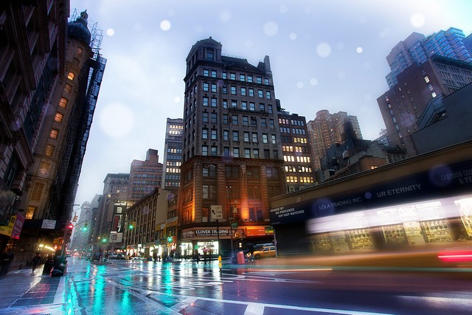
Those who are interested in theater will be able to enjoy different musicals and shows on Broadway.

Slide 14
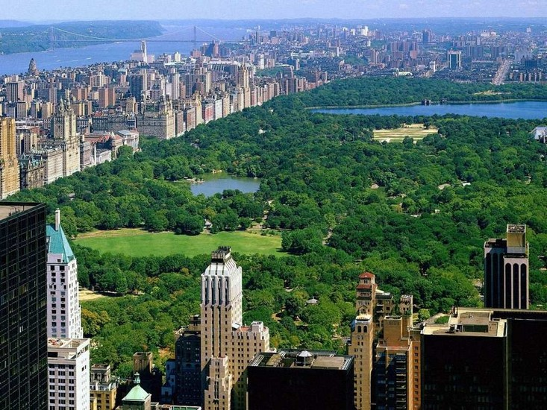
In Central Park you can have a rest and spend a lazy day. It’s so huge that one can get lost there

Slide 15
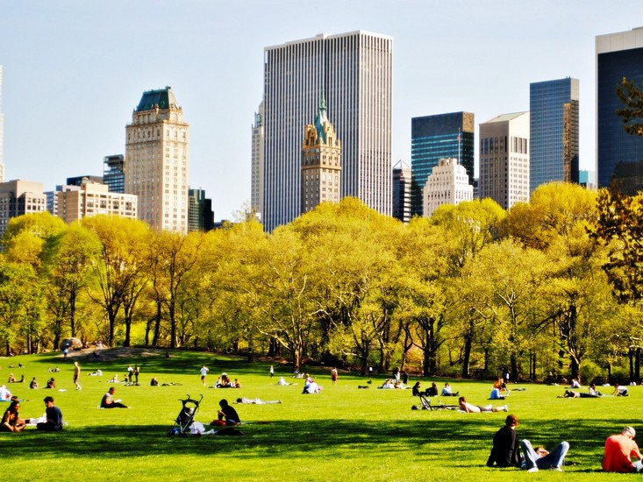

Slide 16
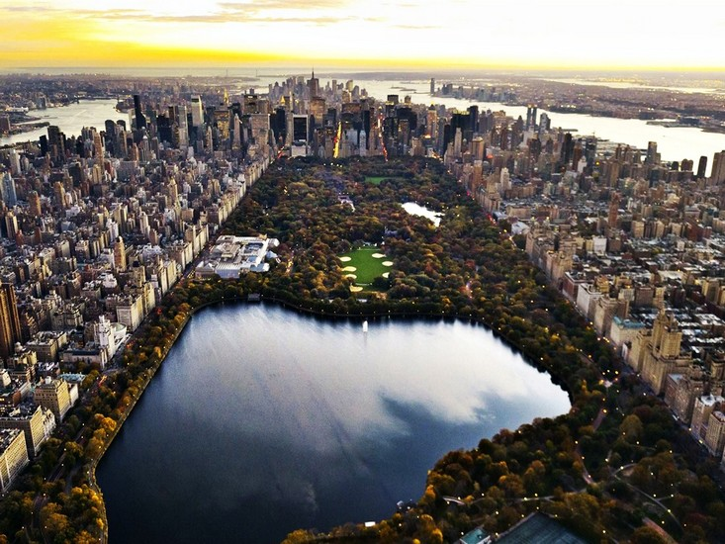
Thank you for attention!

