Slide 1

New Year and Christmas Quiz
Новогодний квиз на английском языке
Автор : Соколова Елена Викторовна
Учитель ГБОУ Школа №1415 «Останкино»
Г Москва
2025г

Slide 2
Tour1
1. What is the traditional Christmas food in Britain now?
a. roast pig’s head, apples, Xmas pudding
b. roast turkey, green vegetables and potatoes , Xmas pudding
c. roast beef, Xmas pudding, apples
roast turkey, green vegetables and potatoes , Xmas pudding
2 Where does the tradition to decorate the Xmas tree come from?
a. Germany b. Russia e. England
Germany

Slide 3
3.Which country traditionally sends a Xmas tree to Londoners?
a. Denmark b. France c. Norway
Norway
4. Where do Londoners put it?
a. At Trafalgar Square b. Picadilly Circus c. The Tower of London
At Trafalgar Square

Slide 4

Music Break

Slide 5


Dashing through the …..
In a one-horse open…..,
Over the fields we go,
………..all the way;
The bells on bob-tail…..,
They make our spirits bright,
What fun it is to ride and ……
A sleighing song tonight, O
Jingle bells, jingle bells,
Jingle all the way!
O what fun it is to ride
In a one-horse open sleigh
Jingle bells, jingle bells,
Jingle all the way!

Slide 6
Dashing through the snow
In a one-horse open sleigh ,
Over the fields we go,
Laughing all the way;
The bells on bob-tail ring,
They make our spirits bright,
What fun it is to ride and sing
A sleighing song tonight, O
Jingle bells, jingle bells,
Jingle all the way!
O what fun it is to ride
In a one-horse open sleigh
Jingle bells, jingle bells,
Jingle all the way!

Slide 7
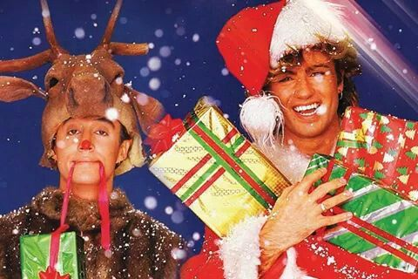
Last christmas
Last Christmas, I gave you my
_____
But the very next day, you gave it away
This year, to save me from __________
I’ll give it to someone_________

Slide 8
Last Christmas
Last Christmas, I gave you my heart
But the very next day, you gave it away
This year, to save me from tears
I’ll give it to someonespecial

Slide 9
tour2
Match two parts.
As mad as
As merry as
As old as
As pale as
As quiet as
As snug as
The hills
A March hare
A mouse
A cricket
A bug in a rug
A ghost

Slide 10
Tour2 .
Finish the phrases.
Answers:
Home is best.
So the buns.
The cat.
Castle.
Is a friend indeed
A friend in need …
East or west …
As the baker …
Curiosity killed …
My house is my …

Slide 11
Tour2
Match the phrases.
Answers:
Is a friend indeed.
Home is best.
So the buns.
The cat.
Castle.
A friend in need …
East or west …
As the baker …
Curiosity killed …
My house is my …

Slide 12
Music Break

Slide 13

Fill in the blanks.
We will, we will jingle
We will, we will jingle
We will, we will jingle
what you’re hearin are the jingles
j-j-j jingles , j-j-j jingles jingle__________
what you’re hearin are the jingles
j-j-j jingles , j-j-j jingles jingle _________
The sound of the season is the sound of bells,
__________carefully ,you can tell
Ev’ryone knows when they hear that sound
Time for the holiday to come ‘round
We will, we will jingle
We will, we will jingle
jingle
Bells
Listen

Slide 14
The interview.
1 Do you celebrate Xmas in your country?
2 Is Xmas a national holiday where you live?
3 How do you celebrate it?
4 Are school and businesses closed?
How long?
5 What do you usually eat at Xmas?
Who cooks it?

Slide 15
The interview.
The Interview
6 Do you give (or get ) presents?
What kind of presents do you buy?
What presents do you like to get?
7What is the weather like at Xmas in your country? Do you like it?
8 Do you write real Xmas cards or send e-cards? Why ?
Do you get any?

Slide 16
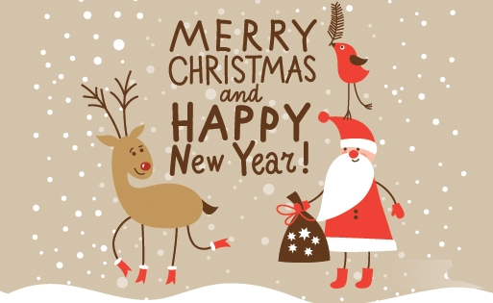

Slide 17
Merry Christmas and a Happy New year!

