Slide 1
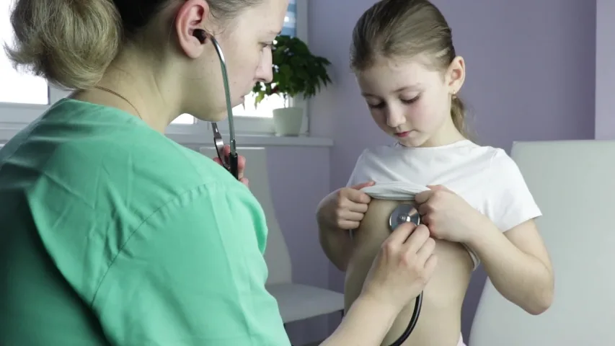
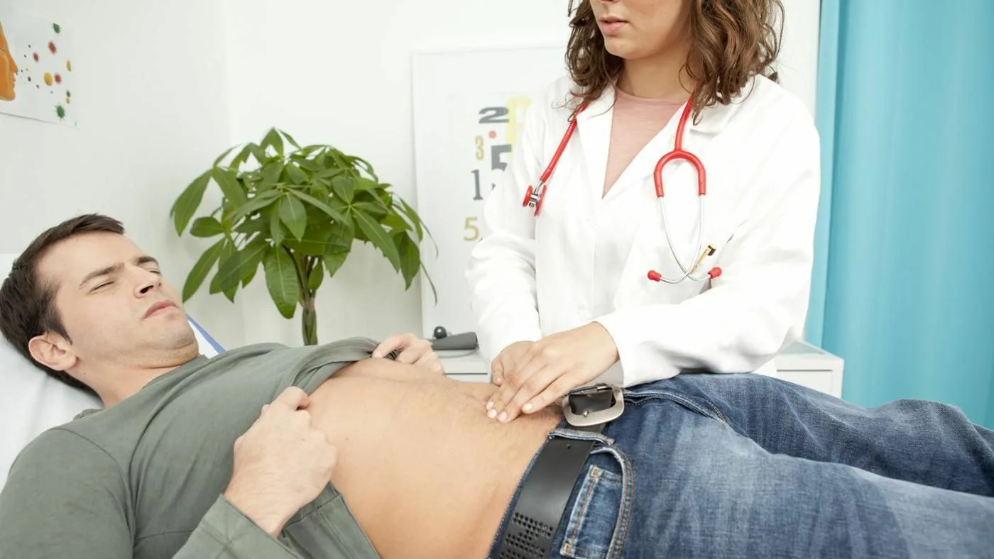
«Methods of physical examination»
Before the treatment of a disease it is necessary to make diagnosis, to determine the cause of the disease, and all symptoms by which it can be revealed.
Correct diagnosis must be based on a complete clinical examination of the patient. The usual methods of examination which doctors use in their practice, are: inquiry, inspection, auscultation, palpation, percussion, taking the temperature, feeling the pulse, taking the blood pressure, making X-ray examinations and various laboratory studies.
By questioning the patient the doctor learns about his complaints, the onset of the disease, his past history and his family history, hereditary diseases.
Inspection is the method by which doctor reveals the appearance of the patient, his build, nourishment, complexion, the state of his skin, mucous membranes, tongue, pupils, etc.
While auscultating the patient, the physician can determine the abnormal heart sounds, crepitations and rales in the lungs.
By palpation the doctor determines elasticity or rigidity of the abdomen, the outlines or the enlargement of the organ, swelling, edema and existence of growth.

Slide 2
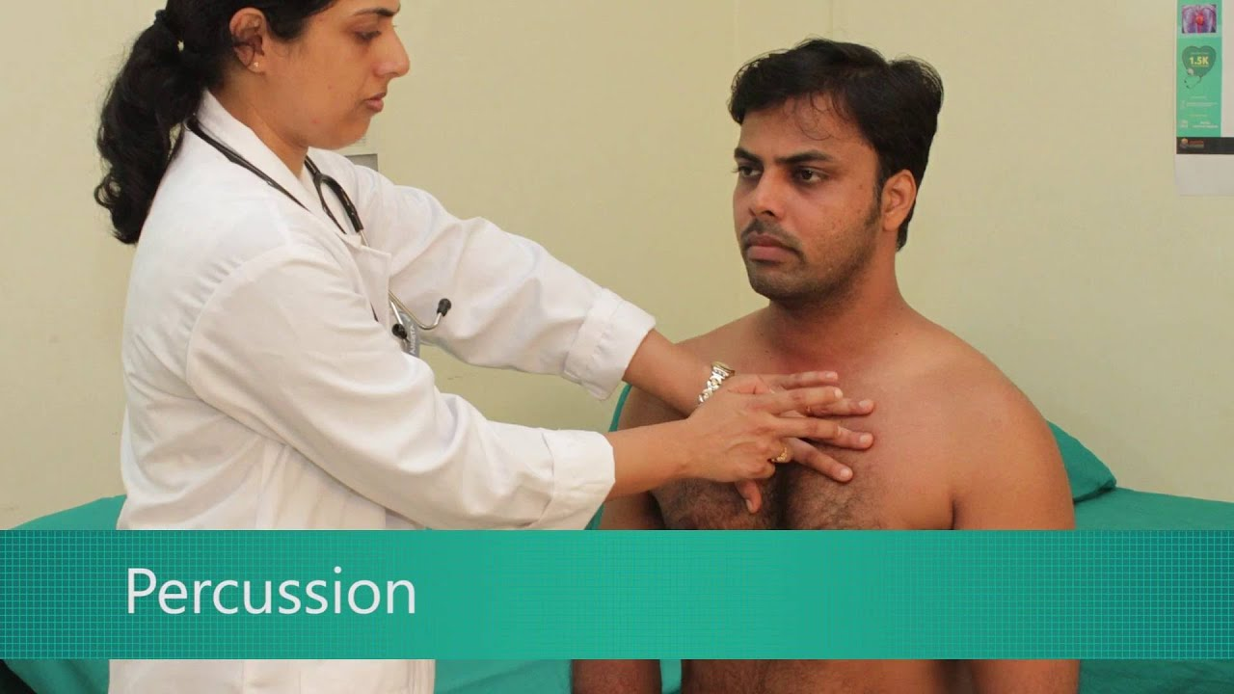
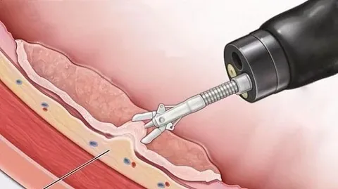

Percussion reveals dullness of sound and distribution of fluids in the body.
The temperature is taken by means of thermometer to ascertain whether the patient has or has no temperature.
The blood pressure is measured by means of monometer to find out whether the patient is suffering from hypertension or hypotension.
The patient's pulse is felt to determine whether the pulse rate is normal or accelerated. The normal rate is 65-70 beats per minute.
The usual laboratory studies are various blood tests, urine analyses, stool studies and sputum, bile examinations.
Patient’s swabs or smears are taken for cytological examination. If the patient suffers from any kind of allergy it is necessary to make allergy tests.
Biopsy specimens are taken to detect the character of tumor.
In order to detect lesions in the bones or tissues patients are X-rayed.
The results of physical examination and laboratory investigations are recorded into patient’s case history.

Slide 3
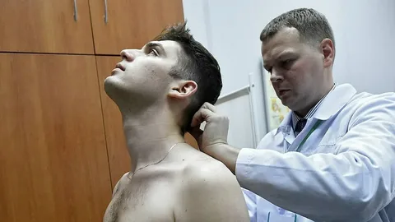
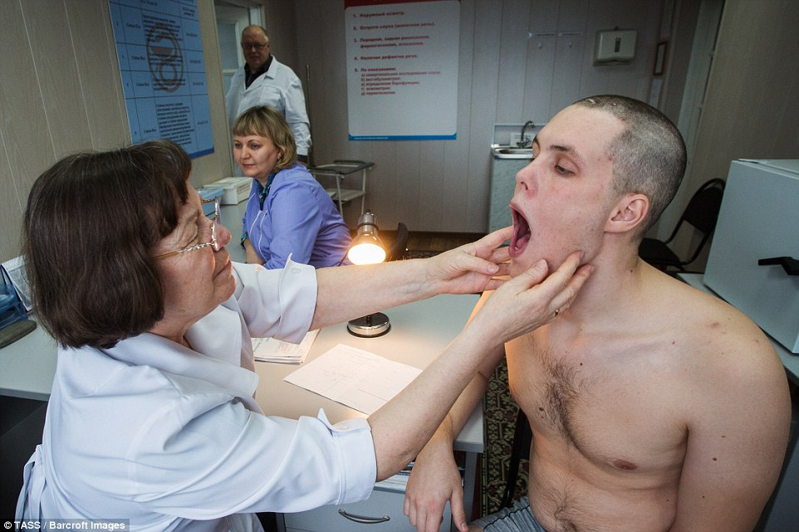
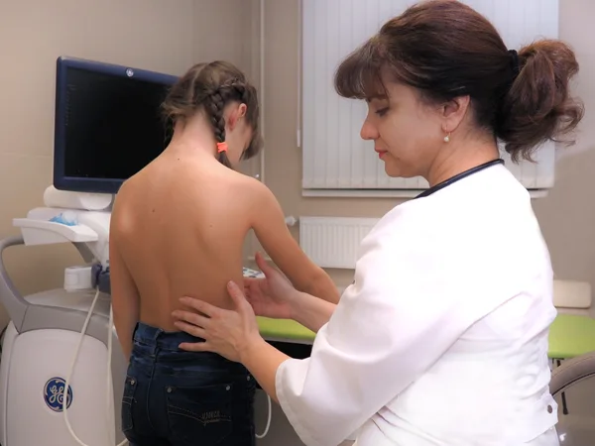
«Physical examination»
A physical examination, also known as a medical or clinical examination, refers to assessing a patient’s physical condition through observation, palpation, percussion, and auscultation. It involves gathering information about the patient’s medical history, conducting a visual inspection, feeling for abnormalities, tapping the body to assess underlying structures, and listening to sounds produced by the body.
A physical examination gathers comprehensive information about a patient’s health status, which helps healthcare providers make informed decisions regarding diagnosis, treatment, and preventive measures. It allows for the early detection of potential health issues, providing an opportunity for prompt intervention and improved patient outcomes. Regular physical examinations are particularly crucial for individuals with chronic conditions, as they aid in monitoring and managing their health.

Slide 4
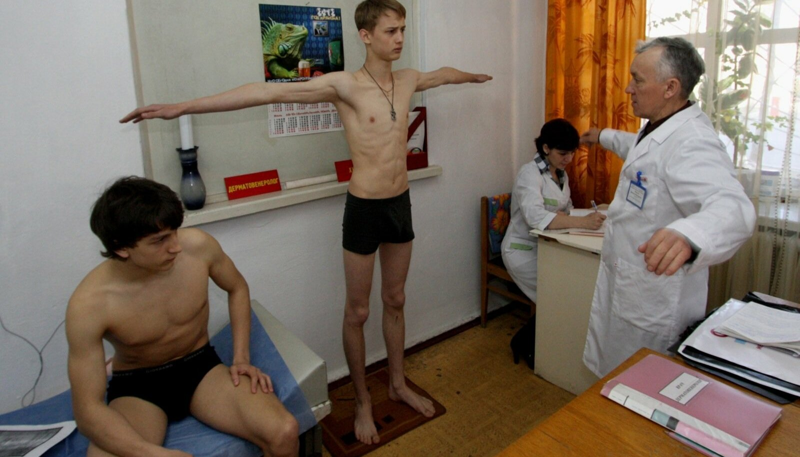
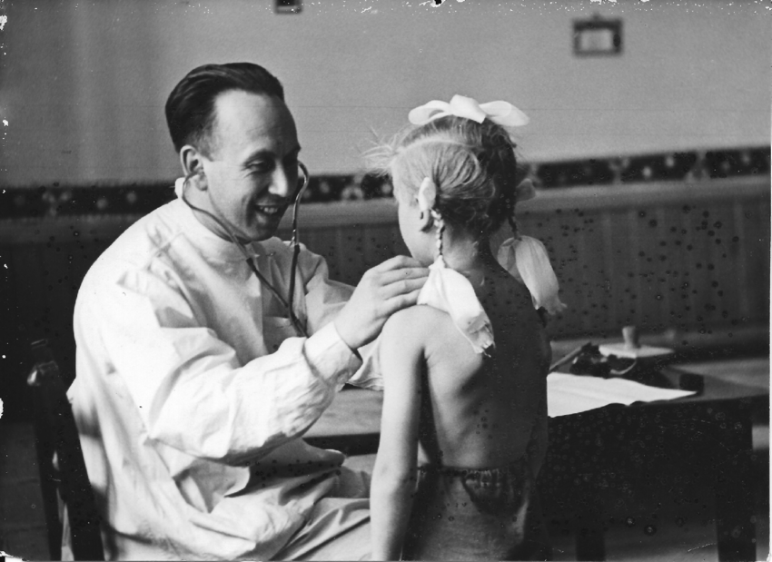
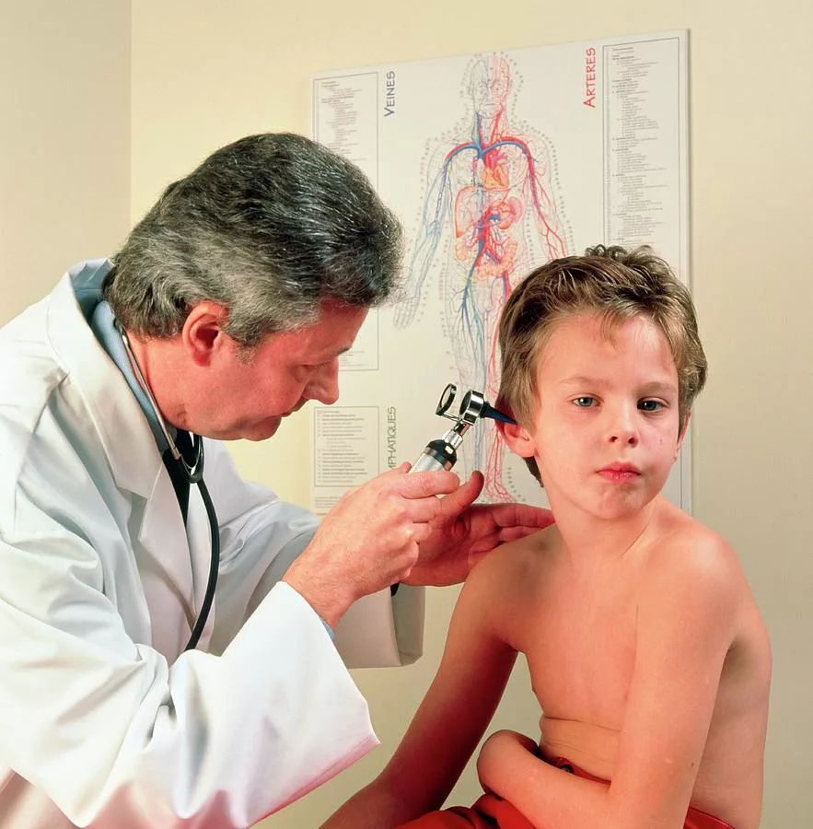
A physical examination encompasses several components, each focusing on a specific aspect of the body’s systems. These components include:
1. General appearance and vital signs assessment
2. Head and neck examination
3. Cardiovascular examination
4. Respiratory examination
5. Abdominal examination
6. Musculoskeletal examination
7. Neurological examination
8. Dermatological examination
Each component helps healthcare providers assess the corresponding body systems, identify abnormalities or deviations from the norm, and evaluate overall health status.

Slide 5
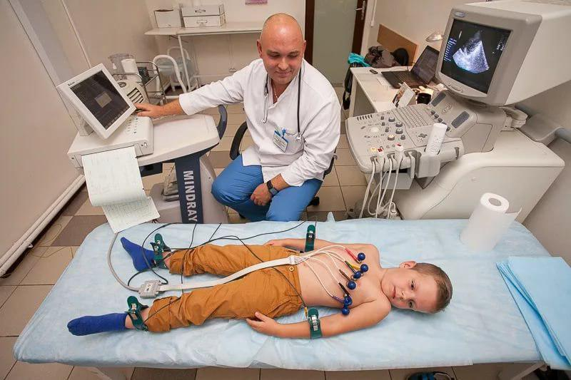
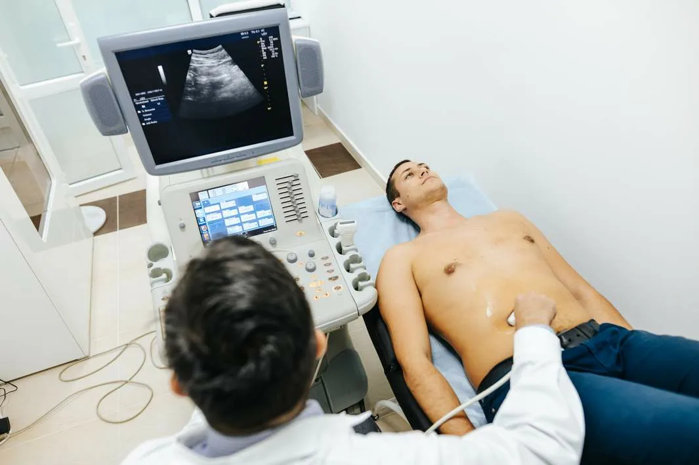
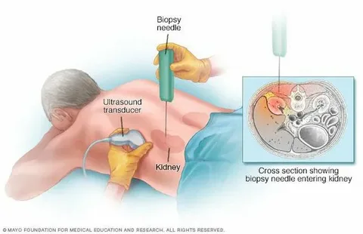
Examination of the internal organs
Inspection, palpation, percussion, auscultation – the unalterable everyday applicable quartet. Whatever part of the patient you examine, whatever disease you suspect, the four motions must be done in that order. You look first then feel; when you have felt, you may tap, but not before; and last of all comes the stethoscope.
After physical examination, the physician makes an initial diagnosis which must be confirmed by laboratory findings before a treatment is decided upon. The most common laboratory procedures are cardiography, X-ray and ultrasound examination, biopsy and blood and urine testing. Cardiography – recording graphically the force and form of the heart beat. X-ray examination of inner organs is performed with short rays of electromagnetic spectrum. The result of it is an X-ray film which shows the organ pathology.
Ultrasound examination of inner organs is performed by means of mechanical vibrations of very high frequency (above 30 000 Hz). Information is derived from echoes which occur when a controlled beam of this energy crosses the boundary between adjacent tissues of different physical properties.
Biopsy – excision of tissue from a living body for microscopic examination to establish a diagnosis.

Slide 6
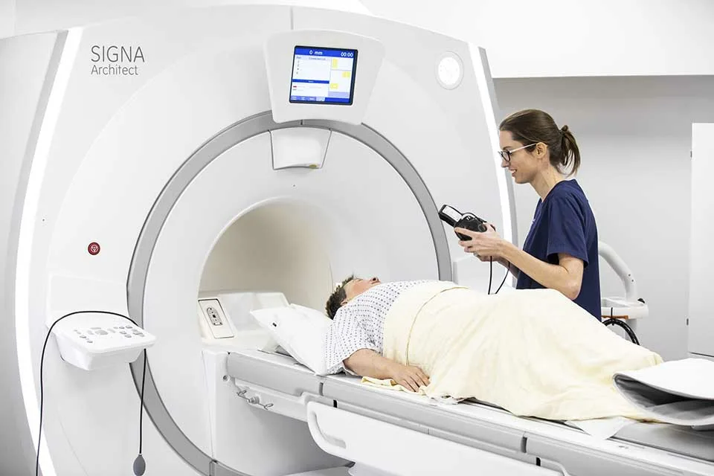
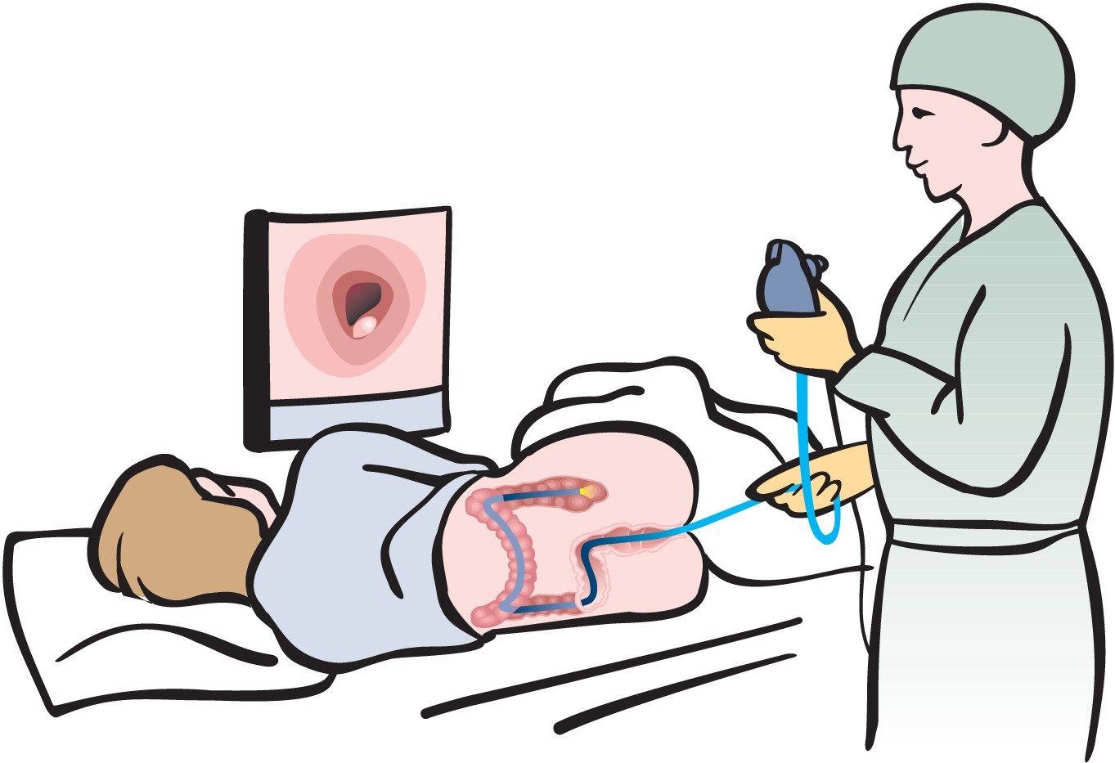
«Colonoscopy. Doppler scanning. MRI»
Colonoscopy. This method is a visual study that helps to identify the lesions of the colon. It is necessary for the doctor to diagnose cancer and in order to determine the cause of the symptoms of your disease. This is the most common method for studying the large intestine at the present time.
Doppler scanning is intended, beforein total, to study the circulation of blood in the arteries and veins. X-rays are not used for this scan. The Doppler method is performed without intrusion into the body in any way, including surgical. This method of diagnosis is the most reliable and convenient, and it is considered the most advanced in the field of research of vascular diseases.
MRI. Magnetic resonance imaging is a method of examining internal organs using a magnetic field and radio waves that act on a person and inject it into a resonant state. The return of a person to his normal state leads to the formation of a certain signal. During the study, this signal is recorded in the computer and with its help you can get a picture of different parts of the body.

Slide 7
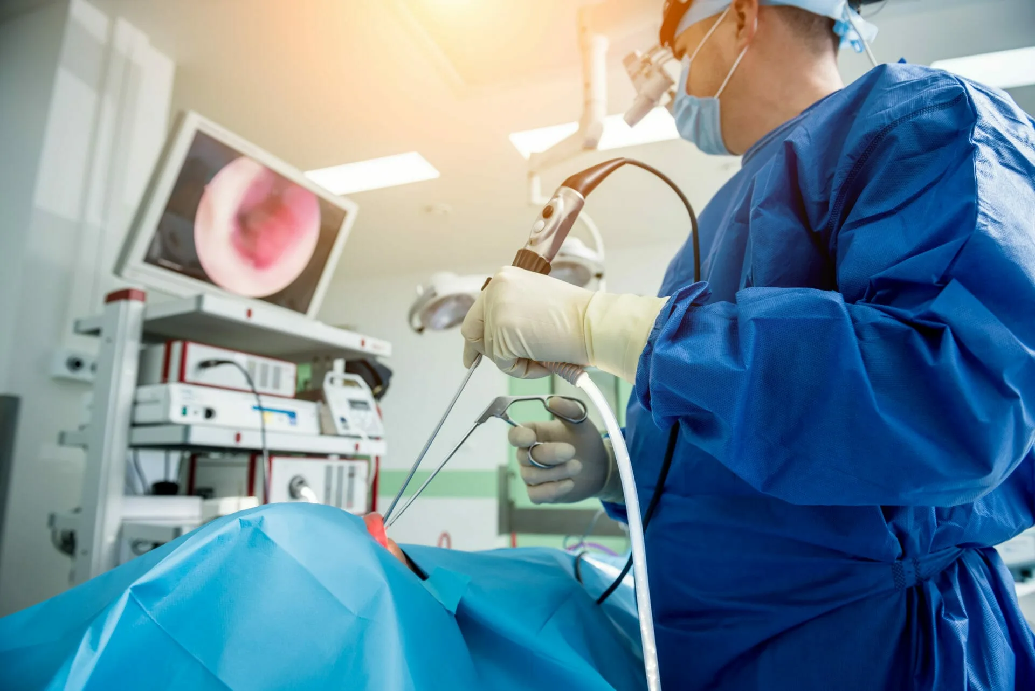
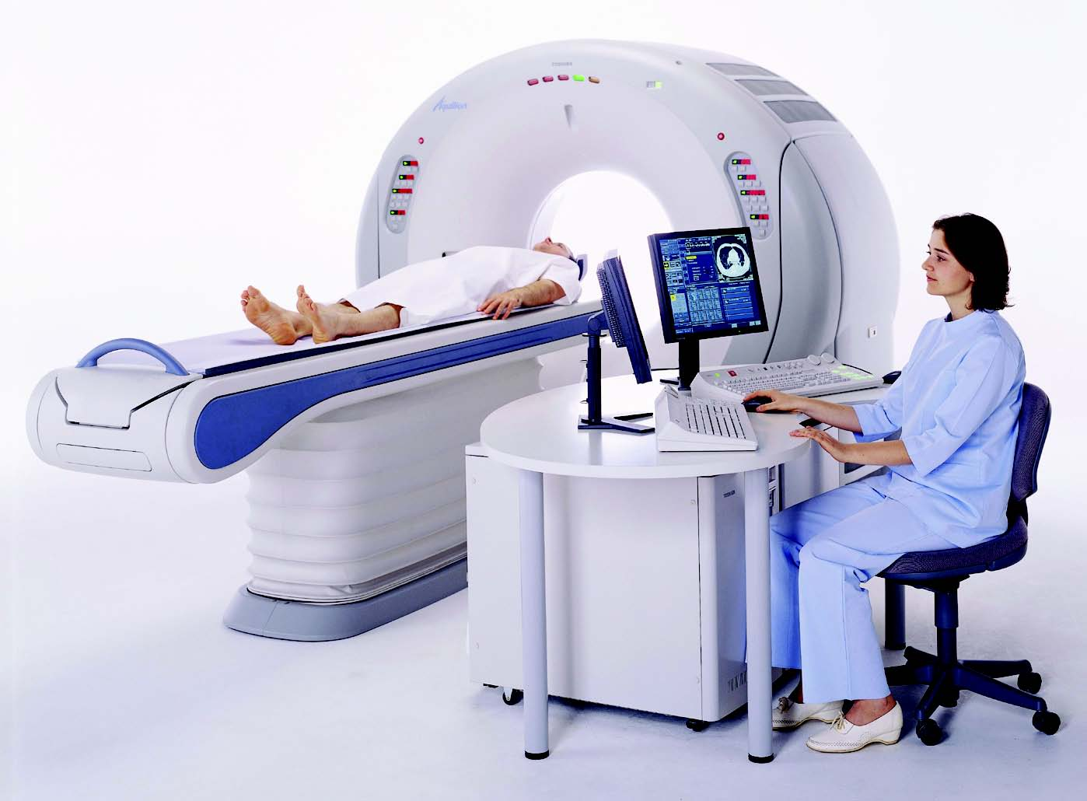
«Endoscopy. Computer tomography»
This is a method of examining and examining certain internal organs with the help of an endoscope. This allows you to determine the visual diagnosis using a video camera, which is attached to the end of the tube, called the endoscope. Such examination will help to determine the damage in the intestines, esophagus and stomach. Currently, there are several types of endoscopy: bronchoscopy - the detection of bronchial diseases; hysteroscopy - examination of the uterus; gastroscopy - examination of the stomach; laparoscopy - abdominal cavity; angioscopy - examination of vessels; Cystoscopy - examination of the bladder; arthroscopy - joint examination; thoracoscopy - examination of the thoracic cavity; Ventriculoscopy - examination of the ventricles of the brain, etc.
Computer tomography is to use the latest scanner, which allows you to create an image in three dimensions. The image can be read on any device.
These diagnostic methods are the most common in modern medicine. It is through these studies that disease can be identified at an earlier stage and cured without loss to the body.

