Slide 1
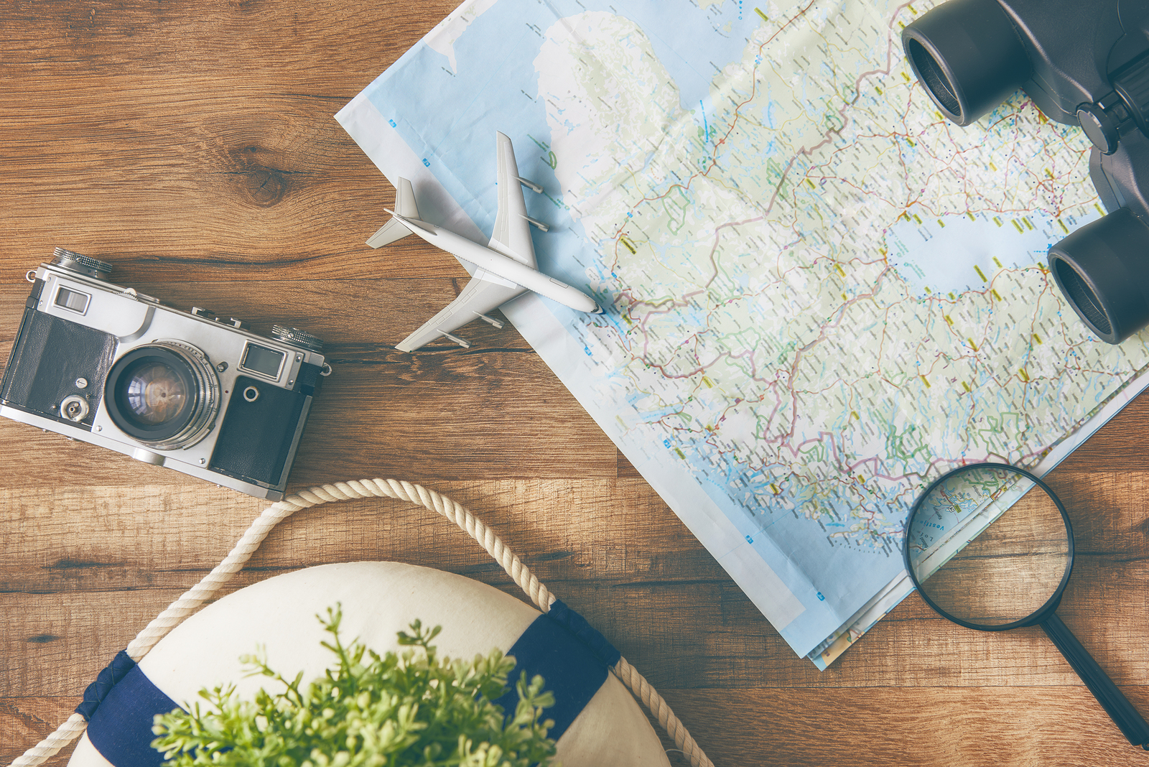
The World of Hobby

Slide 2
Dancing, shopping,
Walking her Collie
These are hobbies
Of my sister Polly.
Cycling, swimming,
Playing computer,
My favourite activities
Of my brother Peter.

Slide 3
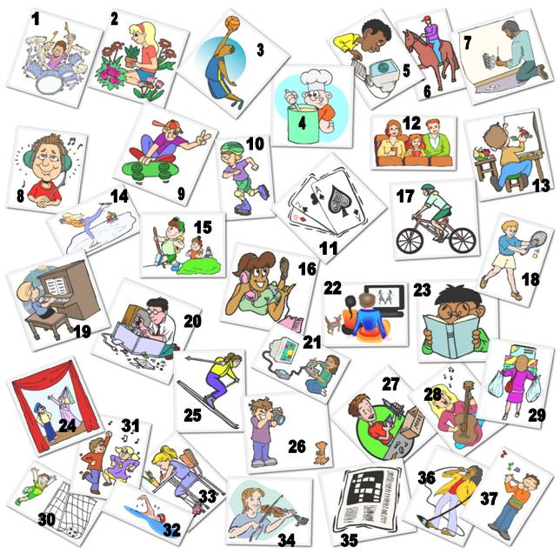

Slide 4
Listening
St.B.
p.22 ex.1
Step 5

Slide 5
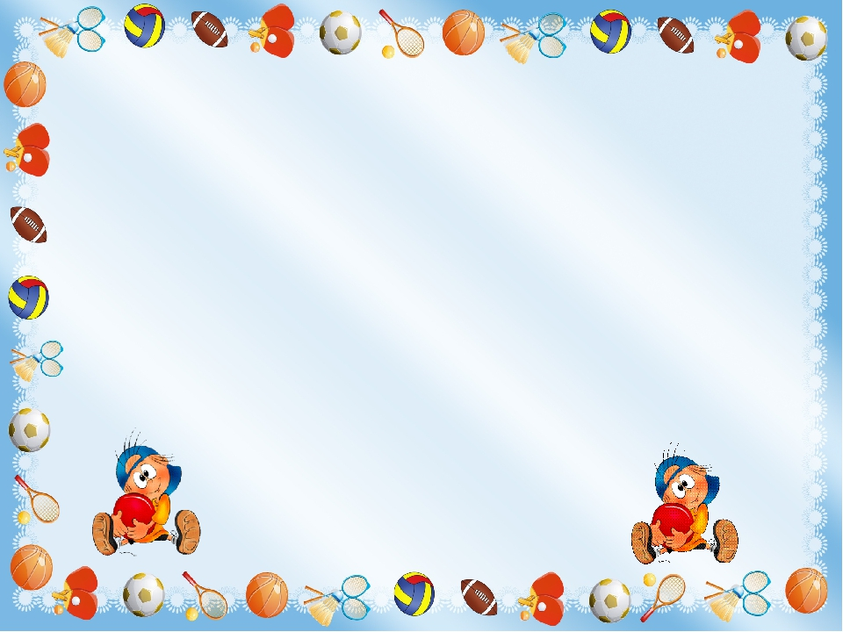
What is the topic of the text?
What are the main characters?
The text is a dialogue, isn’t it?
Where does the action take
place? (any variants)
5. What hobby does Jane have?

Slide 6
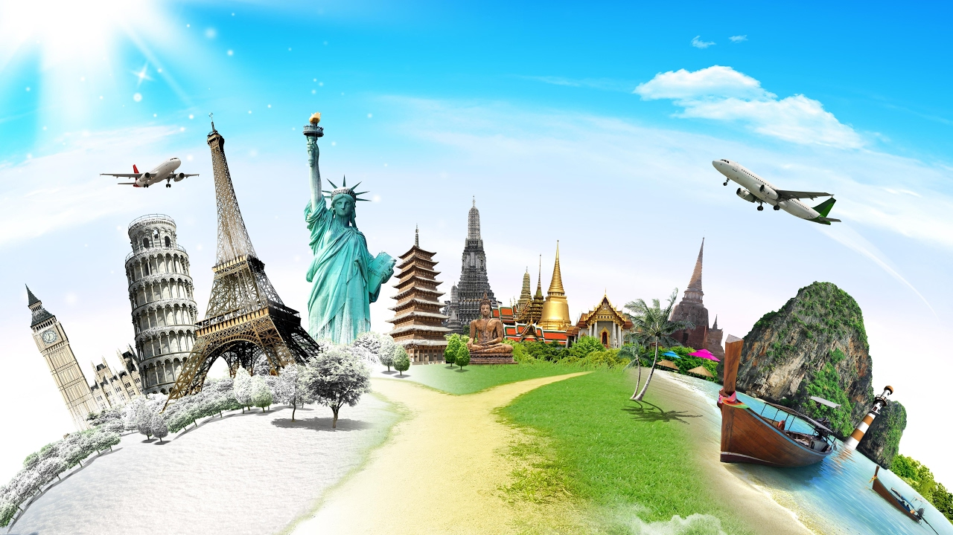
Do you like travelling?
Why people travel?

Slide 7
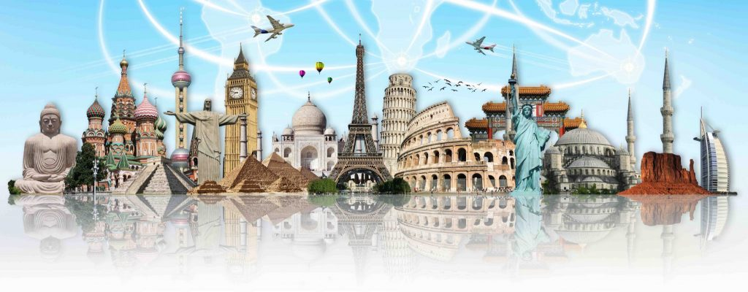
Job (business) or study
to meet new people
to learn a language
to visit friends or relatives
to visit the places of interest
to learn the history and culture
(customs and traditions)

Slide 8
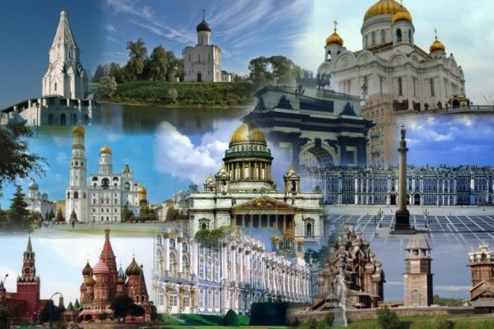
Russia is rich ____
its museums, squares
and churches.

Slide 9
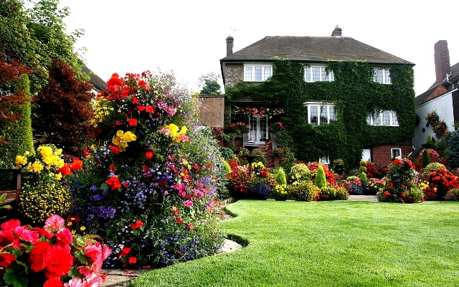
The Englishmen are
fond ____ gardening.

Slide 10
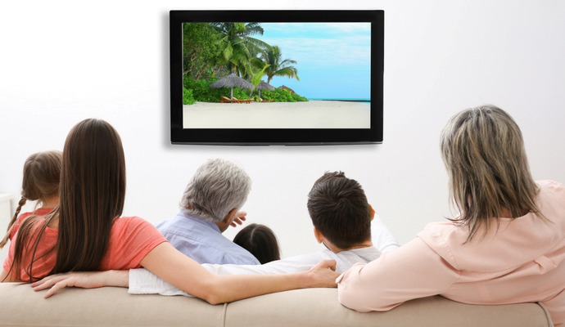
In Germany a lot of
people like
watching _____TV.

Slide 11
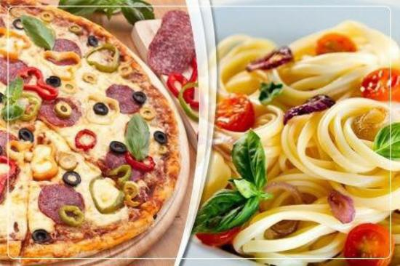
People in Italy are
proud ____ their pizza
and pasta.

Slide 12
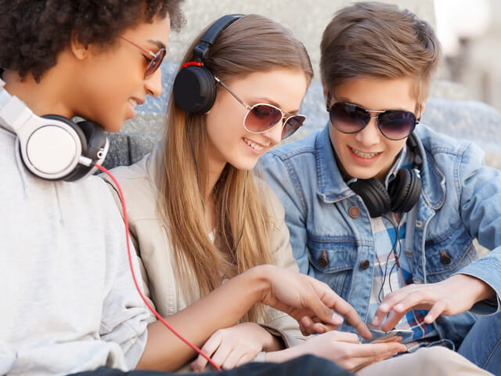
In France a lot of people
prefer listening ____
music.

Slide 13
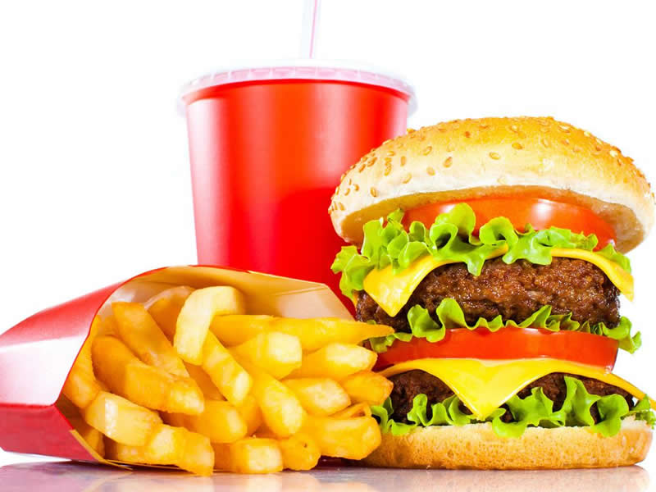
The USA is famous ___ its fast food but it is unhealthy.

Slide 14
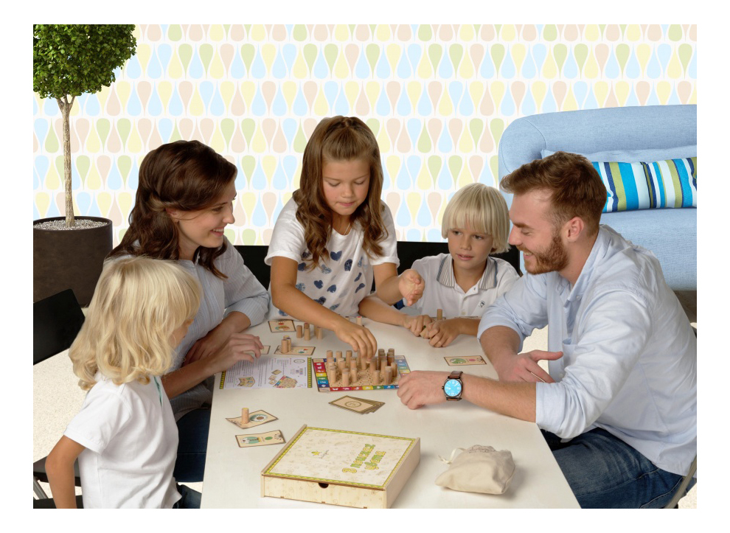
All Russian people often spend their free time ____ their families.

Slide 15
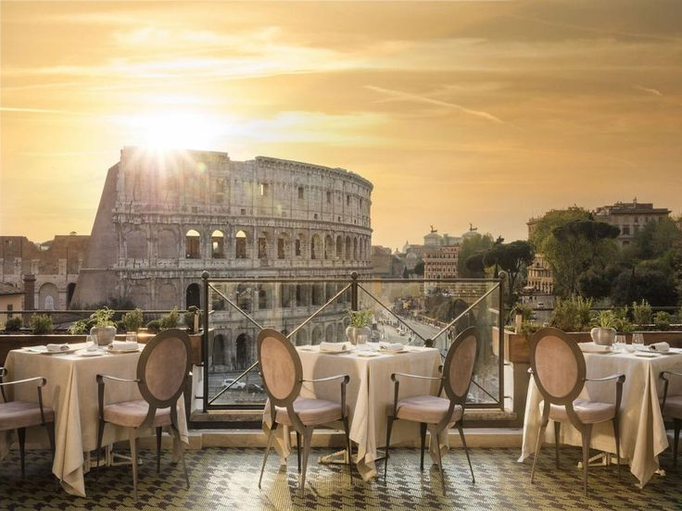
In Italy people often spend their free time ___ the cafes.

Slide 16
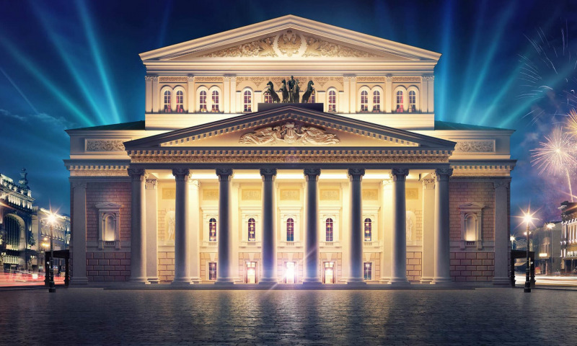
In Moscow people
often go ___ the theatre.

Slide 17
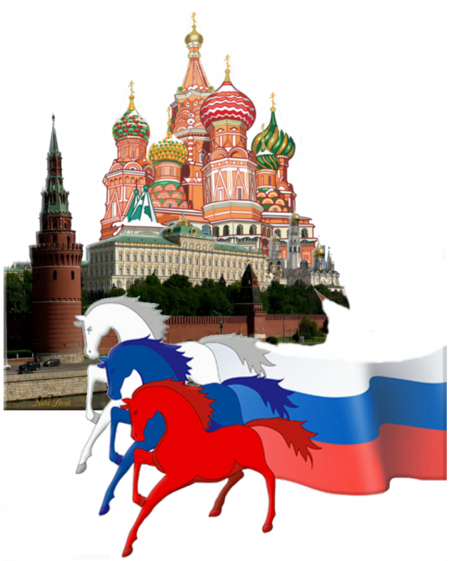
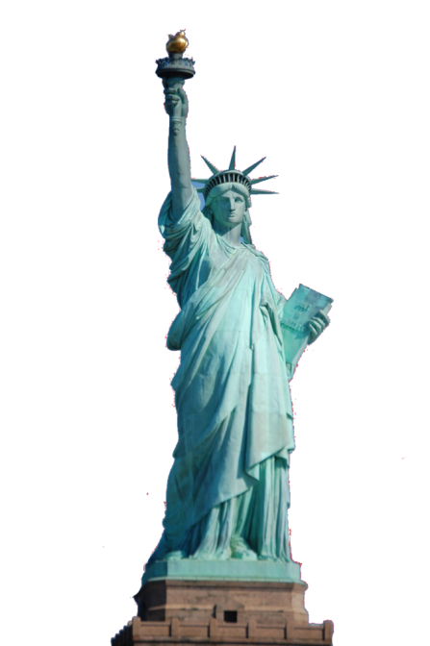
What are
their hobbies?

Slide 18
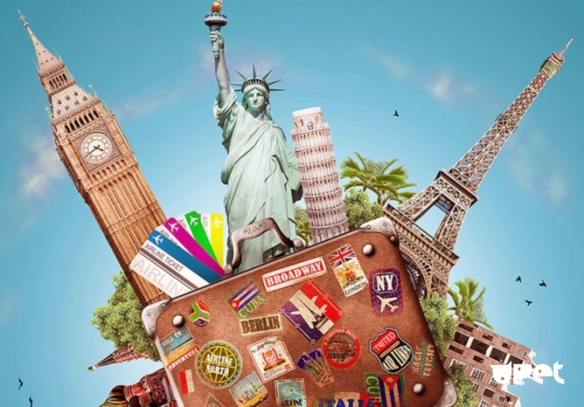
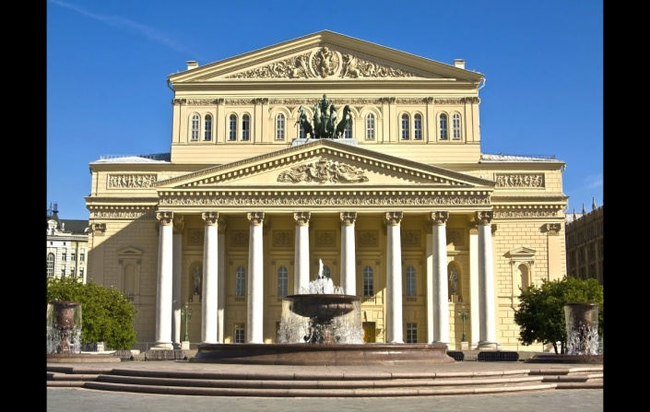
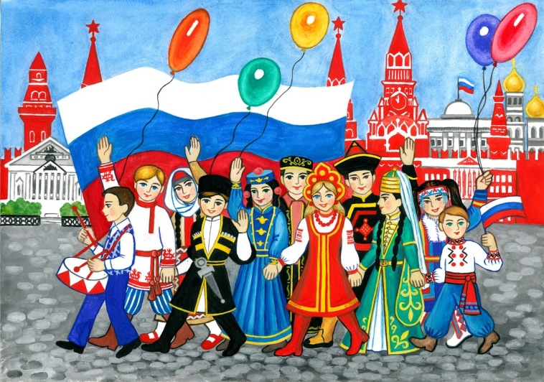
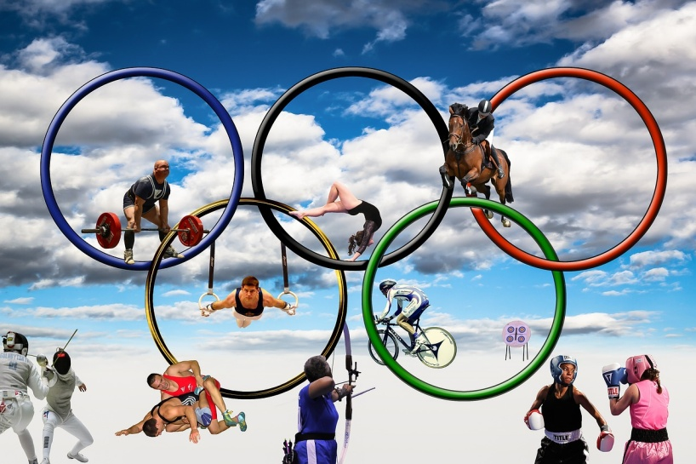

Slide 19
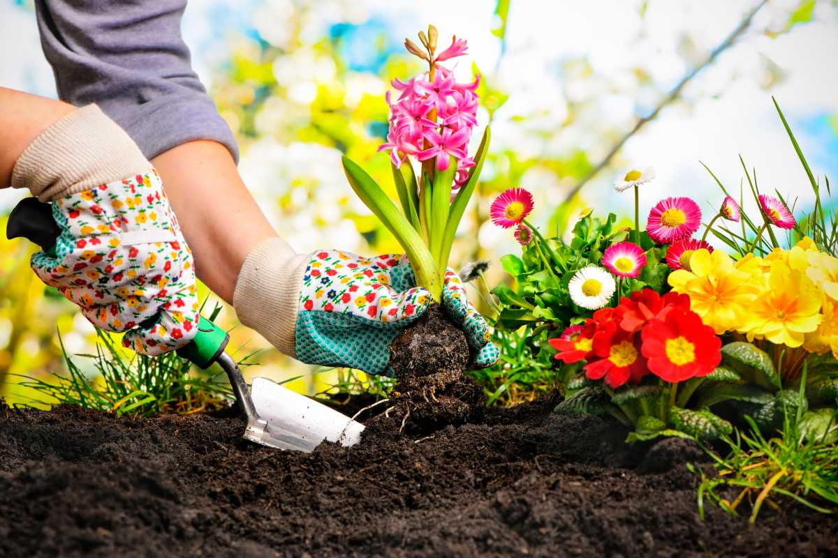
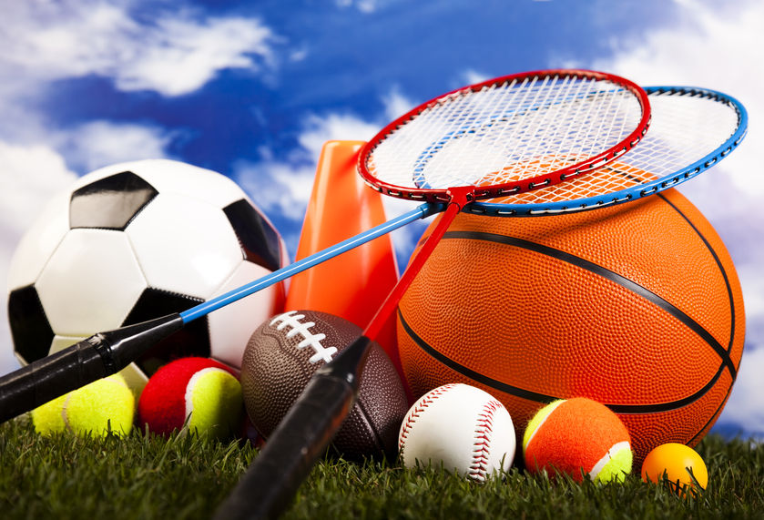
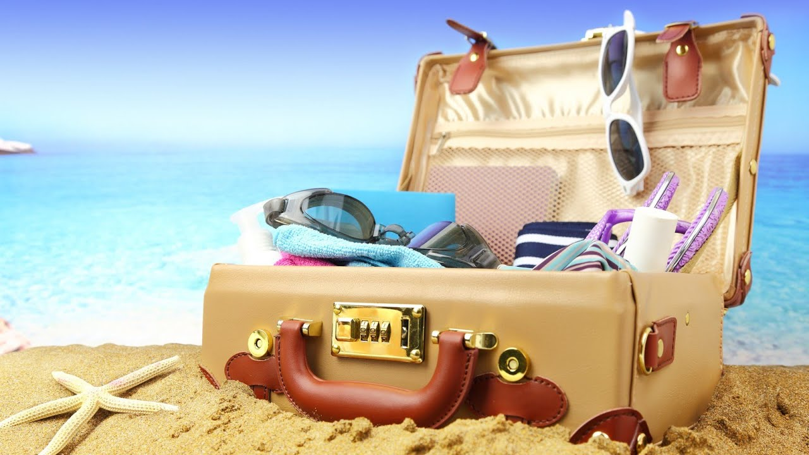
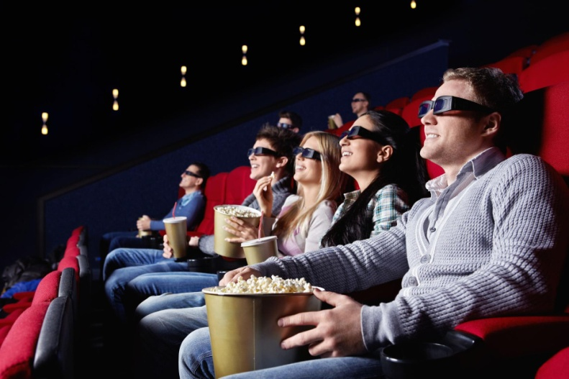

Slide 20
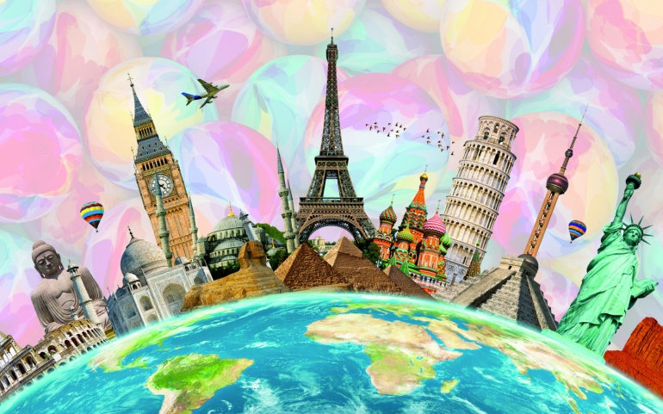
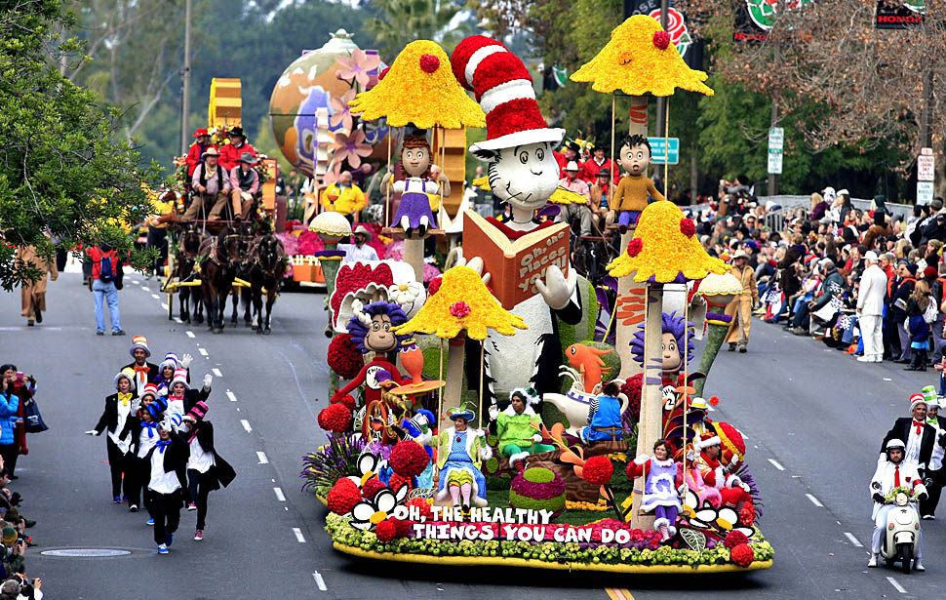
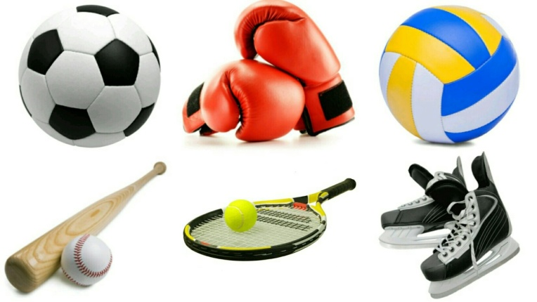
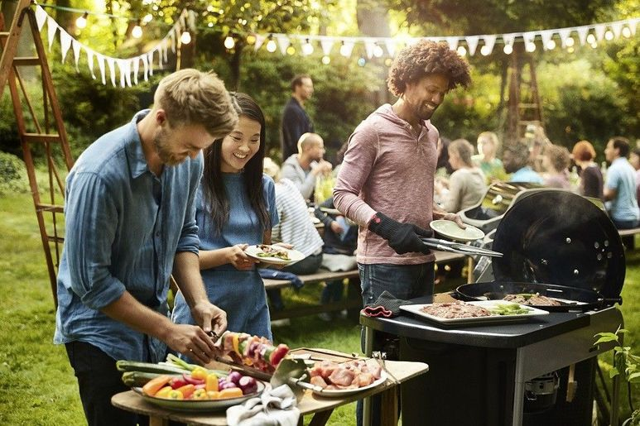

Slide 21
1. I find the lesson (interesting, useful, funny, unforgettable, informative, boring, difficult).
2. It was interesting (to discuss the text about Jane’s hobbies\ to speak about people’s hobbies in different countries\ to speak about aims of travelling\ to read the poem\ to play “Who wants to be a millionaire”)/
3. Now I can speak about hobby \ I don’t know how to speak about my hobby, it is difficult.

Slide 22
THANK YOU!

