Slide 1
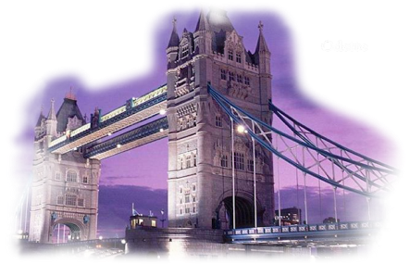
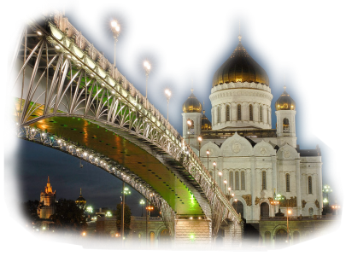
Телемост
«At the Café»

Slide 2
One man’s meat is another man’s poison.
«World Tasty News»

Slide 3
American Sensations

Slide 4
«World Tasty News»

Slide 5
Traditional English Food
8-800-450-0-800

Slide 6
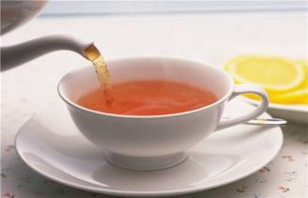
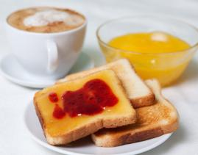
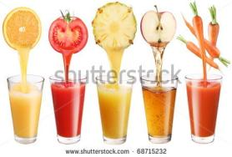
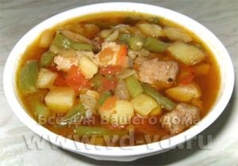
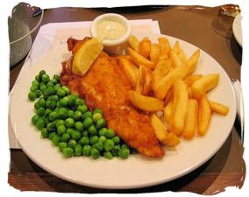
Tea with lemon
Toast with
jam & honey
Cereal with milk
Juice
Fish & Chips
Meat with vegetables &
potatoes
Bacon & Eggs

Slide 7
Video
«Food in Britain»
(из цикла видео
Windows on Britain)

Slide 8
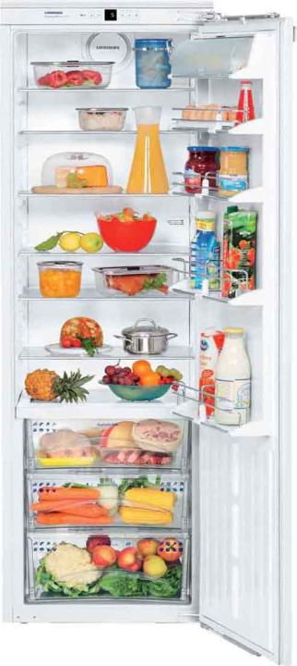
Milkman brings milk to people’s houses…
before lunch b) before breakfast c) before dinner
The usual English breakfast includes…
a) milk and cereal, toast, bacon and eggs, coffee, pizza
b) milk and cereal, bacon and eggs, toast, juice
c) milk and eggs, fish and chips, juice
Lunch is …
about 2 b) about 11 c) about 12
At lunch the British have…
sandwiches or a snack b) fish and chips
c) vegetable soup
5. Food that can be prepared in a microwave is called…
a) fresh food b) convenience food
The evening meal is…
breakfast b) dinner c) lunch
Britain has restaurants from over… countries.
40 b) 32 c) 42
The British people …
go out very often b) never go out
c) go out only on holidays

Slide 9
Milkman brings milk to people’s houses…
before lunch b) before breakfast c) before dinner
The usual English breakfast includes…
a) milk and cereal, toast, bacon and eggs, coffee, pizza
b) milk and cereal, bacon and eggs, toast, juice
c) milk and eggs, fish and chips, juice
Lunch is …
about 2 b) about 11 c) about 12
At lunch the British have…
sandwiches or a snack b) fish and chips
c) vegetable soup
5. Food that can be prepared in a microwave is called…
a) fresh food b) convenience food
The evening meal is…
breakfast b) dinner c) lunch
Britain has restaurants from over… countries.
40 b) 32 c) 42
The British people …
go out very often b) never go out
c) go out only on holidays

Slide 10
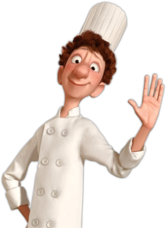
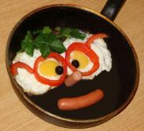
Физкультминутка
«Who is the fastest?»
«Scrambled Eggs»:
Put the instructions into correct order.

Slide 11
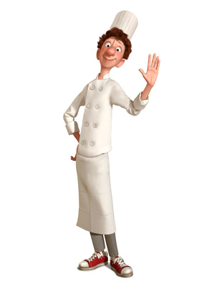
Good
Appetite!
Take three eggs.
Mix with milk.
Add some salt.
Put some oil in the
frying pan.
Fry for 10 minutes.
Cut the omelet into pieces.
Enjoy your meal!

Slide 12
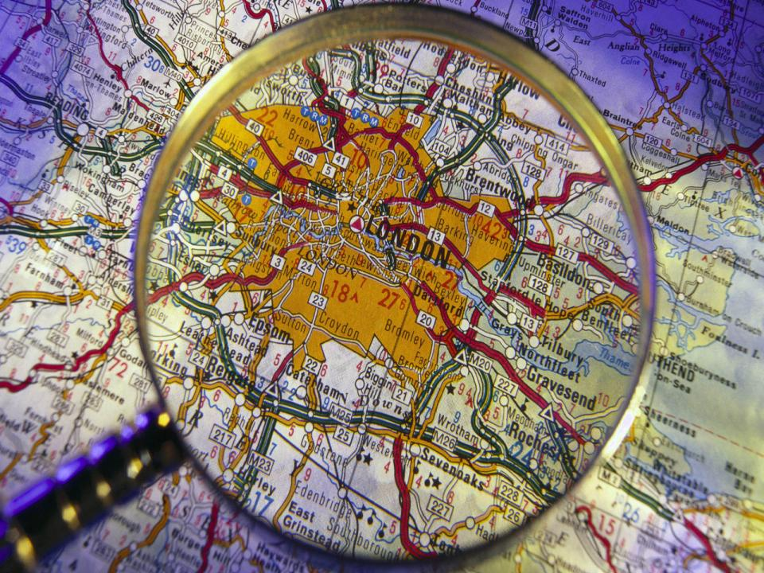
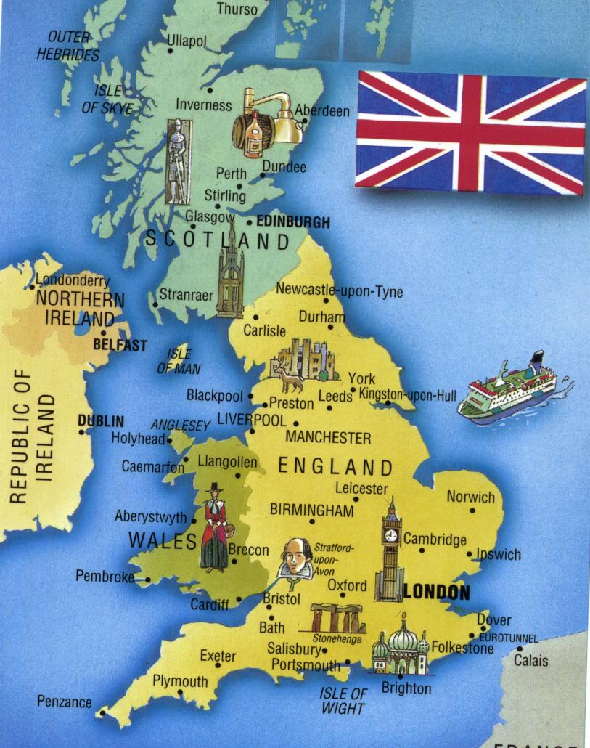

Slide 13
Traditional Russian Food

Slide 14
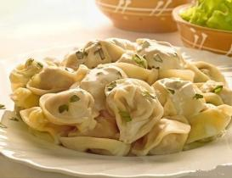
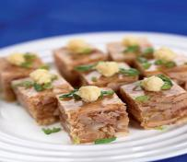
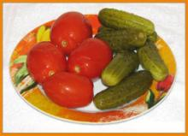
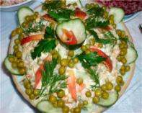
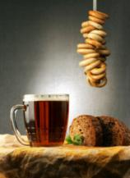
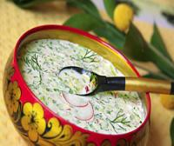
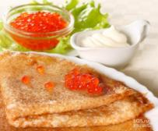
Borsch
Pelmeni
Jellied meat
Salted
cucumbers &
tomatoes
Kvass
Olivier
Pancakes with
caviar
Okroshka

Slide 15
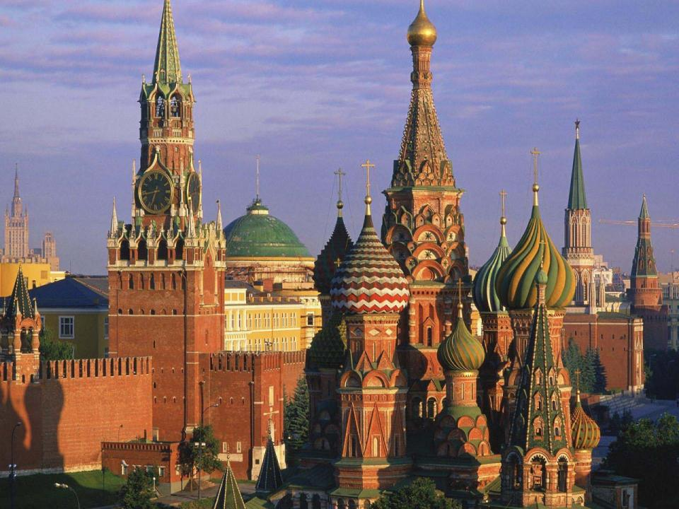
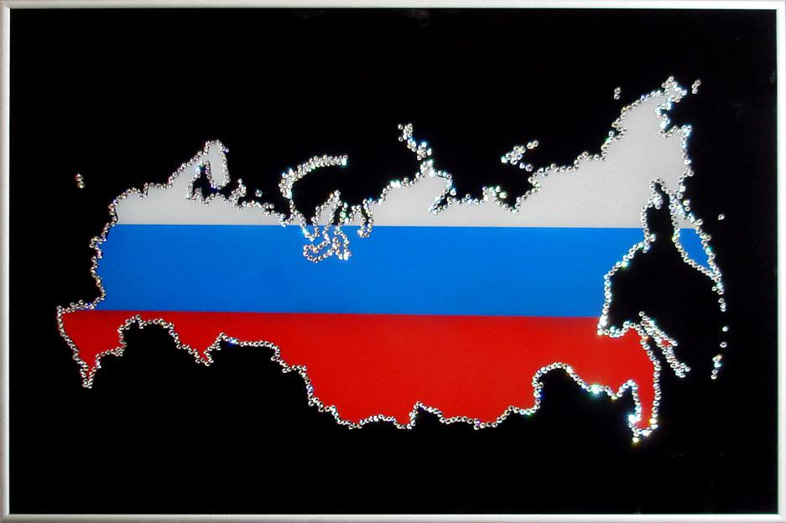

Slide 16
American Sensations

Slide 17
«World Tasty News»

