Slide 1
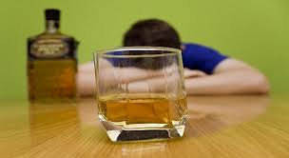
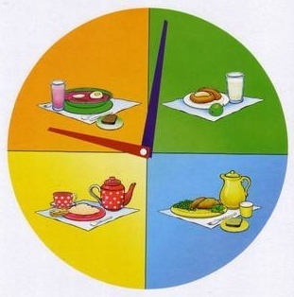
What do you think we are going to speak about?

Slide 2
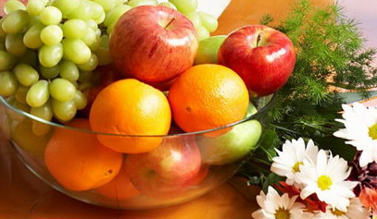
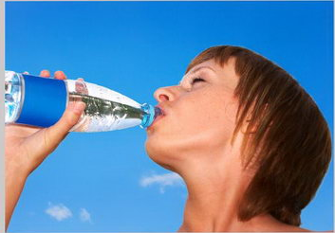
HEALTHY
WAY
Of LIFE

Slide 3
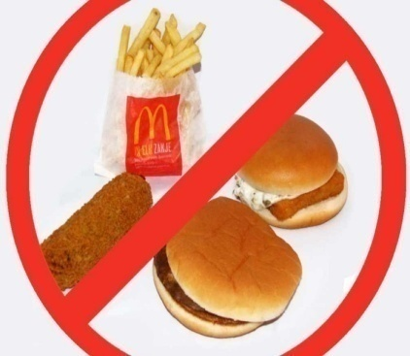
Physical low-fat food
Taking breakfast
Personal activity
Skipping alcohol
Regular drugs
Environmental diet
Health hygiene
Healthy meals
Eating influence
Drinking habits

Slide 4
Health Habits
Smoking
Good
Bad
Exercising
Drinking too much alcohol
Smoking
Exercising
Snacking
Drinking too
much
Good plain food
Good plain food
Snacking
Taking drugs
A healthy diet
A healthy diet
Taking drugs
Eating too many sweets
Eating too
many sweets
Taking a cold shower
Taking a cold shower
Physical inactivity
Physical
inactivity
Personal hygiene
Personal hygiene

Slide 5
Put the words of the proverbs about health in a logical order
wealth is good above health
a day apple an away keeps doctor a
to and healthy bed wise makes a rise man early and early to wealthy
a mind sound in body a sound
eat live to but, to eat not live
he who has everything and has hope he who has hope has health

Slide 6
An apple a day keeps the doctor away.
Health is above wealth
Early to bed and early to rise makes a man healthy, wealthy and wise
A sound mind in a sound body
he who has health has hope and he who has hope has everything
Eat to live, but not live to eat

Slide 7
Questions about health
What habit is the most dangerous for the person?
What are the modern bad habits ?
How many times a day do you eat?
Do you often skip breakfast?
Does our health depend on our way of life?
Do you like sweets? Do you eat a lot of sweets?
Do you sometimes eat at night?
When do people usually follow a diet?
Can a diet cause health problems?
Should we have our meals at regular hours?

Slide 8
Health Code
You should
You shouldn’t
Get up early and go to bed early
Wash your hands before eating
Smoke
Watch TV too long
Go in for sports
Clean your teeth once a day
Sleep enough
Take a cold shower
Eat too many sweets
Spend much time indoors
Eat between meals
Air the room

Slide 9
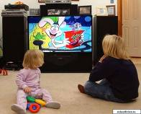
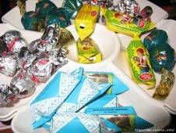
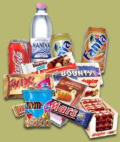
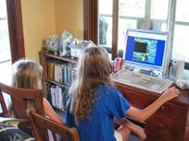
You shouldn’t
Smoke
Watch TV too long
Clean your teeth once a day
Eat too many sweets
Spend much time indoors
Eat between meals

Slide 10
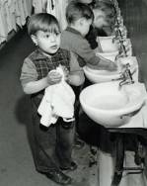
You should
Get up early and go to bed early
Wash your hands before eating
Go in for sports
Sleep enough
Take a cold shower
Air the room

Slide 11
The task is to complete the sentences
….. | causes makes affects | teeth yellow obesity slow reactions skin unhealthy headache cancer clothes smell people around us speech unclear

Slide 12
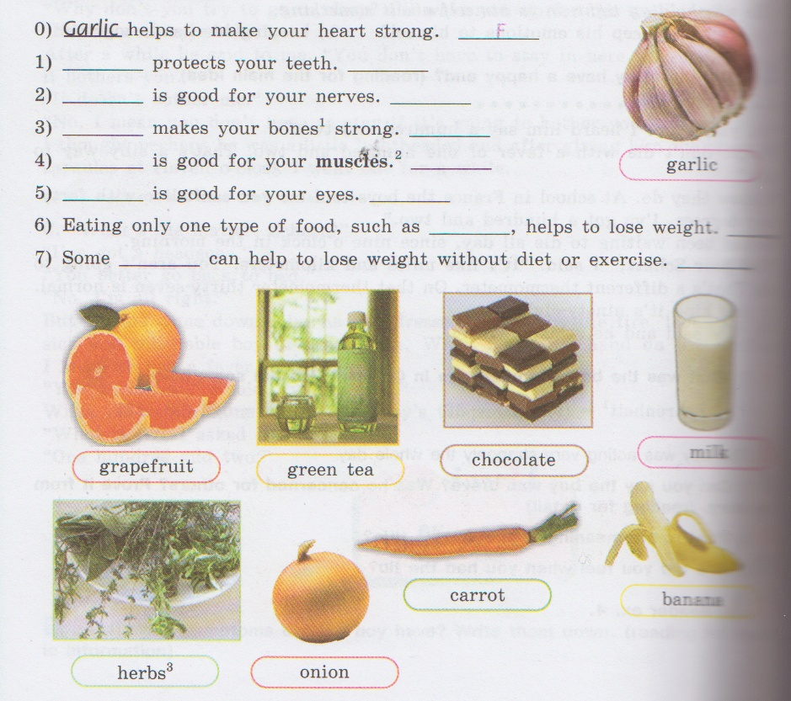

Slide 13
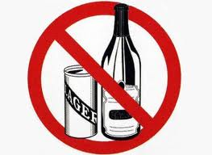
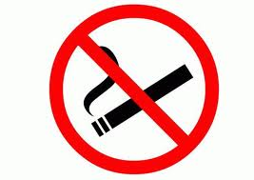
Smoking Good plain food A healthy diet Personal hygiene Taking drugs Bad habits Sleep for 7 or 8 hours Drinking too much alcohol Physical exercises
Smoking Good plain food A healthy diet Personal hygiene Taking drugs Bad habits Sleep for 7 or 8 hours Drinking too much alcohol Physical exercises
1. The modern bad habits are … 2. … is really a good way to live. 3. Our town life today gives us little opportunities for … 4. Doctors always advice us to eat … 5. … makes people healthy and keeps them fit. 6. If you want to keep fit you must … 7. … dangerous for our health. 8. A healthy way of life includes … and absence of …

