Slide 1
Washington

Slide 2
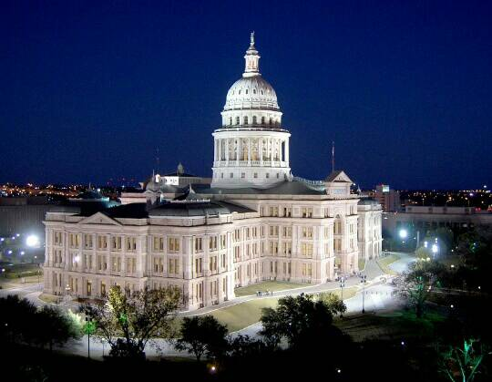
Washington is a city, the capital of the United States of America and is located in the northeast of the United States. The city was founded in 1791 and named after George Washington, the first American president.
White House

Slide 3
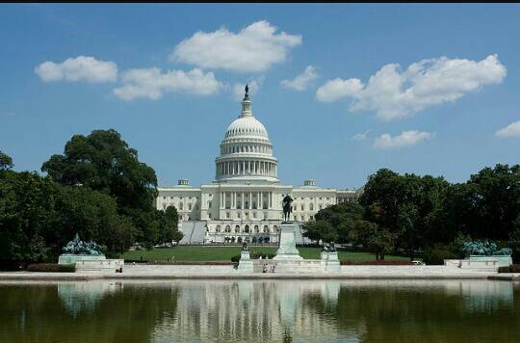
Washington is home to the main offices of all three branches of federal government, including the residence of the President of the United States in the White House, as well as many monuments and museums of national importance.

Slide 4
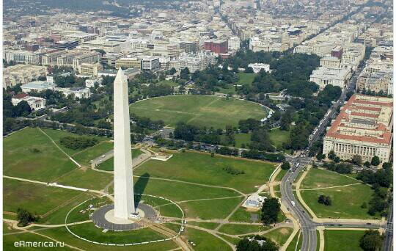
The Washington Monument is considered the main symbol of the American capital. The Washington Monument, the first president of the United States, was opened in 1888 and for some time remained the tallest building on the planet, until it was overtaken by the Paris Eiffel Tower.

Slide 5
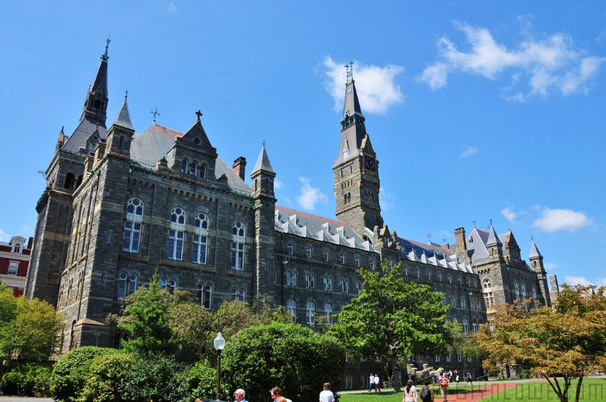
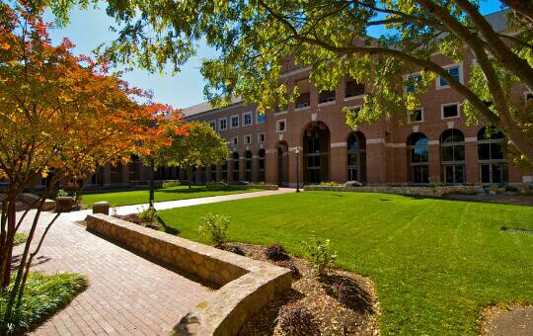
Georgetown University is one of the most prestigious universities in the country, which is considered the heart of the area.

Slide 6
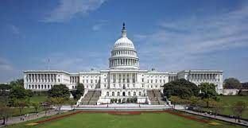
The United States Capitol is the seat of the US Congress on Capitol Hill in Washington DC, the ideological and urban center of the District of Columbia. Connects to the Washington Monument and the Lincoln Monument by the 1,800-meter National Mall. To the east of the parliamentary center are the Library of Congress and the seat of the US Supreme Court (until 1935, the sessions of the Supreme Court were held in the Capitol itself).

Slide 7
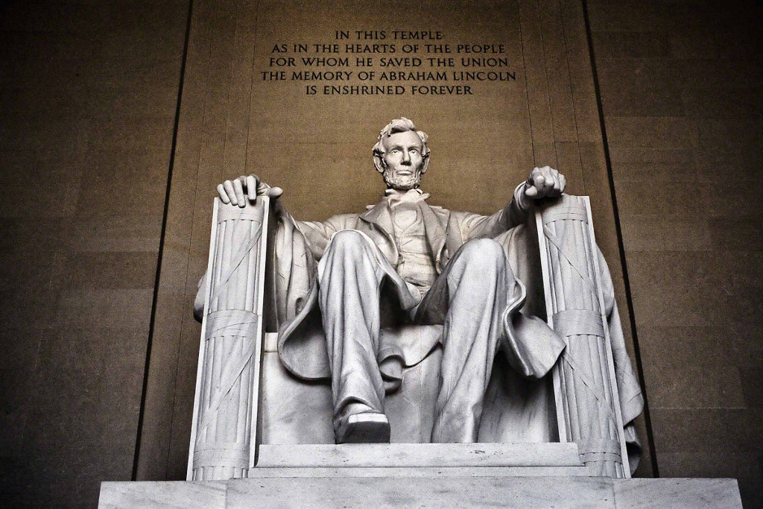
In memory of the 16th President of the United States, it took eight years to build and was fully completed by 1922. Outwardly, the memorial resembles a classical Greek temple with a colonnade. Many details in it are filled with deep symbolic meaning - for example, the memorial is surrounded by 36 columns - exactly the same number of states were united before the assassination of Abraham Lincoln.

Slide 8
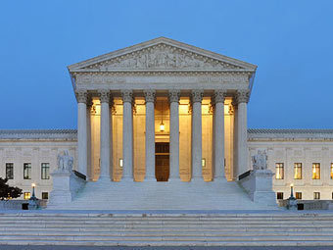
The Supreme Court is the seat of the United States Supreme Court and is located in Washington, D.C. at 1 First Street. Located one block east of the Capitol. Belongs to the office of the architect of the Capitol. On May 4, 1987, the US Supreme Court Building was designated a US National Historic Landmark.

Slide 9
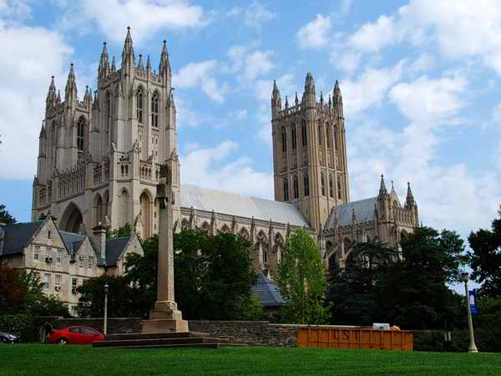
Cathedral

Slide 10
Washington Cathedral is the main cathedral of the Episcopal Church of the United States. The building of the cathedral is the sixth largest in the world. President Theodore Roosevelt was present at the laying of the foundation stone of the cathedral on September 29, 1907. Construction lasted 83 years and was solemnly completed in 1990 in the presence of President George W. Bush. On August 23, 2011, as a result of an earthquake, three spiers of one of the towers of the building broke, and the fourth one squinted.

