Slide 1
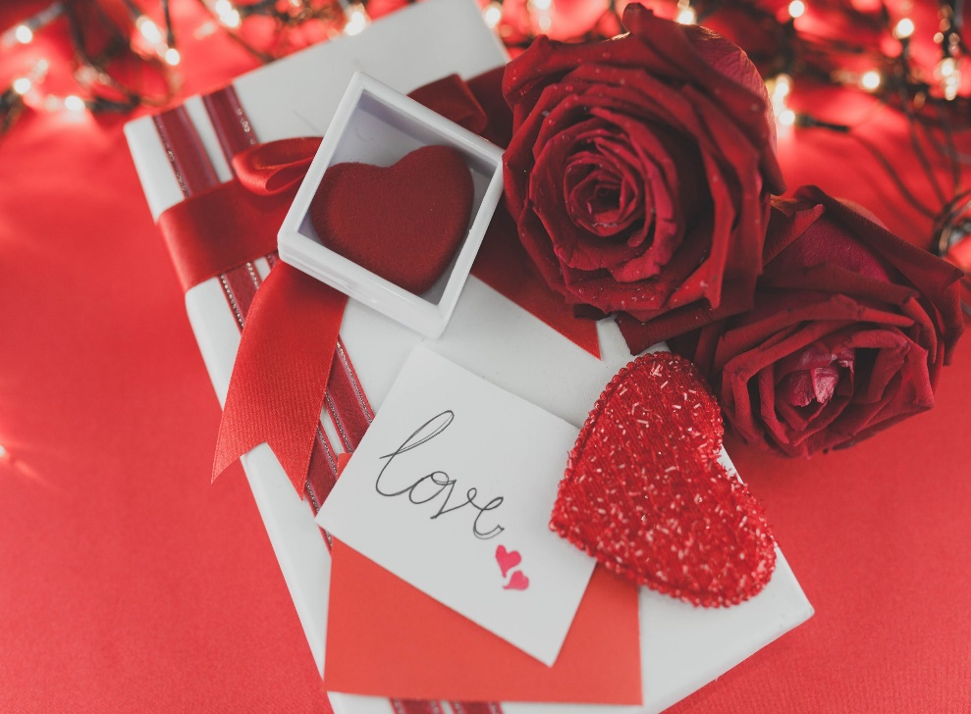
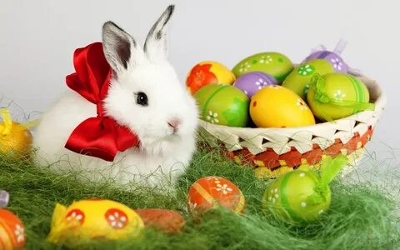
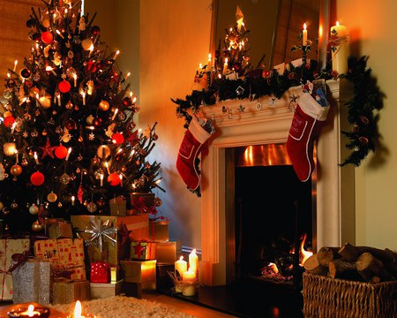
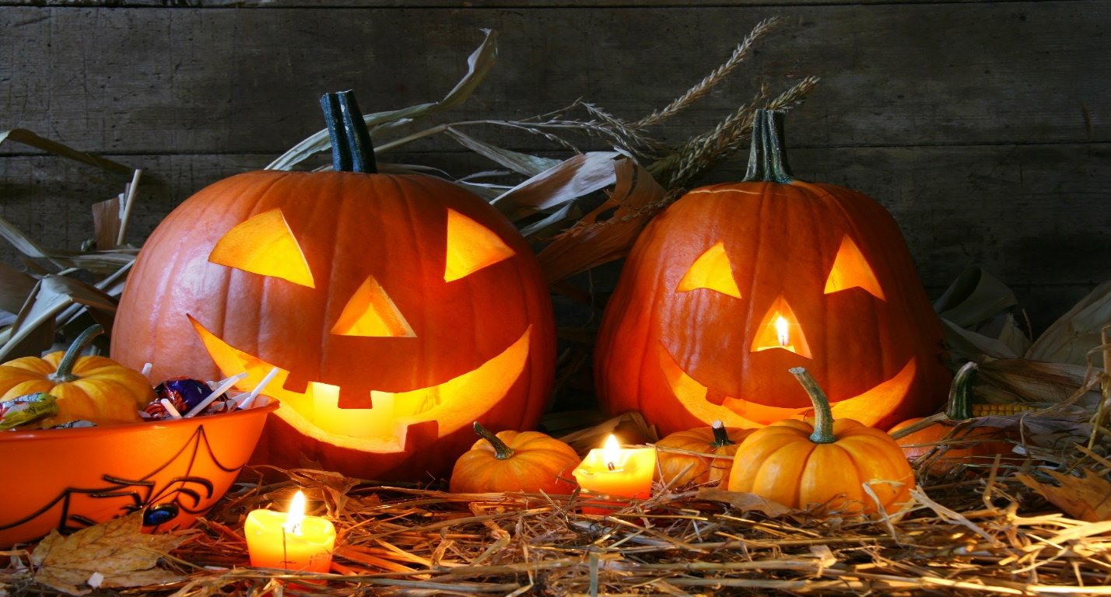
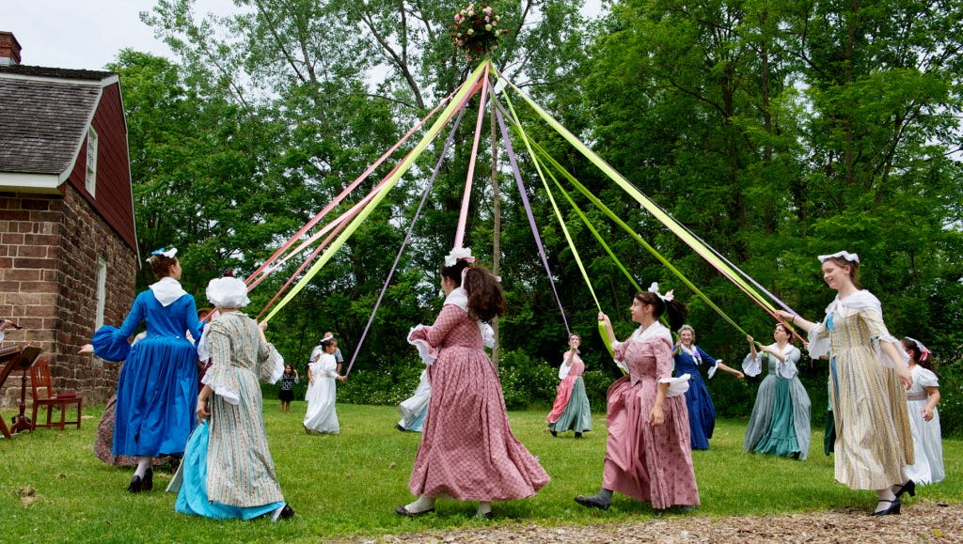
BRITISH HOLIDAYS

Slide 2
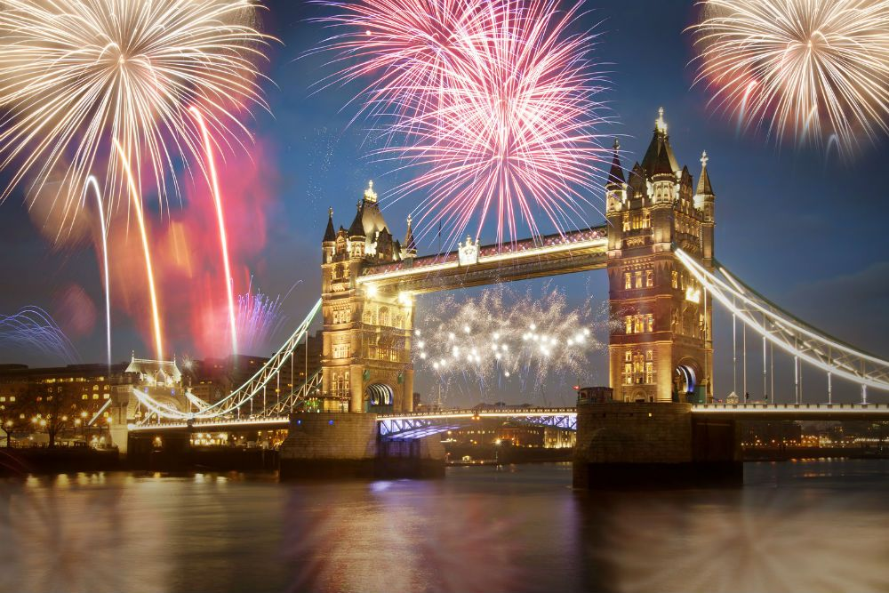
Read and translate the word-combination correctly:
Национальный праздник
Получить статус официального праздника
Праздноваться
Быть религиозного происхождения
Быть связанным с чем-либо
День подарков
Пятница перед Пасхой
Годовщина
Выбрать возлюбленного
Обмениваться символами любви

Slide 3
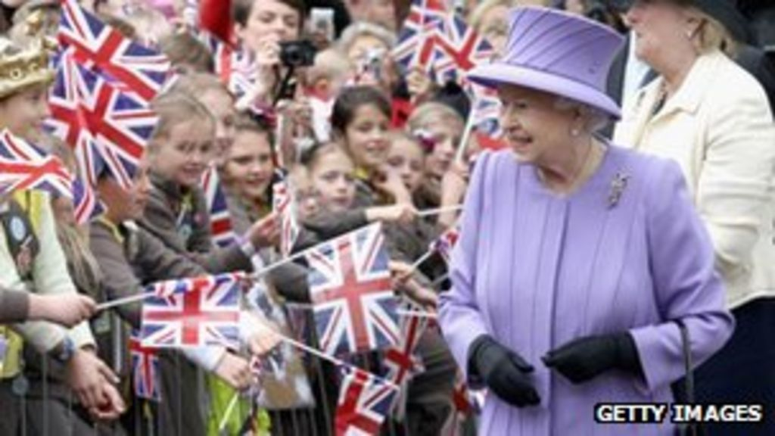
Read and translate the word-combination correctly:
Страстный вторник
Маскарад
Рождественский обед
Жареная индейка
Отмечаться
Деньги в подарок
Разносчики газет
Смотреть рождественское выступление королевы по телевизору
Зажечь свечу внутри

Slide 4
Find the right date for every holiday:
Date | Holiday
January, 1 | Easter
April-May | New Year
February,14 | Halloween
December,25 | St. Valentine’s Day
October,31 | Christmas
The 1st of April | May Day
The 1st Monday after May | April Fool’s Day

Slide 5
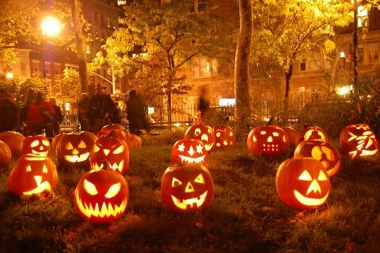
Halloween
Halloween is a festival that takes place on October 31.. It is very funny and interesting holiday. They do funny pumpkins and like telling strange and horrible stories about ghosts and witches. People once believed that there were many ghosts and witches on the Earth and that they met on October31 to worship the devil. The main Halloween activity for Children is trick-or-treating. Children dress in costumes and masks and go from door to door saying "trick or treat". The neighbors give children such treats as candy, fruit and pennies.

Slide 6
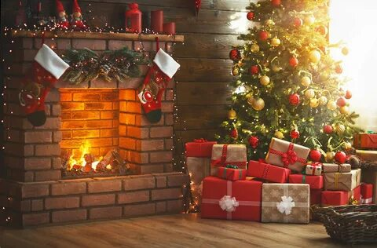
Christmas Day
Christmas Day is celebrated on December 25. For most British families this is the most important festival of the year. Christmas is a time for eating. There are a lot of traditions connected with Xmas, but the most important on is the giving of present. The traditional food is turkey, Christmas cake, Christmas pudding made of fruits. Over the end of the bed people hang stockings.
Children believe that Santa Claus will come down the chimney and fill the stockings with presents. A carrot for the reindeer is usually left on fireplace. On the Sunday before Xmas many churches hold a service. Every family has its own X-mas fir-tree.

Slide 7
St. Valentine’s Day
St Valentine’s is the saint of people in love. On that day , people send valentine cards and presents to their husbands, wives, boyfriends and girlfriends. You can also send a card to a person you don’t know. But traditionally you must never write your name on it. Some British newspapers have a page for Valentine’s Day messages on February 14th.

Slide 8
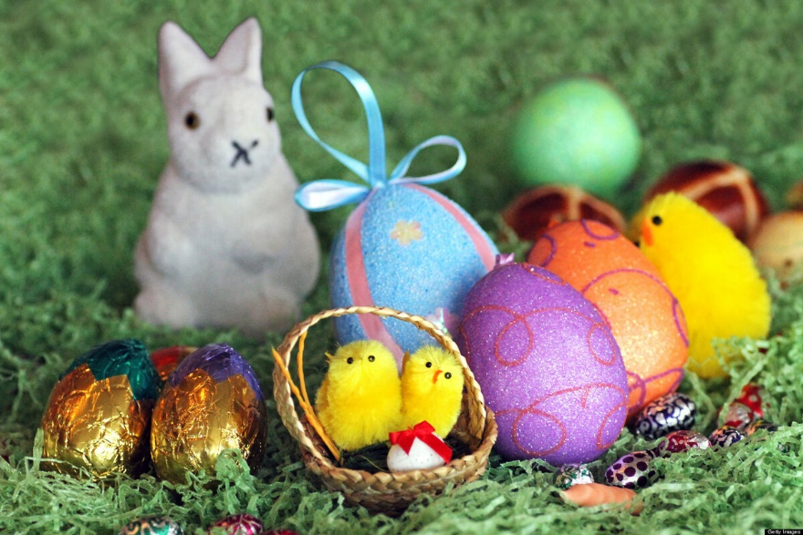
Easter
Easter is a Christmas holiday in March, April or May. At Easter people usually exchange dyed eggs and go to the church. Many modern Easter symbols came from pagan times: the egg was a fertility symbol, the Easter Bunny also is a symbol of a new life.
The Easter Bunny has usually a basket of eggs. The Easter Bunny colors eggs for young children to find on Easter morning. Easter is a spring holiday and it has a religious background. On Easter we celebrate the Resurrection of Jesus Christ. Today children in Britain like eating candy bunnies and listening to the stories about the Easter bunny.

Slide 9
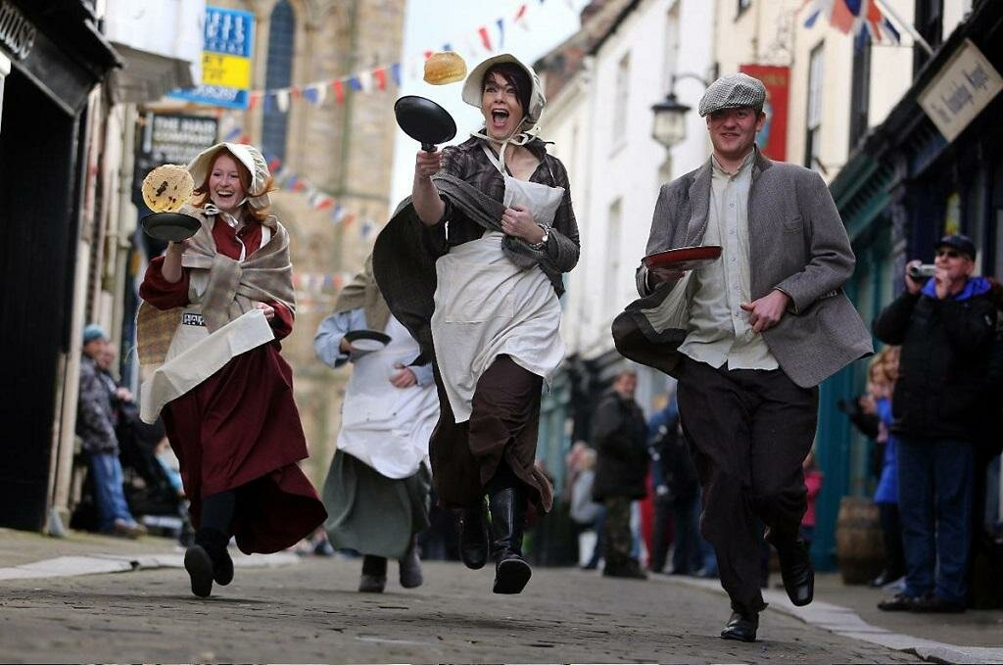
Pancake Day
It is a popular name for Shrove Tuesday- the last day of enjoyment before the fasting of Lent. On this day Christians confessed their sins to a priest. Many people still traditionally eat pancakes. One of the main events of this day is the pancake race at Olney. The competitors in the race are local housewives who make their pancakes and run from the village square to the church

Slide 10
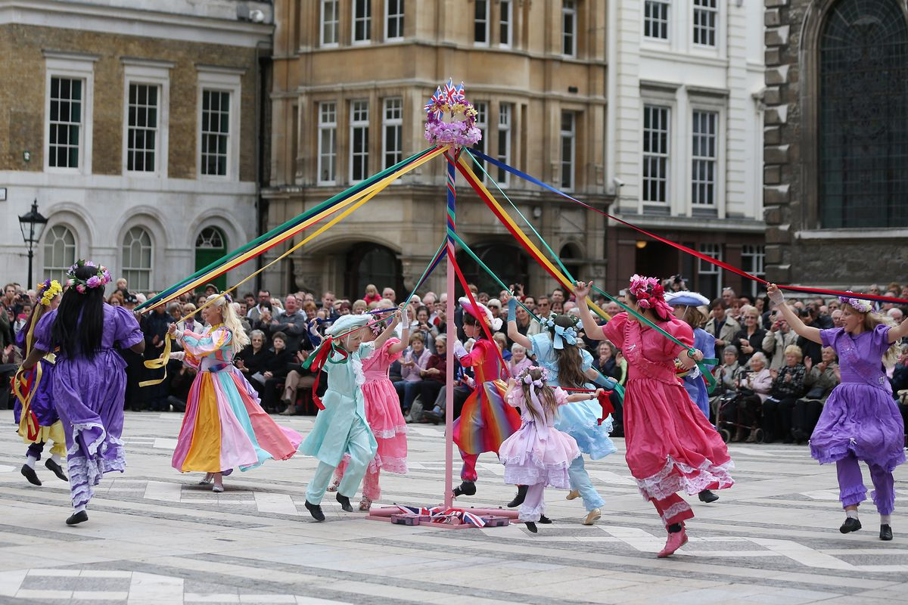
May Day
May Day is a public holiday, in some regions, usually celebrated on 1 May or the first Monday of May.
It is an ancient festival marking the first day of summer, and a current traditional spring holiday in many European cultures. Dances, singing, and cake are usually part of the festivities

Slide 11
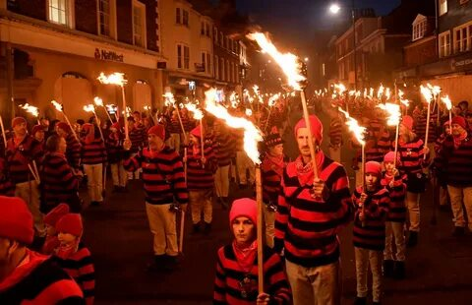
Guy Fawkes’ Day
Guy Fawkes Night or Bonfire Night is one of the most popular festivals in Britain. It commemorates the discovery of the so-called Gunpowder Plot, and is widely celebrated on November 5 all over the country.
The historical meaning of the event is no longer important, but this day is traditionally celebrated with fireworks and a bonfire, on which the figure of a dummy, made of straw and old clothes, called Guy is burnt. The occasion is usually accompanied by a supper or a barbecue in gardens.

