Slide 1
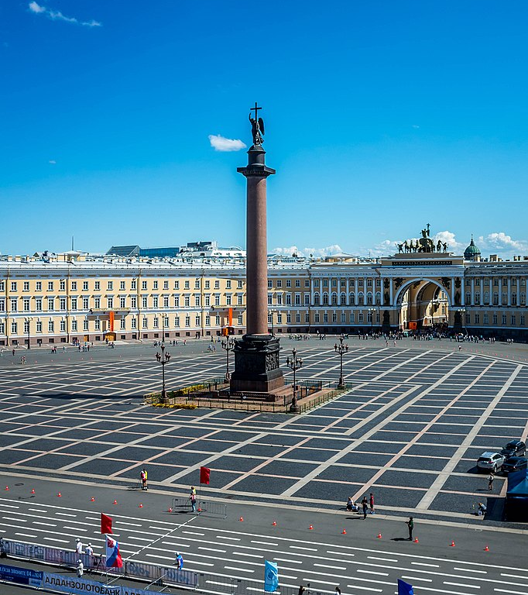
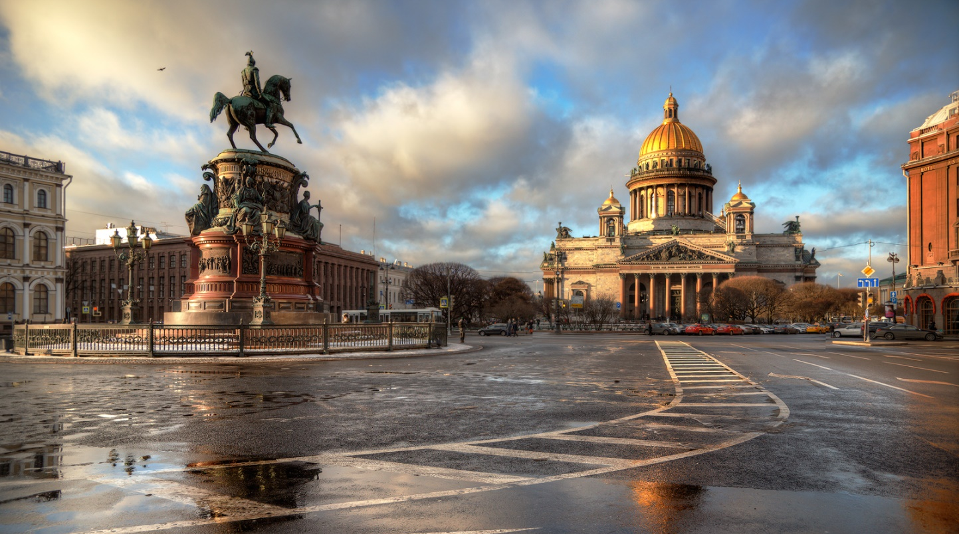
Saint Petersburg

Slide 2
Saint Petersburg is a big Russian city with a population of about 5 million people. The city was founded in 1703 by Peter the Great.

Slide 3
The main sights of Saint Petersburg:
The Hermitage Palace
The Field of Mars

Slide 4
SAINT ISAAC’S CATHEDRAL

Slide 5
The Church of the Savior on Spilled Blood

Slide 6
Kazan Cathedral

Slide 7
The Peter and Paul’s Fortress

Slide 8
The PALACE BRIDGE

