Slide 1
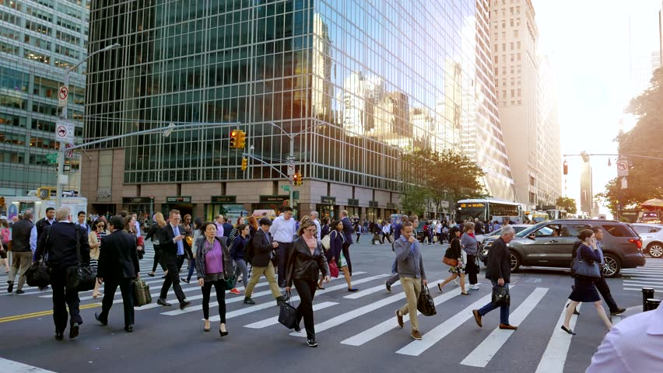
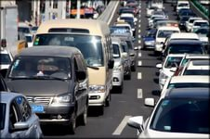
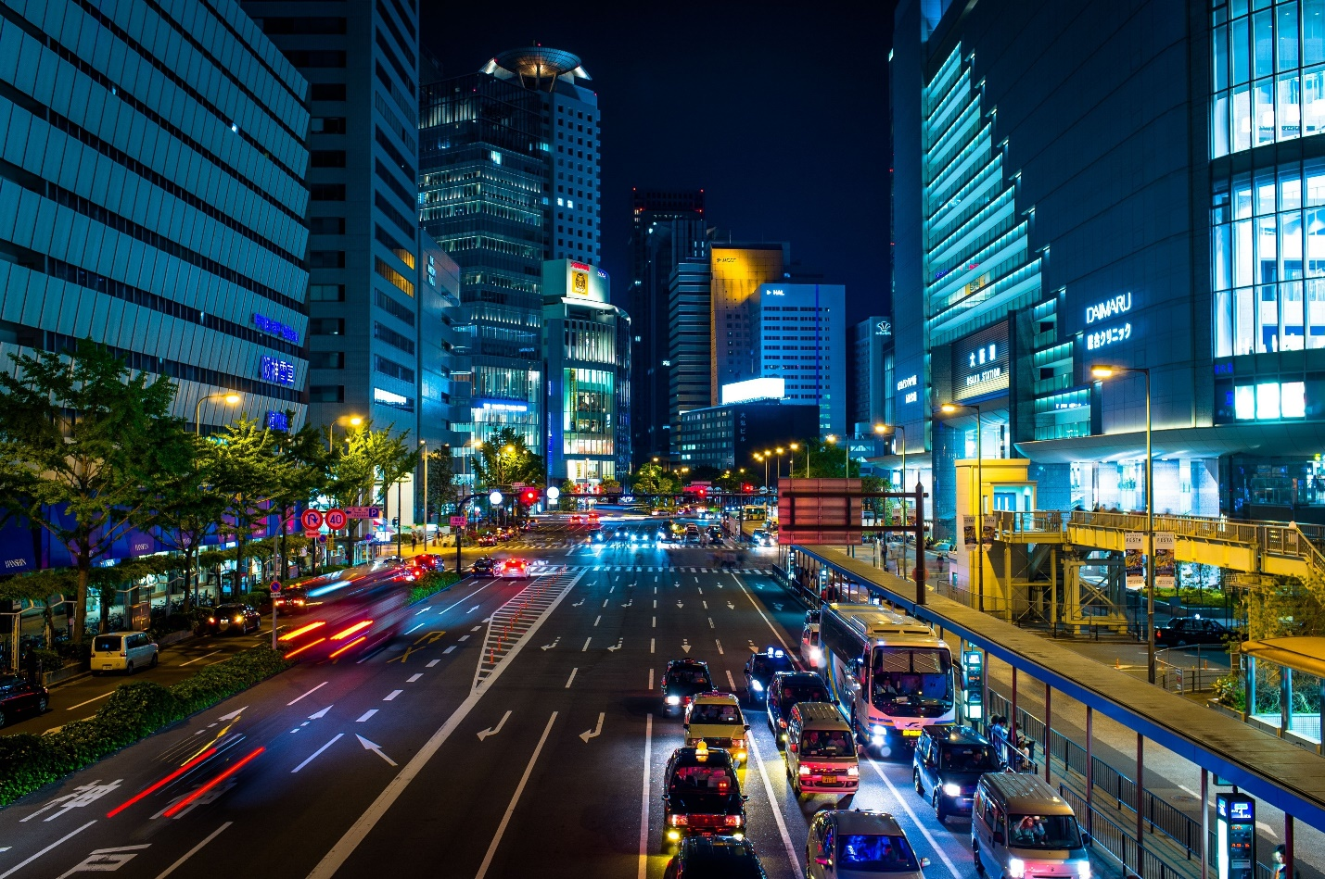
City and the problem of transport

Slide 2
The main aim for us today is to solve the problems of transportation in our city: traffic jams & exhaust emissions
To solve this problem we should:
revise the words related to the topic of the lesson;
read the texts for specific information;
have a talk about different kinds of transport;
decide what we should do to reduce traffic in our town.

Slide 3
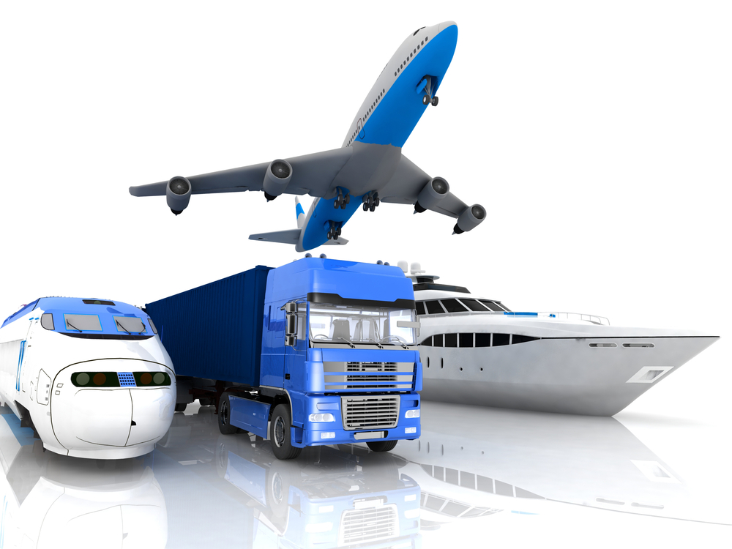
What kinds of transportation are used by people?
air transportation
land transportation
water transportation

Slide 4
Are roads in your town crowded? When?
What public transport is there in your town? When does it run?
Are you rely on busses? Would you like to have the Underground? Why?
Which means of public transport do you and your family members use? How do you find it: cheap, expensive, crowded, efficient, etc.?

Slide 5
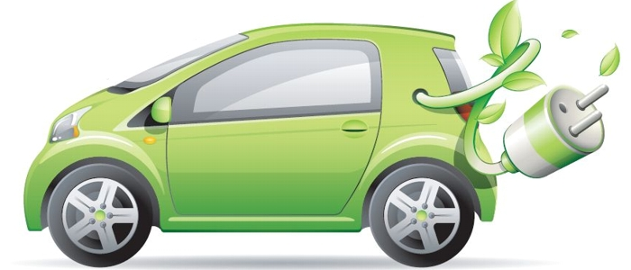
Green transport

Slide 6
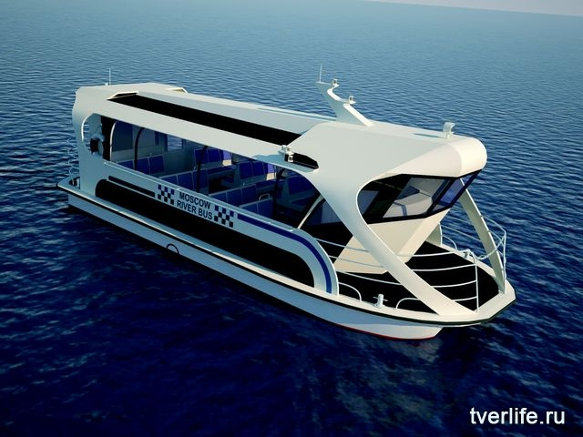
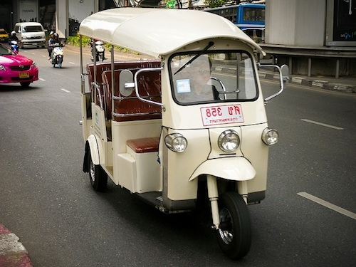
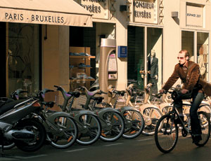
TUK-TUKS
Which of the features belong to each type of transport?
Wheels, a windscreen, windscreen wipers, seats, pedals, handlebars,a basket, headlights, a steering wheel

Slide 7
HOME TASK:
Make up a project or a leaflet about Green Transport / HOW to reduce exhaust emissions
or
Create and present your programme about the reduction of traffic in our town.
or
Write the essay:
What transportation problems does your local area face?
What solutions can you think of?

Slide 8
SELF-ESTEEM
Evaluate your work according to this evaluation card
Level reached | Importance of a problem issued by me | My interesting and useful ideas | My role during the lesson | My Vocabulary and Grammar | My work in the group
poor
fair
good
excellent
MY RESULTS
1. I can speak about …
2. Now I know many facts (words…) about …
3. It was interesting, useful to learn about…
4. The information about … was new, interesting, useful …
5. Next lesson I want to …

Slide 9
Reflection
Was our lesson exciting or boring?
Tell what you have learnt today,
what you liked most of all,
what difficulties you had

