Slide 1
Презентация по дисциплине английский язык на тему: «Our faculties»

Slide 2
Content
"Computer networks"
"Technology of pyrotechnic compositions and products"
“Installation and technical operation of industrial equipment (by industry)"
"Chemical technology of organic substances"
"Economics and accounting (by industry)"
"Master of instrumentation and automation"
“Hardware and software Adjuster«
Conclusion

Slide 3

Computer networks
Computer networks teach students to work in the field of programming. A clear selection of twenty-five people from a variety of applicants allows you to grow good specialists. This faculty is relatively new, but already enjoys success with new applicants.

Slide 4
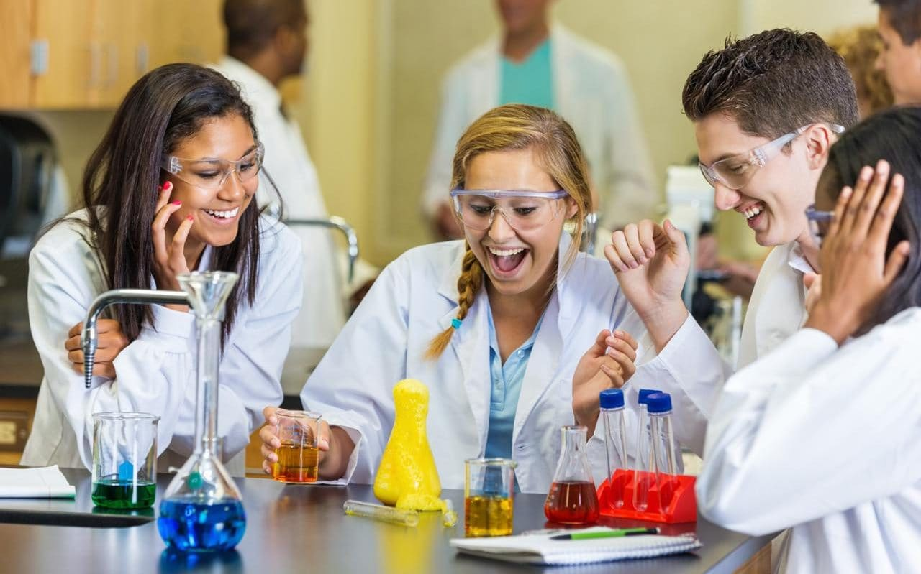
Technology of pyrotechnic compositions and products
Students of this specialty also call themselves "pyrotechnics" for short. This course trains students to work in the laboratory and with machines for research. They also teach you how to make tables and work with substances. It’s very interesting specialty.

Slide 5
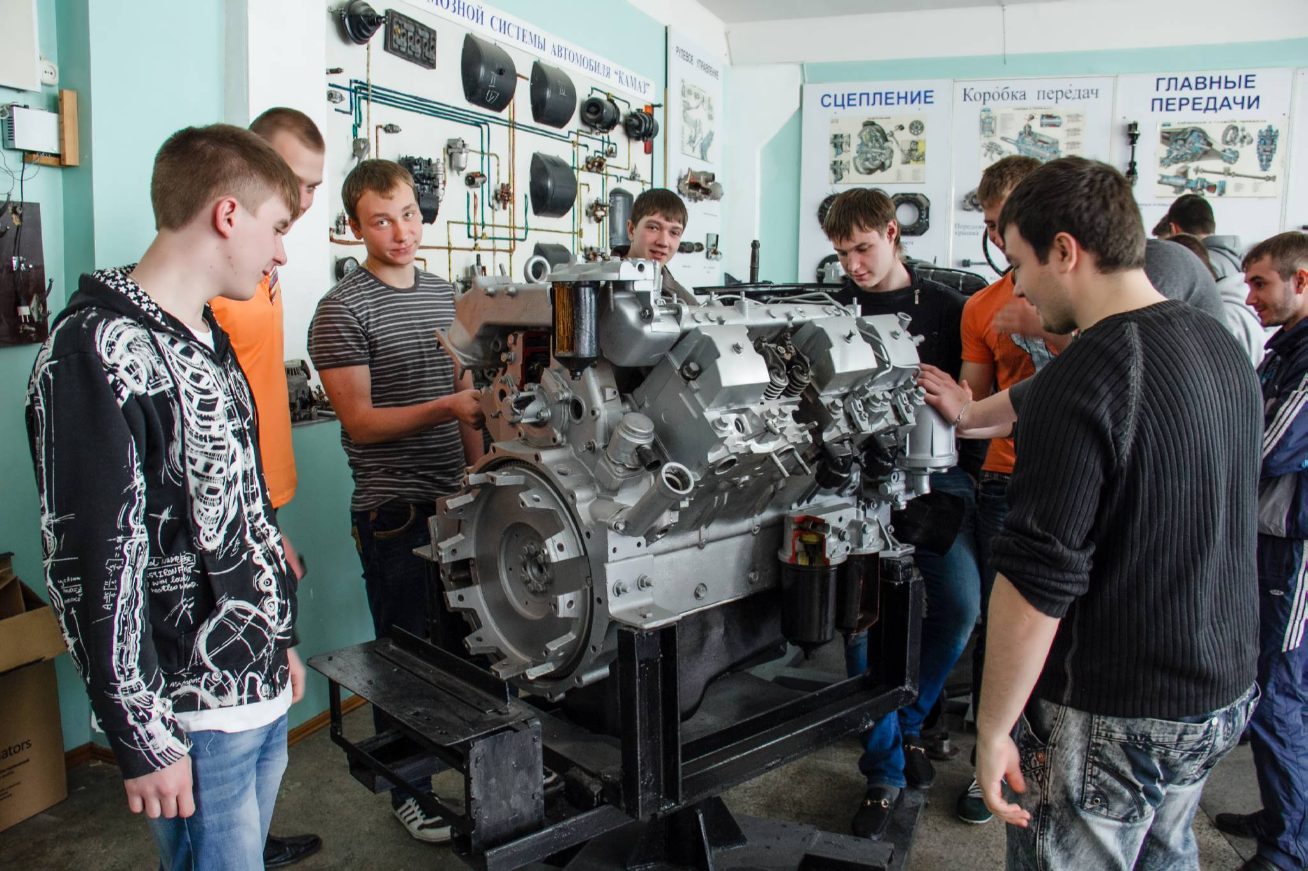
Installation and technical operation of industrial equipment
Students of this specialty are briefly referred to as "mechanics". Mechanics are taught to work with measuring instruments, tools, and industrial equipment. Guys in this specialty are usually very funny.

Slide 6
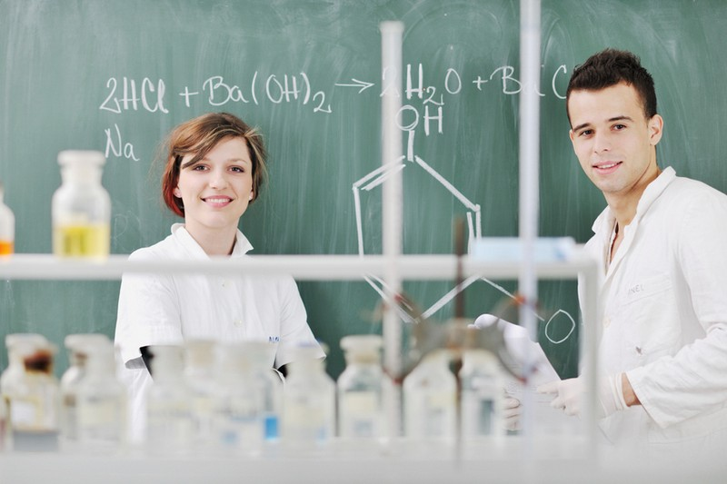
Chemical technology of organic substances
This specialty also trains students to work with chemical reagents, but unlike pyrotechnics, the emphasis is on organic chemistry. The work is carried out using notebooks and a laboratory.

Slide 7

Economics and accounting
Accounting is a paid profession, but despite this, it is still popular. In accounting, they teach counting and working with documents, mostly girls enter the specialty.

Slide 8
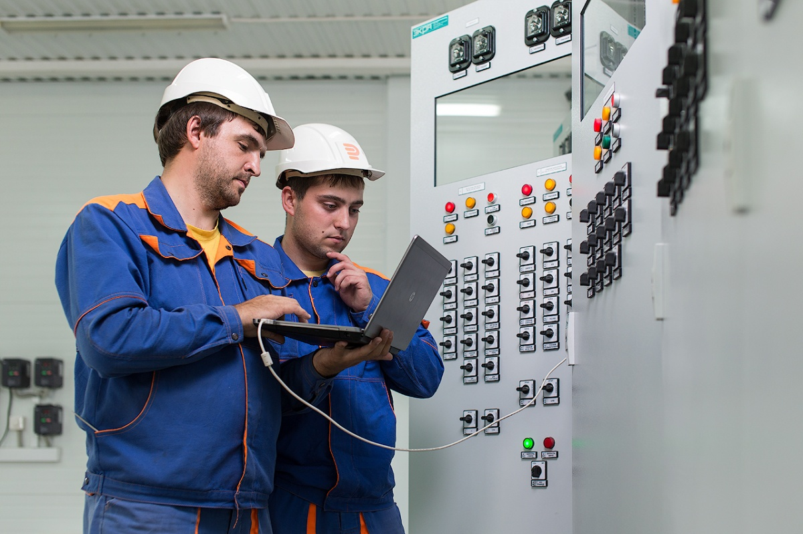
Master of instrumentation and automation
A master of instrumentation and automation is similar to a mechanic, but makes a greater bias towards automation. They will teach you how to work with measuring instruments, analyze their readings, and perform similar work.

Slide 9
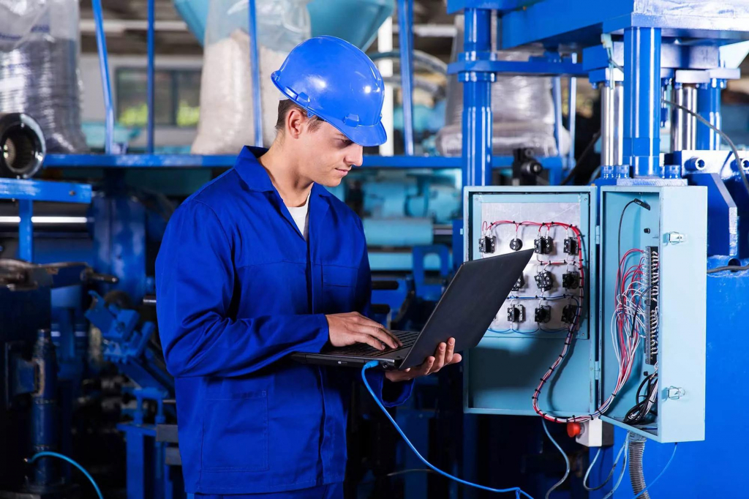
Hardware and software Adjuster
The specialty of the Adjuster is similar to mechanics, but unlike them, students are trained to fix problems related to devices and write off data from them.

Slide 10
All the specialties in our technical school are very interesting and entertaining. Everyone can find something of their own here and try to live the exciting life of a Red Army student.

