Slide 1
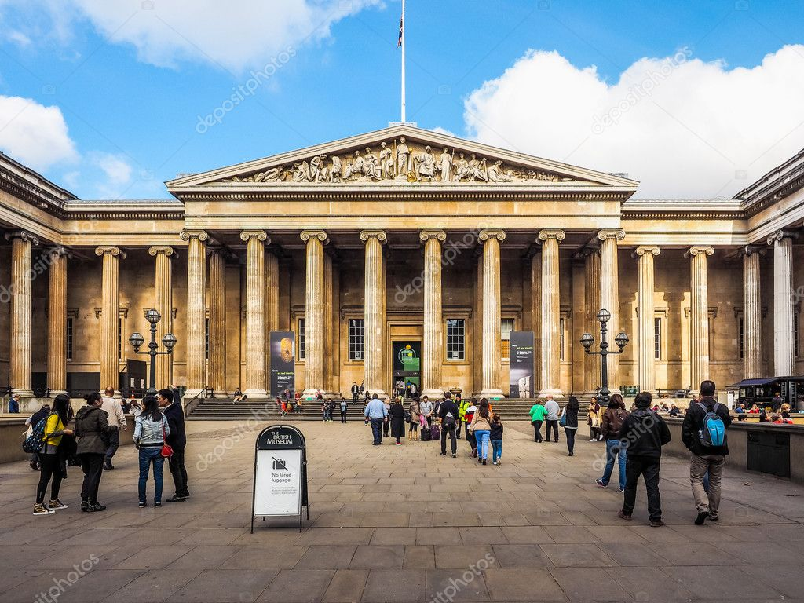
МИНИСТЕРСТВО ОБРАЗОВАНИЯ, НАУКИ И МОЛОДЕЖНОЙ ПОЛИТИКИ НИЖЕГОРОДСКОЙ ОБЛАСТИ Государственное бюджетное профессиональное образовательное учреждение «ДЗЕРЖИНСКИЙ ХИМИЧЕСКИЙ ТЕХНИКУМ ИМЕНИ КРАСНОЙ АРМИИ»
Museums and Art Galleries of London
Подготовил: преподаватель иностранного языка,
Холодилова М.А.

Slide 2
« When the man is tired of London, he is tired of the life; for there is in London all that life can afford.»
Dr. Samuel Johnson

Slide 3
Listen and repeat a tongue – twister:
Betty Botta bought some butter,
«But», she said, «this butter’s bitter,
But a bit of better butter
Will make my batter better».
2) Elizabeth, Betty, Betsy and Bess,
They all went together to seek a bird’s nest.
They found a bird’s nest with five eggs in,
They all took one, and left four in.

Slide 4
Translate from Russian into English:
Осматривать достопримечательности;
Художественная галерея;
Быть известным во всем мире;
Одна из известнейших художественных галерей;
Быть основанным;
Вмещать, содержать что-либо;
Значительная коллекция;
картина;
Известнейшая галерея Великобритании;
портрет

Slide 5
Translate from Russian into English:
Быть известным чем-либо;
Представлять что-либо;
Различные виды портретов;
Традиционная картина маслом;
Содержать уникальную коллекцию;
Современная скульптура;
Изобразительное и прикладное искусство;
Быть названным в честь кого-либо;
Богатейшая коллекция в мире;
Древность;
Восковая фигура;
скульптурный портрет

Slide 6
Translate from English into Russian:
For those people who prefer food for thought there are very many museums, exhibition halls and picture galleries.
There are different kinds of museums.
Those who are interested in history can find a lot of useful and unusual information in history museums.
To understand arts and to enjoy masterpieces of art one should visit Art Galleries and exhibition halls.
There are a great number of museums all over the world.
One of the largest museums in Great Britain is the British Museum, which is the best known national museum of antiquities and ethnography. It is situated in London.
The British Museum is a huge beautiful building with a high round reading hall in it. It is famous for its greatest library.
Here you can find everything you want: English Chronicles, autographs of great writers, Greek and Latin manuscripts, books and magazines from all parts of the world.
There are also lots of other memorials in the museum: the Hall of Mummies, the Ethnography Department, the Arts of Par East and so on.
There are always many visitors from all countries in the British Museum.

Slide 7
Museums and Art Galleries
The title of museums and galleries | The date of foundation | The main exhibits

Slide 8
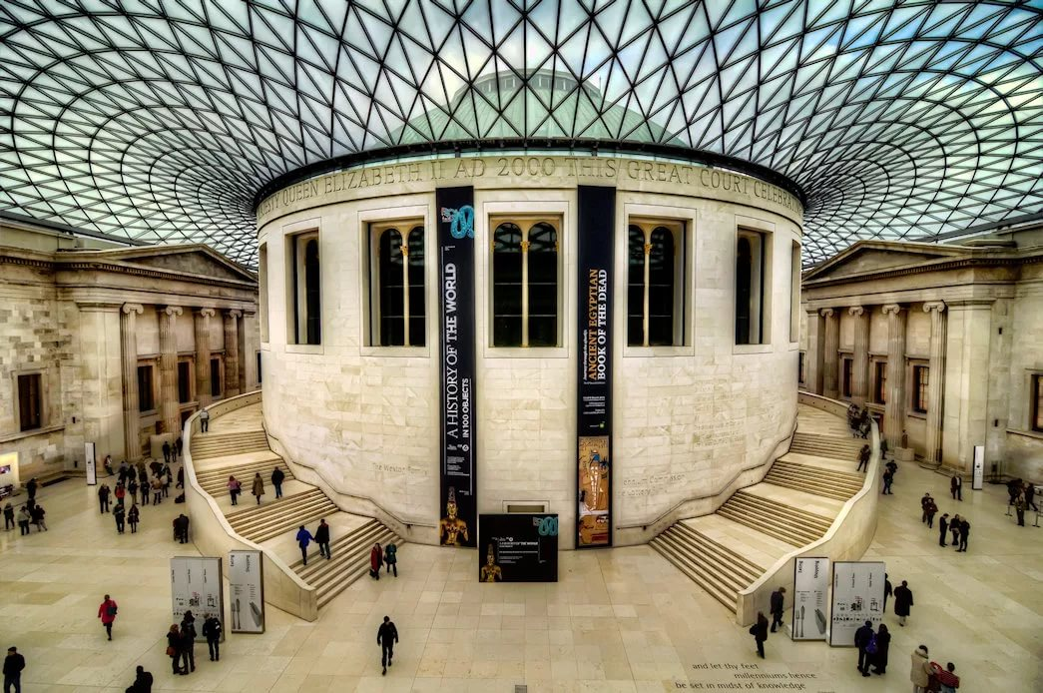
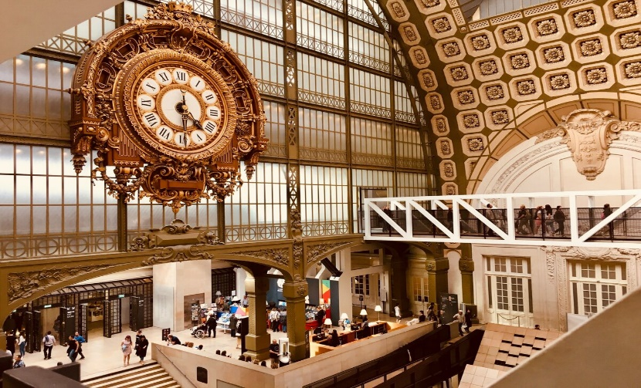
Museums and Art Galleries
1. The British Museum

Slide 9
The British Museum
It was founded in 1753 on the collection of Sir Hans Sloane. The money to house them was raised by a public lottery. Now it has two departments: the Museum of Mankind and the National History Museum. The Museum of Mankind includes a vast collection of antiquities, marbles from the Parthenon, the Rosetta Stone that provides the key to Egyptian hieroglyphics, ancient works of art in stone, bronze and gold, the collection illustrating Western Asiatic civilizations. The Natural History Museum contains 5 principal collections on the history of plants, minerals, the animal kingdom. New permanent exhibitions have been opened in the museum.

Slide 10
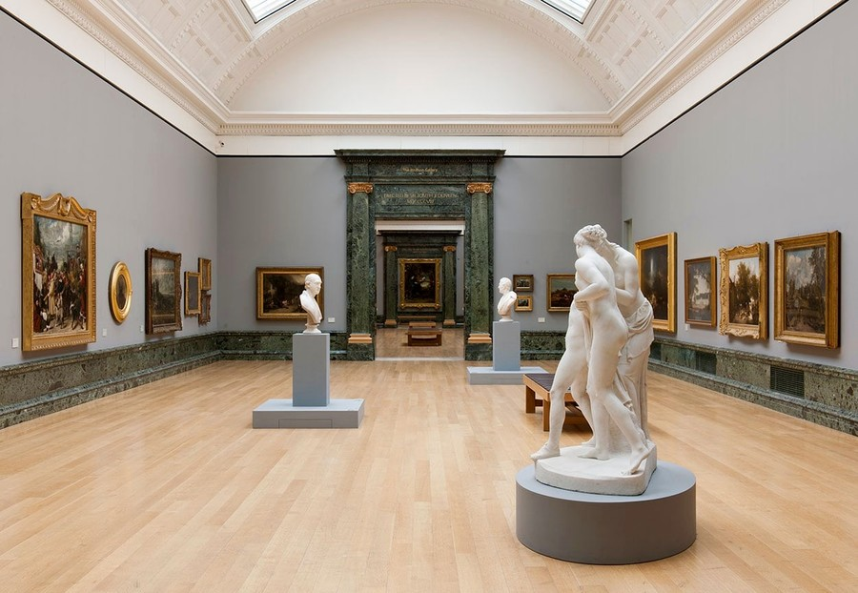
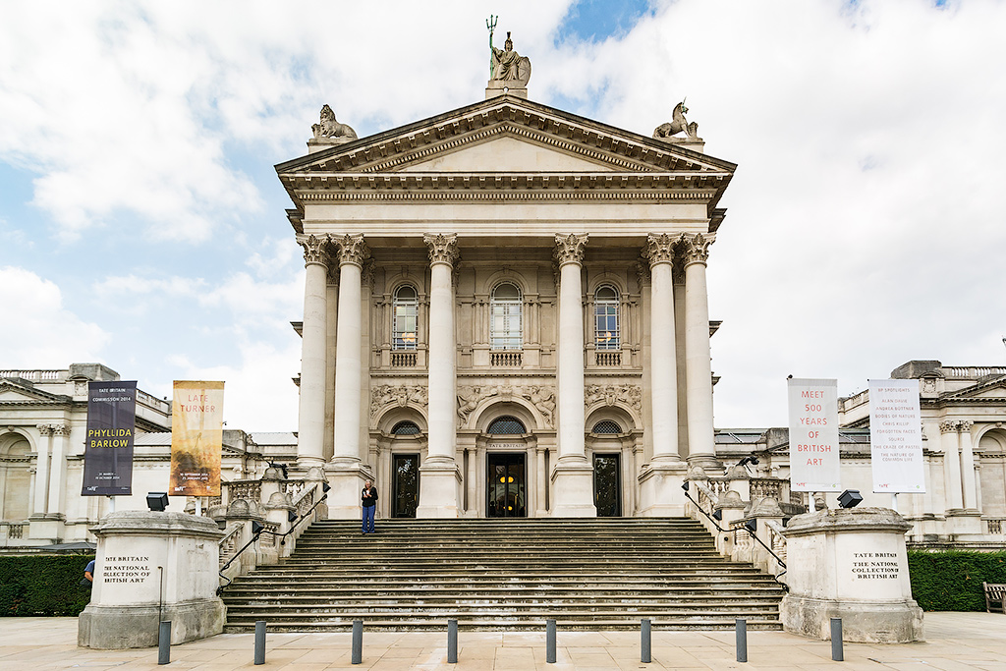
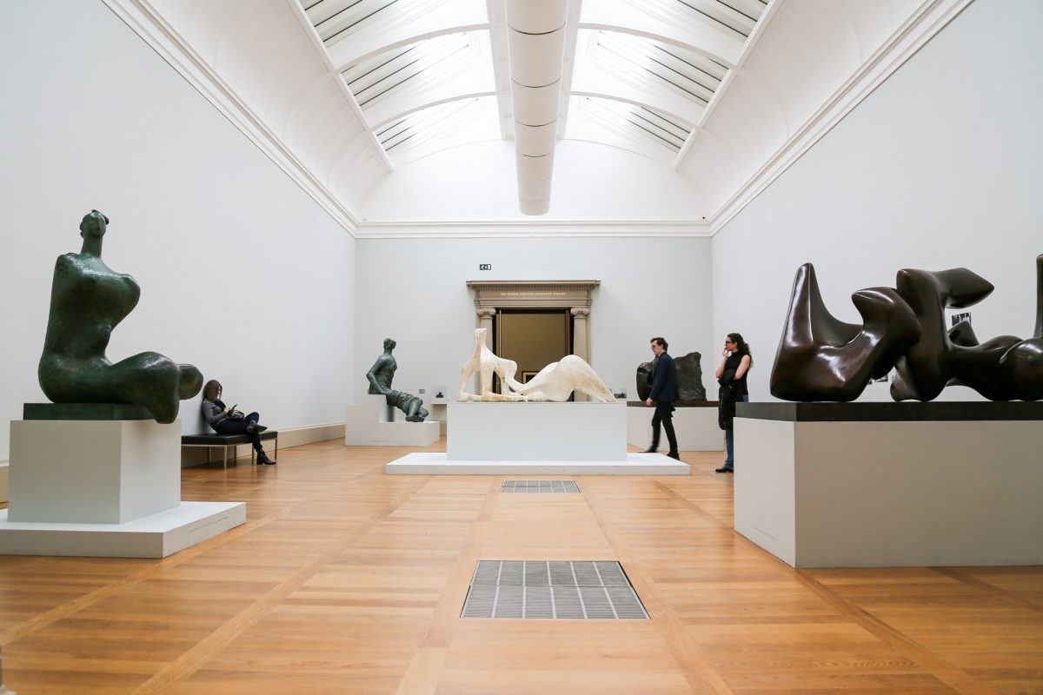
The Tate Gallery

Slide 11
In Westminster we can find the Tate Gallery which contains the unique collection of British painting from the 16th centuries till present days.
It was founded by a sugar manufacturer Henry Tate in 1897 as a private collection. Later it was presented as a gift to the country. Now there are more than 300 oil and 19000 water colours and drawings.
There are a lot of paintings of the 16th century by English painters. Also, you can see many paintings by foreign artists of the 19th century. Here you can see works of William Turner, Pablo Picasso, Henry Moor, Joshua Reynolds, William Hogarth, paintings by impressionists, post-impressionists and others.
The Gallery exhibits many outstanding works of famous English and foreign artists. Here you can see the sculptures of Henry Moor. Besides, you can see the works of a famous English painter William Turner. His pictures are connected with sea. One hall of the Gallery is devoted to the masterpieces of Sir Joshua Reynolds. The most famous of his paintings are: “ Self – portrait “,“ The Portrait of Nelly O’Brien”, “ The Portrait of Samuel Johnson” and others. In the William Hogarth’s hall there are many group portraits. For example: “ The Graham Children”, “ The Marriage – a – la- Mode” and others. The paintings of this Gallery empress everybody who visits it.

Slide 12
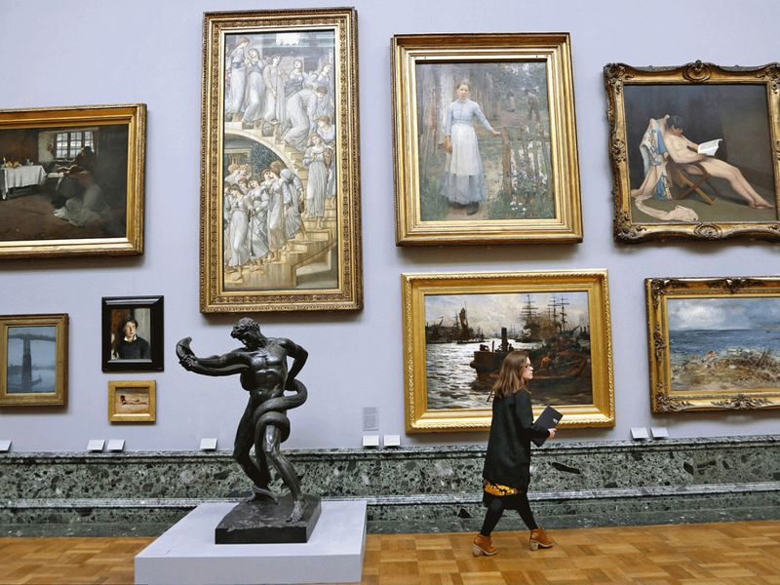
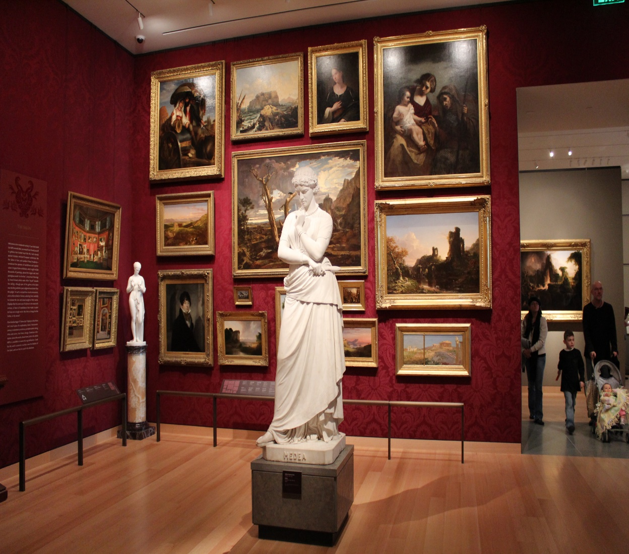
The Tate Gallery

Slide 13
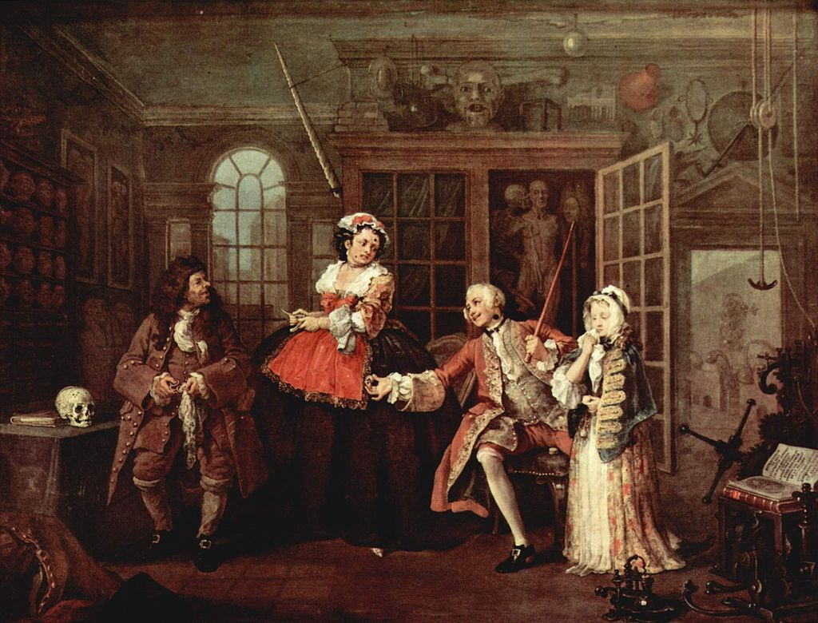
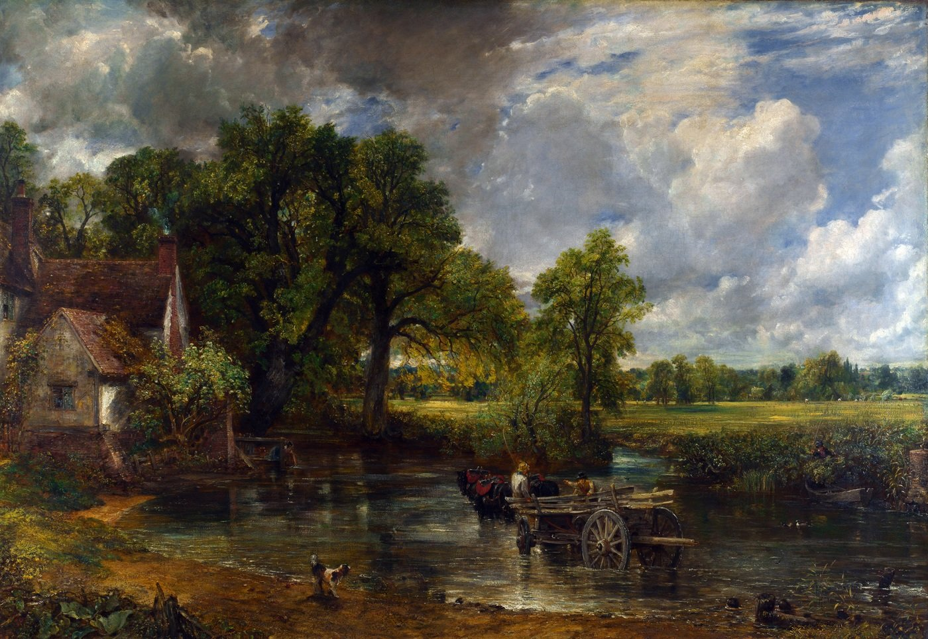
The Tate Gallery
William Hogarth “Marriage a-la-mode”
1743—1745
John Constable “The Hay Wain”
1821

Slide 14
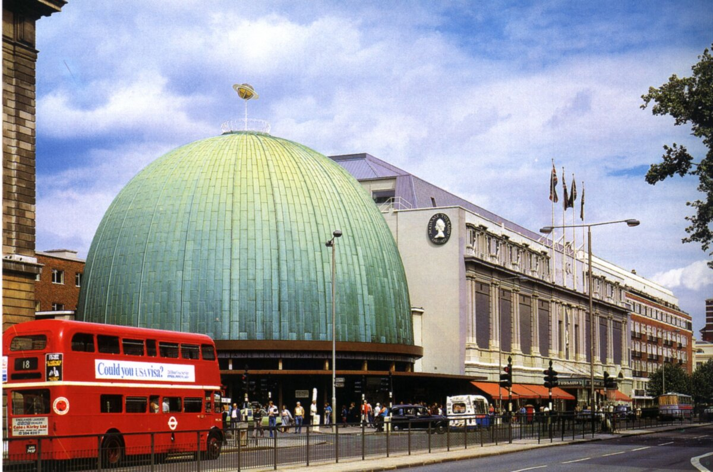
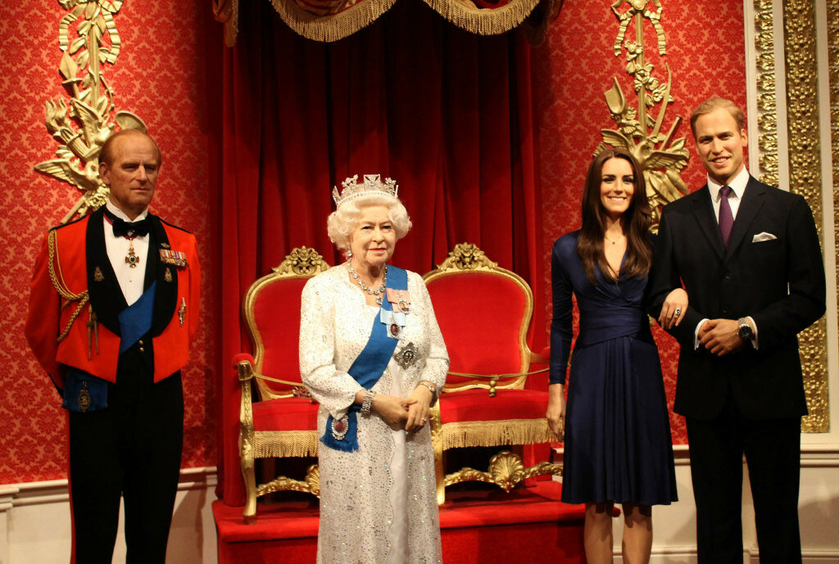
The Museum of Madame Tusseaud

Slide 15
The Museum of Madame Tussaud’s, which is situated in Marylebone.
Who knows what kind of museum is it?
It’s a wax museum.
Situated near the Baker Street tube station, this attraction is one of the most popular that London has to offer. Madame Tussaud first arrived at the capital in 1802 bearing the sculptured heads of executed French aristocrats and ever since “her” wax models have been pulling in the crowds. The exhibition is split into several sections in which visitors can see replicas of the famous and the infamous from both past and present. Models include politicians like Margaret Thatcher, Roosevelt, pop stars like the Beatles, and royalty like Prince Charles and Lady Di, Elvis Priestly, Marilyn Monroe, Michael Jackson, Bill Clinton and others.
There is usually a long queue in front of the museum. Many tourists would consider their trip to London worthless if they didn’t visit the famous museum. There are several halls in the museum. Highlights include the Grand Hall, the Chamber of Horrors and “ The Spirit of London” exhibition.
Here you can see the figures of two famous women. We are sure that you know who they are.They are Victoria Beckham and Marilyn Monroe. You can come to them, ask different questions and ask for a sign. These models can move and speak.
Welcome to our museum every day!

Slide 16
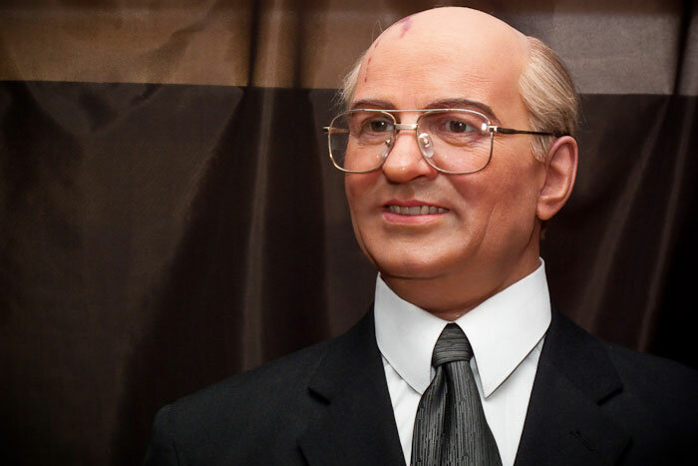
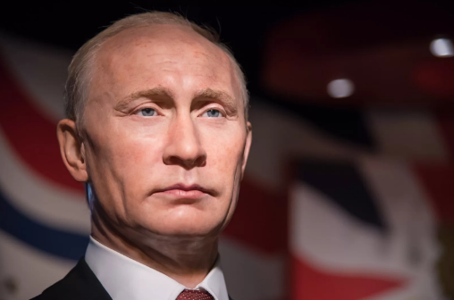
The Museum of Madame Tusseaud

Slide 17
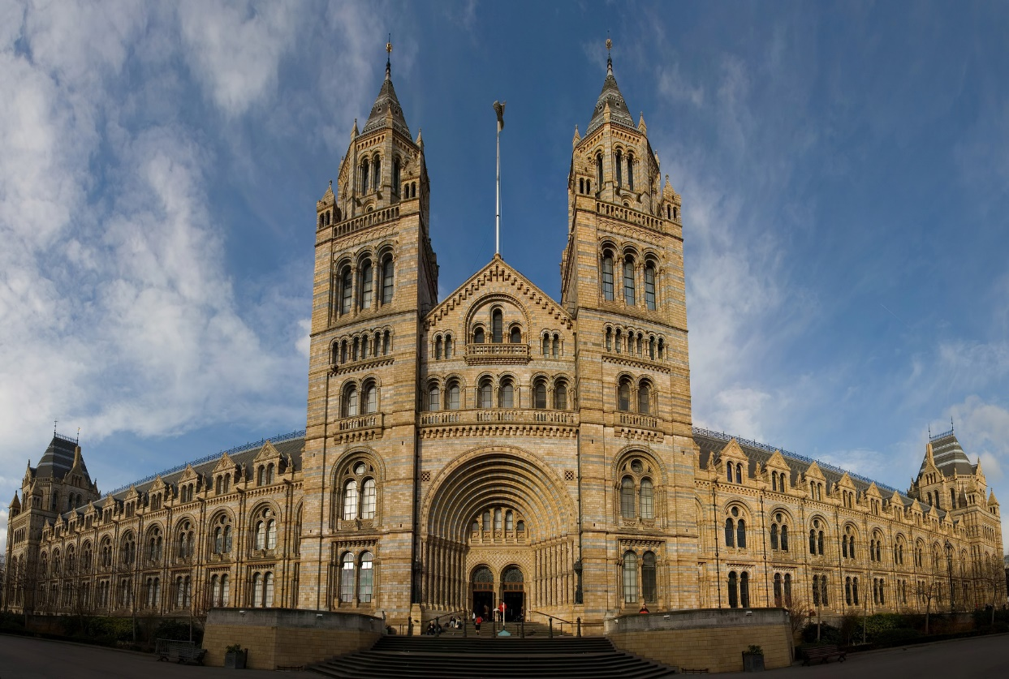
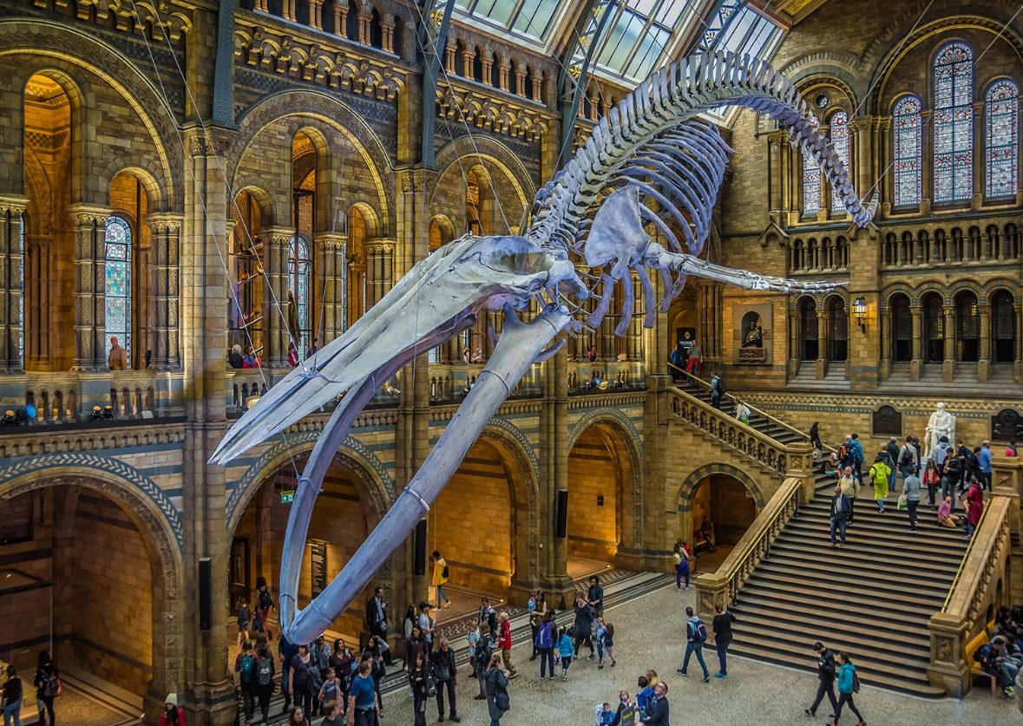
The Natural History Museum

Slide 18
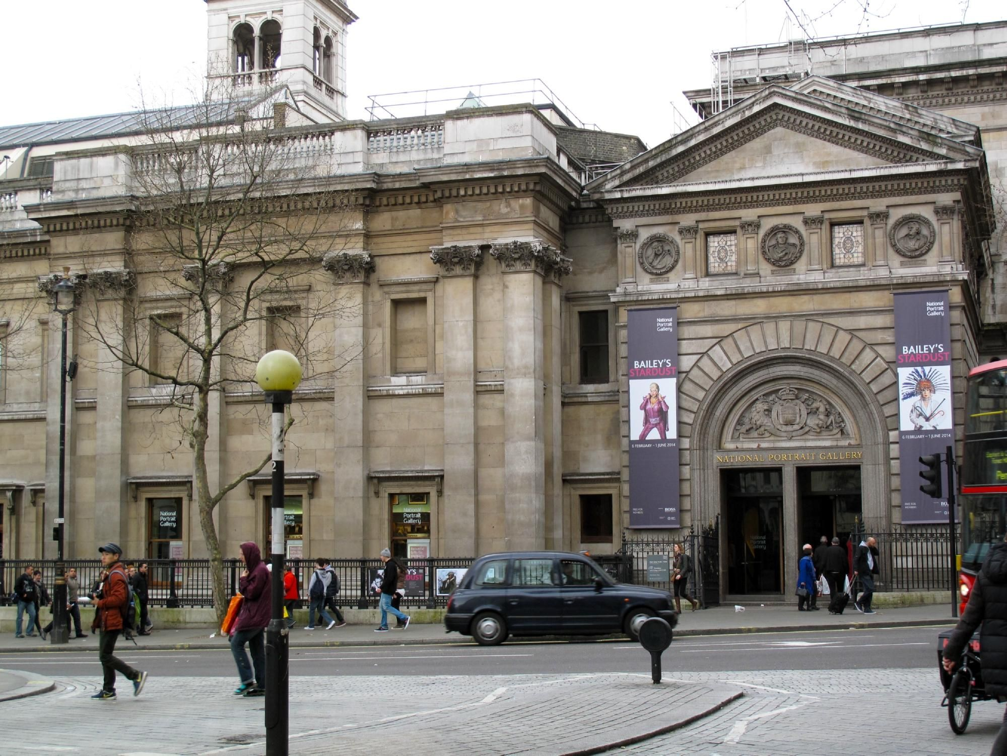
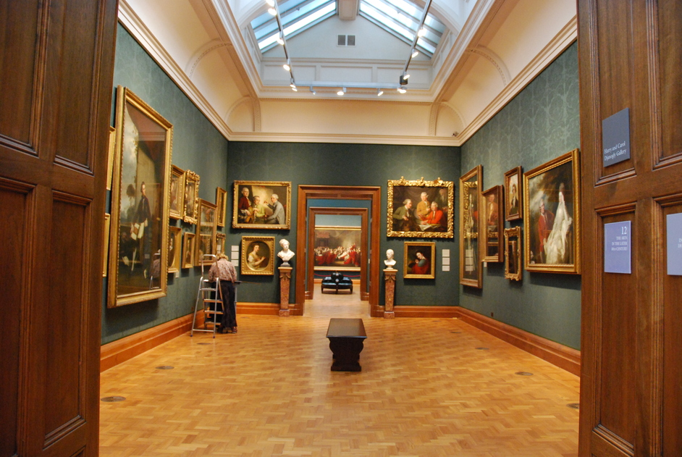
The National Portrait Gallery
The National Gallery is a world-famous art museum. It is located in London in Trafalgar Square. The National Gallery is situated right behind Nelson’s Column.

Slide 19
The National Portrait Gallery (NPG) is an art gallery in London housing a collection of portraits of historically important and famous British people. It was the first portrait gallery in the world when it was opened in 1856. Not all of the portraits are exceptional artistically, although there are self-portraits by William Hogarth, Sir Joshua Reynolds and other British artists of note. Some, such as the group portrait of the participants in the Somerset House Conference of 1604, are important historical documents in their own right.

Slide 20
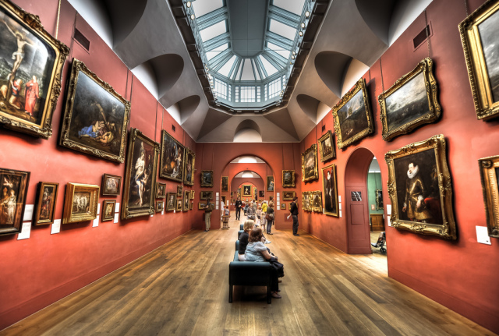
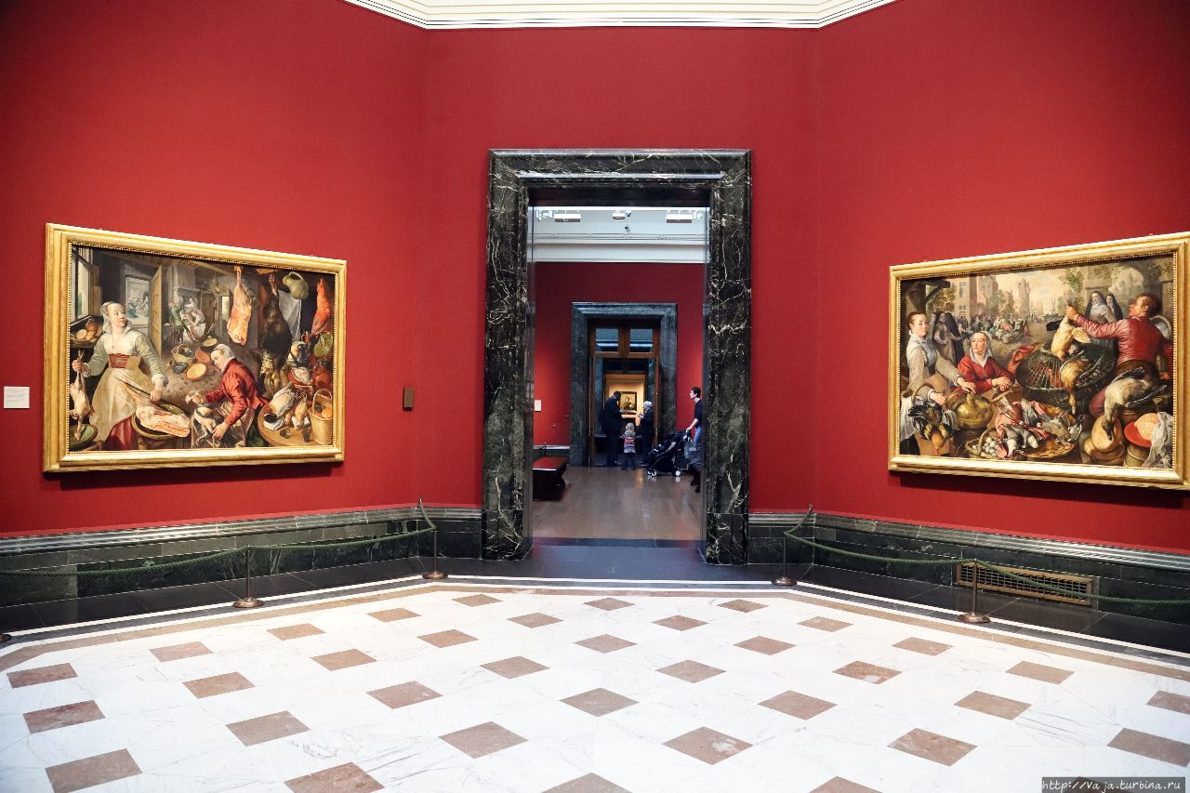
The National Portrait Gallery

Slide 21
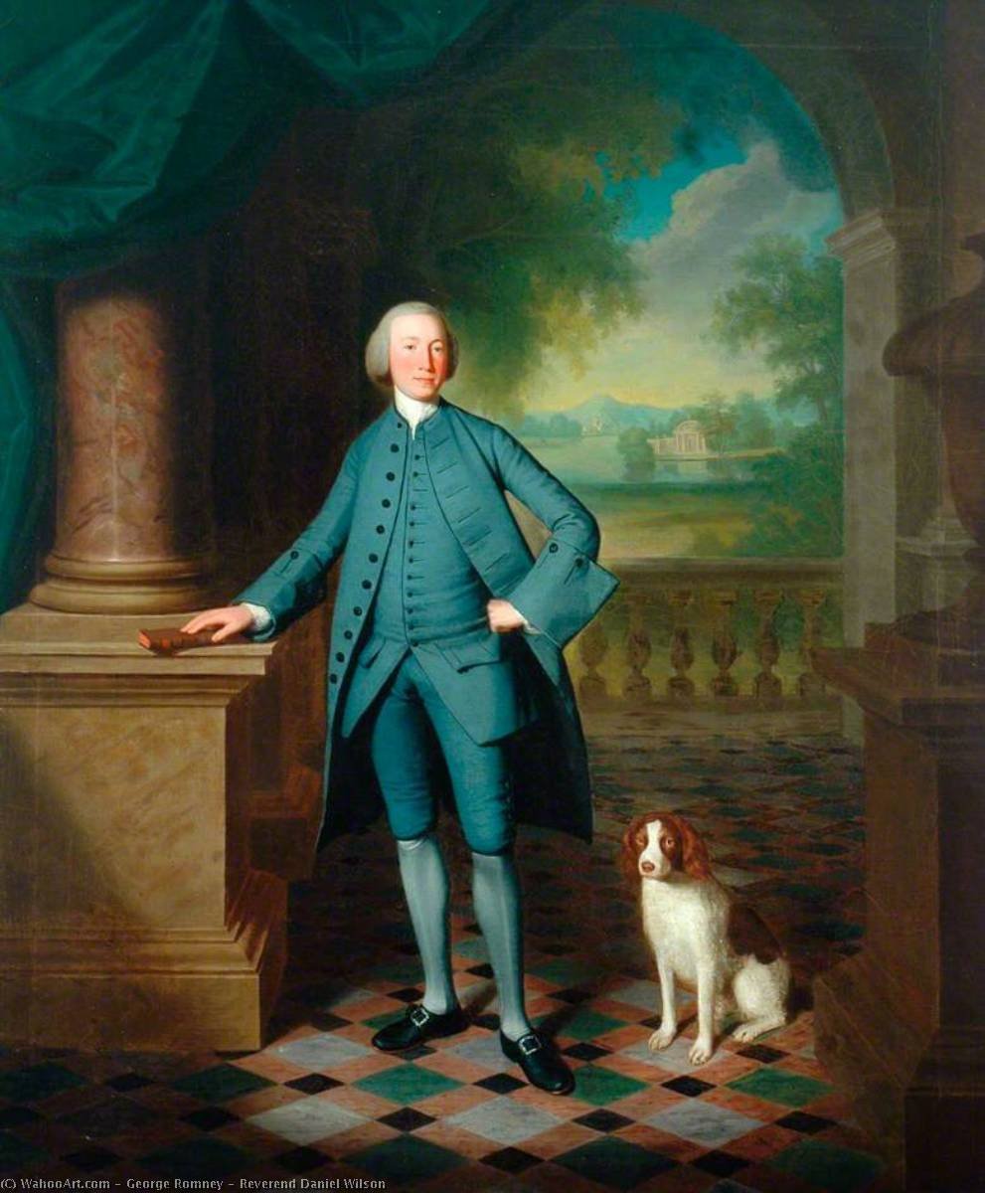
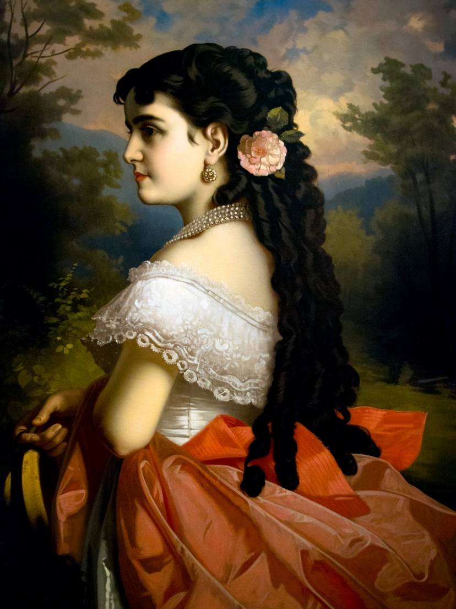
The National Portrait Gallery
Adelina Patti
“George Romne”
Richard Cumberland

Slide 22
Read and translate the text “The Transport Museum”; Answer the following questions:
When was the first double-decher bus built?
What was the speed of the petrol engine bus?
Where were the first train used?
What was the name of the first steam train?
What was world record speed for a steam train?

Slide 23
Fill in the gaps:
1. The Museum of British Transport is in……………………………………
2. In ……………… Shillibeer started the first …………………….. in London.
3. The first bus was drawn by … and looked like ….. .
4. The first trains were used in …………………………………………………………
5. The first passenger railway in England (and in the world) was ………………… .
6. Stephenson’s train was called …………………………………

Slide 24

Listen to the dialogue
Underline the words you have just heard:
Hours of operation, provide, flash, industrial, significant collection sculpture, construction, industrial prosperity, local people
2. Answer the questions

Slide 25
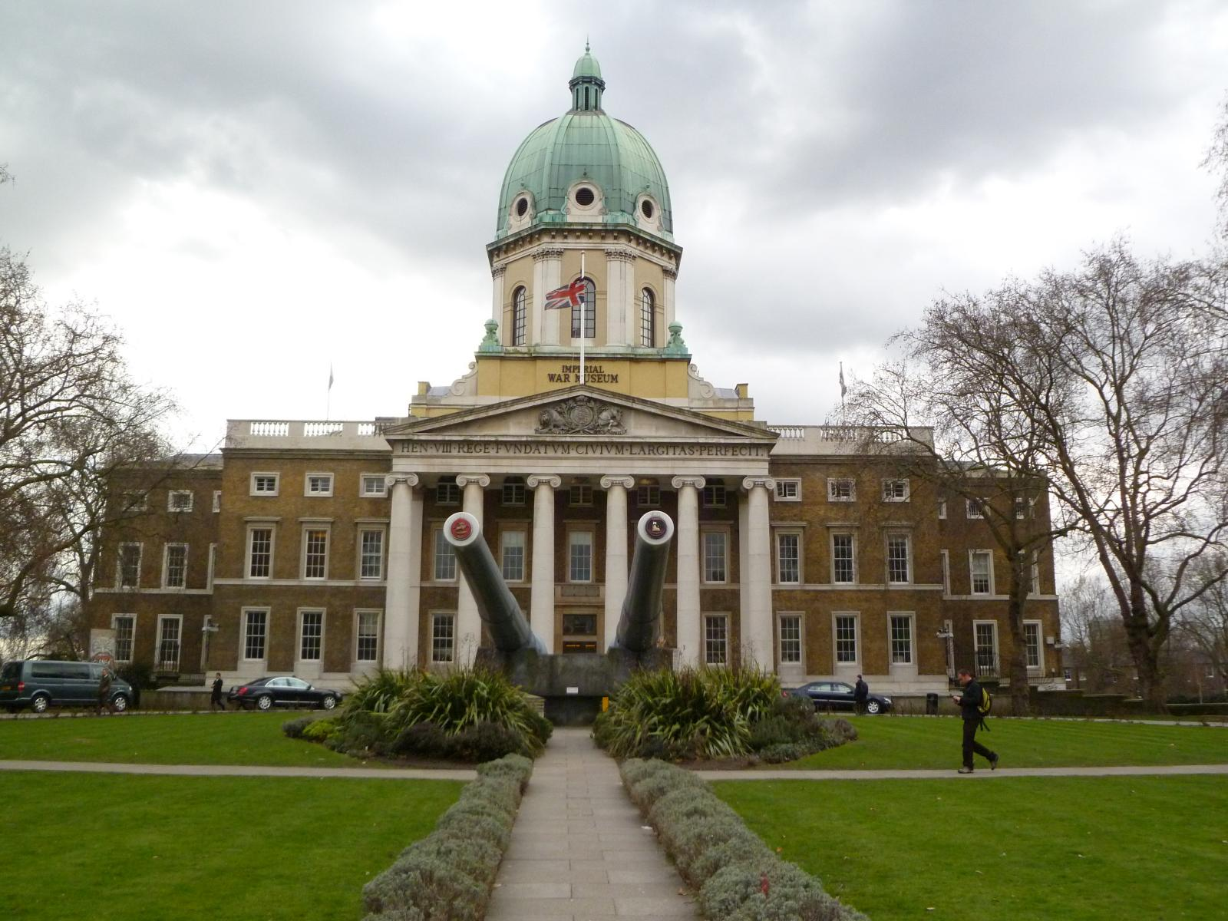
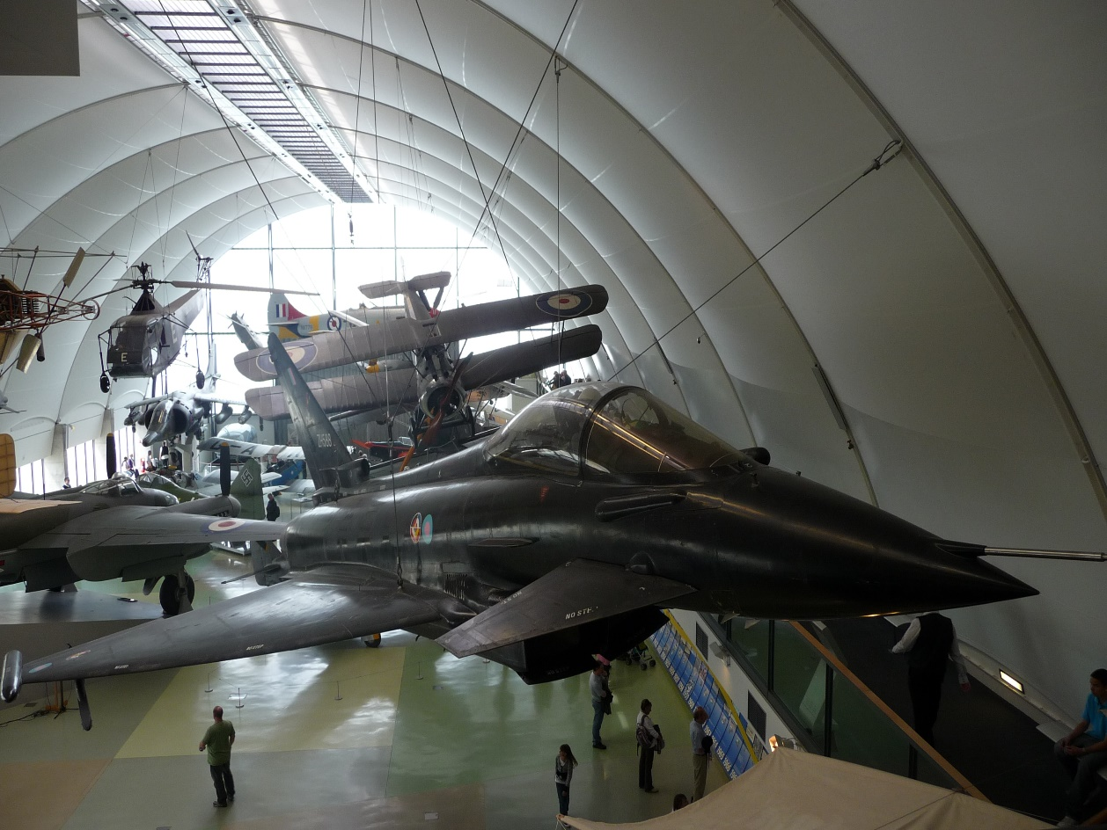
The Imperial War Museum
The Imperial War Museum – 1917 – in Lamberth – a military museum, exhibits that illustrate all aspects of 2 world wars and other military operations of Britain since 1914.

Slide 26
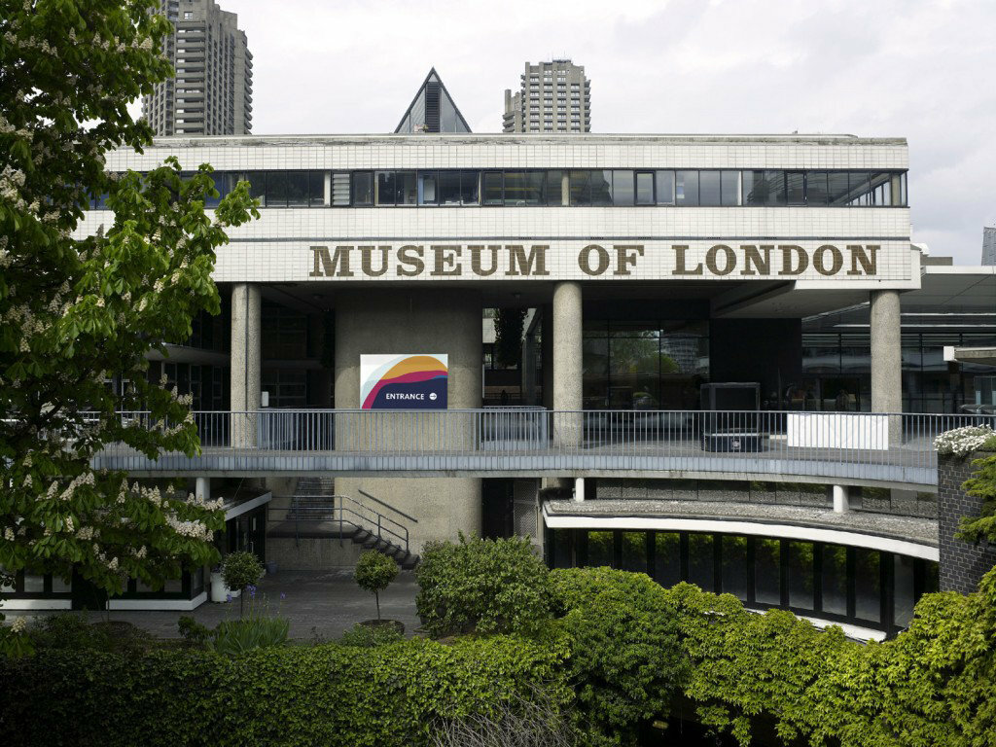
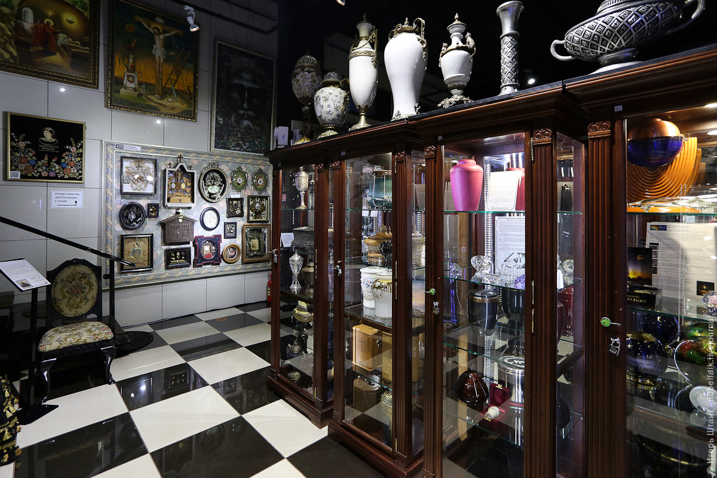
The Museum of London
The Museum of London – 1976 – in the City – a museum of history of London from prehistoric times to the present days.

Slide 27
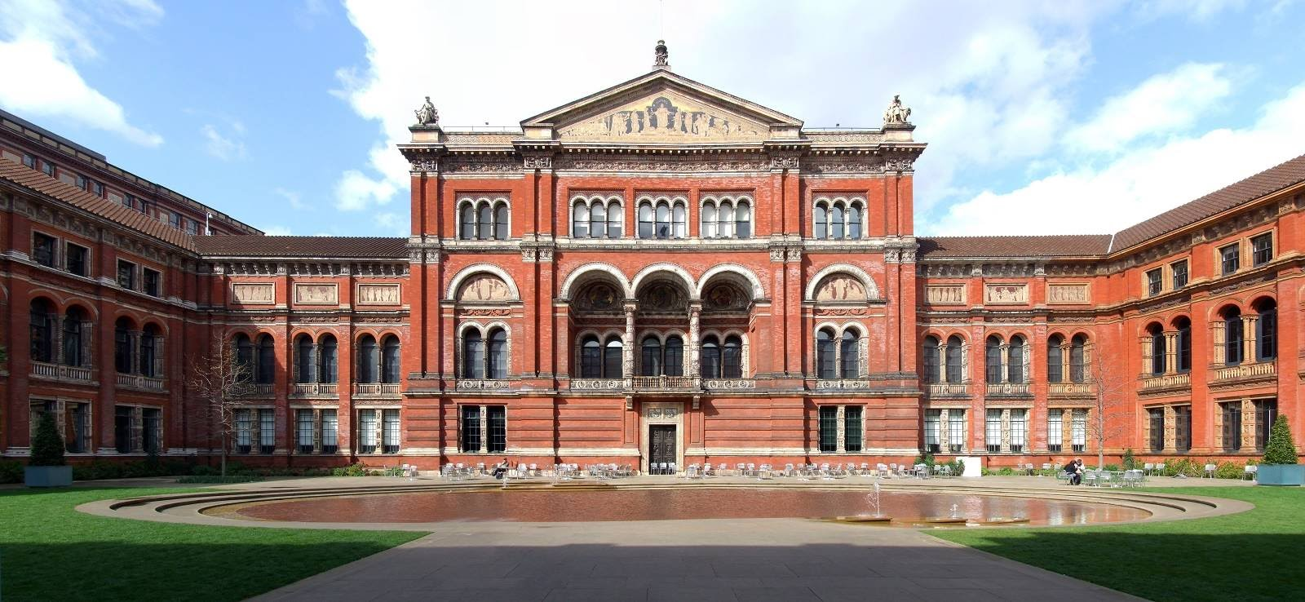
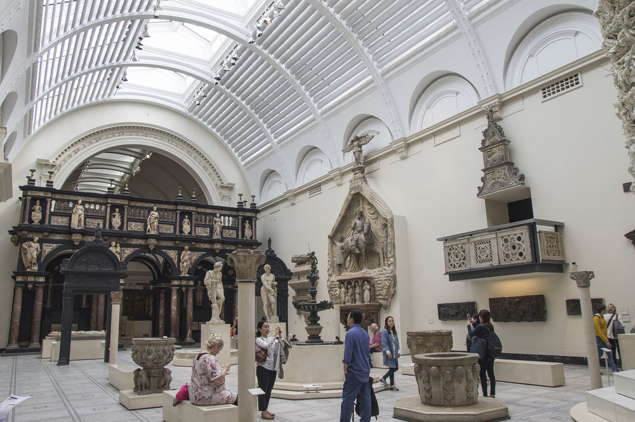
The Victoria and Albert Museum
The Victoria and Albert Museum – 1857- contains a collection of fine and applied arts, a collection of miniatures, watercolors, sculptures. It was named after Queen Victoria and her husband Prince Albert.

Slide 28
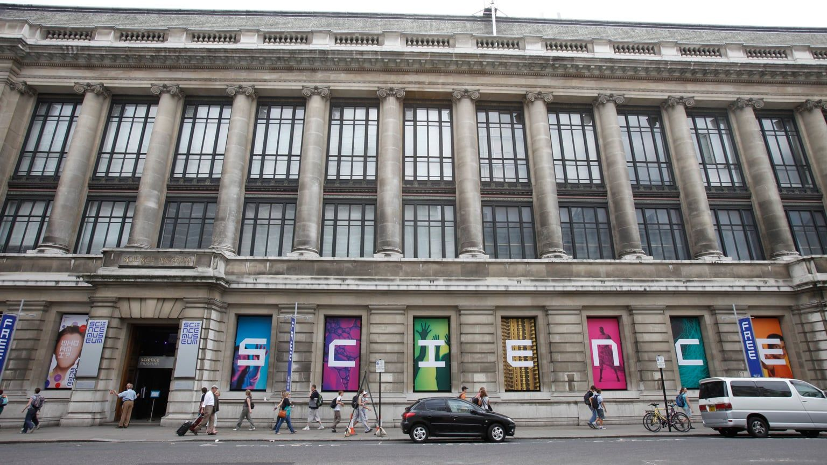
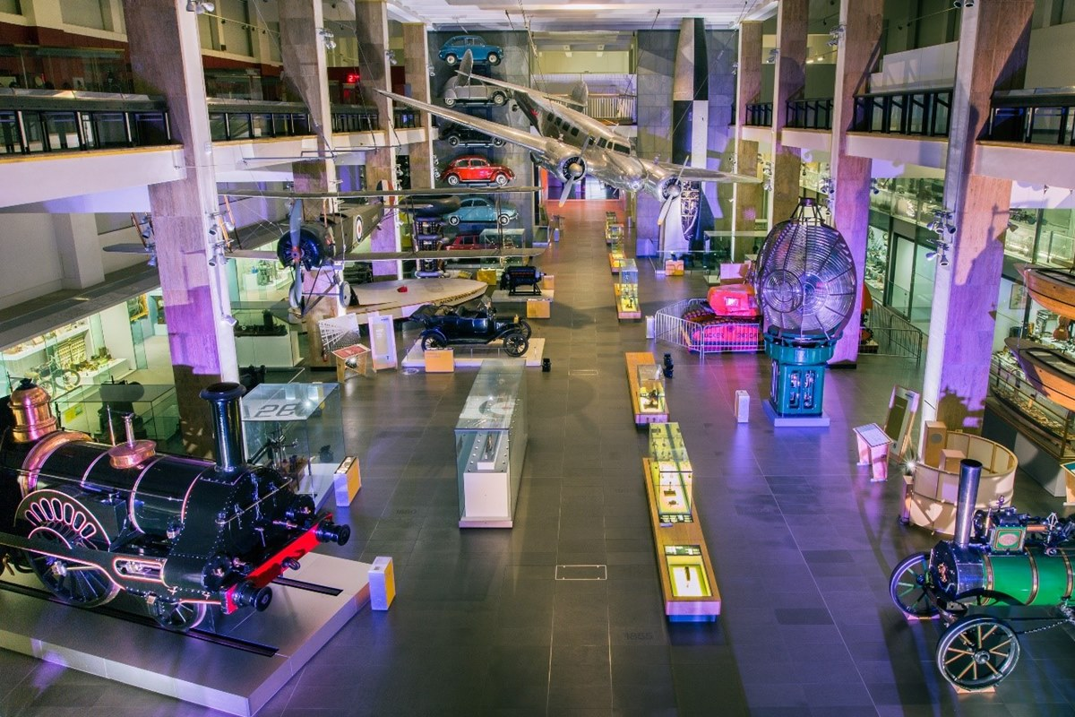
The Science Museum
The Science Museum – 1851- housing collections that illustrate the history and development of science, engineering and industry with many working models

Slide 29
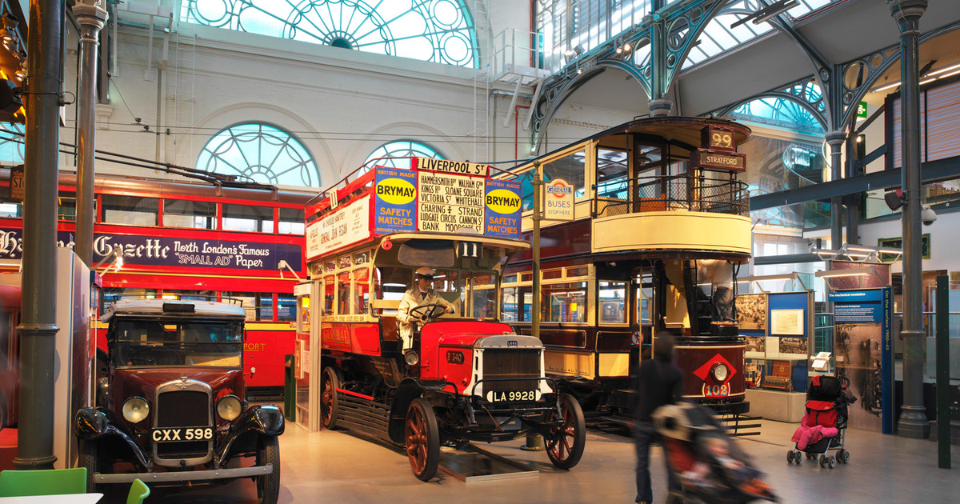
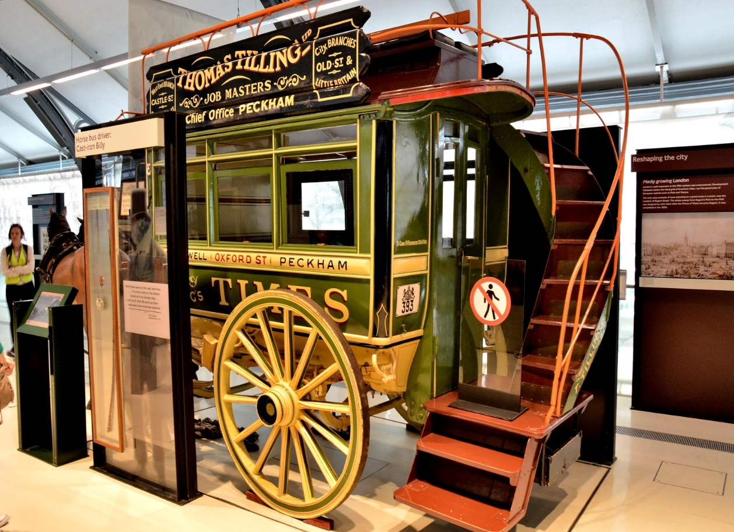
The Transport Museum

Slide 30
Describe a picture according to the plan
The general effect
The contents of the picture
The composition and colouring
Interpretation and evaluation

Slide 31
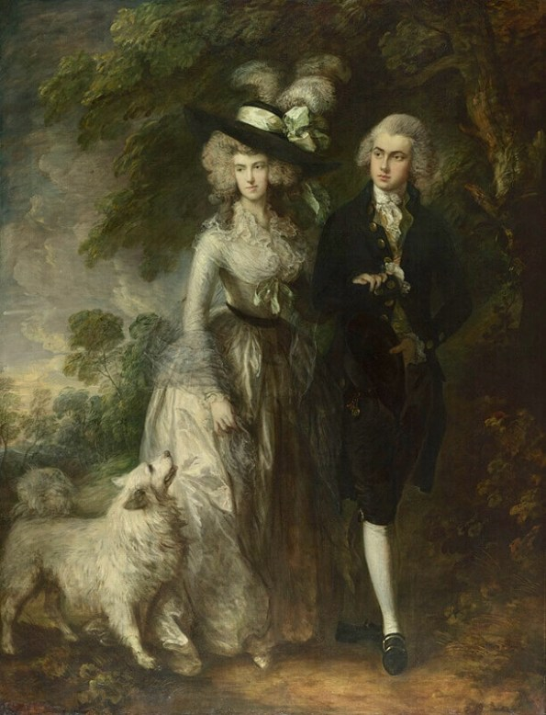
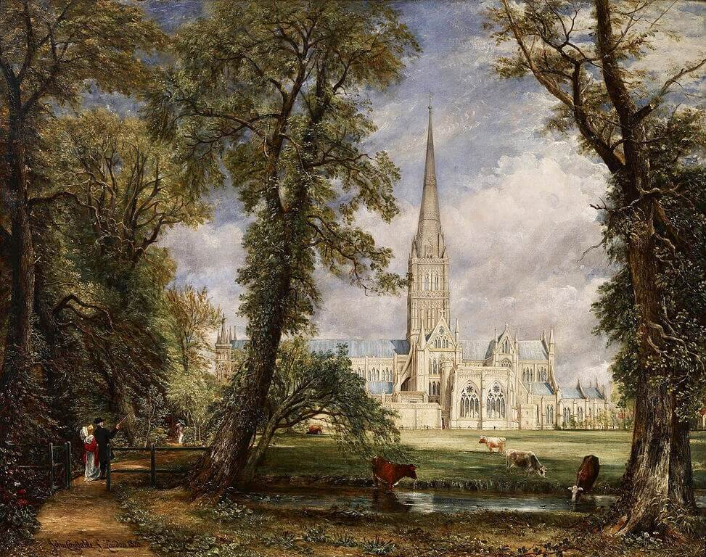
Thomas Gainsborough
Mr and Mrs William Hallett (1785)
John Constable (1776–1837)
Salisbury Cathedral

Slide 32
Do you know the museums of London?
The British Museum
The Tate Gallery
The M. Tusseau’d
The Museum of London
The Victoria and Albert Museum
The Science Museum
The National Portrait Gallery
The Imperial War Museum
The Transport Museum
The Natural History Museum

