Slide 1
a) useful, social, colorful, meaningful; b) usually, handsome, pretty, smart; c) ocean, business, pool, river; d) structure, nature, cultural, creature e) understand, unforgivable, uneasy; f) bikers, rockers, local, punks; g) professor, dancer, teenager, dentist; h) resolution, use, presentation, conversation; i) guitar, rock, drums, violin; j) England, France, English, Germany.

Slide 2
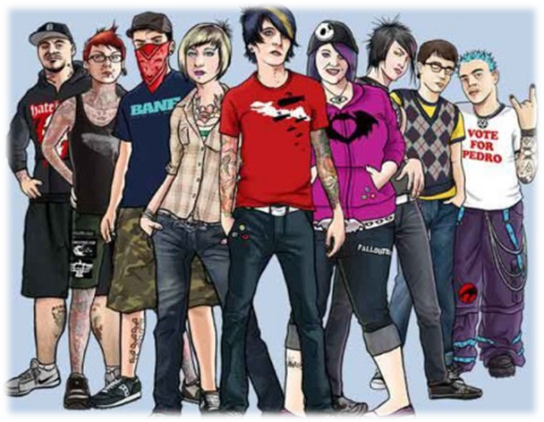
Subcultures

Slide 3
Choose the right characteristics
A subculture is:
1. a way of life.
2. a way for teenagers to express their individuality.
3. the total of the inherited (унаследованный) ideas, beliefs, values and knowledge.
4. any group within a larger complex culture which has interests that vary from those of the mainstream culture.
5. the total range of activities and ideas of a group of people with shared traditions, which are transmitted and reinforced by the members of the group.
6. a group with distinct styles, behaviors and interests.

Slide 4
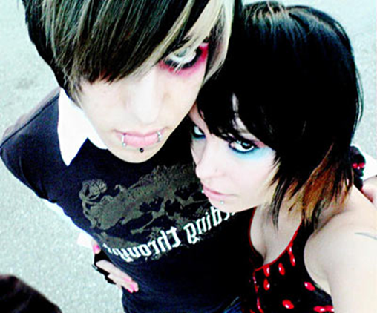
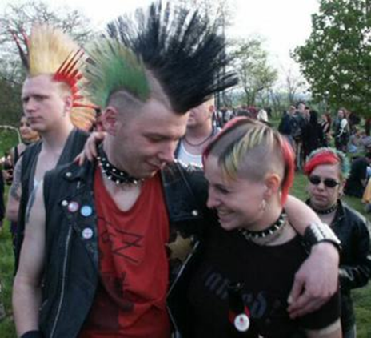
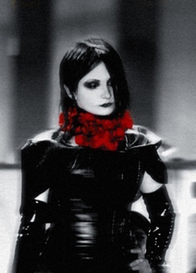
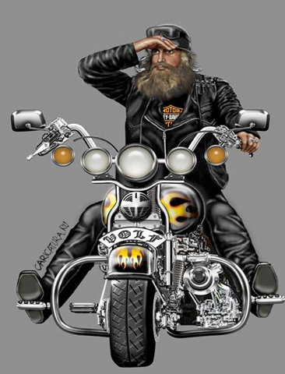
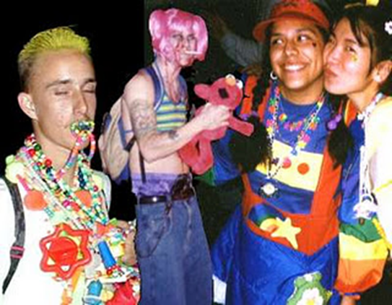
Emo
Punks
Goth
Biker
Ravers

Slide 5
goth; skinhead; raver; biker; hacker
A. He is the wizard of the computer community; he knows how his computer works. He can do things with it that seem “magical”.
B. He is one of a gang of white boys characterized by closely cropped hair, heavy boots, and braces and a nationalist and racist agenda.
C. He is a person who leads a wild or uninhibited social life, especially attending all-night dance parties.
D. He is characterized by his black clothing and deathly white make-up.
E. He is a member of a motorcycle gang.

Slide 6
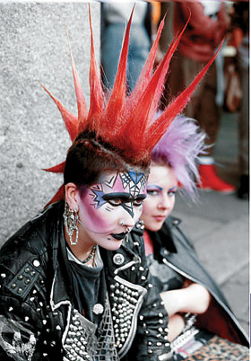
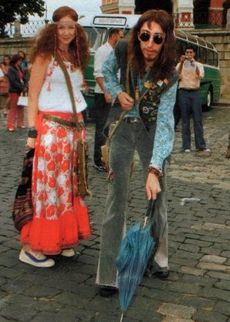
Describe the following members

Slide 7
Main features of subcultures
music
image
lifestyle
ideas

Slide 8
RAP
POP
POCK
Dance music
Heavy metal
Romantic
classical

Slide 9
Use the words from the right column in the correct form.
I have never supposed that there are so many music styles and so many 1) _____ around us. I have only known something about 2) ____, they are the people who like to wear the 3) ____ and lots of silver jewellery. It seems to me, that I begin to 4) ____ why this subculture is so 5) _____ among teenagers and young people. They start to analyse their 6) ___ and become 7) _______ with it. | culture Gothical black misunderstand popularity live satisfy

Slide 10
Lets check!
I have never supposed that there are so many music styles and so many cultures around us. I have only known something about goths, they are the people who like to wear the black and lots of silver jewellery. It seems to me, that I begin to understand why this subculture is so popular among teenagers and young people. They start to analyse their life and become satisfied with it.

Slide 11


match the attitudes (1-5) with the statements (A-F).
Which speaker says that …
A. the teens want to change the world?
B. when you are a teen, you want to know who you are?
C. some people know where they are going, but most teens don’t have any idea?
D. it seems to the teens that the parents are always against?
E. a subculture is a way of life, a real life?
F. all subcultures are awful?

Slide 12

to express themselves
to show off
to identify with a particular subculture
to know who they are
to try out all sort of options
to reject everything
to protest against the parents
Give a talk about
the main problem
to rebel against the society
to have their own values and beliefs
to change the world to the best

Slide 13
“Handsome is as handsome does!”
«Красив тот, кто красиво поступает!»

