Slide 1
“Our world in ten years”
ГБОУ школа №618
Приморского района
г.Санкт-Петербурга
Презентация по дисциплине
Английский язык
на тему:
Разработчик –преподаватель:
Ткалич О.С.
2021

Slide 2
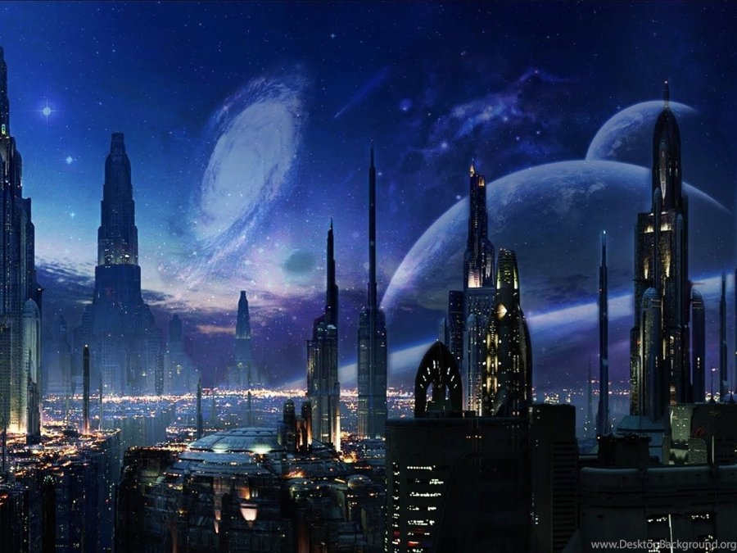
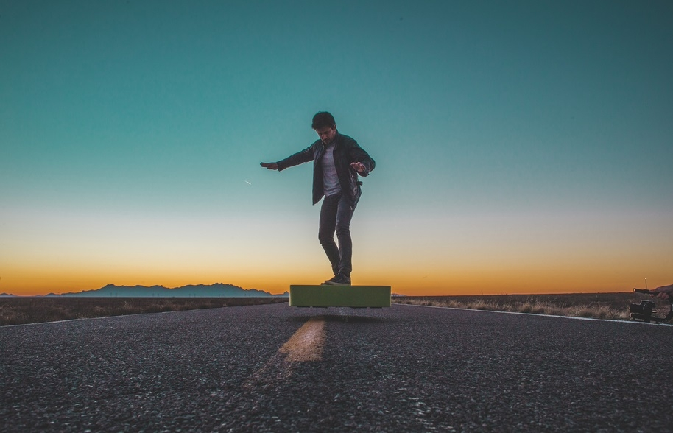
I think our world will get better in 10 years. New technologies will increase, such as cleaning robots, flying cars and space cities. I would like to see flying boards invented. It would be interesting to fly around the city and look around. It would be excellent if people invent machines that could recycle any garbage.

Slide 3
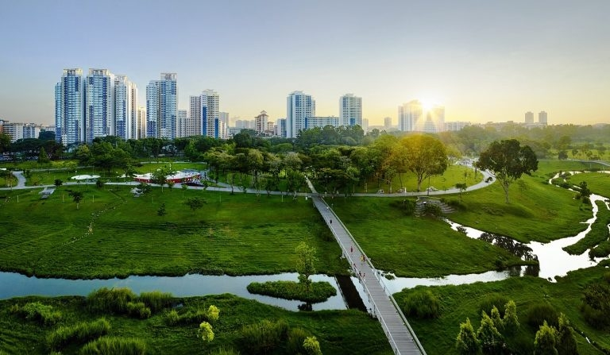
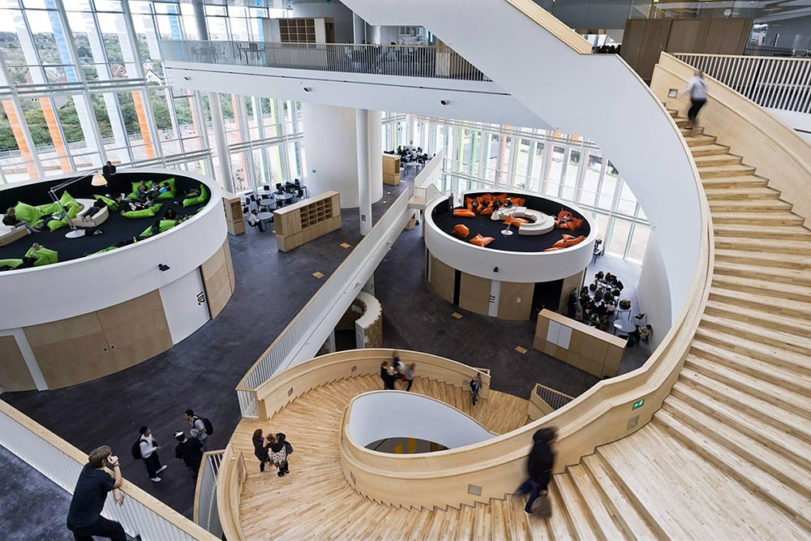
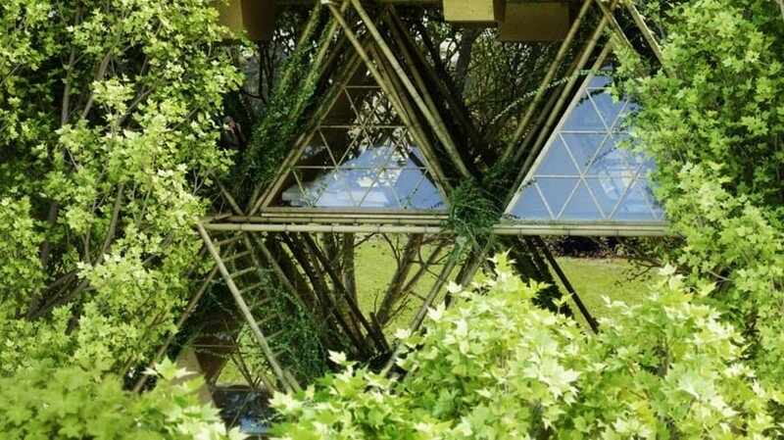
If people start planting forests in larger numbers, it will improve the environment. Ecology affects the health of people and animals. I think that soon they will start building multi-storeyed buildings with vegetation everywhere. It will look like a platform opposite the windows, planted with trees and flowers. Besides the benefits, it is also very beautiful. Schools will also be improved: equipped with new technologies, and each class will have large windows overlooking large and beautiful school grounds.
This is how I imagine our future and I hope it will be this way!

Slide 4
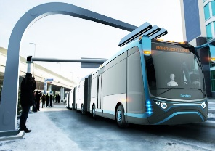
New and improved technologies will be invented
and used in everyday life
Taxis and public transport will be without drivers, robots will give service

Slide 5
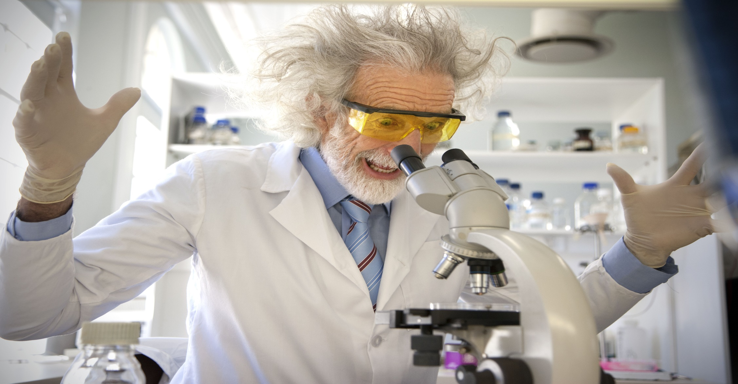
There will be a lot of prominent scientists who will make various useful discoveries

Slide 6
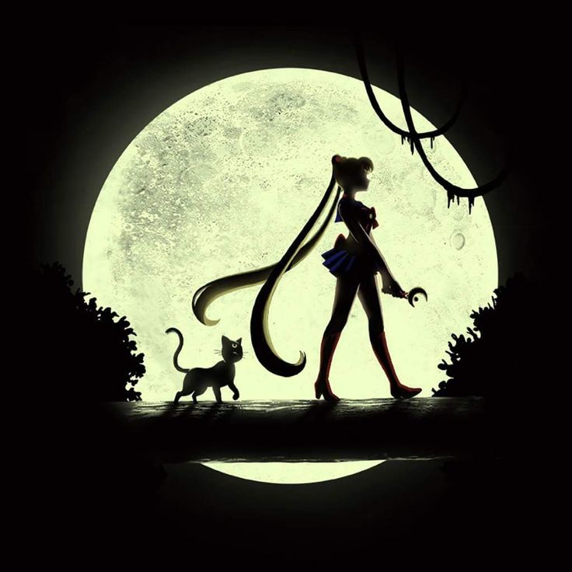
People will be able to fly to the moon to work, educate and live

Slide 7
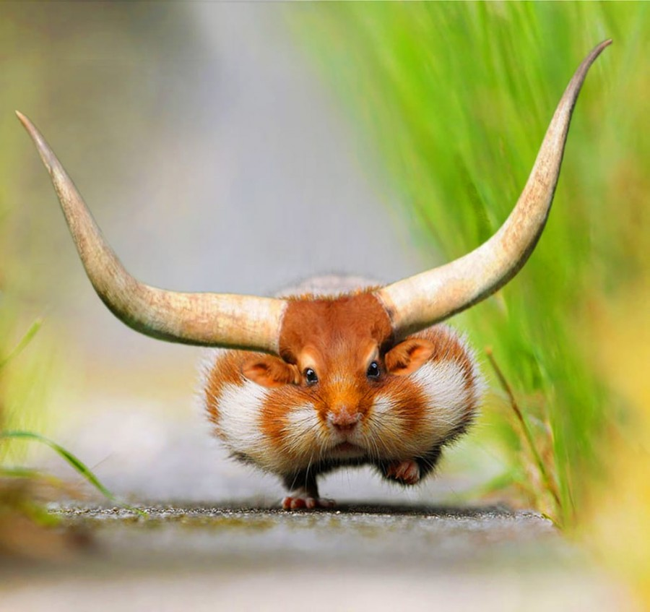
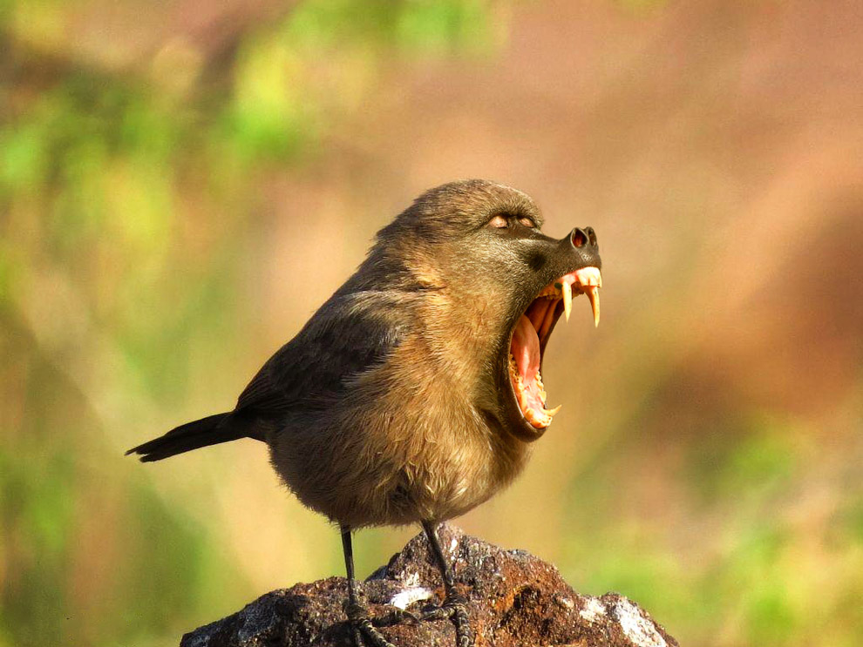
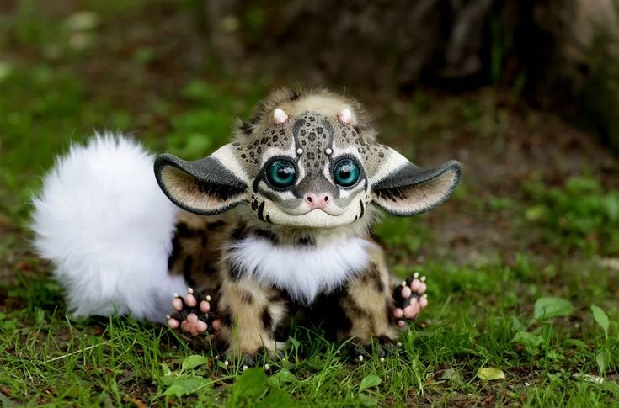
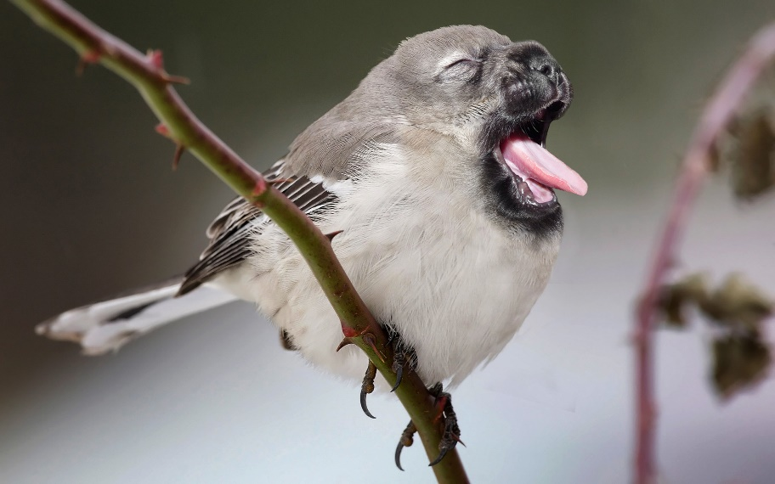
There will be new types of species

Slide 8
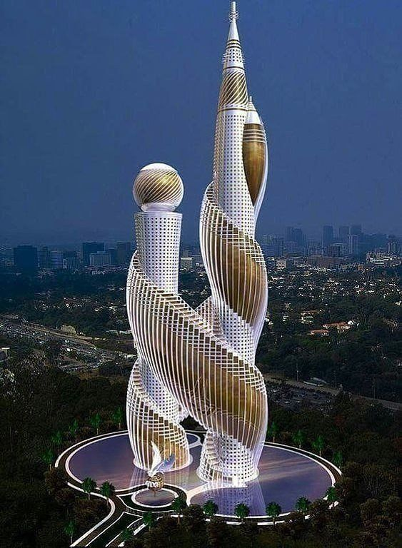
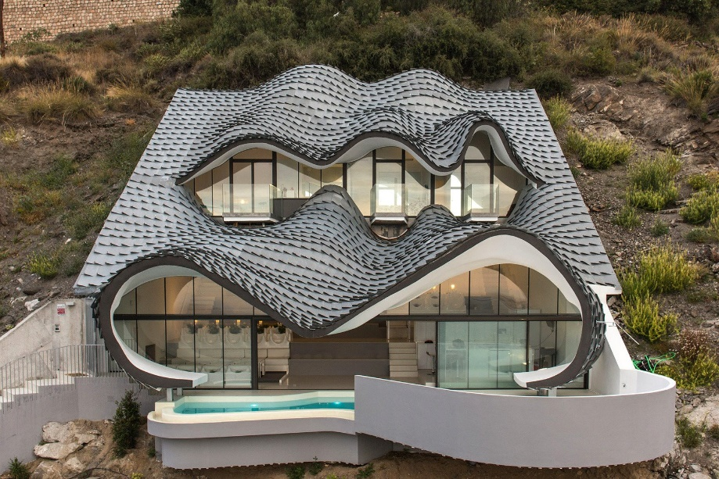
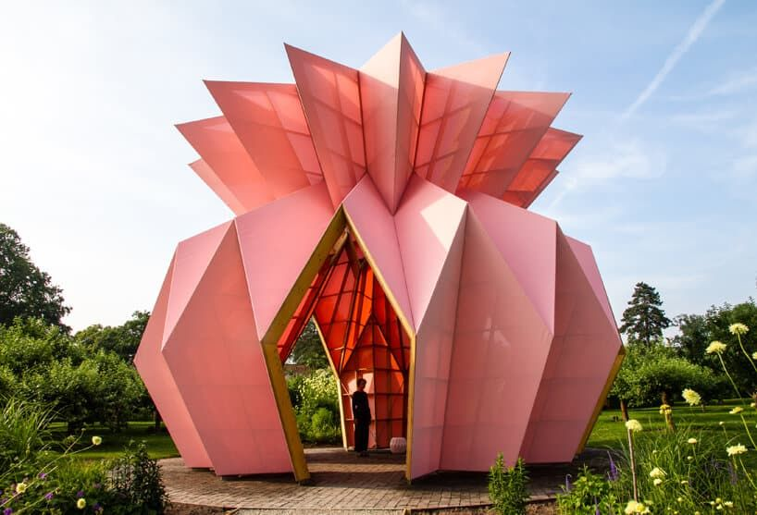
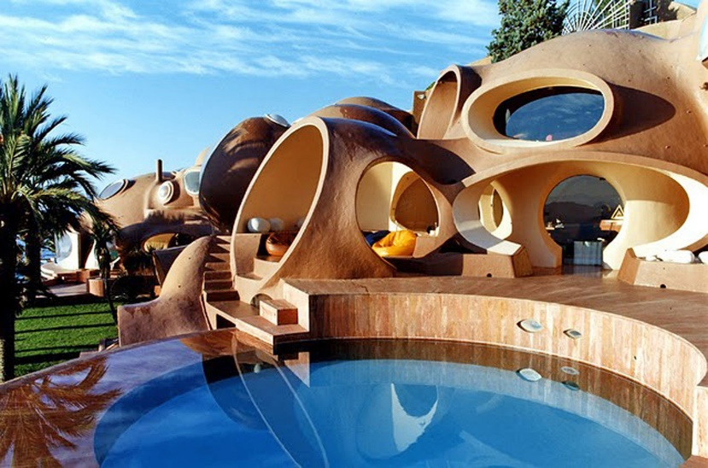
New architectural buildings will appear

Slide 9
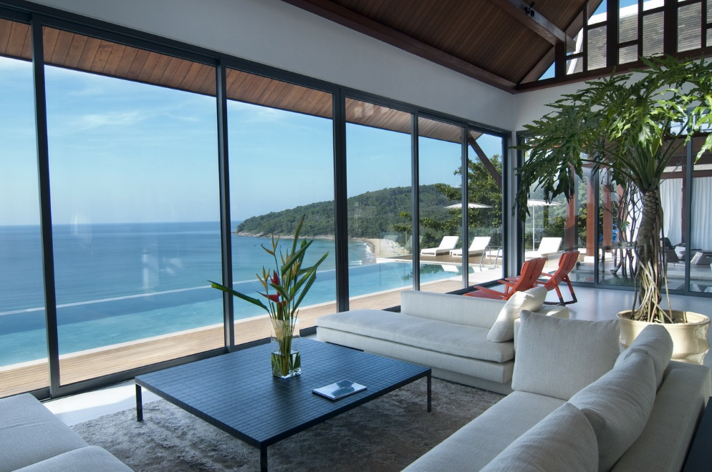
More retired and disable people will get a possibility to live or work at the seaside abroad without a visa

Slide 10
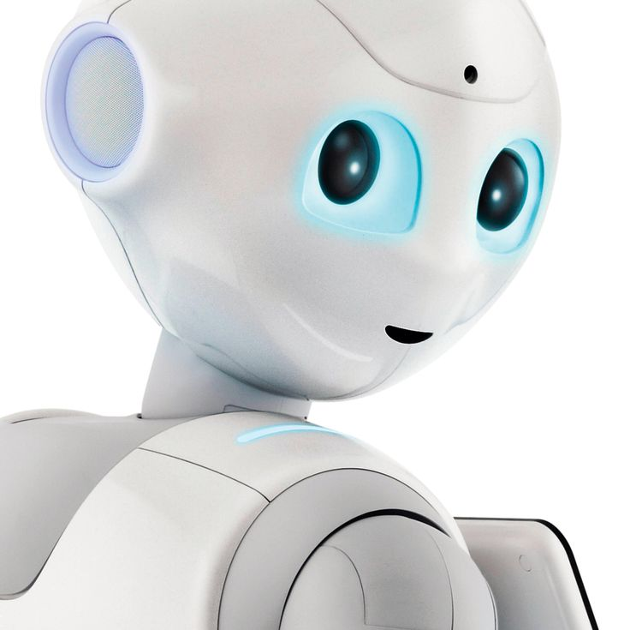

The Working day will be reduced to three hours, so the routine work will be performed by robots.

Slide 11
It is difficult to predict what the future will be like.
Writers describe the future in different ways.
But in most cases, they are similar in one thing: robots with artificial intelligence will appear in human society, and people will begin to move to other planets.
Nevertheless, people will discover and
settle new planets
as they once discovered new continents.

Slide 12
People will be able to travel into space. People will find a cure for most diseases. In ten years, we will have more surveillance: police, video cameras in the streets, tracking personal mail. We'll have more video games, more television programmes

Slide 13
the world in 50 years
In 50 years everything will change in the world.
Buildings, cars, music, and creativity will change.
People will face global problems.
But since progress does not stand still
many problems with health and diseases will be solved.

Slide 14
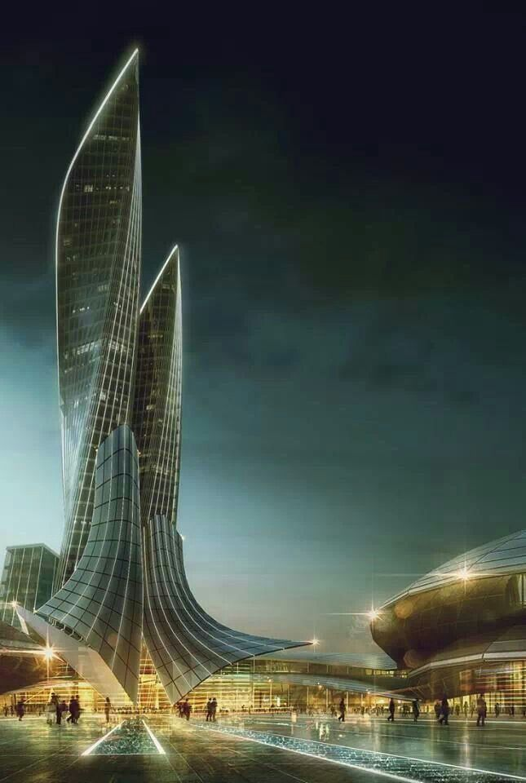
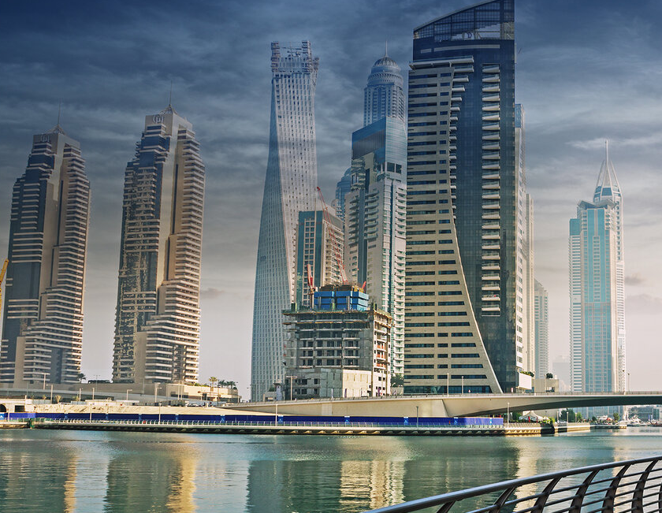
The buildings will be constructed from cheap but high-quality materials

Slide 15
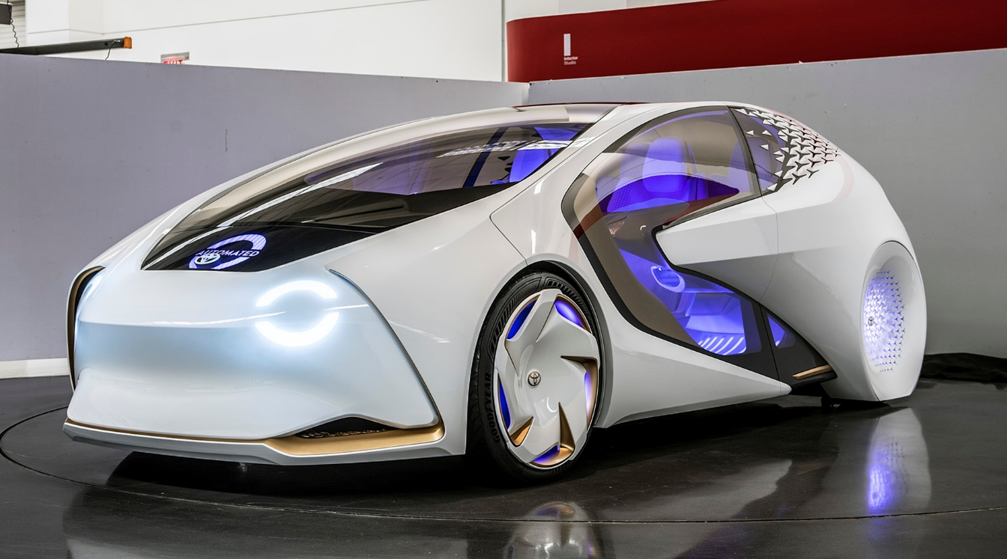
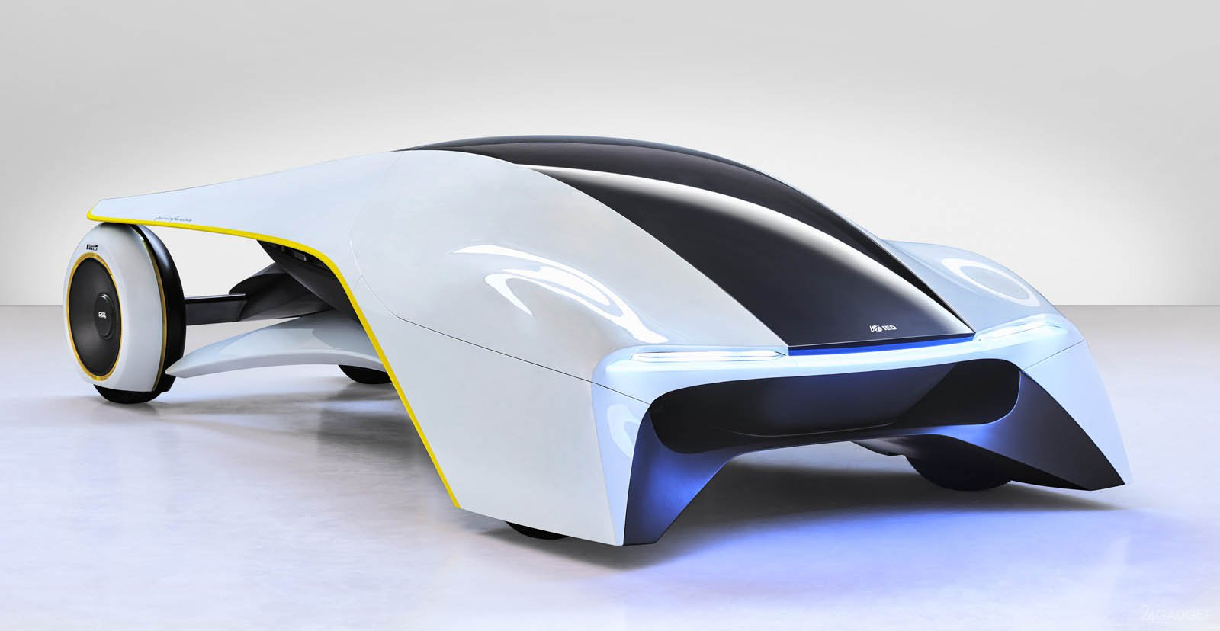
Various cars will be equipped with a flight system.
Modern machines will be faster and easier to maintain

Slide 16
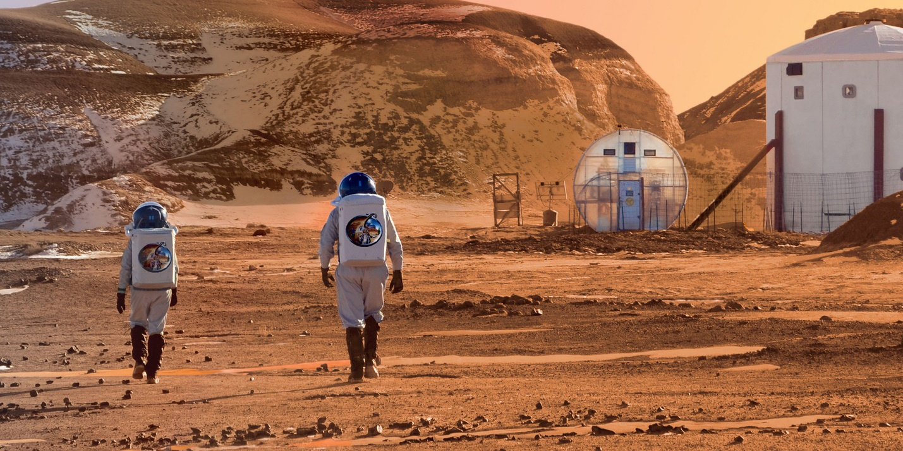
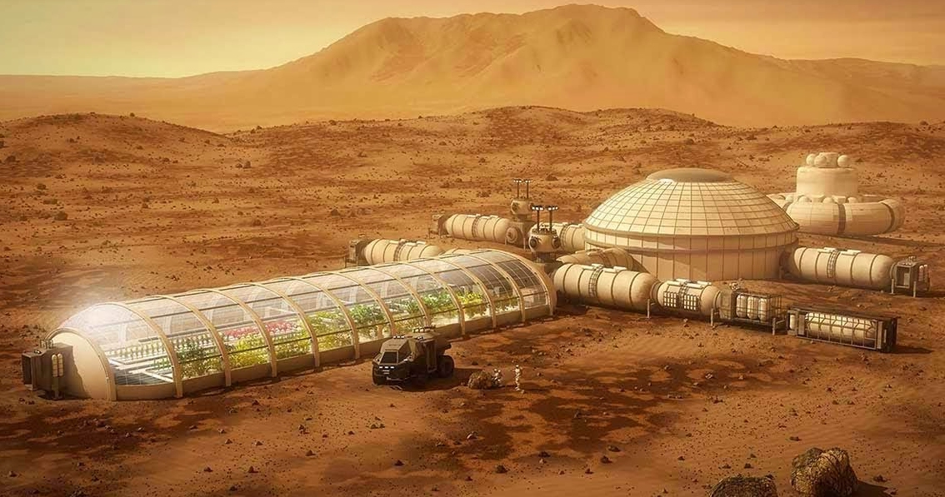
Due to the influence of the population on the Earth: pollution , destruction of natural resources and influence to the climate
there will be new cleaning machines for advance living.
Also it will be possible to move for living at Mars
Expeditions of several dozen people will be sent to Mars to prepare the planet for settlement

Slide 17
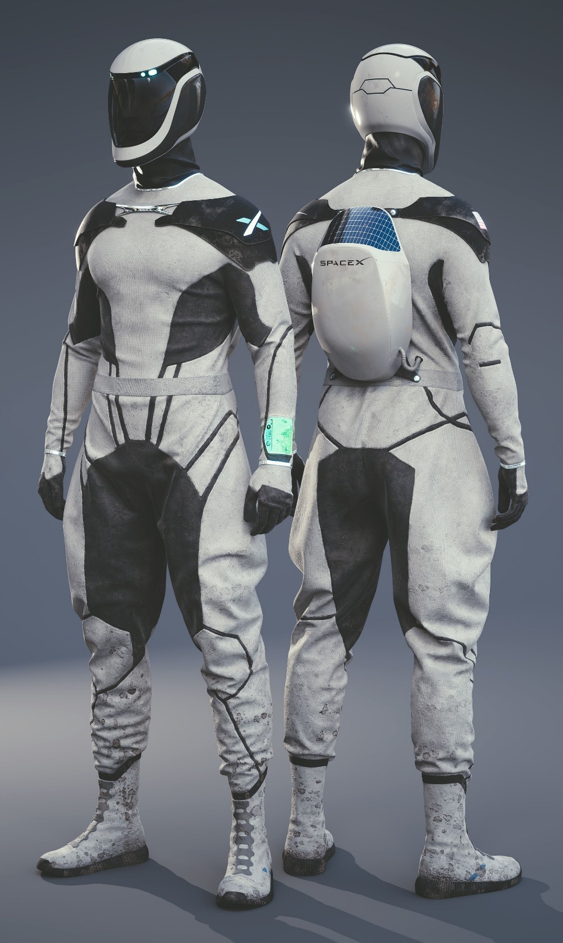
Probably because of the air pollution,
people will have to wear protective suits

Slide 18
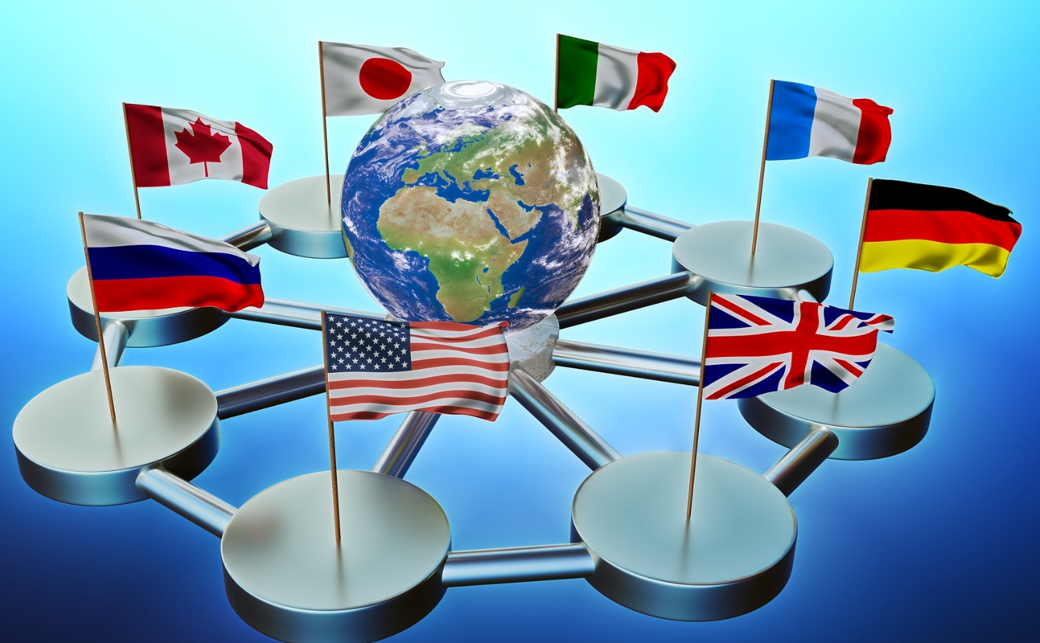
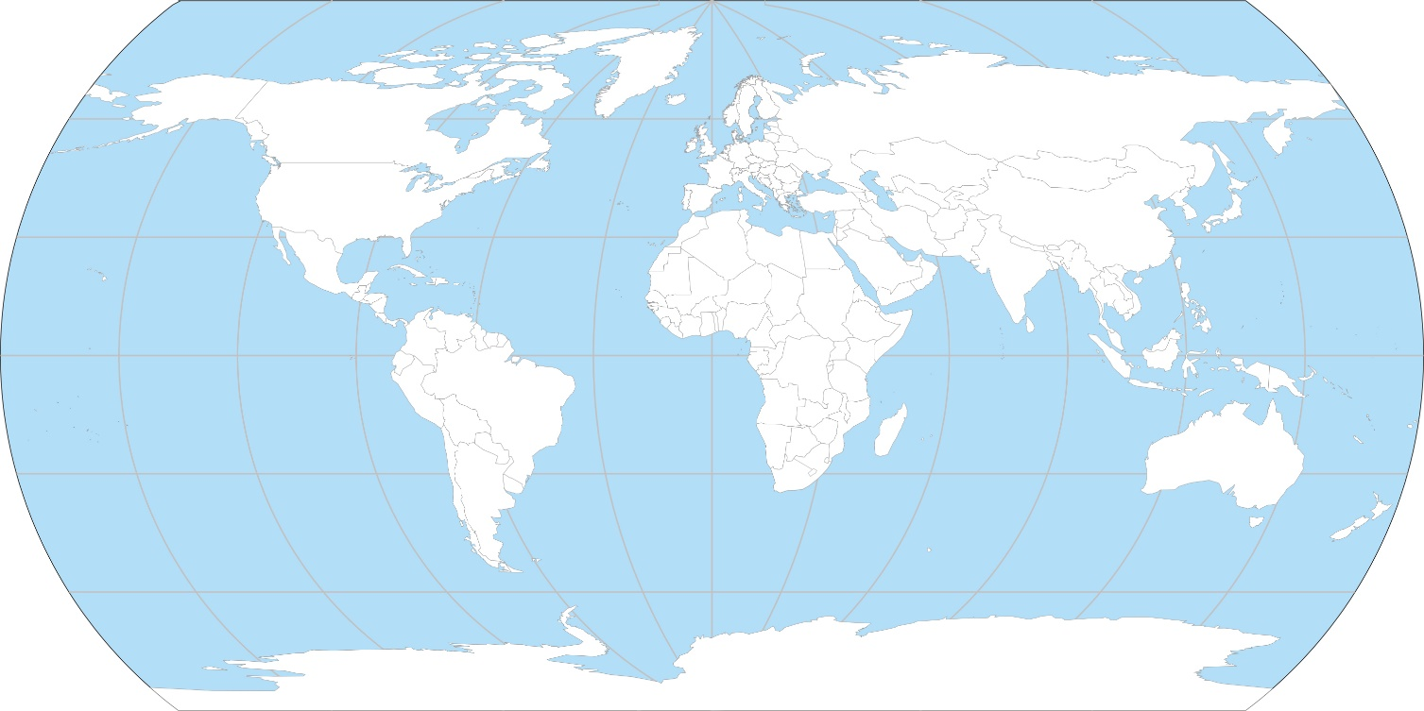
Countries of the world will unite to gain access to all the resources of the planet
By combining common resources and technologies,
you can solve lots of problems and global issues

Slide 19
I hope that in ten years all people will sort garbage on an ongoing basis, cut down less forests, and clear all the seas of garbage.
I expect that people will come to their senses and stop showing racism. They will normally treat people with a gay orientation. I trust that people will solve one of the main problems at the moment: the problem of poverty,
because this is very important. I believe humans have solved the problem of cutting natural resources.
After all, now natural resources are being depleted at an alarming rate.
In general, the future depends on ourselves,
because only we are able to change it.

