Slide 1
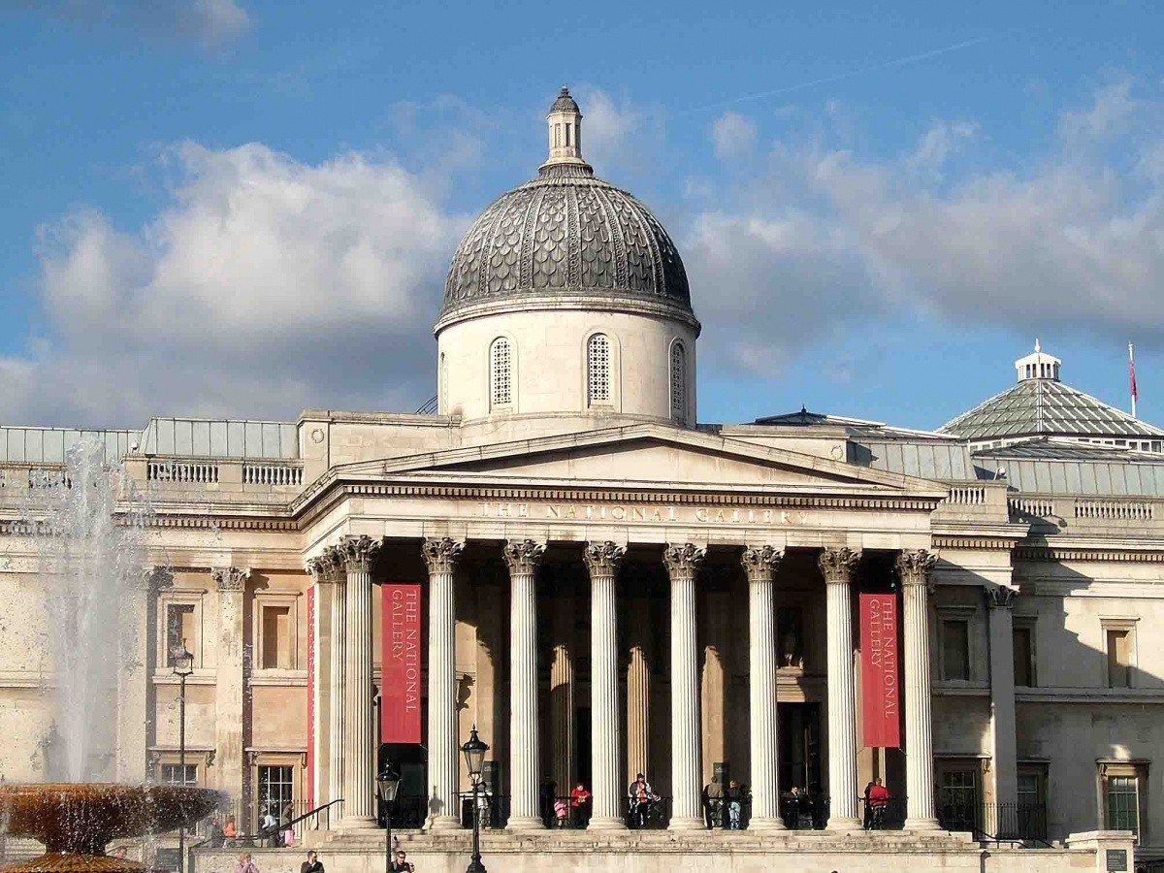
Министерство образования, науки и молодежной политики нижегородской области гбпоу «ДХТ имени Красной Армии»
Презентация по дисциплине
Английский язык
на тему «English artists»
Разработчик: преподаватель
Холодилова М.А.
2020

Slide 2
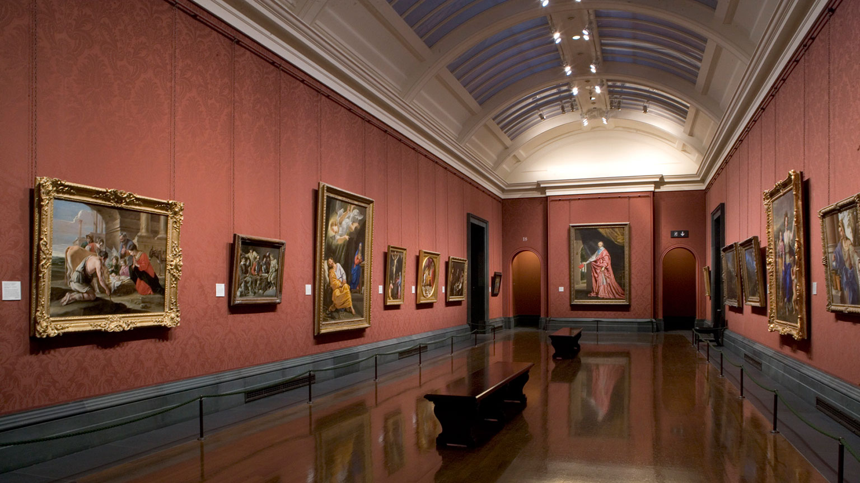
Contents
1. Introduction
2. List of artists
3. Artists and their paintings
Frederick Walker
John Everett
John Martin
Thomas Seddon
Richard Wilson
4. Conclusion
5. Literature List

Slide 3
Introduction
Looking at the virtual gallery of London, we found several paintings that were of interest to us. We would like to tell you about these paintings and their creators.

Slide 4
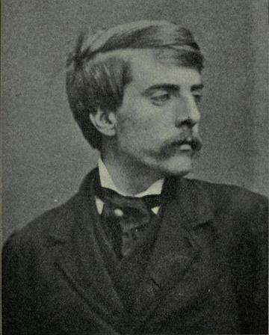
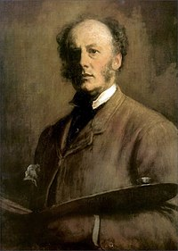
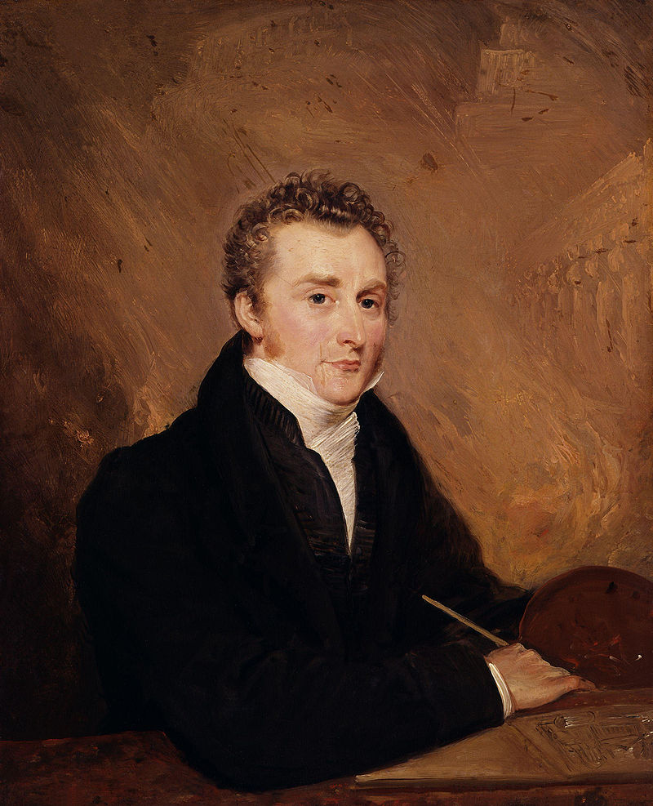
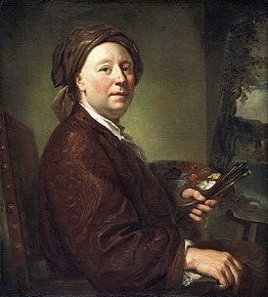
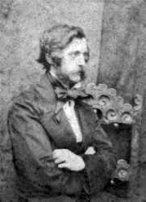
List of artists
Frederick Walker
John Everett
John Martin
Thomas Seddon
Richard Wilson

Slide 5
Frederick Walker
British realist painter and illustrator of the 19th century, described by Sir John Everett Mille as "the greatest artist of the century". His grandfather, William Walker, was an artist of some merit, who was regularly exhibited at the Royal Academy and the British Institute between 1782 and 1802. Frederick received his education at a local school and then at Camden North London College. He showed a talent for art from an early age teaching himself to copy prints with a pen and ink - he also practiced drawing at the British Museum.

Slide 6
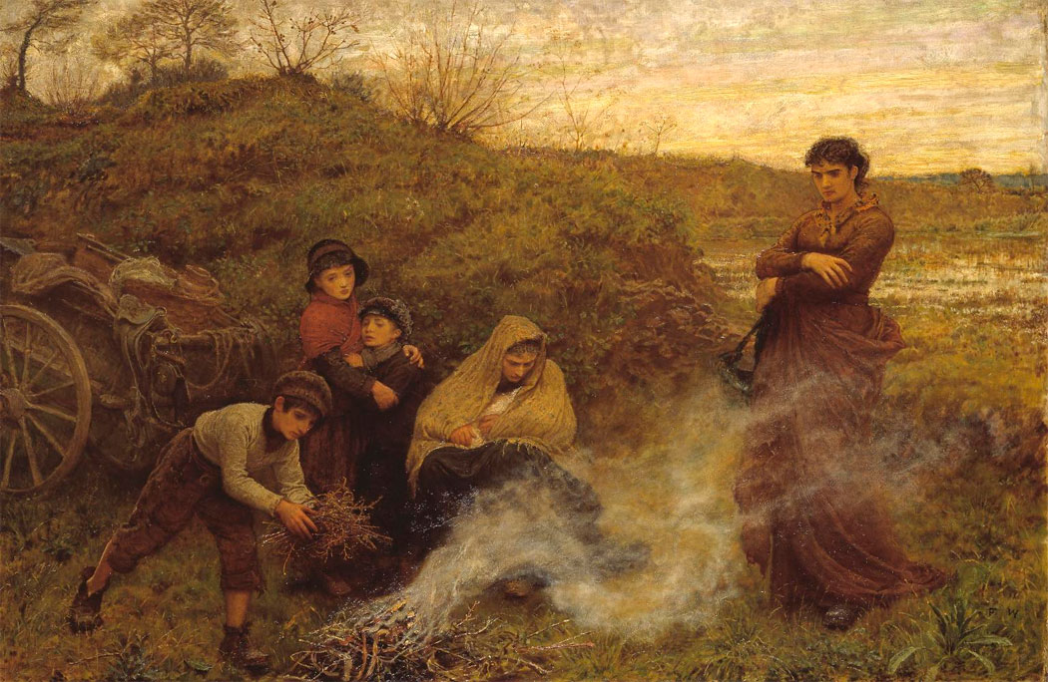
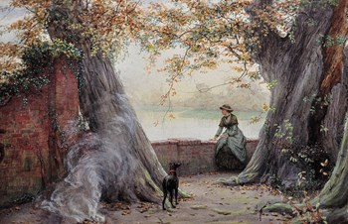
Paintings by Frederick Walker
The Vagrants
Lost in Her Thoughts

Slide 7
John Everett
John Everett is the largest 19th century English artist, also known as one of the three founders of the Pre-Raphaelite Brotherhood. Mille was born in Southampton and began studying drawing at the age of nine. In 1838, when his abilities became apparent, the family moved to London. His whole life has been a succession of achievements and successes, his works in various genres, from historical painting to illustrations and portraits, always distinguished by surprisingly high skill.

Slide 8
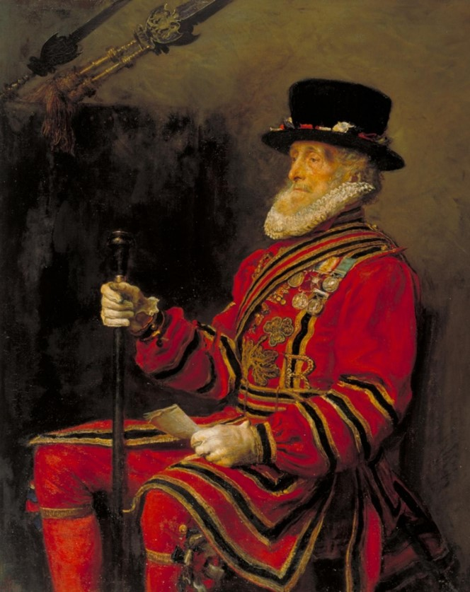
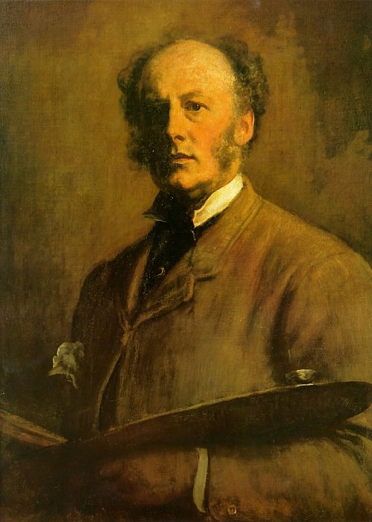
Paintings by John Everett
Jomen the guardsman
Self-portrait

Slide 9
John Martin
English artist of the18 – 19th century, founder of romanticism, engraver and illustrator. He was a disciple of his father and worked in Newcastle Apone Mystery studying heraldic paintings, but due to a dispute over an emission agreement, he was placed under the care of Boniface Musso, the Italian artist and father of enamel painter Charles Musso. In 1810 Martin sent his first oil painting to the Royal Academy of Arts, but it was not exhibited. In 1811, the painting was exhibited. In 1816, Martin has achieved public recognition.

Slide 10
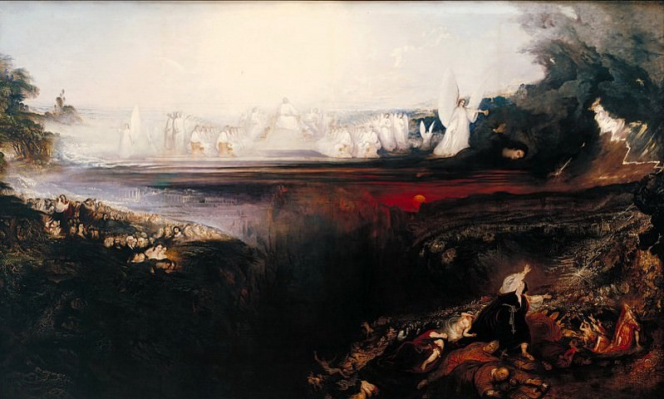
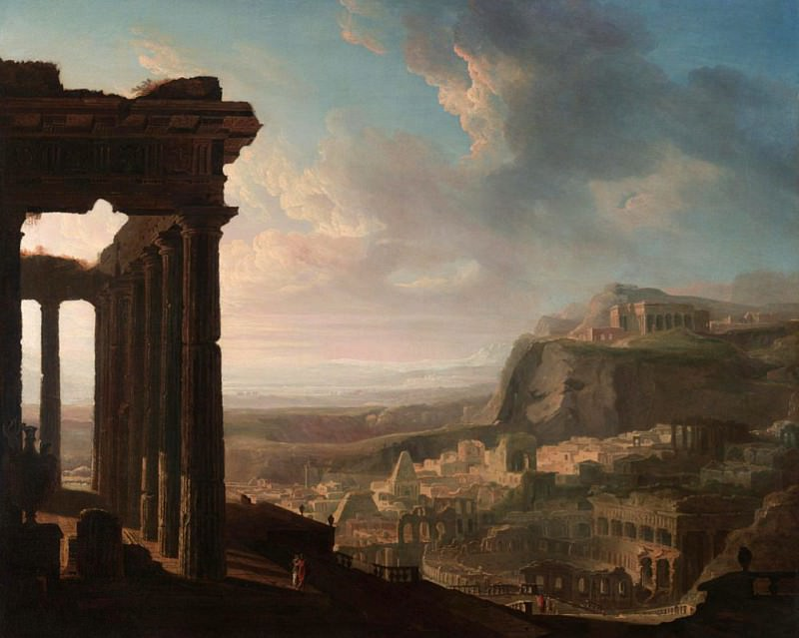
Paintings by John Martin
Last Judgment
The ruins of an ancient city

Slide 11
Thomas Seddon
British artist of the 19th century, landscape painter, orientalist, representative of Dorafaelitism. He was a friend of Dante Gabriel Rossetti and George Price Boyce. In 1842 he went to Paris to study the technique of furniture decoration. In 1849 he made his first trips to Wales and Brittany, during which he painted a number of landscapes. In 1852 he first held an exhibition of his works at the Royal Academy of Arts.

Slide 12
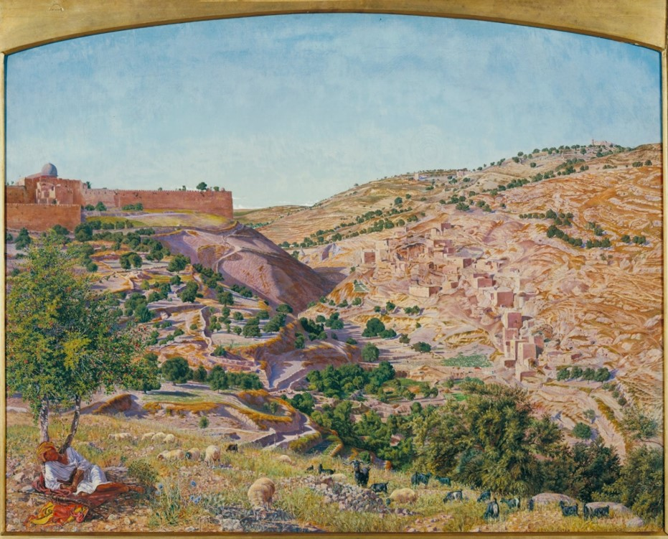
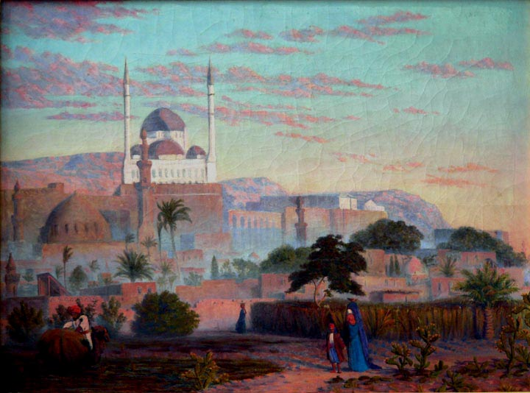
Paintings by Thomas Seddon
View of Jerusalem and the valley of Jehoshaphat
Cairo Citadel

Slide 13
Richard Wilson
He is an artist of the 18th century. In 1729 he moved to London, where he worked as a portraitist. In 1750-1757 years he traveled through Italy, where on the advice of Francesco Zuccarelli turned to landscape painting - thus becoming the first major British artist. Back to England, Wilson was among the 40 founding members of the Royal Academy of Arts in 1768. Wilson's landscapes are somewhat distracted, and their influence was recognized by such outstanding British masters as John Constable and Turner.

Slide 14
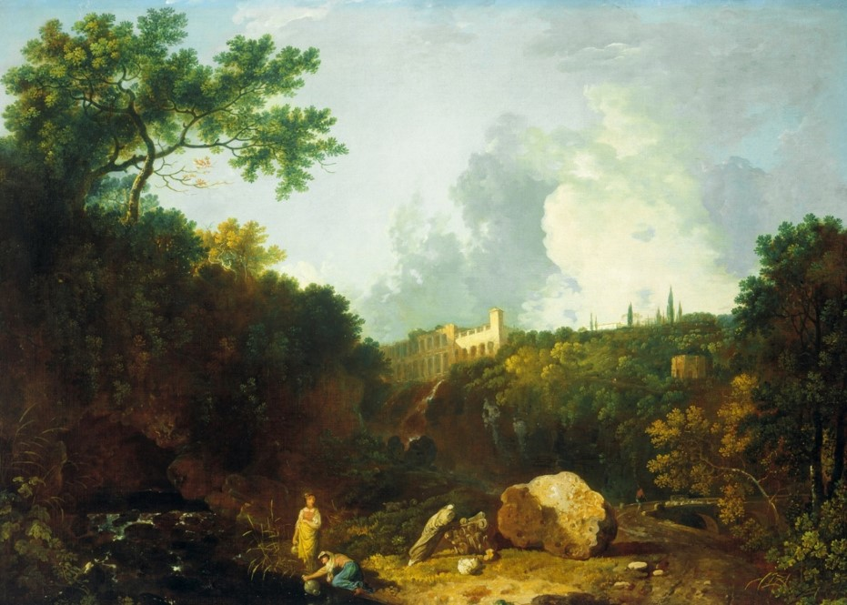
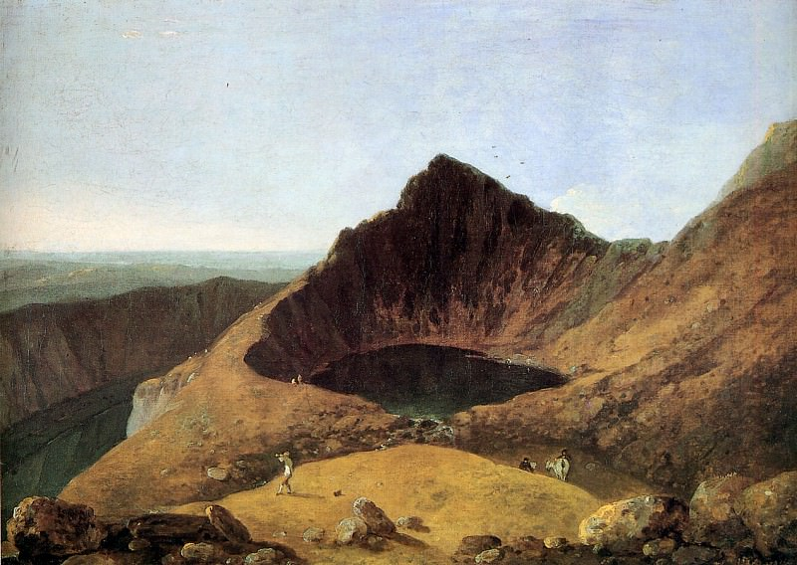
Paintings by Richard Wilson
Landscape in Tivoli overlooking Villa Maecenas
Lake Lin Cau on Mount Kader Idris, Wales

Slide 15
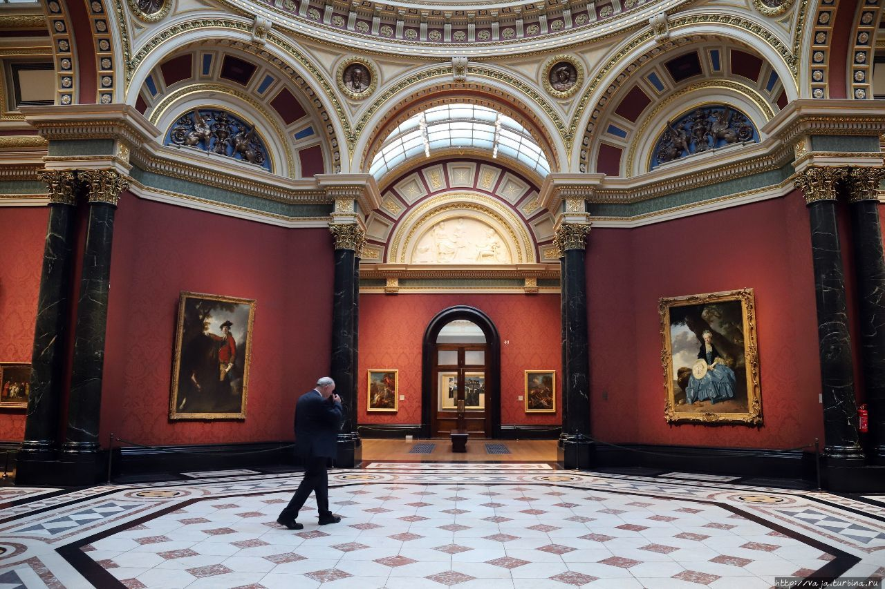
Conclusion
The artists we have studied are masters of their craft, most of the selected ones were landscape artists. Written landscapes fascinate with their realism and can convey the atmosphere of the places depicted in the picture. All presented paintings are in London museums. Unfortunately, we were not able to visit these museums alive. I hope you will be able to do it yourself and get completely different sensations, not in a virtual gallery.

