Slide 1
ГБПОУ «Дзержинский химический техникум имени красной Армии»
Презентация по английскому языку
на тему: «Спорт »
Разработчик: преподаватель
Холодилова М.А.

Slide 2
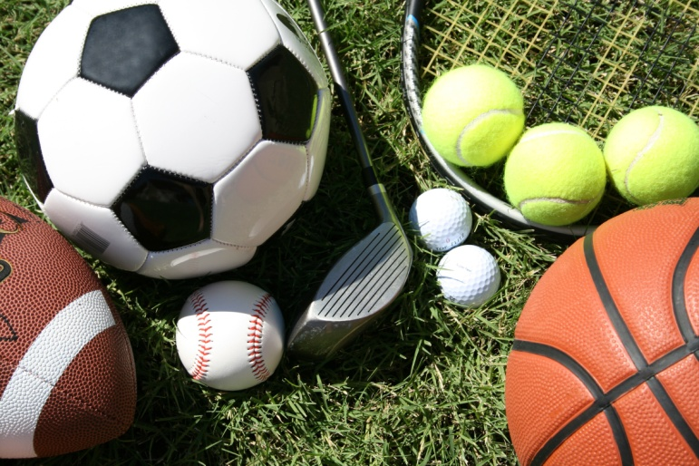
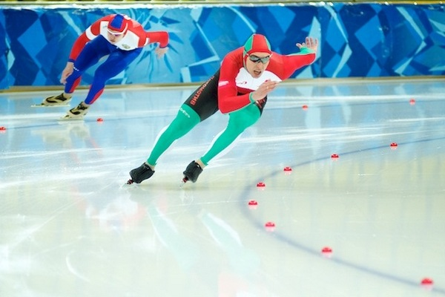
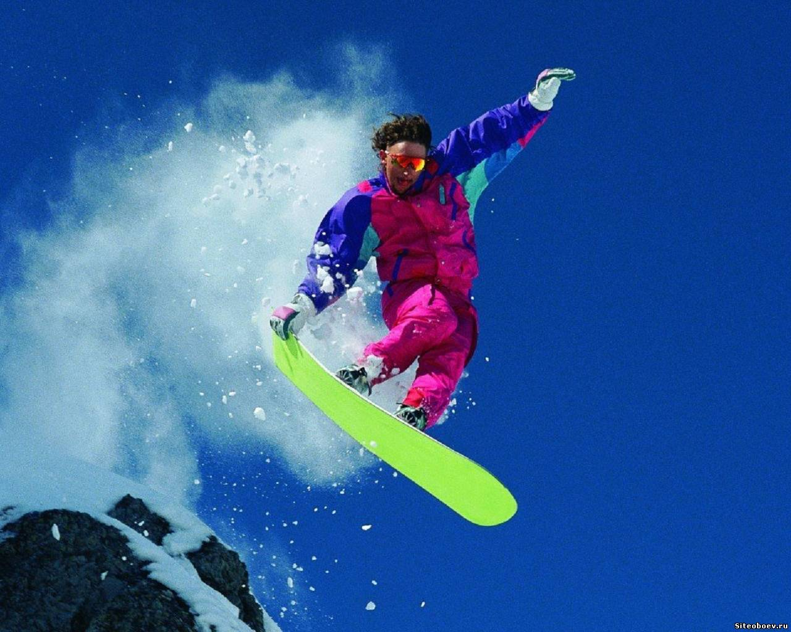
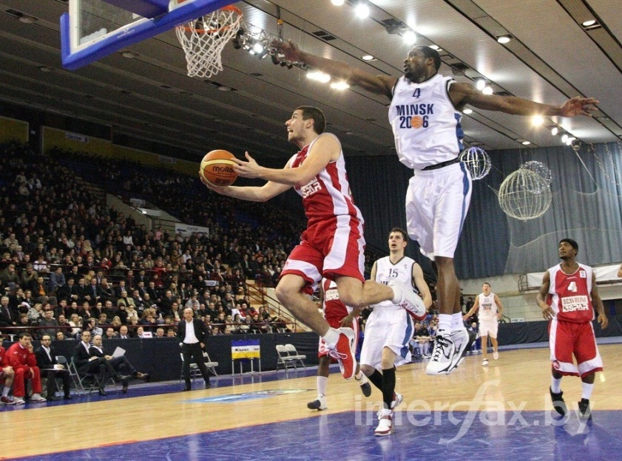
SPORTS AND GAMES

Slide 3
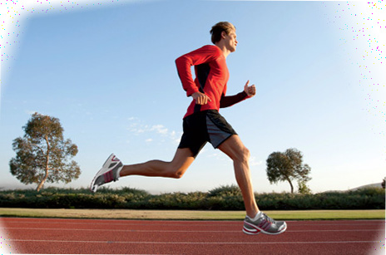
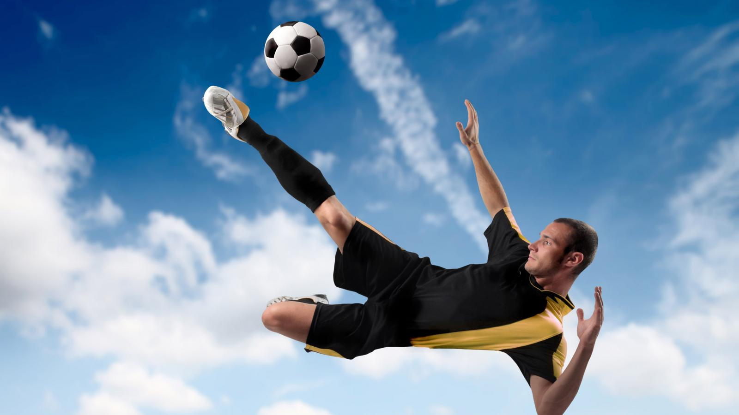
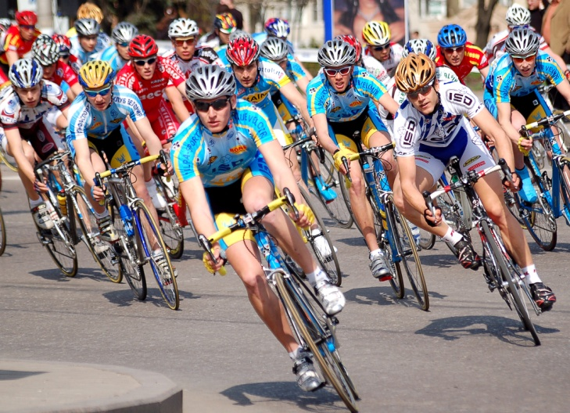
Phonetic exercise
Repeat words and make up the sentences
Rugby, golf, darts, competition, cup,
spectator, loser, referee, football, hockey, athletics, cycling

Slide 4
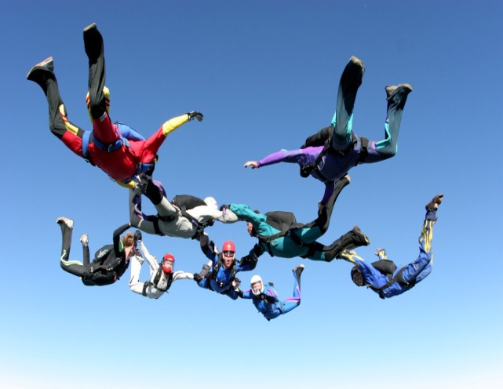
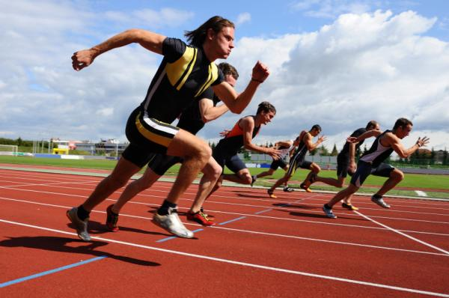
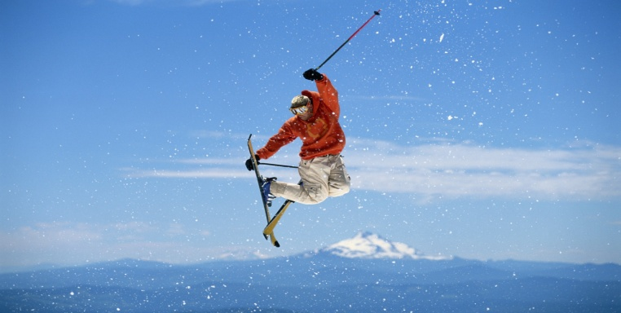
Match the words in English and Russian
Легкая атлетика
Велоспорт
Шашки
Планеризм
Турнир
Катание на лыжах
Горный спорт
Прыжки с трамплина
Охота
Быть в хорошей форме
Skiing
Cycling
Hunting
Ski-jumping
Tournaments
Keep feet
Mountaineering
Gliding
Droughts
Track and field

Slide 5
Answer the following questions:
What kinds of sports are popular in Russia?
Are you against or for sports?
Do you prefer going in for sports or watching it on TV?
Is sports a part of our everyday life?
Is sports important to you?
What is your favourite kind of sport?
Who is the best sportsman in your group?

Slide 6
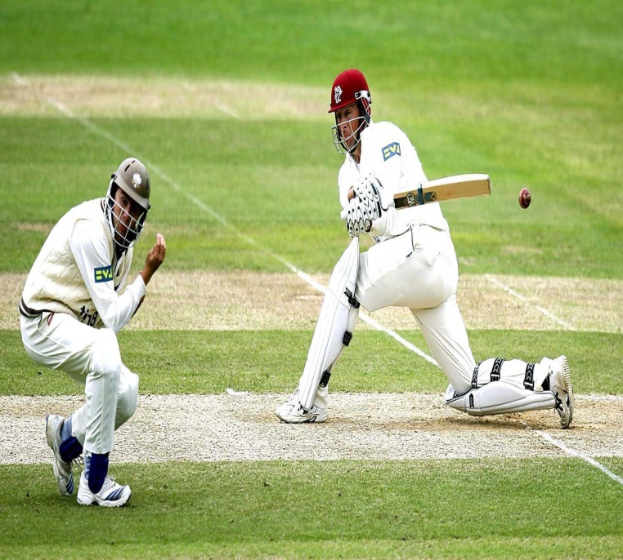
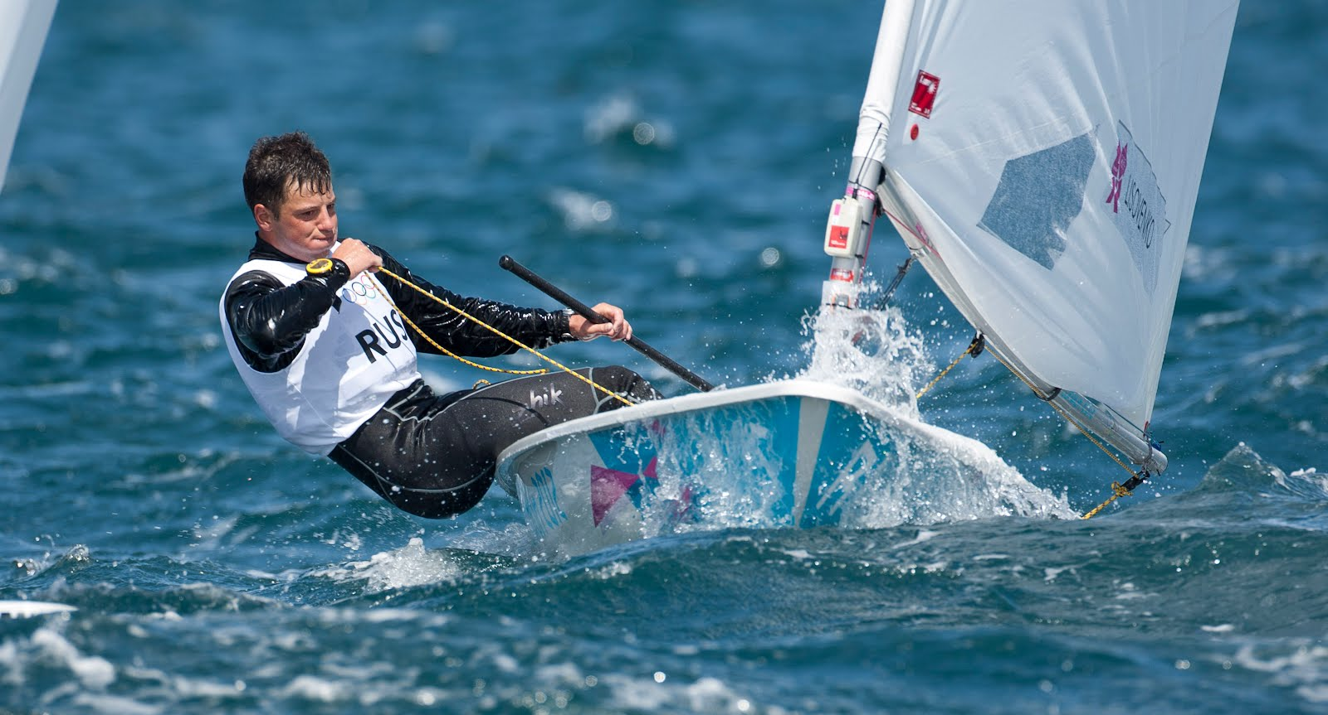
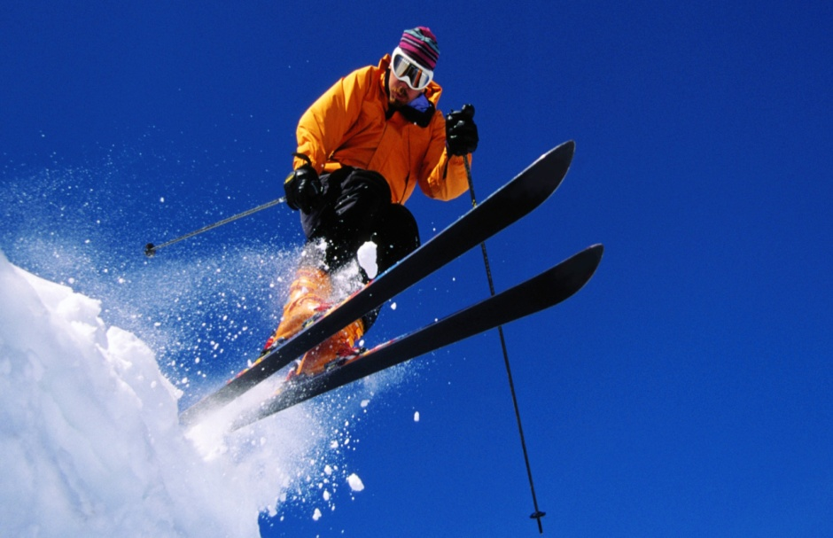
Summer and Winter Sports
Remember new words
Read and translate the text
Answer the questions

Slide 7
Kinds of Sports and Games
Sports or Games | When did it start to develop? | Where did it start to develop? | Rules | The most famous Russian sportsmen | The most famous foreign sportsmen

Slide 8
The quiz
Someone who does an activity for pleasure or interest, not as a job?
(Amateur)
2. Someone that has won a competition, especially in sport?
(Champion)
3. An organized event in which people or teams compete against each other?
( Competition)
4. Someone who likes a particular sport?
(Fan)
5. A specially shaped silver container that is given as a prize in a competition, especially sports competition?
(Cup)

Slide 9
6. A form of sport?
(Game)
7. Someone who has lost a competition or a game?
(Loser)
8. The fastest speed, longest distance, highest or lowest level etc that has ever been reached, especially in sport?
(Record)
9. Someone who is in charge of a game in sports such as football, basketball, boxing?
(referee)
10. The number of points that each team or player has won in a game or competition?
(Score)

Slide 10
11. Someone who is watching an event or a game?
(Spectator)
12. A man/woman who plays several different sports, especially outdoor sports.
(sportsman)
13. A group of people who play a game or sport together against each other?
(Team)
14. To be the best or first in a competition or a game.
(Win)
15. It’s outdoor game, played in summer with a small ball covered with a red leather, a bat and wickets, by two teams of 11 players each, usually dressed in white.
(Cricket)
16. It’s a game in which people hit small hard white balls into holes in the grounds with a set of a special stick.
(Golf)
17. Any of several games in which darts (small sharp-pointed objects) are thrown at a circular board.
(Darts)

Slide 11
Make up the sentences with words and words combinations using Present Simple, Past Simple, Future Simple, Present Continuous, Past Continuous Tense
Play football
Play hockey
The most popular outdoor winter sports
The first place in public interest
Go in for calisthenics
Go for training
Popular games
To watch football match on TV
To ride a bike
Take part
Favourite kind of sport

Slide 12
Home task
Speak on the following topics:
Popular games and sports in England or in Russia.
A sports event I will never forget.

