Slide 1
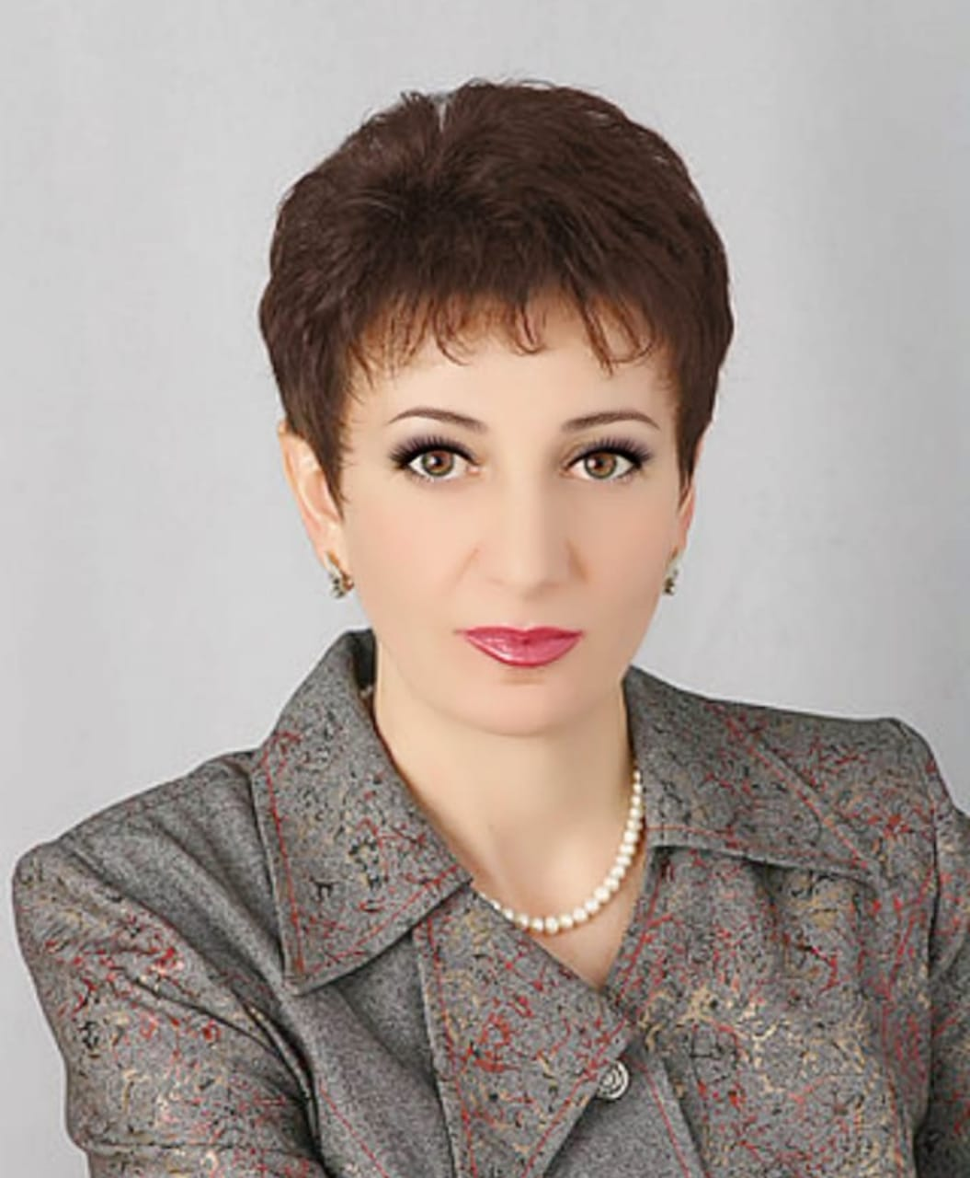
Презентация на тему:Present Continuous
Tense
Выполнила учитель английского языка МБОУ «СОШ №1 им. Д. Хугаева с. Ногир» Козаева Н.Г.

Slide 2
Тема: “Мой день. Настоящее продолженное время”
Цель урока:
Систематизация знаний по теме «Мой день. Настоящее продолженное время»

Slide 3
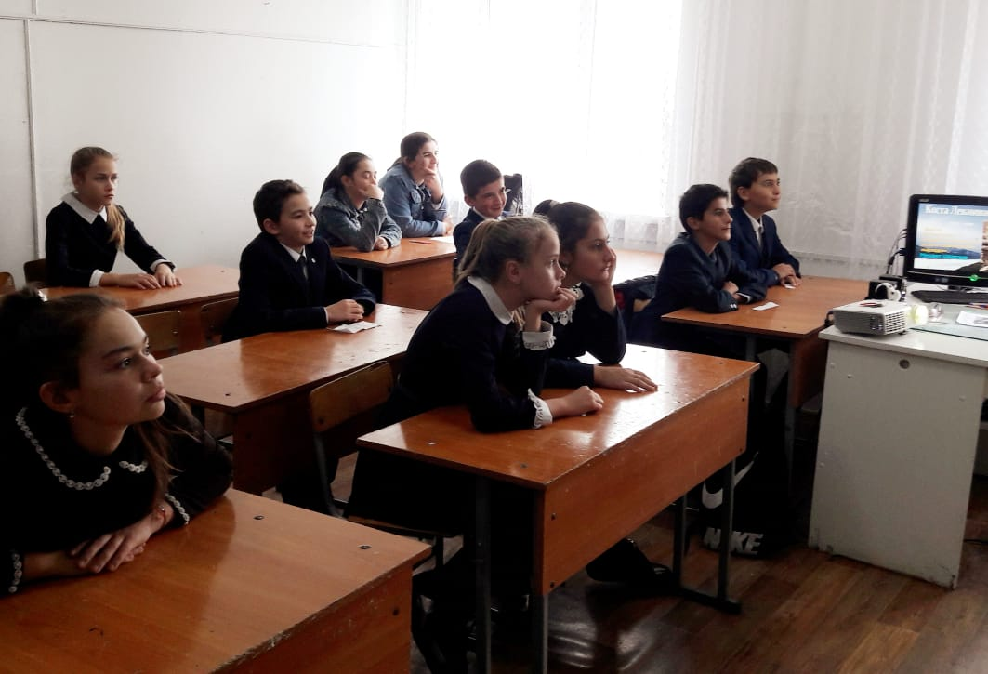
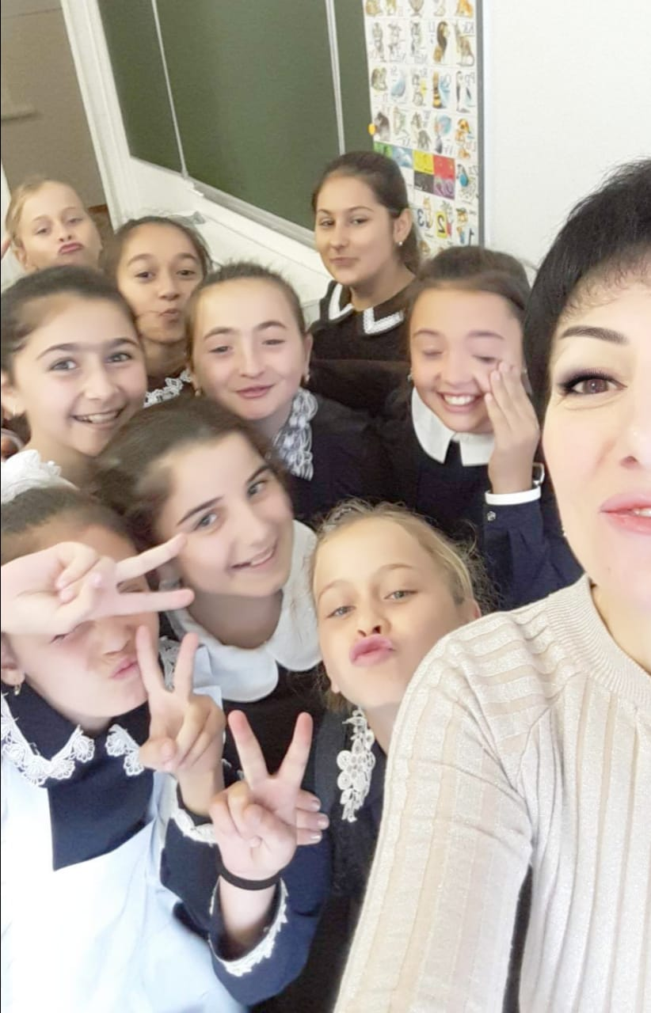
Good morning, good morning!
Good morning to you!
Good morning, good morning!
I am glad to see you!

Slide 4
My busy friends
Kate is reading a book.
Pete is learning to cook.
Jack is feeding his cat. Pat is cleaning her flat.

Slide 5
Repeat after my!
begin, breakfast, dress, finish, get up, home, lunch, be on time

Slide 6
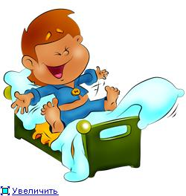
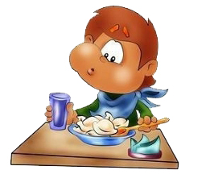


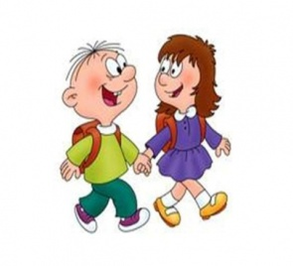
My Day
1. I get up at 7 o clock in the morning.
2. At 8 o clock I have breakfast.
3. My school begins at 9 o clock.
4. At 1 o clock I have lunch.
5. At 3 o clock he goes home

Slide 7

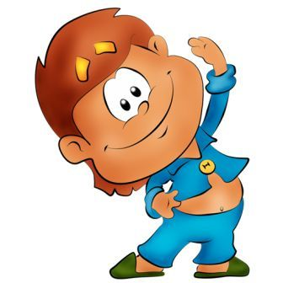
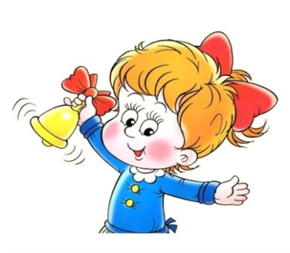
Present Simple - Present Continuous
My Day
I get up at 7 o'clock.
I am getting now.
I go to school at 9 o'clock.
I am going to school now
I do physical exercises.
I am doing physical exercises now
I have English class.
I am having English class now.
My classes finish at one o'clock.
My classes are finishing now.
I have breakfast at 8 o'clock.
I am having breakfast now

Slide 8

Present Continuous
Tense
Настоящее продолженное
время

Slide 9
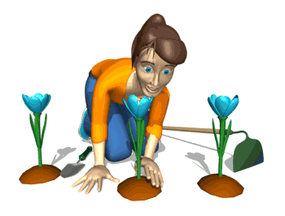
Когда мы употребляем
Present Continuous Tense
Present continuous обозначает
длительное действие, которое совершается
в настоящее время, в момент речи.
Сейчас она сажает розу.
She is planting flowers now.
В данный момент панда кушает.
Panda is eating at this moment.

Slide 10
Слова-маркеры Present Continuous
Now
At present
At this moment

Slide 11


Как образуется
Present Continuous Tense
Present continuous образуется при помощи вспомогательного глагола to be (am, is, are) в настоящем времени и причастия настоящего времени глагола(v + ing).
I am
He
She is
It
We
They are
You
be
+
Verb + ing

Slide 12

утвердительная форма
I am writing.
She is writing.
He is writing.
They are writing.

Slide 13
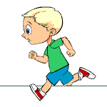
What is he doing now?
He is running now.

Slide 14
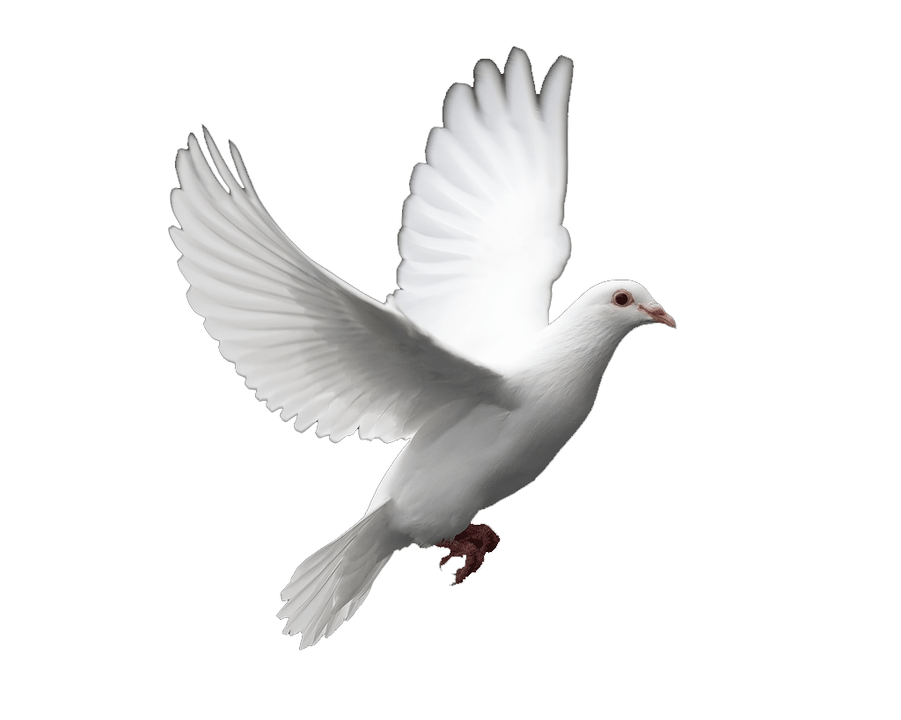
What is it doing now?
It is flying now.

Slide 15
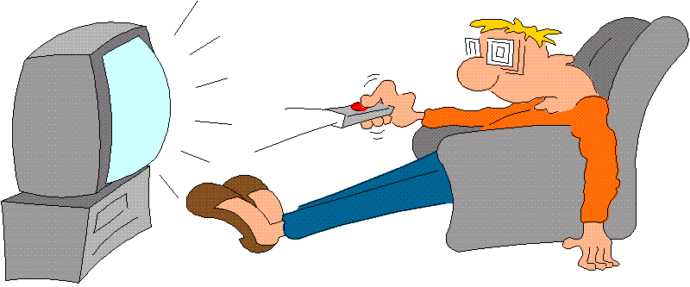
What am I doing now?
I am watching TV.

Slide 16
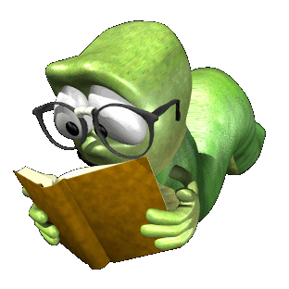
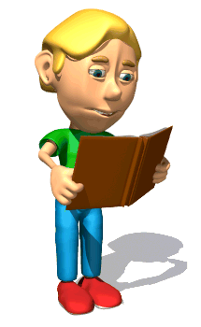
What are they doing?
They are reading at this moment.

Slide 17
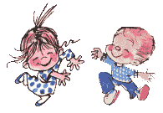
With my foot I tap, tap, tap,
With my hands I clap, clap, clap,
Right foot first, left foot then,
Round and round and back again.

Slide 18
Write the sentences:
Fill in: am, is, are.
1. The boy … watching television.
2. They … having lunch.
3. I … listening to music.

Slide 19
Let's check your work.
1. The boy is watching television.
2. They are having lunch.
3. I am listening to music.

Slide 20
проверь себя
Выбери правильный вариант
They …
is drawing
am drawing
are drawing
I …
is walking
am walking
are walking
Boys …
is playing
am playing
are playing
She …
is cooking
am cooking
are cooking
We …
is having
am having
are having
ошибки | 0 | 2 | 3 | 4 | 5
оценка | 5 | 4 | 3 | 2 | 1

Slide 21
Present Simple – постоянно, регулярно, обычно
Present Continuous – в данный момент, сейчас
I usually (play) football with my friends.
I (swim) at the moment.
My sister (do) her homework every day .
They (sing) now.
She (dress) at the moment.
I (go) to school every day.
He (visit) his granny every weekend.
My granny (cook) now.

Slide 22
LET’S CHECK!!!
I usually play football with my friends.
I am swimming at the moment.
My sister does her homework every day .
They are singing now.
She is dressing at the moment.
I go to school every day.
He visits his granny every weekend.
My granny is cooking now.

Slide 23
GOOOD LUCK!
Home task:
Workbook
p. 24 ex.2
p. 25 ex.3,4,5

Slide 24

Goodbye!

