Slide 1
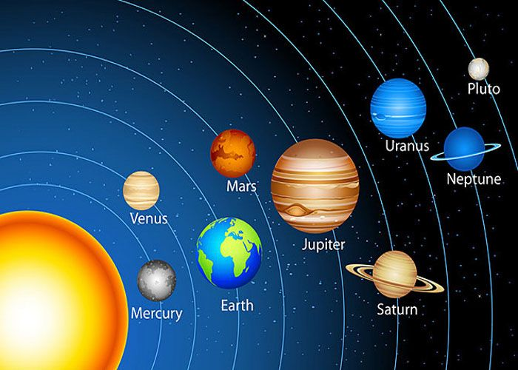
Space

Slide 2
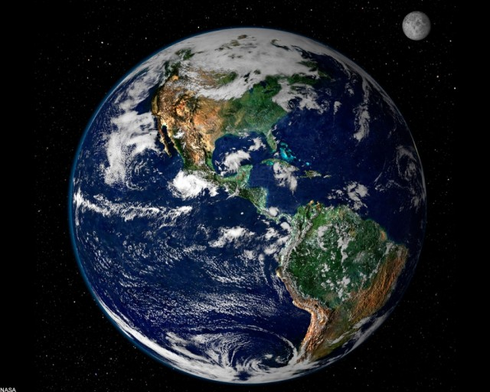
The planet t we live on …
A) the sun B) the Earth C) the moon

Slide 3
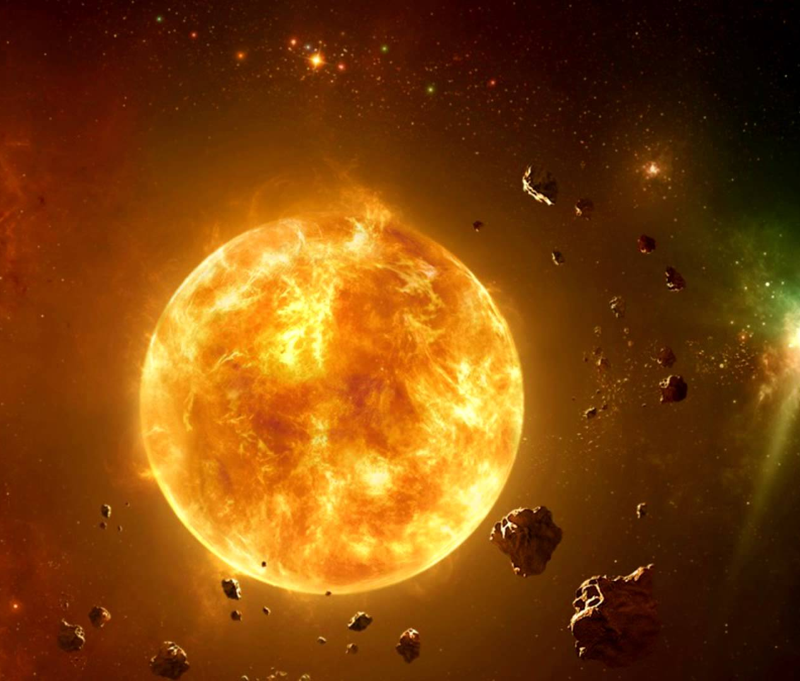
The large bright object in the sky that gives us light and heat, and around which the Earth moves
A) the sun B) the Earth C) the moon

Slide 4
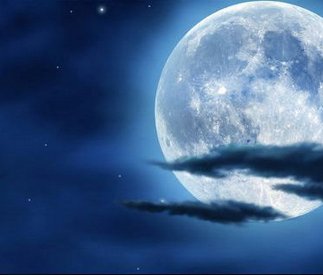
The round object that you can see shining in the sky at night
A) the sun B) the Earth C) the moon

Slide 5
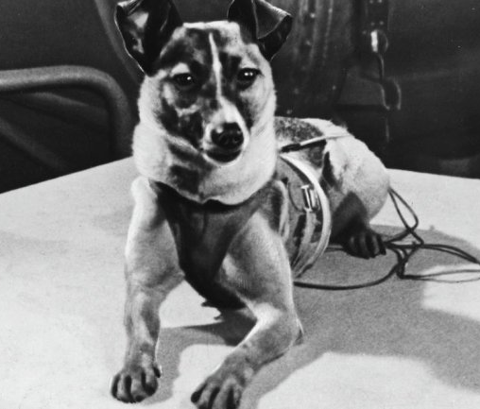
Who was the first animal in space?
A)Laika the dog
B) Strelka the dog C) Vaska the cat

Slide 6
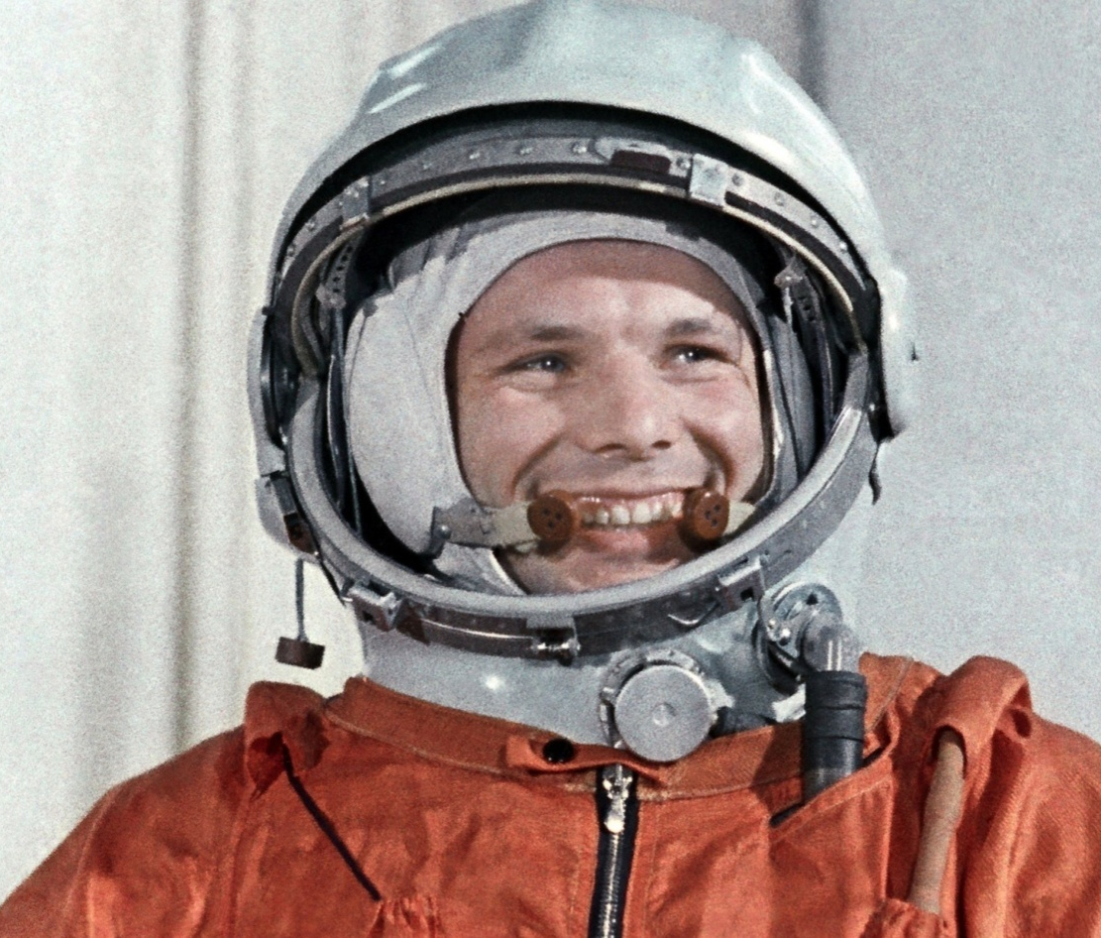
Who was the first person to orbit Earth?
A) Yuri Gagarin B) Neil Armstrong C) Buzz Aldrin

Slide 7
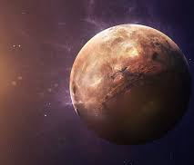
Which planet is the closest to the sun?
A) Mercury B) Venus C) Mars

Slide 8
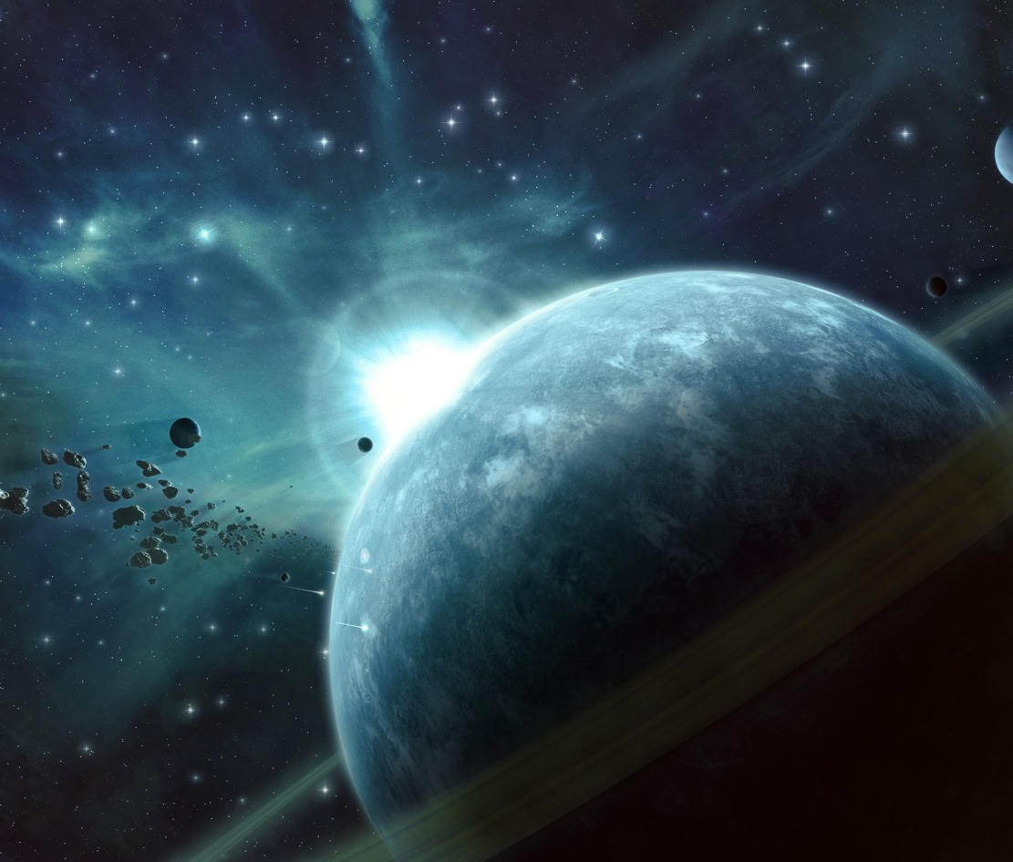
Which planet is the farthest to the sun?
A) Saturn B) Uranus C) Neptune

Slide 9
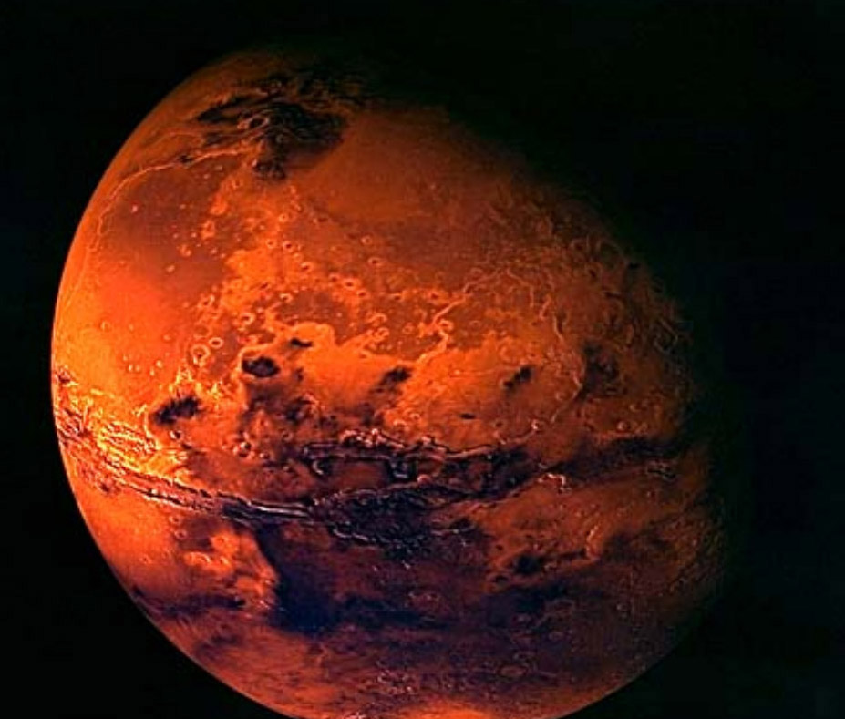
It`s the fourth planet from the Sun. It is sometimes called the Red Planet.
A) Mercury B) Venus C) Mars

Slide 10
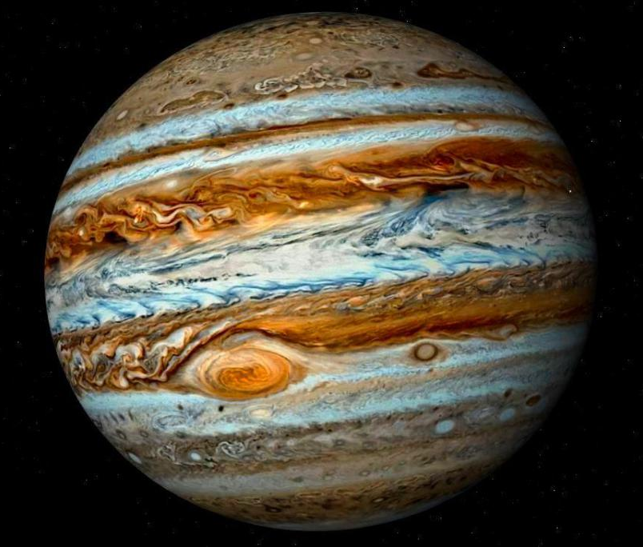
The largest planet in our Solar System is…
A) Jupiter B) Neptune C) Earth

Slide 11
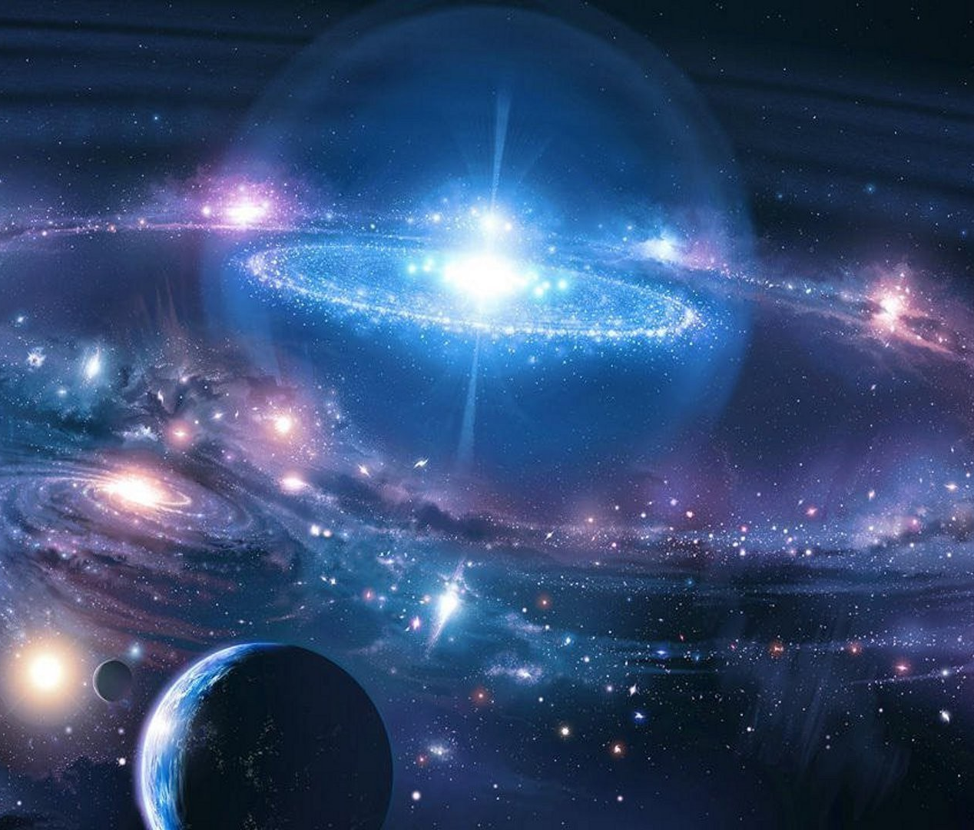
An astronomical unit is the distance from…
A) the sun to other stars B) the Earth to the sun
C) the Earth to the moon

