Slide 1
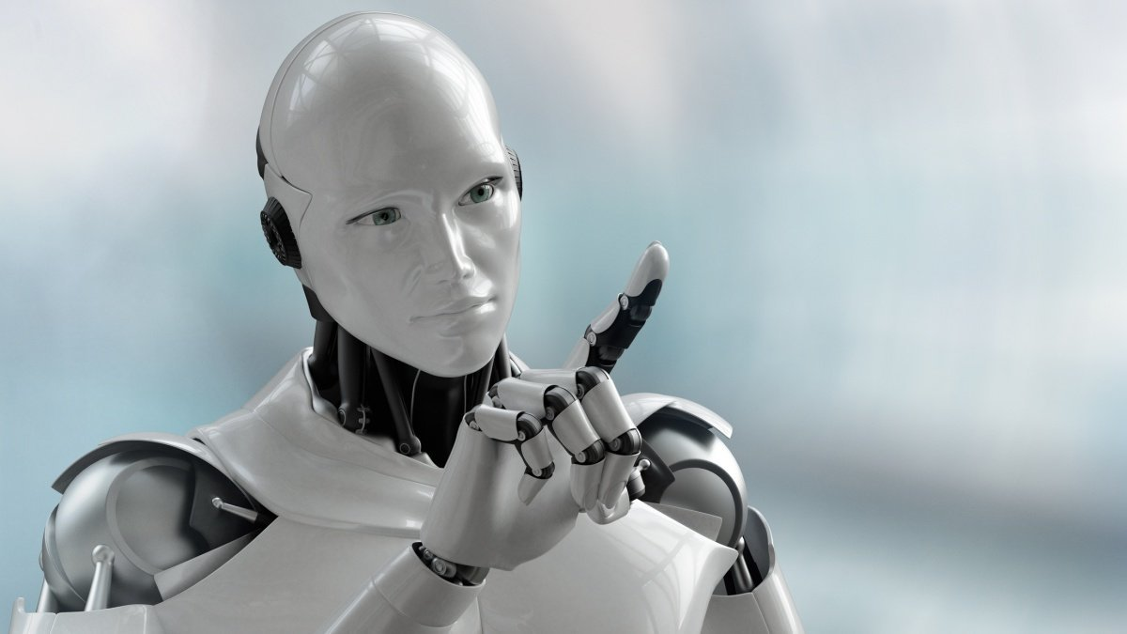
Robots of the future

Slide 2

Let’s revise the pronunciation of some difficult words:
Mechanical [mɪˈkænɪkəl] -механический
Creature [ˈkriːʧə] - создание
Construct [kənˈstrʌkt] – создавать, строить
Determine [dɪˈtɜːmɪn] - определять
Behavior [bɪˈheɪvɪər] - поведение
Humanoid [ˈhjuːmənɔɪd] - человекоподобный
Robotic [rəʊˈbɒtɪk] - роботизированный
Automated [ˈɔːtəmeɪtɪd] автоматизированный

Slide 3
Programmable [ˈprəʊgræməbl] программируемый
Artificial intelligence [ɑːtɪˈfɪʃəl ɪnˈtelɪʤəns] искусственный интеллект
Entertaining [entəˈteɪnɪŋ] - развлекательный
Research [rɪˈsɜːʧ] - исследование
Equipment [ɪˈkwɪpmənt] – оборудование
Manipulation [mənɪpjʊˈleɪʃn] - управление
Orbiter [ˈɔːbɪtər] – орбитальный зонд
Lander [ˈlændər] – посадочный модуль

Slide 4
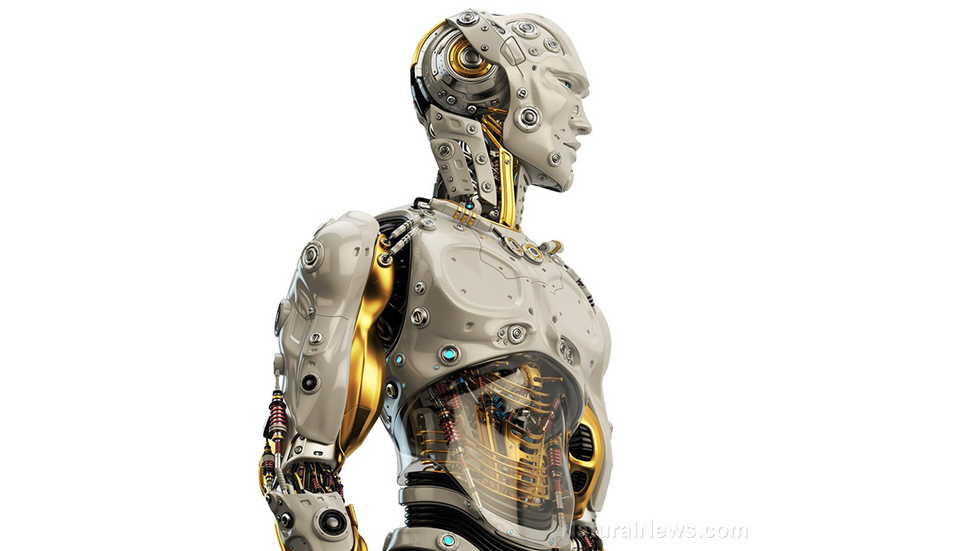
What are your associations with the word robots?
…
…
…
Robots
…
…
…
…

Slide 5
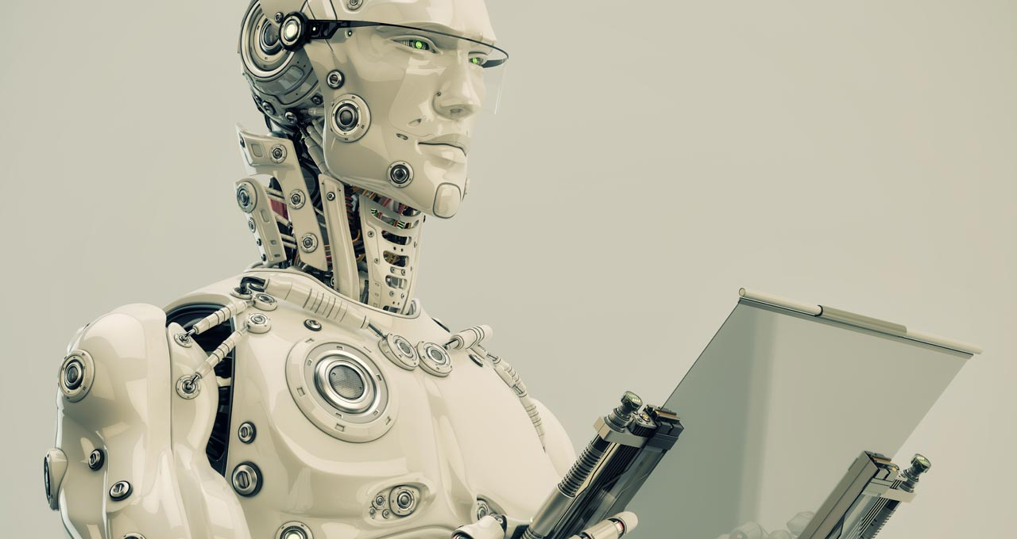
Ex.99 p.121
Listen to the advertisement and answer the following questions.
What creatures does the advert compare the robot to? Why?
How useful can this robot be? What can it do?
How does it react if it notices something unusual in human behavior?
What groups of people can this robot be useful?

Slide 6
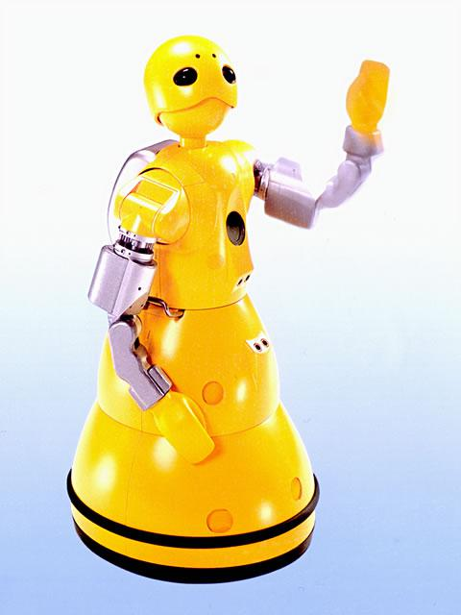
Ex.100 p.121
Listen again and fill in the gaps in the summary. NB: You don’t have to use exactly the same words you hear on the recording.
Wakamaru is a robot designed …
It is … a young Japanese warrior.
It is … and useful for your life at home.
Wakamaru is able to … to people and … .
It is important that it can determine … in people.

Slide 7
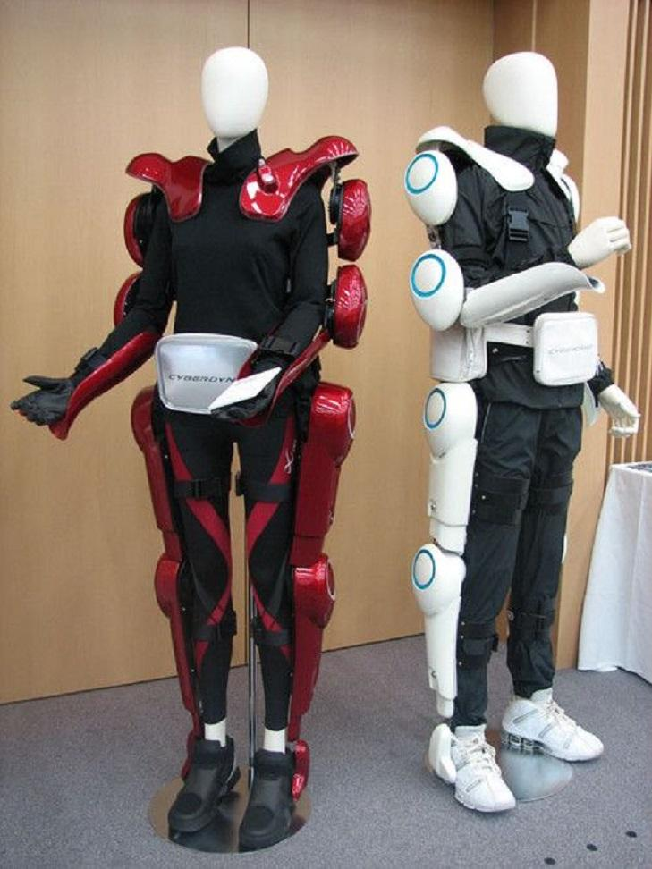
Medical care robots
The robot suit HAL (Hybrid Assistive Limb) has been used in medicine for several years and helps to achieve incredible results in the field of rehabilitation of people with disorders of the musculoskeletal system.
The first version of the suit, HAL 3, helps to restore the motor function of the legs.

Slide 8
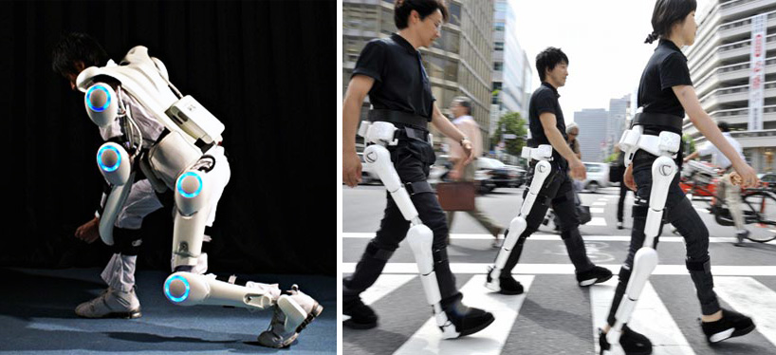
Frames, wires and special sensors are attached to the waist and legs, which send commands from the brain to the muscles.
These impulses come to the built-in computer, which evaluates the load and activates the necessary parts of the exoskeleton.

Slide 9
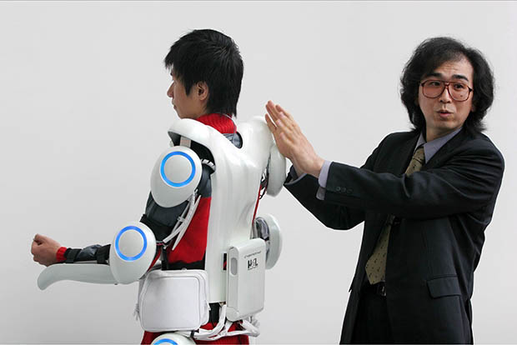
This means that the robot-suit can be used by people who have partially or completely lost their mobility due to spinal injuries, craniocerebral injuries, diseases of the brain or the neuromuscular system.
The miraculous costume was invented by Yoshiyuki Shankai, a professor at Tsukuba University, having spent more than 20 years working on it.

Slide 10
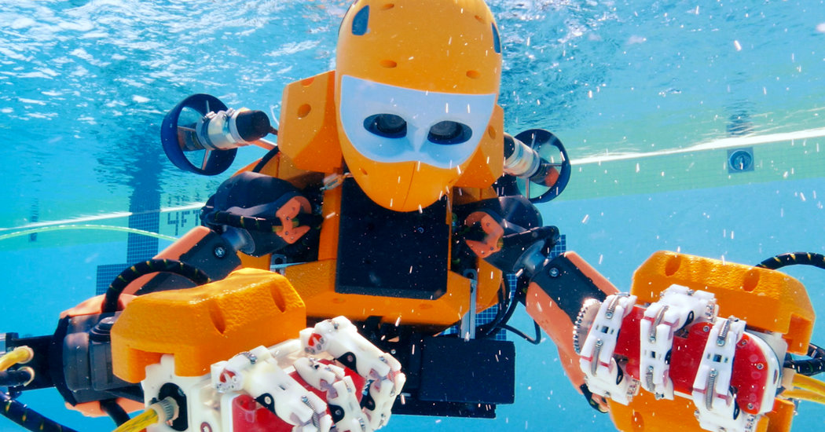
Underwater robots
Computer scientists at the University of Stanford recently developed OceanOne, a humanoid diving robot that travels to wrecks and coral reefs too deep for humans.
The robot was created to bridge the gap between human divers and deepwater vessels.
Existing submarines lack the skill of human divers. It’s almost easier to break artifacts with submarines than collect them.

Slide 11
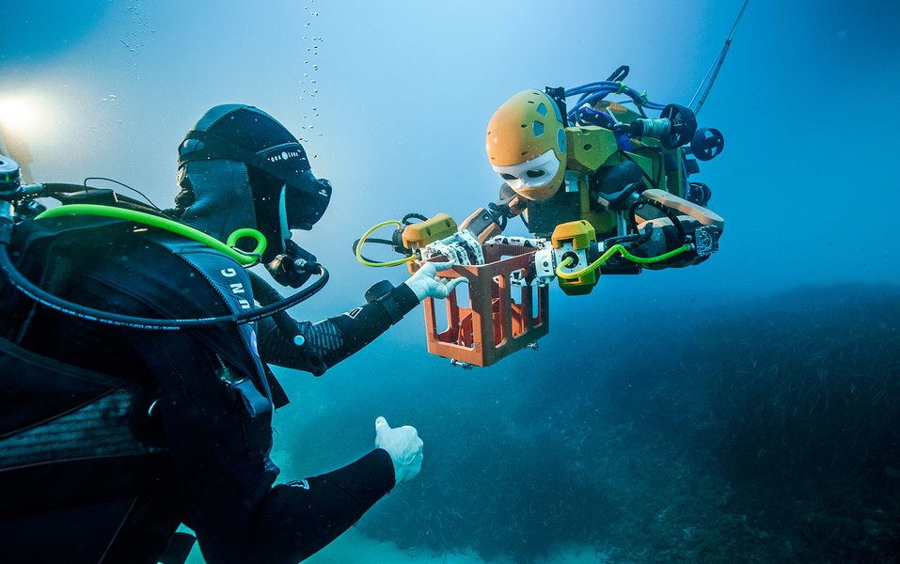
OceanOne is more like a robo-mermaid, with human-like hands and a face, but a tail with batteries and thrusters.
Humanoids aren’t the only robots created for underwater exploration.

Slide 12
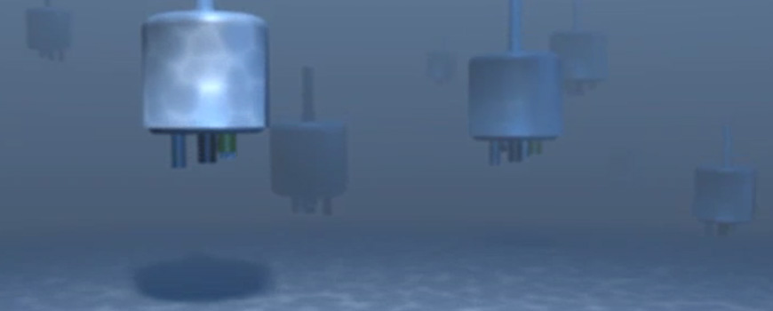
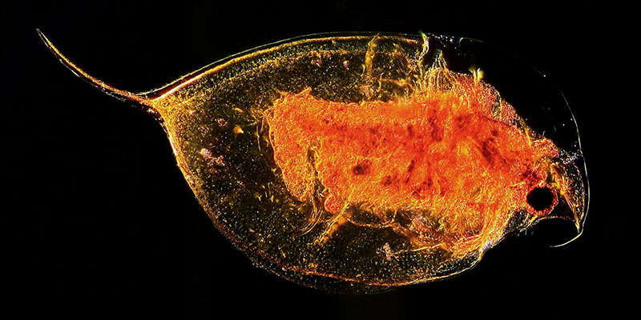
Robot animals are helping humans protect busy ports and catch criminals.
Researchers at the Scripps Institution of Oceanography at UC San Diego developed underwater robots that act like plankton.

Slide 13
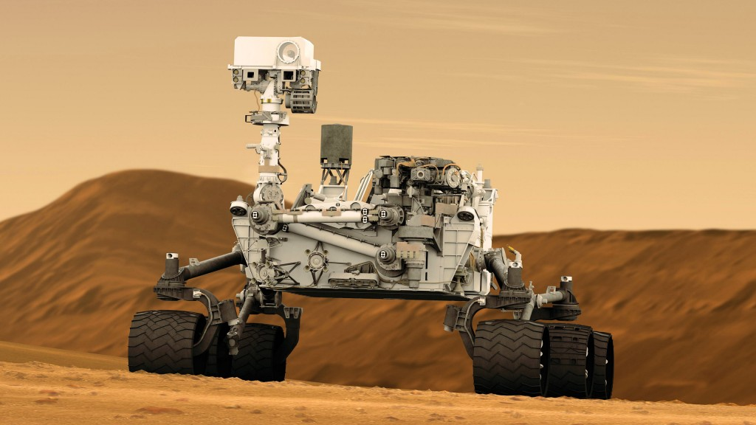
Space robots
Robotic explorers have set down on the Moon, Mars, Venus, Titan and Jupiter, as well as a few comets and asteroids.
Robotic missions can travel further and faster, and can return more scientific data than missions that include humans.

Slide 14
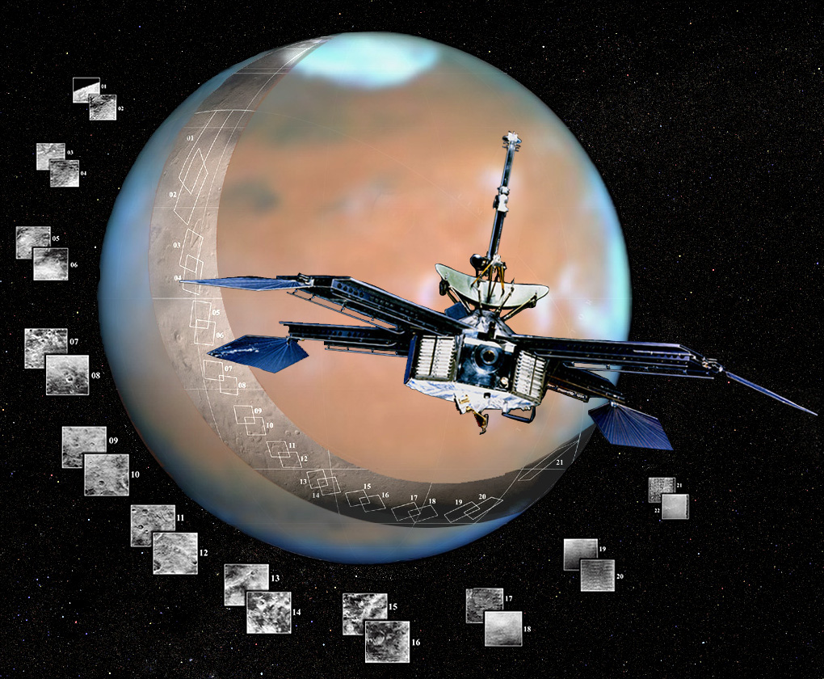
The most famous robots in space have to be the series of orbiters, rovers and landers that have been sent to Mars.
The first orbiter was Mariner 4, which flew past Mars on July 14, 1965 and took the first close up photos of another planet.

Slide 15
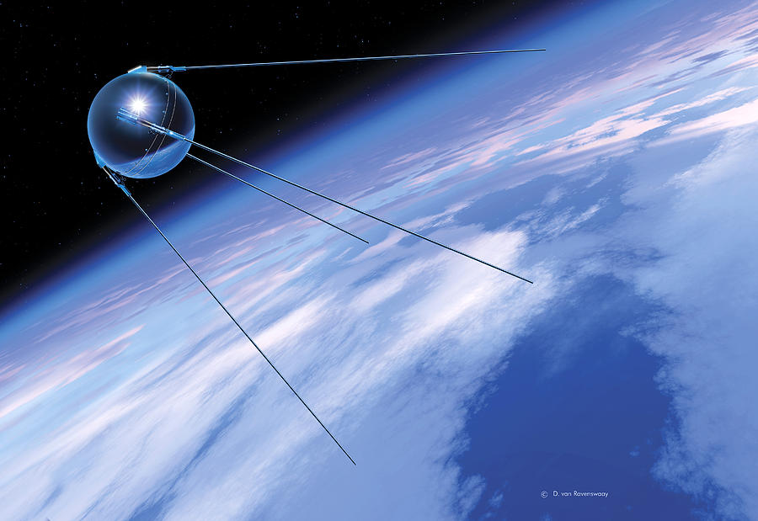
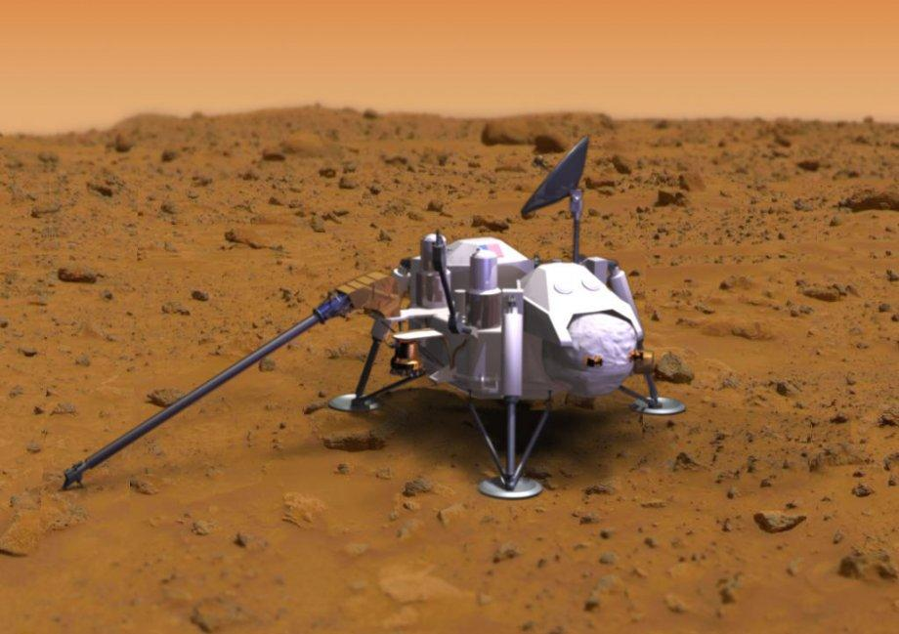
The first landers were the Viking landers. Viking 1 landed July 20, 1976, and Viking 2 on September 3, 1976.
Sputnik 1, of course, was the first robot in space, and was launched October 4th, 1957 by the USSR.

Slide 16
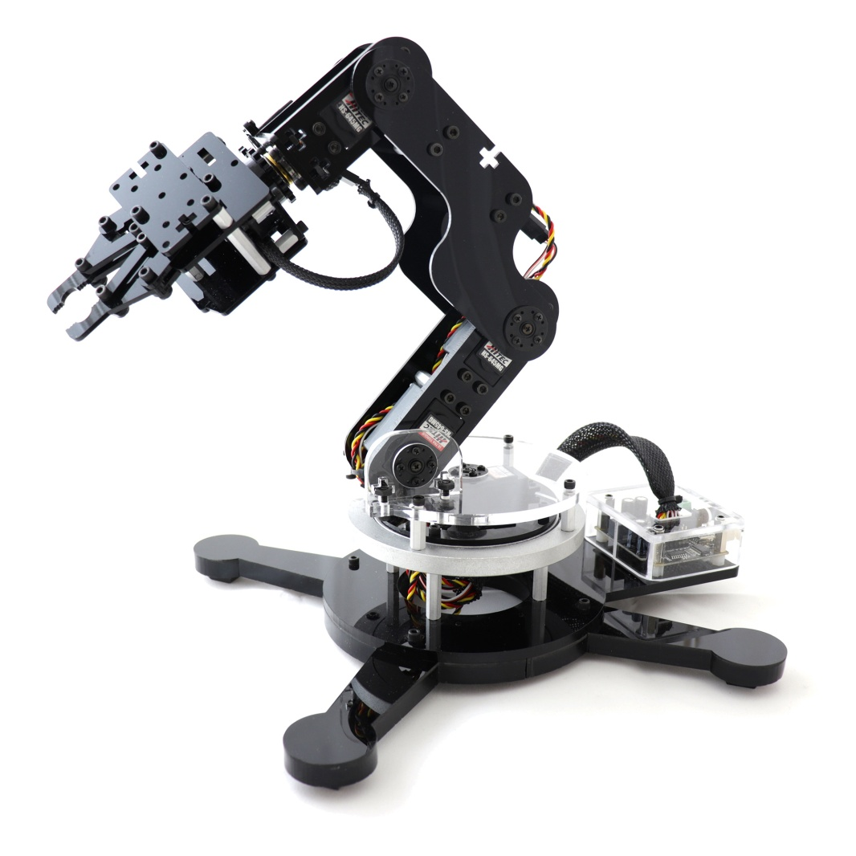
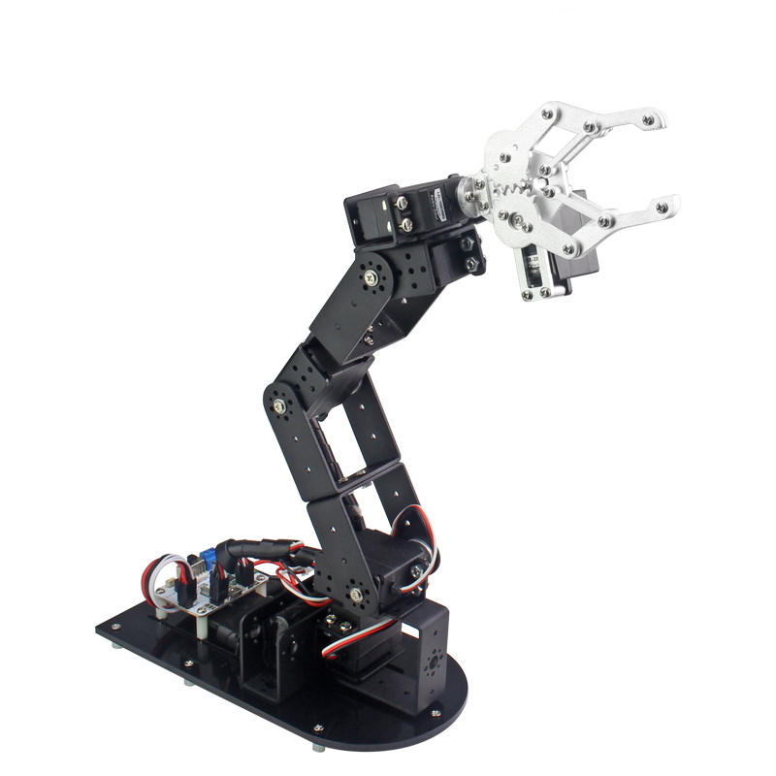
Dexter, a robotic arm developed by the Canadian Space Association, is a very cool robot aboard the International Space Station.
Dexter allows for delicate manipulation of objects outside the station.

Slide 17
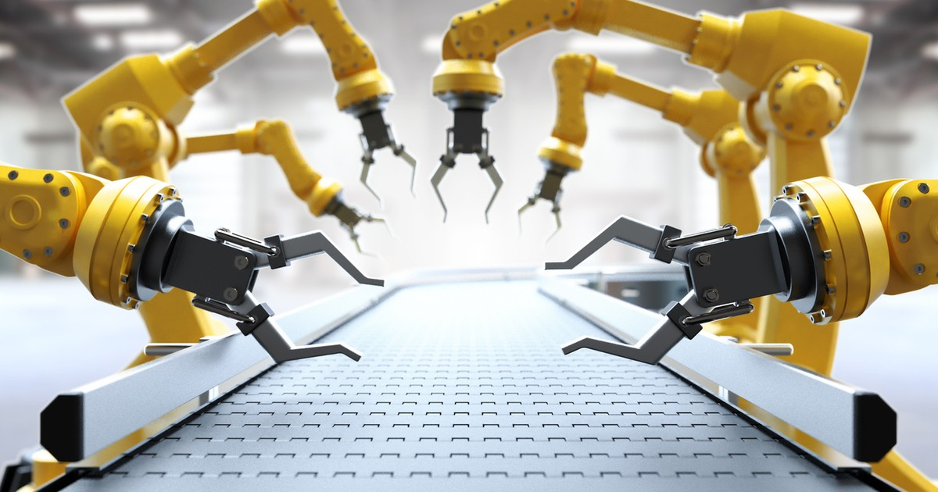
Industrial robots
An industrial robot is a robot system used for manufacturing.
Industrial robots are automated, programmable and capable of movement on two or more axes.

Slide 18
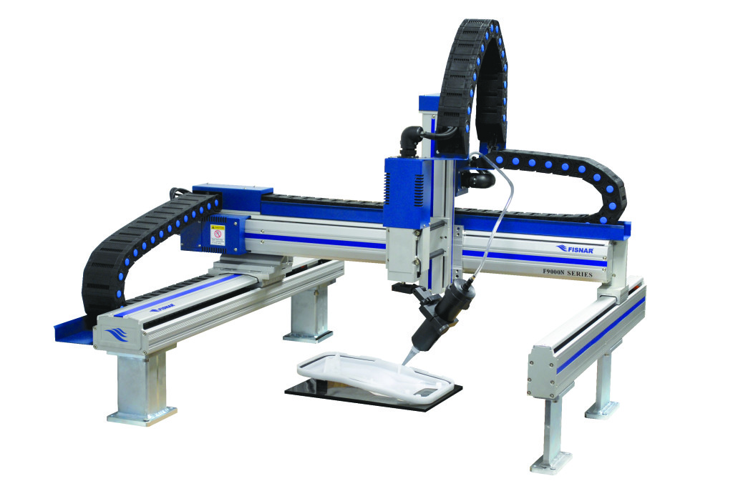
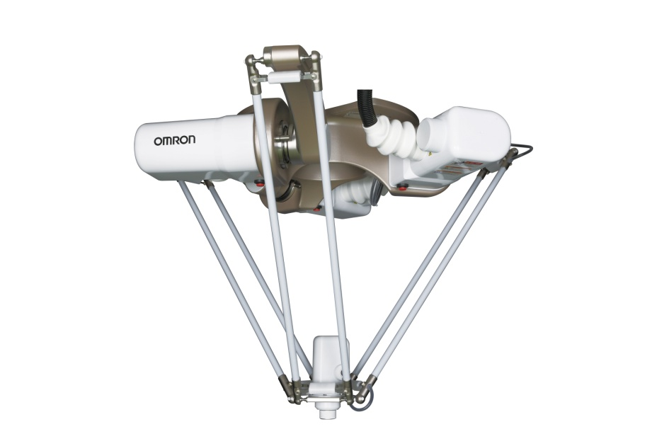
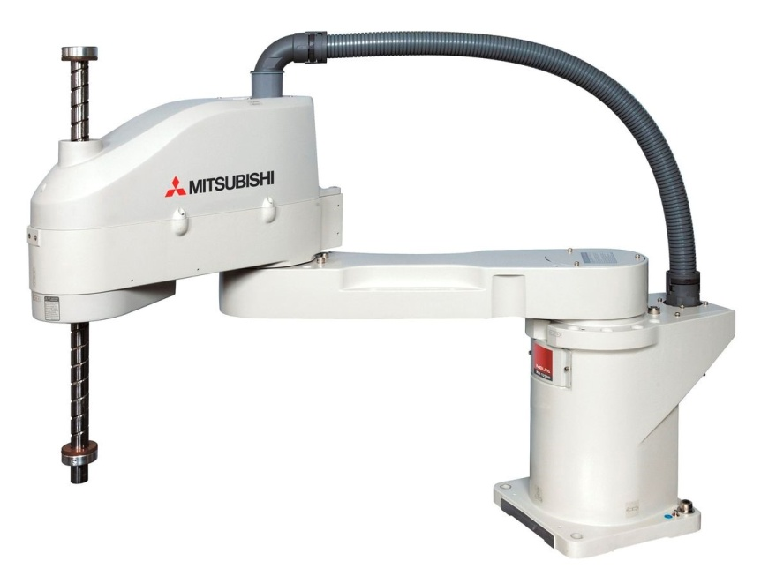
Typical applications of robots include welding, painting, assembly, pick and place, product inspection, and testing; all accomplished with high endurance, speed, and precision.
The most commonly used robot configurations are: articulated robots, SCARA robots, delta robots , Cartesian coordinate robots.

Slide 19
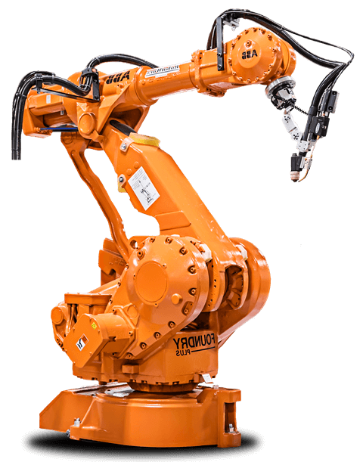
Some robots are programmed to faithfully carry out specific actions over and over again without variation and with a high degree of accuracy.
Artificial intelligence, or what passes for it, is becoming an increasingly important factor in the modern industrial robot.

Slide 20
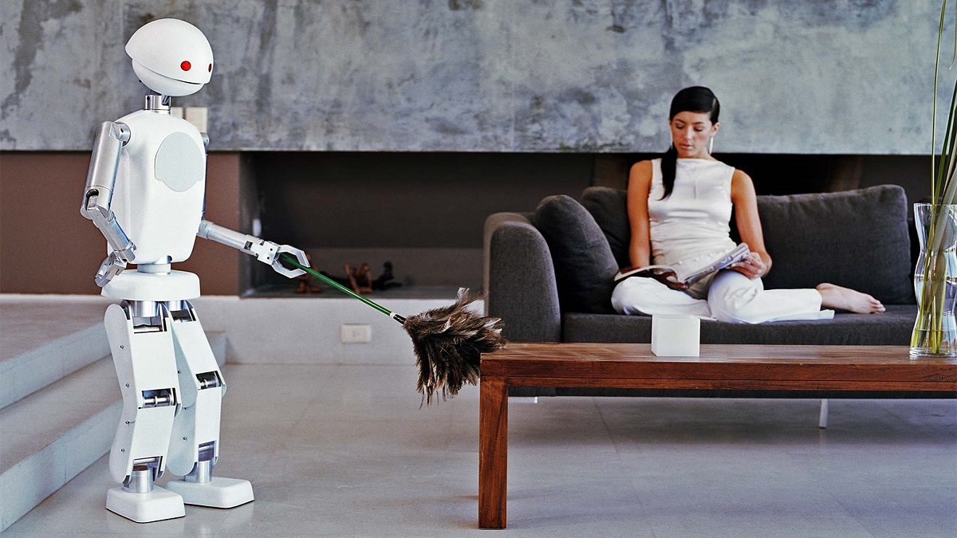
Robots for dirty, dangerous, dull or inaccessible tasks
There are many jobs which humans would rather leave to robots. The job may be boring, such as domestic cleaning, or dangerous, such as exploring inside a volcano.
Other jobs are physically inaccessible, such as exploring another planet, cleaning the inside of a long pipe, or performing laparoscopic surgery.

Slide 21
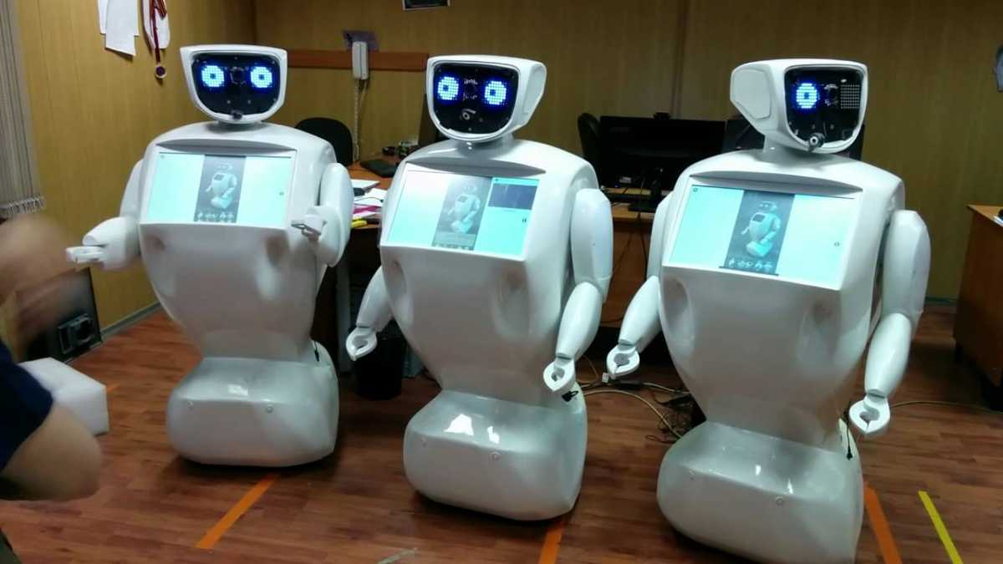
Almost every unmanned space probe ever launched was a robot.
Teleoperated robots, or telerobots, are devices remotely operated and used when a human cannot be present on site to perform a job because it is dangerous, far away, or inaccessible.

Slide 22
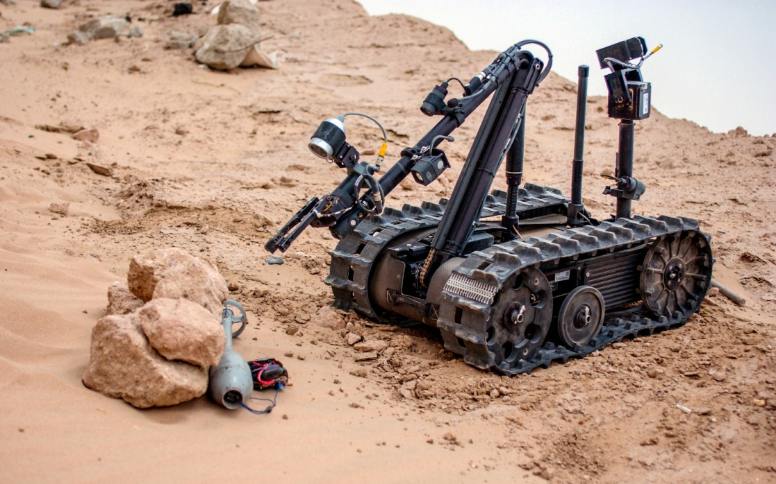
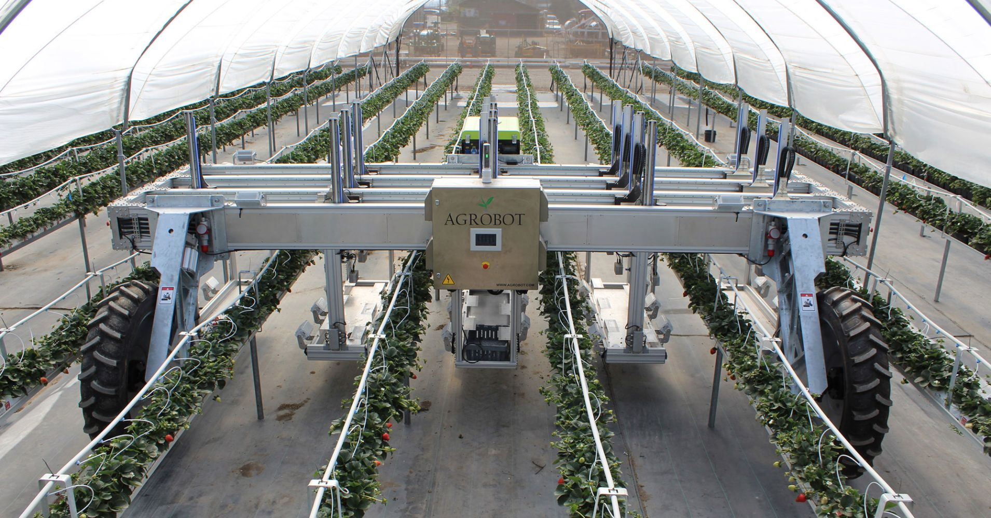
When disabling a bomb, the operator sends a small robot to disable it.
Automated fruit harvesting machines are used to automate picking fruit on orchards at a cost lower than that of human pickers.

Slide 23
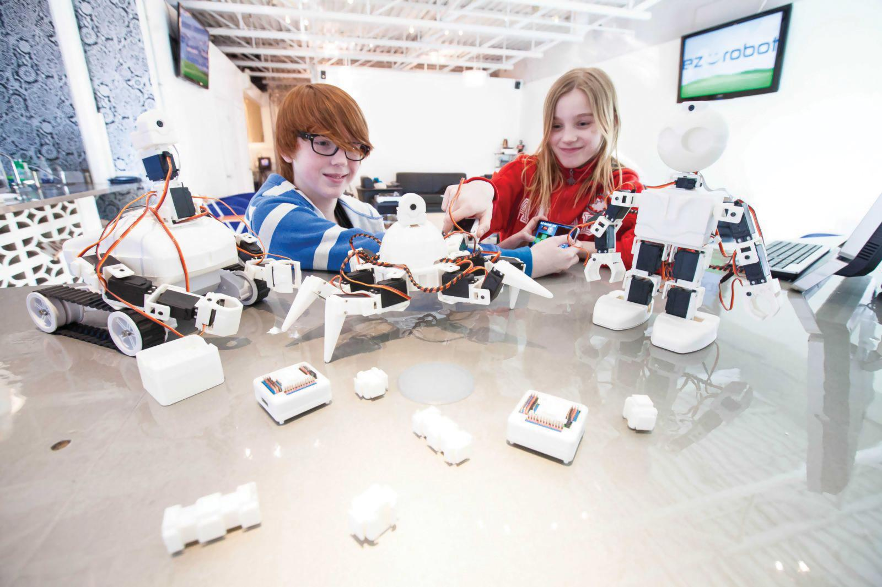
Robot Toys / Educational robots
Educational robots a lot of fun, but they are so much more.
They serve as excellent tools for introducing children in Pre-K, Preschool and Kindergarten to complex subjects.

Slide 24
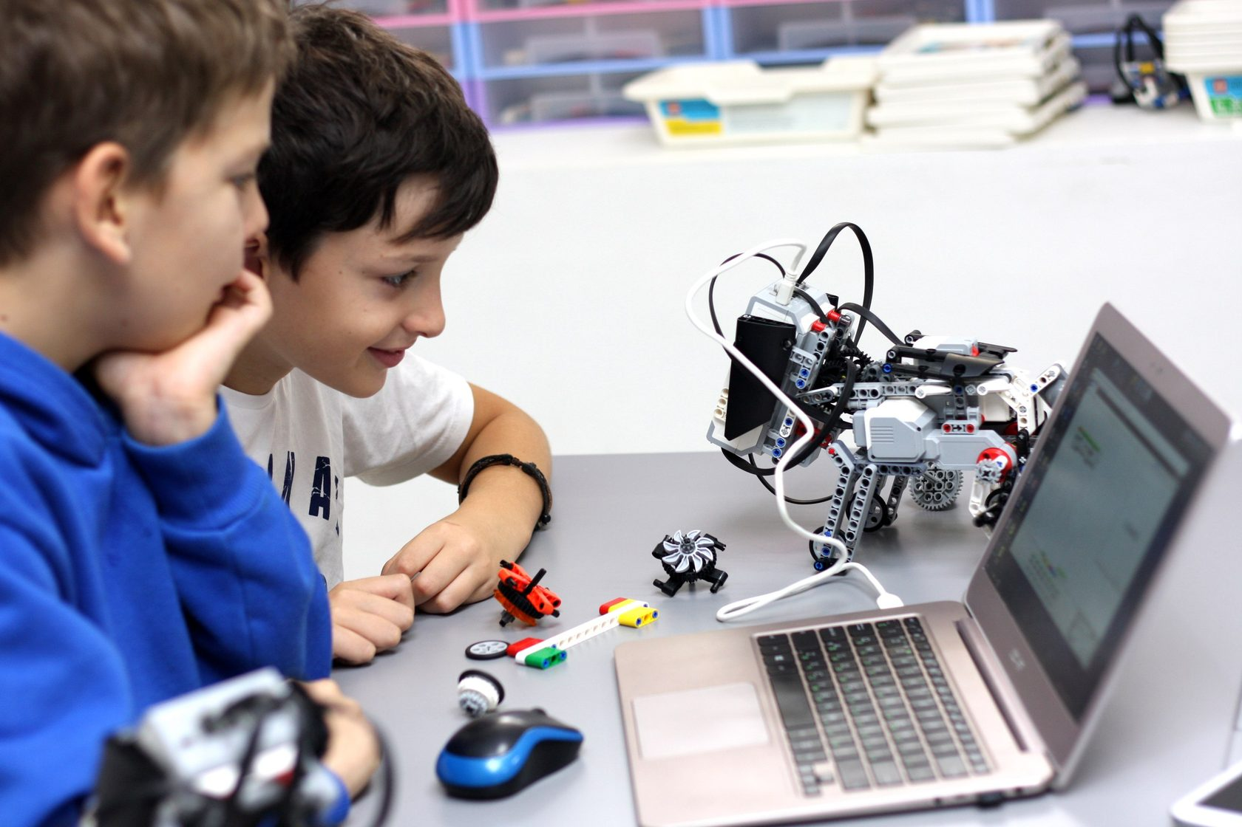
Educators can use specially designed robot kits for kids to teach science fundamentals and concepts in an engaging and entertaining manner.
By using education robots, educators can do three things for young learners all at once.

Slide 25
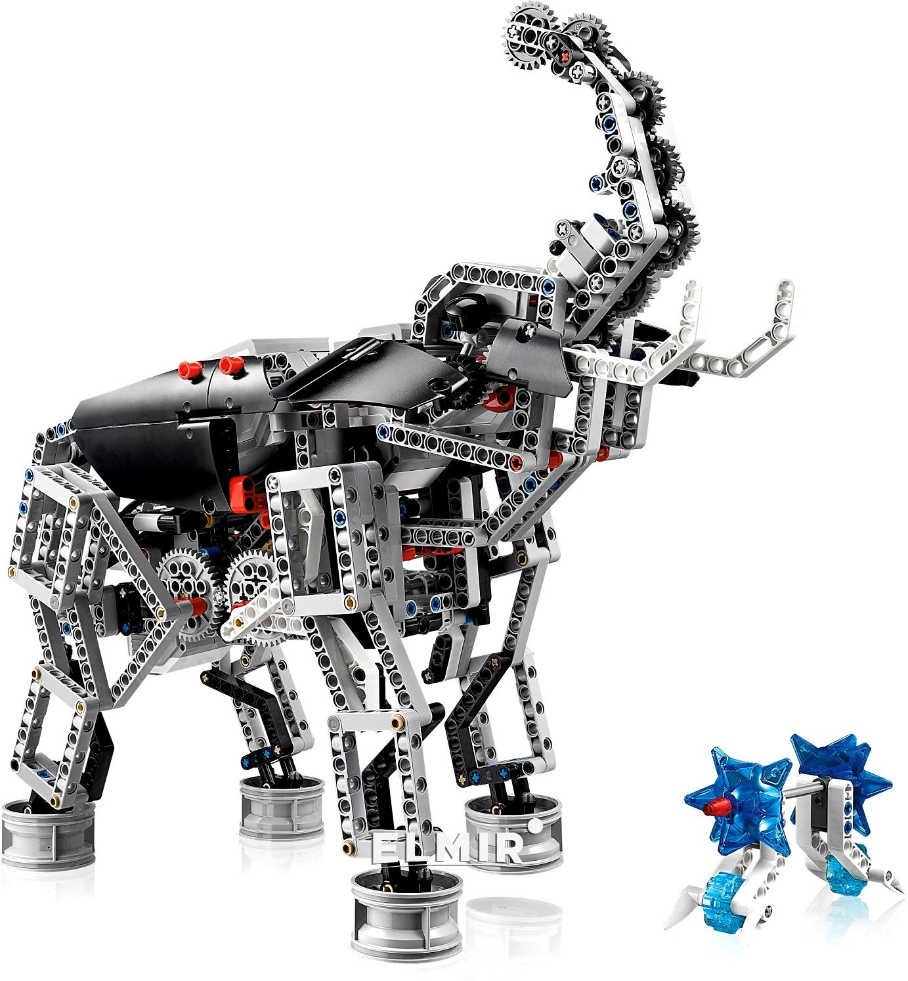
They can: · Stimulate their kids’ critical thinking and creative processes · Help children learn how to plan and work as a team · Make lessons much more enjoyable

Slide 26
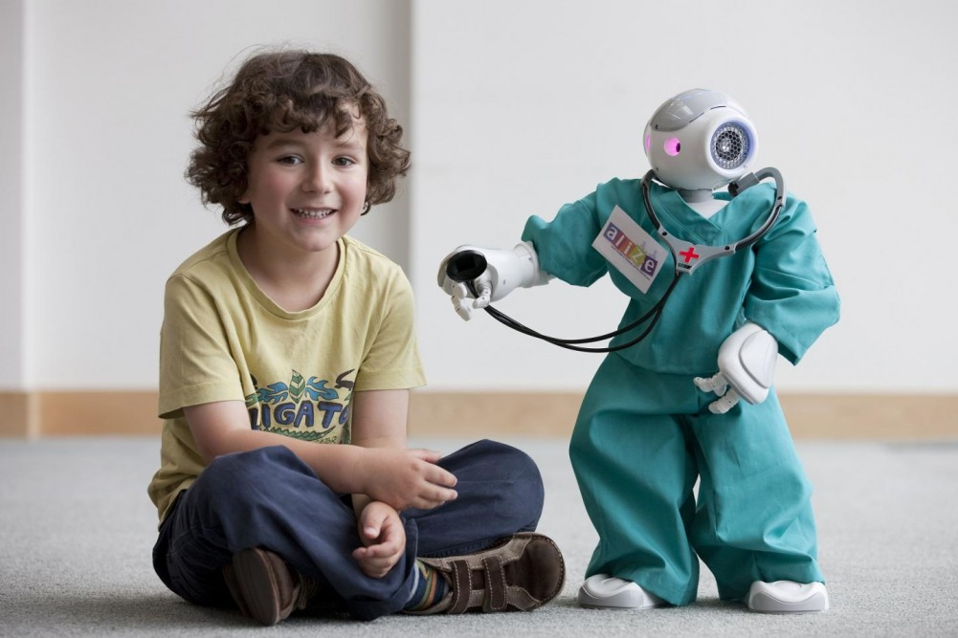
Social robots
Social robots are humanoid types and are intended for the elderly people or people with limited mobility. They are intended primarily for home use.
Robots can serve as companions for an elderly person, provide a wide range of services, for example, to remind you to take medicine or turn off a forgotten electric stove.

Slide 27
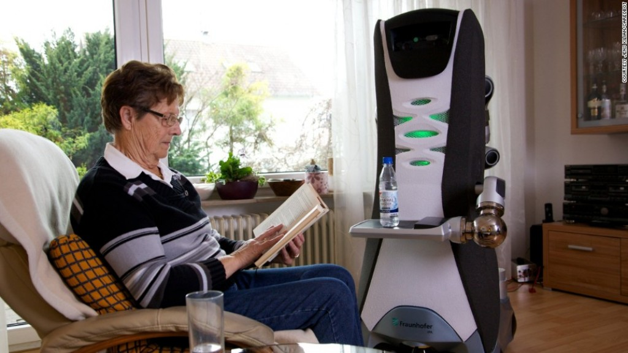
The robot will be able to recognize commands given by voice, for example, to bring water or sweep the floor.
Currently used wheeled platform, in the future it can be replaced by robots.

Slide 28
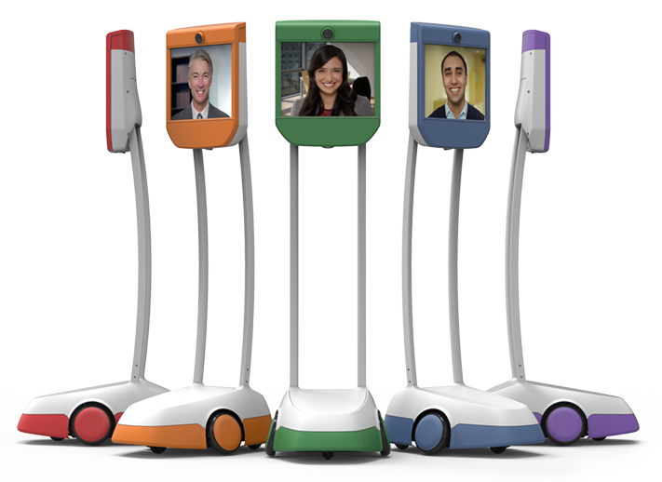
A class of social robots – mobile robotic telepresence (MRT) systems – have already been shown to generate positive social interactions with elderly patients.
They allow relatives and social workers to “visit” elderly people more often, even if they live in rural or distant places.

Slide 29
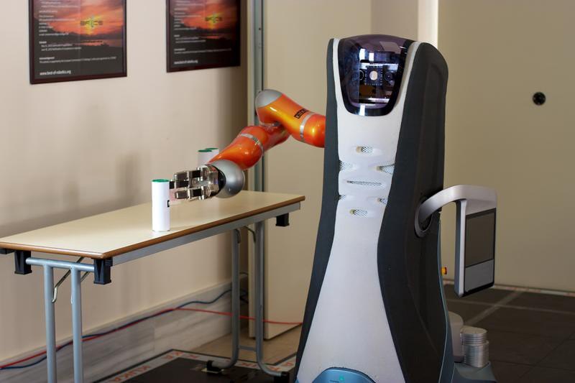
Other humanoid robots, such as the Care-O-bot and Pepper, are able to provide more complex and comprehensive care.

Slide 30
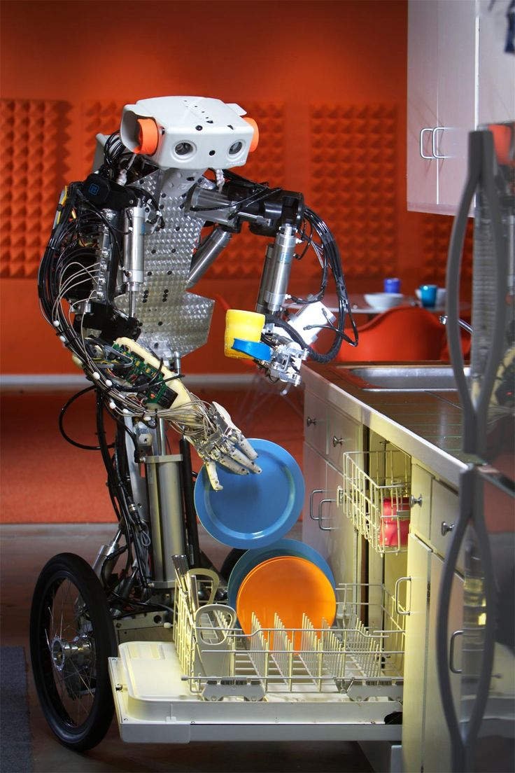
Domestic robots
A domestic robot is a type of service robot, an autonomous robot that is primarily used for household chores, but may also be used for education, entertainment or therapy.
Indoor robot does chores around and inside homes.

Slide 31
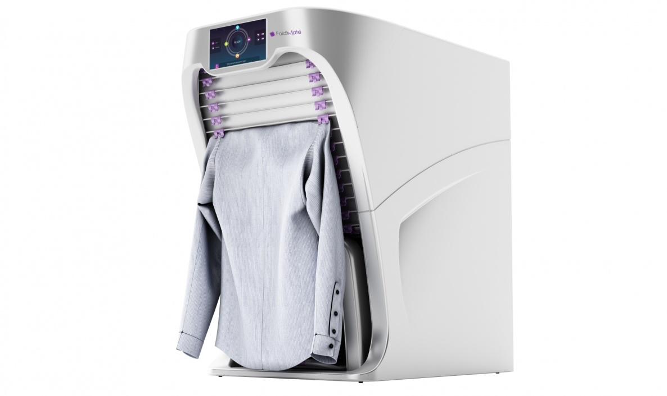
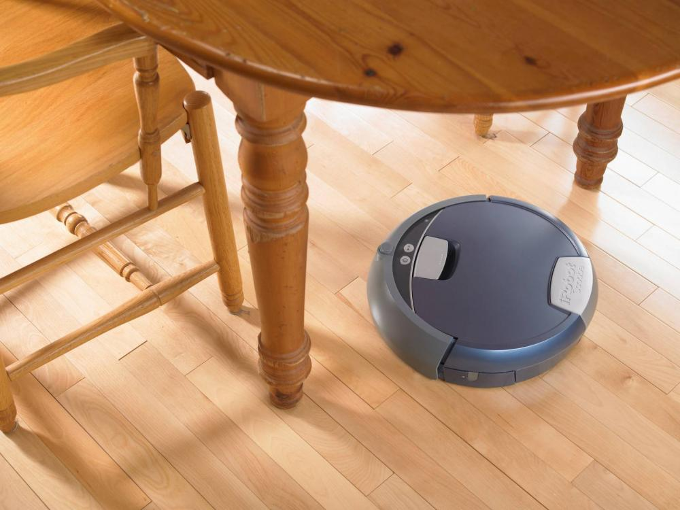
Robotic vacuum cleaners and floor-washing robots that clean floors with sweeping and wet mopping functions.
Within the ironing robots, Dressman dries and iron shirts using hot air.

Slide 32
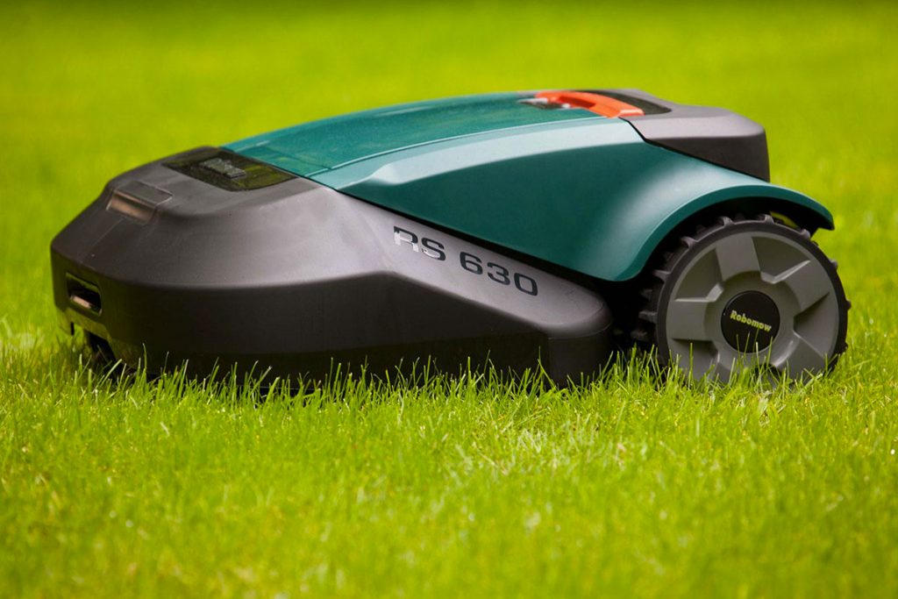
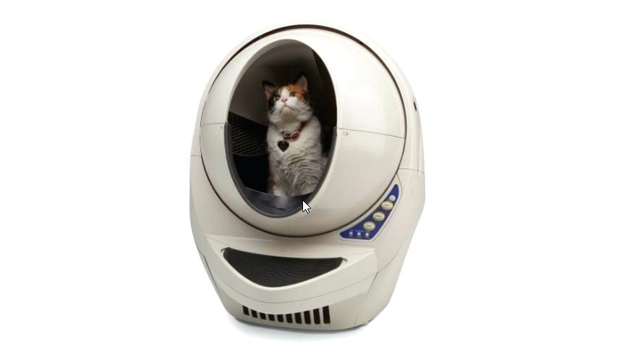
Cat litter robots are automatic self-cleaning litter boxes.
Outdoor robots, for example, robotic lawn mower is a lawn mower that is able to mow a lawn by itself after being programmed.

Slide 33
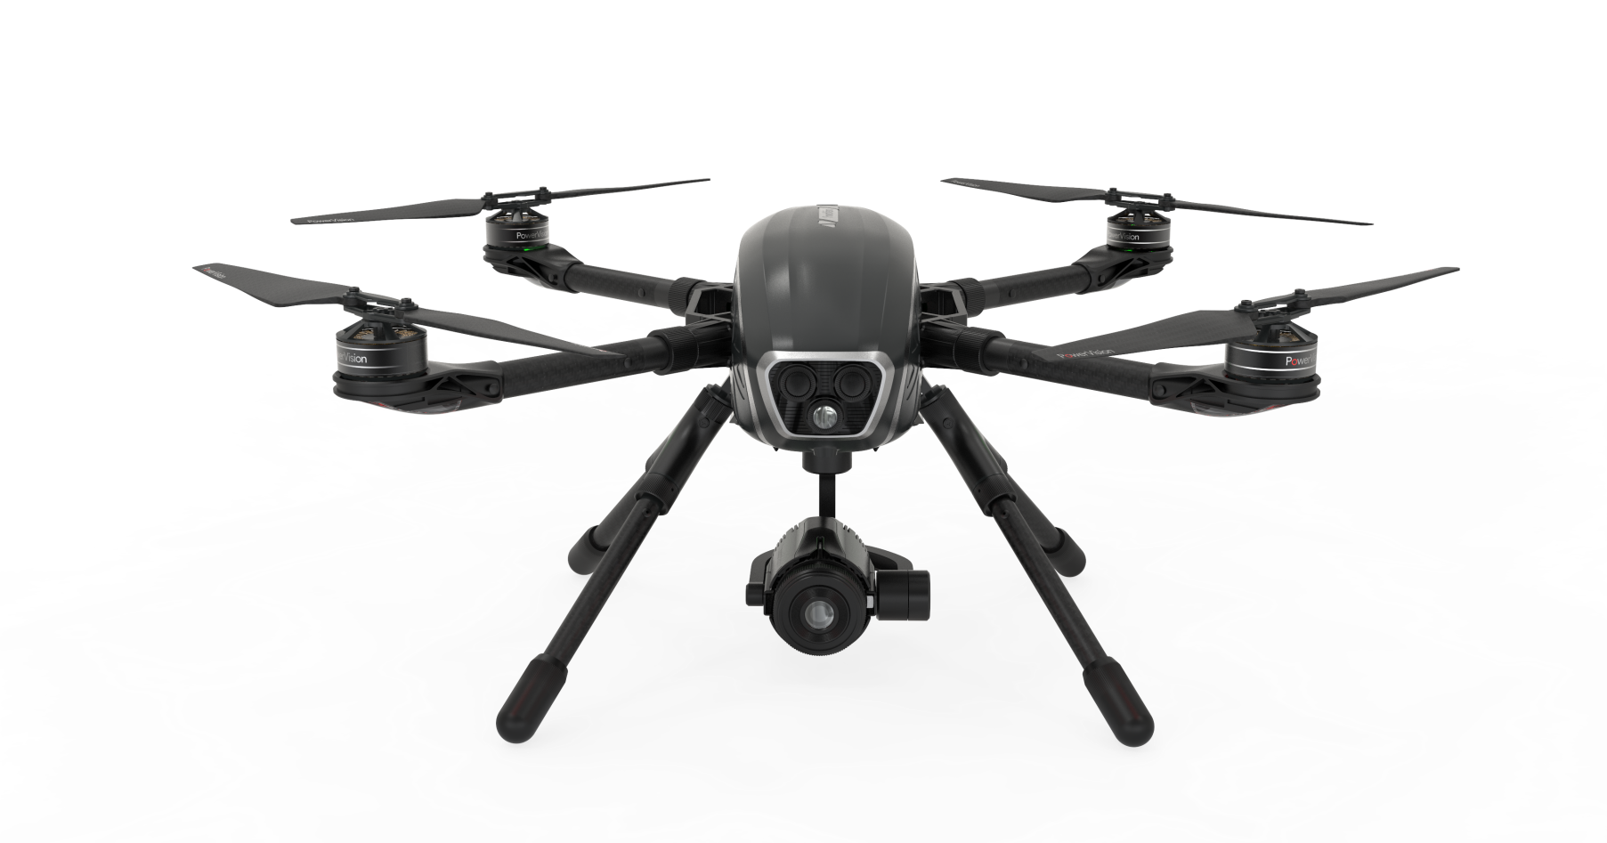
Drones
Drones have been around for years, and they are used for different purposes and can be of help in numerous occasions.
A drone can be equipped with a variety of additional equipment, including cameras, GPS, navigation systems, sensors, and so on.

Slide 34
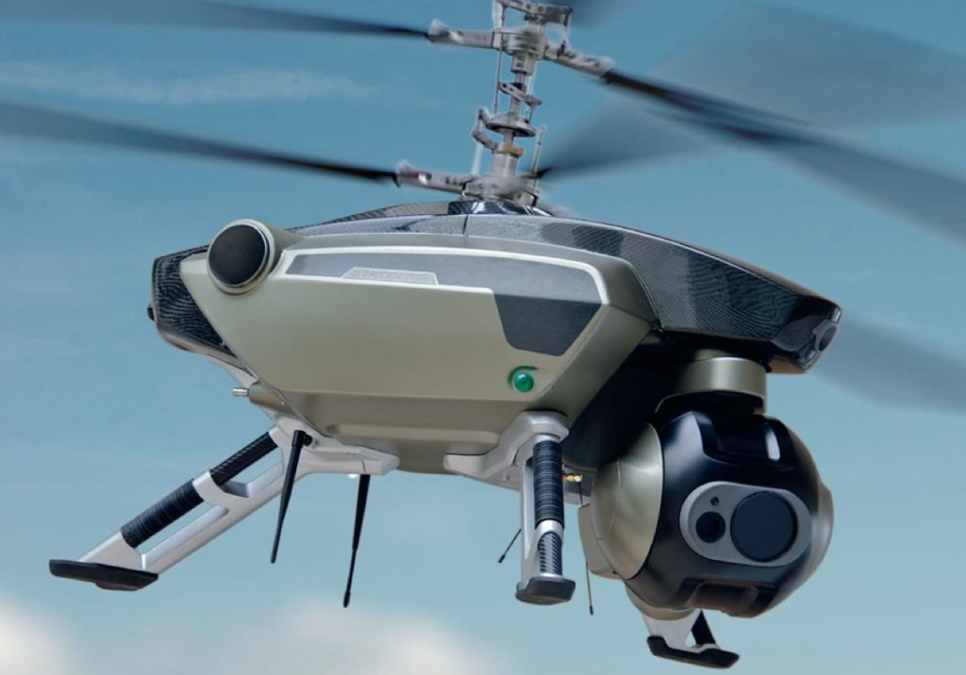
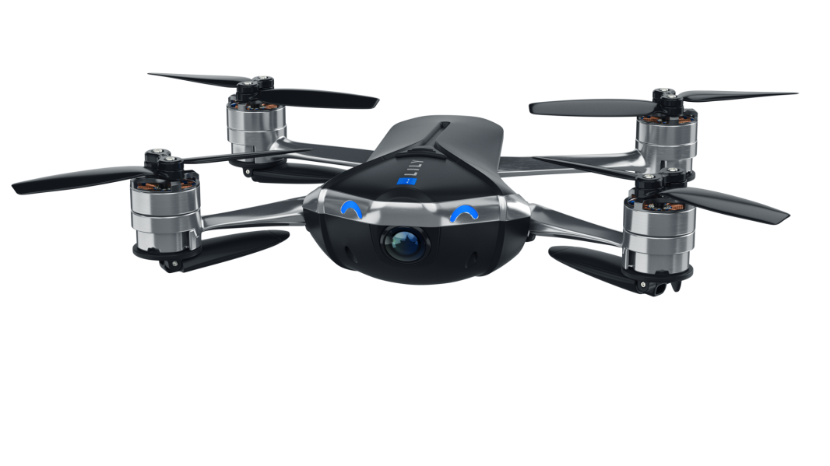
When it comes to commercial drones for entertainment, they have a short control distance and can fly just a few minutes.
On the contrary, the advanced drones which are used in the military or mapping are able to hover for hours in the air and be controlled from a great distance.

Slide 35
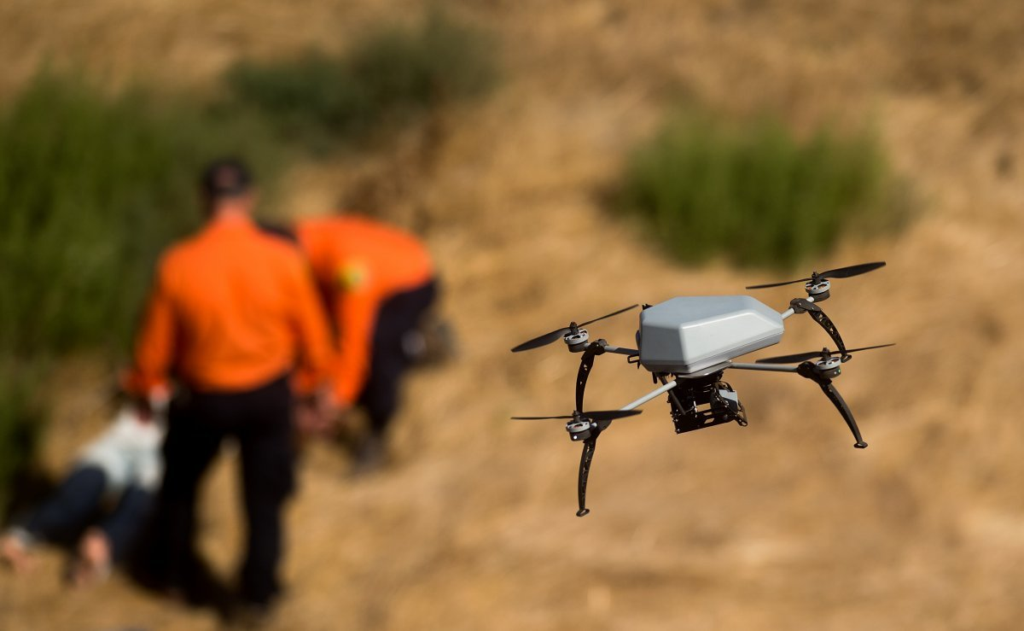
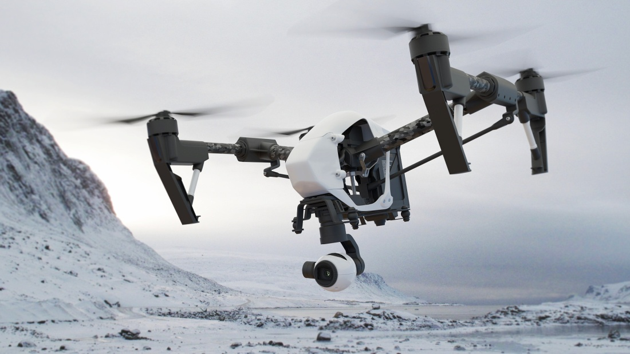
Drones are very useful in searching and rescuing operations.
Many authorities use drones to protect people during various emergencies.
They help scientists a lot in research works.

Slide 36

After watching you should answer the question: What kinds of robot animals did you see in this video?

Slide 37
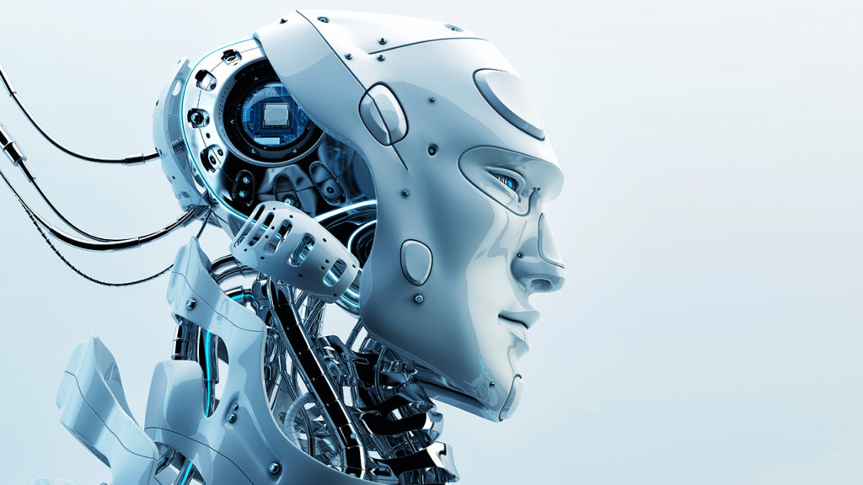
Did you like the theme of the lesson?
Continue the sentence
During today’s lesson I have
-got acquainted with …
- found out …
- learnt …
- remembered …

Slide 38
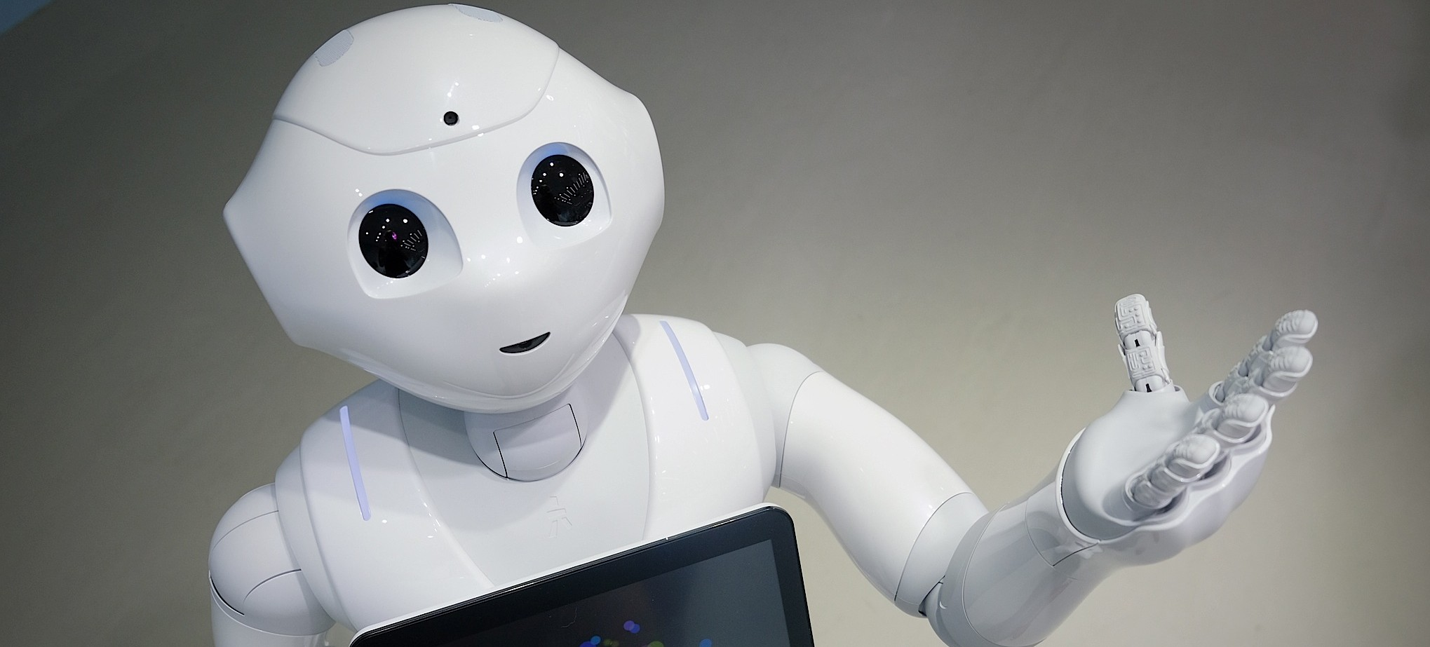
Homework
ex.102 p.121 (read the text and answer the questions)

Slide 39


