Slide 1
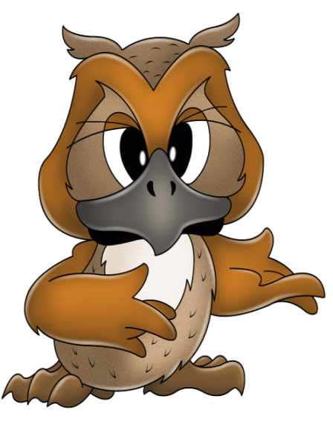
QUIZ

Slide 2
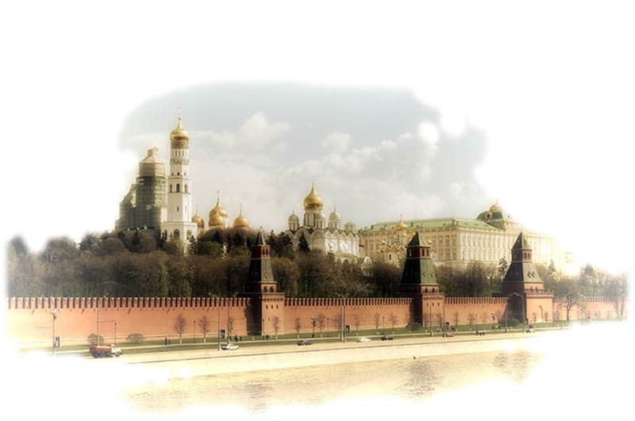
1. What is the age of Moscow?
More than 800 years
More than 8 years
More than 60 years

Slide 3
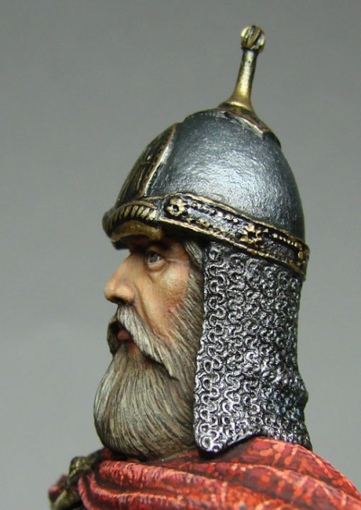
2. Whom was Moscow founded?
Ivan the Terrible
Yuri Dolgorukiy
Ilya Muromets

Slide 4
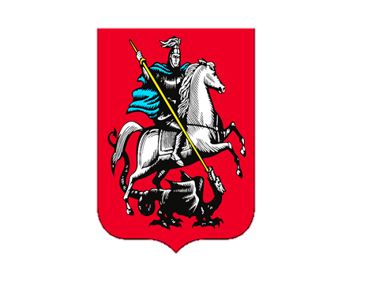
3. Who is represented on the coat of arms of Moscow?
An eagle
A bear
A rider

Slide 5
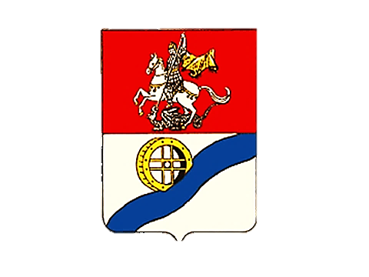
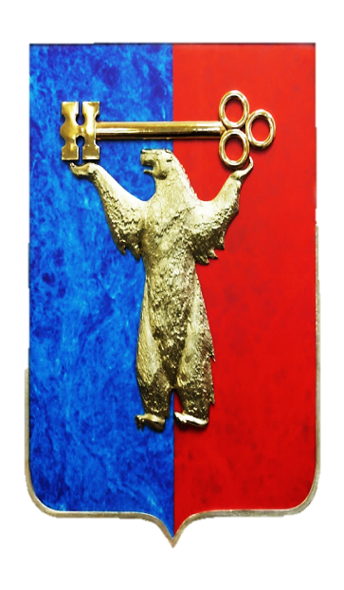
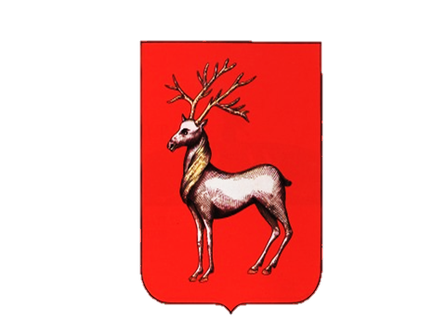
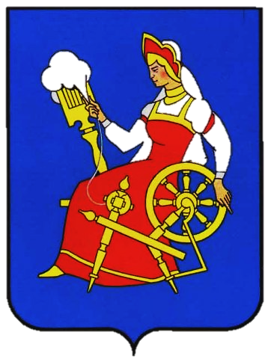
4. Find the coat of arms of Moscow
1
4
3
2
5

Slide 6
5. What river does Moscow stand on?
The Volga
The Moskva River
The Oka

Slide 7
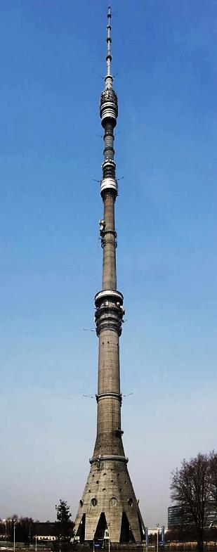
6. What is the highest building in Moscow?
The planetarium
The Bolshoi theatre
The television tower in Ostankino

Slide 8
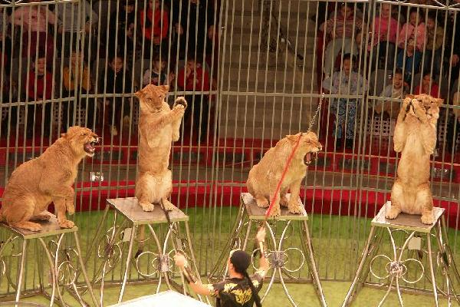
7. Where can wе see the trained animals?
At the zoo
In the State Darwin Museuм
In the circus

Slide 9
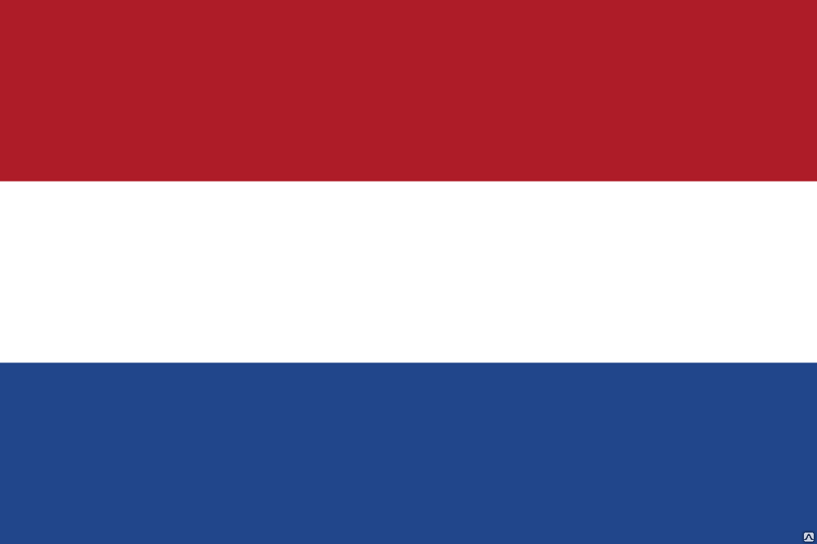
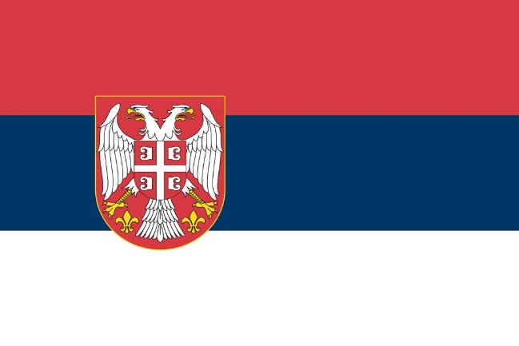
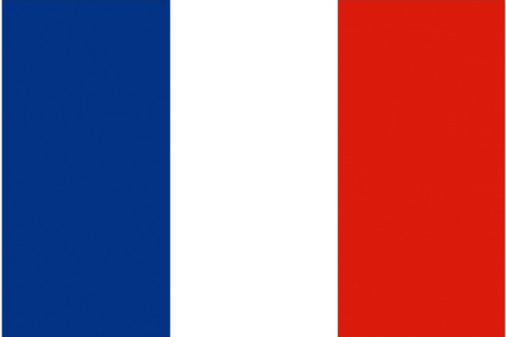
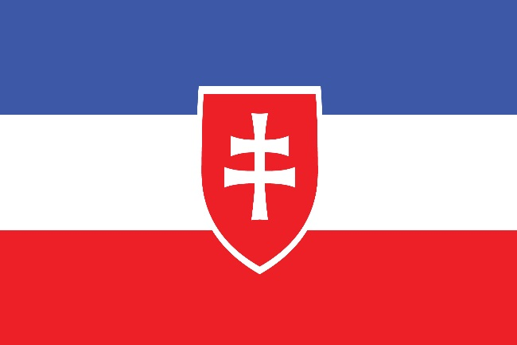
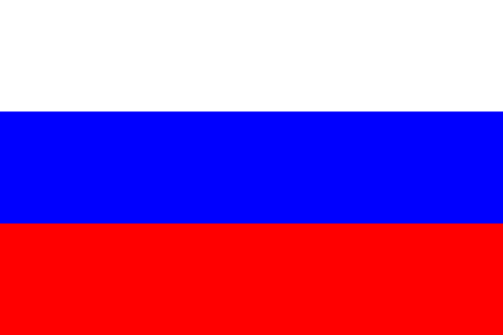
8. Find the flag of Russia
1 2
3
4 5

Slide 10
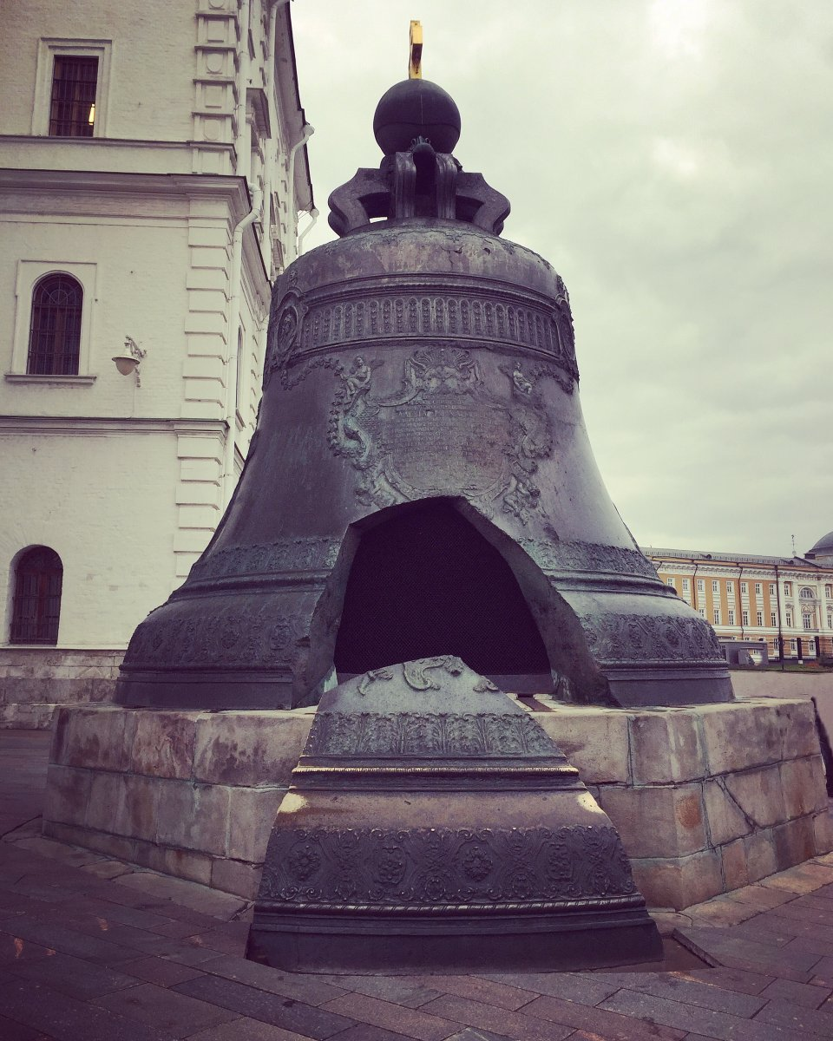
9. Name the well-known Moscow bell
Tsar Bell
Big Ben
Bell Swan

Slide 11
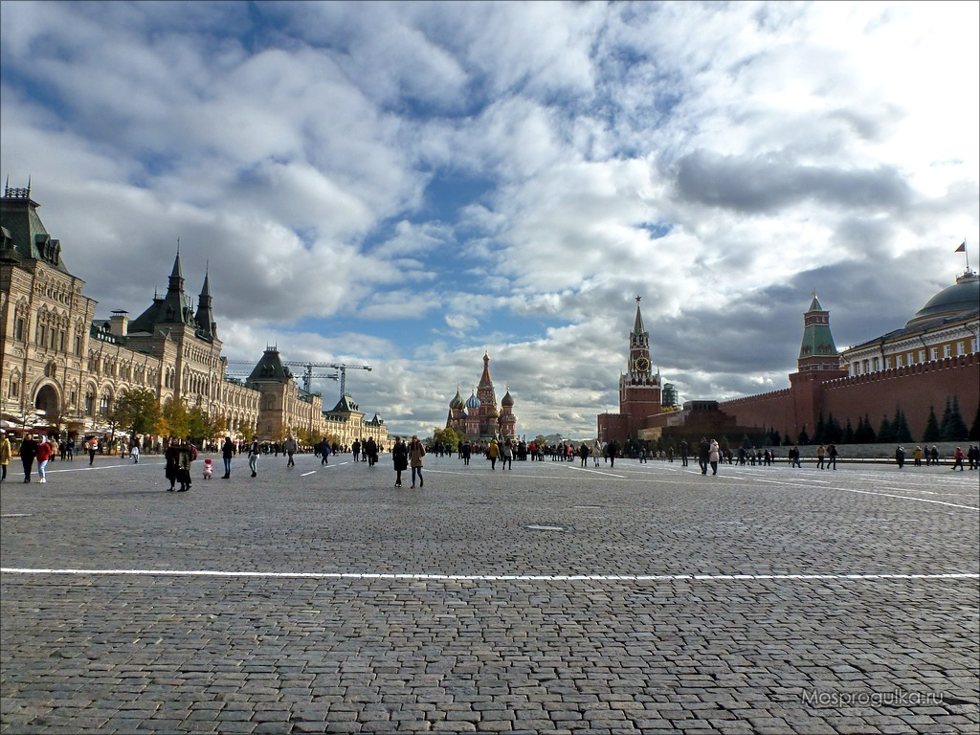
10. How is the main square of the country called?
Teatralnaya Square
Red Square
Manezhnaya Square
Revolution Square

Slide 12
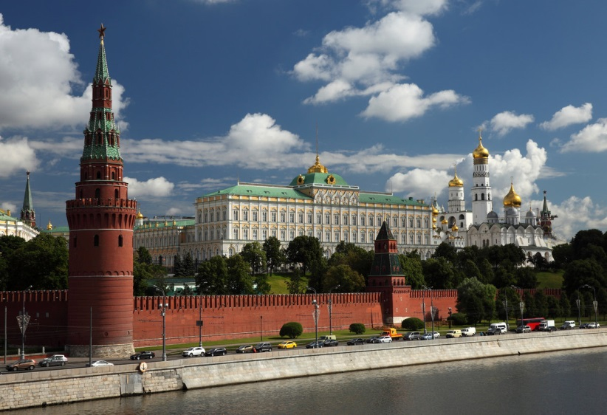
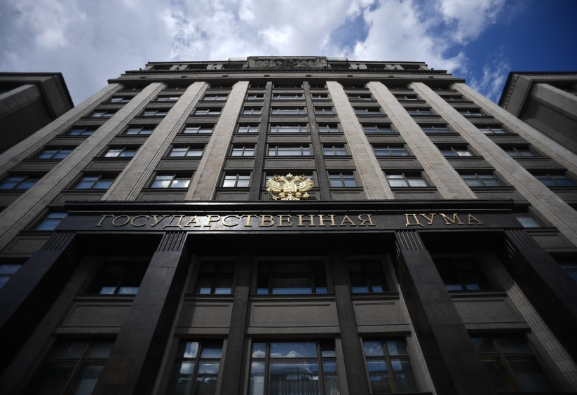
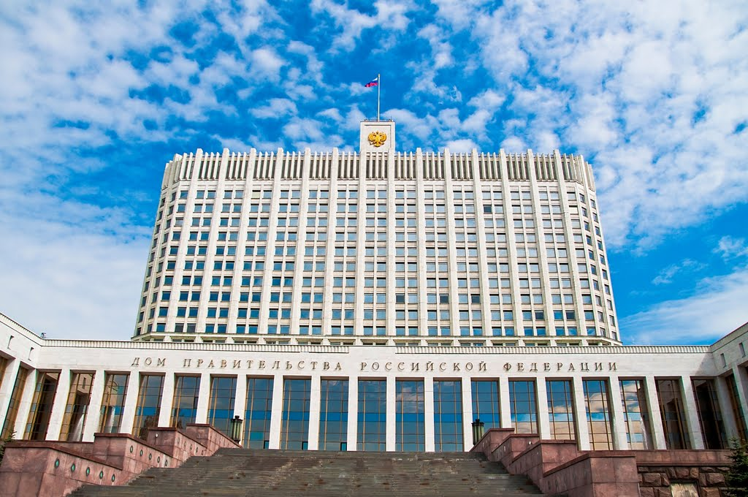
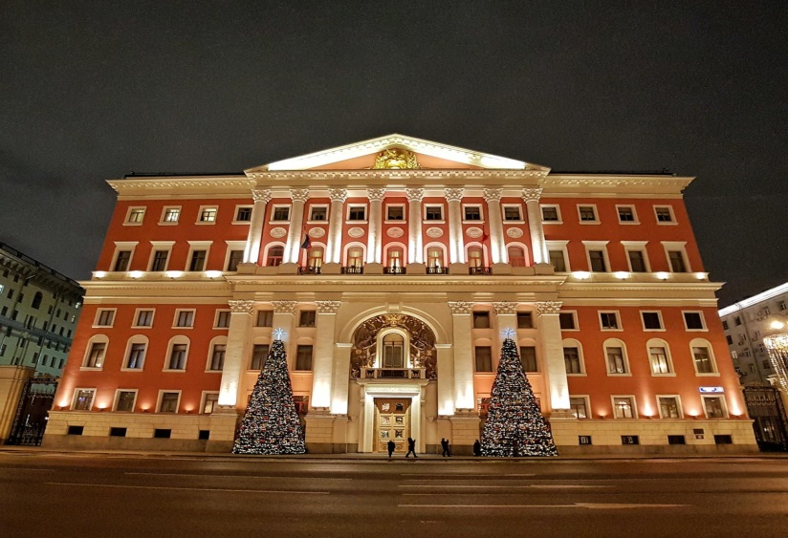
11. Where does the president work?
1 2
3 4

Slide 13
M о S C O W
I

