Slide 1
Урок по английскому языку для 10 класса по теме: «Conditionals»
Учитель: Журавлева А.С.

Slide 2
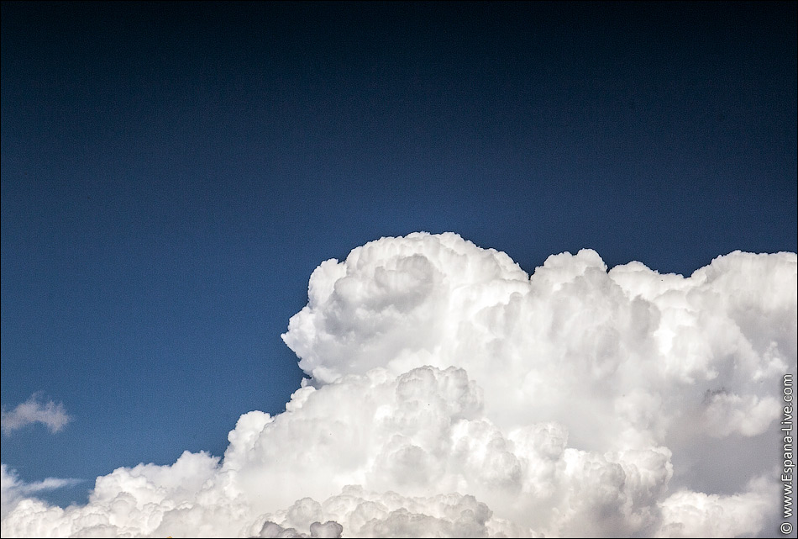
If I could fly
Like the king of the sky
Could not tumble nor fall
I would picture it all
If I could fly
See the world through my eyes
Would not stumble nor fail
To the heavens I sail
If I could fly
What is the main theme of our lesson?

Slide 3
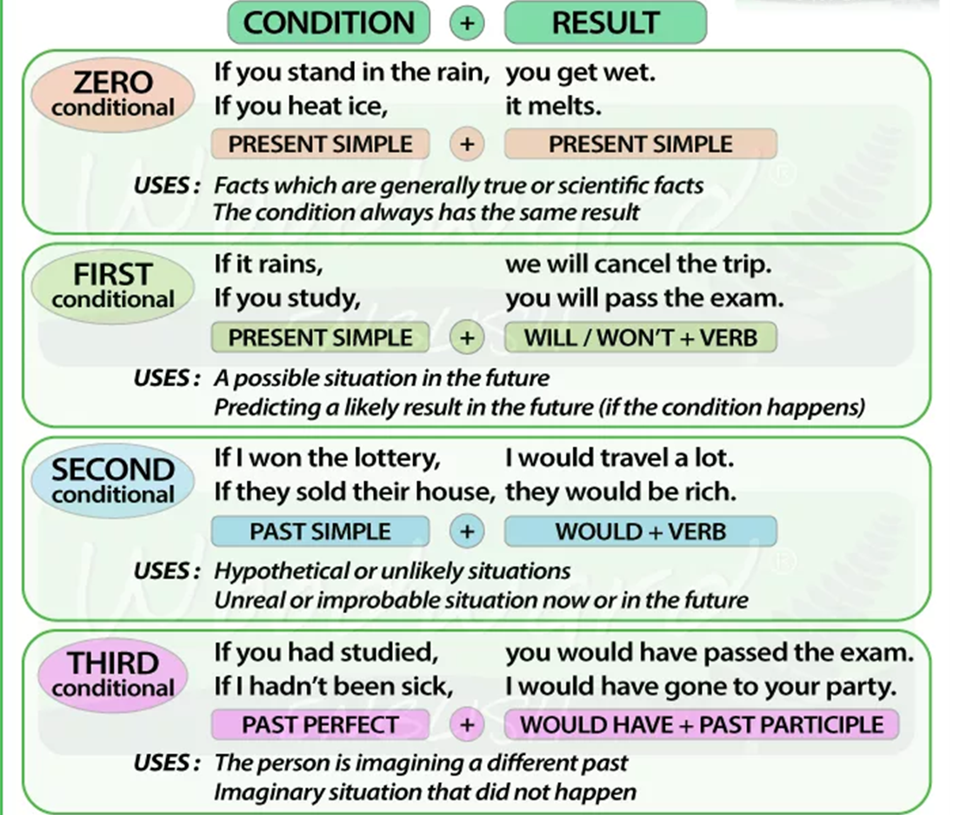



Slide 4
Choose the correct alternative

Slide 5
Complete the sentences using words and phrases from the box
Would it help
Will she say
Will you do
Will it cost
Would you buy
Would you say

Slide 6
d
g
b
c
a
f

Slide 9


Slide 10
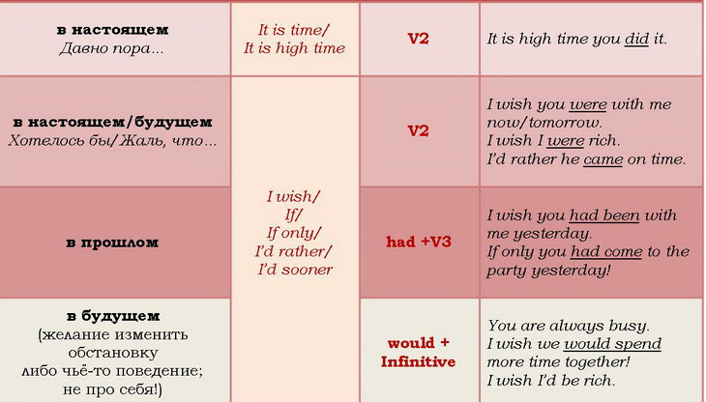

I wish . . .

Slide 12
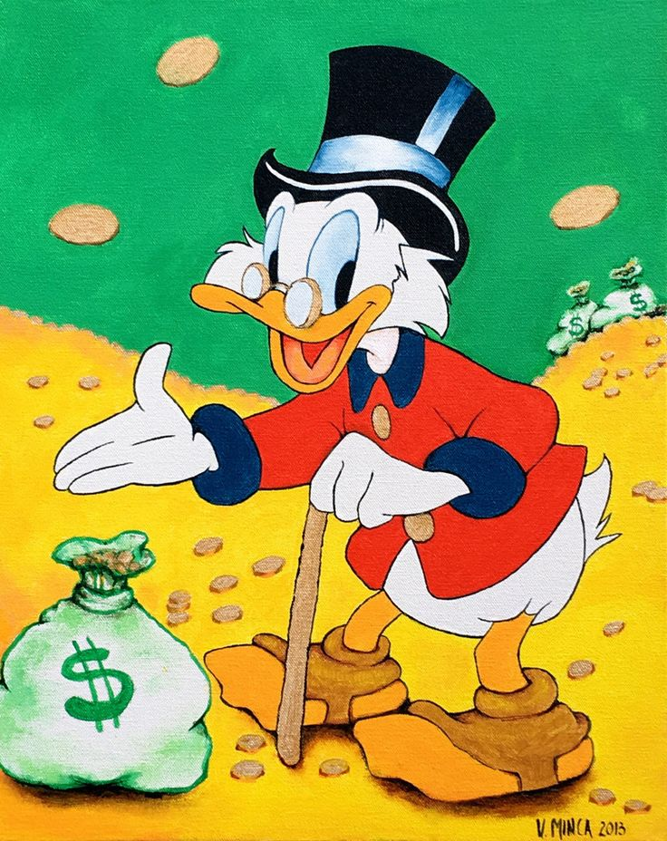

Slide 13
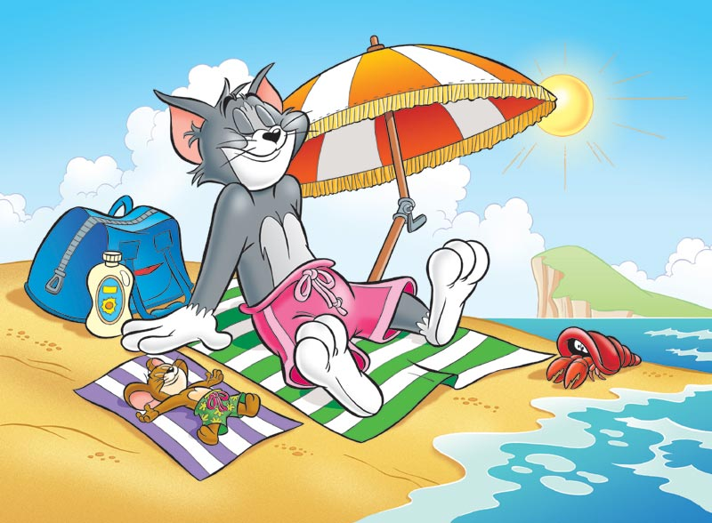

Slide 14
Reflection
I’m ready to go on
I’m ready to go on, but I’m not sure of something
I have some problems and I need your help

