Slide 1
Государственное автономное профессиональное образовательное учреждение мурманской области «Кольский медицинский колледж»
Pregnancy
Автор презентации: Кондратьева Н.А.,
преподаватель английского языка
Апатиты
2018

Slide 2
Целеполагание
1. Обучающая цель;
2. Воспитательная цель;
3. Развивающая цель.

Slide 3
задачи
1. Обобщить тему “Pregnancy. Trimesters of Pregnancy”;
2.Совершенствовать навыки монологической и диалогической речи;
3.Контролировать усвоение лексических единиц и их употребление в речи;
4.Сформировать интерес студентов к будущей профессии;
5. Развить умение студентов воспринимать и осмысливать знания, полученные на уроке.

Slide 4
Ход занятия
1. Организационный момент.
2. Мотивация учебной деятельности. Объявление темы.
3. Проверка исходного уровня знаний по теме “Pregnancy. Trimesters of Pregnancy” при помощи данной презентации;
4. Монологические высказывания с использованием изученной лексики по разделу “Pregnancy. Trimesters of Pregnancy” с использованием материала данной презентации;
5. Здоровьесберегающие технологии (музыкальная минутка физической разминки).
6. Контроль навыков аудирования. Составление диалогов на тему “Pregnancy. Trimesters of Pregnancy” с использованием информации из данной презентации;
7. Лексический тест - контроль.
8. Задание на дом: составление ментальной карты (mind-map) по теме “Pregnancy. Trimesters of Pregnancy”.
9. Подведение итогов занятия. Этап рефлексии. Выставление оценок.

Slide 5
Методы исследования
1. Развивающее обучение;
2. Коллективные способы обучения (КСО);
3. Проблемно-диалогическая технология;
4. Интерактивная лекция с применением мультимедиа-технологии;
5. Обучение в сотрудничестве (работа в парах);
6. Здоровьесберегающие технологии;
7. Технология развития критического мышления (РКМ) – использование ментальных карт (кластеры).

Slide 6
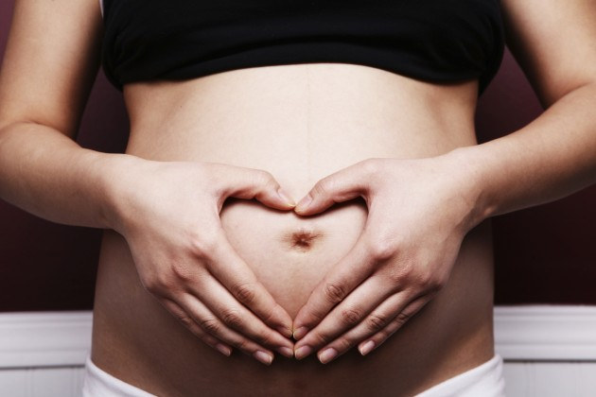
Pregnancy is a period of excitement, expectancy and bit of fear and nervousness for the future mother. It should be an exciting experience, and for that, love and consideration of the family as well as knowledge of what changes are taking place in the body and what to expect, is important.

Slide 7
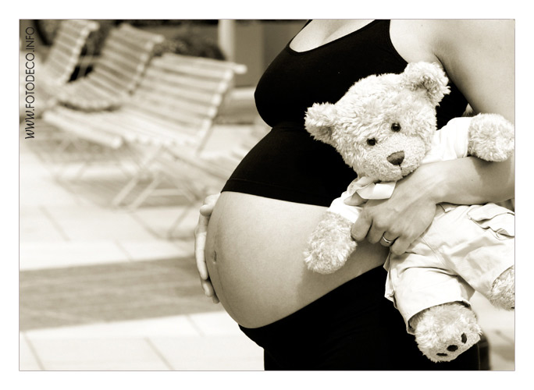
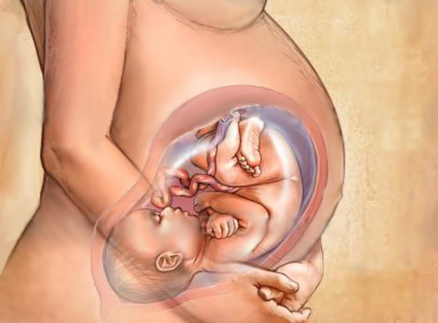
The first 3 months of pregnancy are important because during this period the baby’s organs, like brain, heart, kidneys, limbs, eyes and ears are being formed. Avoid any medicine during this period. Some medicines, particularly pills for sickness, headaches and anxiety should be taken without the advice of the doctor.

Slide 8
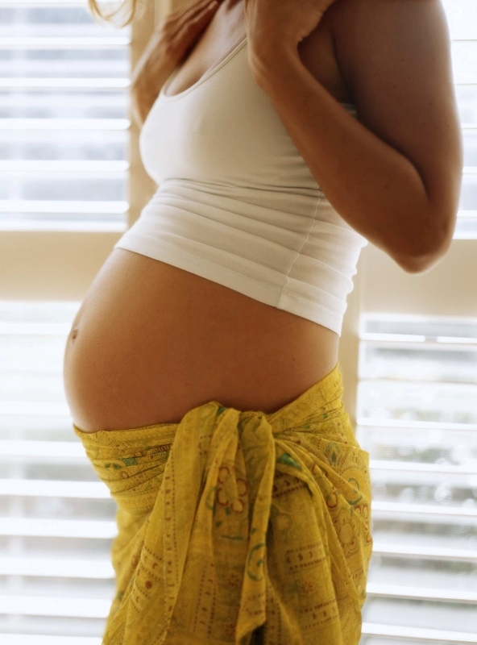
The normal time the baby is in the mother’s womb is about 40 weeks – 9 months and 1 week, but a few days earlier or later is within the range of normality. A baby who is born earlier than his time is called premature.

Slide 9
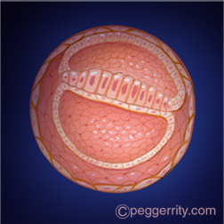
Your developing baby
First trimester (week 1-week 12)
At four weeks:
Your baby's brain and spinal cord have begun to form.
The heart begins to form.
Arm and leg buds appear.
Your baby is now an embryo and one-twenty-fifth inch long.

Slide 10
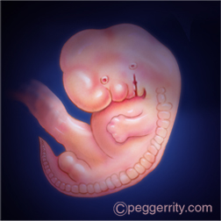
At eight weeks:
All major organs and external body structures have begun to form.
Your baby's heart beats with a regular rhythm.
The arms and legs grow longer, and fingers and toes have begun to form.
The sex organs begin to form.
The eyes have moved forward on the face and eyelids have formed.
The umbilical cord is clearly visible.
At the end of eight weeks, your baby is a fetus and looks more like a human. Your baby is nearly 1 inch long and weighs less than one-eighth ounce.

Slide 11
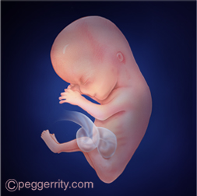
At 12 weeks:
The nerves and muscles begin to work together. Your baby can make a fist.
The external sex organs show if your baby is a boy or girl. A woman who has an ultrasound in the second trimester or later might be able to find out the baby's sex.
Eyelids close to protect the developing eyes. They will not open again until the 28th week.
Head growth has slowed, and your baby is much longer. Now, at about 3 inches long, your baby weighs almost an ounce.

Slide 12
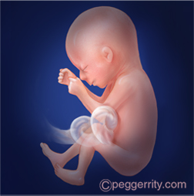
Second trimester (week 13-week 28)
At 16 weeks:
Muscle tissue and bone continue to form, creating a more complete skeleton.
Skin begins to form. You can nearly see through it.
Meconium develops in your baby's intestinal tract. This will be your baby's first bowel movement.
Your baby makes sucking motions with the mouth (sucking reflex).
Your baby reaches a length of about 4 to 5 inches and weighs almost 3 ounces.

Slide 13
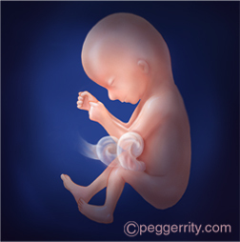
At 20 weeks:
Your baby is more active. You might feel slight fluttering.
Your baby is covered by fine, downy hair called lanugo and a waxy coating called vernix. This protects the forming skin underneath.
Eyebrows, eyelashes, fingernails, and toenails have formed. Your baby can even scratch itself.
Your baby can hear and swallow.
Now halfway through your pregnancy, your baby is about 6 inches long and weighs about 9 ounces.

Slide 14
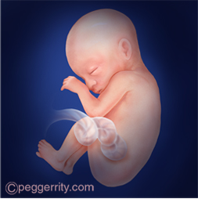
At 24 weeks:
Bone marrow begins to make blood cells.
Taste buds form on your baby's tongue.
Footprints and fingerprints have formed.
Real hair begins to grow on your baby's head.
The lungs are formed, but do not work.
The hand and startle reflex develop.
Your baby sleeps and wakes regularly.
If your baby is a boy, his testicles begin to move from the abdomen into the scrotum. If your baby is a girl, her uterus and ovaries are in place, and a lifetime supply of eggs have formed in the ovaries.
Your baby stores fat and has gained quite a bit of weight. Now at about 12 inches long, your baby weighs about 1½ pounds.

Slide 15
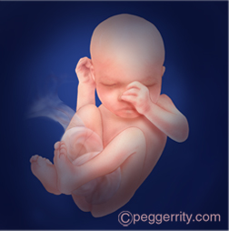
Third trimester (week 29-week 40)
At 32 weeks:
Your baby's bones are fully formed, but still soft.
Your baby's kicks and jabs are forceful.
The eyes can open and close and sense changes in light.
Lungs are not fully formed, but practice "breathing" movements occur.
Your baby's body begins to store vital minerals, such as iron and calcium.
Lanugo begins to fall off.
Your baby is gaining weight quickly, about one-half pound a week. Now, your baby is about 15 to 17 inches long and weighs about 4 to 4½ pounds.

Slide 16
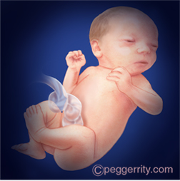
At 36 weeks:
The protective waxy coating called vernix gets thicker.
Body fat increases. Your baby is getting bigger and bigger and has less space to move around. Movements are less forceful, but you will feel stretches and wiggles.
Your baby is about 16 to 19 inches long and weighs about 6 to 6½ pounds.

Slide 17
Weeks
37-40:
By the end of 37 weeks, your baby is considered full term. Your baby's organs are ready to function on their own.
As you near your due date, your baby may turn into a head-down position for birth. Most babies "present" head down.
At birth, your baby may weigh somewhere between 6 pounds 2 ounces and 9 pounds 2 ounces and be 19 to 21 inches long. Most full-term babies fall within these ranges. But healthy babies come in many different sizes.

Slide 18
Class Tasks
1. Make a monologue on the theme “Pregnancy. Trimesters of Pregnancy” using the material of the presentation;
2. Work in pairs. Make dialogues on the theme “Pregnancy. Trimesters of Pregnancy” using the information of the presentation;
3. Let’s make the vocabulary control test!

Slide 19
Home task
Make a mind-map on the theme
“Pregnancy. Trimesters of Pregnancy”.

Slide 20

Reflection
Please,
give your opinion about our lesson using this thermometer!

Slide 21
Reference list
1.Козырева Л.Г. Английский язык для медицинских колледжей и училищ: учебное пособие / Л.Г. Козырева, Т.В. Шадская. – Р.-на-Д.: Феникс, 2007. – 315 с.
2.Sam McCarter. Oxford English for Careers. Medicine 2. Student’s Book / Sam McCarter. - Oxford: Oxford University Press, 2010. – 145 p.

Slide 22
Thank you for your attention!

