Slide 1

MUSIC IDIOMS

Slide 2
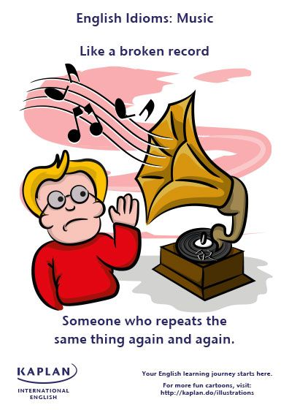
British English also like a stuck record

Slide 3
I hate sounding like a broken record, but I have to say again, we must do more to help.
He's always complaining about the way she treats him. He sounds like a broken record!
I hate to sound like a broken record, but we just don't have enough people on the payroll to work efficiently.
At the risk of sounding like a broken record, let me repeat: it will be difficult to do well in the exam without attending classes regularly

Slide 4


Slide 5
The citizens' group blew the whistle on the street gangs by calling the police.
She was fired for blowing the whistle on the bank's mismanagement of accounts,
but she then sued the bank.
In some jurisdictions, it is illegal to fire a person for blowing the whistle on an employer.

Slide 6
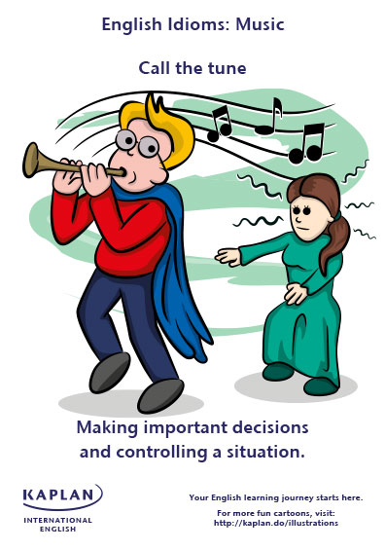

Slide 7
He was technically running the business, but his father still called the tune.
Nancy said that it's her turn to call the tune.
In this part of the mortgage market, the banks call the tune.

Slide 8
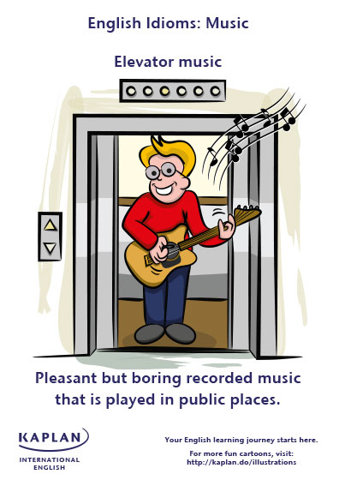
also known as Muzak, piped music, weather music, or lift music

Slide 9
Why can't this store turn off this awful elevator music and put it on 94.5 instead of this boring crap

Slide 10


Slide 11
The property is going for a song because they need to sell it fast.
No one else wanted it, so I picked it up for a song.
I could buy this house for a song, because it's so ugly.

Slide 12
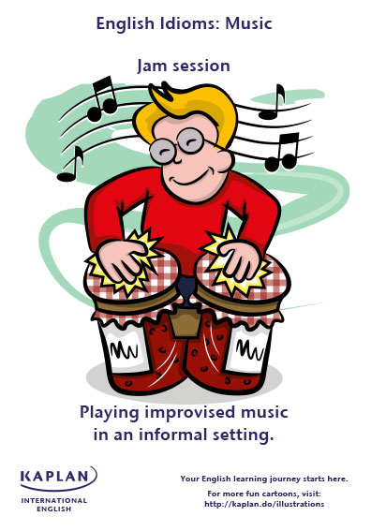

Slide 13
This is going to require a lot of late night, one-on-one jam sessions with me, and we're going to bounce ideas off of each other, you're going to have to take calls for me, any time, day or night.

Slide 14
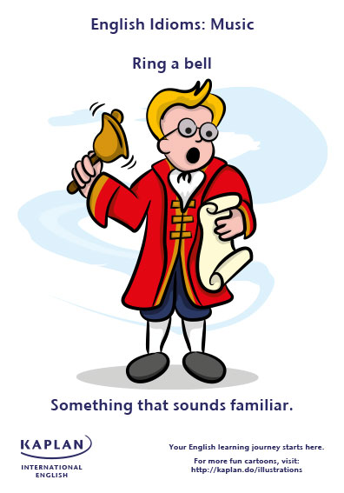

Slide 15
His name rings a bell but I can't think where we met.
Does the name 'Fitzpatrick‘ ring a bell?
No, I'm sorry, that description doesn't ring any bells with me.
Bob: Have we met before?
Geoff: Well, your face rings a bell.

Slide 16
EXERCISE

Slide 17
She bought the painting for ….

Slide 18
She bought the painting for a song

Slide 19
The name ​…… but I couldn't ​remember where I had ​heard it before.

Slide 20
The name ​rang a bell but I couldn't ​remember where I had ​heard it before.

Slide 21
The boy's mother sounds like …… when she tells him to clean his room.

Slide 22
The boy's mother sounds like a broken record when she tells him to clean his room.

Slide 23
The employee …..on the illegal practices of the company.

Slide 24
The employee blew the whistle on the illegal practices of the company.

Slide 25
The artist was neither famous nor popular, so he sold his picture …..

Slide 26
The artist was neither famous nor popular, so he sold his picture for a song.

Slide 27
Nobody can be sure which of the two leaders will now call the…..

Slide 28
Nobody can be sure which of the two leaders will now call the tune.

Slide 29
I knew my company was polluting the water, but I was afraid I would lose my job if I…….

Slide 30
I knew my company was polluting the water, but I was afraid I would lose my job if I blew
the whistle on it.

Slide 31
We were having a little …….during the meeting and we came up with some really amazing ideas.

Slide 32
We were having a little jam session during the meeting and we came up with some really amazing ideas.

Slide 33
Because the shop's ​closing down, most of the stock is going …..

Slide 34
Because the shop's ​closing down, most of the stock is going for a song

Slide 35
Blond, tall and wearing heels? No, I'm sorry, that ​description doesn't ……….me.

Slide 36
Blond, tall and wearing heels? No, I'm sorry, that ​description doesn't ring any ​bells with me.

Slide 37
I wish they would play something else in the mall instead of this boring …….

Slide 38
I wish they would play something else in the mall instead of this boring elevator music.

Slide 39
He's always complaining about the way she treats him. He sounds .........!

Slide 40
He's always complaining about the way she treats him. He sounds like a broken record!

Slide 41
Juan was keen to ….. in the meeting. He wanted to take control of the team

Slide 42
Juan was keen to call the tune in the meeting. He wanted to take control of the team

