Slide 2
Match the names of natural disasters with their descriptions
b
1. Drought |  | a. A violent tropical storm in which the air goes round and round
2. Flood |  | b. A period of time with no rain
3. Tornado |  | c. Large amount of water that covers an area which is usually dry
4. Tsunamy |  | d. An extremely violent wind or storm
5. Earthquake |  | e. A violent wind storm which consists of a tall column of air spinning around very fast
6. Cyclone |  | f. A large mass of snow falling down the side of a mountain
7. Avalanche |  | g. A shakin of the ground
8. Hurricane |  | h. A huge wave caused by an earthquake which flows onto land
c
e
h
g
a
f
d

Slide 3
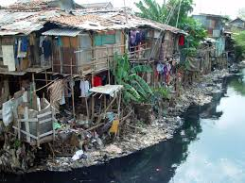
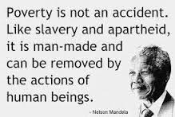
POVERTY

Slide 4
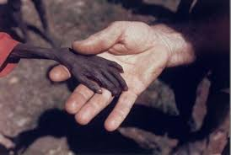
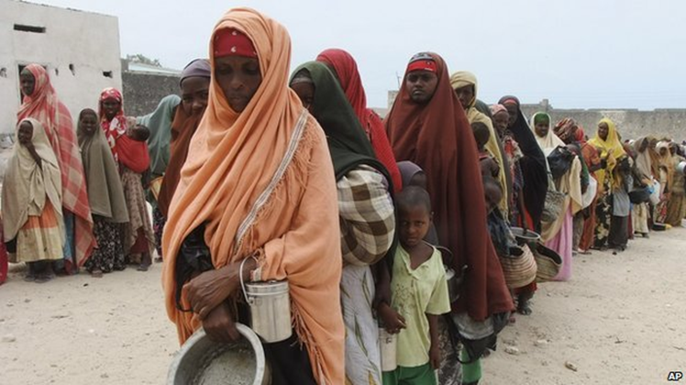
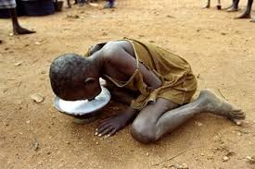
FAMINE

Slide 5
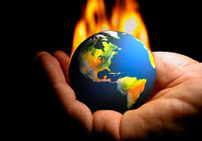
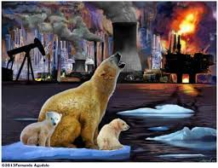
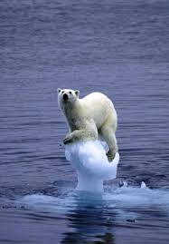
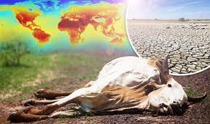
GLOBAL WARMING

Slide 6
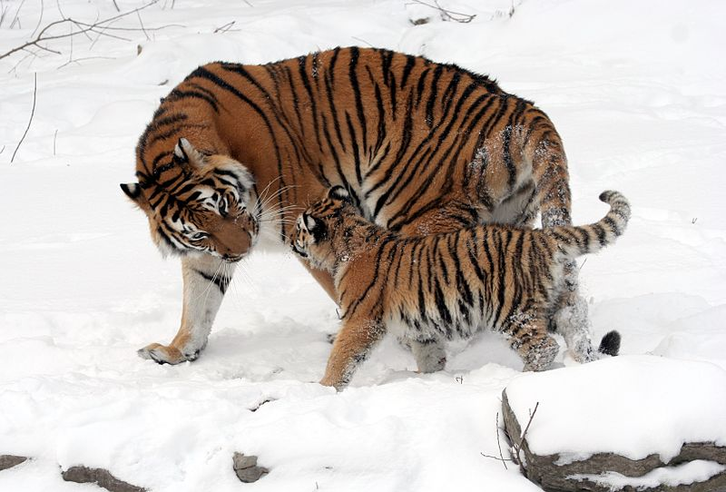
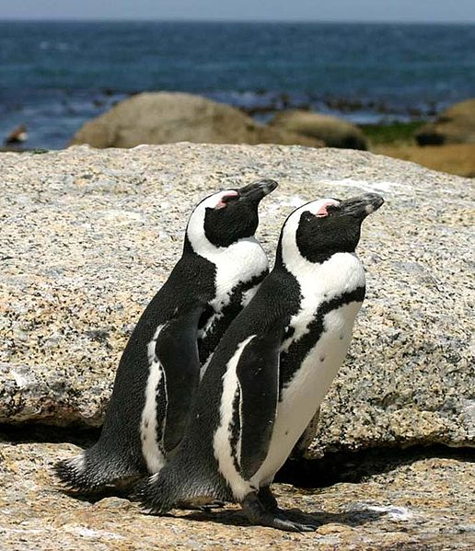
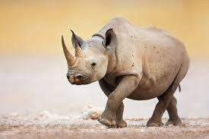
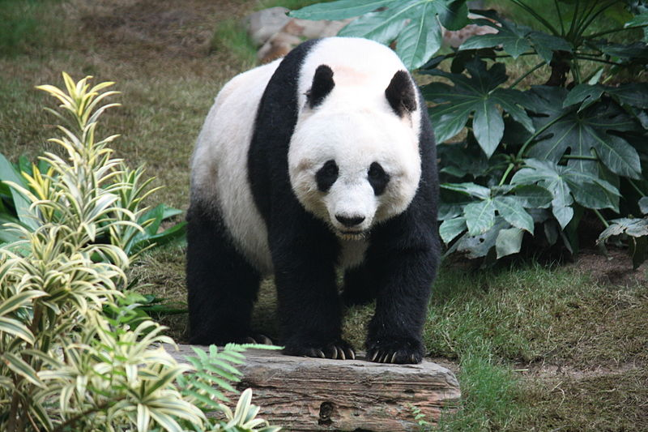
ENDANGERED SPECIES

Slide 7
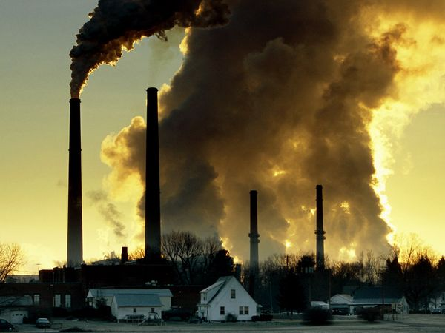
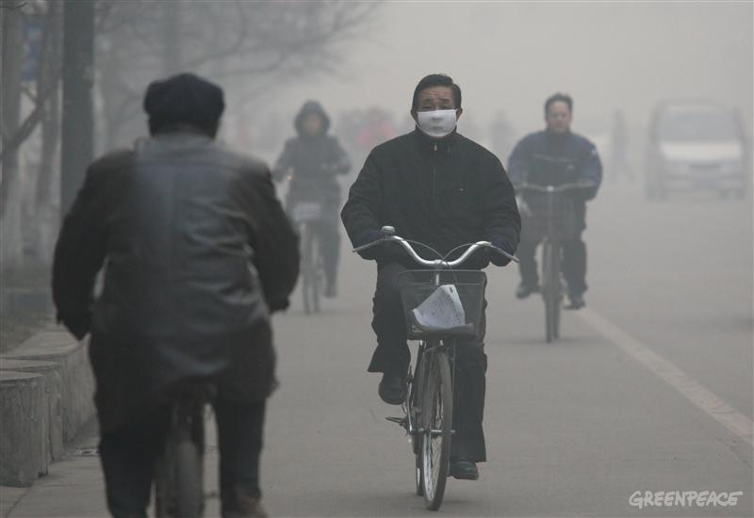
POLLUTION

Slide 8
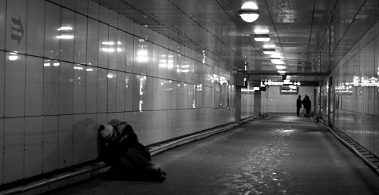
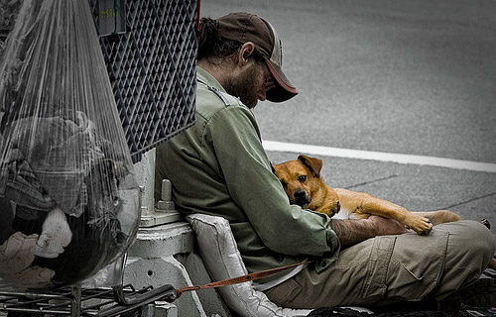
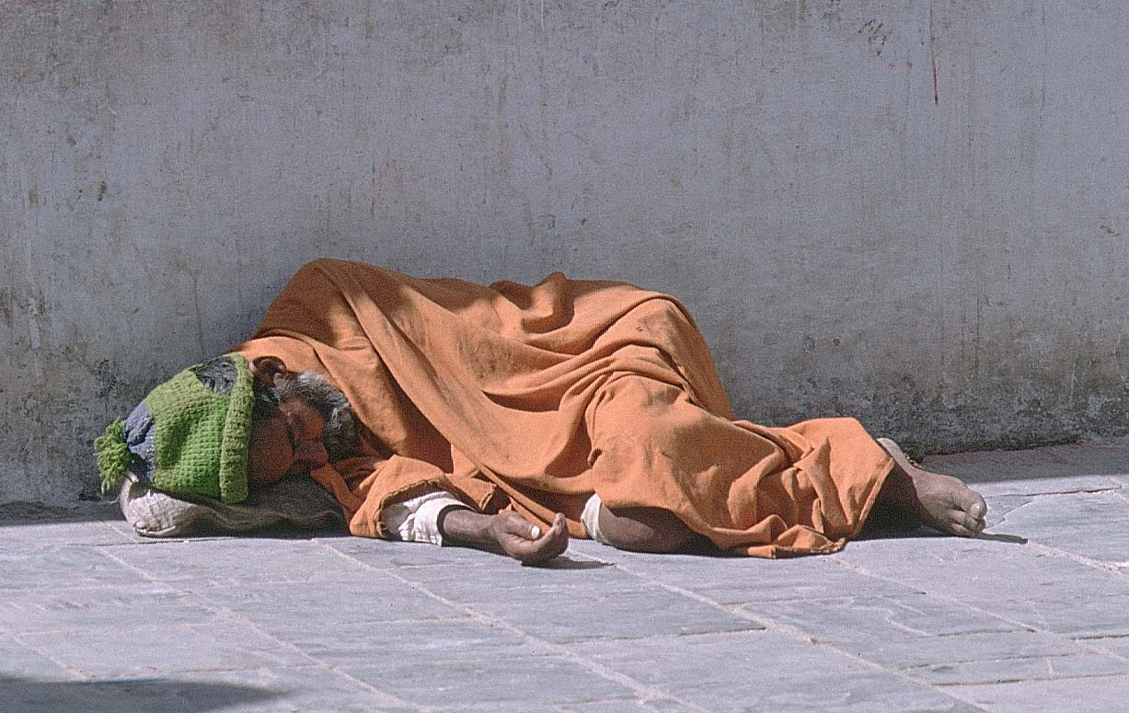
HOMELESSNESS

Slide 9
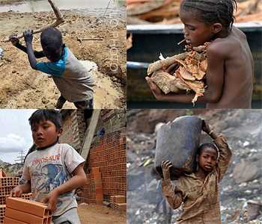
CHILD LABOUR

Slide 10
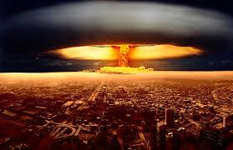
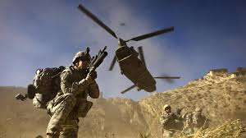
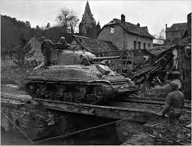
WAR

Slide 11
Listen and match the speakers to the statements. Which global issue are they talking about?
Speaker | 1 | 2 | 3 | 4 | 5 | 6
Statement
D
B
F
E
C
A
war
pollution
homelessness
child labour
global warming
endangered species

Slide 12
Complete the words using the clues in brackets
natural d______s (like floods, fires, earthquakes)
p _____ n (dirty air and water)
home________ (no home)
po____y (no money)
f_____ e (no food)
global w_______ (when the air around the world becomes warmer because of pollution)
w___ (fighting, using soldiers and weapons)
child l_____r (the use of children to do work that should be done by adults)
en_________ species (animals or plants that may soon not exist because there are very few now alive)
isaster
ollutio
lessness
vert
amin
arming
ar
abou
dangered

Slide 13
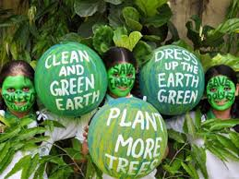
1. Which day is observed as World Earth Day?
A) April 22
B) September 15
C) Augusut 3

Slide 14
2. How many “ecological “ words can you find in the table?
W | T | D | A | M | W | H | O
A | H | E | G | A | I | S | P
S | R | D | F | E | B | C | A
T | O | P | U | T | B | K | R
E | W | D | L | R | U | H | E
A | P | O | L | D | A | N | G

Slide 15
3. What does this sign mean?
A) the thing is made from recycled materials
B) the thing can be recycled
С) Traffic sign “Roundabout”

Slide 16
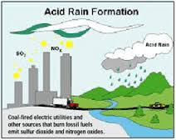
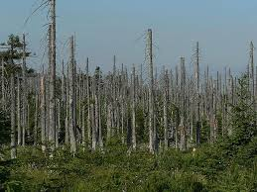
4. What do you call the rain that contains chemicals waste and causes damage to plants and animals?
A) Mashroom rain
B) Smog
C) Acid rain

Slide 17
5. Which way saves more energy?
A) turning your computer off
B) putting it in sleep mode
C) leaving the computer plugged in

Slide 18
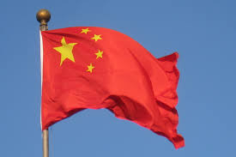
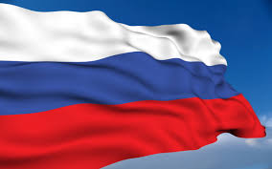
6. What country consumes more energy in the world?
A) China
B) Russia
C) the USA

Slide 19
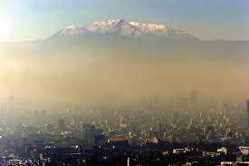
7. What is the most polluted city in the world?
A) Shanghai, China
B) Mexico City, Mexico
C) New Delhi, India

Slide 20
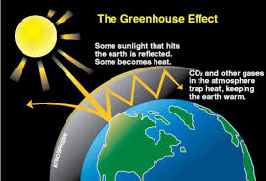
8. Name the phenomenon because of which the earth’s atmospheric temperature is increasing?
A) Greenhouse effect
B) Bluehouse effect
C) Redhouse effect

Slide 21
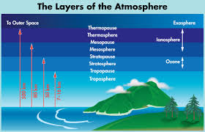
9. Which layer of the earth’s atmosphere protects the earth from dangerous ultraviolet radiation of the sun?
A) Ionosphere
B) Ozonosphere
C) Troposphere

