Slide 1
SEASONS AND WEATHER

Slide 2

Spring is green

Slide 3
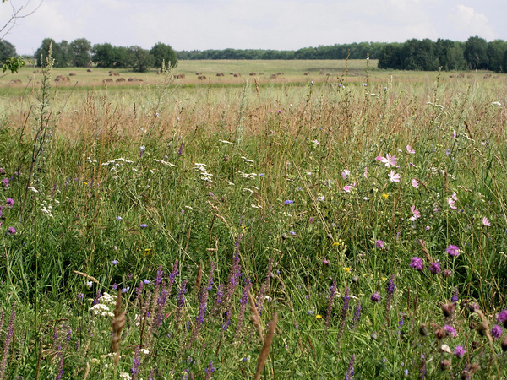
Summer is bright

Slide 4
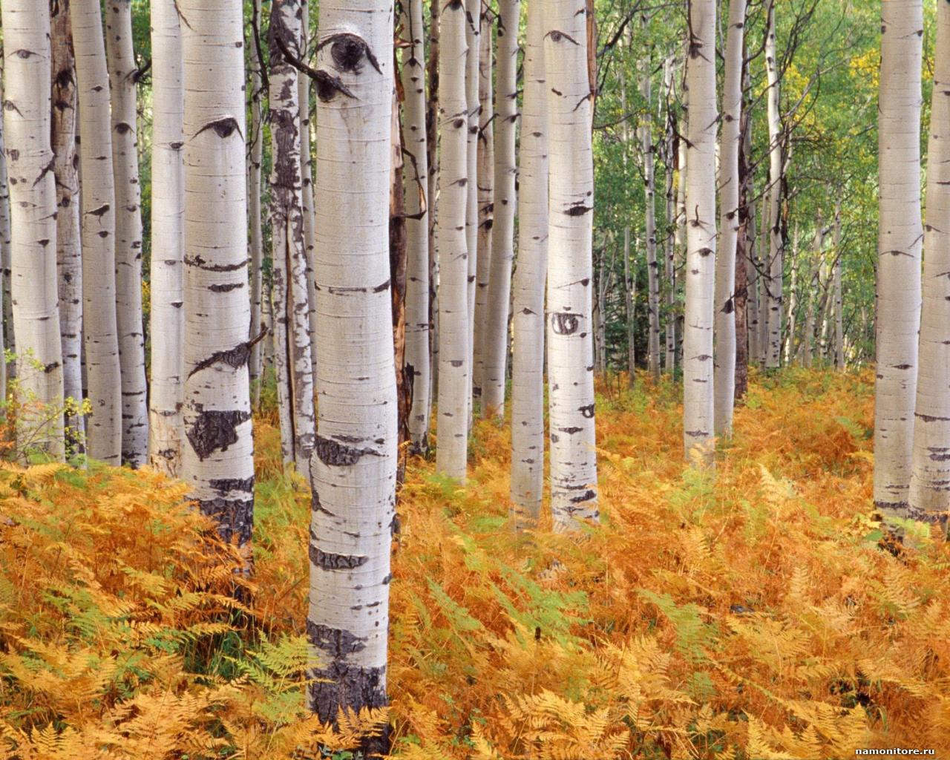
Autumn is yellow

Slide 5
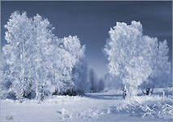
Winter is white

Slide 6
MONTHS
JANUARY
FEBRUARY
MARCH
APRIL
MAY
JUNE
JULY
AUGUST
SEPTEMBER
OCTOBER
NOVEMBER
DECEMBER

Slide 7
Days of the Week
Monday
Tuesday
Wednesday
Thursday
Friday
Saturday
Sunday

Slide 8
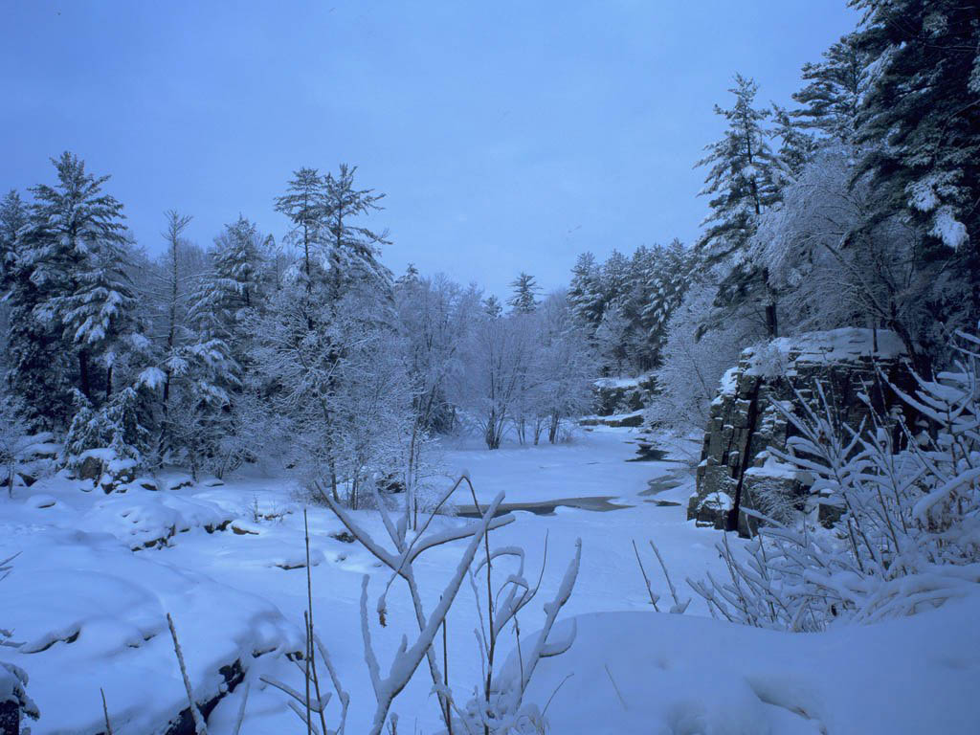

Weather
snowy
foggy

Slide 9
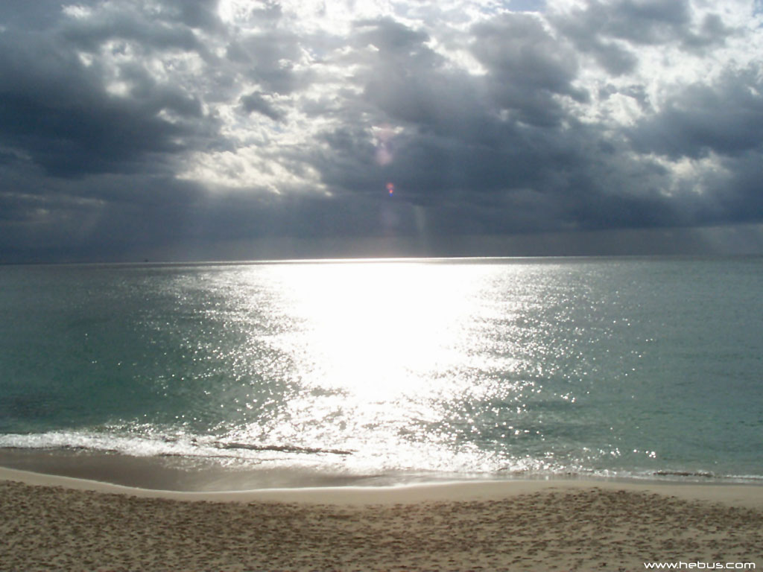
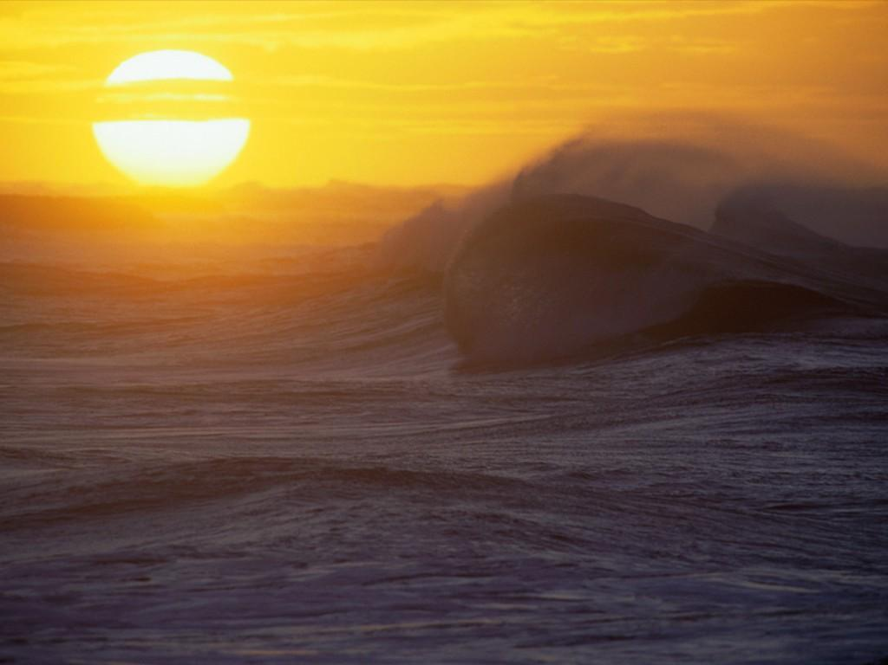
CLOUDY
SUNNY

Slide 10
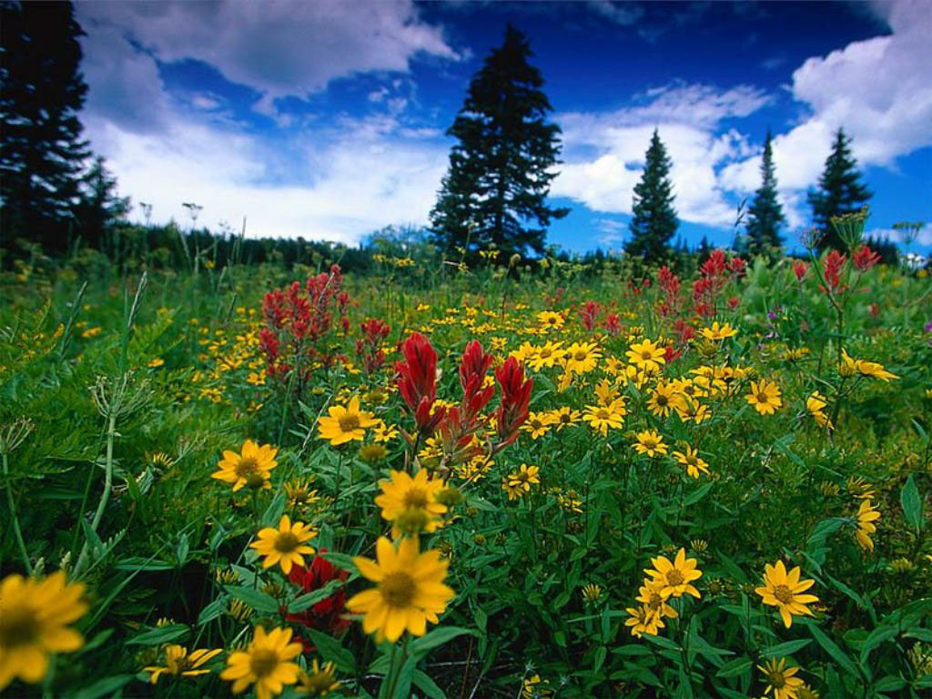
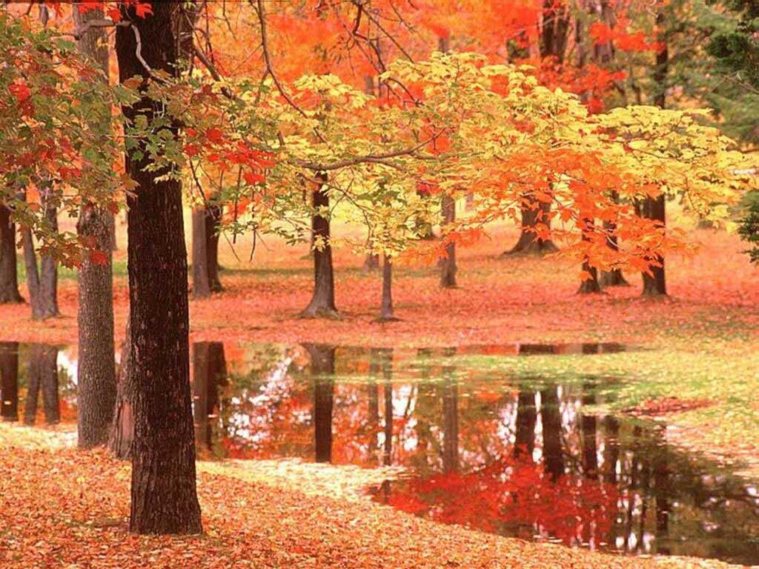
WARM
COLD

Slide 11
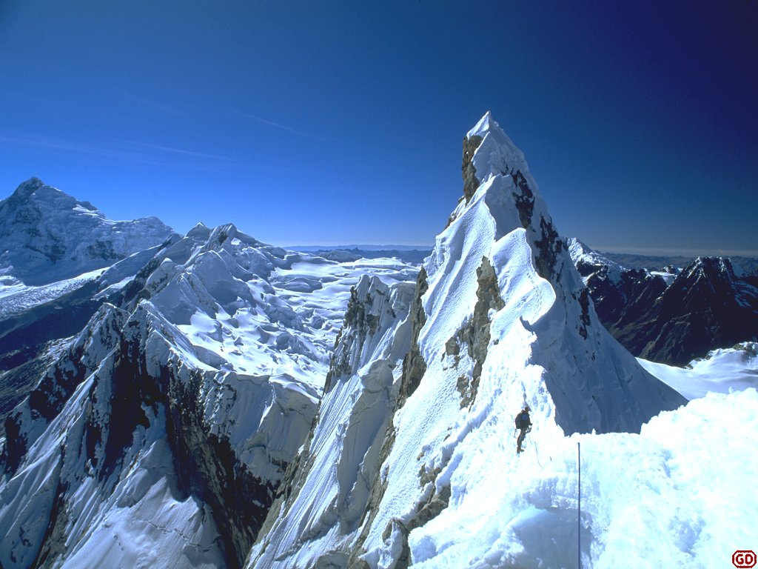

FROSTY
HOT

Slide 12

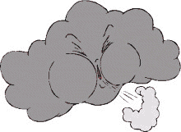
WINDY
RAINY

Slide 13
Рut in the missing letters
sprin_, w_nte_, s_m_er, a_tu_n
S_nday, M_nday, Tu_sday,W_d_esday, T_ur_day,Fr_day, S_tu_day

Slide 14
Fill in the chart
Winter months | Spring months | Summer months | Autumn months

Slide 15
Match the words
1)warm
2)cloudy
3)windy
4)rainy
5)foggy
6)snowy
7)cold
8)frosty
9)hot
A) холодно
В) дождливо
С) тепло
D)туманно
E)жарко
F)морозно
G)снежно
H)облачно
I)ветрено

Slide 16
Match the opposites
Warm
Frosty
Cloudy
Foggy
Cold
Hot

