Slide 1
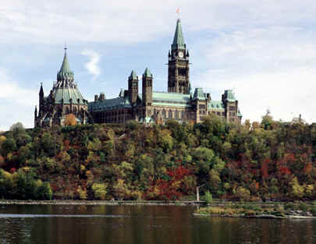
Ottawa

Slide 2
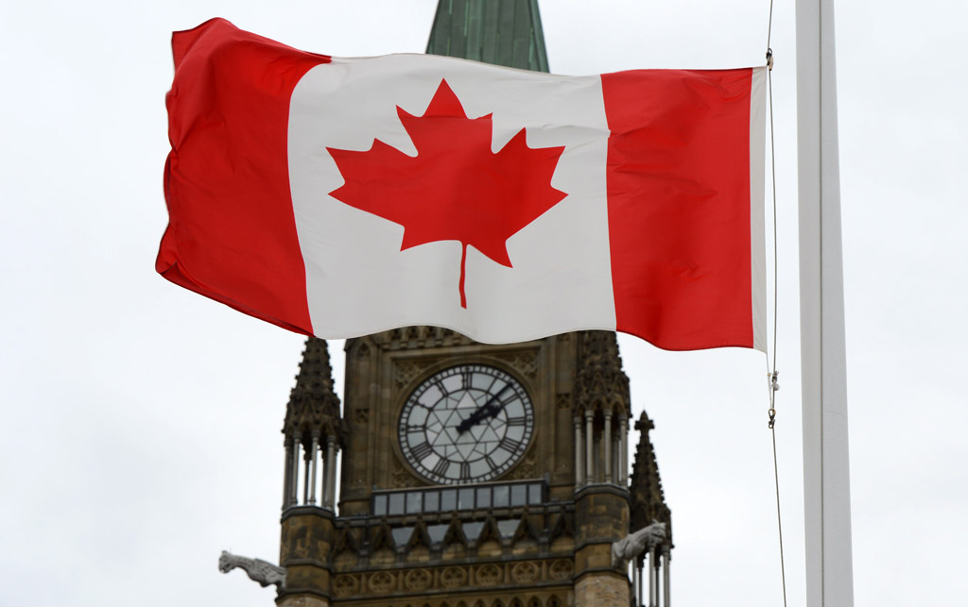
Ottawa is the capital of Canada.

Slide 3
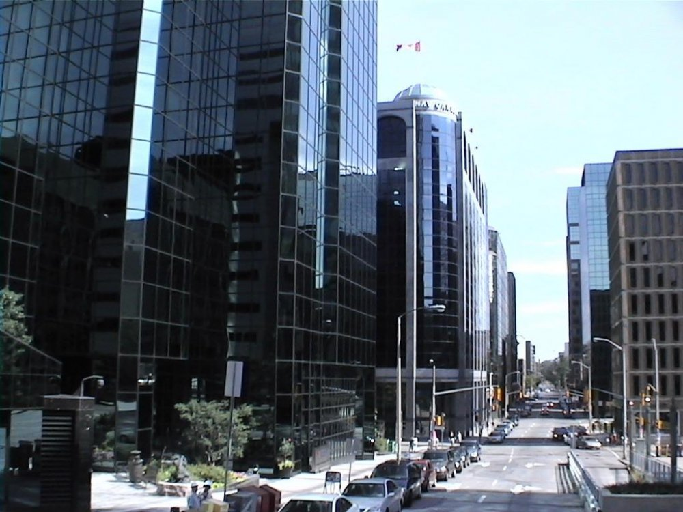
Ottawa is the 4th largest city in Canada.

Slide 4
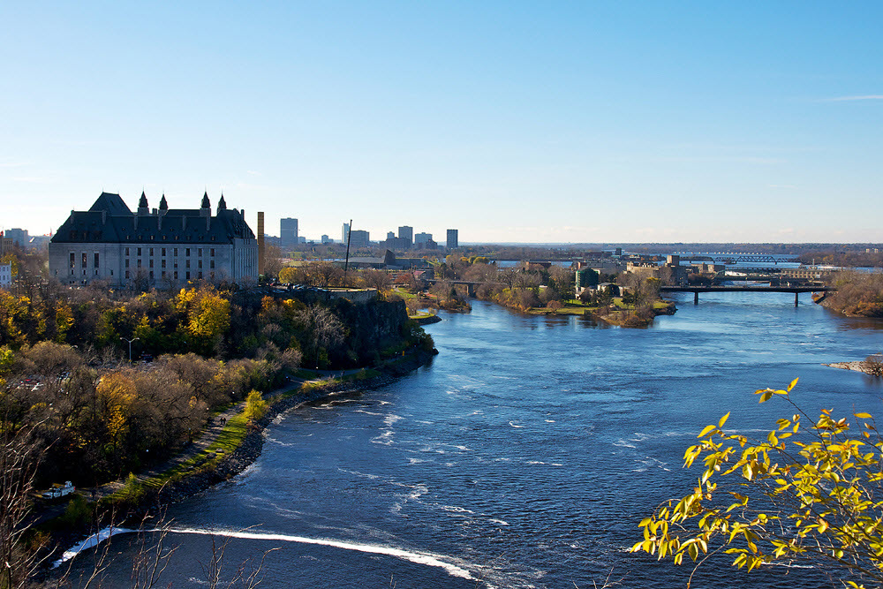
Ottawa is located on the shores of the Ottawa River.

Slide 5
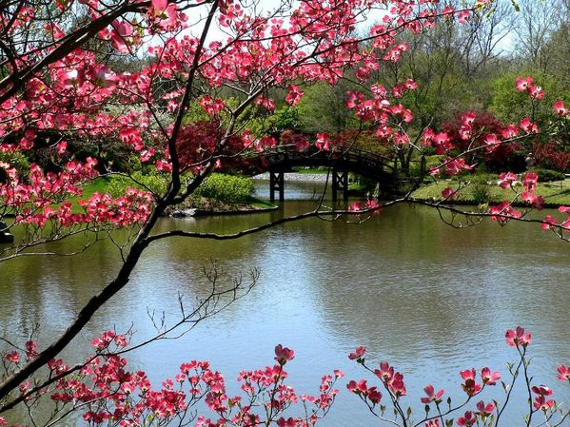
Within the city there are more than 70 parks.

Slide 6
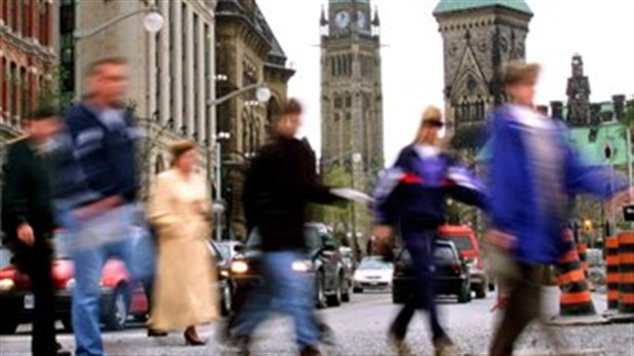
The town is inhabited by different ethnic groups: British, French, Italian, Germans, Ukranians, Greeks, Datch, Asians.

Slide 7
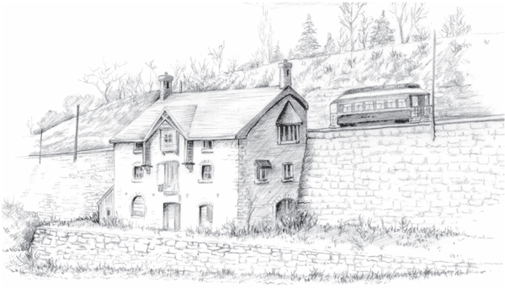
In 1827 Ottawa was a small village.

Slide 8
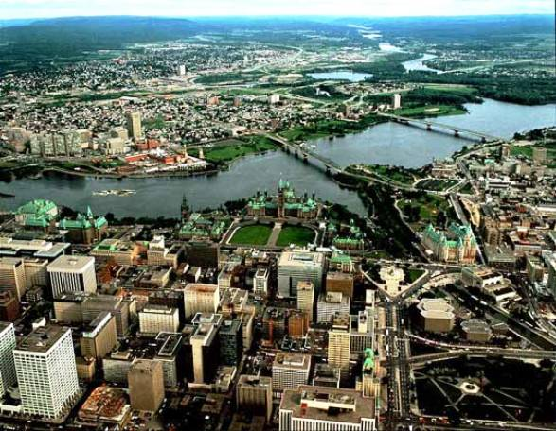
Nowadays Ottawa is a beautiful modern city.

Slide 9
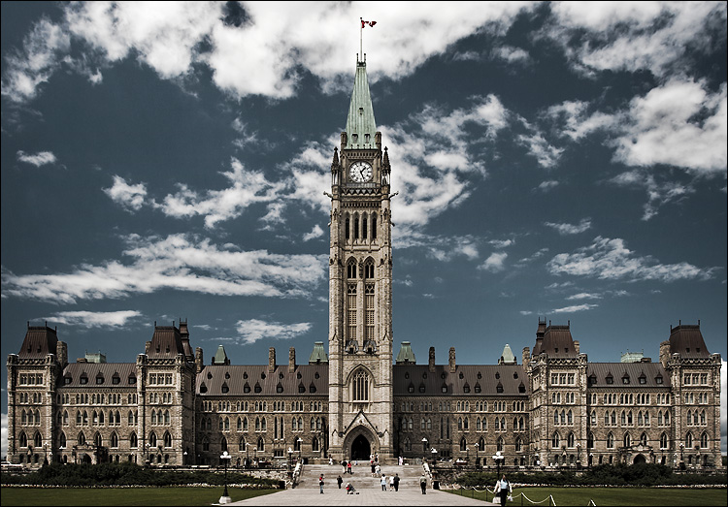
One of the best sightseeins is the Parliament of Canada in Ottawa.

Slide 10
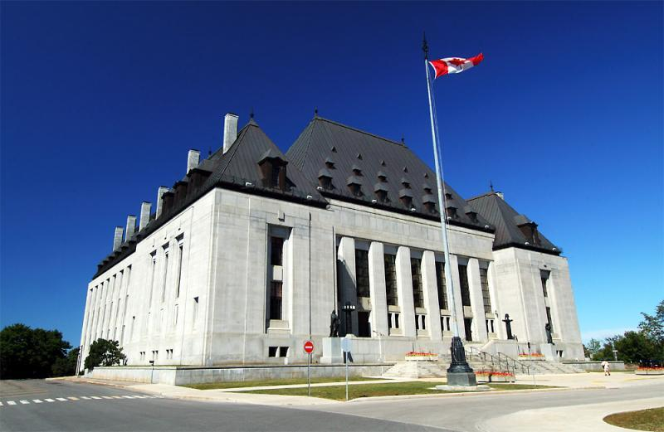
Near the parliament building there is the Supreme Cort building.

Slide 11
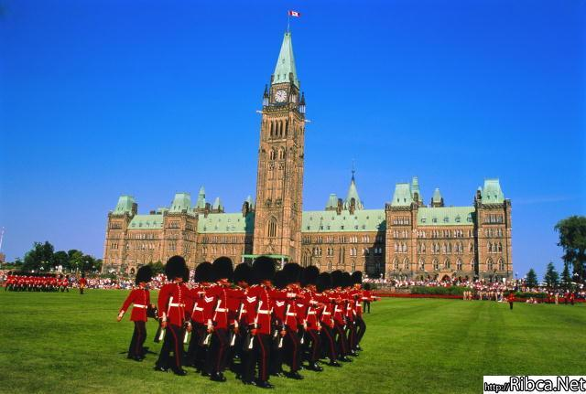
On the square in front of the parliament held regulary the changing of the guard ceremony.

Slide 12
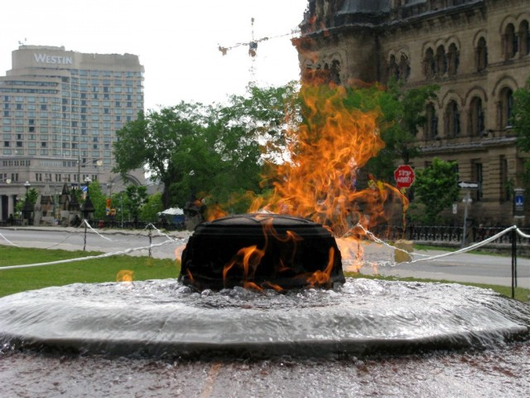
There is a fountain and within there is the eternal flame symbolizing the union of all the provinces.

Slide 13
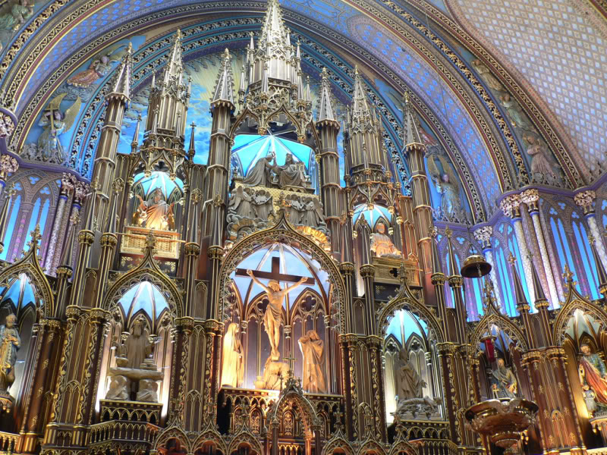
Among the most popular landmarks is Catholic Cathedral of Notre Dame.

Slide 14
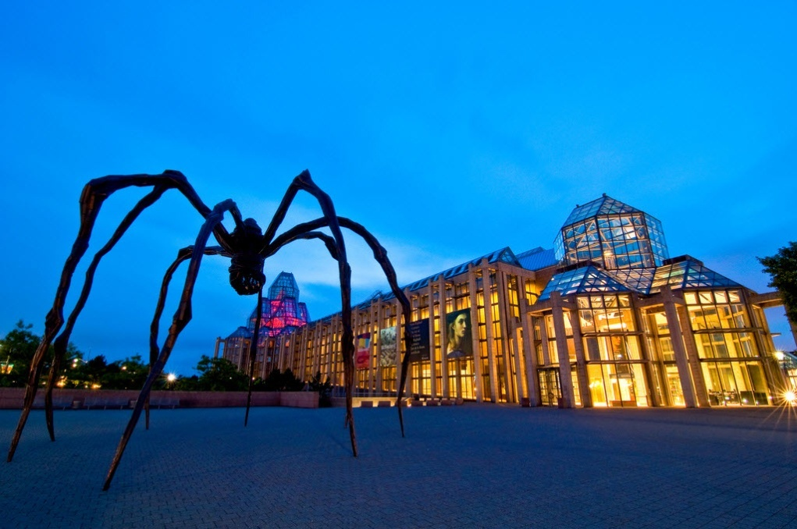
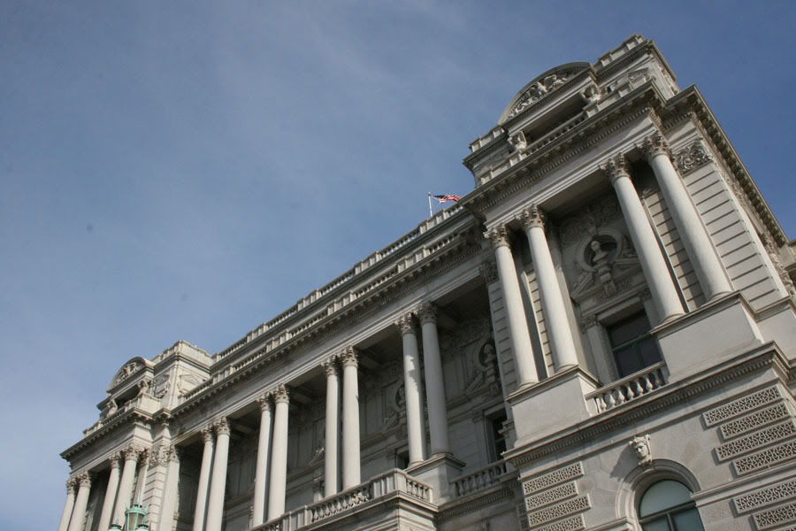
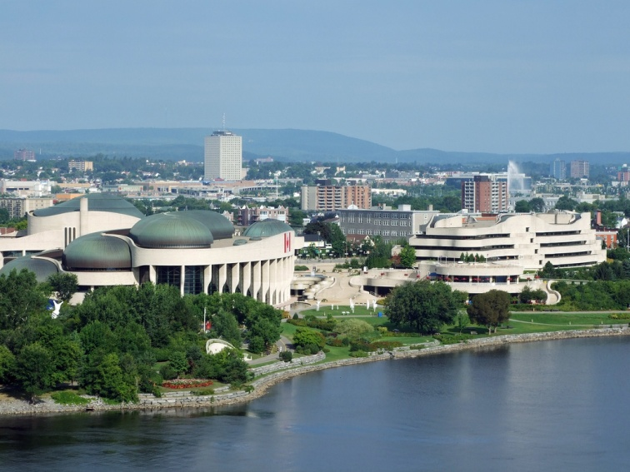
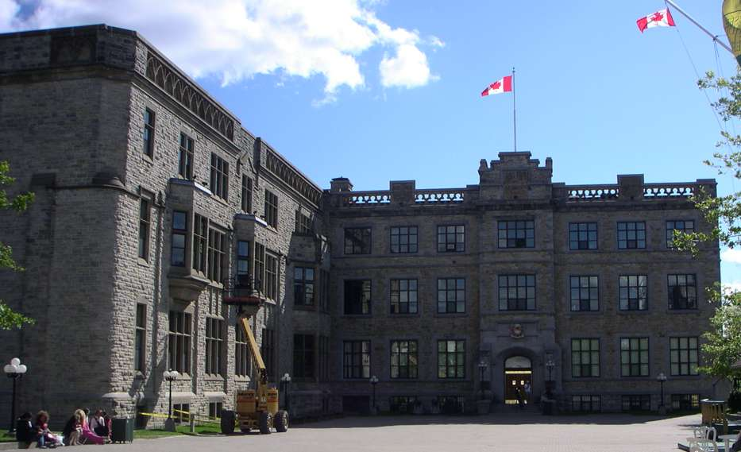
There are many iteresting museums in Ottawa.

Slide 15
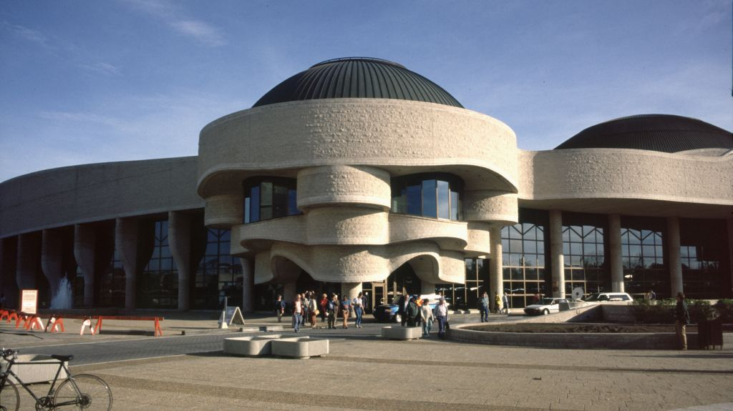
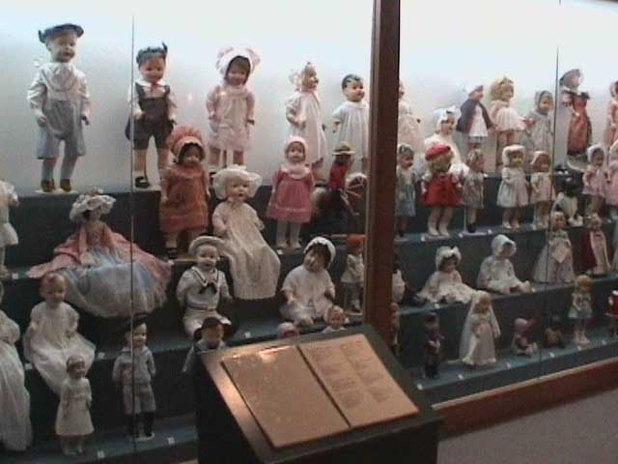
The Museum of Civilization

Slide 16
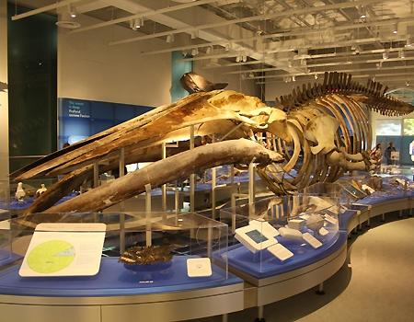
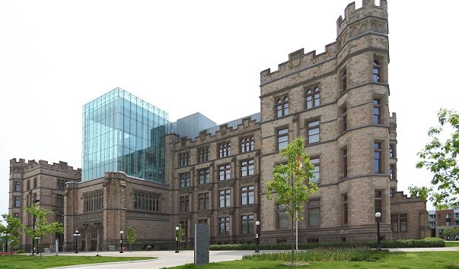
The Museum of Natural Science and Technology

Slide 17
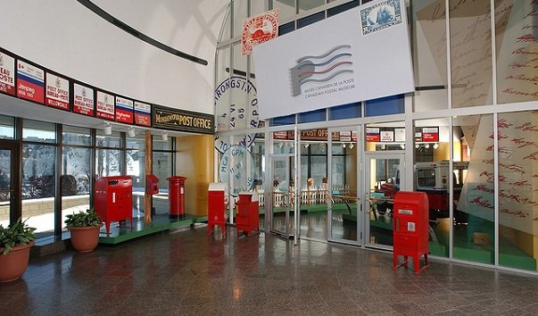
The Postal Museum

Slide 18
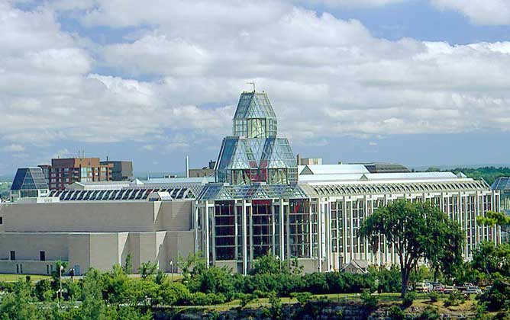
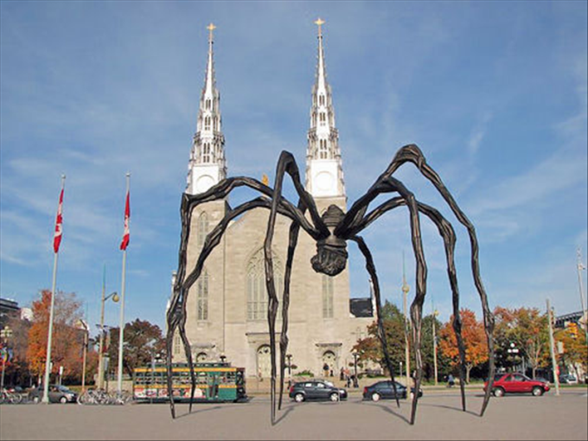
The National Gallery of Art, the pride of Ottawa

Slide 19
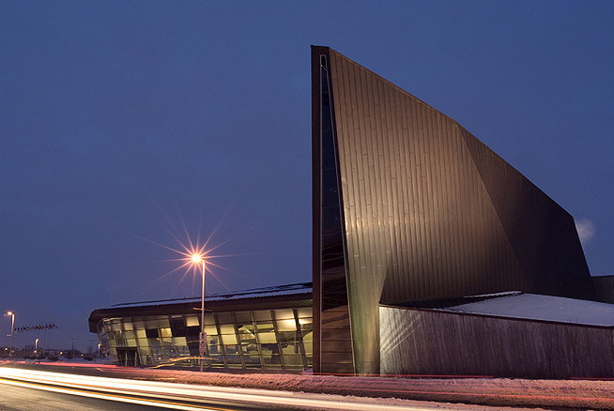
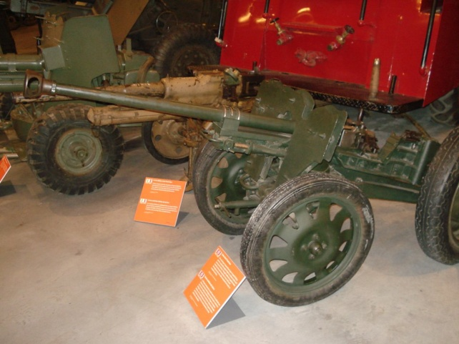
The Military Museum

Slide 20
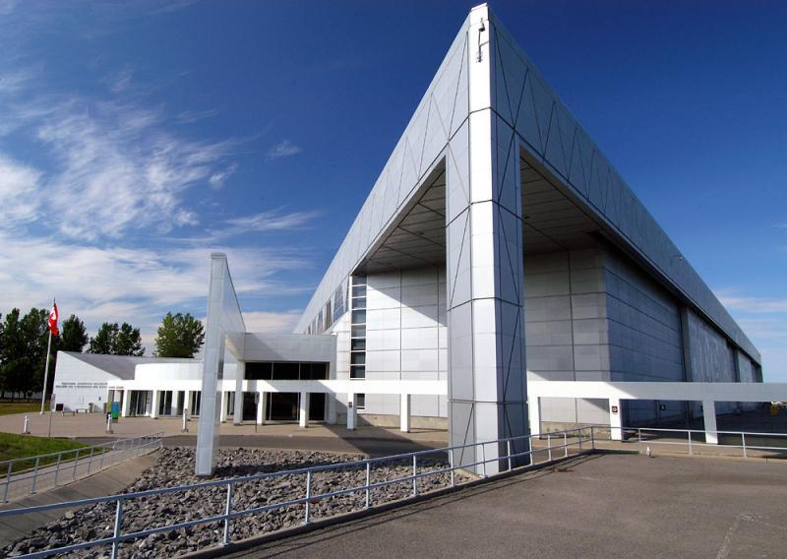
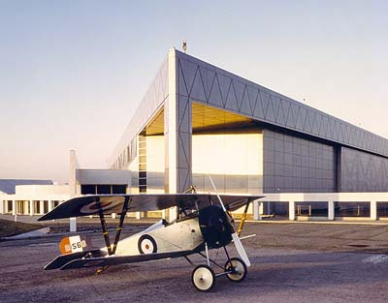
The National Museum of Aeronautics

Slide 21
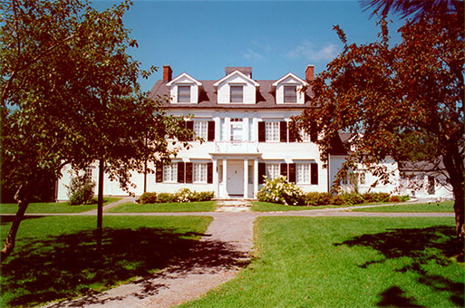
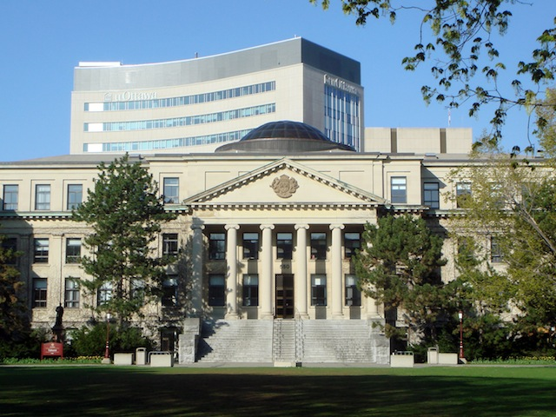
The city has two universitis:
Carleton (English)
Ottawa (biligual)

Slide 22
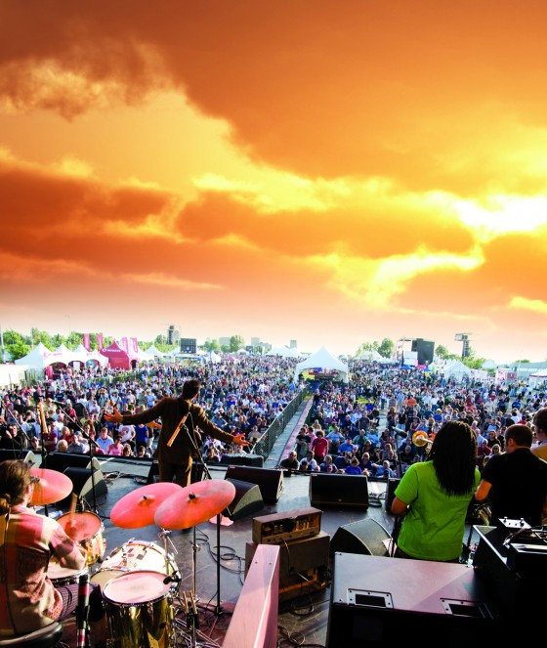
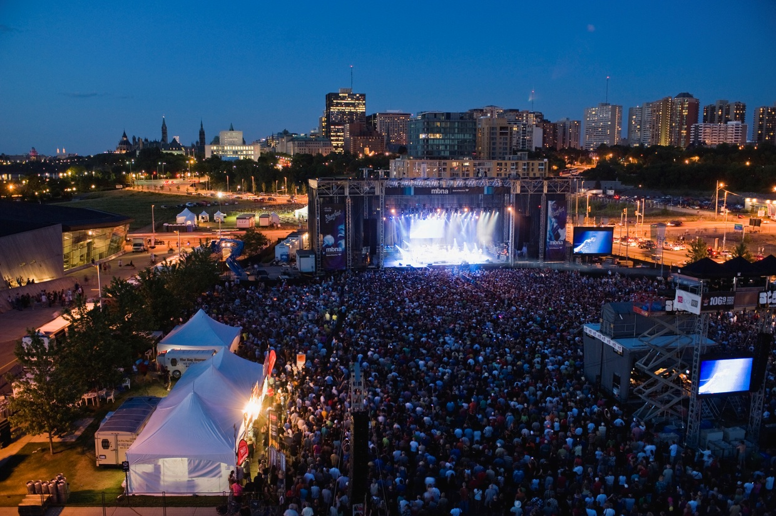
The International Jazz Festival hed from 14 to 23 July.

Slide 23
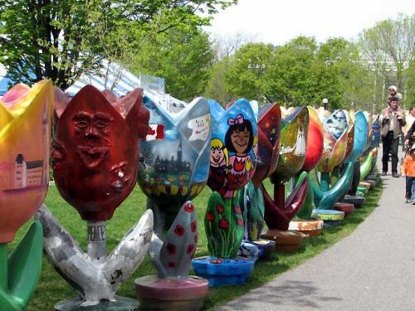
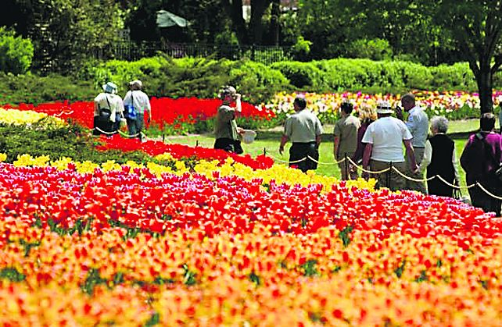
The annual Tulip Festival takes place in early May.

