Slide 1
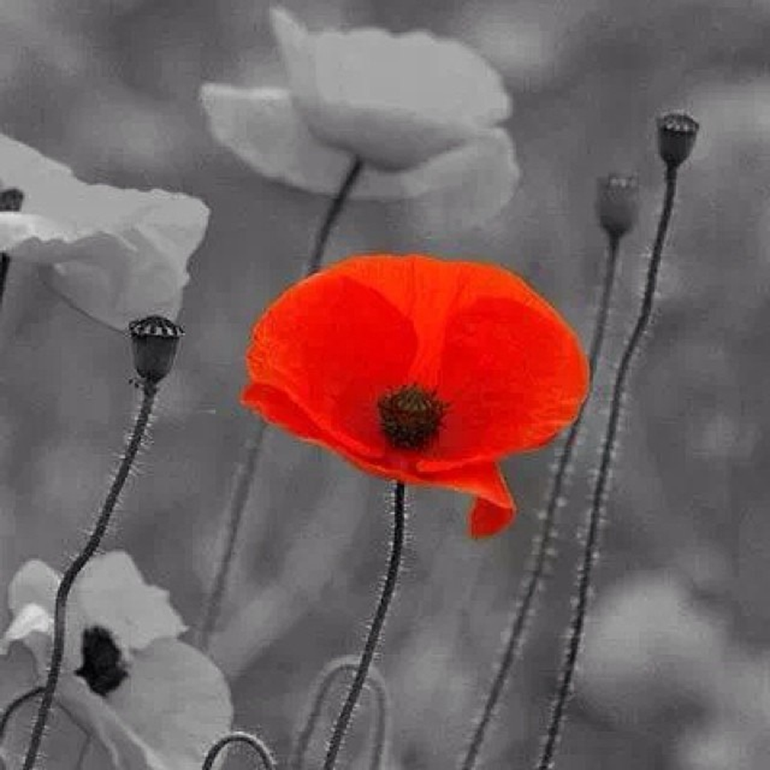
Remembrance day

Slide 2
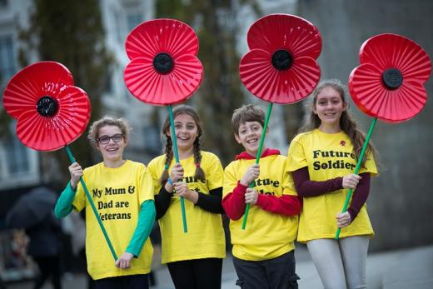
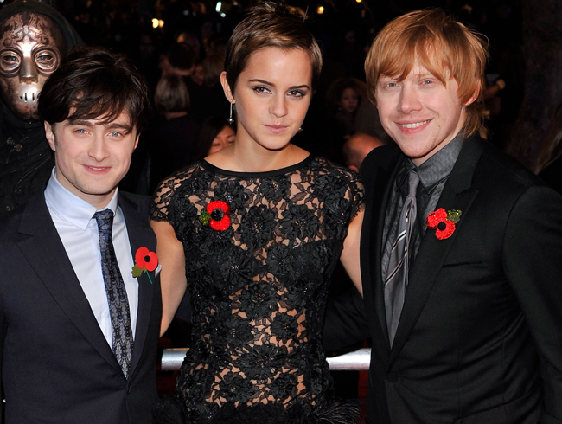
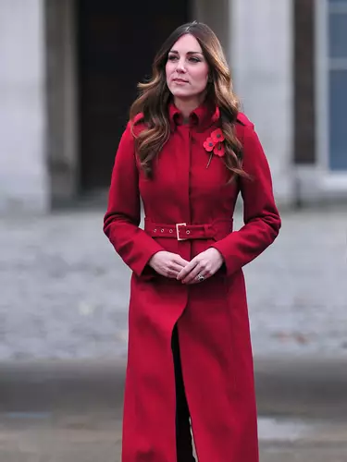
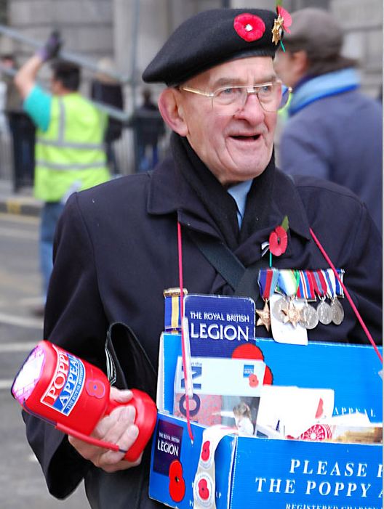
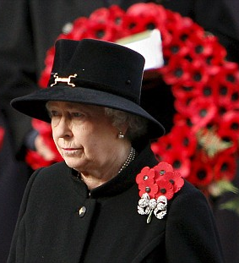
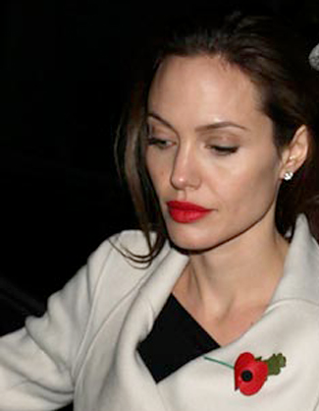
Every year during the week before the 11th of November, people all over Britain wear a little red paper poppy.

Slide 3
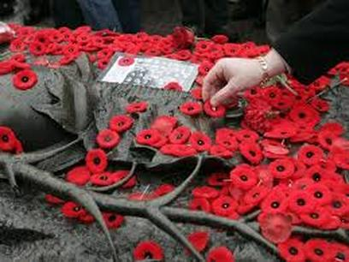
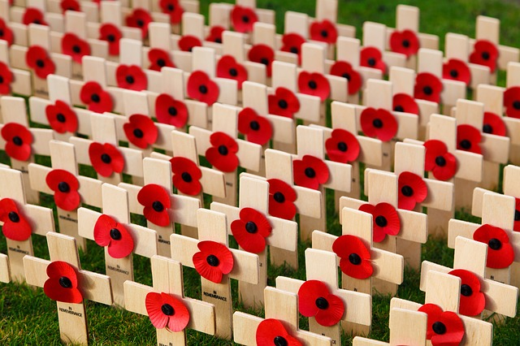
Remembrance Day, or Poppy Day, 11th November, is the day when people in Britain remember the soldiers that died in the First World War (1914-18), the Second World War (1939-45) and all other wars since.

Slide 4
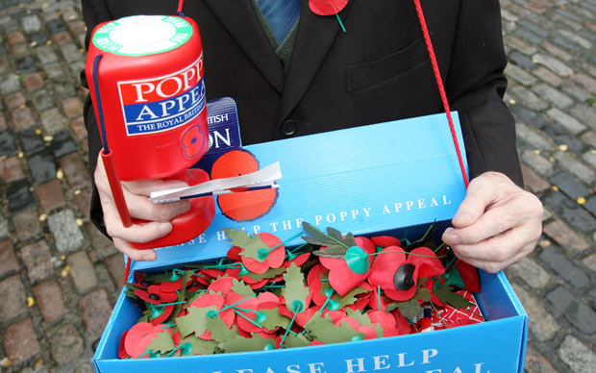
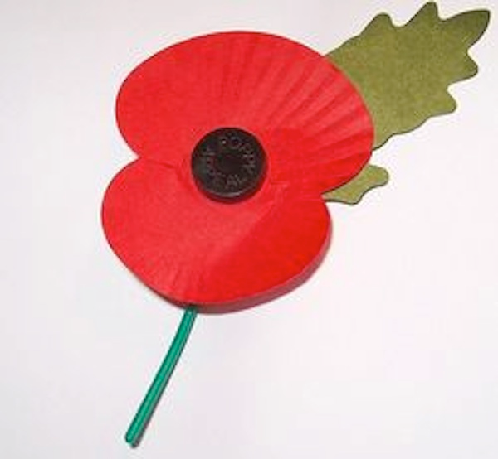
The First World War had ended three years earlier, but it was still very difficult, often impossible, for
ex-soldiers in Britain to find employment. So some of them started making and selling red paper poppies. They gave the money that they raised to ex-soldiers who were disabled or unemployed, and to the families of soldiers who had died.

Slide 5
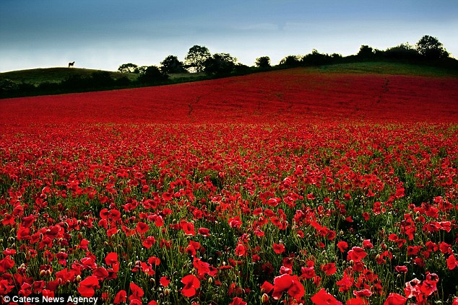
The choice of flower was significant. During the war, the soldiers had noticed poppies growing every year on the battlefields in Belgium and the north of France.

Slide 6
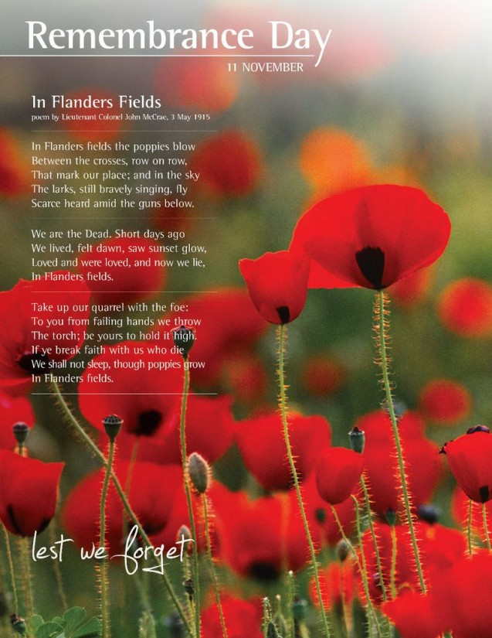

Slide 7
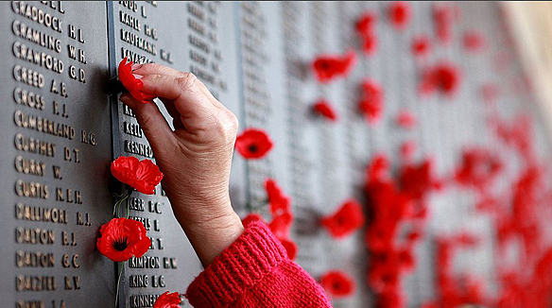
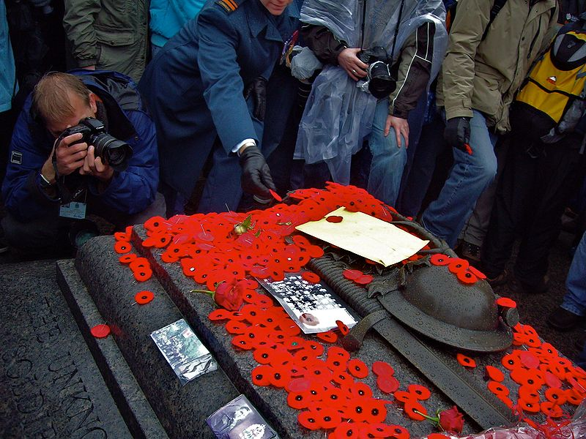
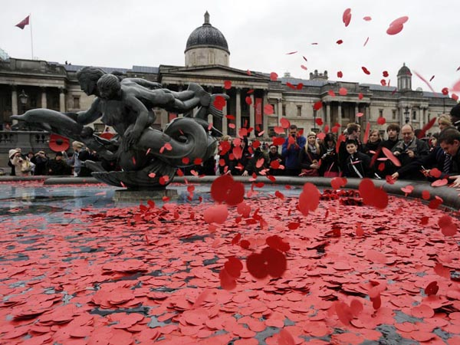
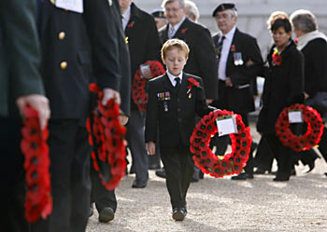

Slide 8
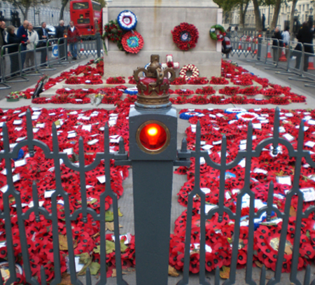
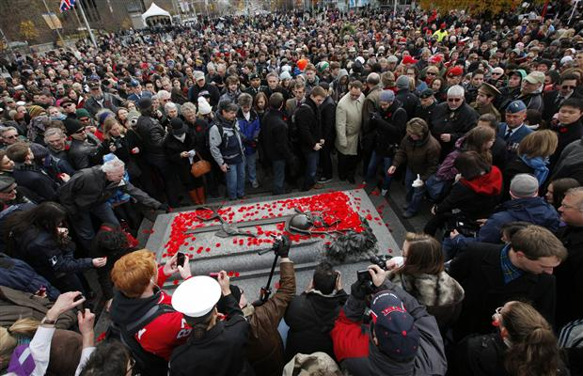
In the days about 32 million people in Britain buy and wear small poppies. Some people choose to wear white poppies because they think that white symbolises peace. Then, at 11 a.m. on 11th November (at the moment when the First World War ended) there's a two-minute silence.

Slide 9
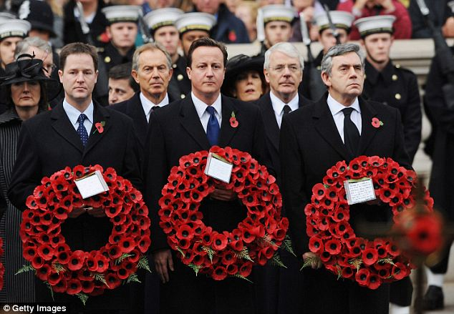
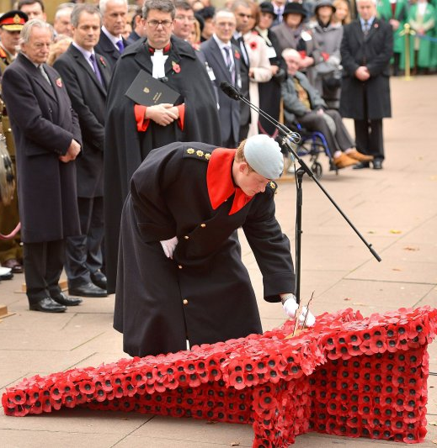
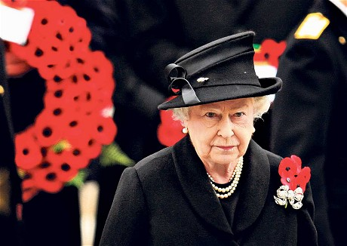
There are ceremonies at war memorials in towns and villages all over the country. The most important ceremony is in London, when the Queen and the Prime Minister lay wreaths of poppies at the Cenotaph, a monument to soldiers who died in battles.

Slide 10
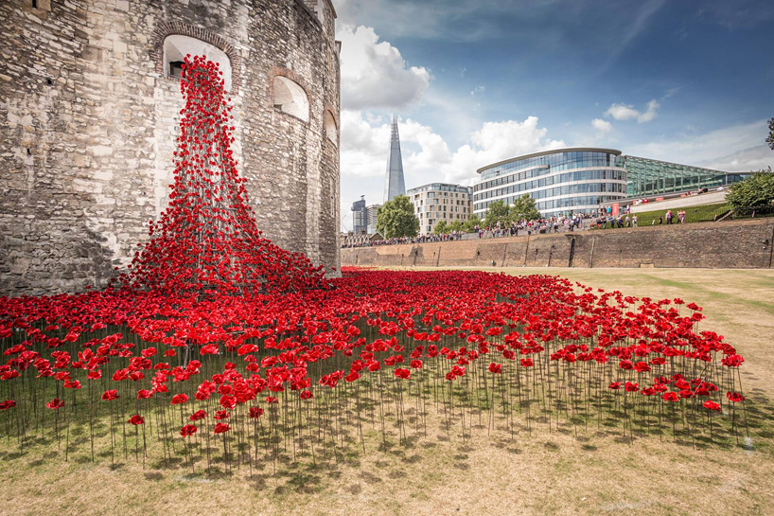

Slide 11
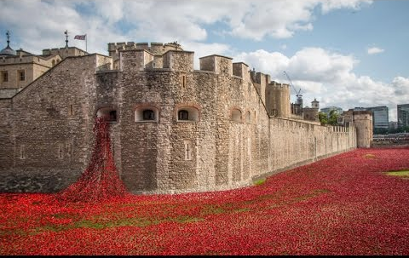

Slide 12
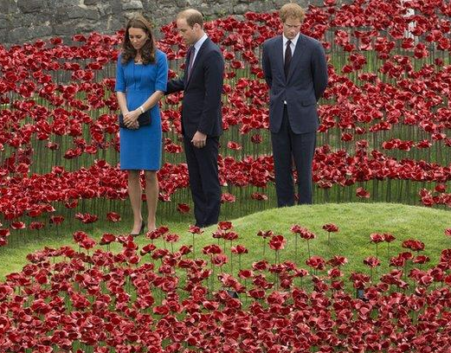
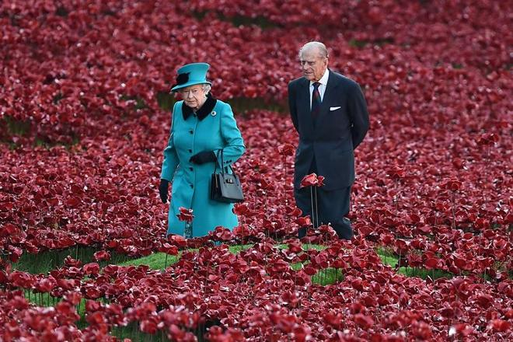
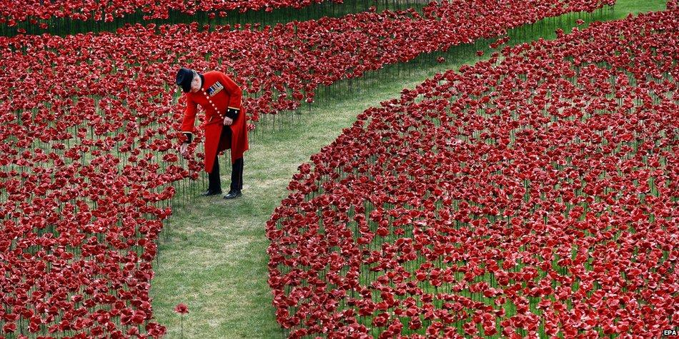
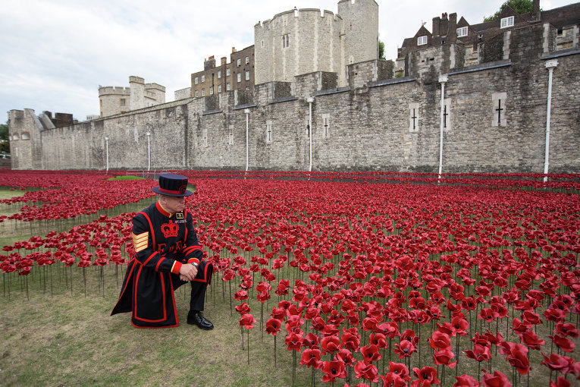

Slide 13
