Slide 1
(Checking the homework)
The history of some popular inventions
Invention | A person, who invented it | The year, when it was invented
The first Russia’s automobile | P.A. Frez and E.A. Yakovlev | 1896
Penicillin | Alexander Fleming | 1928
Scotch tape | Jim Kirst | 1928
The first ballpoint pen | L. Biro | 1940
A solar powered car | Japanese scientists | 1996

Slide 2
Inventions in everyday life!

Slide 3
A quote:
“ I’ m proud of the fact that I never invented weapons to kill”
Thomas Edison

Slide 4
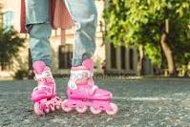
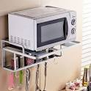
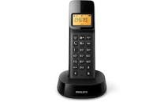
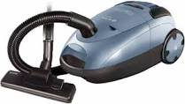

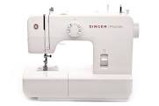
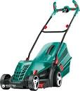

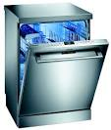
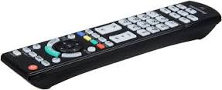
Inventions in our life!
1. A microwave oven
2. a vacuum cleaner
3. a cordless phone
4. a talking alarm clock
5. a sewing machine
6. a TV remote- control unit
7. a mower,
8. a body building machine
9.roller blades
10.a dishwasher

Slide 5
Task 1. Find the suitable invention.
What do people use it for? | The invention
- To build up one’s strength | - a microwave oven
To wash the dishes To cut and collect the grass | - a sewing machine - a dishwasher
To cook, defrost, reheat pre-prepared food To receive or make calls around the home | - a TV remote-control unit - a mower
- To perform everyday cleaning tasks from vacuuming to cleaning up dust | - roller blades
- To not only sew, but do embroidery( вышивание) | - a body building machine
- To operate the TV set from a distance | - a cordless phone
To wake up people and to tell the time - To have fun and entertain | - a vacuum cleaner - a talking alarm clock

Slide 6
Task 2. Role – play:
Excuse me. I don’t speak English very well. I need… a thing for opening cans.
A can opener.
- Yes. Thank you.

Slide 7
Task 3. What gadgets and machines have you got in your home? When did you buy them?
For example:
- We’ ve got a vacuum cleaner/ we’ve used vacuum cleaner since 2009 ( for eighth years).
- We bought it in 2009.

Slide 8
Task 4. What things are the members of the family talking about?
I’ m a couch potato – and I’m proud of it. Every time I have a spare minute you can always find me on my coach. From there I switch from channel to channel until I find my favorite soaps.
They are magic. I also do roller-skating and ice-skating. But these are a mixture of both. It’s like ice-skating in the street. So fast!
If we feel like eating a hot meal, I just get our favorite pre-prepared food and put it into the machine, set the dial and it’s ready in minutes!
1
2
3
Your Mark

Slide 9
Thank you for your active work during the lesson!

