Slide 1
IN THE ZOO
подготовила учитель МБОУ гимназия №1, г.Лебедянь Дорофеева Ольга Евгеньевна

Slide 2
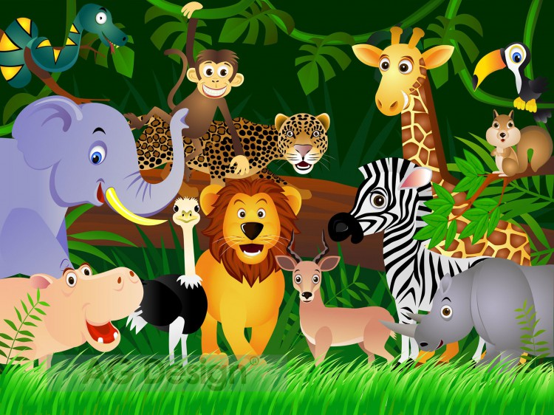
A N I M A L S

Slide 3
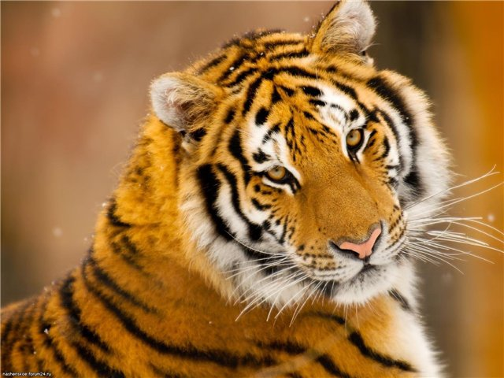
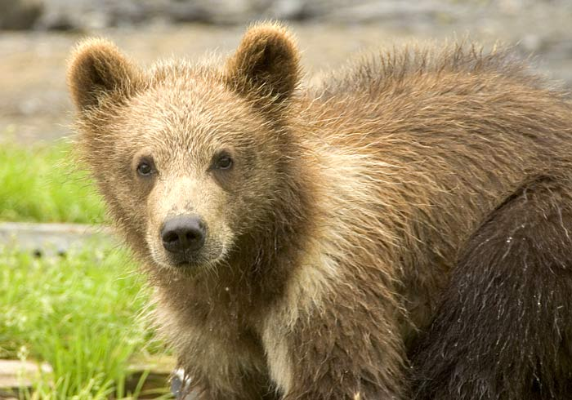
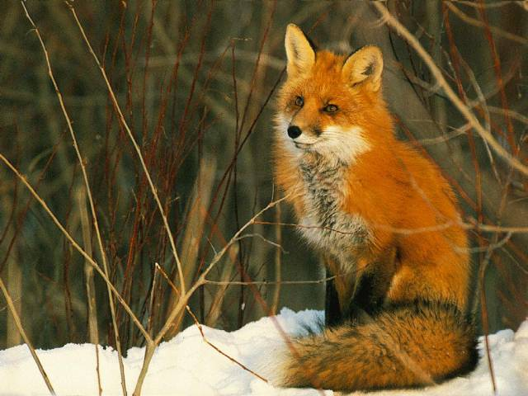
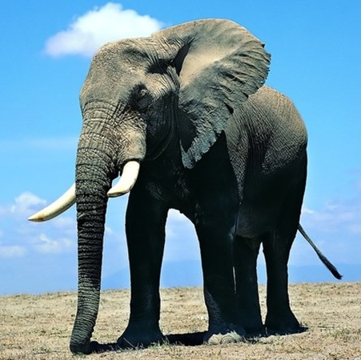
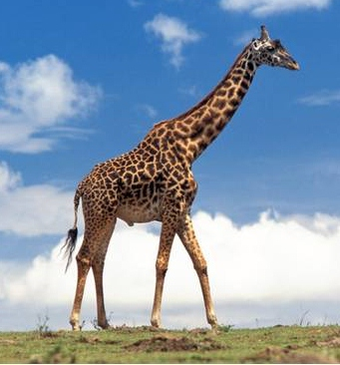
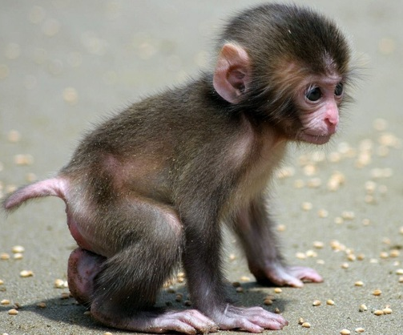
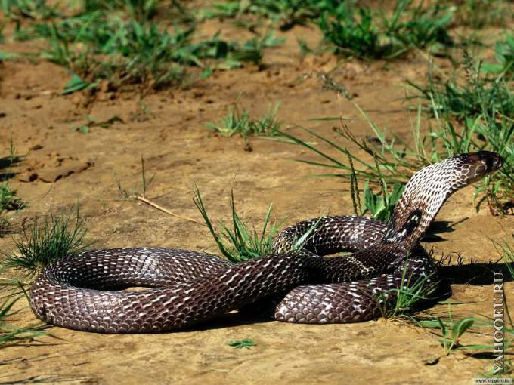
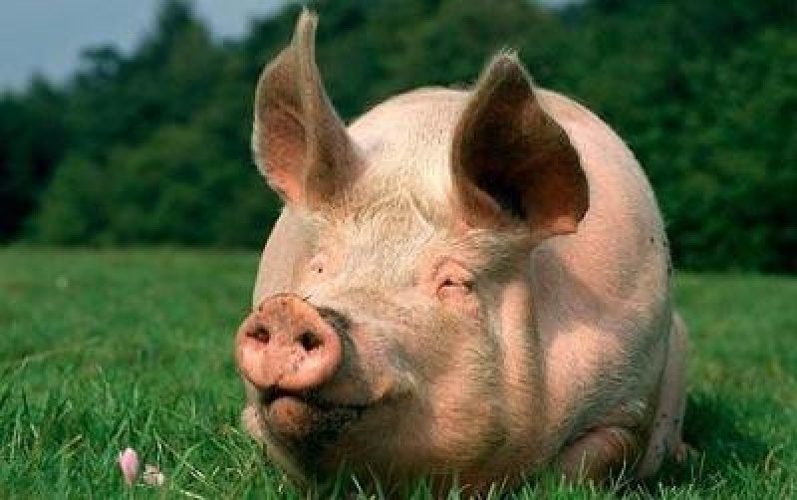
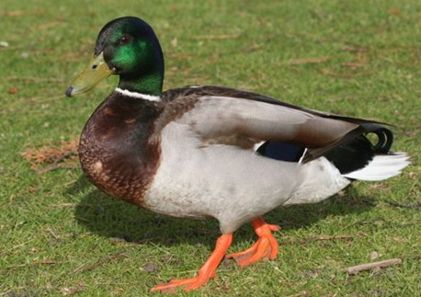

Slide 4
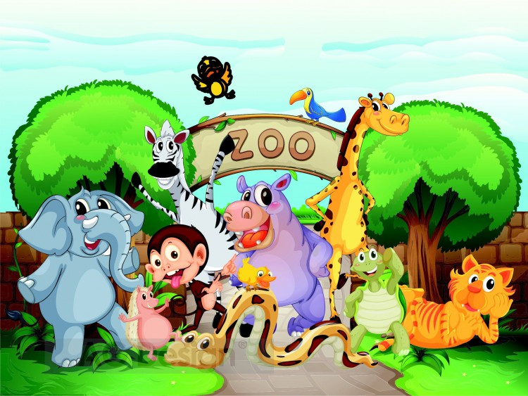

Slide 5
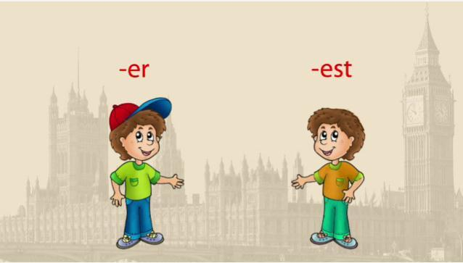
STRONG STRONER THE STRONGEST
СИЛЬНЫЙ СИЛЬНЕЕ САМЫЙ СИЛЬНЫЙ

Slide 6
Fast faster the fastest
Smart smarter the smartest
Tall taller the tallest
Strong stronger the strongest
Long longer the longest
Fat fatter the fattest
Big bigger the biggest
Merry merrier the merriest
Funny funnier the funniest

Slide 7
Long
A snake is … than a duck.
A snake is the … in the zoo.

Slide 8
Funny
A duck is … than a pig.
A duck is the … in the zoo

Slide 9
Fat
A pig is … than a monkey.
A pig is the … in the zoo.

Slide 10
Merry
A monkey is … than a fox.
A monkey is the … in the zoo

Slide 11
Smart
A fox is … than an elephant.
A fox is the … in the zoo.

Slide 12
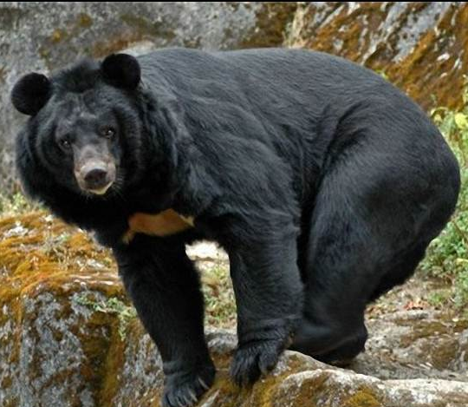
Big
An elephant is … than a bear.
An elephant is the … in the zoo.

Slide 13
Strong
A bear is … than a tiger.
A bear is the … in the zoo.

Slide 14
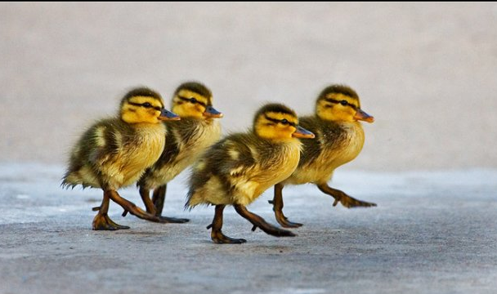
Funny ducks likes dancing
Let’s dance!

Slide 15
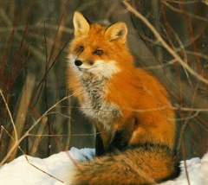
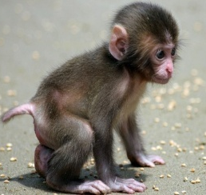
IS THE BIGGEST
IS THE STRONGEST
IS THE FASTEST
IS THE FATTEST
IS THE SAMRTEST
IS THE MERRIEST
IS THE FUNNIEST
IS THE LONGEST

Slide 16
Thank you!

Slide 17
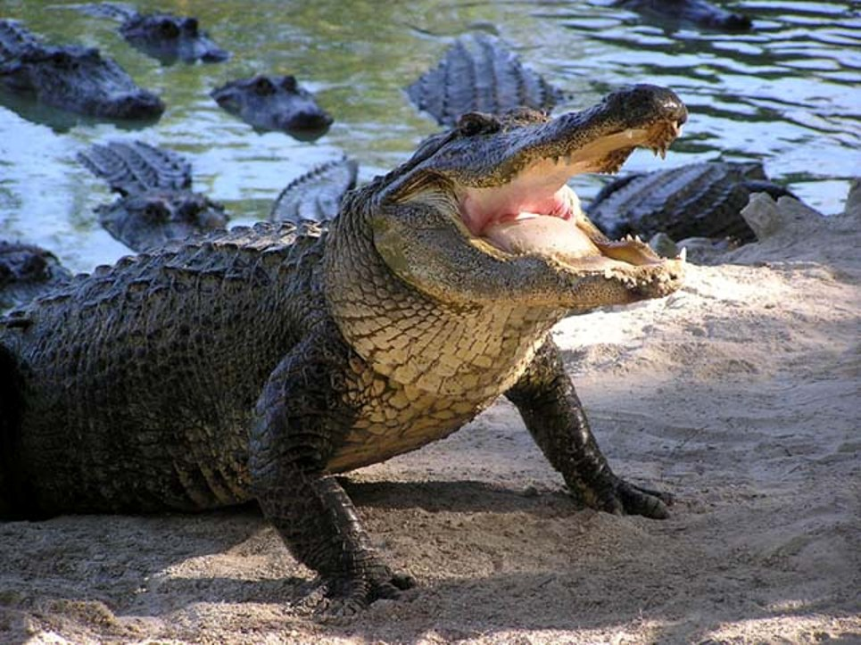
A dangerous crocodile…
…to be continued

